Slide 1



My Favorite Game
World of Warcraft

Slide 2
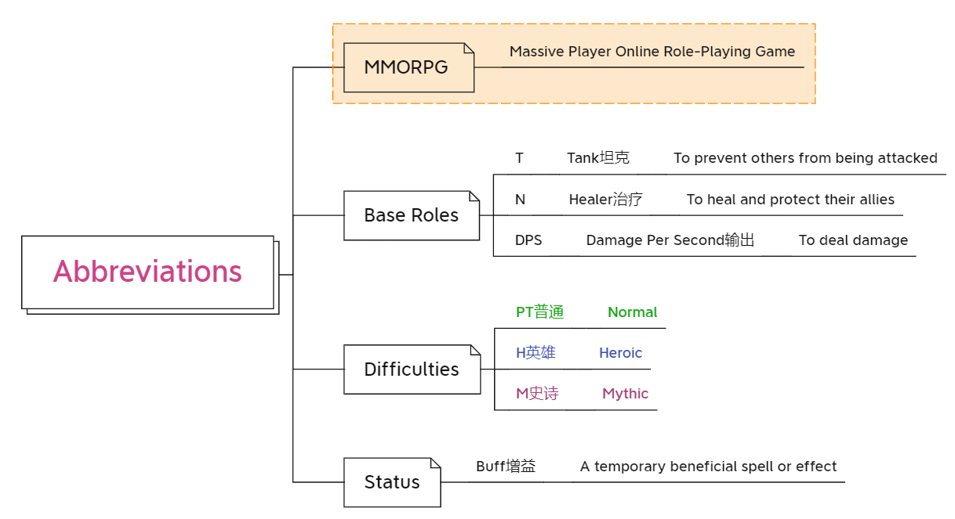



Notes:
At the very beginning, I’ve got some abbreviations to be explained
Wow is MMORPG it means
The base roles in the game can be listed as T N DPS

Slide 3
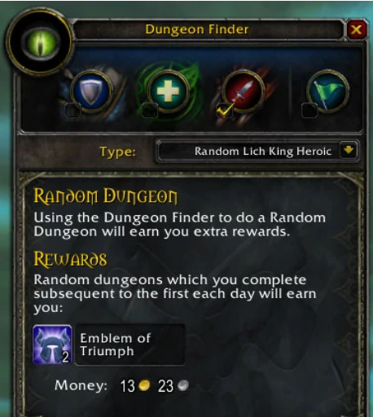
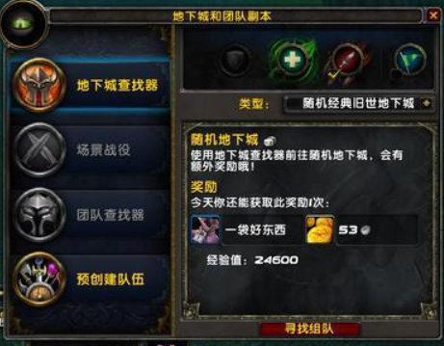

Slide 4
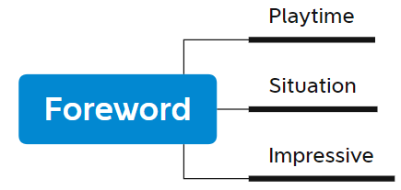
Reason to choose the topic
Playtime: about 2000hours during 2016~2021
Blizzard: Stopped game service in China.
3 impressive features of the game
Notes:
Blizzard is the manufacturer of the game but this year it had stopped all the game service in China.
So, I chose the topic in honor of my fav game.

Slide 5
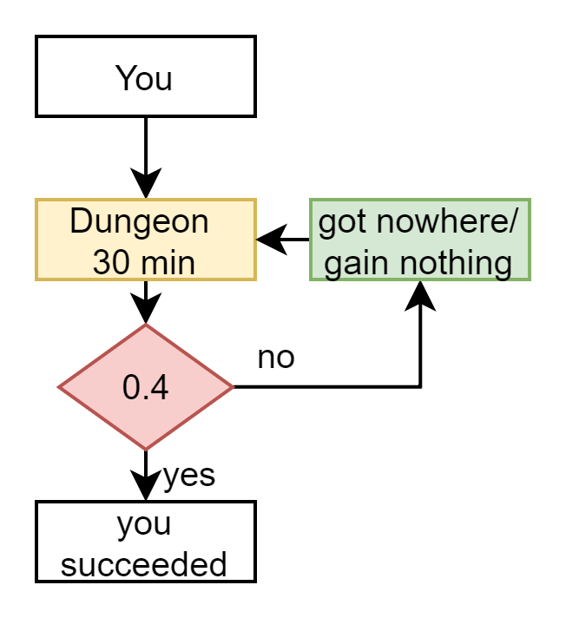
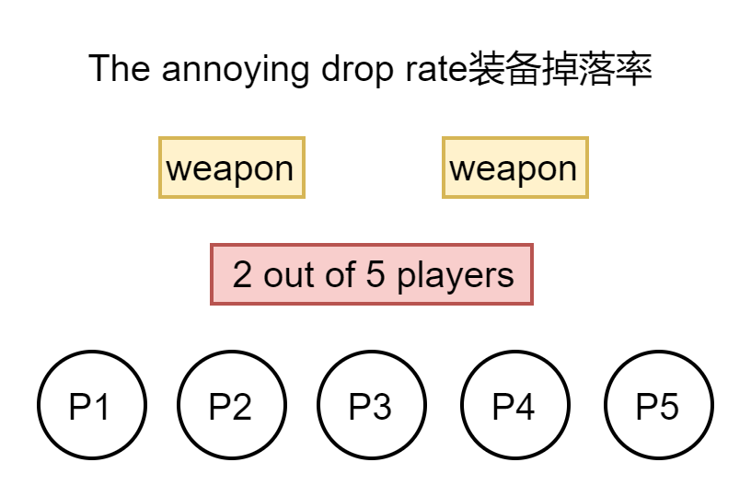
1 treasures
Definitions: bonus you get when you finish a dungeon（地下城）
一事无成
Troublesome repetitive tasks to conquer the low probability
Notes:
Only 2 out of 5 players can gain the weapons and the rest 3 would get nowhere. And if you want to gain specific weapon or clothing, you must do repetitive tasks, which makes the game boring
Every time you finish a dungeon, you go through a probability check .
The mechanism is intended to keep players in the game for more time but for an individual it just waste his or her time

Slide 6
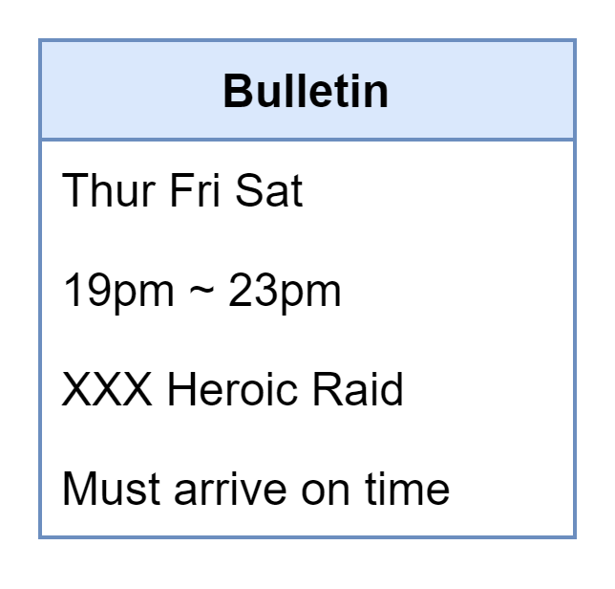
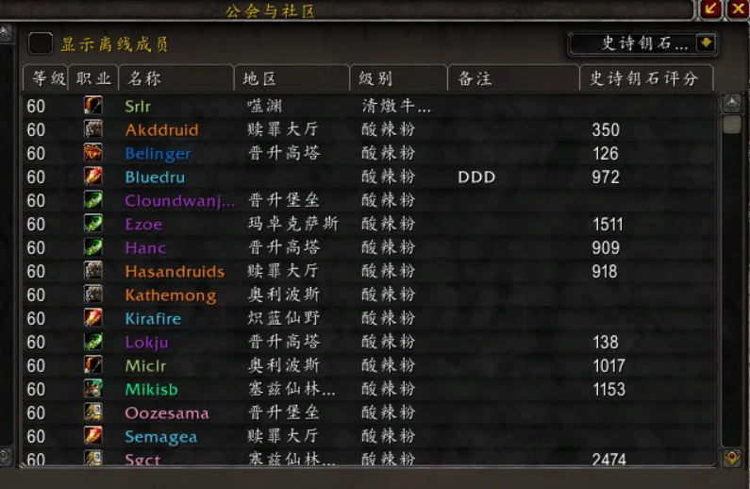
2 Guild公会&Raid 团队副本
Guild: Players gathered with almost the same goal: to gain treasures
Raid Requirements: At least 10 .At most 30
Notes:
Every guild has a bulletin, defining the specific requirements

Slide 7


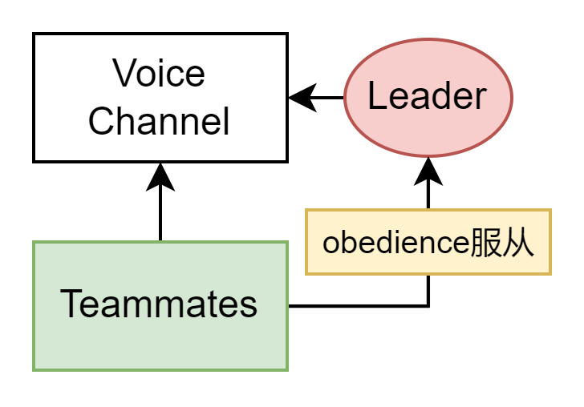
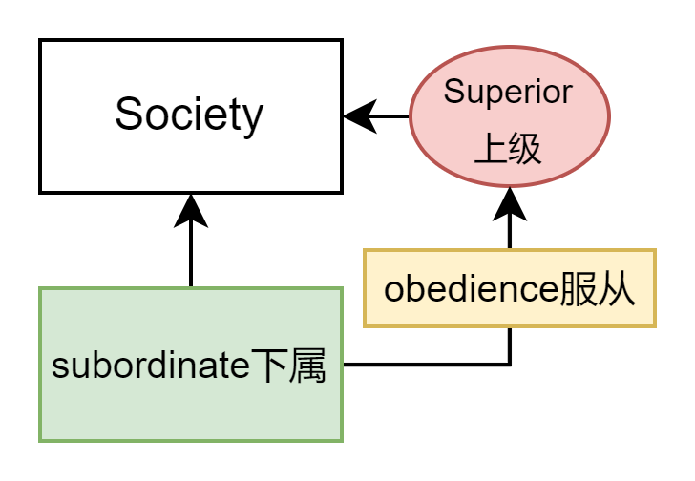
you need to care about is what you are responsible for
SAME?
If you made mistakes, then you might lose the job.
Notes:
In general, you only need to care about what you are responsible for
In game, the result is that next time you may not be included in the raid team, because the leader didn’t like those who often made mistakes.
But you can change/select a guild that fits you.

Slide 8
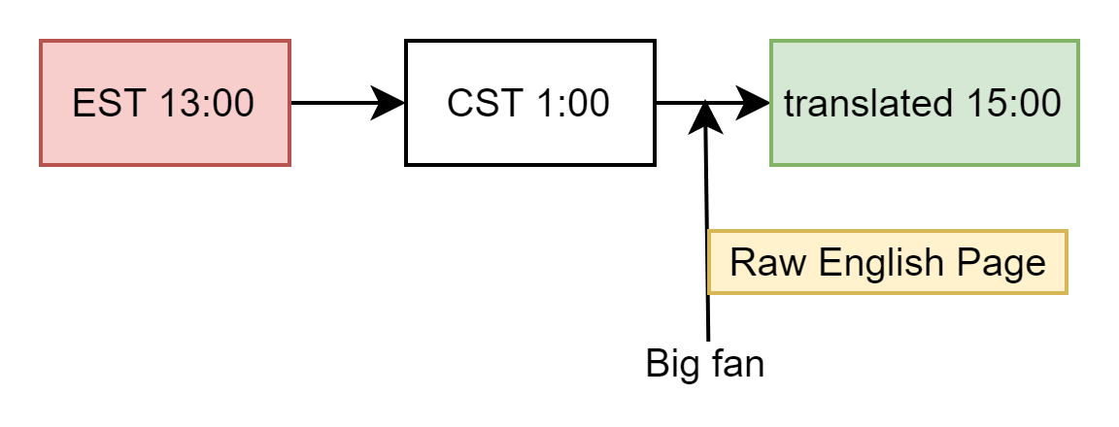
3 Patch Notes
A list including changes to be applied to the current game.
The raw page will eventually be translated into Chinese.
Just burn the midnight oil.
EST 美东时区 比 CST 北京时区 晚 12小时
Notes:
I was an enthusiastic fan of WOW. So, I will often burn the midnight oil the check the raw page of the patch notes.
Trying to figure out every English phrase refers to what included in the game.

Slide 9
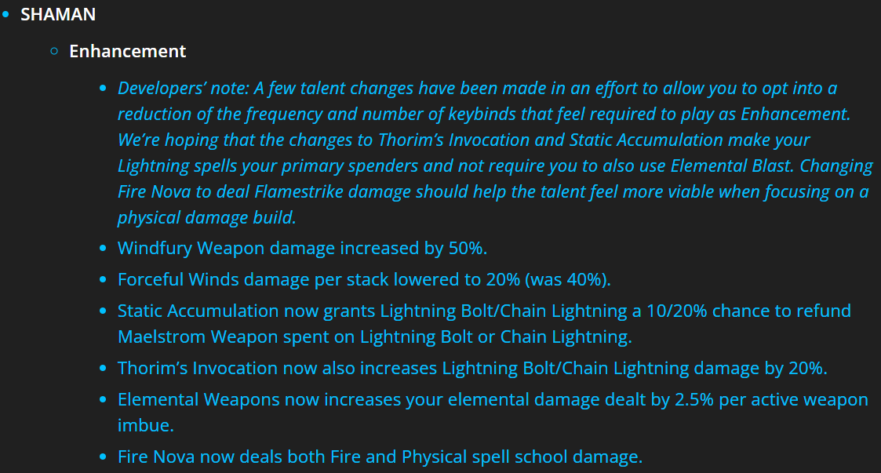
Related with learning English?
Patch: Class Tuning职业调整
Notes:
This was a screenshot from the wow official page about class tuning
The words they used were not as same as I learned from books

Slide 10
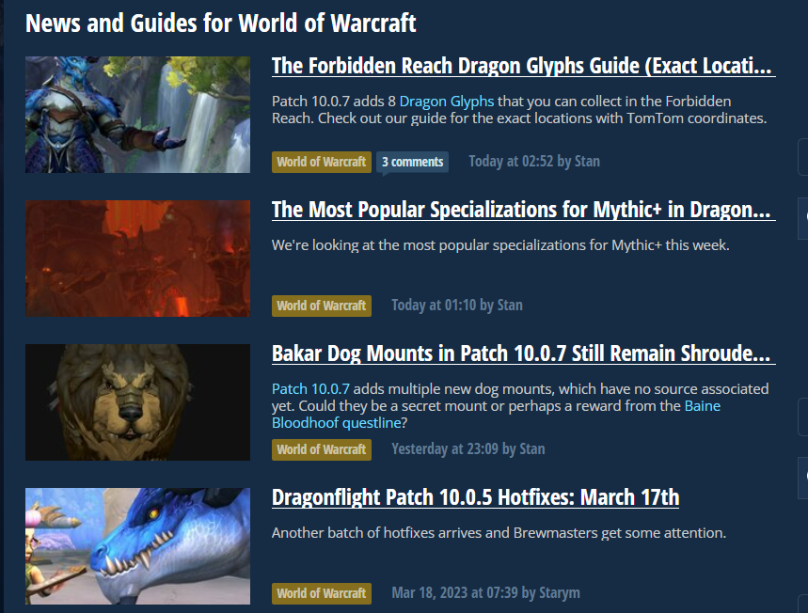
Used as a tool

Slide 11
Thank you!
That’s all I think about my favorite game

