Slide 1
Attention注意力
走马观花流水账

Slide 2
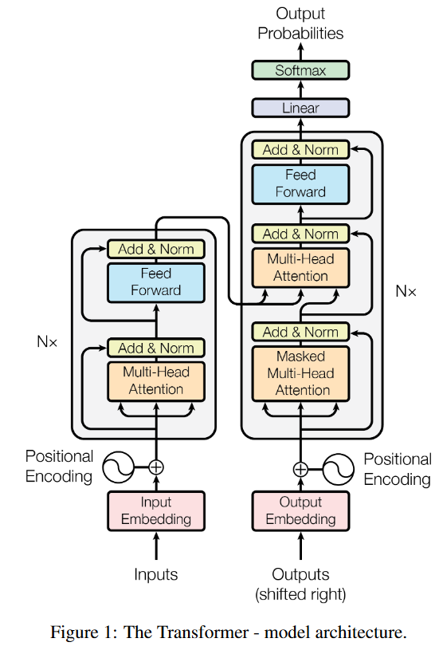
Attention is All you Need 2017
Advances in Neural Information Processing Systems
自注意力：可变参数衡量数据内部相关性
多头：多套可变参数
位置编码：解决数据被无序处理的
点积注意力

Slide 3
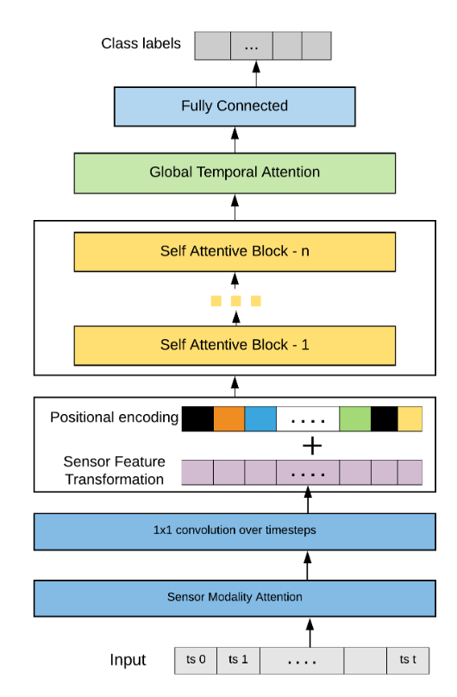
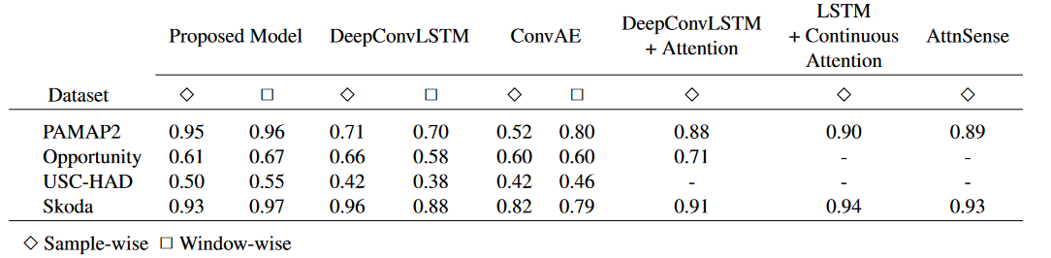
Human Activity Recognition from Wearable Sensor Data Using Self-Attention 2021 IEEE International Conference on Systems, Man and Cybernetics 2021
读作self-attentive block
写作

Slide 4
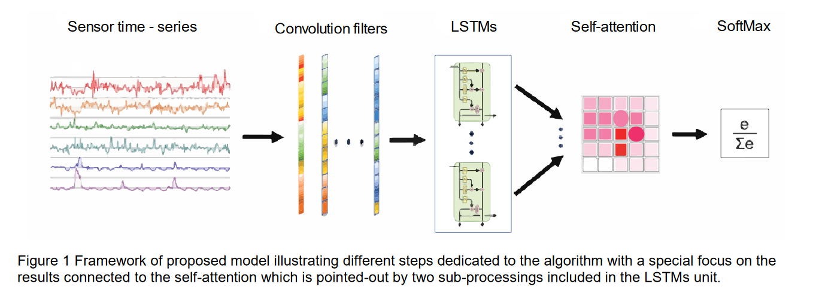
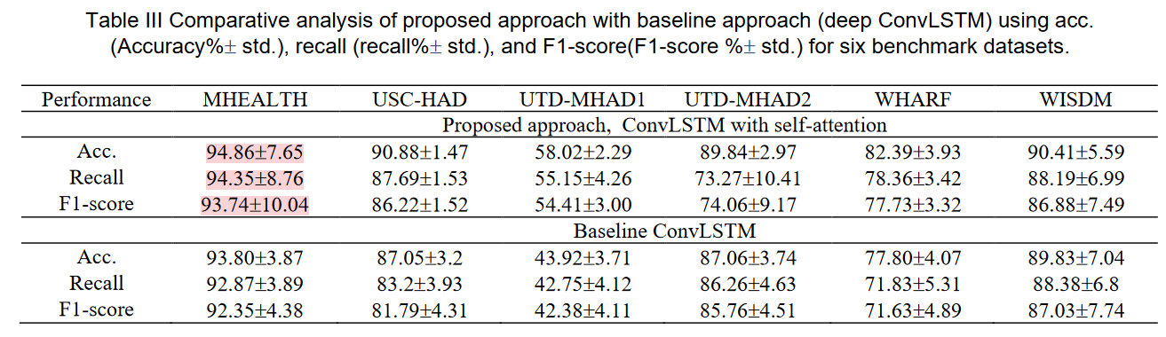
Deep ConvLSTM with self-attention for human activity decoding using wearable sensors 2021
IEEE Sensors Journal

Slide 5
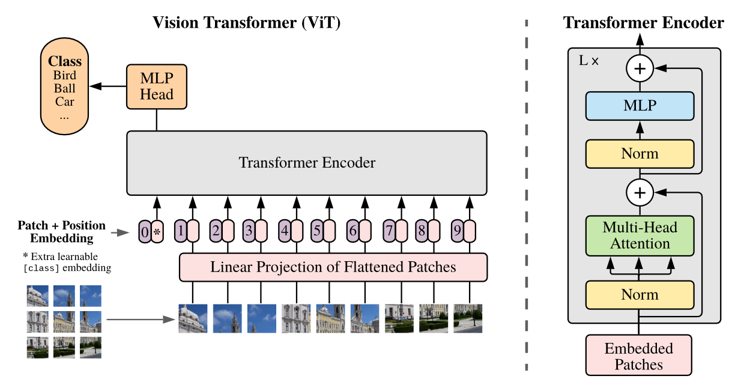
An Image is Worth 16x16 Words: Transformers for Image Recognition at Scale 2021
ICLR 2021
Vi-T: Vision-Transformer

Slide 6
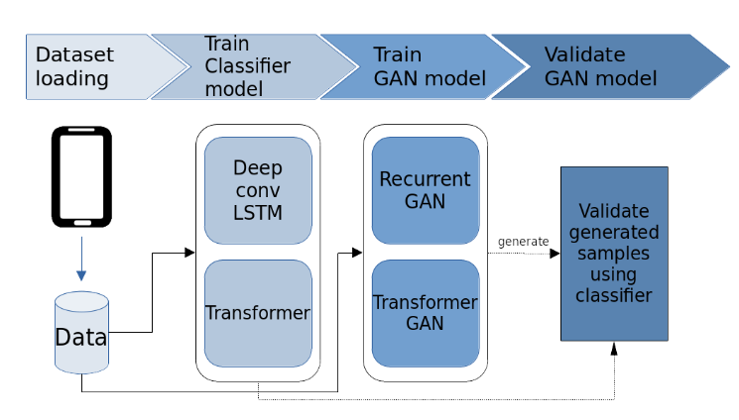
Transformer Networks for Data Augmentation of Human Physical Activity Recognition arxiv 2021
没有对比试验
两个数据集

Slide 7
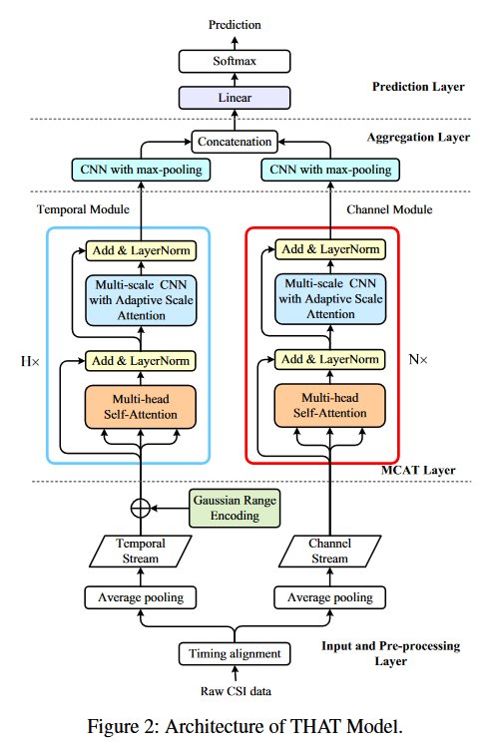
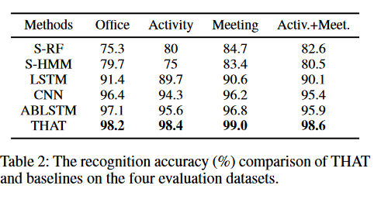
Two-Stream Convolution Augmented Transformer for Human Activity Recognition 2021
AAAI 2021
Wi-Fi CSI 数据

Slide 8
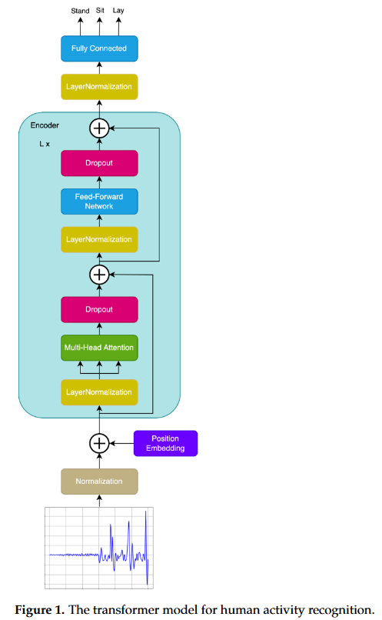
Wearable Sensor-Based Human Activity Recognition with Transformer Model 2022
MDPI Sensors
另类数据集KU-HAR
手动数据增强
原版模型

Slide 9
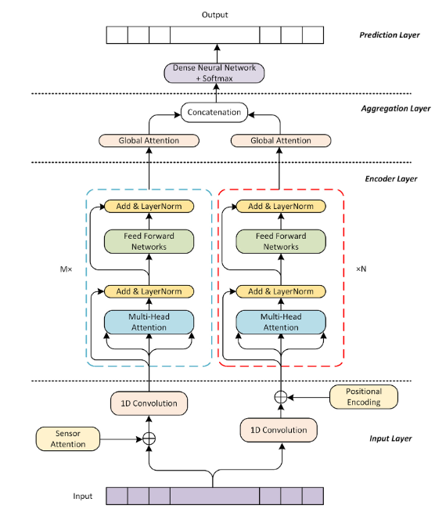
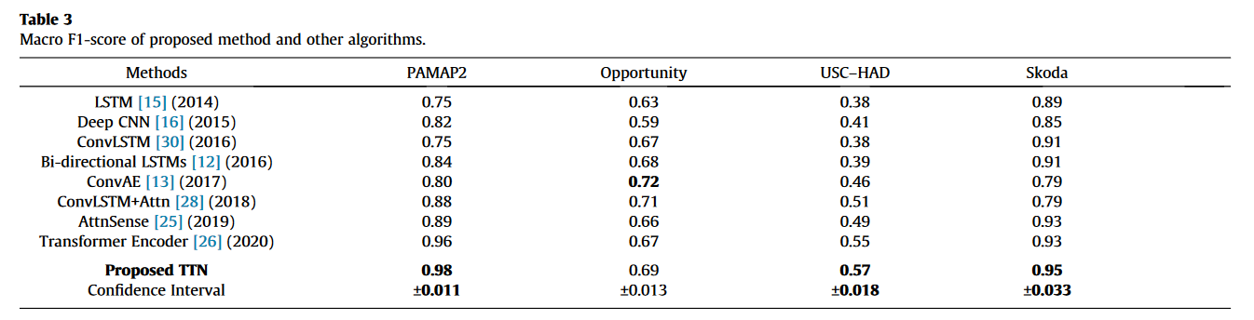
Two-stream transformer network for sensor-based human activity recognition 2022
Neurocomputing
Received 1 November 2021 Revised 2 September 2022 Accepted 15 September 2022 Available online 21 September 2022

Slide 10
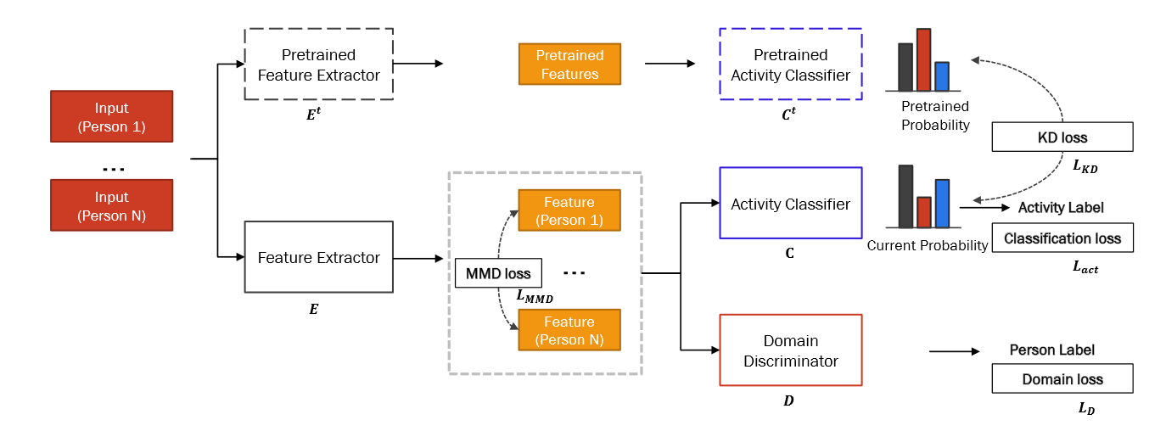
TASKED: Transformer-based Adversarial learning for human activity recognition using wearable sensors via Self-KnowledgE Distillation 2023
Knowledge-Based Systems
知识蒸馏
多任务

Slide 11
Attention-Convolution
在特征图上的注意力，输入输出均为特征图
精炼特征图，可注意多个模块

Slide 12
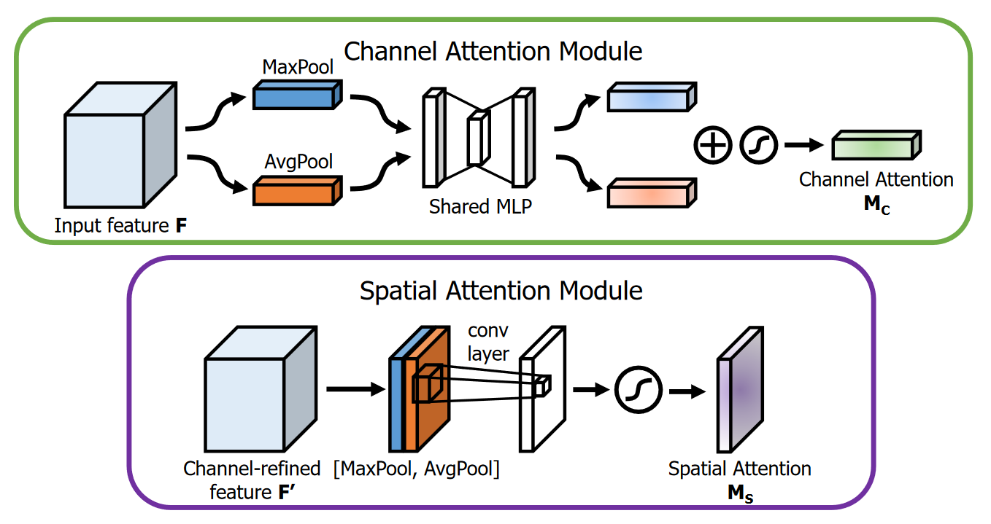
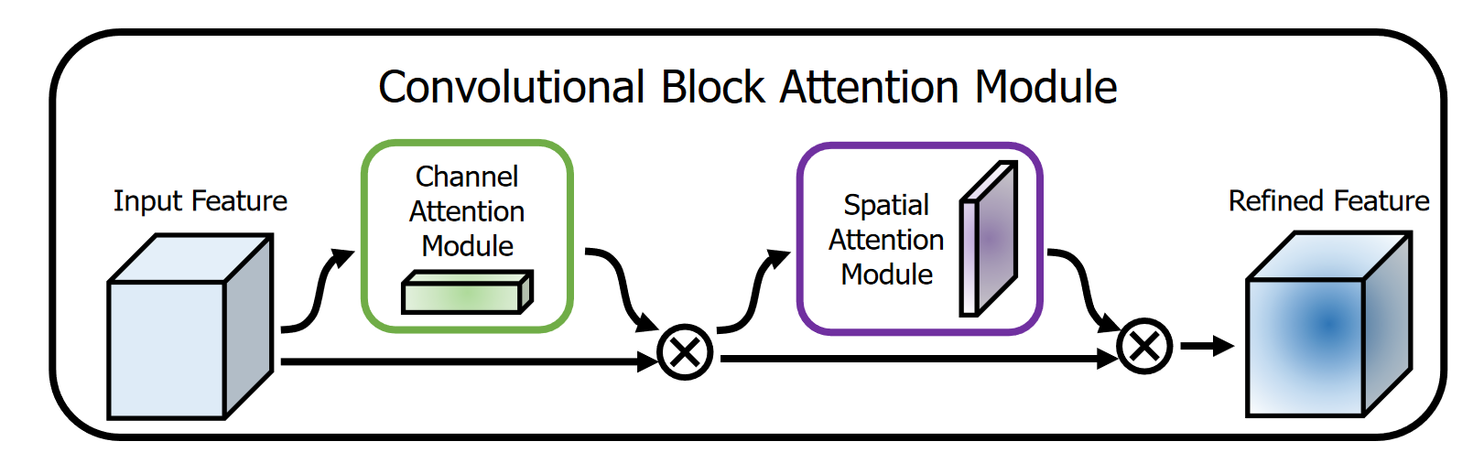
CBAM: Convolutional Block Attention Module 2018
ECCV 2018
先后考虑通道特征和空域特征

Slide 13
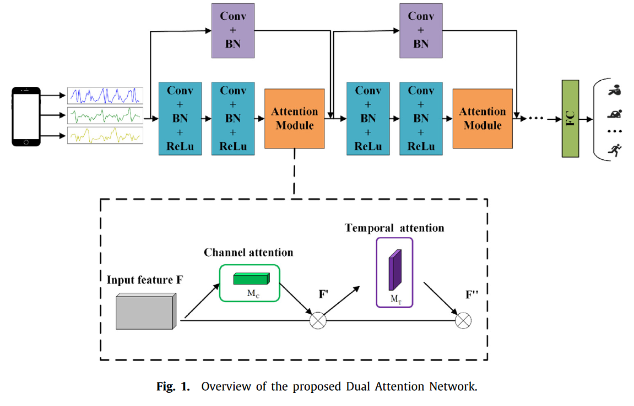
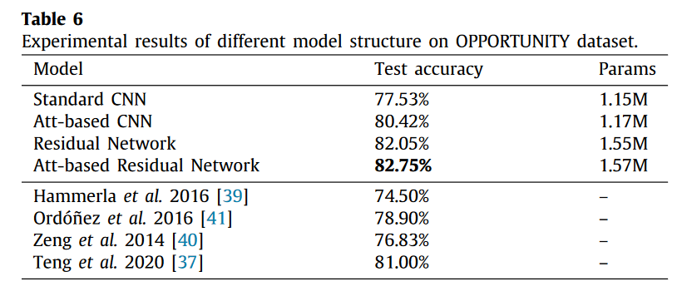
DanHAR: Dual Attention Network for multimodal human activity recognition using wearable sensors 2021
Applied Soft Computing
三个公共数据集
自采数据集

Slide 14
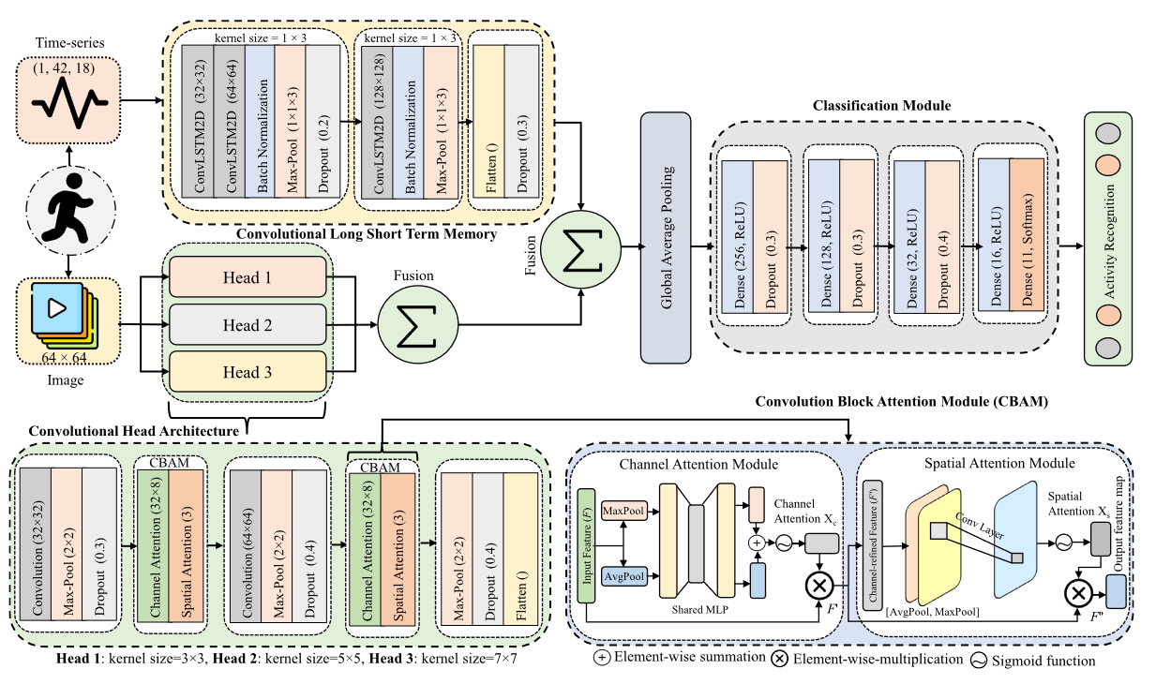
Multi-level feature fusion for multimodal human activity recognition in Internet of Healthcare Things 2023
Information Fusion
UP-Fall detection dataset 图像+传感器对齐

Slide 15
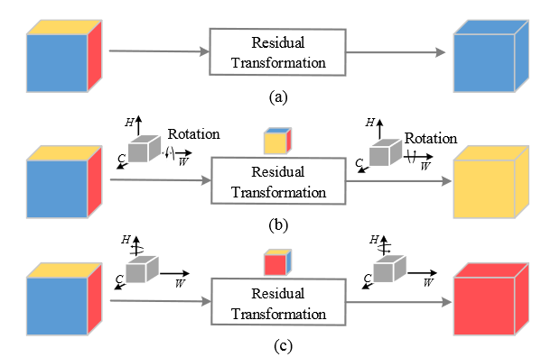
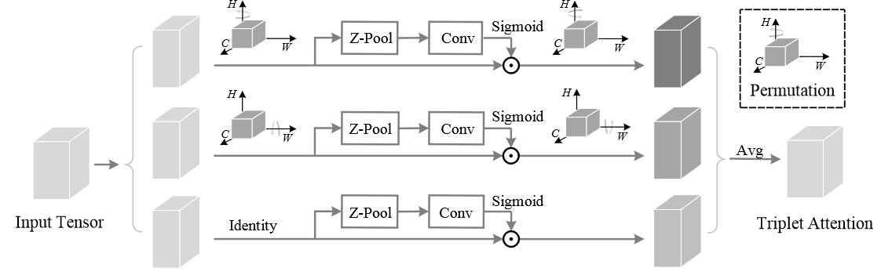
Rotate to Attend: Convolutional Triplet Attention Module 2021
WACV 2021

Slide 16
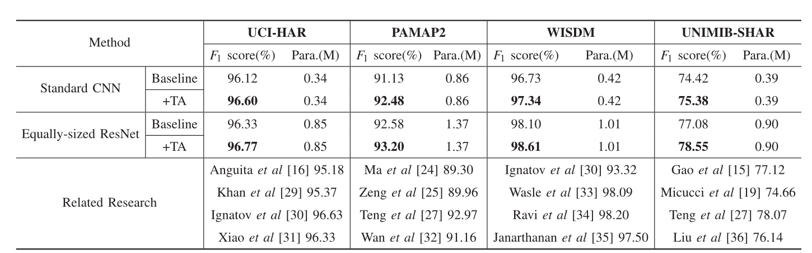
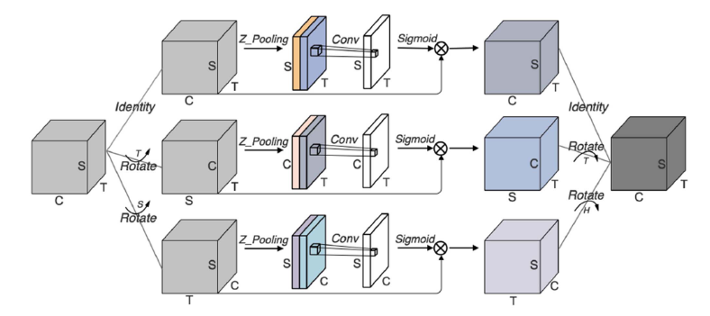
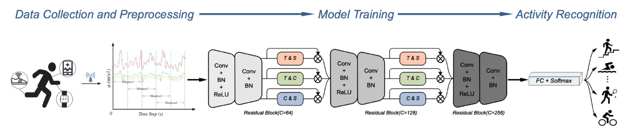
Triple Cross-Domain Attention on Human Activity Recognition Using Wearable Sensors 2022
IEEE TRANSACTIONS ON EMERGING TOPICS IN COMPUTATIONAL INTELLIGENCE

Slide 17
RNN based Attention
这块的工作也不少，但是没有深入研究

Slide 18
未深入研究原因
赛道不同：数据源
基准不同：对比方法
数据集不同：公开、私有
方法规模：大模型方向

