Slide 1

Intro to Git and GitHub

Slide 2
What is Git?
Version Control for local machines
Used by software programmers and data scientists to keep track of changes to their files

Slide 3

Chapter 1: Git Repositories

Slide 4
Learning Objectives
Explain and describe the three phases of code tracking in Git, including:
Working Directory
Staging Area
Repository
Explain how the command `git status` works

Slide 5
Git has three phases of code tracking
Working Directory
Staging Area
Repository

Slide 6
The working directory
The working directory area is our “normal” file system. This tracks the code as it exists on our computer right now.
If we’ve made changes, then the working directory sees all of those changes.
It doesn’t track any history. It just says, “this is how my code looks right now.”
Working Directory

Slide 7
Git status
Repository
Staging Area
The repository is where all of our checkpoints live.
Run the command `git status` to display all the files that have been modified in the working directory since the last time changes were saved.
Working Directory

Slide 8
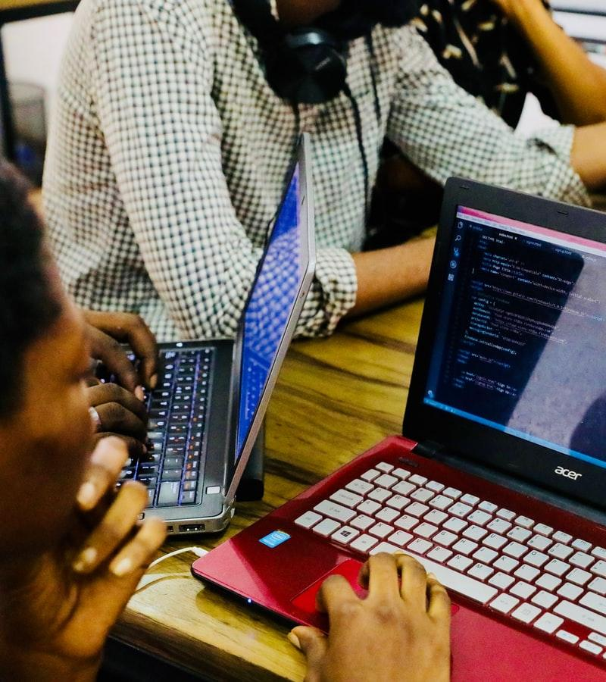
Chapter 2: Git Commits

Slide 9
Learning Objectives
Recognize that Git repos are changed using commits
Explain the two steps when git commits happen including:
git add
git commit

Slide 10
The staging area
Staging Area
The staging area is how we prepare for a commit.
Before making a commit, we’ll tell git that we want certain files to be “staged” for the commit.
In non-git terms, we’re telling git that we want it to check this file to see if it’s changed since the last checkpoint.
Working Directory

Slide 11
The repository
Repository
Staging Area
Every time we make a commit, all of those changes are pushed into the repository.
The repository is the holder of all knowledge about each version of a project.
Until the code is committed to the repository, no checkpoints have been made.
Working Directory

Slide 12
Step 1: Add files to staging area
Working Directory
Staging Area
Repository
Code. Code. Code.
Code. Code. Code.
git add my_code_file.py

Slide 13
Step 2: Commit all files in staging area
Working Directory
Staging Area
Repository
Code. Code. Code.
Code. Code. Code.
Code. Code. Code.
git commit –m “making my first checkpoint”

Slide 14
Git commit messages should be clear
git commit –m “making my first checkpoint”
Commit messages should:
Clearly state what’s changed since the last commit
Tell what bugs were fixed, and what new code was added

Slide 15
Git commit messages should be clear
git commit –m “making my first checkpoint”
If we remove the -m “message here” part from the previous example, we will be taken to a text editor to make our commit messages instead and can make it more specific.

Slide 16

Chapter 3: Git Reset

Slide 17
Learning Objectives
Describe how to revert to a previous Git stage using Git reset
Explain what git log can be used for

Slide 18
How can we revert to a previous commit?
Working Directory
Staging Area
Repository
Code. Code. Code.
Code. Code. Code.
Code. Code. Code.
Code. Code. YEAH.
Code. Code. YEAH.
Code. Code. YEAH.

Slide 19
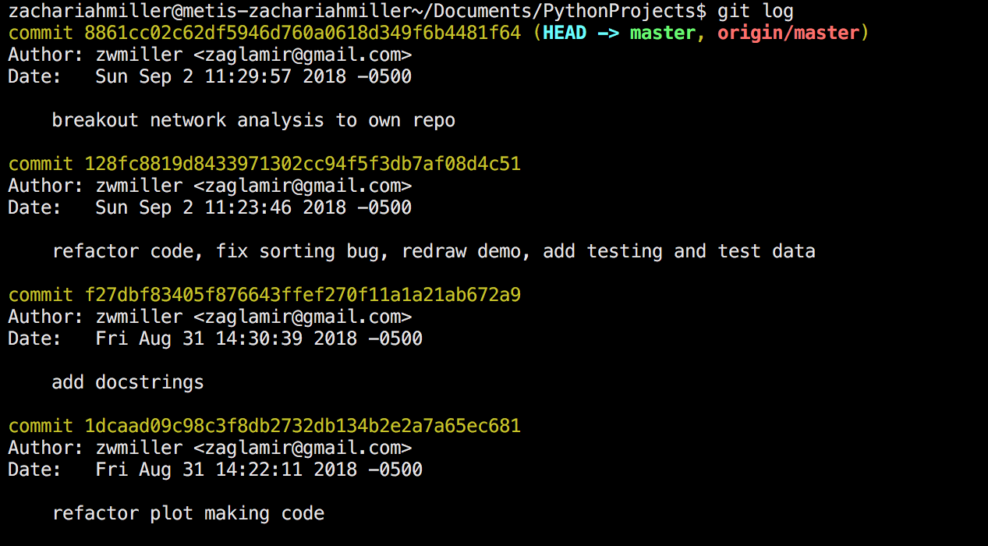
Use Git Log
Commit IDs

Slide 20
Use Git Log
Commit Messages

Slide 21
Use Git Reset
git reset 128fc8819d8433971302cc94f5f3db7af08d4c51

Slide 22
After Git Reset
Working Directory
Staging Area
Repository
Code. Code. Code.
Code. Code. Code.
Code. Code. Code.
Code. Code. Code.

Slide 23

Chapter 4: GitHub

Slide 24
Learning Objectives
Recognize that GitHub extends Git online
Recognize the components of a GitHub repository
Explain how to import a GitHub repository onto a local machine using the git clone command

Slide 25

What is GitHub?
Online Version Control
Back up Git local machine changes
Allow for shared collaboration

Slide 26
GitHub extends Git online
Working Directory
Staging Area
Repository
Remote Repo on GitHub
Code. Code. Code.
Code. Code. Code.
Code. Code. Code.
GitHub’s Servers
My Computer

Slide 27
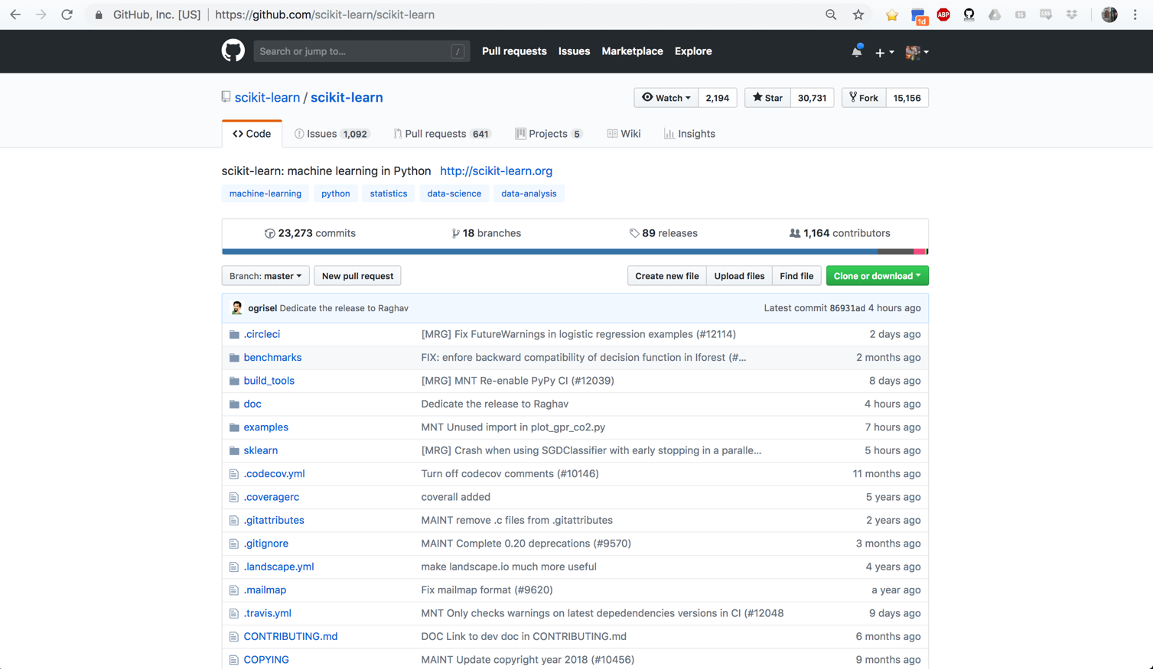
GitHub Example: Scikit-learn

Slide 28
Scikit-learn has many contributors
1000+ Coders

Slide 29
GitHub keeps track of all contributors’ commits
23,000+ Commits

Slide 30
GitHub stores every file that has been committed
All of Scikit Learn

Slide 31
Git Clone
git clone github.com/scikit-learn/scikit

Slide 32

Chapter 5: Git Push and Git Pull

Slide 33
Learning Objectives
Describe how to move changes from Git to GitHub using git push
Explain how to move changes from GitHub to Git using git pull

Slide 34
Syncing between Git and GitHub
Git push:
“Make the remote version look like my code” and update any files that changed in the last commits
Git pull:
“Bring in any changes that have occurred on the remote version of the repo and make my code match those”

Slide 35
Git Push
Working Directory
Staging Area
Repository
Remote Repo on GitHub
Code. Code. Code.
Code. Code. Code.
Code. Code. Code.
Push
Code. Code. Code.
git push origin main

Slide 36
Git Push
Working Directory
Staging Area
Repository
Remote Repo on GitHub
Code. Code. Code.
Code. Code. Code.
Code. Code. Code.
Push
Code. Code. Code.
git pull origin main
Code. Code. Whoo!
Pull
Code. Code. Whoo!

Slide 37

Chapter 6: Git Branches

Slide 38
Learning Objectives
Recognize the main branch of a Git repo
Create new branches using git branch
Switch between branches using git checkout

Slide 39
Git branches allow for individual code changes
MAIN
MAIN
ALICE BRANCH
git branch alice_branch
git checkout alice_branch

Slide 40
Git branches allow for individual code changes
MAIN
MAIN
ALICE BRANCH
ALICE BRANCH
Alice can make whatever changes she wants on her own branch. She can make commits to her branch.

Slide 41
Git branches allow for individual code changes
MAIN
MAIN
ALICE BRANCH
If someone changes the main branch, Alice can keep up with other changes to the main branch using “merges”.

Slide 42
Git branches allow for individual code changes
MAIN
MAIN
ALICE BRANCH
Alice’s code changes are added to the main branch, with all of the commit history via a merge.

Slide 43
Git branches support simultaneous code edits
BRIAN BRANCH
MAIN
MAIN
ALICE BRANCH

Slide 44
Git branches support simultaneous code edits
MAIN
MAIN
Alice’s and Brian’s changes made it back to the main branch.
They were working on different pieces at the same time, but were able to contribute to the project in a cohesive way.

