Slide 1
Ước lượng runtime lượng tử
Bằng chứng từ QPU lưu trữ và simulator local
Phạm vi khoa học PARTIAL
Không chạy live QPU. Không gộp các clock khác nhau thành một bảng xếp hạng.
Bản nội bộ | 02.10.2026
Notes:
Báo cáo benchmark nội bộ, khoảng 10 phút.
Evidence: artifacts/benchmark_v1/results/benchmark_summary/two_domain_scorecard_v3/REPORT.md
Brief authority: docs/presentation.md

Slide 2
Dữ liệu và phạm vi
Nguồn / panel | Quy mô | Circuit hoặc label được dùng
Real QPU · Ma–Li | 340 observations | Logical QASM; observed execution labels
Real QPU · Qonductor | 4.482 observations | Submitted physical QASM; one-circuit jobs
Real QPU · QPack | 3.945 observations | 46 workflows; reconstructed inputs, labels archived
Unified QPU ledger | 8.767 observations | Join giữ source ID và row identity; không đồng nhất timing boundary
Simulator local | 204 members / 191 hashes | 22 families; q2–q16; 162 core + 42 frontier
Local RTX 5070 Ti · ~45 GiB RAM / 16 GiB VRAM. QPU service ≠ schedule ≠ simulator wall-clock.
02
Notes:
Nguồn: artifacts/benchmark_v1/results/benchmark_summary/two_domain_scorecard_v3/REPORT.md
Chi tiết QPU: artifacts/benchmark_v1/results/benchmark_summary/two_domain_scorecard_v3/qpu/archived_method_coverage.csv
Panel simulator: artifacts/benchmark_v1/results/benchmark_summary/two_domain_scorecard_v3/simulator/common_exact_qasm_panel.csv
QPU nguồn có 340 Ma–Li, 4.482 Qonductor và 3.945 QPack observations. Simulator gồm 204 members, 191 exact hashes, 162 core và 42 frontier. QPU observed service, QPU scheduled duration và local simulator execution là các clock riêng.

Slide 3
Thiết kế so sánh
Nguyên tắc | Áp dụng | Giới hạn
Rows chung | Graph V3-large và polynomial dùng cùng unified ledger và grouped outer folds | So sánh theo source-local shared rows
Fit | Preprocessing và calibration chỉ fit trên outer-train | Không chọn theo labels của test
Coverage | Unavailable và failures giữ trong denominator được giao | Coverage khác accuracy
Clock | Hiển thị output clock cùng evaluation target clock | Không xếp hạng chéo clock
MAE thấp hơn trên shared rows không tự động chứng minh superiority trên toàn ledger.
03
Notes:
Nguồn: docs/presentation.md
Scorecard authority: artifacts/benchmark_v1/results/benchmark_summary/two_domain_scorecard_v3/manifest.json
QPU coverage denominator: artifacts/benchmark_v1/results/benchmark_summary/two_domain_scorecard_v3/qpu/archived_method_coverage.csv

Slide 4
Coverage phương pháp
QPU approach | Evidence status | Simulator approach | Evidence status
Ma–Li graph | Unified adaptation; 8,763–8,766 / 8,767 | Ma–Li-style graph | Aer + fixed-MPS local adaptations
Qonductor | Unified polynomial adaptation; 8,767 / 8,767 | Azizov-style | Source / hybrid / transpiled GNN + baselines
Scholten | Nominal proxy; 5,769 / 8,767 | Family-Aware-style | MPS runtime-only residual; joint target unavailable
QCRE | Scheduled proxy; 8,766 / 8,767 | Maestro | Pilot gate failed; no predictor score
Qiskit estimate_duration | Native schedule; 8,766 / 8,767 | cuTensorNet | Native same-plan estimate / actual diagnostic
Hyb-HANAS | One-circuit cost adaptation; 8,420 finite | Pasqal emu-MPS | Analog companion; not digital common panel
MPS runtime-only adaptation was evaluated; 24 QPU variants are not 24 papers. Coverage ≠ accuracy.
04
Notes:
Method scope: artifacts/benchmark_v1/results/benchmark_summary/two_domain_scorecard_v3/method_scope.csv
QPU coverage table: artifacts/benchmark_v1/results/benchmark_summary/two_domain_scorecard_v3/qpu/archived_method_coverage.csv
Full 24-variant detail: presentations/figures/fig2_qpu_prediction_coverage.png; metadata in presentations/figures/README.md

Slide 5
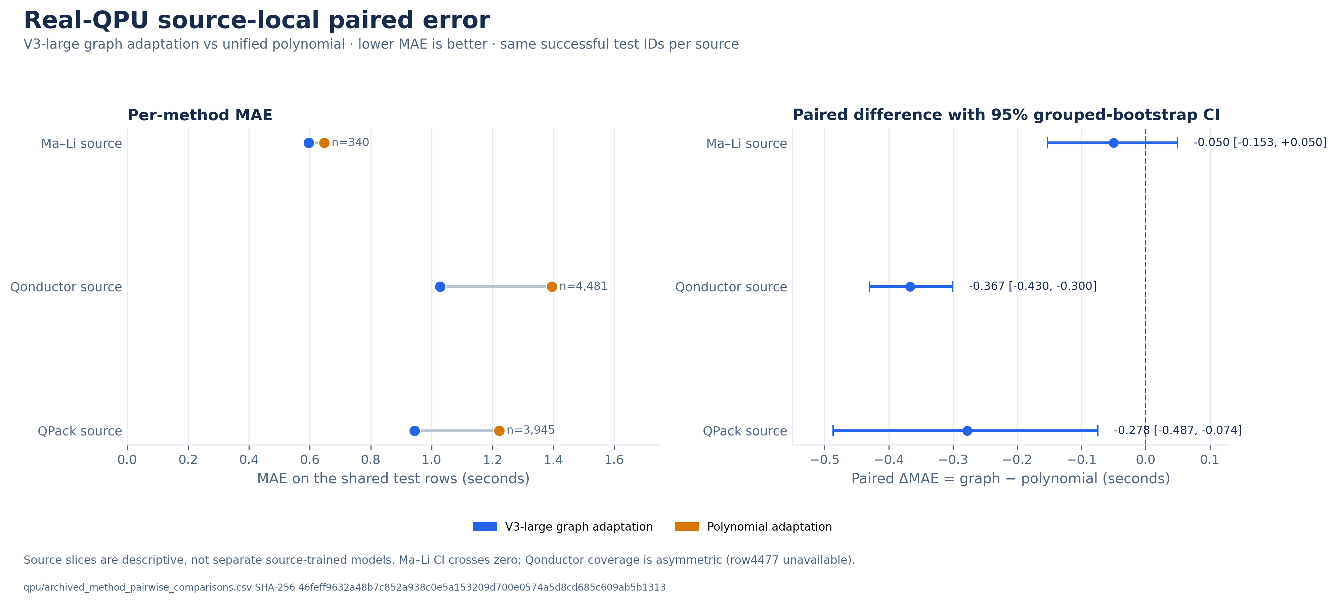
MAE theo source trên shared rows
Shared rows by source. 95% grouped-bootstrap CI for graph minus polynomial MAE. Lower MAE favors the graph adaptation.
05
Notes:
Figure: presentations/figures/fig1_qpu_paired_mae_by_source.png
Figure caption/metadata: presentations/figures/README.md
Source table: artifacts/benchmark_v1/results/benchmark_summary/two_domain_scorecard_v3/qpu/archived_method_pairwise_comparisons.csv
Comparison: candidate_method_id=mali_graph_architecture_v3_large; reference_method_id=unified_polynomial_v3. Units: seconds of MAE difference, graph minus polynomial. Evaluation target: archived observed service/execution time. Shared-row hashes in source order: Ma–Li 3ad175f3b2cf88f52f9f0dedd404684fbff696b2d776f8d55538083dcdeac8e7; Qonductor a785df4abc98e96ad899bdf4f53837806715232d440bc620de74b88639c74655; QPack d8f5438afbc5179bc99a96672022627411c6d6ead8597fcee6b9abbe383a36d7. Ma–Li interval crosses zero. Qonductor graph coverage is asymmetric because row4477 is unavailable. This is paired descriptive evidence, not primary superiority on 4,482 rows.

Slide 6
QPack: MAE và R²
MAE (s)
R²
Polynomial
−0.631629
Graph V3-large
−0.094887
-0.8
-0.6
-0.4
-0.2
0.0
Equal-workflow MAE diagnostic: 0.946290 s vs 1.217754 s across 46 workflows. Both R² values remain negative.
6 templates recur; workflow holdout is not unseen-template validation.
06
Notes:
Source metrics: artifacts/benchmark_v1/results/benchmark_summary/two_domain_scorecard_v3/qpu/archived_method_source_metrics.csv
Unified pairwise results: artifacts/benchmark_v1/results/benchmark_summary/two_domain_scorecard_v3/qpu/archived_method_pairwise_comparisons.csv
Limitations: docs/presentation.md
QPack slice is row-weighted for the primary displayed MAE and R². Equal-workflow MAE is a diagnostic over 46 workflows. Six templates recur across multiple workflows; workflow holdout does not mean unseen-template validation. Negative R² means squared error exceeds that of the test-set mean reference, which is not a deployable baseline fitted from test labels.

Slide 7
Scheduled duration và observed service time
Route | Output clock | What it excludes or changes
QCRE critical path | Scheduled single-shot | No queue, service, transport, or fixed overhead
Qiskit estimate_duration | Scheduled single-shot | Native API output under frozen Target
Shot-scaled variants | Scheduled total proxy | Non-native multiplication by shots
Outer-train calibration | Calibrated service-time target | Adaptation, fit on outer-train only
8.766 predictions per raw route. Row4477 is unavailable. Scheduled duration does not replace observed QPU service time.
07
Notes:
Method coverage: artifacts/benchmark_v1/results/benchmark_summary/two_domain_scorecard_v3/qpu/archived_method_coverage.csv
Method scope: artifacts/benchmark_v1/results/benchmark_summary/two_domain_scorecard_v3/method_scope.csv
Source notes: docs/presentation.md
QCRE critical path and Qiskit estimate_duration outputs are scheduled single-shot proxies, not provider service/execution times. Their equality under the same Target is a cross-check, not two independent wins. Shot scaling and outer-train-only affine/log-affine calibration are adaptations.

Slide 8
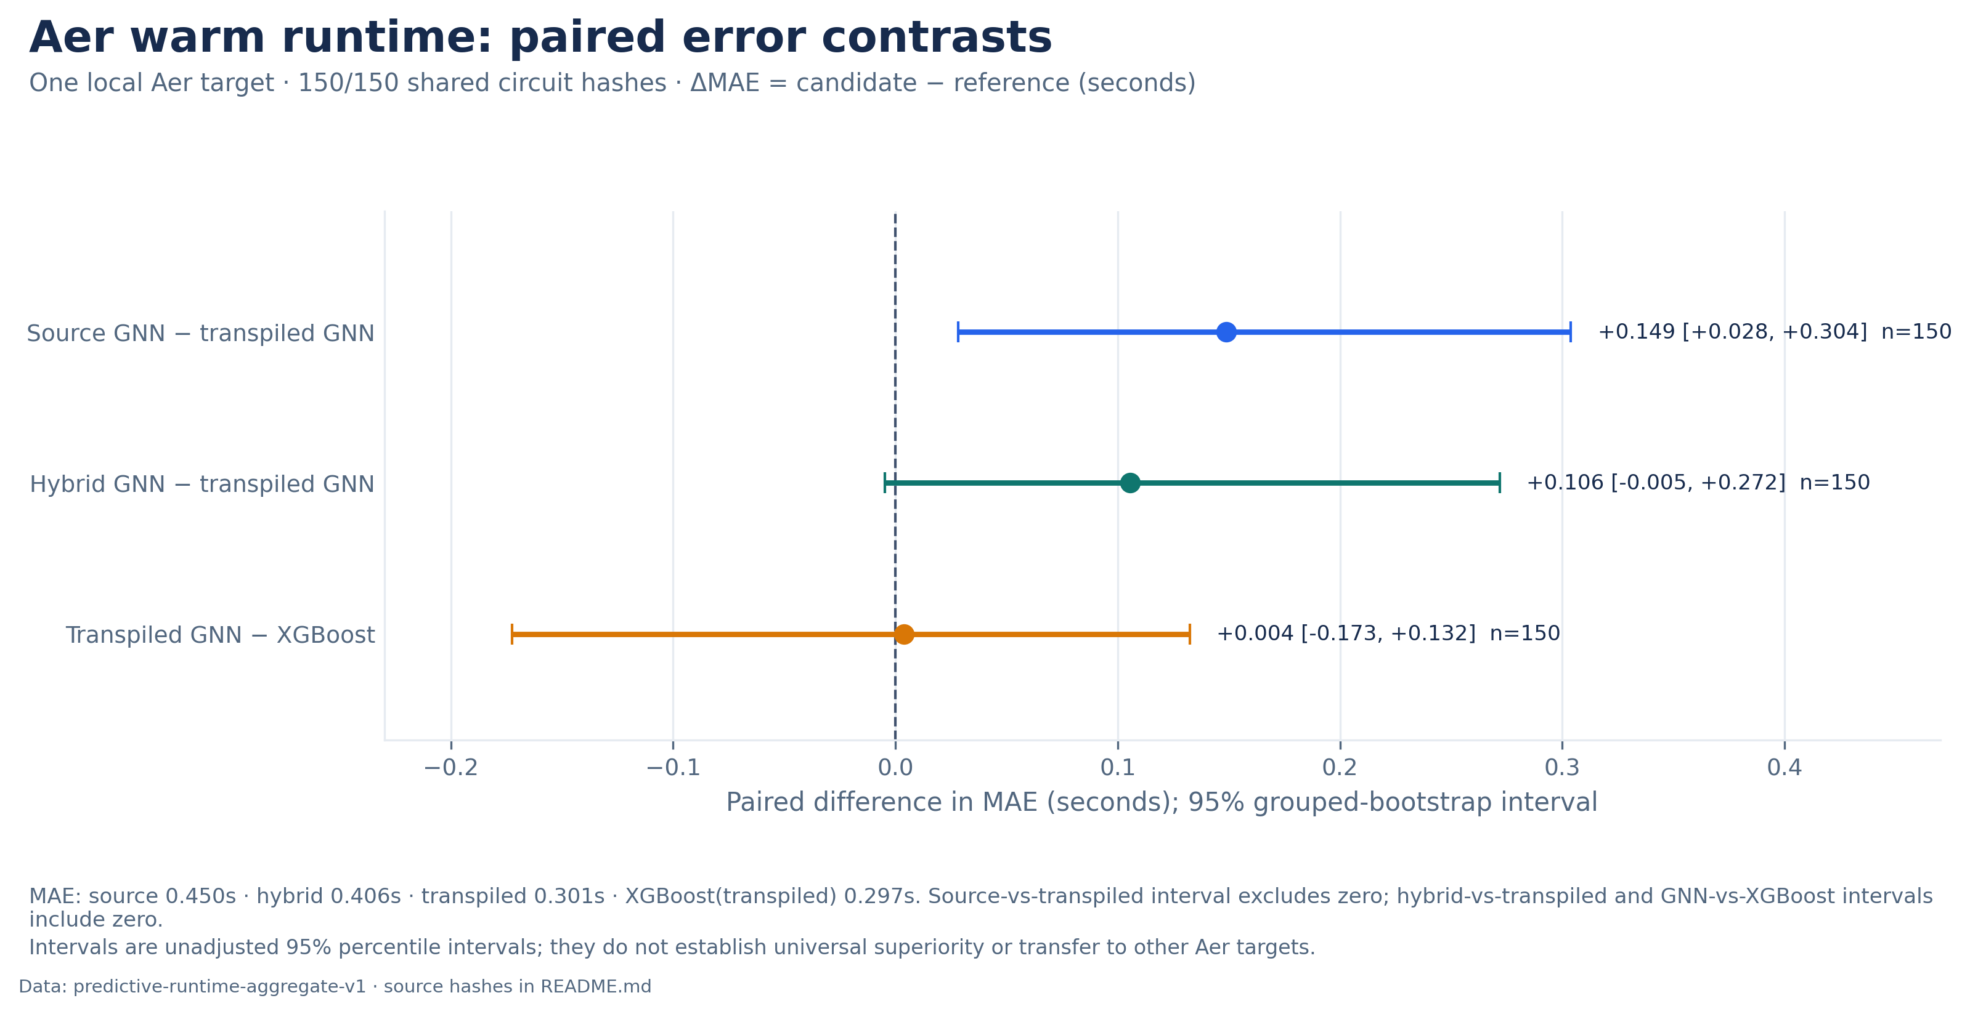
Aer: predictor trên 150 circuit hashes
Noisy-Aer warm · n=150. MAE: source 0.450 s, hybrid 0.406 s, transpiled 0.301 s, XGBoost 0.297 s; GNN–XGBoost Δ unresolved.
08
Notes:
Aer figure: presentations/figures_v2/fig1_aer_paired_predictor_contrasts.png
Figure evidence/captions: presentations/figures_v2/README.md
E6 aggregate and method cards: artifacts/benchmark_v3/simulator/predictive_runtime_aggregate_v1/aggregate_manifest.json
Target: noisy Aer warm execution on the same 150 exact-QASM hashes. Source/hybrid/transpiled GNN MAE 0.4497/0.4064/0.3008 s; transpiled XGBoost 0.2970 s. Paired delta GNN−XGBoost +0.0037 s, 95% pointwise hash-bootstrap CI [−0.1726,+0.1324], unresolved. Three-seed median predictions, five frozen outer folds. Intervals are exploratory and conditional on fits. Local FakeSherbrooke/Opt1 adaptation, not full Azizov-paper reproduction.

Slide 9
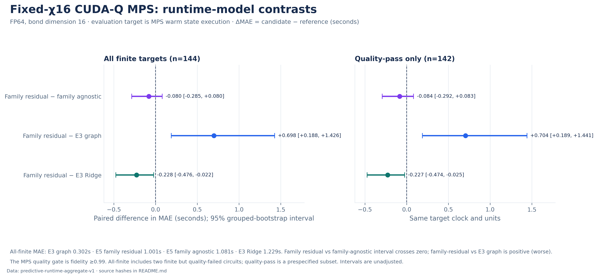
CUDA-Q MPS: fixed-configuration runtime predictor
MPS FP64 · bond 16 · warm state · 144 finite / 142 quality-pass. Graph MAE 0.304 s; max error 25.10 s. Family benefit unresolved.
09
Notes:
MPS figure: presentations/figures_v2/fig2_mps_paired_predictor_contrasts.png
Figure evidence/captions: presentations/figures_v2/README.md
E6 aggregate and method cards: artifacts/benchmark_v3/simulator/predictive_runtime_aggregate_v1/aggregate_manifest.json
Target: CUDA-Q MPS FP64 bond=16 warm-state execution. Assigned n=150 exact-QASM hashes; 144 finite labels, 142 quality-pass. Graph MAE 0.3024 s on finite labels and 0.3037 s on quality-pass; max quality-pass error 25.0964 s. Family residual−matched family-agnostic ablation MAE difference −0.0804 s, 95% pointwise hash-bootstrap CI [−0.2852,+0.0804], crosses zero. Runtime-only adaptation, not original joint approximation/runtime method. Intervals are exploratory and conditional on fits.

Slide 10
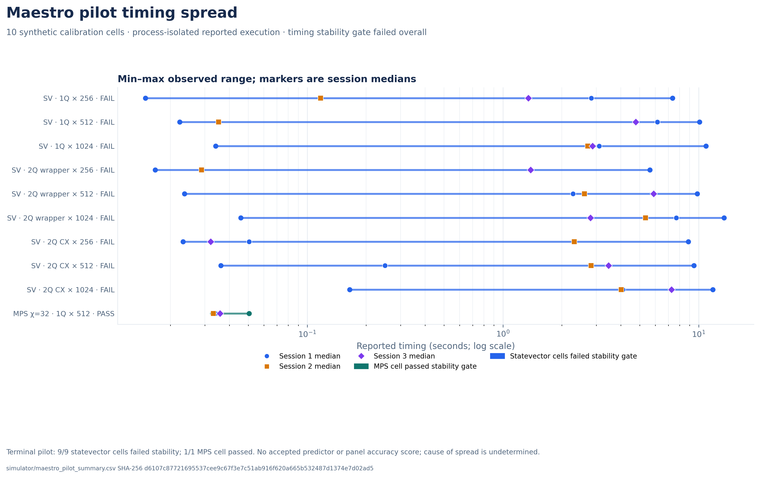
Notes:
Figure: presentations/figures/fig4_maestro_pilot_timing_spread.png
Figure caption/metadata: presentations/figures/README.md
Canonical pilot summary: artifacts/benchmark_v1/results/benchmark_summary/two_domain_scorecard_v3/simulator/maestro_pilot_summary.csv
Scope brief: docs/presentation.md
Clock: maestro_qcsim_process_isolated_reported_execution. Fresh process per timing call; do not call these persistent-process warm measurements. Pilot terminal status: pilot_gate_failed; no resume. The 15 reported values belong to one statevector n=16, one-qubit noncommuting, R=256 cell and range from 0.014905151 s to 7.355305934 s. MPS n=12/chi=32 session medians: 0.033975028 / 0.033144007 / 0.035826843 s. Cause of variation is unknown; do not attribute it to threading, hardware, or algorithm. No panel attempt or predictor accuracy score exists.

Slide 11
Kết luận và phạm vi còn thiếu
Có thể kết luận | Chưa đủ evidence để kết luận
Graph V3-large có MAE thấp hơn polynomial trên source-local shared rows. | Không có pooled cross-source superiority claim.
QPack có MAE thấp hơn nhưng cả hai R² đều âm. | Không nói model giải thích tốt biến thiên runtime.
E6 có Aer GNN và fixed-MPS predictor OOF results. | Chỉ một Aer config; MPS một bond/config; CI exploratory.
Maestro pilot ghi nhận stability failure. | Không có accepted Maestro predictor hoặc panel score.
Scientific coverage: PARTIAL. Build validation không đồng nghĩa full replication hoặc public-release approval.
11
Notes:
Scorecard: artifacts/benchmark_v1/results/benchmark_summary/two_domain_scorecard_v3/REPORT.md
Method scope: artifacts/benchmark_v1/results/benchmark_summary/two_domain_scorecard_v3/method_scope.csv
Presentation brief: docs/presentation.md

Slide 12
Fidelity phương pháp và tái dựng đầu vào
Mảng | Đã dùng | Giới hạn fidelity
QPU graph | Ma–Li/QPack logical; Qonductor exact submitted physical QASM | Không thực thi compiled-input promise cho Ma–Li/QPack
Qonductor recovery | 230 archive-resolved logical recipes | Recipe resolution, not byte-exact original logical QASM
QPack replay | 6 reconstructed structures; representative rz(0.3)/rx(0.2) | Không có original optimizer angles / submitted routing
Graph features | 7 global features; DAG + global MLP branches | Polynomial có 5 features; không cô lập causal graph effect
Native estimates | Snapshot calibration theo backend | Không phải row-day historical calibration
Family-Aware-style | Fixed-MPS runtime-only residual + matched ablation | Original joint threshold/runtime target not evaluated
Maestro | Component calibration / local context pilot | No accepted held-out predictor score; pilot gate failed
Archived labels vẫn là runtime quan sát; replay reconstruction không thay đổi labels.
12
Notes:
Scorecard scope disclosures: artifacts/benchmark_v1/results/benchmark_summary/two_domain_scorecard_v3/REPORT.md
Method cards: artifacts/benchmark_v1/results/benchmark_summary/two_domain_scorecard_v3/method_scope.csv
Representation protocol: benchmark_v1/decisions/circuit_representation_v3.md

Slide 13
Clocks, quality, và release boundary
Domain | Clock or outcome | Interpretation
QPU target | Archived observed service/execution | Evaluation target, not schedule duration
QPU analytical | Scheduled single-shot / shot-scaled | Proxy; provider overhead excluded
Simulator | First / warm execution; quality gate | MPS: 573/612 ok; 21 quality fail, 18 adapter error
cuTensorNet | Selected-plan estimate | 603/612 ok; compare only to same-plan contraction
Maestro | Process-isolated reported execution | Fresh process, terminal pilot failure
Reproducibility | Local clean clone at 461cc6e | Tables/E6 rebuilt; current reporting edits need final C6 check
Rights/provenance | Owner decision remains open | Not a public-release approval; see third-party notices
Unavailable rows, timeouts, adapter errors, and quality failures stay in coverage denominators.
13
Notes:
Scorecard: artifacts/benchmark_v1/results/benchmark_summary/two_domain_scorecard_v3/REPORT.md
QPU clock coverage: artifacts/benchmark_v1/results/benchmark_summary/two_domain_scorecard_v3/qpu/archived_method_coverage.csv
Simulator availability: artifacts/benchmark_v1/results/benchmark_summary/two_domain_scorecard_v3/simulator/availability_matrix.csv
Simulator configuration metrics: artifacts/benchmark_v1/results/benchmark_summary/two_domain_scorecard_v3/simulator/per_configuration_metrics.csv
Maestro pilot: artifacts/benchmark_v1/results/benchmark_summary/two_domain_scorecard_v3/simulator/maestro_pilot_summary.csv
Package README: docs/reproduction.md
Report authority: benchmark_v1/execution/manifests/report_finalization.json

Slide 14
Appendix: coverage của 24 QPU variants
Variant | Pred / 8,767 | Cover | Output clock
MaLi graph V3 | 8,763 | 99.95% | Observed service
MaLi graph V3-large | 8,766 | 99.99% | Observed service
Unified polynomial V3 | 8,767 | 100.00% | Observed service
QCRE CP raw | 8,766 | 99.99% | Scheduled CP
QCRE CP affine | 8,766 | 99.99% | Cal. service
QCRE CP log-affine | 8,766 | 99.99% | Cal. service
QCRE shot raw | 8,766 | 99.99% | Shot schedule
QCRE shot affine | 8,766 | 99.99% | Cal. service
QCRE shot log-affine | 8,766 | 99.99% | Cal. service
Qiskit duration raw | 8,766 | 99.99% | Scheduled 1-shot
Qiskit duration affine | 8,766 | 99.99% | Cal. service
Qiskit duration log-affine | 8,766 | 99.99% | Cal. service
Variant | Pred / 8,767 | Cover | Output clock
Qiskit shot raw | 8,766 | 99.99% | Shot schedule
Qiskit shot affine | 8,766 | 99.99% | Cal. service
Qiskit shot log-affine | 8,766 | 99.99% | Cal. service
Hyb 1-circuit raw | 8,420 | 96.04% | T_eff
Hyb 1-circuit affine | 8,420 | 96.04% | Cal. service
Hyb 1-circuit log-affine | 8,420 | 96.04% | Cal. service
Hyb shot-linear raw | 8,420 | 96.04% | Shot-linear cost
Hyb shot-linear affine | 8,420 | 96.04% | Cal. service
Hyb shot-linear log-affine | 8,420 | 96.04% | Cal. service
Scholten nominal raw | 5,769 | 65.80% | CLOPSv-like
Scholten affine | 5,769 | 65.80% | Cal. service
Scholten log-affine | 5,769 | 65.80% | Cal. service
Notes:
Full coverage figure (companion): presentations/figures/fig2_qpu_prediction_coverage.png
Figure SHA-256: d8dc1661d0bd415eda6c33f8bcad935eb4fed424b832504a138b89225c20f365
Readable native table source: artifacts/benchmark_v1/results/benchmark_summary/two_domain_scorecard_v3/qpu/archived_method_coverage.csv
Source table SHA-256: ee408a85b5fef378103a2ada6709c791f9e66a8db192e15445bdd6e9803aa915
Scorecard manifest: artifacts/benchmark_v1/results/benchmark_summary/two_domain_scorecard_v3/manifest.json
Exact row set: all 24 method_id rows in archived_method_coverage.csv; assigned denominator 8,767 per row. Predicted counts and coverage percentages reproduce the source table. Method-output clock labels are abbreviated in the table: service=archived observed service; cal. service=outer-train calibrated observed service; sched.=scheduled duration; T_eff=one-circuit effective cost. Coverage only, not accuracy; method clocks and fidelity differ, so rows are not ranked.

