Slide 1
Metasploit
Introduction to Metasploit
By John Ombagi

Slide 2


What is metasploit?

Slide 3
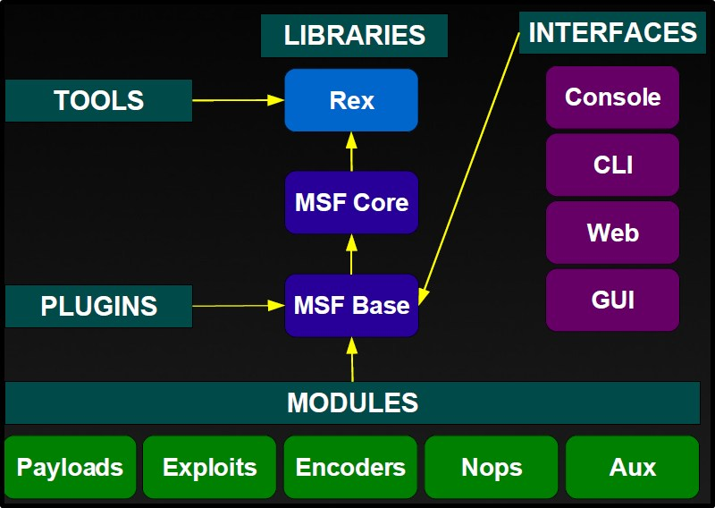
Metasploit Architecture

Slide 4
File system
lib: the 'meat' of the framework code base
data: editable files used by Metasploit
tools: various useful command-line utilities
modules: the actual MSF modules
plugins: plugins that can be loaded at run-time
scripts: Meterpreter and other scripts
external: source code and third-party libraries

Slide 5
MSF Libraries
Rex
Contains basic lib for most tasks
Handles sockets, protocols, text transformations etc
SSL, SMB, HTTP, XOR, Base64, Unicode
Msf::Core
Provides the 'basic' API
Defines the Metasploit Framework
Msf::Base
Provides the 'friendly' API
Provides simplified APIs for use in the Framework

Slide 6
Terms you should Know!
Payload – code that runs remotely
ShellCode – code that runs remotely to provide Shell access
Exploit – Any module that uses payloads
Encoders – Ensure payloads make it to their destination
NOPs – keep the payload size consistent

Slide 7

BASICS of MSF
There are different interface to the framework.
Msfcli
Msfweb
Msfconsole
Others
( BTW: I don't mean MRI interfaces)

Slide 8
Msfcli Interface
It's a command line interface to the framework.
Variables are assigned using “=”
Use “msfcli -h” to learn more about the options to set/use with msfcli
Convenient to use when testing or developing a new exploit
Good in scripts and basic automation

Slide 9
msfweb
Provides a web based (ajax-y) interface to the framework.
Currently not actively developed
It's a removed from the Metasploit trunk
Good for demonstration

Slide 10
msfconsole
It's the actively developed interface which provides a console to almost every part of Metasploit framework
Execution of external commands is possible
Has full readline support, tabbing & command completion
Very stable

Slide 11
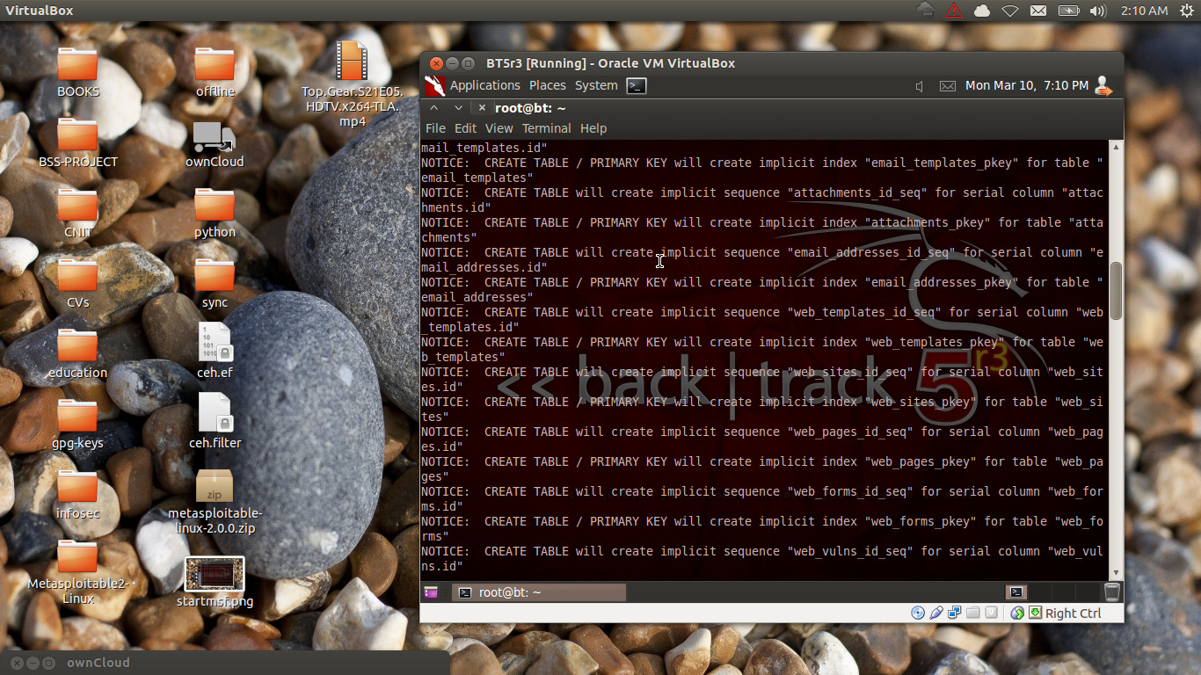
Starting MSF
root@bt5:~# msfconsole

Slide 12
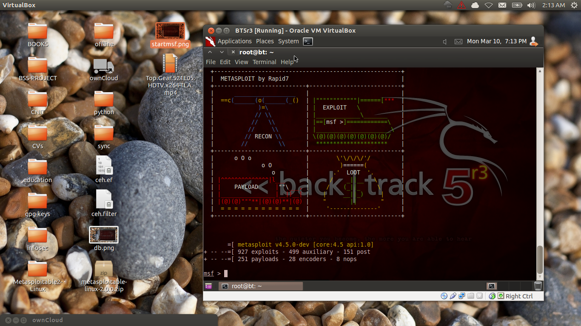
Welcome to Msfconsole

Slide 13
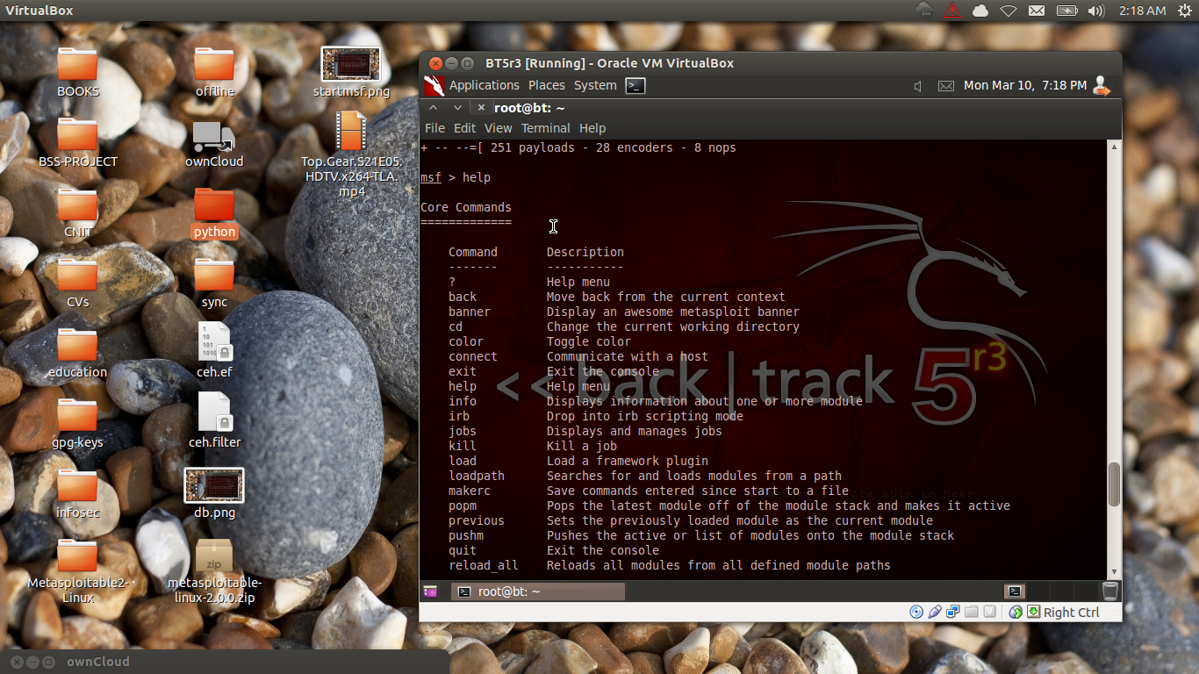
Getting Help: Entering 'help' or a '?' at the msf command prompt

Slide 14
Tab Completions
Almost every command in the console supports tab completion
e.g
msf > use exploit/windows/smb/ms
(after pressing tab it will display possible exploits to be used... starting with ms*)
After using a particular module you can use
Msf > back
(to move return 1 step back)

Slide 15
Checking an Exploit Accuracy
Some exploits allow you to check if the vulnerable victim can be attacked with the Exploit you have selected by issuing, eg:
msf exploit(ms04_045_wins) > check
NB: all the parameters of an exploit should be set before checking
When Launching the attack use “exploit” command. In case of an auxiliary module, use “run” command

Slide 16
Plugins
To load a plug-in from the MSF “plugin” dir, use the command “load” and arguments are passed as “foo=bar”
Eg: msf> load pcap_log
To remove an extended command and a previous loaded plugin use
msf> unload pcap_log

Slide 17
Resource Command
Some batch files assist in rapid test with MSF.
Msf will run the commands in from the file in sequence
With this in place you can automate repeated tasks.
Use command “resource” then pass the file.rc

Slide 18
Route Command
This command assist In setting the targets subnet, network-mask once you have a session.
Pivoting is easily accomplished with this setup, understanding your victim network is a crucial point to note.. eg:
msf exploit(ms08_067_netapi) > route add 192.168.1.0 255.255.255.0 2
msf exploit(ms08_067_netapi) > route print (this will display the settings)

Slide 19
Details about a Module?
To get a brief detailed information about a particular module, use the “info” command
It will show you the options you can set, author, Vulnerability references, payload restrictions (if any) and other info..
e.g:
Msf> info /module/etc/

Slide 20
Configuring Options
To configure parameters and other options for the module you are working with, use the “set” and “unset” commands.
E.g. to set a Victim's ip address
Msf > set RHOST 192.168.193.12
“uset” command is the vice-versa of “set”
To clear all set parameters use the “unset all” command

Slide 21
Spawned Sessions.
Once you have a shell, a Meterpreter shell, VNC, DB etc use the “sessions” command to manipulate them.
“sessions -l” shows a list of all sessions obtained with their numbers on their left
To jump to a specific session, use “sessions -i n” where n represent the session id/number

Slide 22
Seraching for Modules etc
Since the framework has a lot of modules, payloads and a bunch of other stuff, you may need to use the “search” command once in a while.
Eg:
Msf> search keyword

Slide 23
Show Command
The “Show” command displays every module within MSF
most frequently are
“show auxiliary”
“show exploits”
“show payloads',
“show encoders” &
“show nops”

Slide 24

Show Command contd.
show targets
show advanced
Show options

Slide 25
Pentest Tip:
While doing a pen-test you can save time by setting Global Variables.
In this case, “setg” command is used.
When you have correctly set them you can use them in many exploit and auxiliary modules.
Make sure you have checked your options before running an exploit or an auxiliary module.
Use “unsetg” to remove the global variables

Slide 26
Examples
msf > setg LHOST 192.168.1.101
LHOST => 192.168.1.101
msf > setg RHOSTS 192.168.1.0/24
RHOSTS => 192.168.1.0/24
msf > setg RHOST 192.168.1.136
RHOST => 192.168.1.136
You can save the current global settings too. They are automagically loaded on start up :)
msf > save
Saved configuration to: /root/.msf3/config
msf >

Slide 27

Lastly...
When you have decided which module to engage with, “use” command will select it.
Eg msf > use dos/windows/smb/ms09_001_write
msf auxiliary(ms09_001_write) > show options

Slide 28

Metasploit part 2
ADVANCED METASPLOIT TECHNIQUES
DEMO.
REAL HACKING Scenarios

