Slide 1
MITM ATTACK
MAN IN THE MIDDLE
Attacks
By John Ombagi

Slide 2
What is MITM?
a form of active eavesdropping.
Attacker makes independent connections with the victims and relays messages between them.
when in fact the entire conversation is controlled by the attacker.

Slide 3
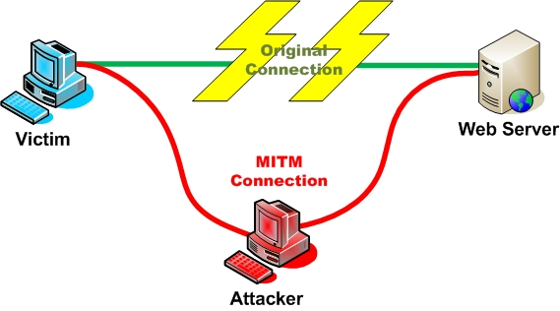
MITM ATTACK

Slide 4
MITM Attack tools
PacketCreator
Ettercap
Dsniff
Cain e Abel

Slide 5
PacketCreator
Uses ARP cache poisoning and generate ICMP packets to send over the LAN
Spoofs and redirect switch based network traffic
It is possible to create a own made IP packet in which you can edit IP header or every ICMP field.
Version 2.2 has memory leaks correction and better reliability.
I use Hping in Linux :)

Slide 6
Ettercap
supports active/passive dissection of many protocols
Character injection into an established connection
creation of custom plugins using Ettercap's API.
Packet filtering/dropping

Slide 7
Dsniff
decodes passwords sent in clear-text across a LAN
It can also be used to disrupt the normal behavior of switched networks

Slide 8
Cain & Abel
It has a lot of features (check wikipedia for the list)
Can sniff passwords in LAN

Slide 9

Questions?

