Slide 1
Life cycle of a container Interface inside a VM
Bui Hoang Dung - 19/4/2023

Slide 2
Condition:
OVN provide virtual network abstraction by converting information written in OVN_NB db to OpenFlow flows in each hypervisor.
Secure virtual networking for multi-tenants can only be provided if OVN controller is the only entity that can modify flows in OvS (to make sure that tenant workloads running inside VMs cannot make any changes to OvS flows).

Slide 3
2. Distinguish network traffic of CIFs
When multiple containers are created -> multiple CIFs associated.
Network traffic associated with these CIFs need to reach the OvS integration bridge running in the hypervisor.
OVN should be able to distinguish network traffic coming from different CIFs.
Two ways to distinguish network traffic of CIFs:
+ Provide one VIF for every CIF ( 1:1 model) -> make slow down
+ Provide one VIF for all CIFs (1 : many model)

Slide 4
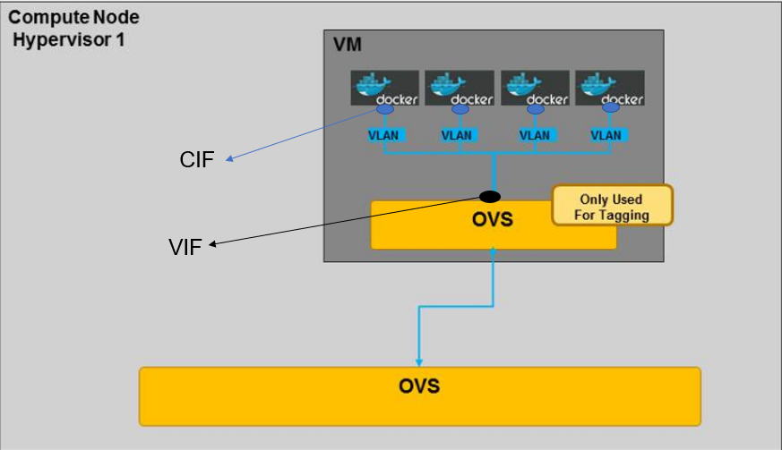
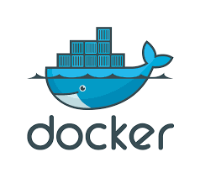
2 Distinguish network traffic of CIFs
CIF
VIF
OVS
OVS
1:many model
1:1 model

Slide 5
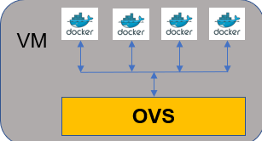
3. Life cycle of container in 1:many model
CMS
(OpenStack Neutron/K8s)
1. CMS create containers inside VM ( need to know vif_id, choose an unused VLAN inside that VM).
6. The entity stops container, through the CMS delete its row in Logical_Switch_Port table.
2. CMS update the OVN Northbound db by adding a row (name, parent_name, tag) to Logical_Switch_Port table.
OVN-Northbound db
7. ovn-northd removes or updates the rows from Logical_Flow table and deletes the row in Binding table for now-destroyed CIF.
5. Ovn-northd updates chasis column in Binding table the up column in Logical_Switch_Port table -> CIF is now up.
3. Ovn-northd update OVN Southbound db by adding a row to Logical_Flow table and a row to Binding table.
northd
OVN-Southbound db
8. ovn-controller receives the Logical_Flow table updates -> Ovn-controller updates OpenFlow table.
4. Ovn-Controller update local hypervisor’s OpenFlow table. Afterward it updates the Chassis column of the Binding.
OVN-controller
OVN-controller
OVS
OVS

