Slide 1
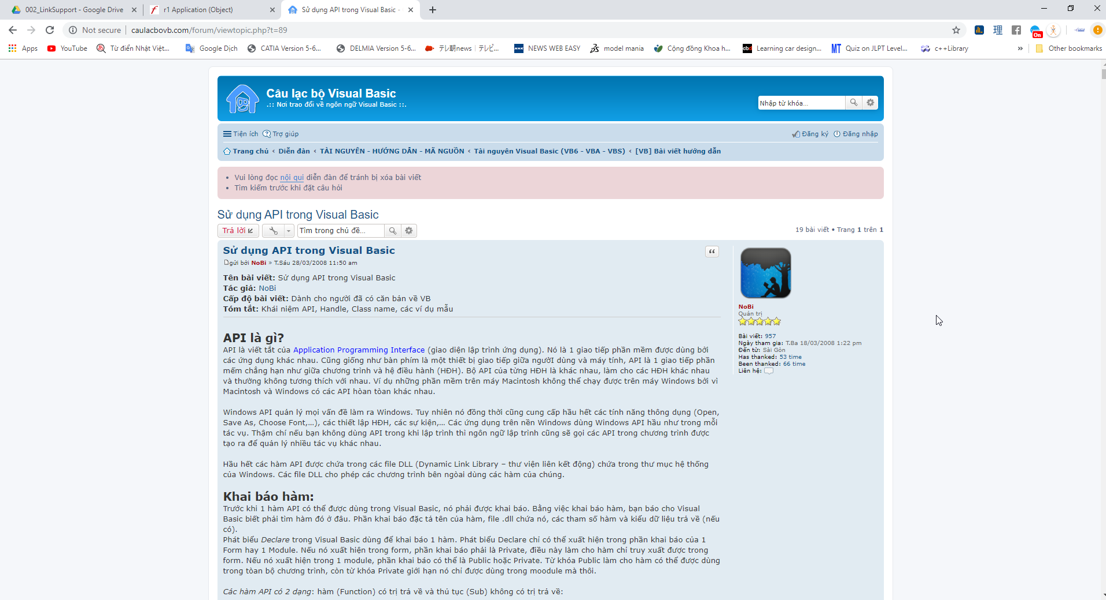
PLM
THE AGE OF
http://caulacbovb.com/forum/viewtopic.php?t=89

