Slide 1
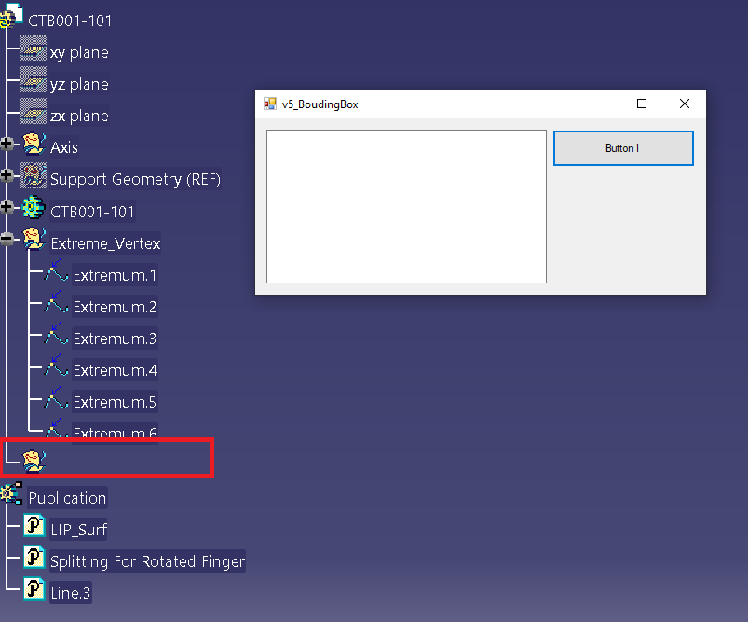
PLM
THE AGE OF
Dim oBodies As HybridBodies = oPart.HybridBodies
Dim oBodyAddNew As HybridBody = oBodies.Add
oBodyAddNew.Name = TextBox1.Text

