Slide 1

GROUP: NamDT5, DungBQ3, DinhMV2

Slide 2

INTRODUCTION
The PHP Framework For Web Artisans
Author: Taylor Otwell
MVC framework – base on PHP >=5.4
Use Composer
Large community
Full Documentation
Text
Video

Slide 3
INSTALLATION
Install composer
Server requirements
PHP >= 5.4
Mcrypt PHP Extension
OpenSSL PHP Extension
Mbstring PHP Extension
Tokenizer PHP Extension
Create a new project
Start project
composer create-project laravel/laravel projectName --prefer-dist
php artisan serve

Slide 4
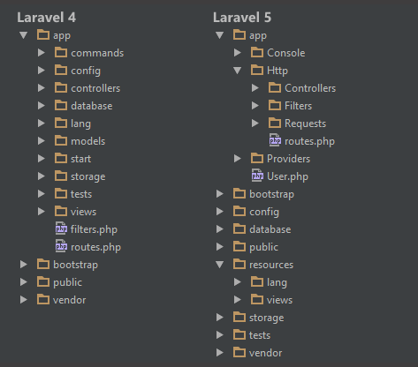
FOLDER STRUCTURE

Slide 5
BASE FEATURES
Bundles
Composer
Eloquent ORM
Application logic
Routes
Restful Controller
Class auto loading
View
Migrations
Unit Testing
Automatic pagination

Slide 6
HIGHLIGHTS FEATURES
Flexible routing
Middleware
Controller
Request
Response
Templates
Cache
Powerful ActiveRecord ORM
Command-line Utility

Slide 7
FLEXIBLE ROUTING
Route For Multiple Verbs
Route Parameters
Defining Global Patterns
Route::post('foo/bar', function() {
return 'Hello World';
});
Route::match(['get', 'post'], '/', function() {
return 'Hello World';
});
Route::get('user/{id}/{name?}', function($id, $name = ‘john’) {
if ($request->route('id')) {
// To do
}
})
->where(['id' => '[0-9]+', 'name' => '[a-z]+'])
$router->pattern('id', '[0-9]+');
Route::get('user/{id}', function($id) {
// Only called if {id} is numeric.
});

Slide 8
FLEXIBLE ROUTING
Named route, route group
Route Prefixing
Route Model Binding
Route::group(['middleware' => 'auth', 'prefix' => 'admin'], function() {
Route::get('/', function() {
// Has Auth Filter
});
Route::get('user/profile', [
'as' => 'profile‘, 'uses' => 'UserController@showProfile‘
]);
});
Route::group(['prefix' => 'admin'], function() {
Route::get('user', function() {
//
});
});
Route::model('user', 'User', function() {
throw new NotFoundHttpException;
});

Slide 9
MIDDLEWARE
Filtering HTTP requests entering your application
Located in: app/Http/Middleware
Ex:
Authentication
Logging
CSRF protection
Etc.

Slide 10
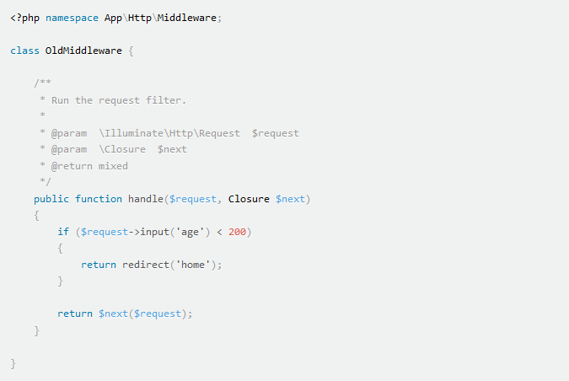
Create a new Middleware
Middleware
php artisan make:middleware OldMiddleware

Slide 11
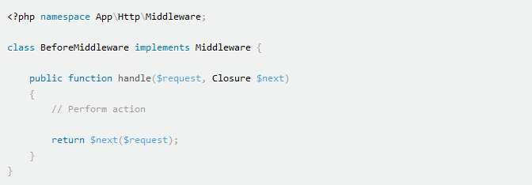
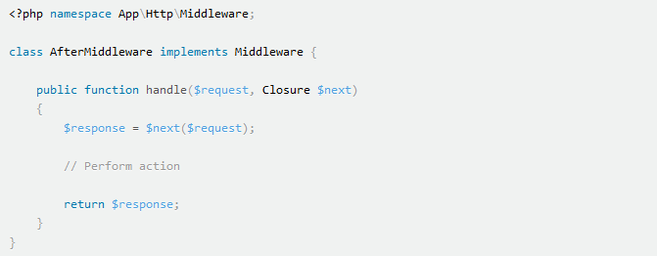
Before / After Middleware
Middleware

Slide 12
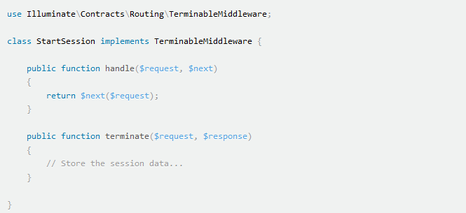
Terminable Middleware
Middleware
Do some work after the HTTP response has already been sent to the browser
Ex: SessionStart middleware

Slide 13

Registering
Middleware
Global Middleware
Run during every HTTP request
Declare in app/Http/Kernel.php
Assigning To Routes
Assign a short-hand key in app/Http/Kernel.php
Use the middleware key in the route options array
protected $routeMiddleware = [ 'auth' => 'App\Http\Middleware\Authenticate', 'auth.basic' => 'Illuminate\Auth\Middleware\AuthenticateWithBasicAuth', 'guest' => 'App\Http\Middleware\RedirectIfAuthenticated', ];

Slide 14
CONTROLLER
Group related HTTP request handling logic
Ex:
Route::get('user/{id}', 'UserController@showProfile');
<?php namespace App\Http\Controllers;
use App\Http\Controllers\Controller;
class UserController extends Controller {
/**
* Show the profile for the given user.
*
* @param int $id
* @return Response
*/
public function showProfile($id) {
return view('user.profile', ['user' => User::findOrFail($id)]);
}
}

Slide 15
REQUEST
Illuminate\Http\Request
Simple method to access all user input
$name = Request::input('name');
$name = Request::input('name', 'Sally');
if (Request::has('name')) {
//
}
$input = Request::all();
// Get only some of inputs
$input = Request::only('username', 'password');
$input = Request::except('credit_card');
// Working with array input
$input = Request::input('products.0.name');

Slide 16
RESPONSE
Basic response
Redirects
File download response
return response()->view('hello')->header('Content-Type', $type)
->withCookie(cookie('name', 'value'));
// Redirect with flash message
return redirect('user/login')->with('message', 'Login Failed');
// Redirect back
return redirect()->back();
return redirect()->back()->withInput();
// For a route with the following URI: profile/{user}
return redirect()->route('profile', ['user' => 1]);
// Redirect to a action
return redirect()->action('App\Http\Controllers\HomeController@index');
return response()->download($pathToFile);
return response()->download($pathToFile, $name, $headers);
return response()->download($pathToFile)->deleteFileAfterSend(true);

Slide 17
TEMPLATES
Use Blade template engine
Defining A Blade Layout
Using blade layout
<!-- Stored in resources/views/layouts/master.blade.php -->
<html>
<body>
@section('sidebar')
This is the master sidebar.
@show
<div class="container">
@yield('content')
</div>
</body>
</html>
@extends('layouts.master')
@section('sidebar')
@parent
<p>This is appended to the master sidebar.</p>
{{ isset($name) ? $name : 'Default' }}
@stop
@section('content')
<p>This is my body content.</p>
@stop

Slide 18
CACHE
Configuration: config/cache.php
Support popular caching backends:
APC
Array
Database
File cache (default)
Memcache
Redis
Note:
In-memory cache is recommended for large applications: (memcache, APC)
Install “predis/predis” package via composer before use Redis cache

Slide 19
DATABASE
Configuration: config/database.php
Support 4 database systems:
Mysql
Postgres
SQLite
SQL Server
Read/ write connection
'mysql' => [
'read' => [
'host' => '192.168.1.1',
],
'write' => [
'host' => '196.168.1.2'
],
'driver' => 'mysql',
'database' => 'database',
'username' => 'root',
'password' => '',
'charset' => 'utf8',
'collation' => 'utf8_unicode_ci',
'prefix' => '',
],

Slide 20
Running Queries
Database
Basic queries
Listen for Queries Events
Database Transactions
Rollback automatically if has any exception thrown
Query logging
Log in memory all queries that have been run for the current request
$results = DB::select('select * from users where id = :id', ['id' => 1]);
DB::insert('insert into users (id, name) values (?, ?)', [1, 'Dayle']);
DB::update('update users set votes = 100 where name = ?', ['John']);
DB::delete('delete from users');
DB::listen(function($sql, $bindings, $time) {
//
});
DB::transaction(function() {
DB::table('users')->update(['votes' => 1]);
DB::table('posts')->delete();
});
DB::connection()->enableQueryLog();
$queries = DB::getQueryLog();

Slide 21
ELOQUENT ORM
Simple ActiveRecord implementation
Very powerful and expressive ORM in Laravel
each Eloquent model represents a single database table
Very easy to use
Easy to design database

Slide 22
REFER
Laravel 5.0 document
http://laravel.com/docs/5.0
Laracasts forum
https://laracasts.com/discuss
Laravel.io forum
http://laravel.io/forum
Laravel Vietnam
http://laravel-viet.net
www.qhonline.info
laravelviet.net

Slide 23
THANK YOU FOR YOUR TIME
PLEASE ENJOY OUR DEMO

