Slide 1
CHUYÊN ĐỀ THIẾT KẾ HỆ THÔNG NHÚNG
GVHD: Phạm Minh Quân
Nguyễn Văn Tín – 19521022
Cao Phan Tiến Dũng - 19521387
Copyrights 2016 UIT-Khoa KTMT . All Rights Reserved.

Slide 2
QUESTION
Task 1
  Đọc dữ liệu từ UART
Task 2
  Xuất dữ liệu vừa đọc UART
  Xuất dữ liệu “Program’s running…” chu kỳ 500ms
Task 3
  Điều khiển bật tắt LED theo dữ liệu UART
Copyrights 2016 UIT-Khoa KTMT . All Rights Reserved.

Slide 3
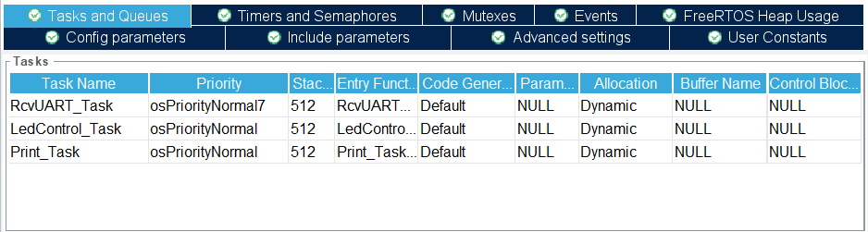
TASK
Copyrights 2016 UIT-Khoa KTMT . All Rights Reserved.

Slide 4
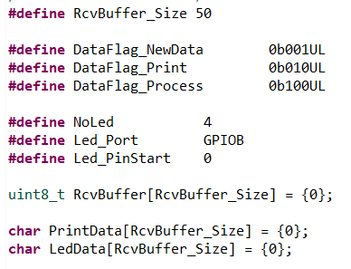
DEFINE
Copyrights 2016 UIT-Khoa KTMT . All Rights Reserved.

Slide 5
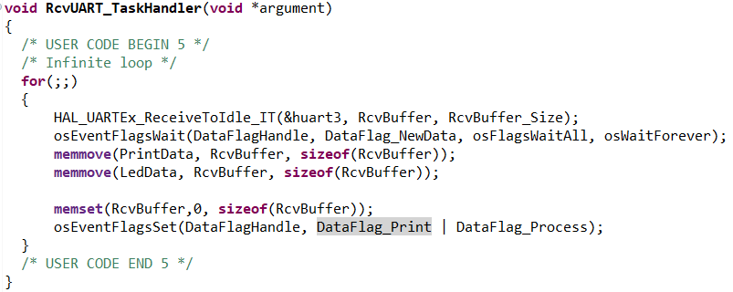
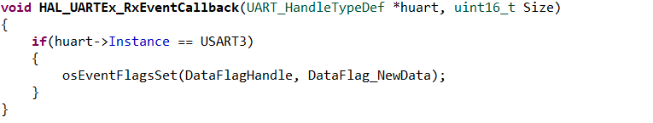
RECIVE UART TASK
Copyrights 2016 UIT-Khoa KTMT . All Rights Reserved.

Slide 6
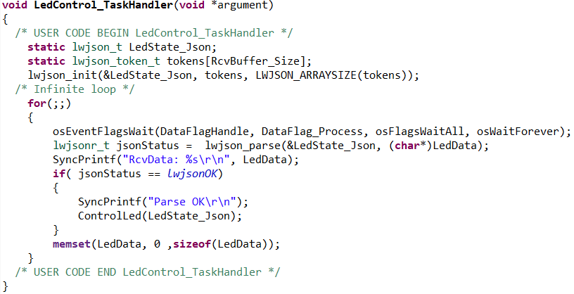
LED CONTROL TASK
Copyrights 2016 UIT-Khoa KTMT . All Rights Reserved.

Slide 7
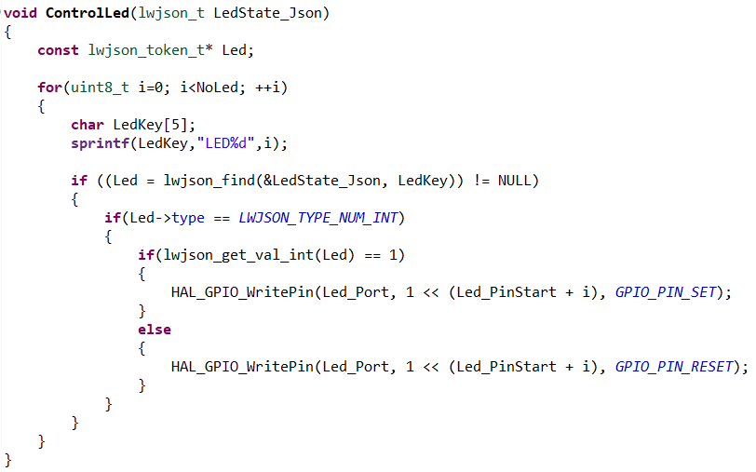
LED CONTROL TASK
Copyrights 2016 UIT-Khoa KTMT . All Rights Reserved.

Slide 8
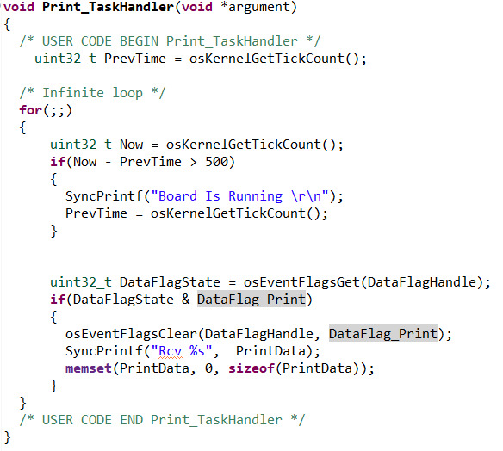
PRINT TASK
Copyrights 2016 UIT-Khoa KTMT . All Rights Reserved.

Slide 9
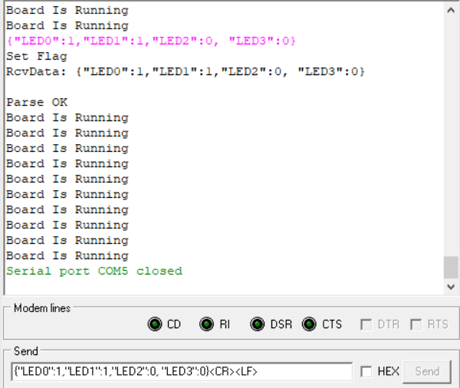
FRAME DATA
{"LED0":1,"LED1":1,"LED2":0, "LED3":0}
Copyrights 2016 UIT-Khoa KTMT . All Rights Reserved.

Slide 10
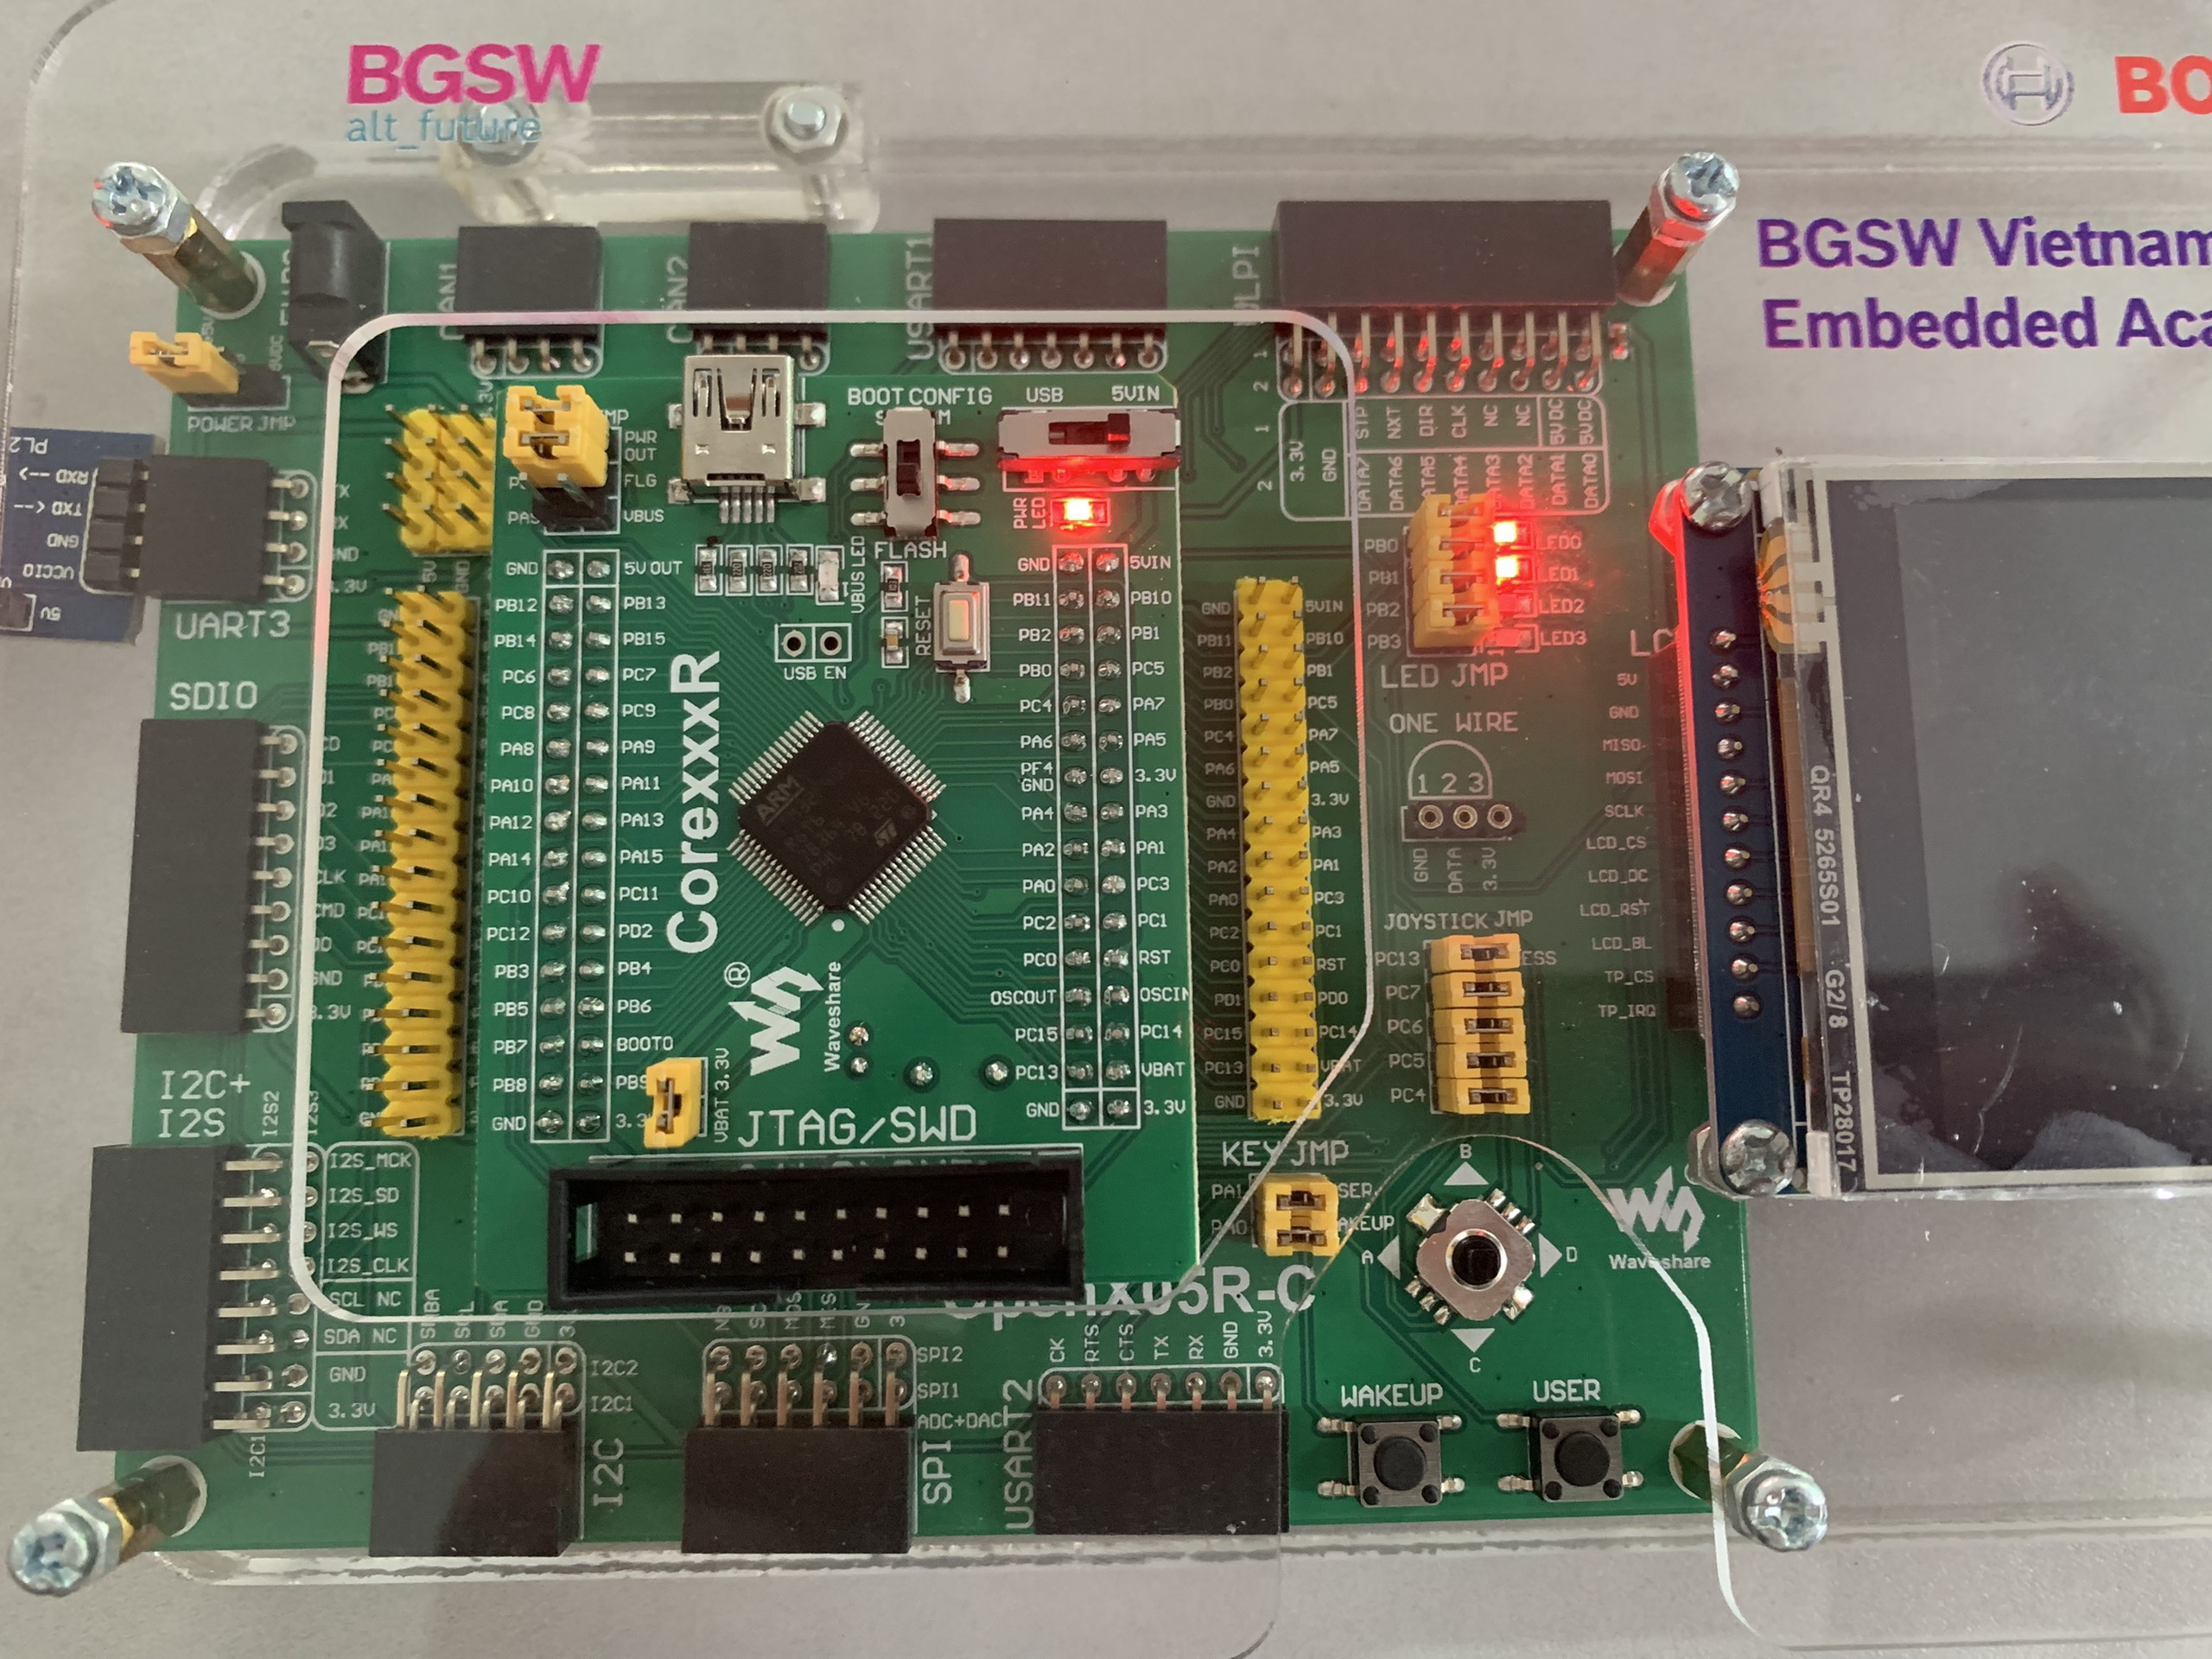
Copyrights 2016 UIT-Khoa KTMT . All Rights Reserved.

Slide 11
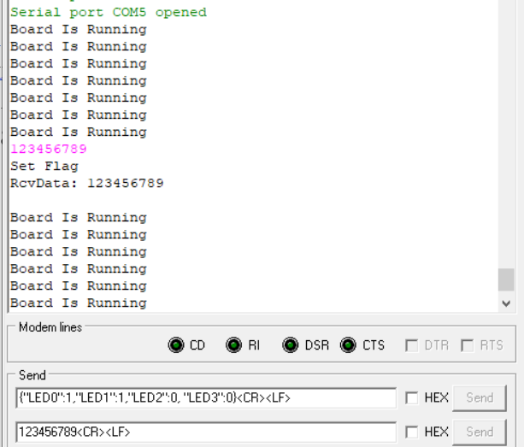
DEMO
Copyrights 2016 UIT-Khoa KTMT . All Rights Reserved.

Slide 12
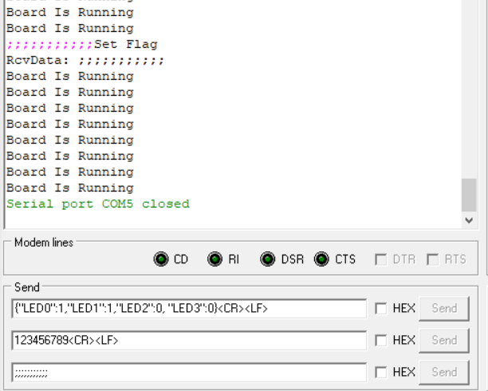
DEMO
Copyrights 2016 UIT-Khoa KTMT . All Rights Reserved.

Slide 13
Copyrights 2016 UIT-Khoa KTMT . All Rights Reserved.

