Slide 1
Module 4
Storing SQL Data in Azure
Notes:
20532C
4: Storing SQL Data in Azure

Slide 2
Module Overview
Azure SQL Database Overview Managing SQL Databases in Azure Azure SQL Database Tools Securing and Recovering an Azure SQL Database Instance
Notes:
20532C
4: Storing SQL Data in Azure

Slide 3
Lesson 1: Azure SQL Database Overview
Azure SQL Database Azure SQL Database Tiers Databases as a Service vs. SQL Server in a Virtual Machine
Notes:
20532C
4: Storing SQL Data in Azure

Slide 4
Azure SQL Database
Fully managed database solution
Highly compatible with existing management tools
Built-in high availability and predictable performance as you scale out
Notes:
20532C
4: Storing SQL Data in Azure

Slide 5
Azure SQL Database Tiers
Tiers
Basic
Standard
Premium
Retired tiers
Web
Business
Notes:
Start a discussion with the students on when they would need reserved resources. Some examples are applications that need predictable latency, handle many concurrent requests, or have a high-peak compute load.
Remind the students that this doesn’t mean that Standard databases are slow. They are consistent in their performance and the Premium offerings are there for scenarios when more is needed.
20532C
4: Storing SQL Data in Azure

Slide 6
Databases as a Service vs. SQL Server in a Virtual Machine
SQL Database
SQL Server in an Azure VM
Standardized, interoperable, and scalable managed database solution
Contains size limits for each standard edition
Requires some re-architecture of existing applications
Ideal for new cloud-based applications
Provides high compatibility with SQL on premise.
Ideal for existing applications that require the SQL installation to be customized.
Requires more maintenance and customization to achieve scalability
Notes:
Selecting between SQL Database and SQL Server on virtual machines in Azure can be debated infinitely. SQL/VM is ideal for scenarios where you need to migrate an existing application or you are having a tightly planned database scale (scale up). SQL Database is ideal for new applications and applications that need to scale on demand.
20532C
4: Storing SQL Data in Azure

Slide 7
Databases as a Service vs. SQL Server in a Virtual Machine (cont.)
Azure SQL Databases
SQL Server in an Azure VM
Can be made available to any Azure service by selecting an option in the portal
Can be made available to specific IP addresses through the portal
A port must be opened so you can connect to the SQL instance from outside of the VM
Azure Services are treated like any other outside connection
Notes:
20532C
4: Storing SQL Data in Azure

Slide 8
Discussion
What business requirements would you use to determine whether you should host SQL Standalone in an Azure VM or use Azure SQL Databases?
Notes:
20532C
4: Storing SQL Data in Azure

Slide 9
Lesson 2: Managing SQL Databases in Azure
Creating an Azure SQL Database Instance Demonstration: Creating a SQL Database
Notes:
This lesson focuses on the tools that are available in the Azure portal to create and manage databases.
20532C
4: Storing SQL Data in Azure

Slide 10
Creating an Azure SQL Database Instance
The SQL Database service
The server instance
The database instance
Notes:
Creating a server is the first step in creating SQL databases in Azure. Even if you try to create a database without a server, you will be prompted with dialog boxes to create a server along with the database. You can use the server to logically group your databases and also to use existing tools that understand the server to database taxonomy.
20532C
4: Storing SQL Data in Azure

Slide 11
Demonstration: Creating a SQL Database
In this demonstration, you will learn how to:
Create a SQL Database instance by using the Portal
Create a logical server instance by using the Portal
Notes:
Preparation Steps
Note: The demo steps are accurate as of the publishing date of this course. To view the latest demo steps, visit the GitHub repository for the course.
Before starting this demo, you must complete the lab in Module 2. For this demo in this module, you will use the available host machine. Also, you must complete the following steps:
On the host computer, click Start, type Remote, and then click Remote Desktop Connection.
In Remote Desktop Connection, provide the name of your virtual machine in the Computer box by using the following format:
vm20532[Your Name Here].cloudapp.net:[Your VM RDP Port]
Note: The name and port for your virtual machine might be saved in the Computer drop-down list. If this is the case, use this value instead of typing it in manually. If you are unsure about your virtual machine’s RDP port, use either of the Azure portals to find your virtual machine’s endpoints. The endpoint with the name Remote Desktop is the correct port for RDP. This port is randomized to protect your virtual machine from unauthorized access.
In Remote Desktop Connection, click Connect. Wait until the RDP client accesses the virtual machine.
If necessary, sign in by using the following credentials:
User name: Student
Password: AzurePa$$w0rd
Verify that you received the credentials to sign in to the Azure portal from your training provider. You will use these credentials and the Azure account throughout the labs in this course.
20532C
4: Storing SQL Data in Azure

Slide 12
Lesson 3: Azure SQL Database Tools
SQL Server Management Studio Migration Tools
Notes:
This lesson covers developer-centric tools that are available in Visual Studio 2013. You can use these tools to manage both SQL databases in Azure and SQL Server databases on a virtual machine in Azure.
20532C
4: Storing SQL Data in Azure

Slide 13
SQL Server Management Studio
You can connect to an Azure SQL Database using many of the tools that you use right now such as SQL Server Management Studio
First, you must add your IP address to the firewall rules of allowed IP addresses. This is done in the configuration page for the server
The Server Name is viewable on the dashboard of the database or the server
Use SQL Server Authentication and the username/password you set up in the creation of the server
Notes:
Mention to the students that you can use familiar tools to manage your SQL Server instances. Although there are some limitations, the overall experience will be very familiar. The following slides cover the tools that are available in Visual Studio 2013 to manage a SQL database whether it is on a virtual machine or it is managed.
20532C
4: Storing SQL Data in Azure

Slide 14
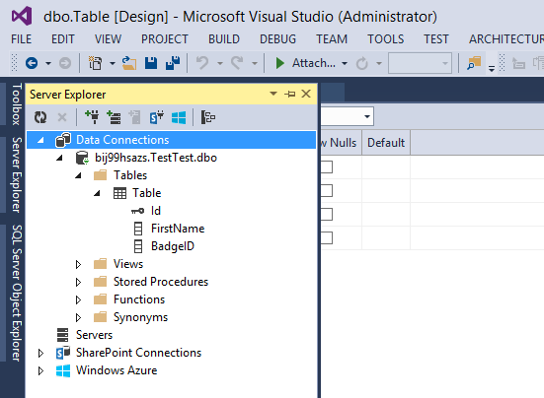
Visual Studio Server Explorer
You can use Server Explorer to manage SQL databases in the same way as you use SQL Server Management Studio
The improved query editor and updated preview tools can be helpful for determining the collateral of changes made through a SQL script
Notes:
Even though students might have used Server Explorer in the past, encourage them to check out the Server Explorer again. The script editor and table designer are enhanced greatly with Visual Studio 2013. This is a great way to allow a development team to view the SQL database in Azure and their on-metal development database side by side.
20532C
4: Storing SQL Data in Azure

Slide 15
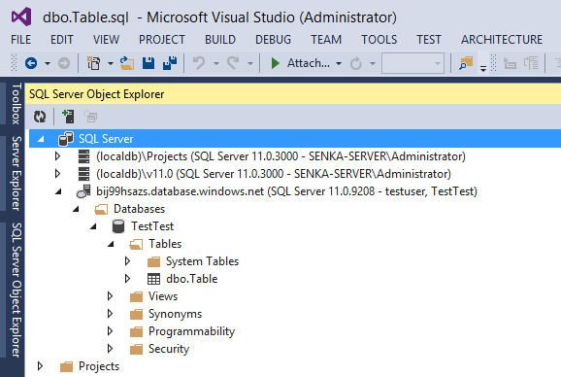
Visual Studio SQL Server Object Explorer
You can use the SQL Server Object Explorer to manage your local databases or SQL databases in Azure.
You can access the SQL Server Object Explorer by right-clicking a database in Server Explorer.
Notes:
20532C
4: Storing SQL Data in Azure

Slide 16
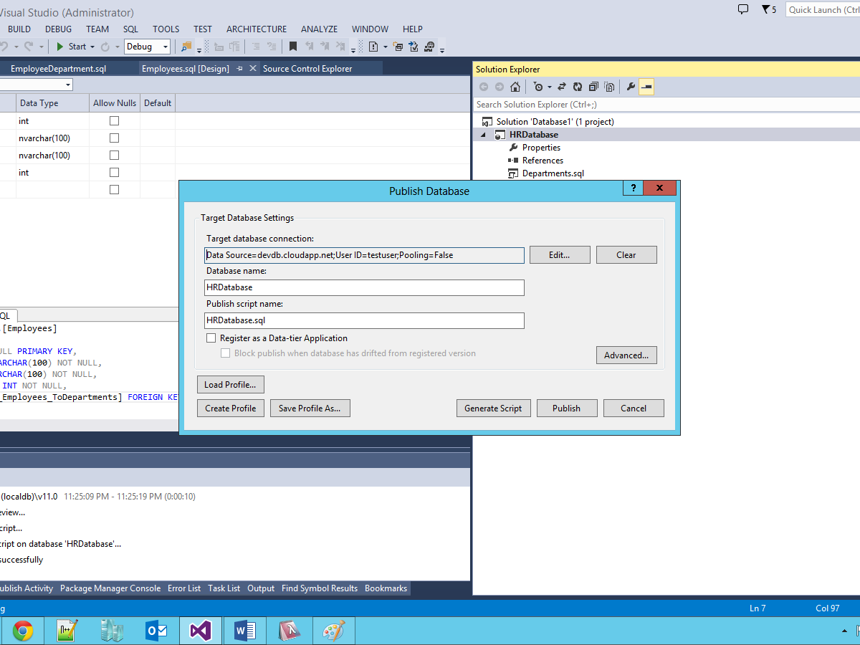
Visual Studio Database Projects
Database projects in Visual Studio allow you to:
Place the schema of a database in-development within source control
Publish the database to a SQL Database instance
Notes:
Discussion Question: Why would you use a database project to create your schema as opposed to a SQL management tool?
Answer: You can use a database project to place the design in source control, share the design among your team members, and roll back to previous revisions of the design. You also can use it to generate SQL scripts from the design that can be used to create development copies of the database locally.
20532C
4: Storing SQL Data in Azure

Slide 17
Migration Tools
You can use SQL Server Integration Services to define a migration plan for on-premises databases
SQL Database Migration Wizard analyzes your existing database and generates a script (and bulk copy files) to migrate your database
Azure Websites Migration Assistant uses SQL Management Objects to analyze your existing database and migrate it
Notes:
20532C
4: Storing SQL Data in Azure

Slide 18
Lesson 4: Securing and Recovering an Azure SQL Database Instance
Recovery Options for Azure SQL Database Azure SQL Databases Geo-Replication
Notes:
20532C
4: Storing SQL Data in Azure

Slide 19
Recovery Options for Azure SQL Database
You can count on infrastructure redundancy in the Azure data centers for the most basic scenarios
SQL Database also provides it’s own set of options for HADR
Built-in replicas
Transactions are not considered committed to the database until they are written to the target DB, one primary replica, and two secondary replicas
Backup and restore
Allows you to protect against errant transactions
Database is backed up as a whole and can be recovered through the portal
The retention period (in days) of your backup is based on your selected service tier
Notes:
20532C
4: Storing SQL Data in Azure

Slide 20
High Availability for Azure SQL Databases (cont.)
Database copy
You can create a one-time copy of the database within the same region
The copy is disconnected from the source database so any future transactions will not be applied to the copy
The import and export service
You can import and export BACPACK files from a database instance either automatically or manually
You can use this service to offer a minimum HADR option for web and business databases that do not support the point-in-time recovery option
You also can use this service for custom backup and recovery scenarios
Notes:
20532C
4: Storing SQL Data in Azure

Slide 21
Azure SQL Databases Geo-Replication
Active geo-replication is available for Premium SQL Database instances
This feature is asynchronous by default and guarantees that replicas will be eventually consistent
You can replicate transactions to as many as four copies of the database
Replicas can exist in different regions for geo-redundancy
You can use the replica of the database as a read-only data source in load-balancing scenarios
Example: An application uses the primary database for line-of-business functionality and the replica for reports
Notes:
20532C
4: Storing SQL Data in Azure

Slide 22
Lab: Storing Event Data in Azure SQL Databases
Estimated Time: 45 minutes
Notes:
Occasionally the Preview Portal may not successfully create a new service instance. The portal is still technically in preview and can potentially have unresolved bugs. If this happens, you can simply retry the operation until your service instance is successfully created.
20532C
4: Storing SQL Data in Azure

Slide 23
Lab Scenario
Now that the web application is ready for publishing, you can begin migrating the web application to Azure by creating a database in Azure. You decided to use a database initializer and Entity Framework Code First to automate the creation of your database in SQL Database.
Notes:
20532C
4: Storing SQL Data in Azure

Slide 24
Lab Review
What are some scenarios where it is appropriate to use seed data from an ORM framework in your SQL database in Azure?
Notes:
Question
What are some scenarios where it is appropriate to use seed data from an ORM framework in your SQL database in Azure?
Answer
Typically when you are first starting out with the earliest iterations of your cloud application, seed data can help cut down on the amount of manual work necessary to refresh or reset your database for testing.
20532C
4: Storing SQL Data in Azure

Slide 25
Module Review and Takeaways
Review Question(s) Best Practice
Notes:
Review Question(s)
Question
When you implement database sharding, why is the federation distribution key important? How does this key help drive performance?
Answer
Best Practice: You can use configuration settings and web.config transformations to point your application to a different database depending upon the build definition or environment. This allows you to automate your build and test processes with the least amount of code customizations for each environment.
20532C
4: Storing SQL Data in Azure

