Slide 1

Analytics Bayer
-Yash Ashish Parte (NJIT, MS Data Science)

Slide 2
Ask
What are the Primary Drivers of Bayer?
How is cost benefit analysis for different tactics?
What help the business grow or decline recently?
How is the Sales funnel improving month-wise?
Are there any quarterly trends on how different Tactics improve?
How are summary groups performing in terms of Profit, Spend, and Sales Volumes?

Slide 3
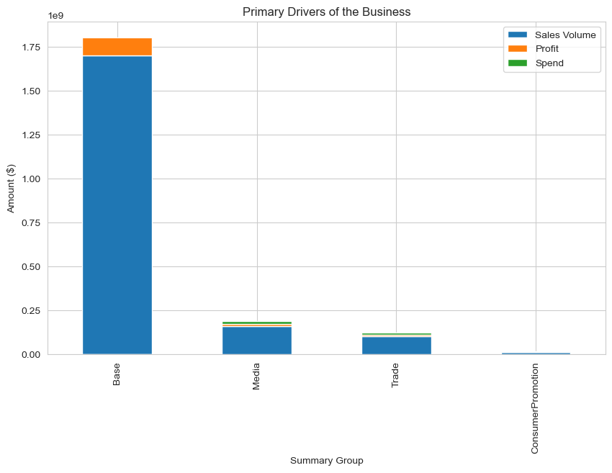
Primary Drivers of the Bayer
Core/Base tactic plays major role in Base group
Three surprising trends,
Trade Promo in Trade group
Covid tactic in Base group
3 of the Base group tactics makes loss with VPC being the last actual Profit-making tactic
Among the top 10 Profit generating tactics, 6 of them were from Media Group

Slide 4
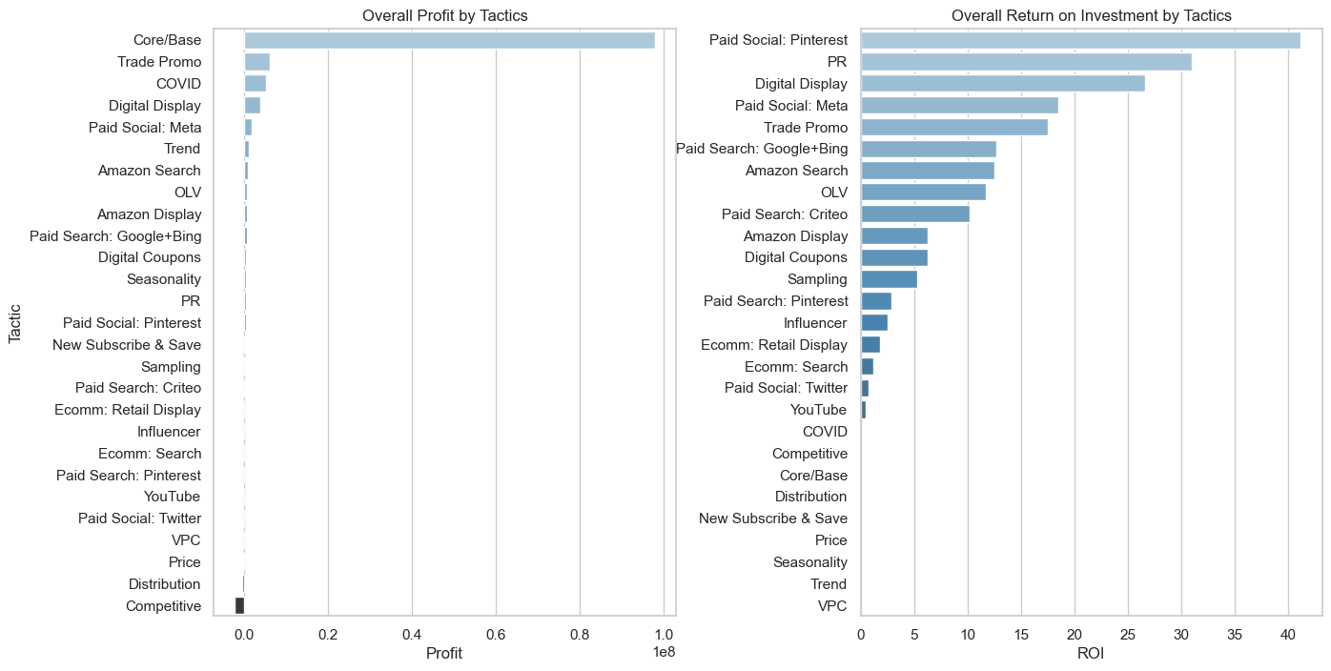
Cost Benefit Analysis
Overall Profit Analysis
Profit Margin Analysis
Paid Social: Pinterest was the tactic with highest ROI.
From October 2020 to September 2022, this tactic had an ROI between 0.0 to 0.7, except October 2022 (31.4)

Slide 5
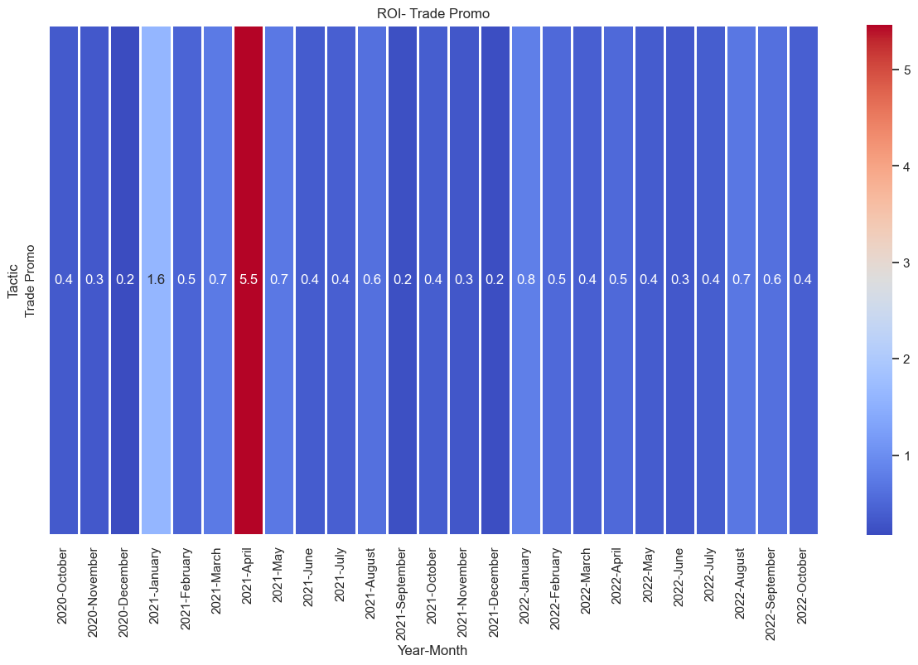
Profit margin Analysis- Trade Promo

Slide 6
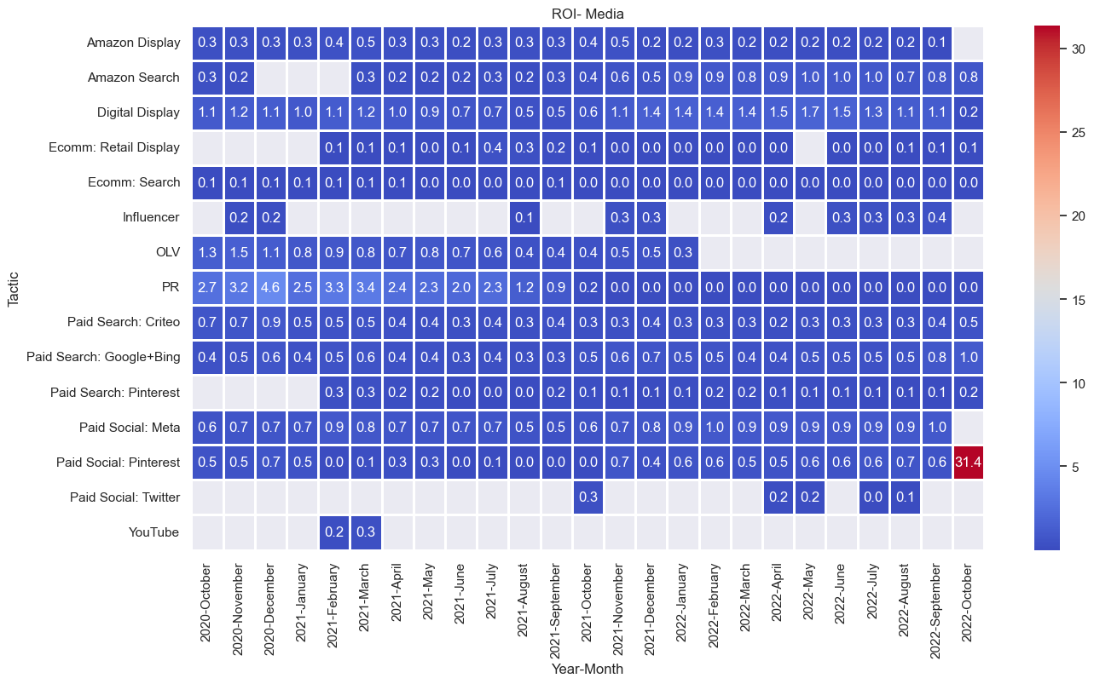
Profit margin Analysis- Media Tactics

Slide 7
Highest ROIs and in what month?
Tactics with top 10 ROIs were dominated by Media Group, with 9 out of 10 spots
Trade Promo from Trade Group had the 5th highest ROI in all of tactics
Heatmaps in the next slide gives an idea of tactics performance for all the months and years
More Spend and Less ROI is a Tactic with major concern, Trade Promo has the highest Spend, but the
ROI is near 75th percentile of the values of ROI for Tactics, whereas the maximum ROI is 41.15
Using the Statistical approach, the Spend for Trade Promo is the max amount.

Slide 8
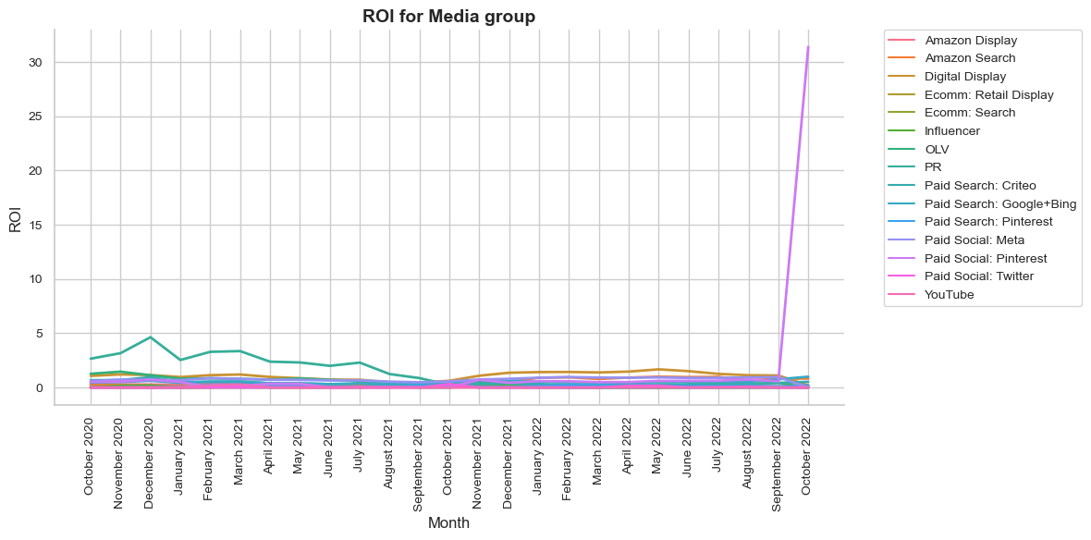
Channel Analysis- Media
Profit Margin Analysis- Media
Profit Margin

Slide 9
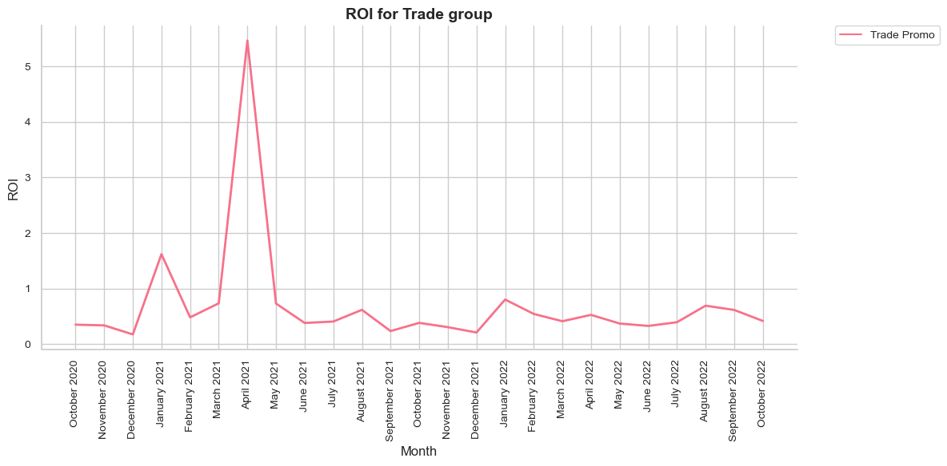

Channel Analysis- Trade
Profit Margin Analysis- Trade
Profit Margin

Slide 10
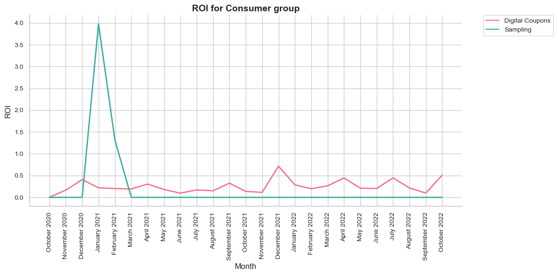
Channel Analysis- Consumer Promotion
Profit Margin Analysis- Consumer Promotion
Profit Margin

Slide 11
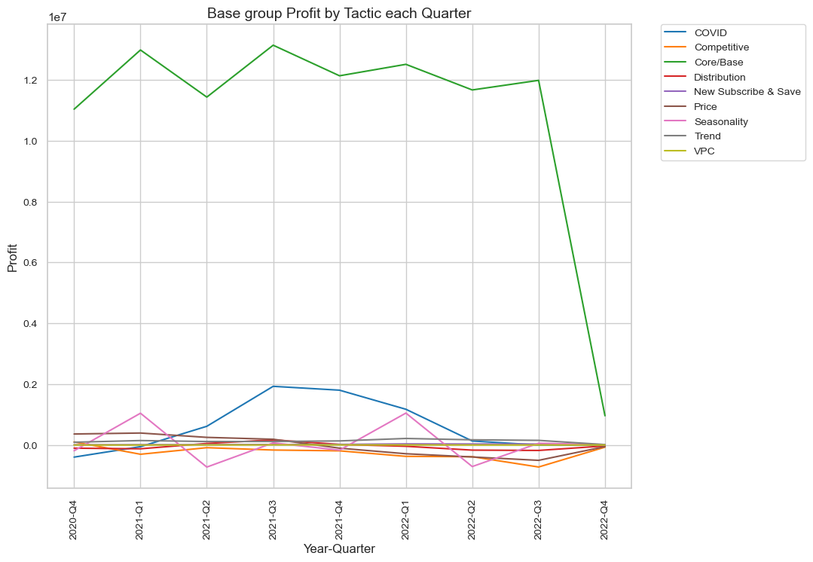
Quarterly Analysis Profit- Base
Core/Base tops the Quarterly Profits in Base Group
In Media group Digital display is the highest profit-making tactic in majority of quarters

Slide 12
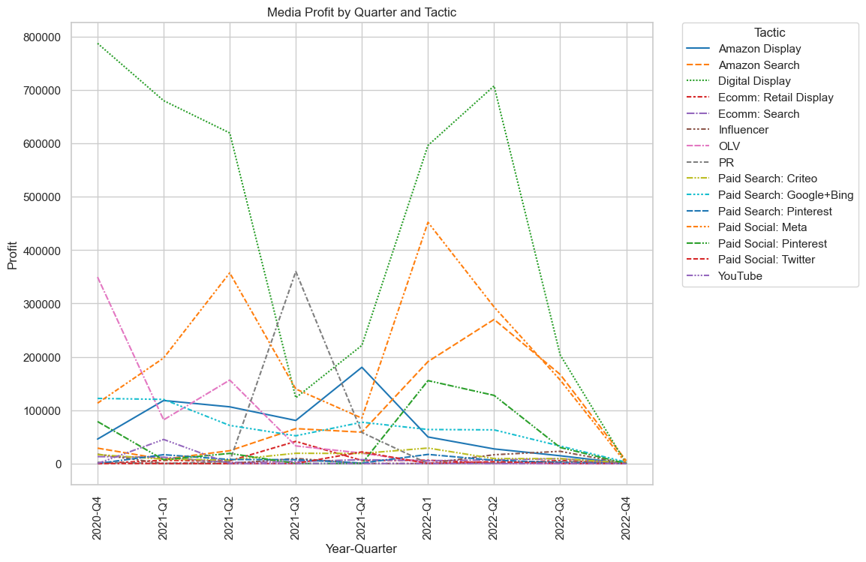
Quarterly Analysis Profit- Media

Slide 13
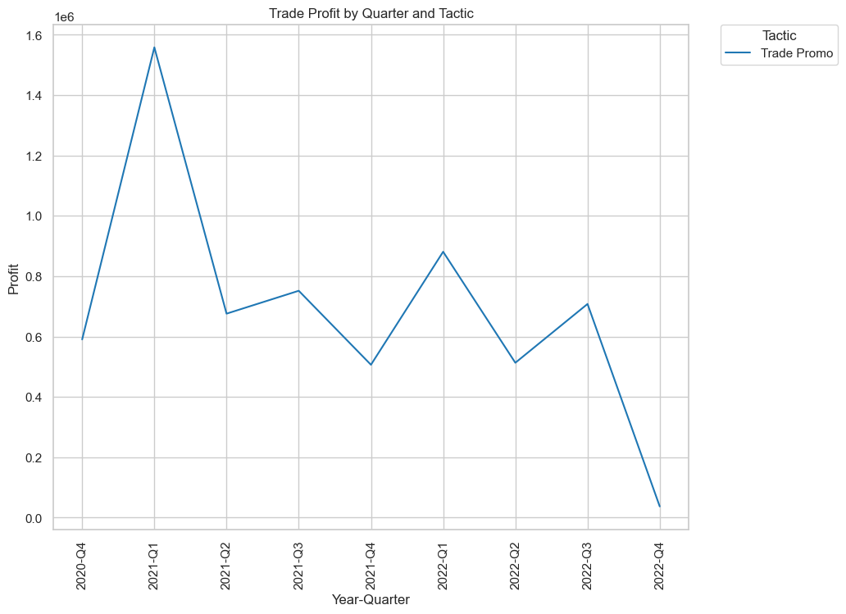
Quarterly Analysis Profit-Trade

Slide 14
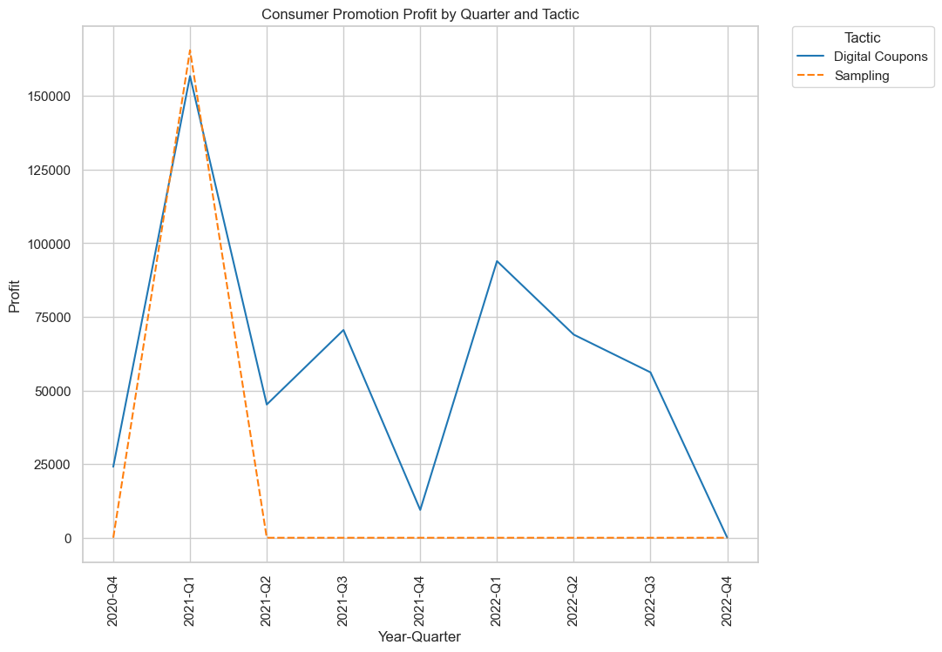
Quarterly Analysis Profit- Consumer Promotion

Slide 15
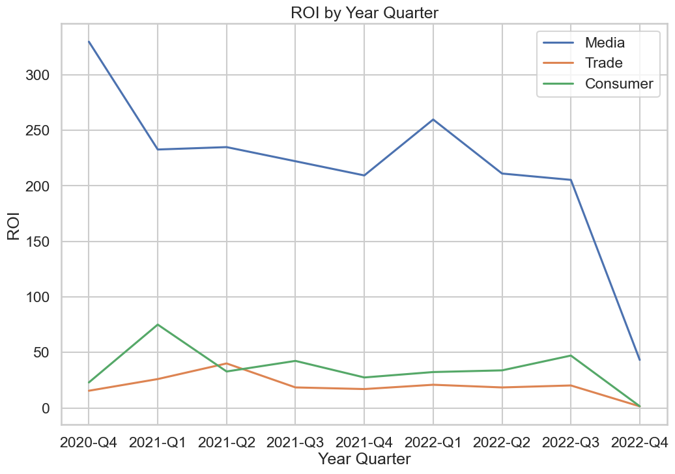
ROI Analysis

Slide 16
Quarter-wise highest Profit-making Tactic
Year | Quarter | Tactic | Group
2020 | Q-4 | Core/Base | Base
2021 | Q-1 | Core/Base | Base
2021 | Q-2 | Core/Base | Base
2021 | Q-3 | Core/Base | Base
2021 | Q-4 | Core/Base | Base
2022 | Q-1 | Core/Base | Base
2022 | Q-2 | Core/Base | Base
2022 | Q-3 | Core/Base | Base
2022 | Q-4 | Core/Base | Base

Slide 17
Quarter-wise Media highest Profit-making Tactic
Year | Quarter | Tactic
2020 | Q-4 | Digital Display
2021 | Q-1 | Digital Display
2021 | Q-2 | Digital Display
2021 | Q-3 | PR
2021 | Q-4 | Digital Display
2022 | Q-1 | Digital Display
2022 | Q-2 | Digital Display
2022 | Q-3 | Digital Display
2022 | Q-4 | Amazon Search

Slide 18
Quarter-wise Consumer Promotion highest Profit-making Tactic
Year | Quarter | Tactic
2020 | Q-4 | Digital Coupons
2021 | Q-1 | Sampling
2021 | Q-2 | Digital Coupons
2021 | Q-3 | Digital Coupons
2021 | Q-4 | Digital Coupons
2022 | Q-1 | Digital Coupons
2022 | Q-2 | Digital Coupons
2022 | Q-3 | Digital Coupons
2022 | Q-4 | Digital Coupons

Slide 19
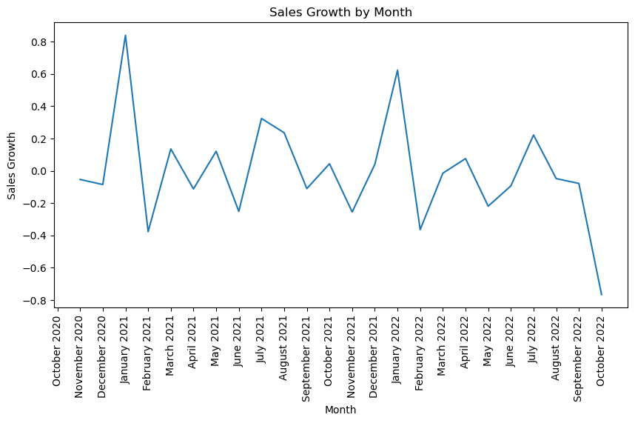
Sales Volume Analysis
Sales growth shows the Bayer’s historical Sales Volume periodic increase month-wise starting from October 2020
Many factors influence the sales growth, e.g., COVID-19, with the decline of first wave, a rise in the sales growth has been seen at the last quarter of 2020, and as the second wave July 2021, a steep downwards slope till November 2021

Slide 20
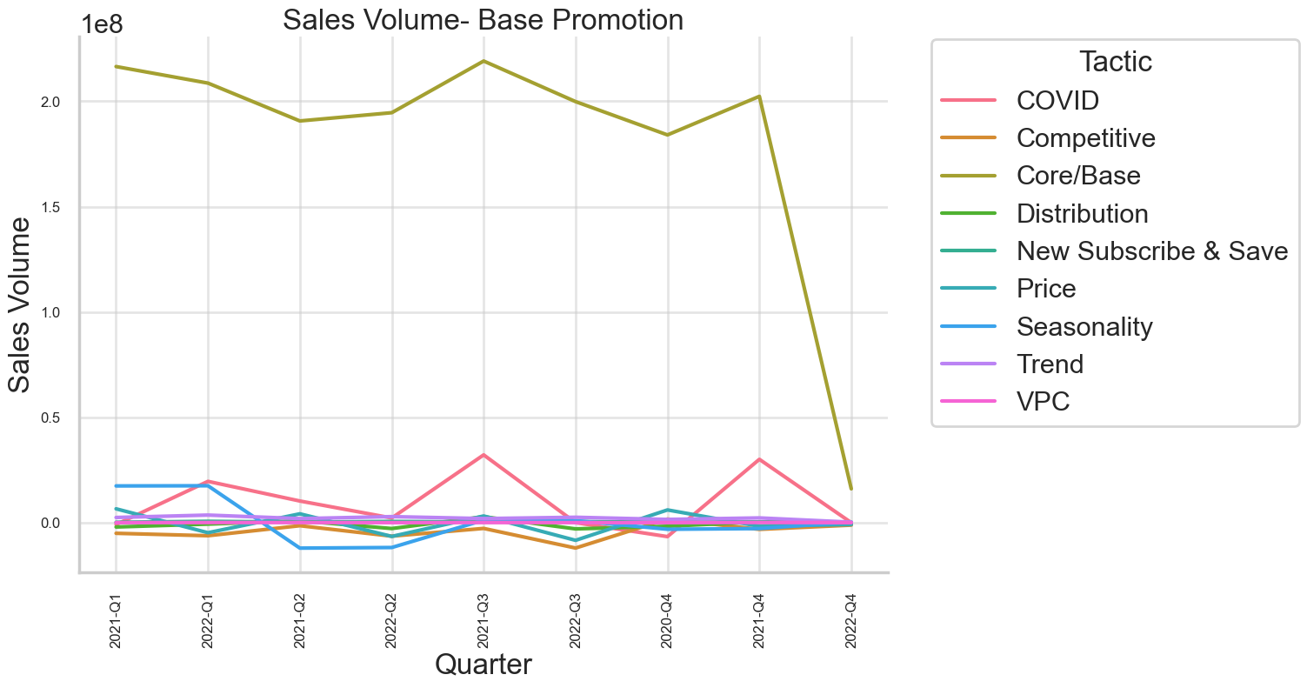
Sales Volume Analysis
Base

Slide 21
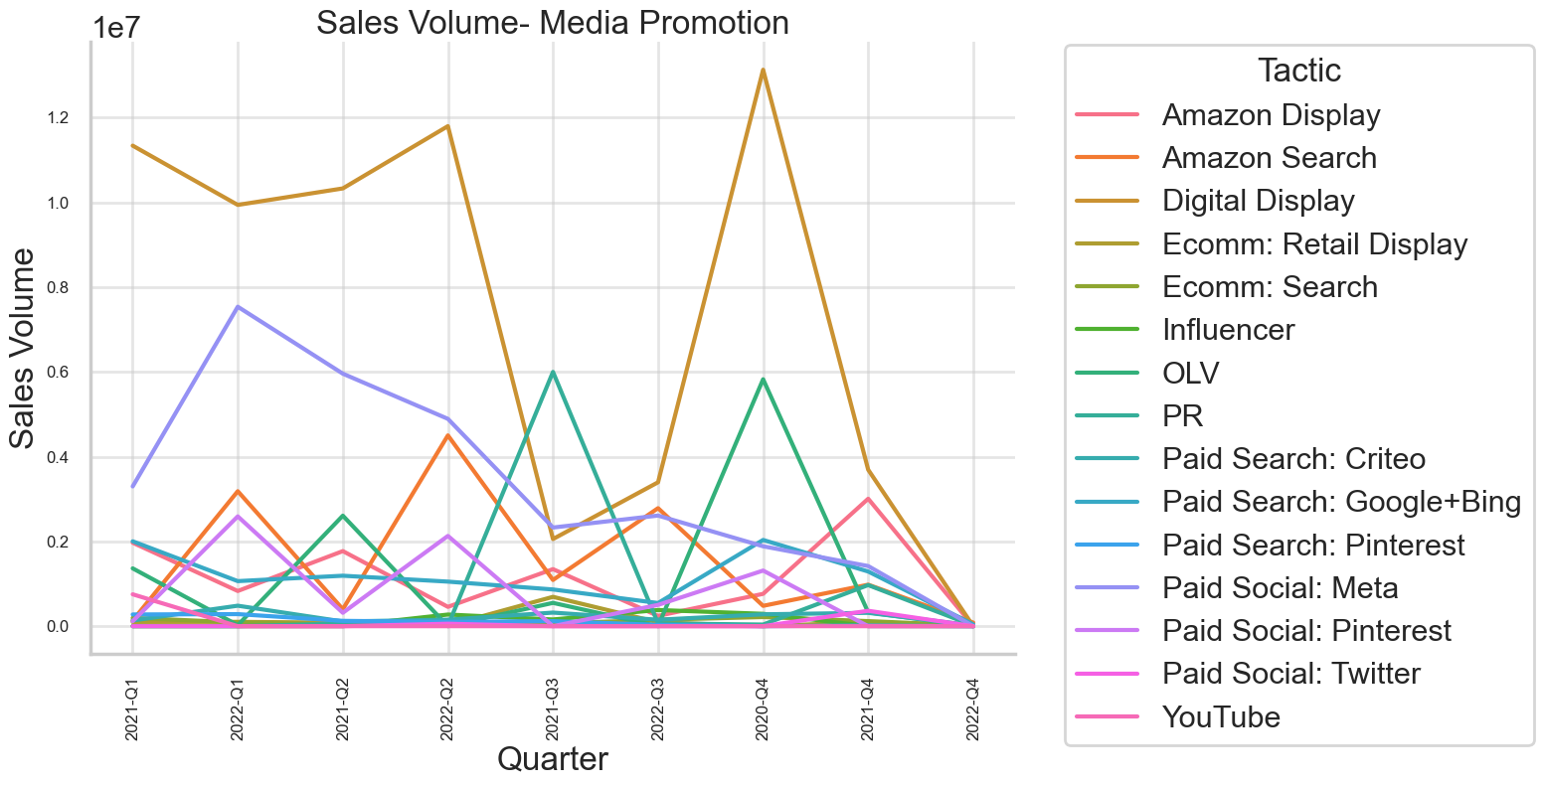
Sales Volume Analysis
Media

Slide 22
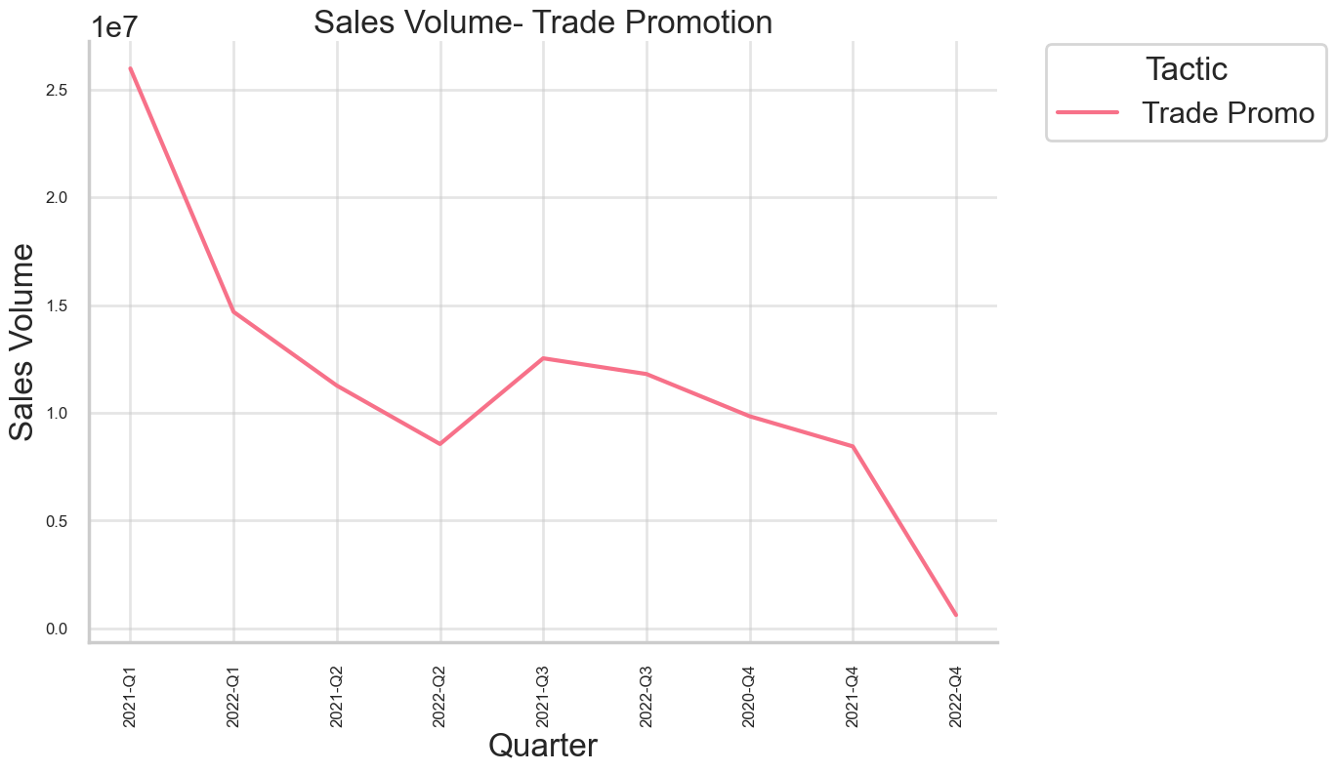
Sales Volume Analysis
Trade

Slide 23
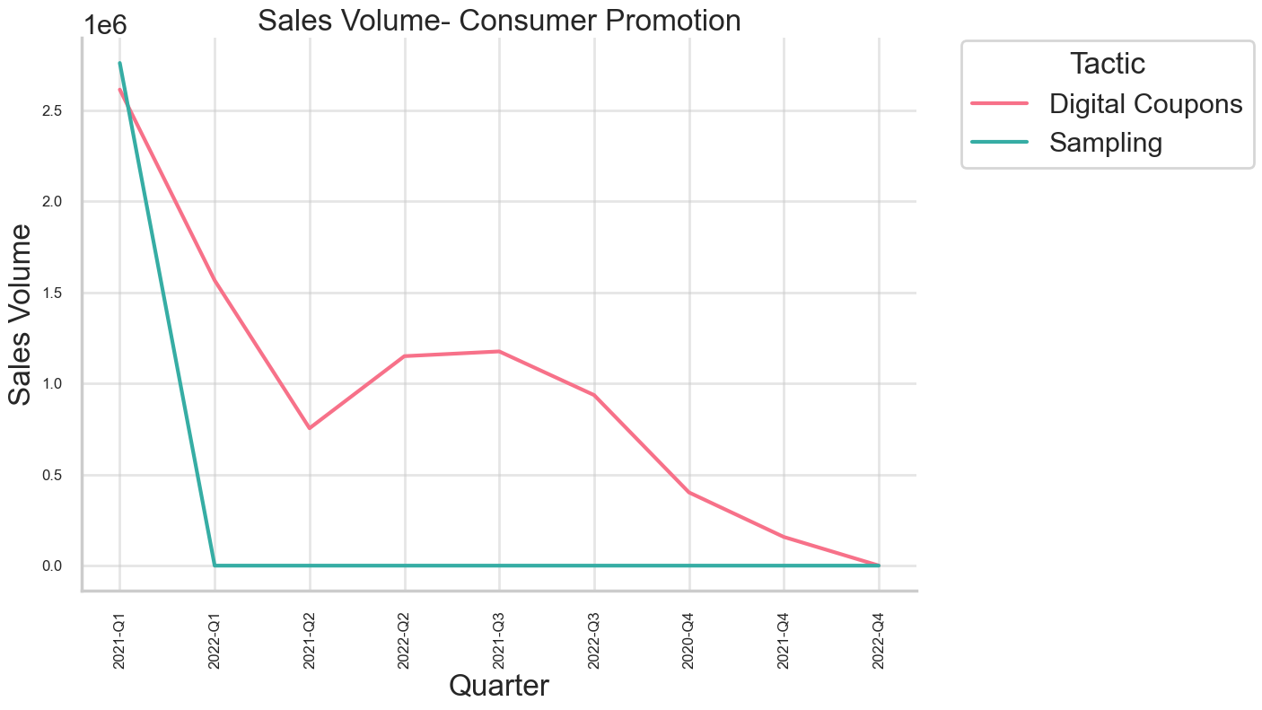
Sales Volume Analysis
Consumer Promotion

Slide 24
Usability of Resources and low Profit
For all the 4th Quarter of 2020 to the 3rd Quarter of 2022, Trade Promo tactic of Trade Group, despite giving the second highest profit overall, use the most expenditure, with most sales volume, generating the lowest profit. In the 4th Quarter of 2022, PR tactic of Media Group, replaces Trade Promo.
The same trend follows for the high expenditure, low sales volume and low profit, with the same tactics.
The exact same trend for all quarters follow for the high spend, high sales volume, and high profit

Slide 25
Majority of Media tactics have performed well on Profit and ROI scale, or have they?
We analyze this by understanding from the pair plot that higher Sales Volume, leads to higher Profit, and high Spending on campaigns, had a more linear relation to the Sales Volume.
Let’s see our Quarterly top tactics based on-
High Spending, low Sales Volume
High Spending, high Profit
High Sales Volume, low Profit
Low Sales Volume, high Profit
Low Spending, high Profit

Slide 26
Year | Quarter | High Spend, Low Sales | High Spend, High Profit | High Sales, Low Profit | Low Sales, High Profit | Low Spend, High Profit
2020 | Q4 | Digital Display | Digital Display | Digital Display | PR | PR
2021 | Q1 | Digital Display | Digital Display | Digital Display | PR | PR
 | Q2 | Digital Display | Digital Display | Digital Display | Ecomm: Search | PR
 | Q3 | PR | PR | PR | PS: Pinterest | PS: Pinterest
 | Q4 | Amazon Display | Amazon Display | Digital Display | PS: Pinterest | PS: Pinterest
2022 | Q1 | PS: Meta | PS: Meta | Digital Display | PR | OLV
 | Q2 | Digital Display | Digital Display | Digital Display | PR | Paid Social: Twitter
 | Q3 | PR | PR | Digital Display | Paid Social: Twitter | Paid Social: Twitter
 | Q4 | PR | PR | Amazon Search | Digital Display | Digital Display

Slide 27
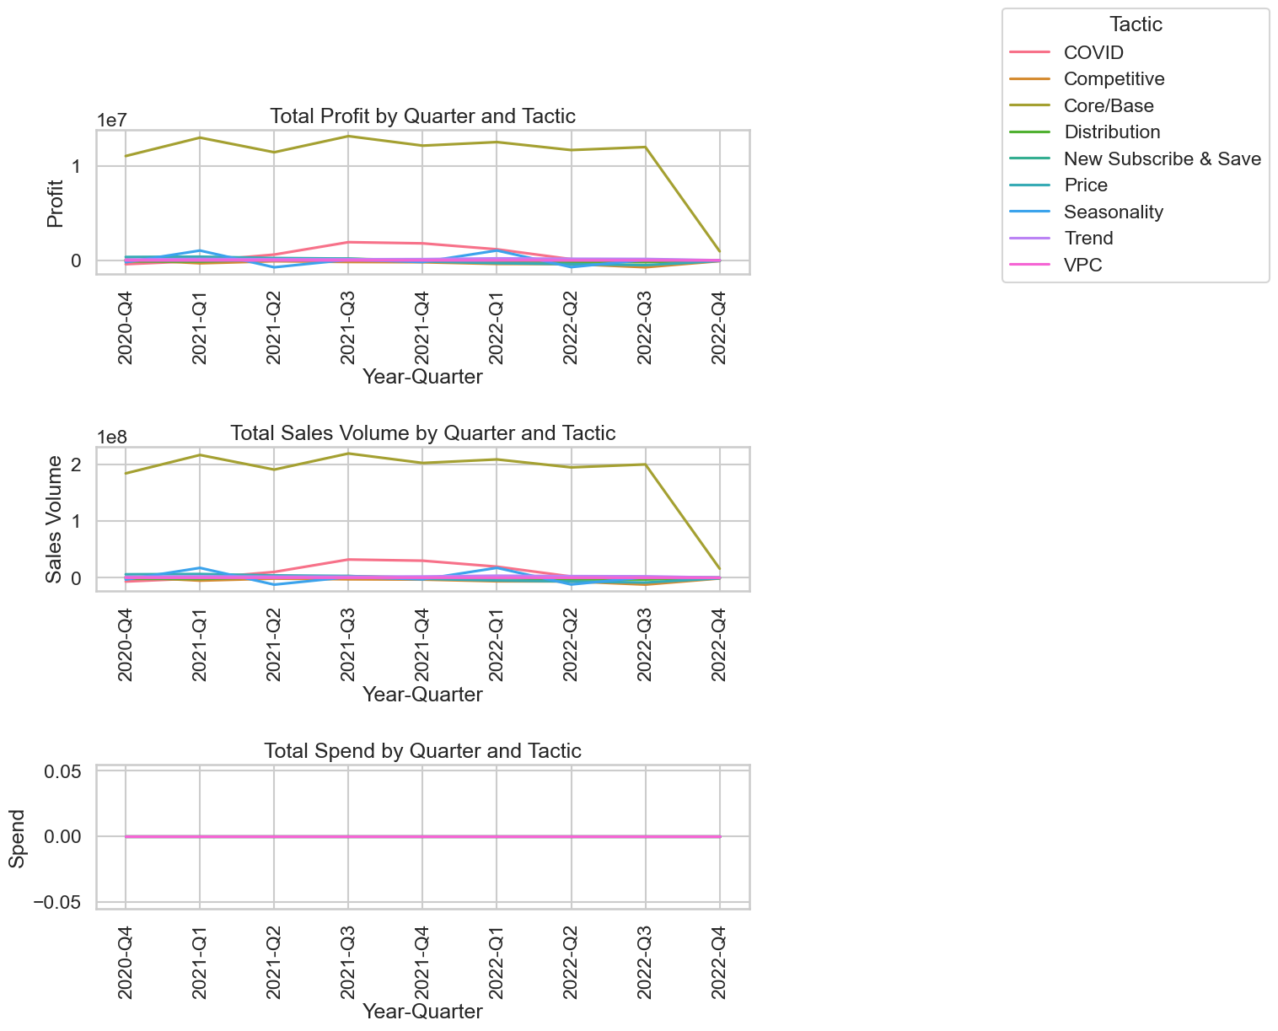
Tactic Performance Analysis- Base Group

Slide 28
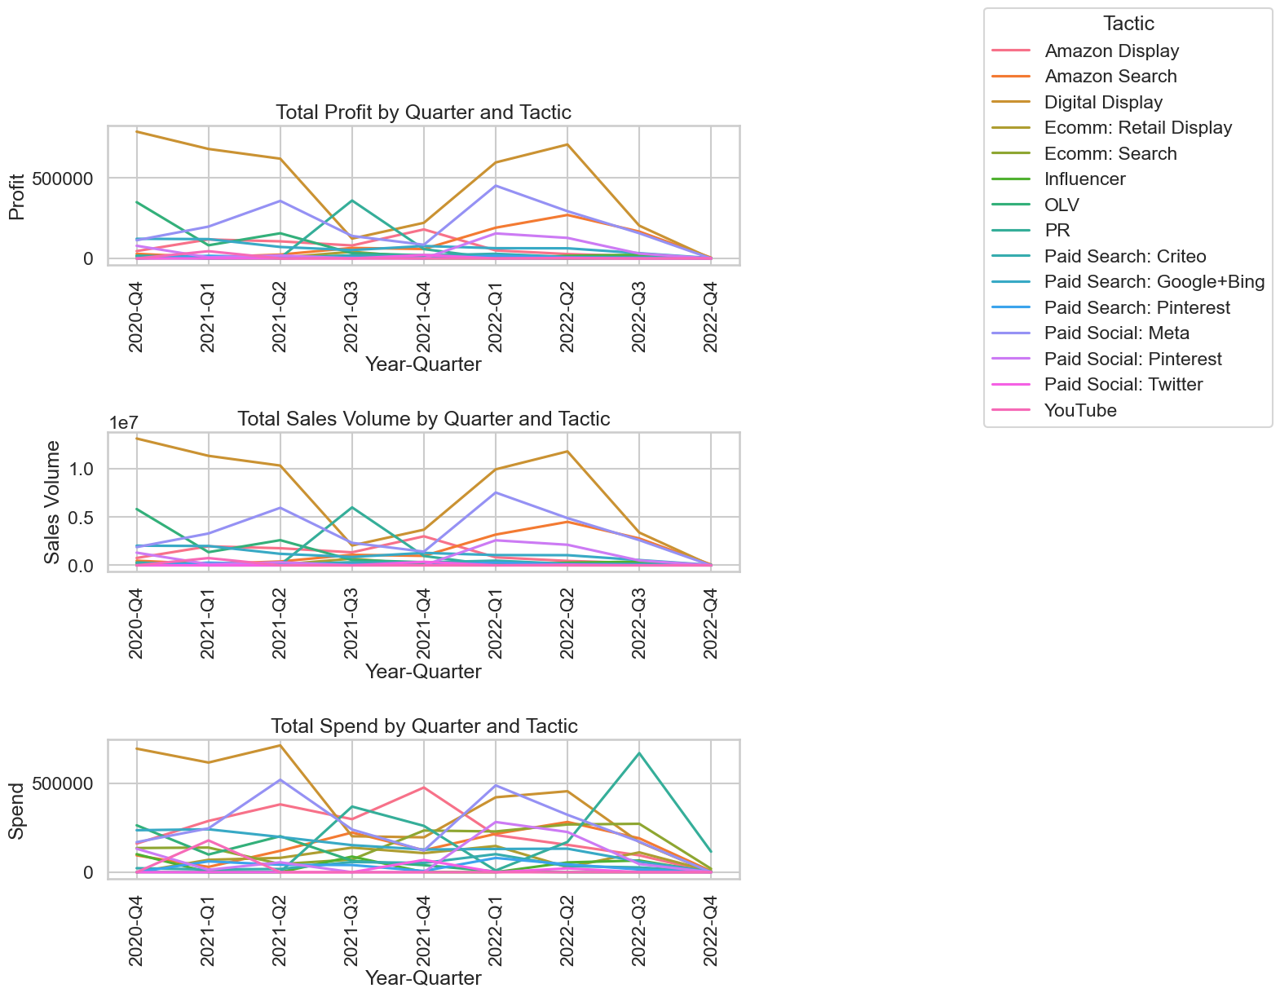
Tactic Performance Analysis- Media Group

Slide 29
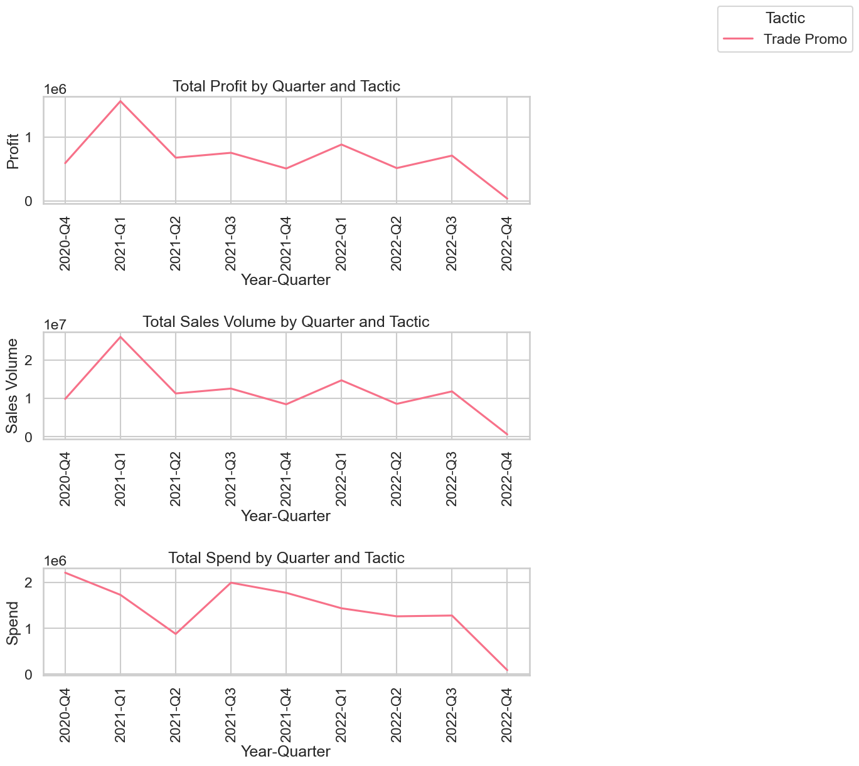
Tactic Performance Analysis- Trade

Slide 30
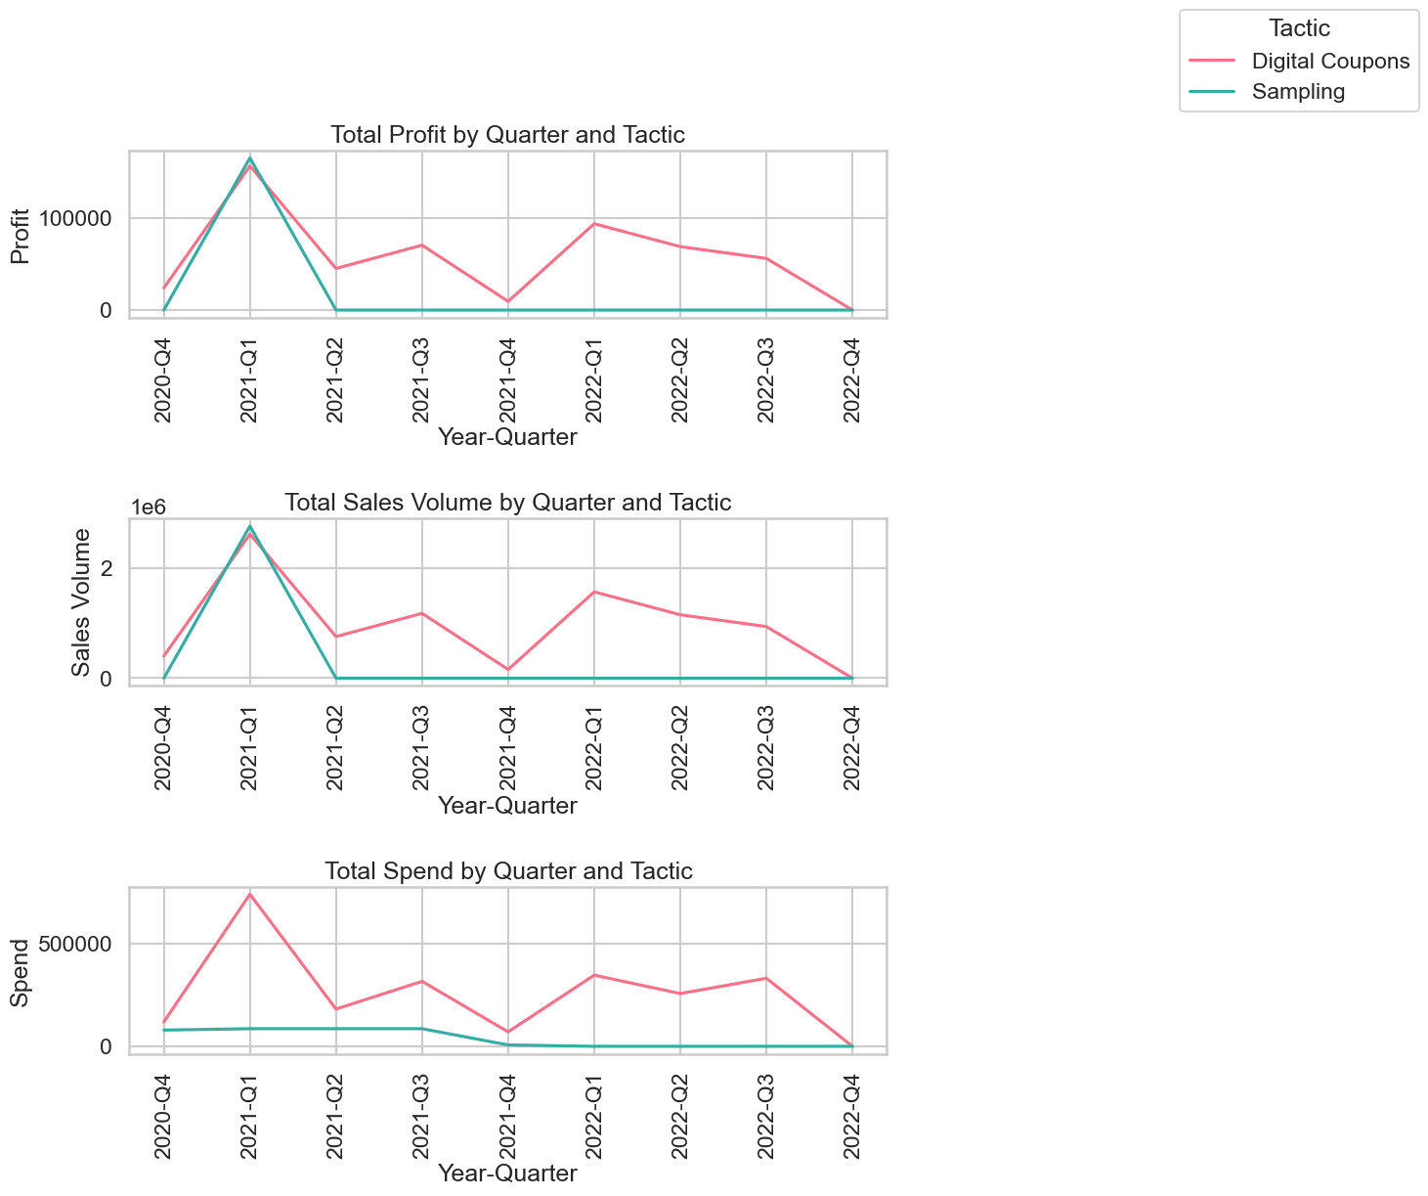
Tactic Performance Analysis- Consumer Promotion

Slide 31
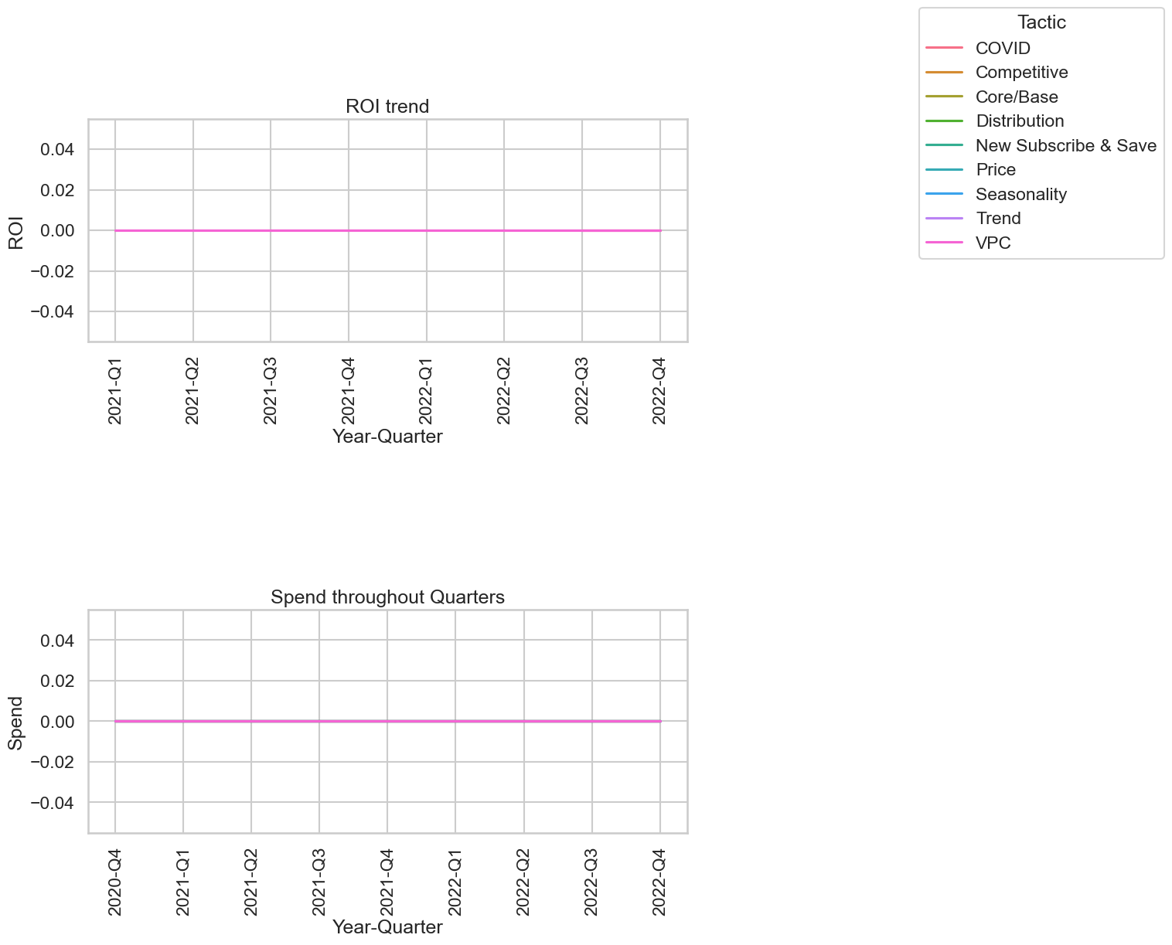
Budget Allocation Analysis- Base

Slide 32
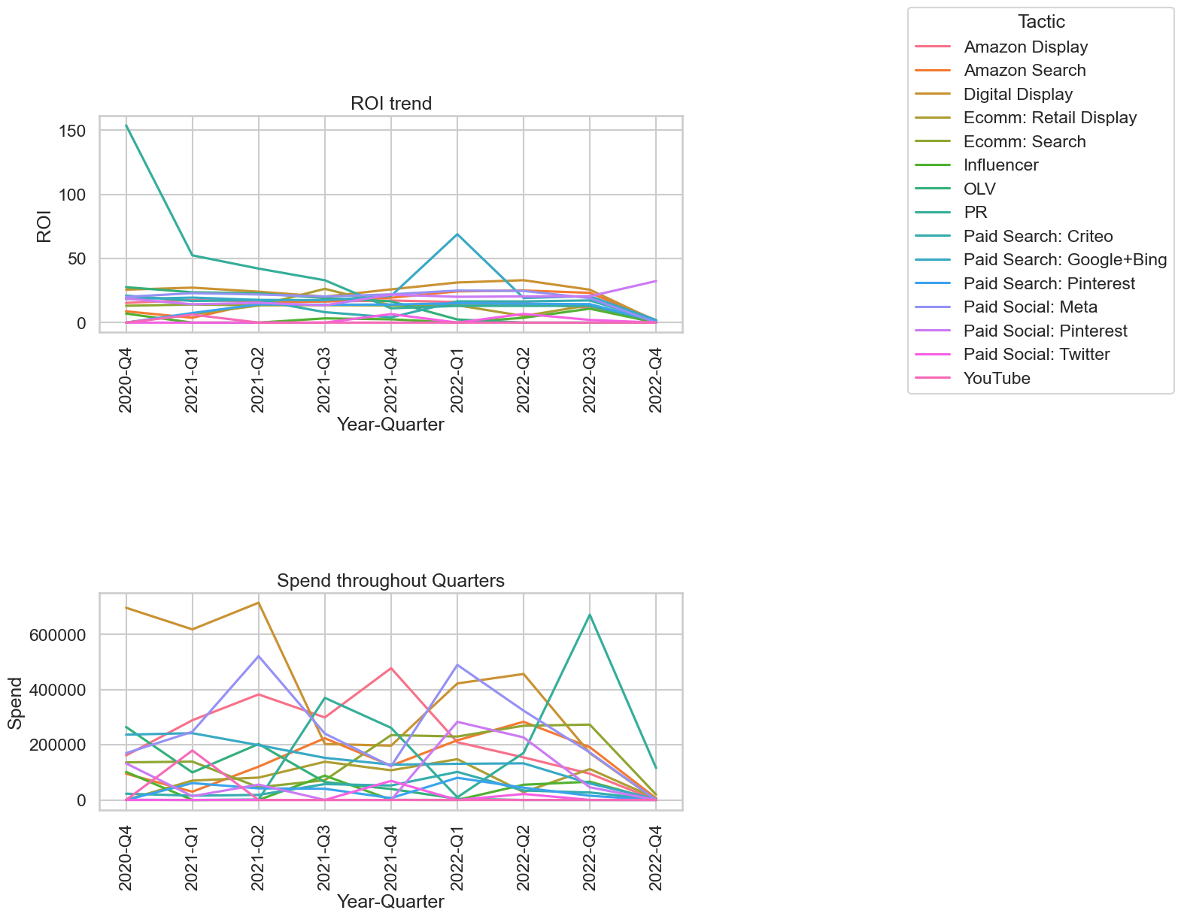
Budget Allocation Analysis- Media

Slide 33
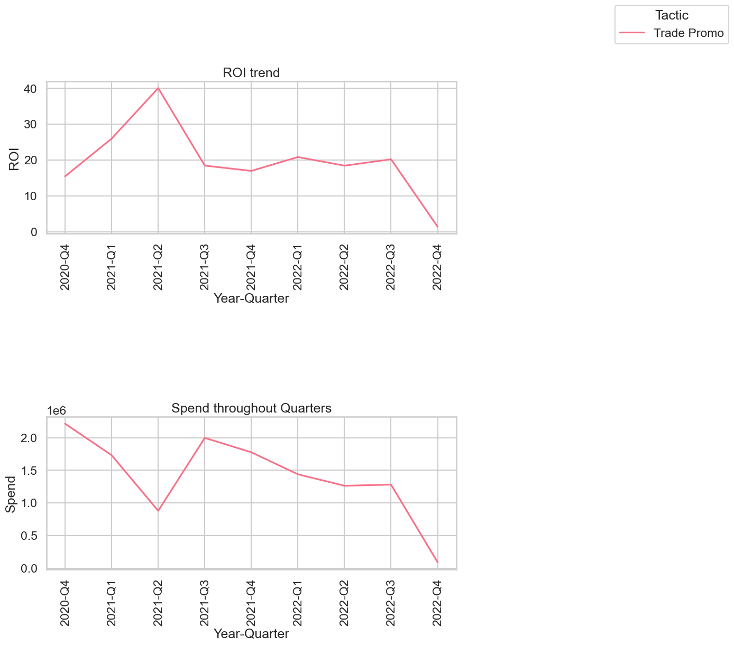
Budget Allocation Analysis- Trade

Slide 34
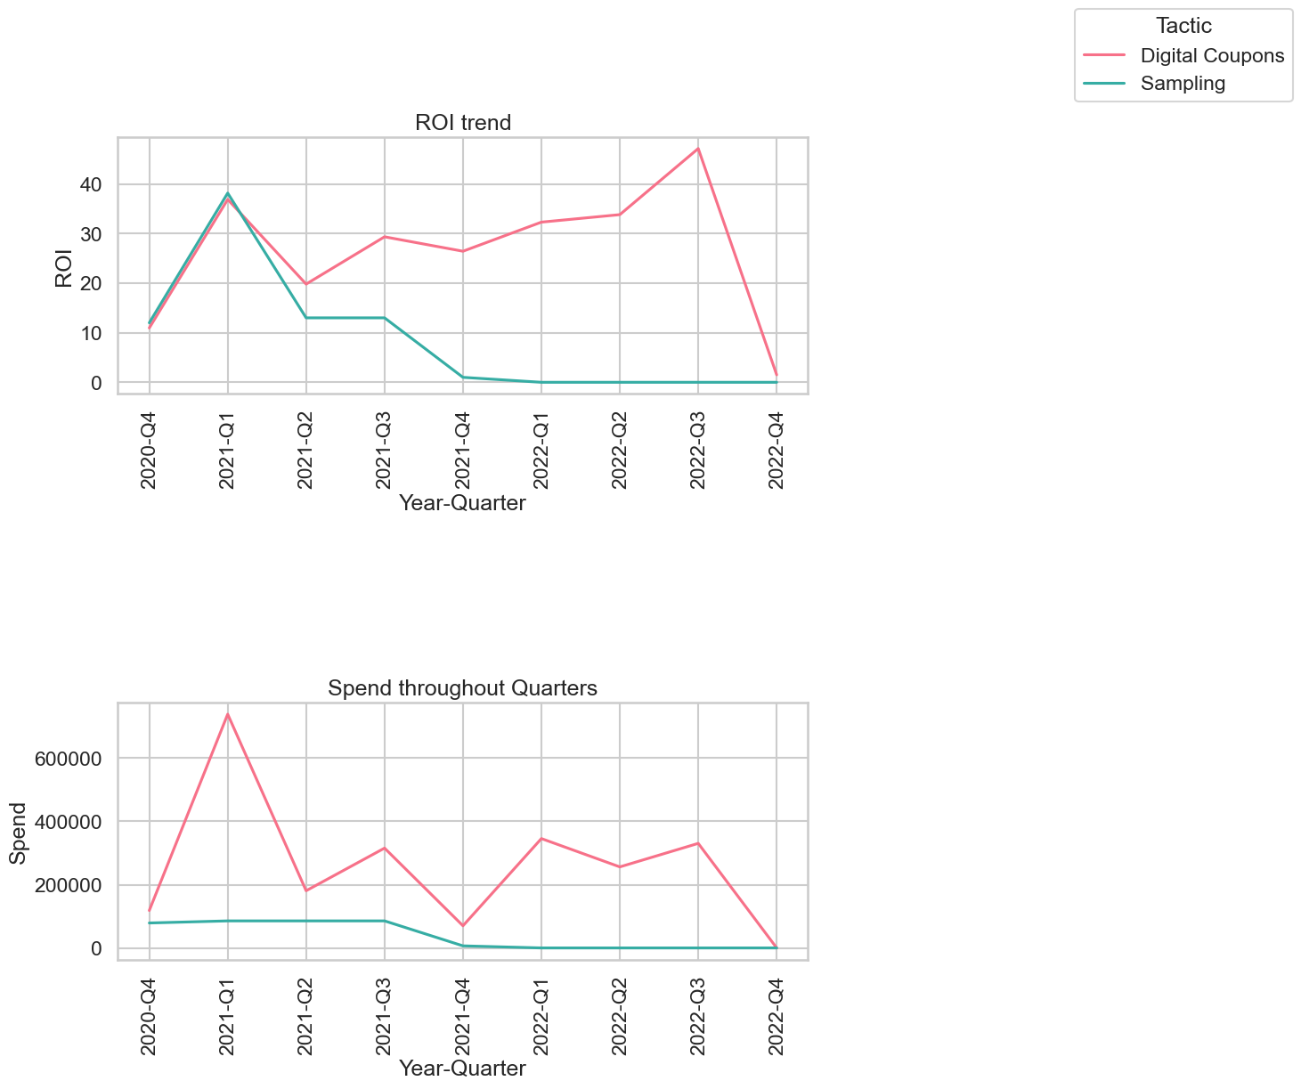
Budget Allocation Analysis- Consumer Promotion

Slide 35
Year | Quarter | Tactic | Spend | ROI | Year-Quarter
2020 | 4 | Sampling | 78923.076924 | 12.000000 | 2020-Q4
2020 | 4 | Digital Coupons | 118411.123380 | 10.963537 | 2020-Q4
2021 | 1 | Sampling | 85500.000001 | 38.164872 | 2021-Q1
2021 | 1 | Digital Coupons | 738890.974363 | 36.887681 | 2021-Q1
2021 | 2 | Digital Coupons | 180822.263490 | 19.807815 | 2021-Q2
2021 | 2 | Sampling | 85500.000001 | 13.000000 | 2021-Q2
2021 | 3 | Digital Coupons | 315567.739812 | 29.348720 | 2021-Q3
2021 | 3 | Sampling | 85500.000001 | 13.000000 | 2021-Q3
2021 | 4 | Digital Coupons | 70092.013559 | 26.436051 | 2021-Q4
2021 | 4 | Sampling | 6576.923077 | 1.000000 | 2021-Q4
2022 | 1 | Digital Coupons | 345713.025310 | 32.306319 | 2022-Q1
2022 | 1 | Sampling | 0.000000 | 0.000000 | 2022-Q1
2022 | 2 | Digital Coupons | 256212.115214 | 33.818427 | 2022-Q2
2022 | 2 | Sampling | 0.000000 | 0.000000 | 2022-Q2
2022 | 3 | Digital Coupons | 330540.809855 | 47.148673 | 2022-Q3
2022 | 3 | Sampling | 0.000000 | 0.000000 | 2022-Q3
2022 | 4 | Digital Coupons | 74.825011 | 1.509082 | 2022-Q4
2022 | 4 | Sampling | 0.000000 | 0.000000 | 2022-Q4
year | quarter | Tactic | Spend | ROI | Year-Quarter
2020 | 4 | Trade Promo | 2.215404e+06 | 15.471010 | 2020-Q4
2021 | 1 | Trade Promo | 1.731692e+06 | 25.985764 | 2021-Q1
2021 | 2 | Trade Promo | 8.786200e+05 | 40.055911 | 2021-Q2
2021 | 3 | Trade Promo | 1.997392e+06 | 18.461526 | 2021-Q3
2021 | 4 | Trade Promo | 1.776534e+06 | 16.992757 | 2021-Q4
2022 | 1 | Trade Promo | 1.438567e+06 | 20.855757 | 2022-Q1
2022 | 2 | Trade Promo | 1.263035e+06 | 18.446125 | 2022-Q2
2022 | 3 | Trade Promo | 1.280548e+06 | 20.220976 | 2022-Q3
2022 | 4 | Trade Promo | 8.855686e+04 | 1.418582 | 2022-Q4
Tactic Comparison Analysis
Consumer Promotion vs Trade Group ROI vs Spend Comparison quarterly

Slide 36
Forecasting Sales Volume

Slide 37
Conclusions
Sales Volume / Profit = 16.66
STOP Spending on Trade Promo
INVEST in Consumer Promotion Group- especially in Discount Coupons strategy
In Media, invest in tactics- Digital Display, Paid Search: Meta, Google + Bing, Pinterest, Amazon Search, PR

