Slide 1

FINGERPRINT CLASSIFICATION
BIOMETRIC AUTHENTICATION
Lecturer: Trần Nguyên Ngọc/Nguyễn Thành Trung
GROUP 8
Tên thành viên | MSSV
Phạm Đăng Tấn Dũng | 20225569
Nguyễn Minh Tú | 20225588
Nguyễn Minh Đức | 20225567

Slide 2
MOTIVATION

Slide 3
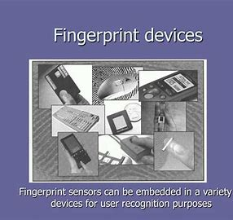

MOTIVATION
Degraded System Performance
Weakened Security
Increased User Frustration
Inefficient Resource Utilization

Slide 4
INTRODUCTION

Slide 5
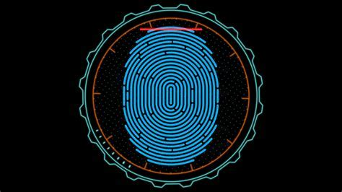

INTRODUCTION
Definition: Fingerprint recognition is a biometric technology that uses unique fingerprint patterns to identify individuals
Real-world Applications:
Security systems (smartphones, access control)
Law enforcement (criminal identification)
Border control (passport verification)

Slide 6
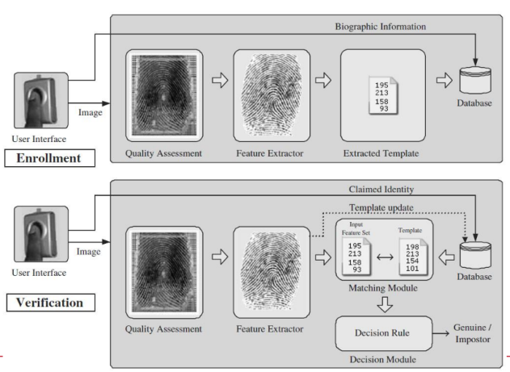
IMPORTANCE OF QUALITY ASESSMENT STEP

Slide 7
Contents
Overview
Data Collection and Preprocessing
Feature Extraction
Deep Learning Approach CNN
Evaluation
Conclusion

Slide 8
DATASET
DATA COLLECTION &
PREPROCESSING

Slide 9
Dataset
NIST-4 Fingerprint Dataset
Description: A collection of fingerprint images from NIST, used for developing and testing fingerprint recognition algorithms.
Number of Images: 4,000 quality fingerprint images.
Key Features:
Multiple fingerprints per person
High variability in quality and orientation
Includes various fingerprint patterns (loops, whorls, arches)

Slide 10
Data Collection
Total Images: 8,000 images, split into 2 labels:
Label 1: 4,000 high-quality fingerprints.
Label 0: 4,000 low-quality fingerprints with noise.
Process: Applied 5 noise algorithms to 4,000 quality images, creating noisy versions in batches.
Purpose: To train a model on both high-quality and real-world noisy fingerprints.

Slide 11
Data Collection
Noise Algorithms Applied to Fingerprint Batches (800 each)
1st Batch: Gaussian Blur Applied to smooth and reduce high-frequency noise, simulating degraded, low-quality images.
2nd Batch: Partial Elastic Transform Introduced localized deformations to mimic realistic variations, enhancing model robustness by simulating real-world distortions.
3rd Batch: Adding random lines
Randomly drawing lines of varying length, position, and color across the image, with adjustable thickness to control the intensity of the noise.
4th Batch: Adding black and white smudges
This technique involves randomly placing circular black and white blur spots of varying radius across the image.
5th Batch: A combination of both Gaussian and Smudges
In the final batch of images, both Gaussian Blur and white smudges are applied to simulate a more complex degradation of fingerprint quality

Slide 12
Preprocessing
Preprocessing
To prepare the dataset for future extraction, noise removal, normalization and enhancement were applied.
We used 5 preprocessing methods:
Convert to grayscale
This converting the fingerprint images to grayscale, simplifies the image by reducing the color information to a single intensity channel, making it easier to focus on the structural features of the fingerprint.
Gaussian Blur
Smooth the image and reduce noise.
CLAHE
CLAHE (Contrast Limited Adaptive Histogram Equalization) enhance the contrast of the fingerprint image, this enhances important features like ridge patterns and minutiae while preserving the global structure of the fingerprint.

Slide 13
Preprocessing
Preprocessing
To prepare the dataset for future extraction, noise removal, normalization and enhancement were applied.
Binarization
Image is converted into a binary format to highlight the essential features of the fingerprint. We used Otsu’s Thresholding Method to automatically determines the optimal threshold value
Resize
Resizing the fingerprint image from a resolution of 512x512 to 256x256 pixels. By reducing the image dimensions to 256x256, we maintain crucial structural features while optimizing the image for further analysis and processing

Slide 14
FEATURE EXTRACTION

Slide 15
Feature Extraction
Feature Extraction
Bag of Words (BoW)
History of Oriented Gradient (HoG)

Slide 16
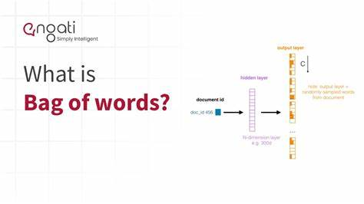
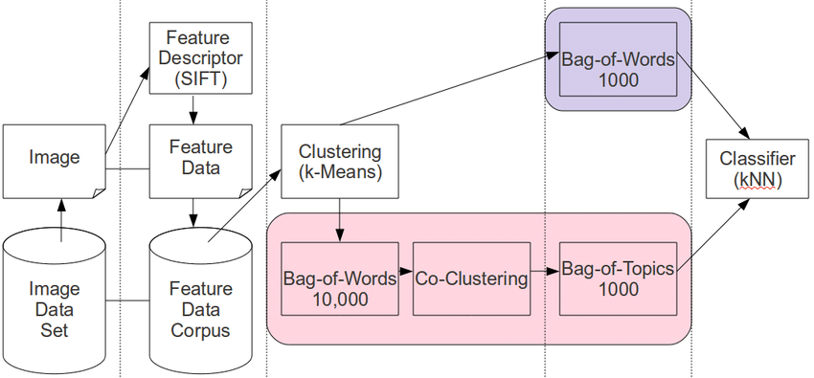
Feature Extraction: BoW
KMeans
Purpose: Clusters image features into visual words for BoW.
ORB
Key Features: Fast feature detection with FAST and BRIEF, uses a multiscale image pyramid for scale invariance.
BoW
Concept: Converts features into a visual vocabulary for image classification

Slide 17
Feature Extraction: HoG
Purpose: Detect and recognize objects in images by focusing on their shape and edge features
Key Features: Captures the structure and appearance of objects by analyzing the distribution of intensity gradients and edge directions in an image.
Main process:
Gradient calculation: Compute the intensity gradient of the image to capture edge and texture information.
Histogram of Gradient Orientation binning: Group gradients into orientation bins based on their angles to represent local edge directions.
Block normalization: Normalize grouped histograms within overlapping blocks to improve invariance to lighting and contrast changes.
Final HoG descriptor: Concatenate all normalized block histograms into a single vector as the feature representation of the image.
Applying PCA: Optionally reduce the dimensionality of the HoG descriptor to enhance computational efficiency and reduce redundancy.

Slide 18
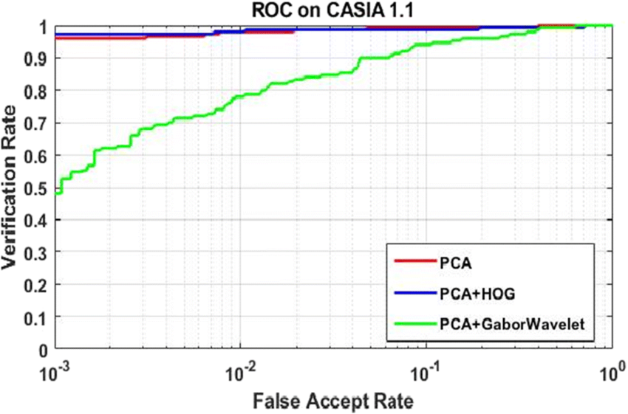
Feature Extraction: HoG (PCA)
Principal Component Analysis (PCA) is a dimensionality reduction technique that identifies the most important features in a dataset while preserving as much variance as possible.
It transforms the original features into a new set of uncorrelated variables, called principal components, ranked by the variance they explain.
The first few principal components, explaining the most variance, are selected to reduce dimensionality with minimal information loss.
PCA number of features: 500
Online Figures

Slide 19
ML Models

Slide 20

ML Models: Logistic Regression
Logistic Regression is a supervised machine learning algorithm used for binary classification tasks, predicting the probability of an outcome belonging to one of two categories.
It uses the sigmoid function to map input features to probabilities, enabling decision-making based on a threshold (e.g., 0.5).
Logistic Regression optimizes a cost function based on maximum likelihood estimation to find the best-fitting model parameters for classification.
Parameters: default

Slide 21
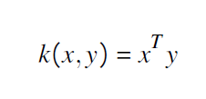
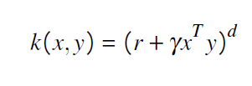
ML Models:Support Vector Machine
Support Vector Machine (SVM) is a supervised machine learning algorithm that finds the optimal hyperplane to separate data points into distinct classes with the maximum margin.
SVM is effective for both linear and non-linear classification problems, using kernel functions to transform data into higher dimensions for better separability.
Linear Kernel
Polynomial Kernel:
Parameters:
Kernel: rbf
HoG: C = 10, γ = .002
BoW: C =1, γ = scale

Slide 22



ML Models:LightGBM
LightGBM (Light Gradient Boosting Machine) is a gradient boosting framework designed for fast training and high efficiency, especially with large datasets. It consist of:
The objective function:
Leaf-Wise Tree Splitting formula:
Weighted Data Point Contribution:
Parameters:
HoG: class_weight="balanced",num_leaves=15
BoW: num_leaves= 10, n_estimators=100, learning_rate= 0.1

Slide 23
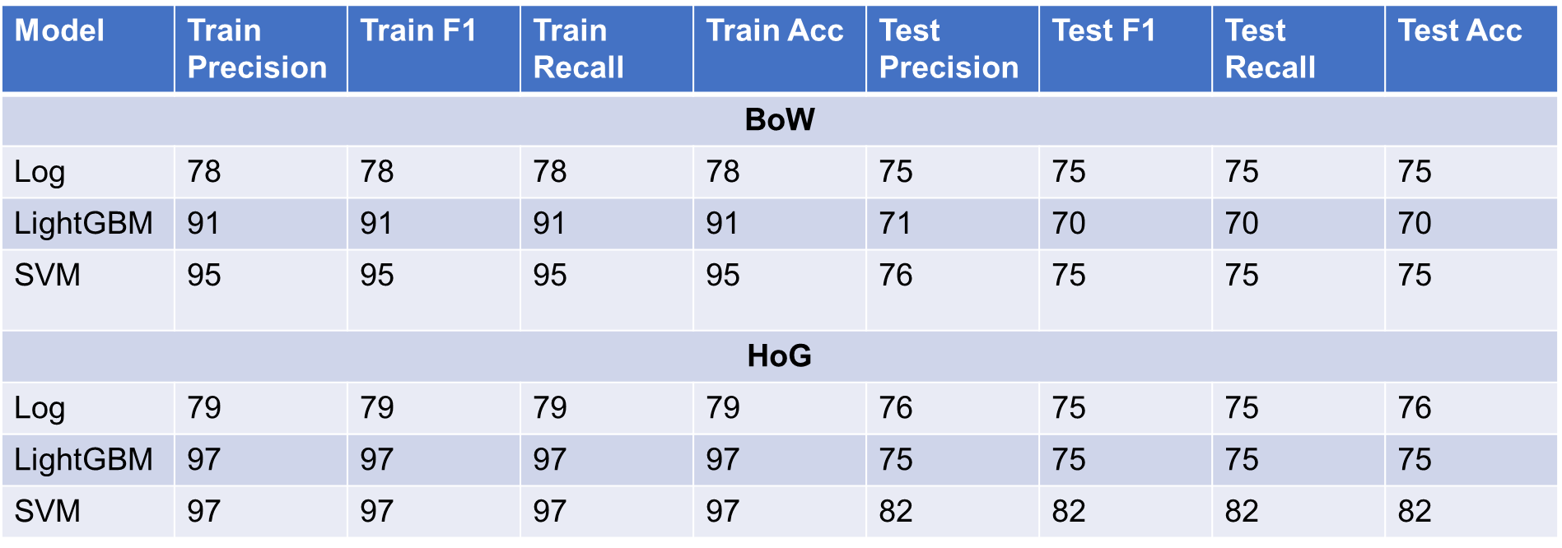
Evaluation

Slide 24
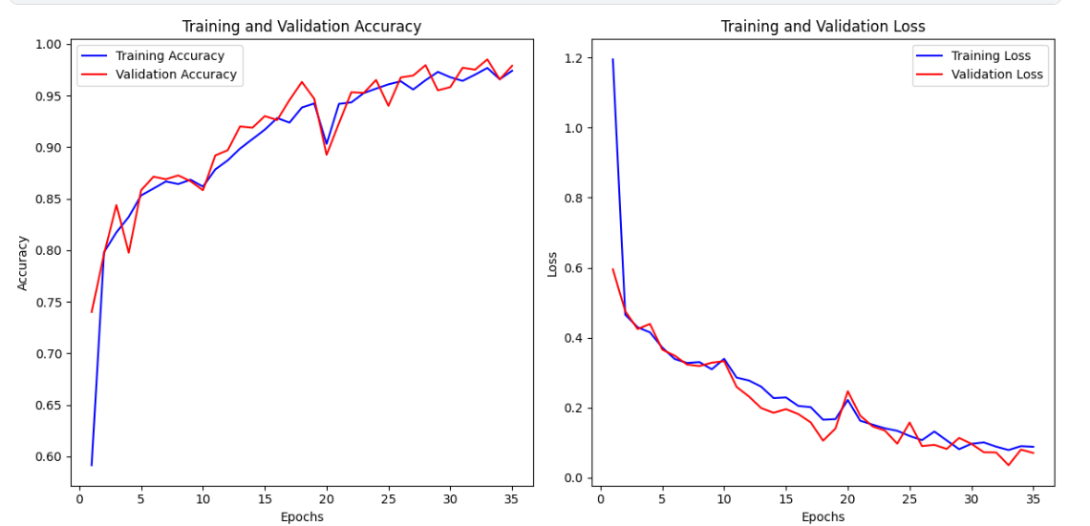
CNN

Slide 25
Conclusion
- Conclusion
Developed a CNN-based system to enhance fingerprint registration.
Key challenges addressed:
Incomplete fingerprints (sensor issues, liquids, dust, etc.).
Degradations (rotation, blur, cuts).
- Future Work
Advanced Preprocessing: Use Gabor filters for ridge enhancement.
Acceptance Thresholds: Balance security vs. usability.
Handling Scars/Wounds: Incorporate specialized feature extraction.
Accurate Dataset Labeling: Ensure precise labels for training.
Real-time Optimization: Enhance computational efficiency.
Applications
High-Security Systems: Banking, access control, etc.
National ID Systems: Reliable data for lifelong identification.
Goal: Deploy robust fingerprint quality systems for improved accuracy, reliability, and security in real-world applications.

Slide 26
Task Assigning
Name | Data Collection | Preprocessing | Feature Extraction |  | CNN | Machine Learning Model |  |  | Evaluation | UI | Slide | Report
 |  |  | BoW | HoG |  | SVM | LGBM | Log
Dũng | x | x | x | x | x | x | x | x | x | x |  | x
Tú | x | x | x | x |  | x | x | x | x | x | x | x
Đức | x | x |  |  | x |  |  |  | x | x | x | x

Slide 27
Thank you for paying attention!​

