Slide 1
WEB PROJECT
PRESENTATIONS

Slide 2
TABLE OF CONTENTS
01
04
Group members
Ratio
02
05
The goal of website
Diagram
03
06
Report
Functions

Slide 3
GROUP MEMBERS
GOSTUDIO
2059006 - Lê Anh Dũng
2059042 - Nguyễn Hoàng Trường Thịnh
2059013 - Quách Phú Hào
2059043 - Hà Minh Thuận
Notes:
12345

Slide 4
THE GOAL OF THE WEBSITE
BUSINESS
ACCESSIBLE
CUSTOMER SERVICE
Functions of E-commerce include buying and selling goods, transmitting funds or data over the internet.
Website has an attractive interface with easy-to-access operations for customers.
Customers can communnicate with the Admin about product sales information such as preview, quantity checks, etc.

Slide 5
FUNCTIONS
+ Admin account, Customer account.
+ Log in, Log out.
+ Add, Delete, Update (only for admin account)
+ Add, Delete, Update (shopping cart)
+ Comment (for Customer)

Slide 6
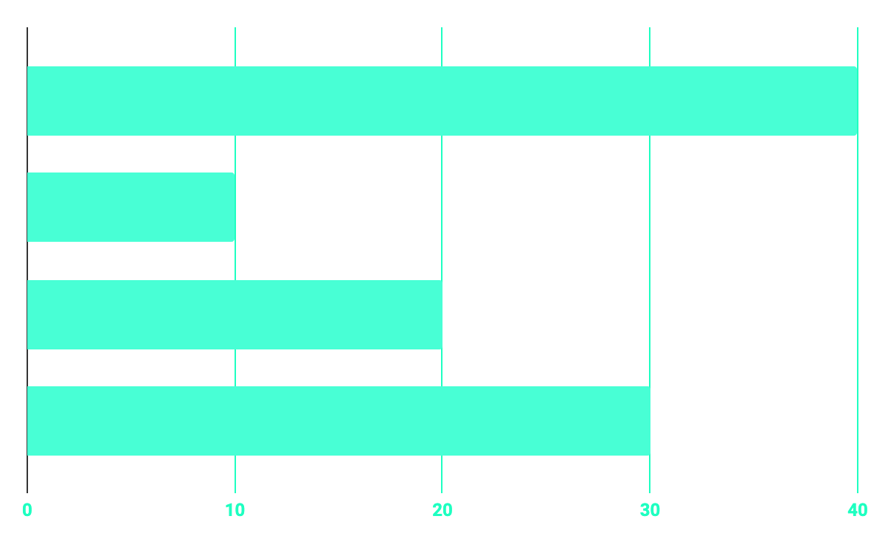
COMPONENT RATIO
40%
20%
PROGRAMMING
10%
30%
DATABASE
WEB DESIGN
UX RESEARCH

Slide 7
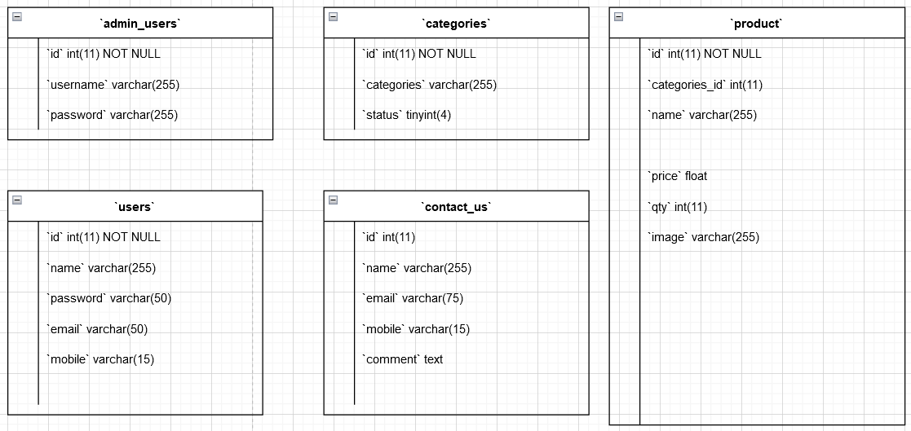
ERD DIAGRAM

Slide 8
NOW
POOR DESIGN
PROGRAMMING MISTAKES
LACK OF CREATIVITY

Slide 9
THANKS!
Does anyone have any question? Please contact with Mr. Thuận Email: 2059043@itec.hcmus.edu.vn
addyouremail@freepik.com
+84 354 379 699
https://www.facebook.com/thuan.ha.583671.com

