Slide 1
Bluetooth Low Energy
Aurelio Arango, Dung Ly, Moises Guadalupe

Slide 2
Project Details
Using BLE API from embed and the BLE expansion board for the STM nucleo board, we make the board broadcast Advertising data that allows us to connect to the board through a bluetooth connection from a smartphone using the nRF Connect app from Nordic Semiconductor
Once a connection is created, we use the TEXT LCD library from mbed to display string variables on the LCD screen.

Slide 3
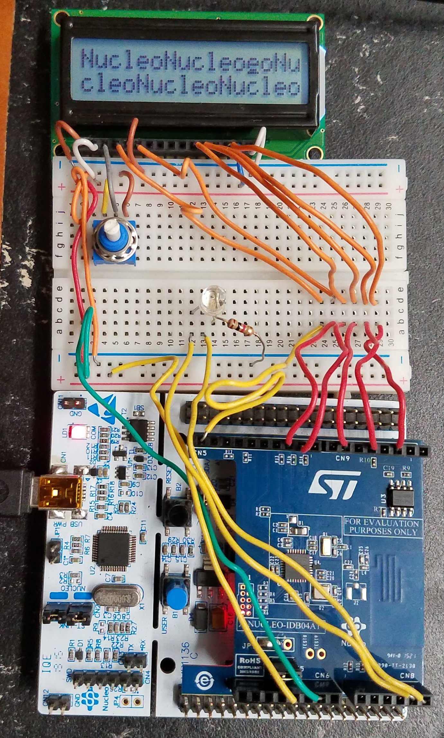
Project Setup
Pins used to connect LCD display: PB_8, PB_6, PC_7, PB_10, PB_5, PA_10

Slide 4
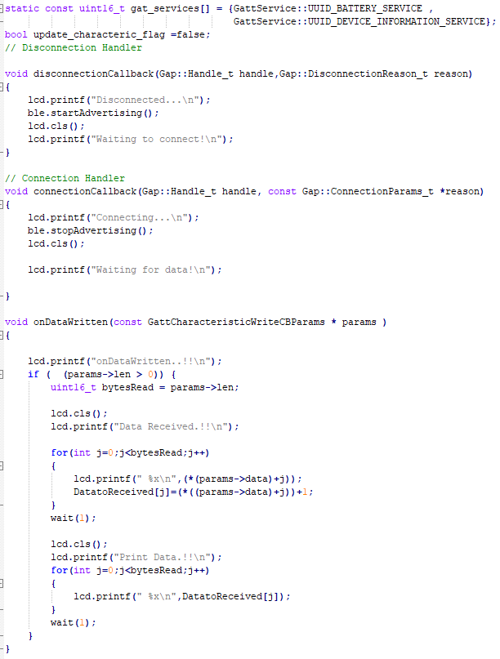
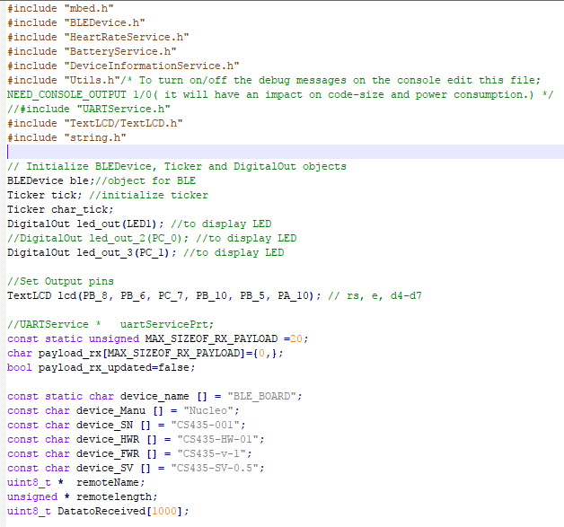
Project code

Slide 5
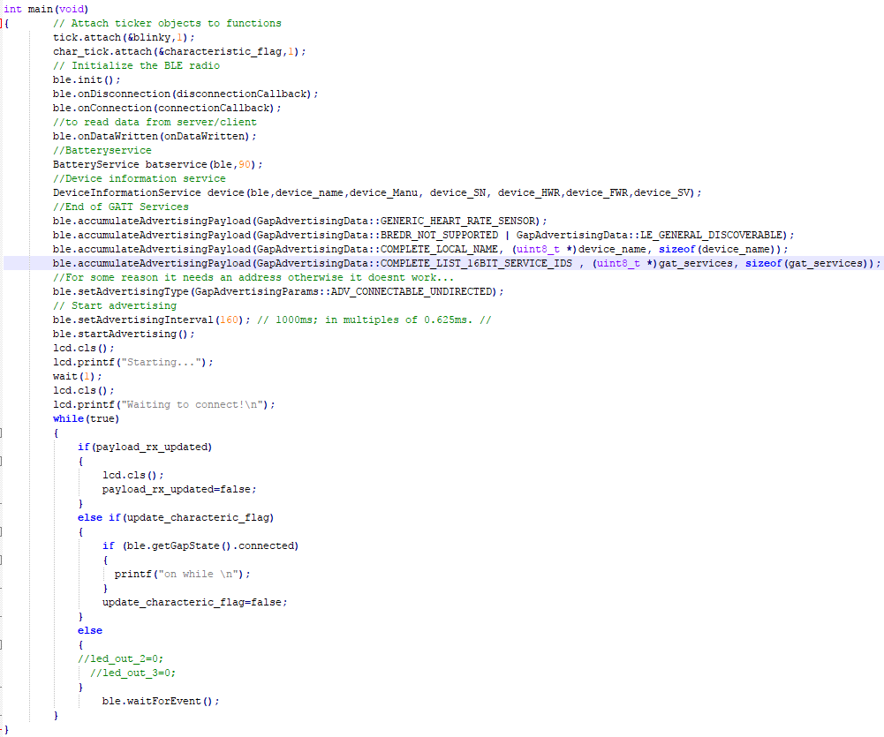
Project code

Slide 6
Bill of Materials
STM32F4RE01 board
X-NUCLEO-IDB04A1 expansion board
BreadBoard
Any smartphone capable of running NRF Connect app
NRF connect app by Nordic Semiconductor

