Slide 1
Human Protein Atlas Image Classification
Re. 1 v2
Tp.HCM, 01/11/2018

Slide 2
Problem
Classify subcellular protein patterns in human cells
  28 class in total
Input
  Each input sample is represented by 4 filters of size 512x512 (stored as 4 image files)
    green: protein of interest
    blue: nucleus
    red: microtubules
    yellow: endoplasmic reticulum
Output
  Multi-label classification
  Each sample is assigned to labels of the 28 classes above
The most informative one
cellular landmarks

Slide 3
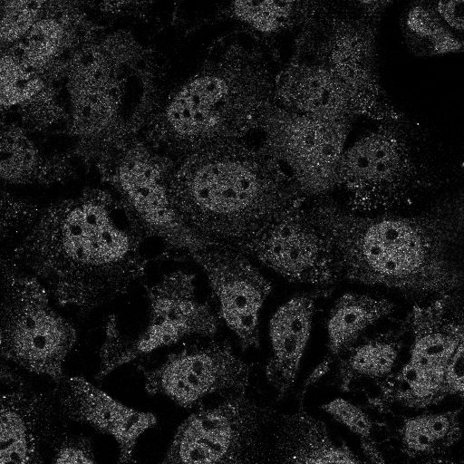
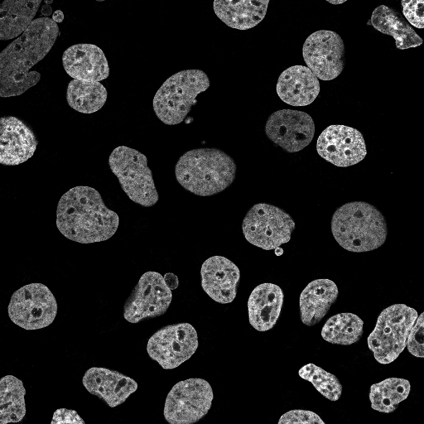
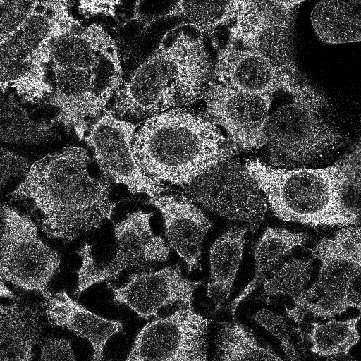
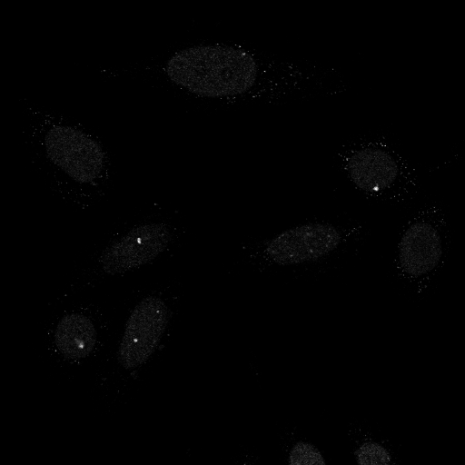
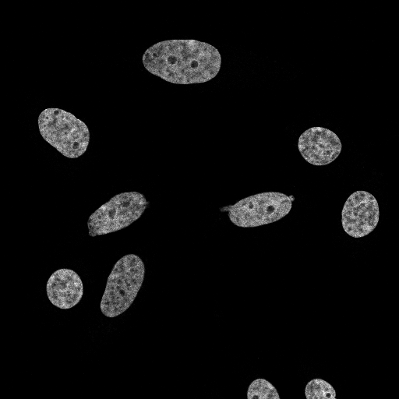
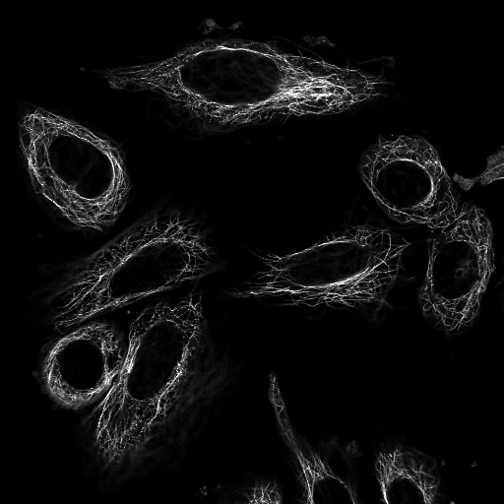
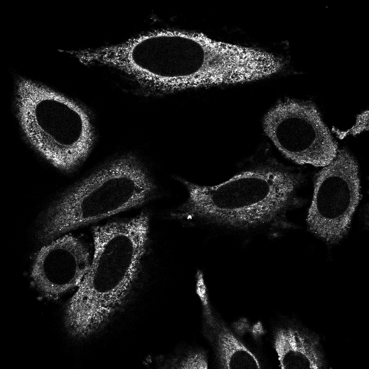
Data examples
Labels
Nucleoplasm
green
blue
red
yellow
Labels
Nuclear bodies

Slide 4
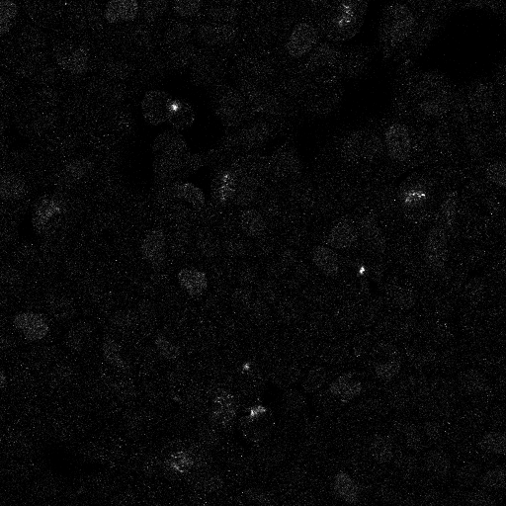
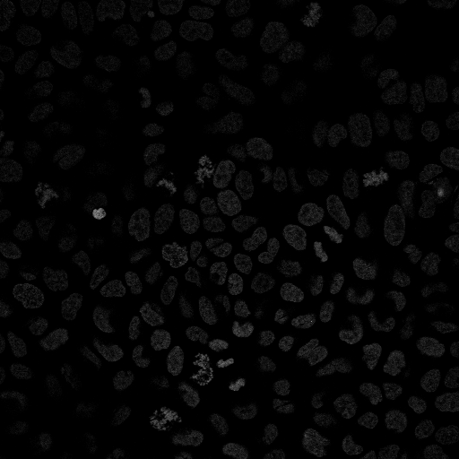
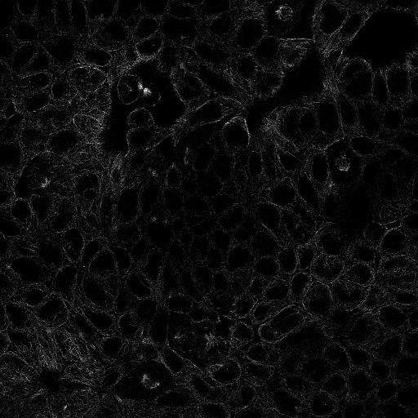
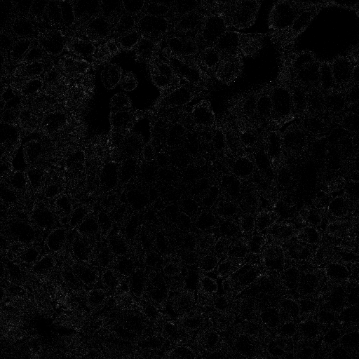
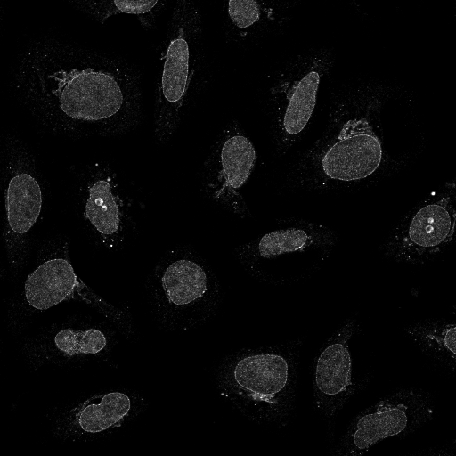
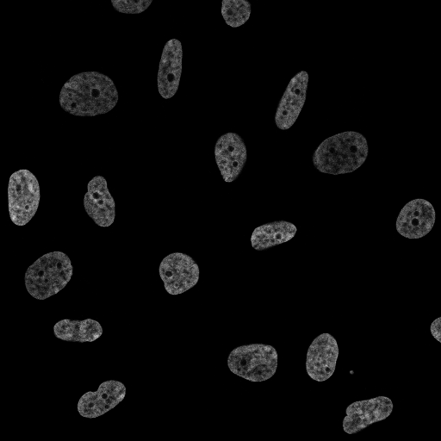
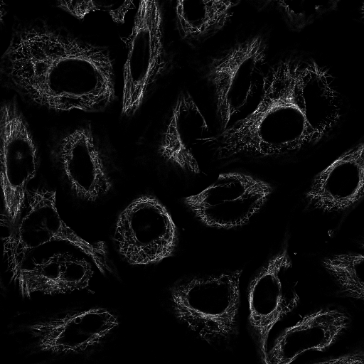
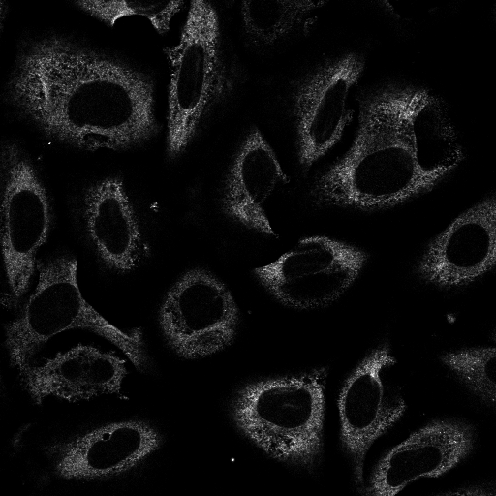
Data examples
Labels
Cytokinetic bridge
Nucleoplasm
green
blue
red
yellow
Labels
Golgi apparatus
Nuclear membrane
Nucleoli
Nucleoplasm

Slide 5
Data statistics
Overview: 31072 training samples with 50782 training target labels belong to 28 classes
Class | Total | Class | Total | Class | Total | Class | Total
0. Nucleoplasm | 12885 | 7. Golgi apparatus | 2822 | 14. Microtubules | 1066 | 21. Plasma membrane | 3777
1. Nuclear membrane | 1254 | 8. Peroxisomes | 53 | 15. Microtubule ends | 21 | 22. Cell junctions | 802
2. Nucleoli | 3621 | 9. Endosomes | 45 | 16. Cytokinetic bridge | 530 | 23. Mitochondria | 2965
3. Nucleoli fibrillar center | 1561 | 10. Lysosomes | 28 | 17. Mitotic spindle | 210 | 24. Aggresome | 322
4. Nuclear speckles | 1858 | 11. Intermediate filaments | 1093 | 18. Microtubule organizing center | 902 | 25. Cytosol | 8228
5. Nuclear bodies | 2513 | 12. Actin filaments | 688 | 19. Centrosome | 1482 | 26. Cytoplasmic bodies | 328
6. Endoplasmic reticulum | 1008 | 13. Focal adhesion sites | 537 | 20. Lipid droplets | 172 | 27. Rods & rings | 11

Slide 6
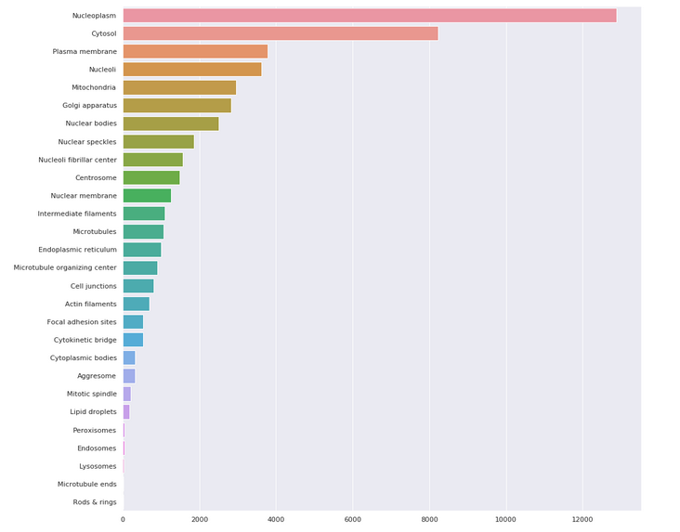
Data statistics - Visualization
Most occurred class
  Nucleoplasm (Label 0): 12885
Least occurred class
  Rods & rings (Label 27): 11

Slide 7
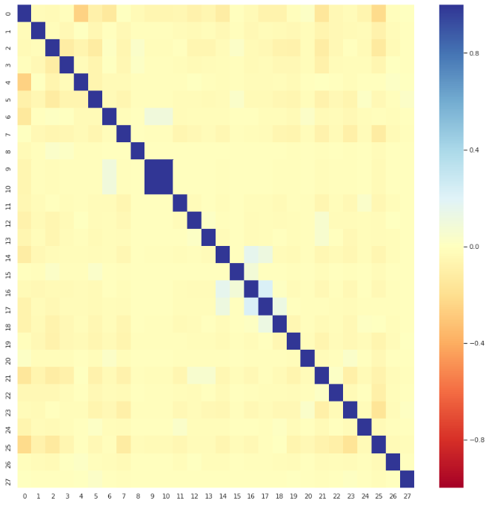
Data statistics - Visualization
Correlation map of the 28 classes
  Endosomes (Label 9) and Lysosomes (Label 10) often occur together
  Mitotic spindle (Label 17) often comes together with the Cytokinetic bridge (Label 16)

Slide 8
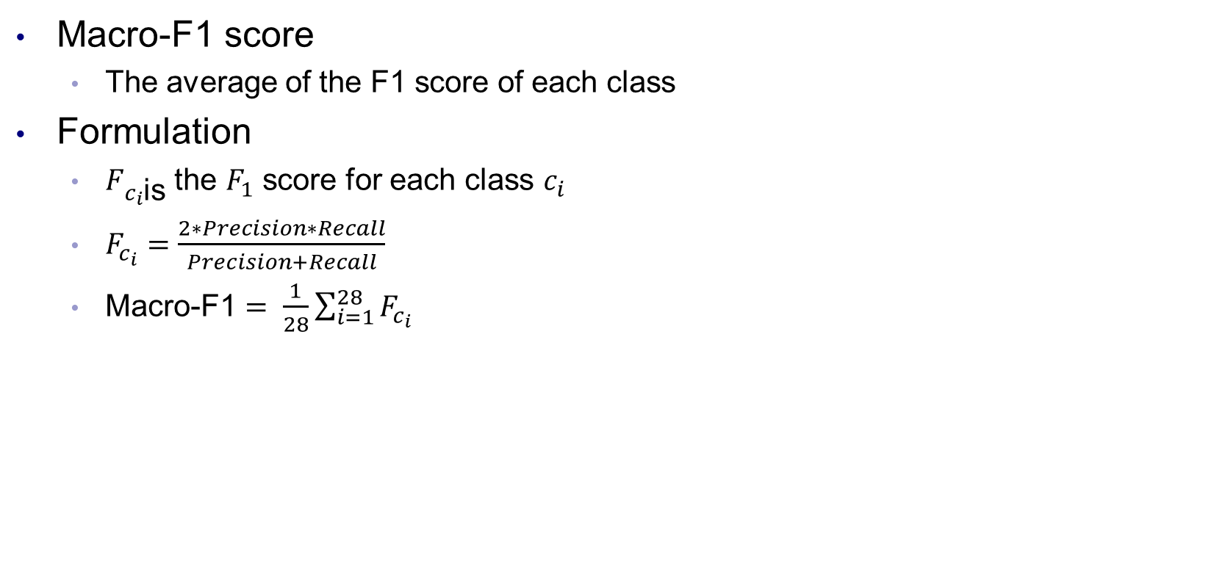
Evaluation metrics

Slide 9
EXPERIMENTAL RESULTS

Slide 10
Approach
Construct a baseline
  Transfer learning from pretrained CNN models
Try to improve from the baseline

Slide 11
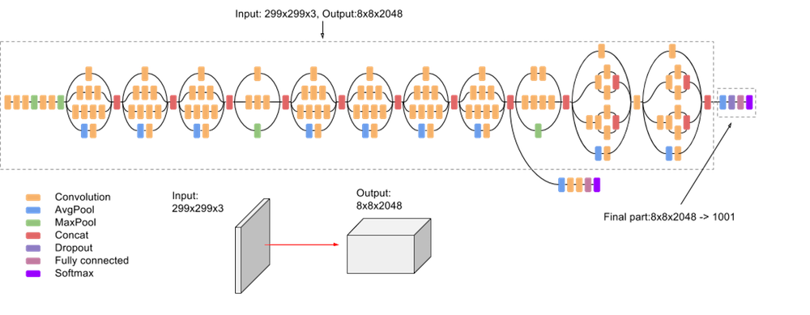
Base model – Pretrained InceptionNet

Slide 12
Experimental results – Common config
Common configuration
  Input: Scale image size from 512 to 299 and use only 3 out of 4 filters (green, red, blue, discard yellow) (in order to be compatible with InceptionNet)
    Input size is 299x299x3
  Base model: InceptionNet v3 + (1 conv + 2 fully connected)
  Output: 28 node corresponding to 28 classes
  Probability threshold when classifying: 0.2
  Training epoch: 10
  Train/validation split: 26411/4661 (31072 in total)
  Data augmentation: Flip, affine transformation

Slide 13
Experimental results – Run1 Baseline
Configuration
  Loss: Binary cross entropy loss
Result
  0.341 macro-F1 on public leader board

Slide 14
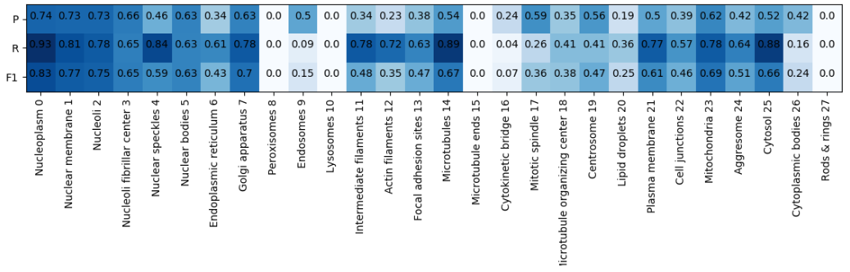
Experimental results – Run1 Baseline
Analysis on validation set
Class 8, 10, 15, 16, 27: f1 is nearly 0, because of few data

Slide 15
Experimental results – Run2 Weighted class
Configuration
  Loss: Weighted binary cross entropy loss
    Each class is weighted based on their occurrences in the training set.
    For example, if we have 2 classes A, B with occurrences of 4, 6. Then the weight of class A , B is 10/4 and 10/6, respectively. These weights is then used to compute loss function.
Result
  0.374 macro-F1 on public leader board

Slide 16
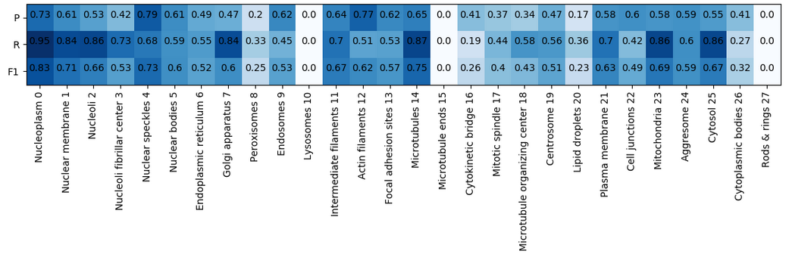
Experimental results – Run2 Weighted class
Analysis on validation set
Performance on class 8 improved.
There is still classes with f1 score of 0.

Slide 17
Next plan
TODO
  Continuing investigate data
    Focus on classes that have few data
    Misclassification matrix
    Classes that often come together
  Exploiting yellow filters of each sample
  Investigate if there is any other loss function used in multi-label classification problem
  (If have time) Read + implement method proposed in the paper: Cyclical Learning Rates for Training Neural Networks (https://arxiv.org/abs/1506.01186)
    Purpose: check if the trained network reach the global optimum

