Slide 1
Game Introduction Timber!
Nguyễn Đức Dũng

Slide 2
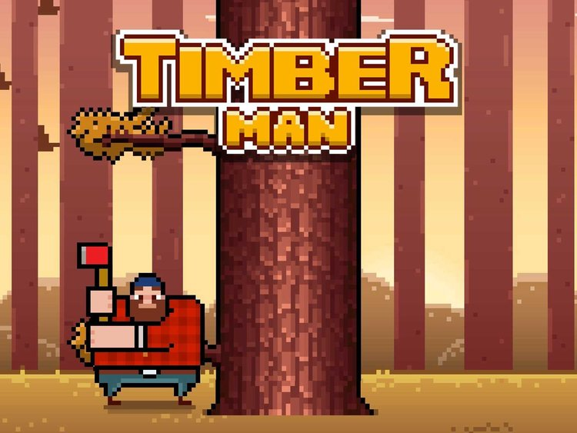
Idea?
game Timberman on Steam

Slide 3
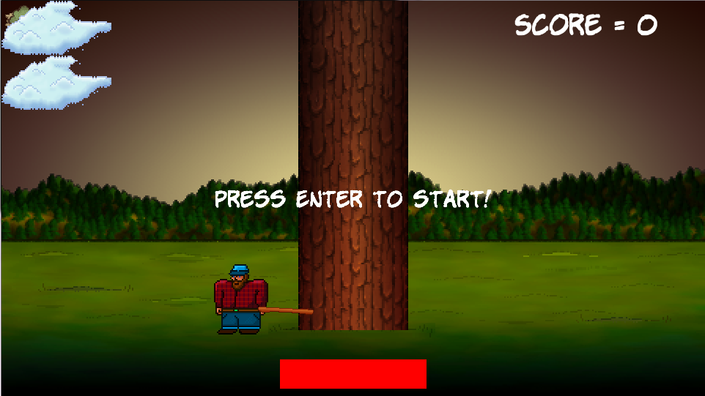
Overview

Slide 4
How do I play?
Just smash Left and Right. Hard. And fast

Slide 5
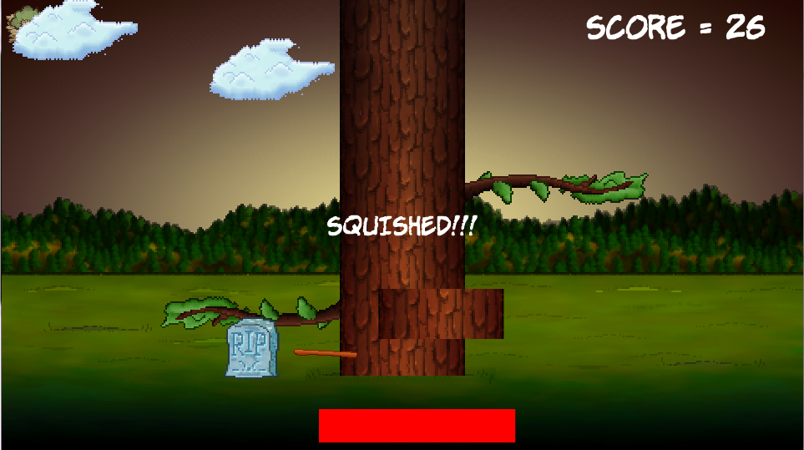
Don’t get hit by a branch!

Slide 6
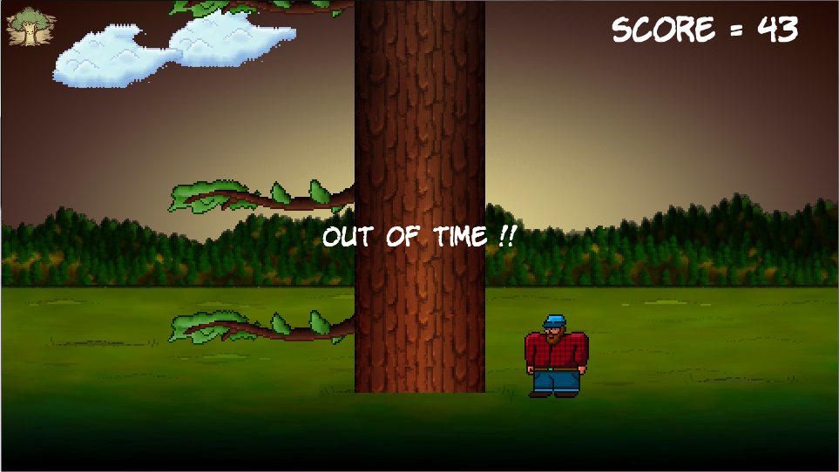
…or play too slowly

Slide 7

Why should I play?
Easy to play
Easier to master!
Good game if you hate your L & R buttons
F2P

Slide 8
Thanks for listening !

