Slide 1
Chapter 6
Application of Information Theory: Crytography

Slide 2
6.1. Introduction
Fundamental objective of cryptography: enable two people (Alice and Bob) communicate over an insecure channel in such a way that an opponent (Chris) cannot understand what is being said
Operation of cryptography:
Information sent by Alice: “plain text”
Alice encrypts the “plain text” using predetermined key: “cipher text”
Bob knows key: convert “cipher text” to “plain text”
Chris does not know key: can not understand the “plain text”

Slide 3
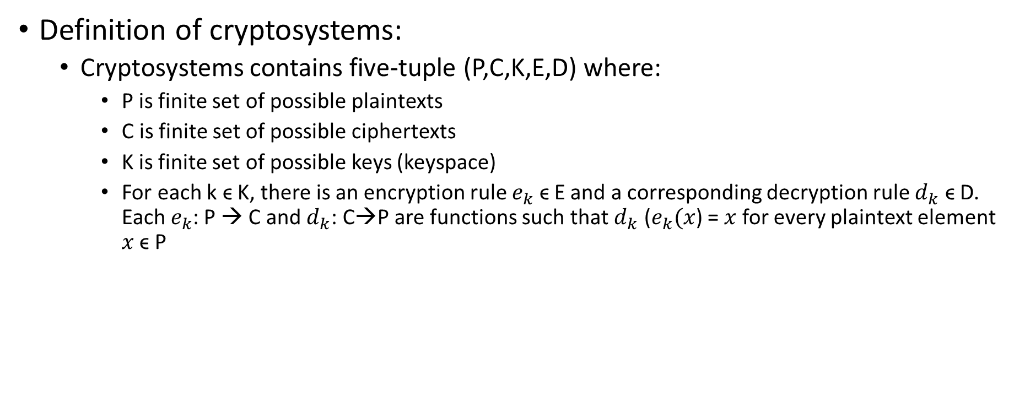
6.1. Introduction (Cont.)
Definition of cryptosystems:
Cryptosystems contains five-tuple (P,C,K,E,D) where:
P is finite set of possible plaintexts
C is finite set of possible ciphertexts
K is finite set of possible keys (keyspace)
For each k ϵ K, there is an encryption rule $e_{k}$ ϵ E and a corresponding decryption rule $d_{k}$ ϵ D. Each $e_{k}$: P → C and $d_{k}$: C→P are functions such that $d_{k}$ ($e_{k}(x$) = $x$ for every plaintext element $x$ ϵ P

Slide 4
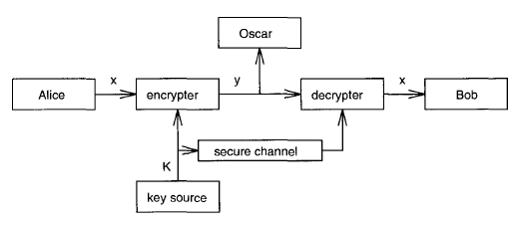
6.1. Introduction (Cont.)
Communication using cryptography

Slide 5
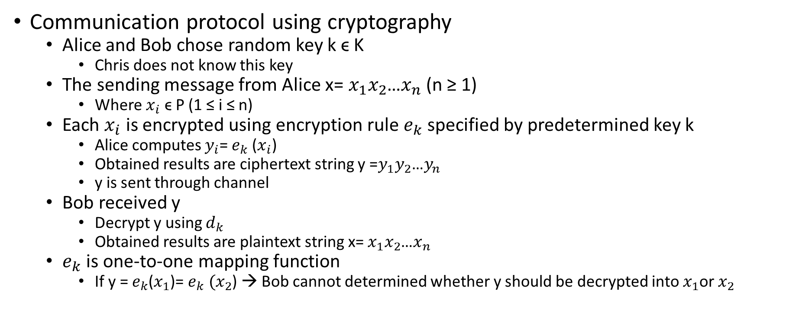
6.1. Introduction (Cont.)
Communication protocol using cryptography
Alice and Bob chose random key k ϵ K
Chris does not know this key
The sending message from Alice x= $x_{1}x_{2}$…$x_{n}$ (n ≥ 1)
Where $x_{i}$ ϵ P (1 ≤ i ≤ n)
Each $x_{i}$ is encrypted using encryption rule $e_{k}$ specified by predetermined key k
Alice computes $y_{i}$= $e_{k}$ ($x_{i}$)
Obtained results are ciphertext string y =$y_{1}y_{2}$…$y_{n}$
y is sent through channel
Bob received y
Decrypt y using $d_{k}$
Obtained results are plaintext string x= $x_{1}x_{2}$…$x_{n}$
$e_{k}$ is one-to-one mapping function
If y = $e_{k}$($x_{1}$)= $e_{k} (x_{2}$) → Bob cannot determined whether y should be decrypted into $x_{1}$or $x_{2}$

Slide 6
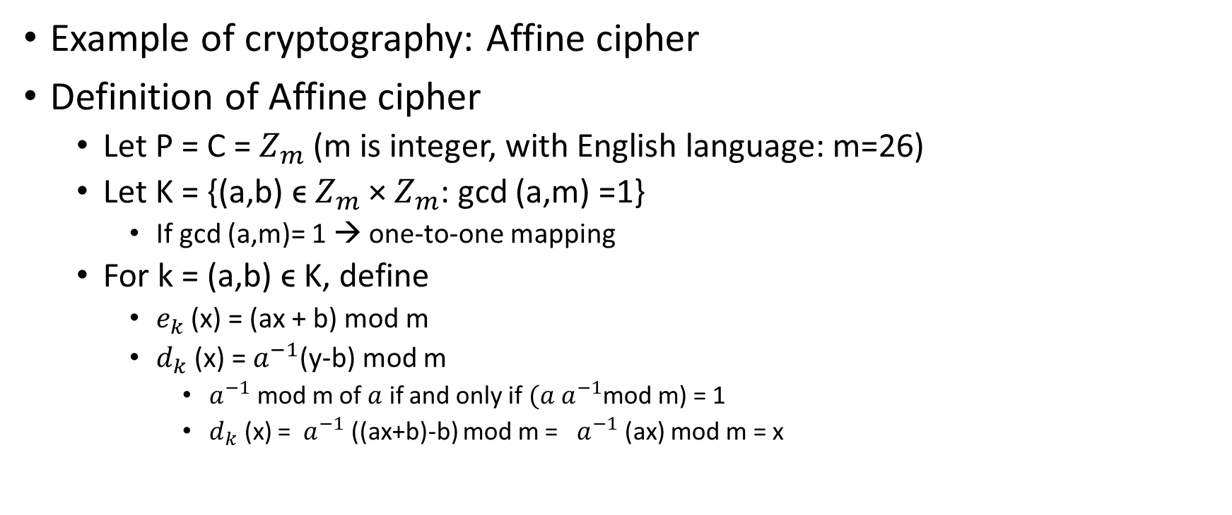
6.1. Introduction (Cont.)
Example of cryptography: Affine cipher
Definition of Affine cipher
Let P = C = $Z_{m}$ (m is integer, with English language: m=26)
Let K = {(a,b) ϵ $Z_{m}$ × $Z_{m}$: gcd (a,m) =1}
If gcd (a,m)= 1 → one-to-one mapping
For k = (a,b) ϵ K, define
$e_{k}$ (x) = (ax + b) mod m
$d_{k}$ (x) = $a^{−1}$(y-b) mod m
$a^{−1}$ mod m of $a$ if and only if $(a a^{−1}$mod m) = 1
$d_{k}$ (x) = $a^{−1}$ ((ax+b)-b) mod m = $a^{−1}$ (ax) mod m = x

Slide 7
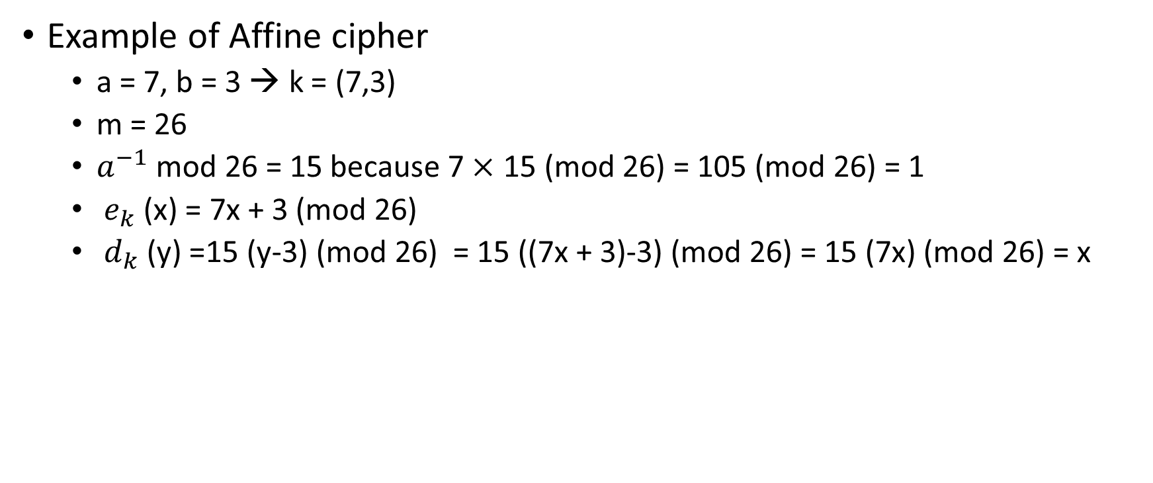
6.1. Introduction (Cont.)
Example of Affine cipher
a = 7, b = 3 → k = (7,3)
m = 26
$a^{−1}$ mod 26 = 15 because 7$×$ 15 (mod 26) = 105 (mod 26) = 1
$e_{k}$ (x) = 7x + 3 (mod 26)
$d_{k}$ (y) =15 (y-3) (mod 26) = 15 ((7x + 3)-3) (mod 26) = 15 (7x) (mod 26) = x

Slide 8
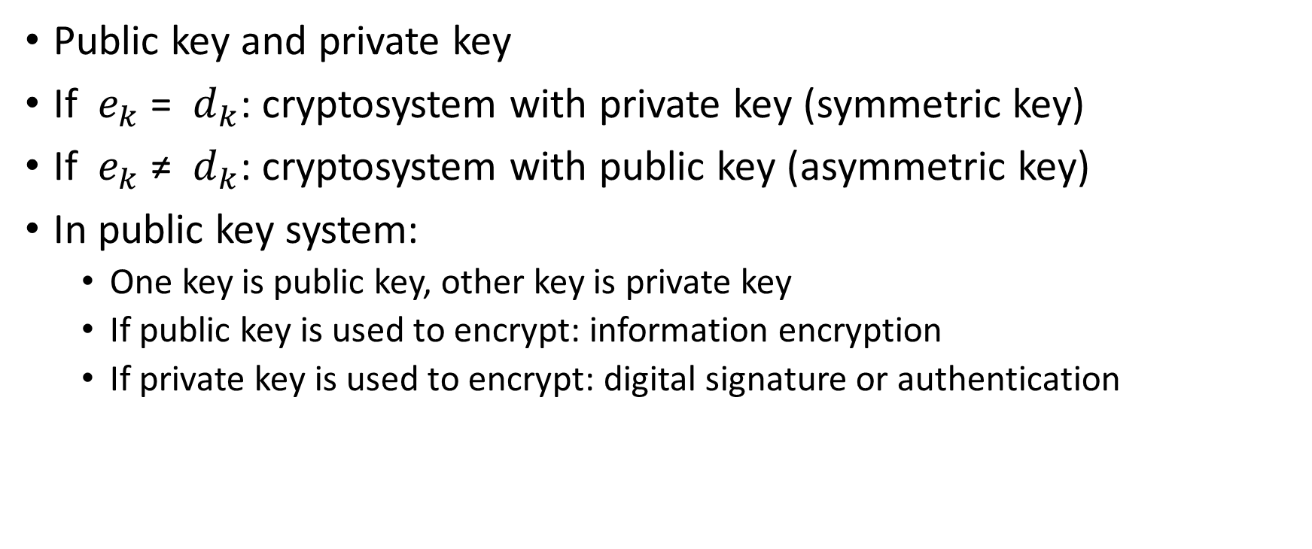
6.1. Introduction (Cont.)
Public key and private key
If $e_{k}$ = $d_{k}$: cryptosystem with private key (symmetric key)
If $e_{k}$ ≠ $d_{k}$: cryptosystem with public key (asymmetric key)
In public key system:
One key is public key, other key is private key
If public key is used to encrypt: information encryption
If private key is used to encrypt: digital signature or authentication

Slide 9
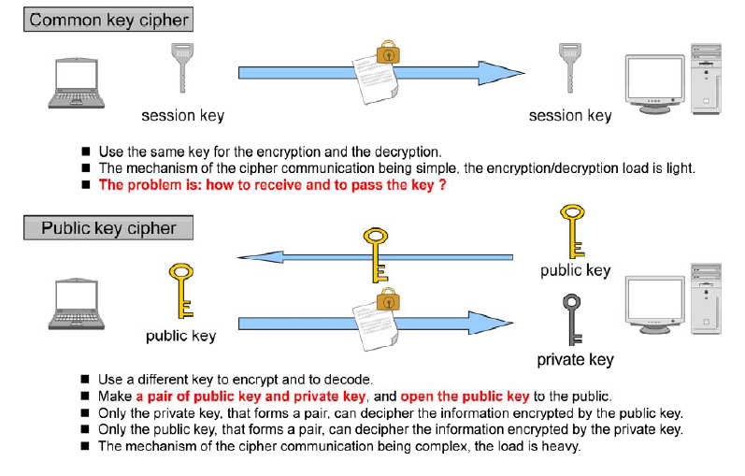
6.1. Introduction (Cont.)

Slide 10
6.2. Cryptanalysis
Different models of attack:
Ciphertext only attack: opponent Chris possesses a string of cipher text y
Know plain text only attack: opponent Chris possesses a string of plaintext x, and the corresponding ciphertext y. It is need to find the key to decrypt y1, y2….
Choses plain text attack: opponent temporary access to encryption machinery. He can choose a plaintext x and constructs corresponding ciphertext y. it is need to decrypt y1,y2 at other moments
Chosen ciphertext attack: opponent temporary access to decryption machinery. He can choose a ciphertext y and constructs corresponding plaintext x . it is need to decrypt y1,y2 at other moments

Slide 11
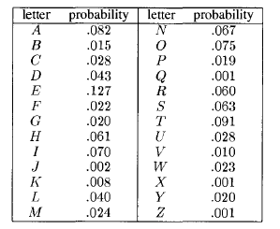
6.2. Cryptanalysis (Cont.)
The objective is to determine key that was used.
From key →determine plaintext
Many techniques of cryptanalysis uses statistical properties of the languages.
Estimate the appearance frequency of letter of language. For example:

Slide 12
6.2. Cryptanalysis (Cont.)
To do cryptanalysis
1) Divide the letter into the groups that have similar probability
E: 0.120
T.A,O,I,N,S,H,R probability from 0.6 to 0.9
D,L probability around 0.4
C,U,M,W,F,G,Y,P,B probability between 0.015 and 0.028
V,k,J,X,Q,Z probability less than 0.01
2) Calculate the probability of the most common combinations for example: TH, HE, IN
3) Calculate the frequency of letter in ciphertext
4) Assume Alice uses a specific cryptosystem
5) Assume the letters have higher frequency of ciphertext corresponds with the letters that have higher probability in the language
6) Find the key from 4) and 5)

Slide 13

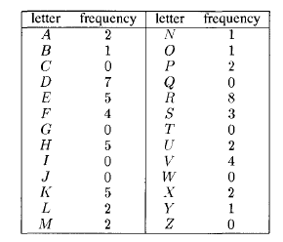
6.2. Cryptanalysis (Cont.)
Example of affine cipher
Ciphertext:
Frequency:

Slide 14
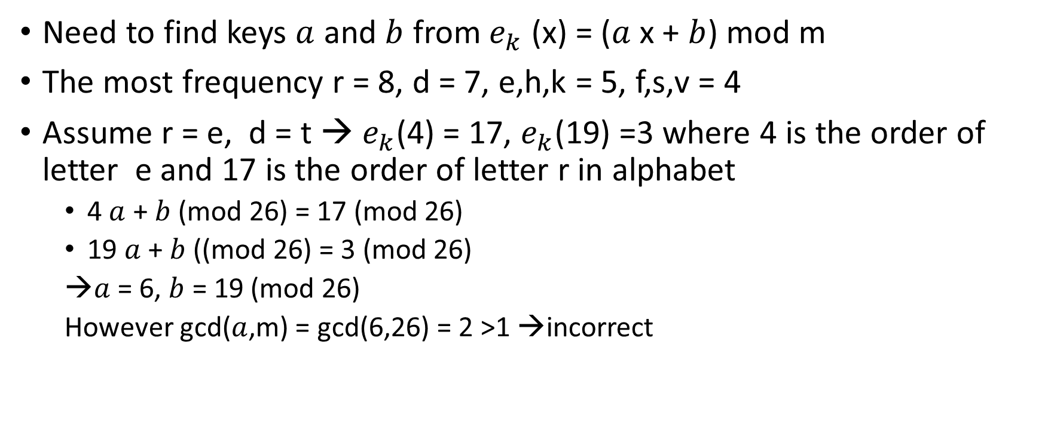
6.2. Cryptanalysis (Cont.)
Need to find keys $a$ and $b$ from $e_{k}$ (x) = ($a$x + $b$) mod m
The most frequency r = 8, d = 7, e,h,k = 5, f,s,v = 4
Assume r = e, d = t → $e_{k}$(4) = 17, $e_{k}$(19) =3 where 4 is the order of letter e and 17 is the order of letter r in alphabet
4 $a$ + $b$ (mod 26) = 17 (mod 26)
19 $a$ + $b$ ((mod 26) = 3 (mod 26)
$a$ = 6, $b$ = 19 (mod 26)
However gcd($a$,m) = gcd(6,26) = 2 >1 →incorrect

Slide 15
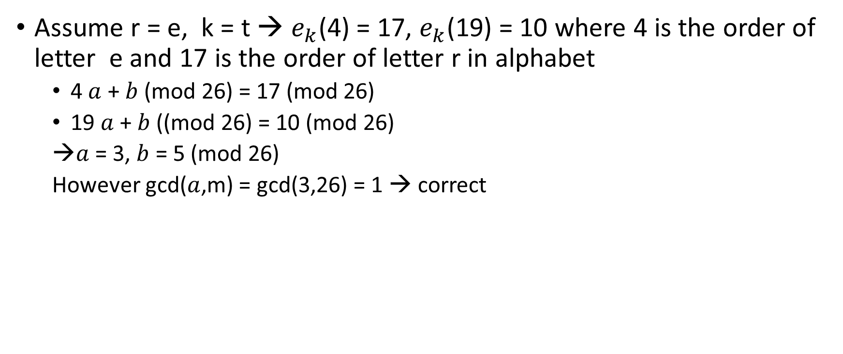
6.2. Cryptanalysis (Cont.)
Assume r = e, k = t → $e_{k}$(4) = 17, $e_{k}$(19) = 10 where 4 is the order of letter e and 17 is the order of letter r in alphabet
4 $a$ + $b$ (mod 26) = 17 (mod 26)
19 $a$ + $b$ ((mod 26) = 10 (mod 26)
$a$ = 3, $b$ = 5 (mod 26)
However gcd($a$,m) = gcd(3,26) = 1 → correct

Slide 16
6.2. Cryptanalysis (Cont.)
to prevent the cryptanalysis → the letter needs to have similar probability
→ Need to compress the information (reduce the redundancy of source)

Slide 17
Shannon’s theory
A cryptosystem has perfect secrecy if P(x|y) = P(x) for all x ϵ P, y ϵ C
A posteriori probability that the plaintext is x, given that the ciphertext y is observed is identical to the priori probability that the plaintext is x

