Slide 1
BDP306x_01_EN Capstone project - Blockchain in Financial Services

Slide 2
Table of content
1. Project Overview
2. Use Case
3. Software design
4. Demo
5. Product Upgrade
6. Q&A

Slide 3
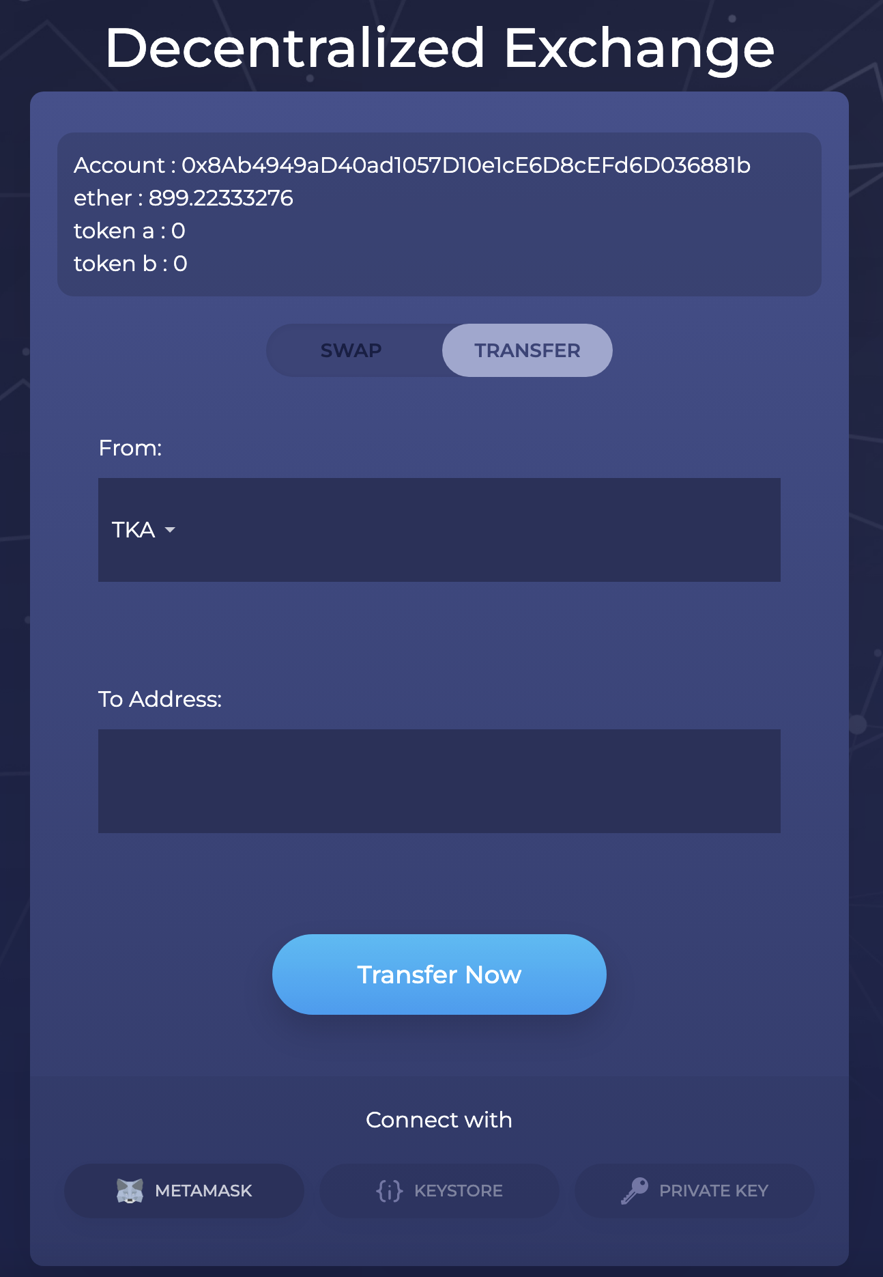
1. Project Overview
Condition: Considering the problem of various tokens issued by startup companies out there have gone into forsaken because of low liquidity in the market, the inconvenience of trading between tokens through other indexed coins like BTC or ETH, the issue of trusting your precious assets to other centralized exchanges.
=> Build a secured and trustful decentralized exchange that connects all the tokens in the same network and swaps tokens directly on the platform

Slide 4
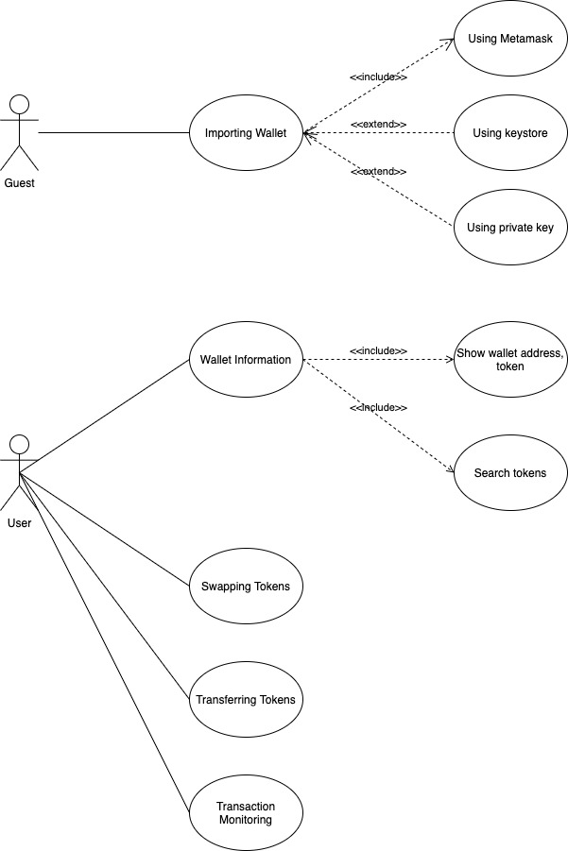
2. Use Case
Importing Wallet (For Guest)
Wallet Information
Swapping Tokens
Transferring Tokens
Transaction Monitoring

Slide 5
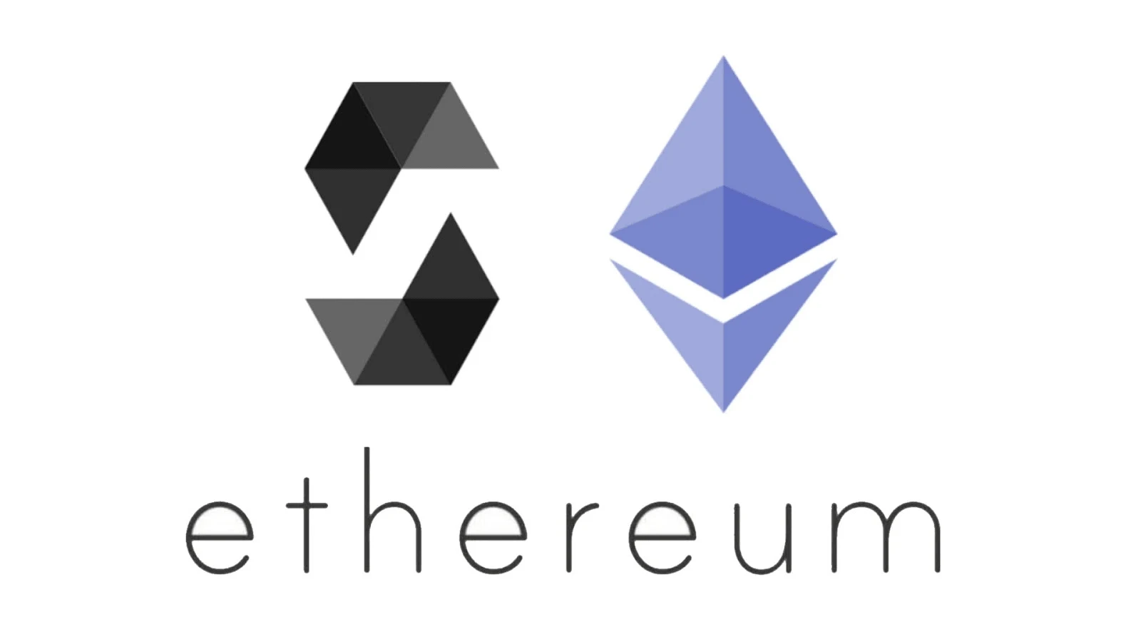

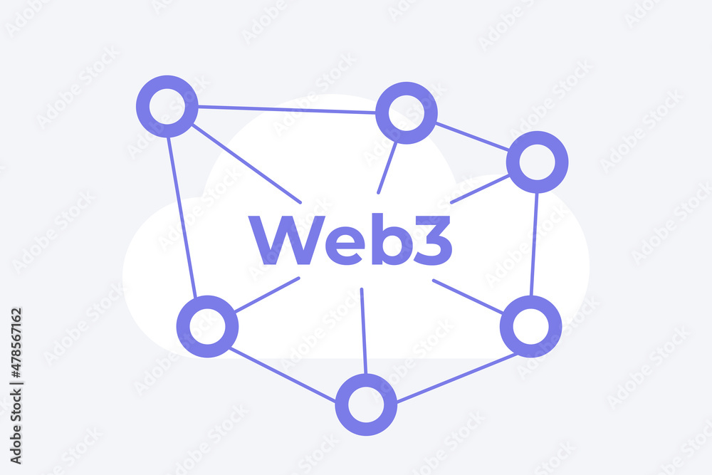

3. Software Design

Slide 6
3. Software Design

Slide 7
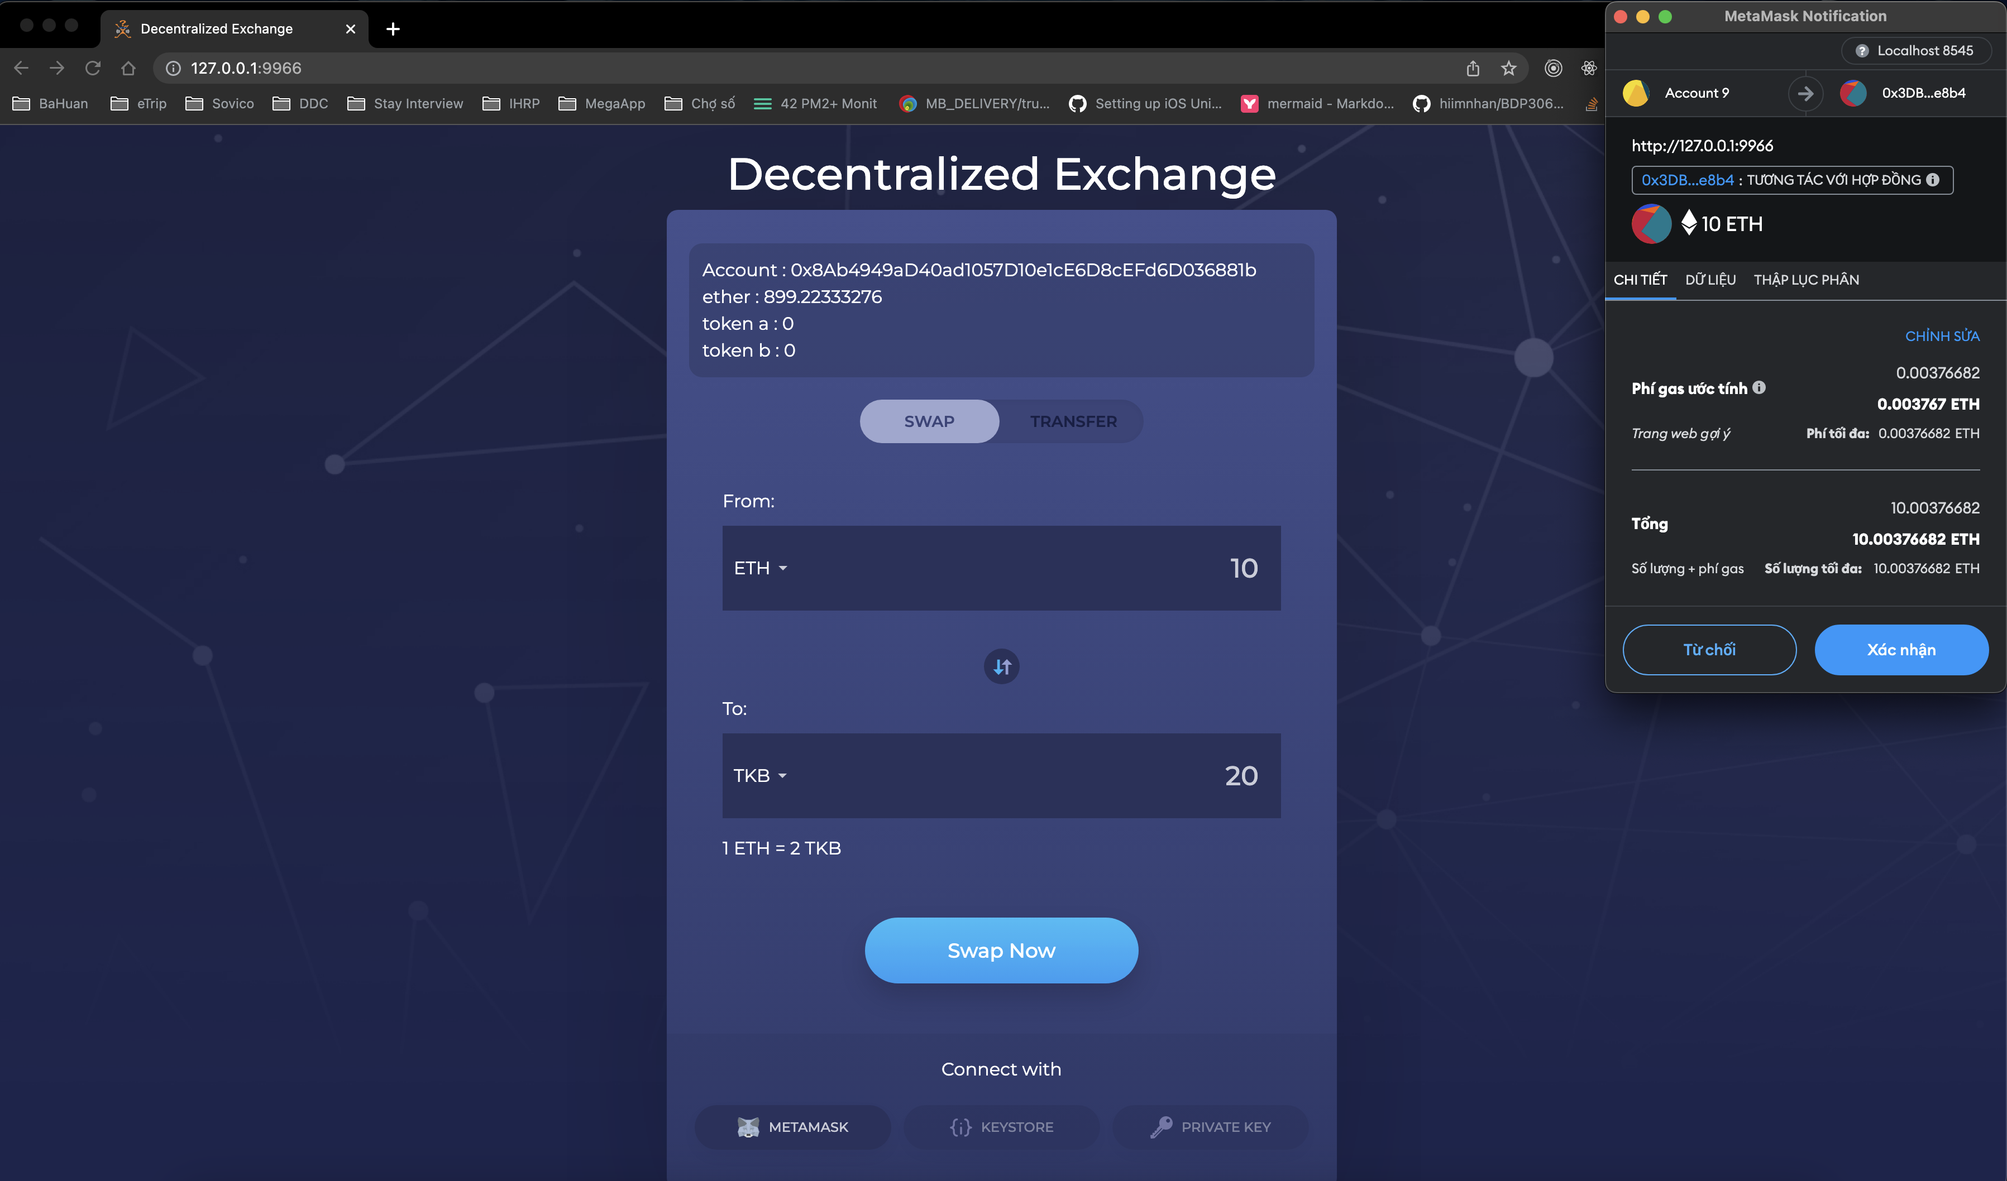
4. Demo

Slide 8
5. Product Upgrade
1. Intergate more way to import wallet
- KeyStore
- Private Key
- Hard Wallet (Trezor, Ledger)
2. Get real exchange rate.
3. Create mobile application.

