Slide 1
FEC Encoder, convolution encoder, viterbi decoder, LDPC encoder, decoder
08/09/2017
Tên:Võ Nguyễn Thiên Phúc MSSV:14520703
Tên:Phan Trí Dũng MSSV:14520203

Slide 2
Nội dung báo cáo hôm nay
Nội dung 1: FEC Encoder
Nội dung 2: Convolution Encoder
Nội dung 3: Viterbi Decoder
Nội dung 4 : LDPC Encoder

Slide 3
Nội dung 1: FEC Encoder
FEC is a technique used for controlling errors in the data transmission
This technique uses the redundant (which is derived from information code).
Advantage:The redundancy allows the receiver to detect a limited number of errors that may occur anywhere in the message, and often to correct these errors without retransmission.
Disavantage: at the cost of a fixed, higher forward channel bandwidth.

Slide 4
Nội dung 1: FEC Encoder (cont)
Application: FEC is therefore applied in situations where retransmissions are costly or impossible, such as one-way communication links and when transmitting to multiple receivers in multicast.
FEC information is usually added to mass storage devices to enable recovery of corrupted data, and is widely used in modems.
There are 2 main catergories of FEC codes:
+ Block code
+ Convolution code

Slide 5
Nội dung 2: Convolution Encoder
In this type, word code depends on the k bits message block and “m”(the data of previous block).
Encoder has a memory order of ‘m’. As it contains memory, it is implemented with sequential logic circuits.
Example:
K: constrant length
n: number of output bits
k : number of input bits
k/n: the rate
The number of states: 2^(k -1)

Slide 6
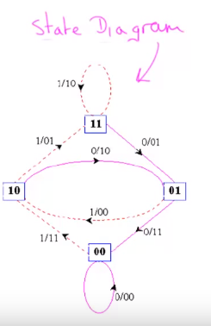
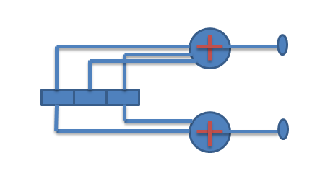
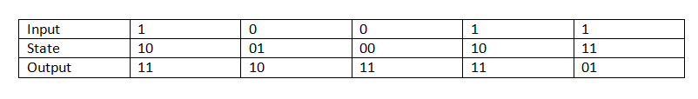
Nội dung 2: Convolution Encoder (cont)
Message:11001
Encoder code : 0111111011

Slide 7
Nội dung 3 : viterbi decoder
Widely used in communication systems to decode a data sequence that has been encoded by a “finite‐ state” process – Ex: ethernet receiver,hard disk read electronics
Advantage: it does the maximum likelihood decoding
Disavantage: the viterbi algorithm is the most resource- consumming

Slide 8
Nội dung 3 : viterbi decoder (cont)
ALGORITHM STEPS
Step 1: first state & sencond state just like a trellis. Finding metric value for each node(Metric value to be find by compare the output code with receive code). In initial metric value is 0.
Step 2: after the stage 2 each node receiving to path , each path will have a single metric value. Therefore after the second state each node has 2 metric value.
Step 3 : find the survivor path by picking the minimum metric value (minimum metric path only retained others are discard)

Slide 9
Nội dung 3 : viterbi decoder (cont)
Step 4: step 2 & step 3 are repeat until the receiving bit sequence stop
Step 5 : finally find active path. This active path code word is the correct code word & find original sequences

Slide 10
Nội dung 3 : viterbi decoder (cont)
Example: we consider to transmit message sequence 100000 code word in a transmission medium. In this medium some error ro be occurs due to several noises. In a receiver side we receive error code word 011011100000.Find & correct the error and get original message sequences in the receive side by using viterbi algorithm.

Slide 11
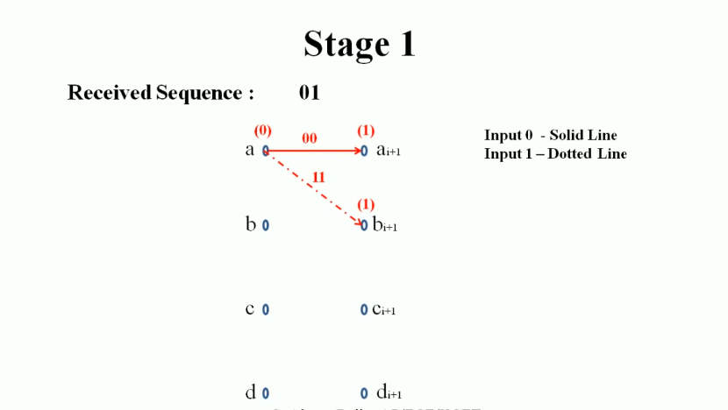
Nội dung 3 : viterbi decoder (cont)

Slide 12
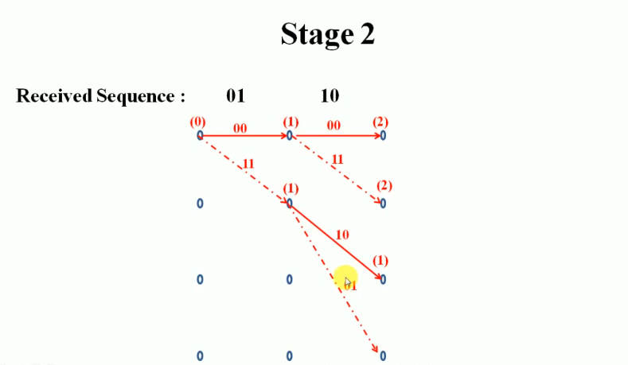
Nội dung 3 : viterbi decoder (cont)

Slide 13
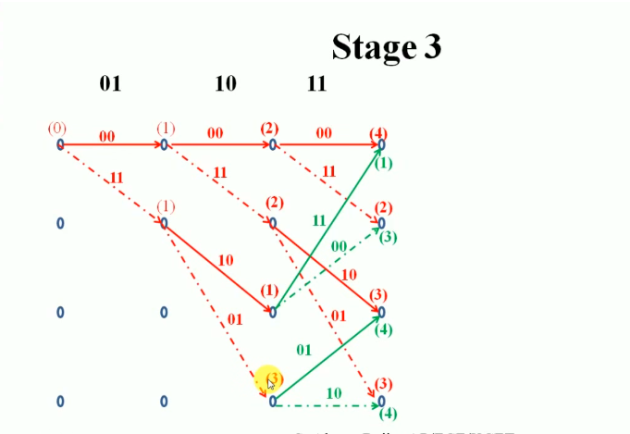
Nội dung 3 : viterbi decoder (cont)

Slide 14
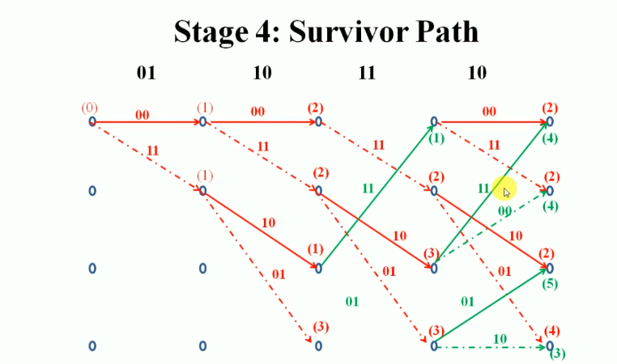
Nội dung 3 : viterbi decoder (cont)

Slide 15
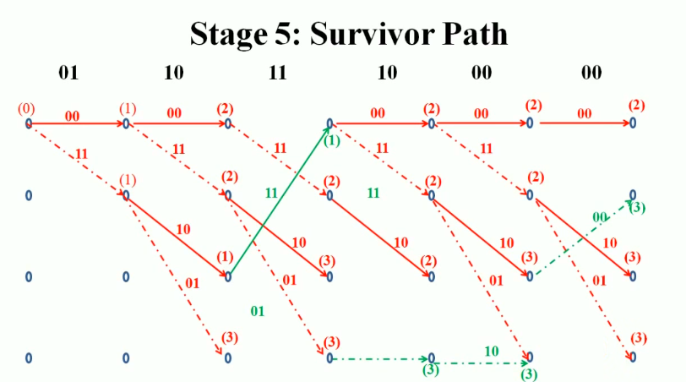
Nội dung 3 : viterbi decoder (cont)

Slide 16
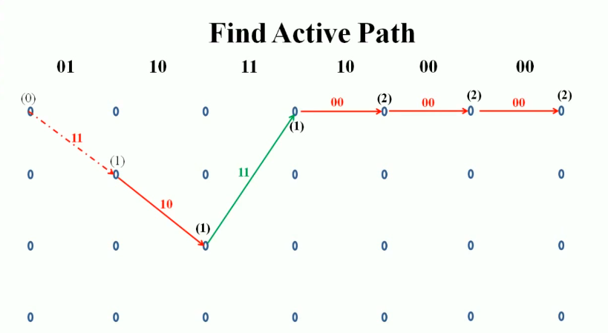
Nội dung 3 : viterbi decoder (cont)

Slide 17
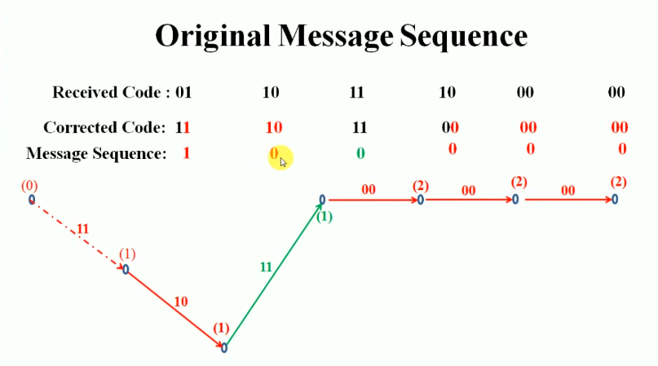
Nội dung 3 : viterbi decoder (cont)

Slide 18
Nội dung 4 : LDPC Encoder
First we talk about Parity Check Code
A binary parity check code is a block code: i.e., a collection of binary vectors of fixed length n.
The symbols in the code satisfy r parity check equations of the form: xa ⊕ xb ⊕ xc ⊕ … ⊕ xz = 0
where ⊕ means modulo 2 addition and xa, xb, xc , … , xz
are the code symbols in the equation.
Each codeword of length n can contain (n-r)=k information digits and r check digits.

Slide 19
Nội dung 4 : LDPC Encoder
Parity Check Matrix
A parity check matrix is an r-row by ncolumn binary matrix. Remember k=n-r.
The rows represent the equations and the columns represent the digits in the code word.
There is a 1 in the i-th row and j-th column if and only if the i-th code digit is contained in the j-th equation.

Slide 20
Nội dung 4 : LDPC Encoder
Parity Check Matrix
Example: The 7-bit ASCII string for the letter S is 1010011, and a parity bit is to be added as the eighth bit. The string for S already has an even number of ones (namely four) and so the value ofthe parity bit is 0, and the codeword for S is 10100110.
c = [c1 c2 c3 c4 c5 c6 c7 c8]

Slide 21
Nội dung 4 : LDPC Encoder
Parity Check Matrix
where each ci is either 0 or 1, and every codeword satisfies the constraint
c1 ⊕ c2 ⊕ c3 ⊕ c4 ⊕ c5 ⊕ c6 ⊕ c7 ⊕ c8 = 0 (1.1)
Equation (1.1) is called a parity-check equation, in which the symbol ⊕ represents modulo-2 addition.

Slide 22
Nội dung 4 : LDPC Encoder
Parity Check Matrix
Next, A 7-bit ASCII letter is encoded with the single parity check code 1, The resulting codeword was sent though a noisy channel and the string y = [1 0 0 1 0 0 1 0] was received. To check if y is a valid codeword we test y with (1.1).
y1 ⊕ y2 ⊕ y3 ⊕ y4 ⊕ y5 ⊕ y6 ⊕ y7 ⊕ y8 = 1 ⊕ 0 ⊕ 0 ⊕ 1 ⊕ 0 ⊕ 0 ⊕ 1 ⊕ 0 = 1.
Since the sum is 1, the parity-check equation is not satisfied and y is not a valid codeword. We have detected that at least one error occurred during the transmission

Slide 23
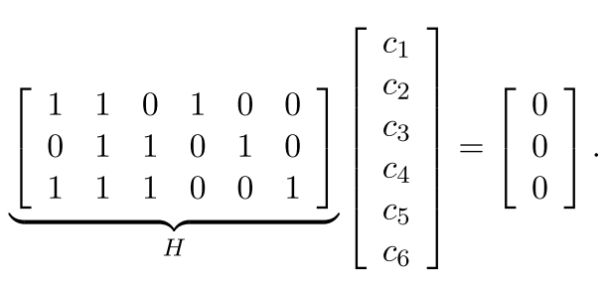
Nội dung 4 : LDPC Encoder
Parity Check Matrix
Codeword constraints are often written in matrix form and so the constraints of (1.2) become
(1.3)

Slide 24
Nội dung 4 : LDPC Encoder
Parity Check Matrix
The matrix H is called a parity-check matrix. Each row of H corresponds to a parity-check equation and each column of H corresponds to a bit in the codeword. Thus for a binary code with m parity-check constraints and length n codewords the parity-check matrix is an m×n binary matrix. In matrix form a string y = [c1 c2 c3 c4 c5 c6] is a valid codeword for the code with parity-check matrix H if and only if it satisfies the matrix equation
Hy^{T} = 0. (1.4)

Slide 25
Nội dung 4 : LDPC Encoder
Parity Check Encoding
To distinguish between the message bits and parity bits in the codeword in Example 1.3 we re-write the code parity-check constraints so that each one solves for a different codeword bit.
The code constraints from 1.3 can be re-written as
c4 = c1 ⊕ c2
c5 = c2 ⊕ c3 (1.5)
c6 = c1 ⊕ c2 ⊕ c3
The codeword bits c1, c2, and c3 contain the three bit message, c1, c2, and c3, while the codeword bits c4, c5 and c6 contain the three parity-check bits. Written this way the codeword constraints show how to encode the message.

Slide 26
Nội dung 4 : LDPC Encoder
Parity Check Encoding
Using the constraints in (1.5) the message 110 produces the parity-check bits
c4 = 1 ⊕ 1 = 0
c5 = 1 ⊕ 0 = 1
c6 = 1 ⊕ 1 ⊕ 0 = 0,
and so the codeword for this message is c = [1 1 0 0 1 0]..

Slide 27
Nội dung 4 : LDPC Encoder
Parity Check Encoding
Using the constraints in (1.5) the message 110 produces the parity-check bits
c4 = 1 ⊕ 1 = 0
c5 = 1 ⊕ 0 = 1
c6 = 1 ⊕ 1 ⊕ 0 = 0,
and so the codeword for this message is c = [1 1 0 0 1 0]..

Slide 28
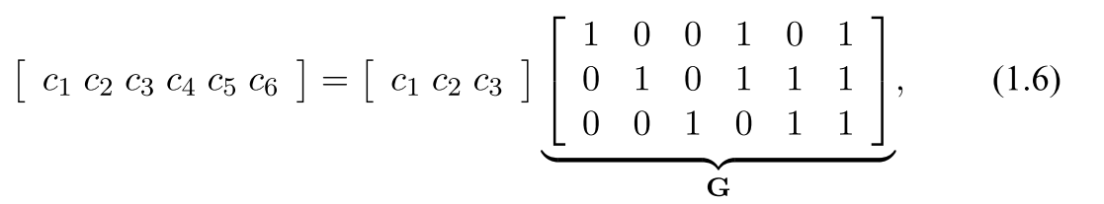
Nội dung 4 : LDPC Encoder
Parity Check Encoding
Again these constraints can be written in matrix form as follows:

Slide 29
Nội dung 4 : LDPC Encoder
Parity Check Error detection and correction
Firstly, we know that every codeword in the code must satisfy (1.4), and so errors can be detected in any received word which does not satisfy this equation.
The codeword c = [1 0 1 1 1 0] from the code in Example 1.3 was sent through a binary symmetric channel and the string y = [1 0 1 0 1 0] received. Substitution into equation (1.4) gives

Slide 30
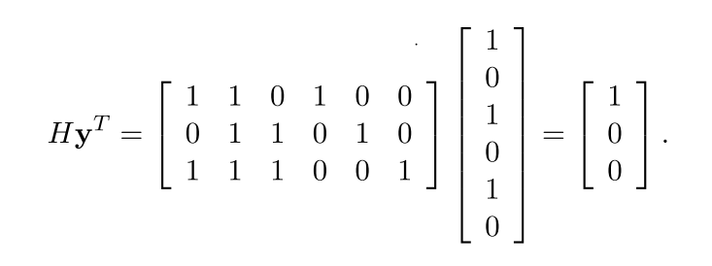
Nội dung 4 : LDPC Encoder
The result is nonzero and so the string y is not a codeword of this code. We therefore conclude that bit flipping errors must have occurred during transmission.
The vector s = Hy^{T},
is called the syndrome of y. The syndrome indicates which parity-check constraints are not satisfied by y.

Slide 31
Nội dung 4 : LDPC Encoder
What is an LDPC Code?

Slide 32
Nội dung 4 : LDPC Encoder
Are linear block codes.Means every linear combination of code owrd is its self a code word.
Assuming our message is binary string.
We divide our message in blocks of bits with length k all information we have can be represented in 2^k different messages
u = (u0, u1 ,u2 … un)
We add ‘m’ redundancy bits to our message now u becomes a new message x represent by n bit: n = k + m
X = u₀g₀ + u₁g₁ + .. + u_{n-1} g_{n-1}

Slide 33
Nội dung 4 : LDPC Encoder
Also is written as x = uG
Where G is a matrix (k, n) dimesion called generator matrix
There exists a matrix H(m,n) dimension such that
GH^{T} = 0
u GH^{T} = u0
xH^{T} = 0 and also Hx^{T}=0
H: parity check matrix
At receiver if we know this parity matrix H. if we receive a n bit message, we have to do a sclar product with H^{T} . If we don’t get a null matix => error happens

Slide 34
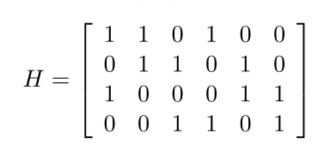
Appendix
Example: A regular parity-check matrix for the code in (1.3) with wc = 2, wr = 3 and rank2(H) = 3, which satisfies (1.4) is,
(1.7)
For an irregular parity-check matrix we designate the fraction of columns of weight i by hi and the fraction of rows ofweight i by hi. Collectively the set v and h is called the degree distribution of the code.

Slide 35
Tài liệu tham khảo
LDPC constructions
The construction of binary LDPC codes involves assigning a small number of the values in an all-zero matrix to be 1 so that the rows and columns have the required degree distribution
The original LDPC codes presented by Gallager are regular and defined by a banded structure in H

Slide 36
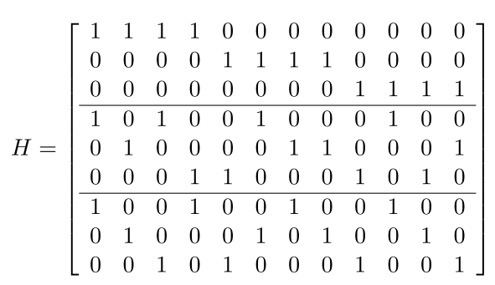
Tài liệu tham khảo
LDPC constructions
A length 12 (3,4)-regular Gallager parity-check matrix is

Slide 37
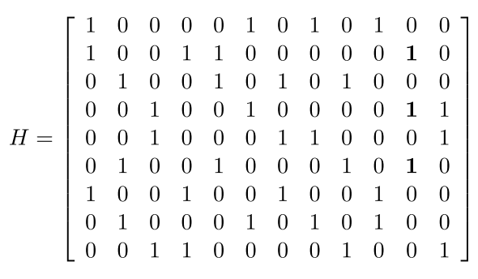
Tài liệu tham khảo
LDPC constructions
Another common construction for LDPC codes is a method proposed by MacKay and Neal.
A length 12 (3,4)-regular MacKay Neal parity-check matrix is

Slide 38
Tài liệu tham khảo
LDPC constructions
Another type of LDPC codes called repeat-accumulate codes have weight 2 columns in a step pattern for the last m columns of H. This structure makes the repeat-accumulate codes systematic and allows them to be easily encoded.

Slide 39
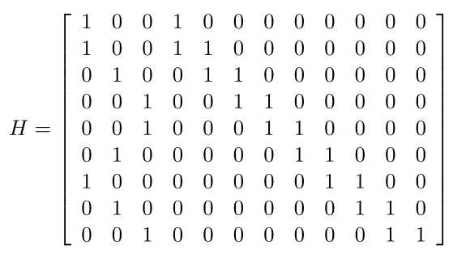
Tài liệu tham khảo
LDPC constructions
A length 12 rate-1/4 repeat-accumulate code is

Slide 40
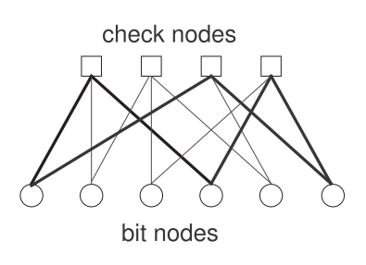
Tài liệu tham khảo
LDPC constructions
A LDPC codes are often represented in graphical form by a Tanner graph.
Figure 1.1: The Tanner graph representation of the parity-check matrix in (1.7). A 6-cycle is shown in bold.

Slide 41
Tài liệu tham khảo
LDPC constructions
A LDPC codes are often represented in graphical form by a Tanner graph.
Figure 1.1: The Tanner graph representation of the parity-check matrix in (1.7). A 6-cycle is shown in bold.

Slide 42
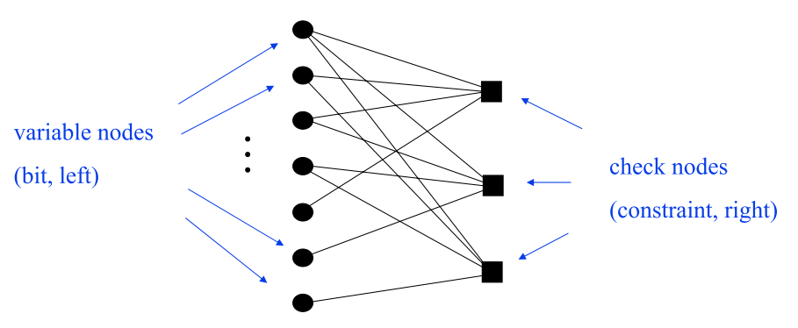
Tài liệu tham khảo
Tanner Graph Terminology
The degree of a node is the number of edges connected to it

Slide 43
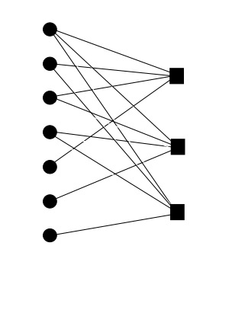
Tài liệu tham khảo
LDPC Decode
Decoding with the Tanner Graph: an a-Peeling Decoder
• Initialization:
• Forward known variable node values along outgoing edges
• Accumulate forwarded values at check nodes and “record” the parity
• Delete known variable nodes and all outgoing edges

Slide 44
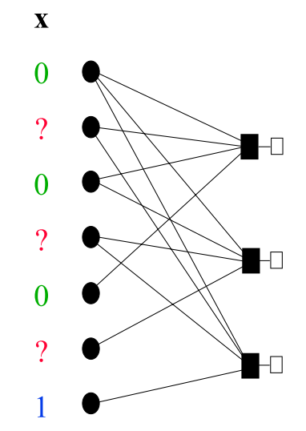
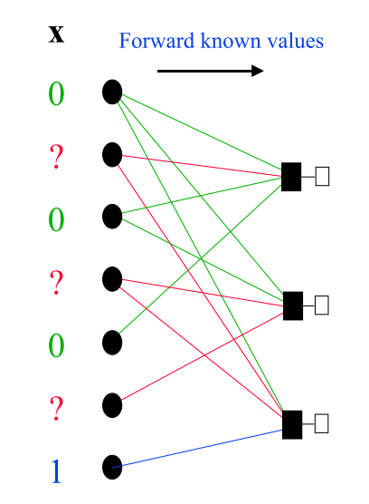
Tài liệu tham khảo
Peeling Decoder – Initialization

Slide 45
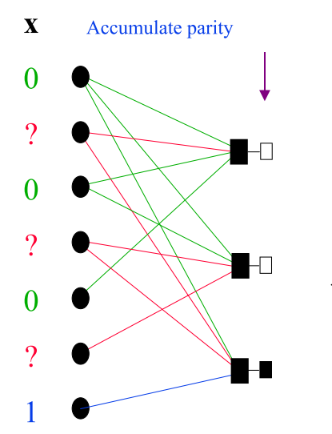
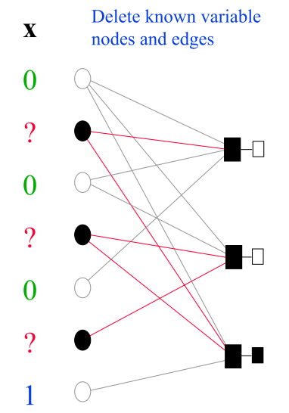
Tài liệu tham khảo
Peeling Decoder – Initialization

Slide 46
Tài liệu tham khảo
Decoding step:
Select, if possible, a check node with one edge remaining; forward its parity, thereby determining the connected variable node
Delete the check node and its outgoing edge
Follow procedure in the initialization process at the known variable node
Termination:
If remaining graph is empty, the codeword is determined
If decoding step gets stuck, declare decoding failure

Slide 47
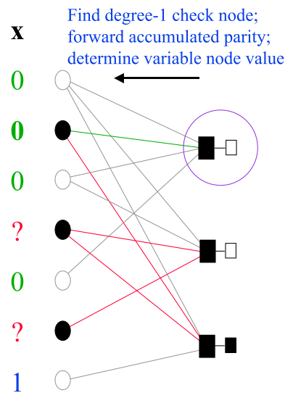
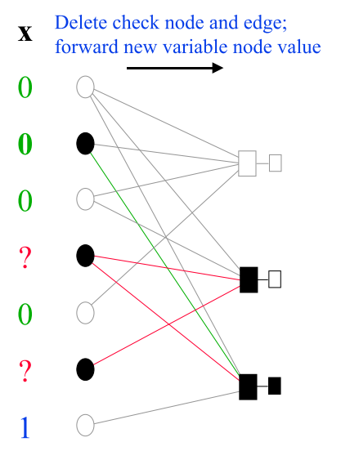
Tài liệu tham khảo
Peeling Decoder – Step 1

Slide 48
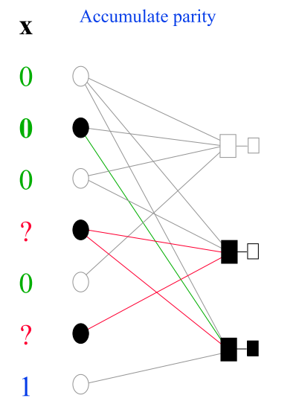
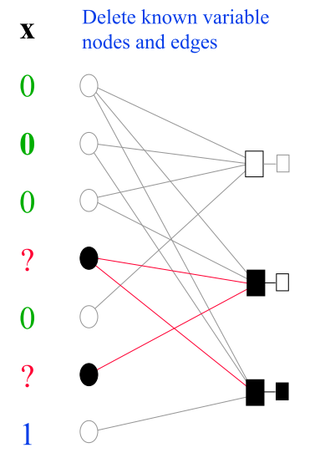
Tài liệu tham khảo
Peeling Decoder – Step 1

Slide 49
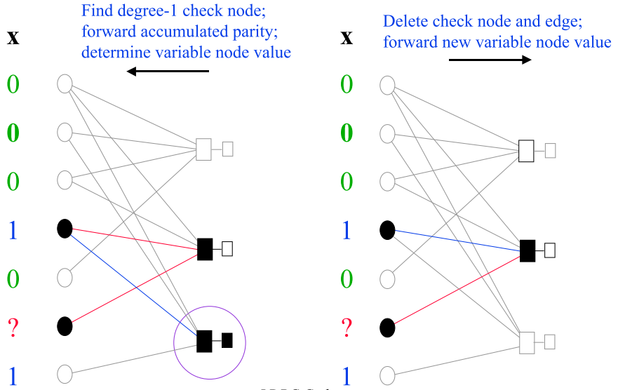
Tài liệu tham khảo
Peeling Decoder – Step 2

Slide 50
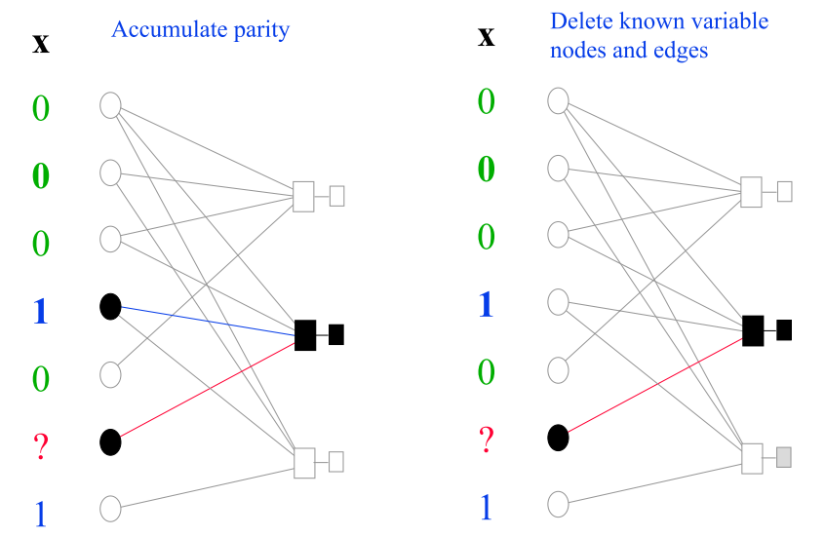
Tài liệu tham khảo
Peeling Decoder – Step 2

Slide 51
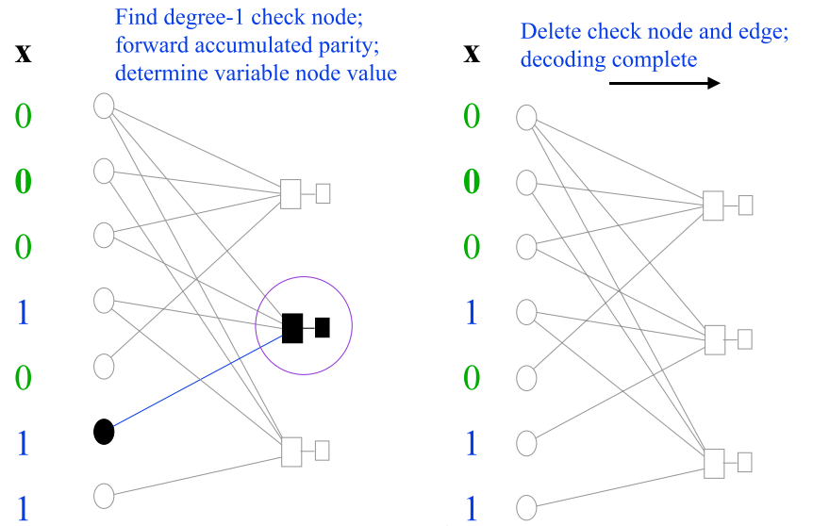
Tài liệu tham khảo
Peeling Decoder – Step 3

Slide 52
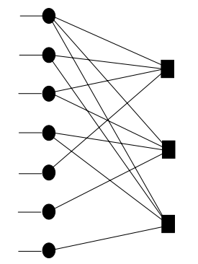
Tài liệu tham khảo
Message-Passing Decoding
The local decoding procedure can be described in terms of an iterative, “message-passing” algorithm in which all variable nodes and all check nodes in parallel iteratively pass messages along their adjacent edges.
The values of the code bits are updated accordingly.
The algorithm continues until all erasures are filled in, or until the completion of a specified number of iterations.

Slide 53
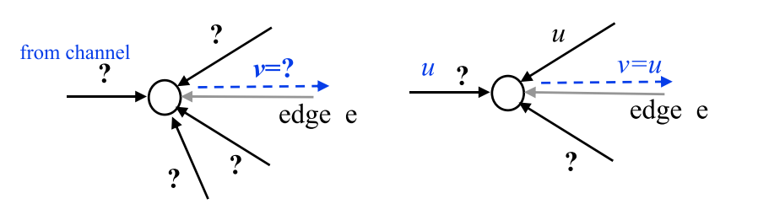
Tài liệu tham khảo
Variable-to-Check Node Message
Variable-to-check message on edge e If all other incoming messages are ?, send message v = ? If any other incoming message u is 0 or 1, send v=u and, if the bit was an erasure, fill it with u, too.
(Note that there are no errors on the BEC, so a message that is 0 or 1 must be correct. Messages cannot be inconsistent.)

Slide 54
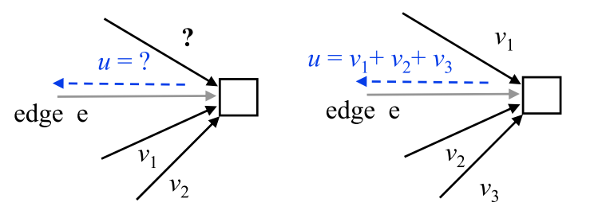
Tài liệu tham khảo
Check-to-Variable Node Message
Check-to-variable message on edge e
If any other incoming message is ?, send u = ?
If all other incoming messages are in {0,1}, send the XOR of them, u = v1+ v2+ v3.

Slide 55
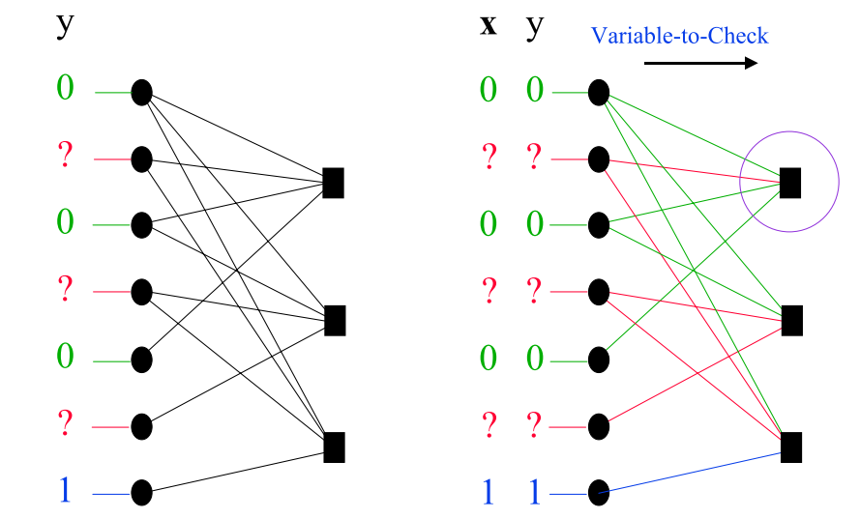
Tài liệu tham khảo
Message-Passing Example – Initialization

Slide 56
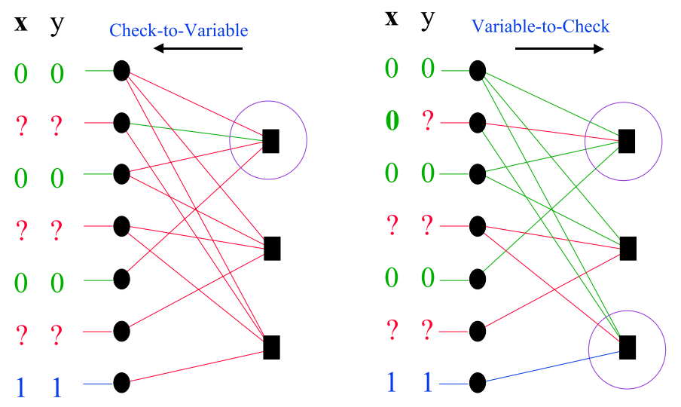
Tài liệu tham khảo
Message-Passing Example – Round 1

Slide 57
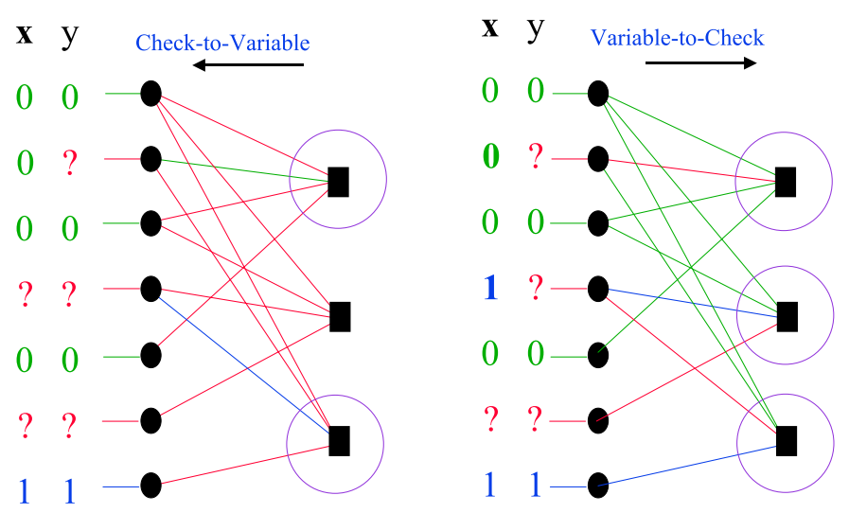
Tài liệu tham khảo
Message-Passing Example – Round 2

