Slide 1
FEC Encoder, convolution encoder, viterbi decoder, LDPC encoder, decoder
08/09/2017
Tên:Võ Nguyễn Thiên Phúc MSSV:14520703
Tên:Phan Trí Dũng MSSV:14520203

Slide 2
Nội dung báo cáo hôm nay
Nội dung 1: FEC Encoder
Nội dung 2: Convolution Encoder
Nội dung 3: Viterbi Decoder
Nội dung 4 : LDPC Encoder

Slide 3
Nội dung 1: FEC Encoder
FEC is a technique used for controlling errors in the data transmission
This technique uses the redundant (which is derived from information code).
Advantage:The redundancy allows the receiver to detect a limited number of errors that may occur anywhere in the message, and often to correct these errors without retransmission.
Disavantage: at the cost of a fixed, higher forward channel bandwidth.

Slide 4
Nội dung 1: FEC Encoder (cont)
Application: FEC is therefore applied in situations where retransmissions are costly or impossible, such as one-way communication links and when transmitting to multiple receivers in multicast.
FEC information is usually added to mass storage devices to enable recovery of corrupted data, and is widely used in modems.
There are 2 main catergories of FEC codes:
+ Block code
+ Convolution code

Slide 5
Nội dung 2: Convolution Encoder
In this type, word code depends on the k bits message block and “m”(the data of previous block).
Encoder has a memory order of ‘m’. As it contains memory, it is implemented with sequential logic circuits.
Example:
K: constrant length
n: number of output bits
k : number of input bits
k/n: the rate
The number of states: 2^(k -1)

Slide 6
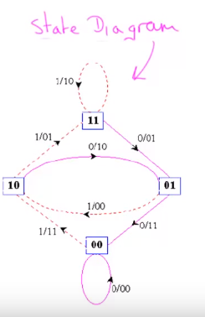
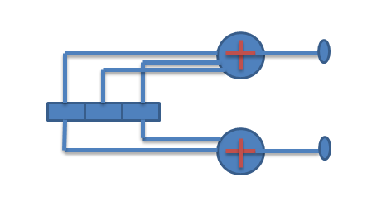
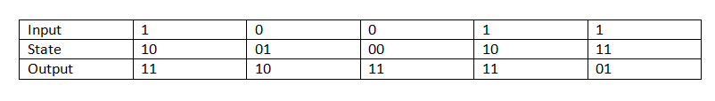
Nội dung 2: Convolution Encoder (cont)
Message:11001
Encoder code : 0111111011

Slide 7
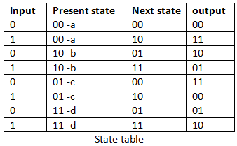
Convolutional code using Trellis
Trellis will have L+ K level
L: length of message sequences(ex: message=10011 = > L=5)
K: contraint length of the encoder
Level K-1<= J <= L. the structure is periodic. (J : count variable)

Slide 8
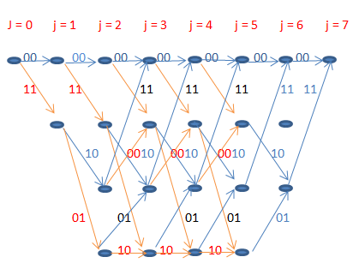
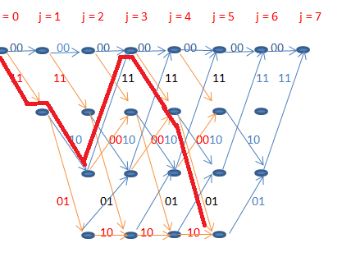
Convolutional code using Trellis
Example : m = 10011 = > L = 5, K = 3=> j = 0,…,7
Encoder code: 11 10 11 11 01

Slide 9
Nội dung 3 : viterbi decoder
Widely used in communication systems to decode a data sequence that has been encoded by a “finite‐ state” process – Ex: ethernet receiver,hard disk read electronics
Advantage: it does the maximum likelihood decoding
Disavantage: the viterbi algorithm is the most resource- consumming

Slide 10
Nội dung 3 : viterbi decoder (cont)
ALGORITHM STEPS
Step 1: first state & sencond state just like a trellis. Finding metric value for each node(Metric value to be find by compare the output code with receive code). In initial metric value is 0.
Step 2: after the stage 2 each node receiving to path , each path will have a single metric value. Therefore after the second state each node has 2 metric value.
Step 3 : find the survivor path by picking the minimum metric value (minimum metric path only retained others are discard)

Slide 11
Nội dung 3 : viterbi decoder (cont)
Step 4: step 2 & step 3 are repeat until the receiving bit sequence stop
Step 5 : finally find active path. This active path code word is the correct code word & find original sequences

Slide 12
Nội dung 3 : viterbi decoder (cont)
Example: we consider to transmit message sequence 10011 code word in a transmission medium. In this medium some error ro be occurs due to several noises. In a receiver side we receive error code wordn 10101111 01.Find & correct the error and get original message sequences in the receive side by using viterbi algorithm.

Slide 13

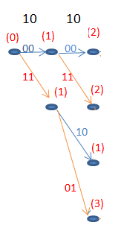
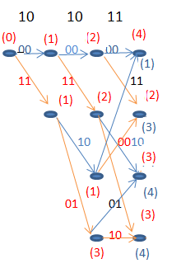
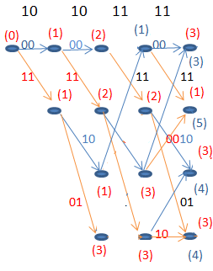
Nội dung 3 : viterbi decoder (cont)
State 1
State 2
State 3
State 4

Slide 14
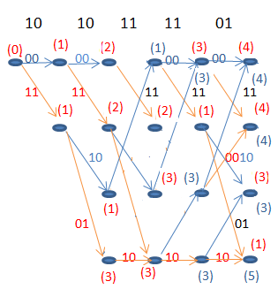
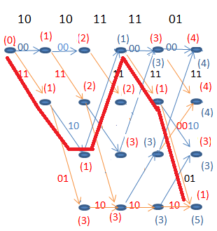
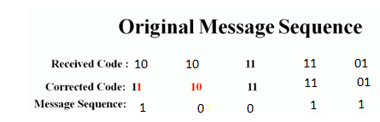
Nội dung 3 : viterbi decoder (cont)
State 5
Final

Slide 15
Nội dung 4 : LDPC Encoder
Are linear block codes.Means every linear combination of code owrd is its self a code word.
Assuming our message is binary string.
We divide our message in blocks of bits with length k all information we have can be represented in 2^k different messages
u = (u0, u1 ,u2 … un)
We add ‘m’ redundancy bits to our message now u becomes a new message x represent by n bit: n = k + m
X = u₀g₀ + u₁g₁ + .. + u_{n-1} g_{n-1}

Slide 16
Nội dung 4 : LDPC Encoder
Also is written as x = uG
Where G is a matrix (k, n) dimesion called generator matrix
There exists a matrix H(m,n) dimension such that
GH^{T} = 0
u GH^{T} = u0
xH^{T} = 0 and also Hx^{T}=0
H: parity check matrix
At receiver if we know this parity matrix H. if we receive a n bit message, we have to do a sclar product with H^{T} . If we don’t get a null matix => error happens

Slide 17
Kết luận và Công việc tiếp theo
Kết luận:
Công việc tiếp theo: block code

Slide 18
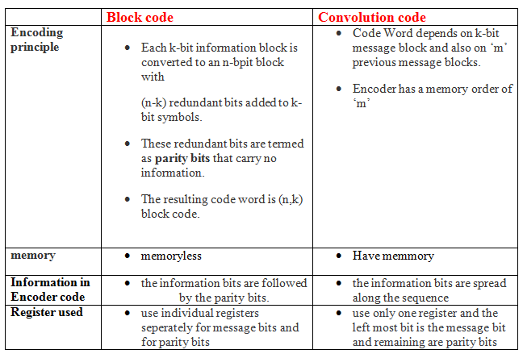
Hỏi và Trả lời
The different between block code and convolution code

Slide 19
Appendix

Slide 20
Tài liệu tham khảo

