Slide 1

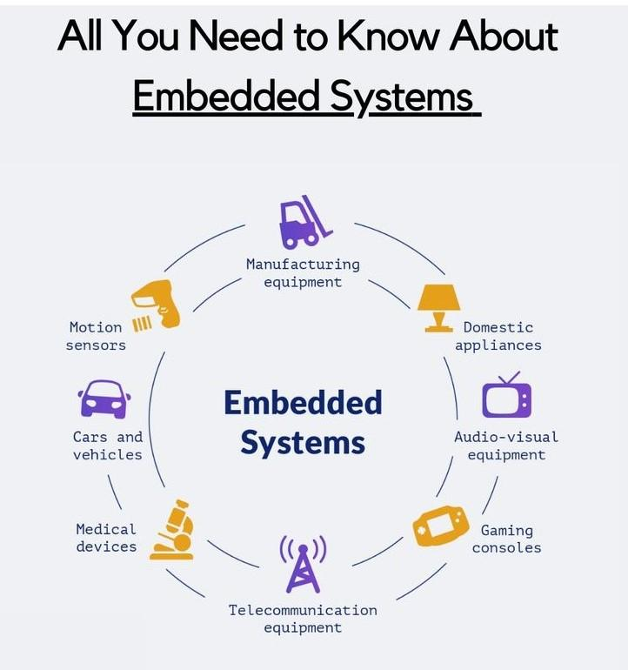
CHAPTER I. OVERVIEW OF EMBEDDED SYSTEMS
Foundations, Core Characteristics & Layered Architecture
▶ Curriculum Scope: Core Embedded Systems & Edge Computing Architecture
▶ Engineering Paradigms: Deep hardware-software co-design, deterministic timing & tight resource budgets
▶ Target Platform: 32-bit Microcontroller Architecture (ARM Cortex-M85 / Renesas RA8M1)
▶ Implementation Standards: C99/POSIX firmware patterns, Hard RTOS, standardized MCAL/HAL stacks
1

Slide 2
TABLE OF CONTENTS
1. Concept & Nature of Embedded Systems
1.1. Standard Definition, 3-Element Triad, and Physical Embedded Nature
1.2. Role of Embedded Systems in IoT & Edge Computing
2. Core Technical Characteristics
2.1. Dedicated Functionality & Severe Resource Constraints
2.2. Deterministic Real-Time Execution & High Reliability (WDT, BOD, CRC)
2.3. Ultra-Low Power, Embedded Security & Firmware Maintenance (OTA)
3. Embedded Systems vs. General-Purpose Computers
3.1. Architectural Paradigms: Specialization vs. Versatility
3.2. Detailed Multi-Criteria Technical Comparison Matrix
4. Layered Embedded Software Architecture
4.1. The 5-Layer Stack Model: Hardware -> MCAL -> HAL -> RTOS -> Middleware -> Application
4.2. RTOS Layer: Multitasking vs. Super-Loop & Inter-Process Communication
4.3. Middleware & Application Layer: Decoupling and Host Testability
⇒ Guiding Question: What fundamentally distinguishes embedded software from desktop/PC software?
2

Slide 3
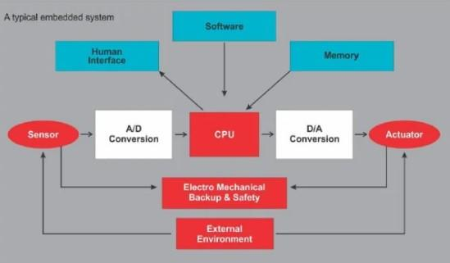
1.1. EMBEDDED SYSTEM DEFINITION & NATURE
▶ Definition: Specialized computer system integrated within a host device to perform dedicated, pre-defined functions.
▶ Triad Nature: Inseparable co-design between Computation (Hardware) — Processing Logic (Firmware) — Real-world Interaction (Sensors/Actuators).
▶ Design Goal: Fulfill dedicated tasks under strict constraints: deterministic latency, ultra-low power, compact size, high MTBF, and low unit cost.
▶ Distinction: Not a general-purpose PC — strictly eliminates software bloat in favor of deep optimization for a single mission.
▶ Real Example: Smart Environmental Edge Node: Continuous multi-sensor sampling, local wildfire/anomaly detection, and 24/7 telemetry.
Figure 1.1: Architecture of a Typical Embedded System.
3

Slide 4
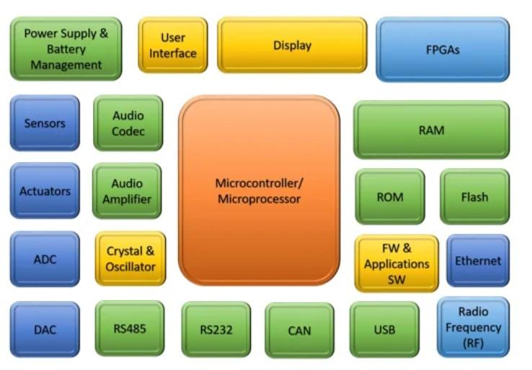
1.1. HARDWARE ARCHITECTURE & SUBSYSTEMS
▶ Core Processing (MCU): Silicon microcontroller integrating CPU core, hardware timers, DMA controllers, and low-latency NVIC.
▶ Memory Hierarchy: Embedded Flash Memory for persistent firmware; tight on-chip SRAM for execution stack, heap, and buffers.
▶ Physical Transducers: High-precision analog/digital Sensors paired with robust Actuators (relays, buzzers, solenoid valves).
▶ Communication Buses: Local serial interfaces (UART, SPI, I2C, CAN) alongside networked transceivers (Ethernet, Wi-Fi, Cellular).
▶ Power & Protection: Integrated LDO regulators, Brown-Out Detector (BOD), and hardware Watchdog Timers.
Figure 1.2: Hardware Subsystems of an Embedded Device.
4

Slide 5
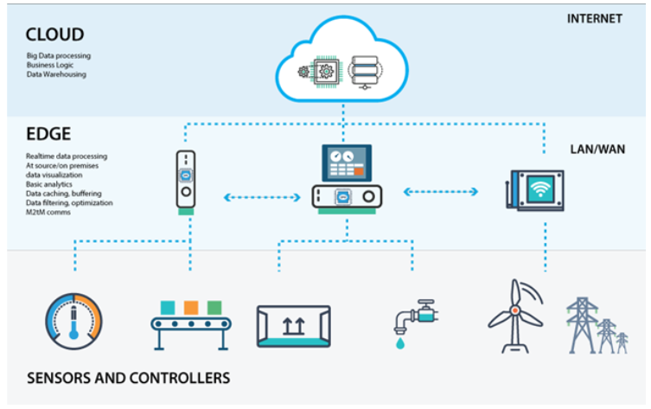
1.1. EMBEDDED NATURE & EDGE COMPUTING IN IOT
▶ The 'Embedded' Nature: Deeply encapsulated inside host machinery; user interacts solely via HMI or cloud; requires bare-metal register manipulation.
▶ Frontline IoT Edge Node: Serves as the vital physical bridge collecting field telemetry and driving deterministic real-time actuation.
▶ On-Device Edge Computing: Performs local filtering, anomaly classification, and inference at the edge, drastically reducing cloud bandwidth and latency.
▶ Disconnection Resilience: Operates 100% autonomously during WAN network blackouts; maintains local safety cutoffs independently.
▶ Data Fallback: Retains critical telemetry on local SD/Flash memory during signal loss and automatically synchronizes upon reconnection.
Figure 1.3: Embedded Edge Node in Cloud-IoT Topology.
5

Slide 6
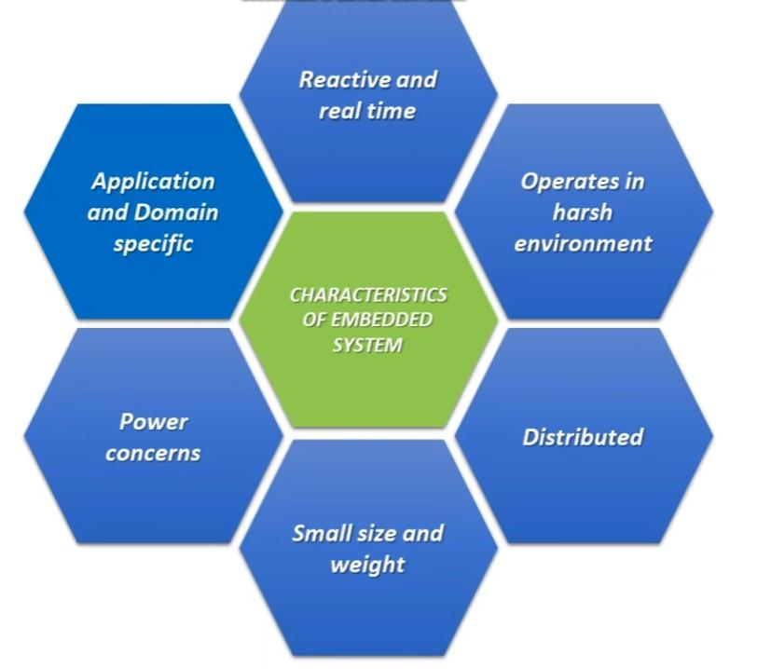
1.2. DEDICATED FUNCTIONALITY & RESOURCE CONSTRAINTS
▶ Dedicated Functionality: Hardware and firmware are strictly trimmed to the target workload -> minimizes BOM unit cost and eliminates software bloat.
▶ Engineering Trade-off: High specialization reduces generic software reusability; major specification shifts necessitate PCB redesign.
▶ Scarce Flash Memory: Constrained to tens of KB to few MB (vs. hundreds of GB SSD on PCs) -> demands aggressive code footprint minimization.
▶ Extremely Tight SRAM: Limited to 16 KB – 512 KB -> dynamic heap allocation (malloc) is strictly prohibited; static allocation is mandatory.
▶ Clock Speed & Pinout: Conservative MHz clock rates to conserve battery; tightly budgeted GPIO pinout requires pin multiplexing.
Figure 1.4: Multi-dimensional Constraints in Embedded Design.
6

Slide 7
1.2. REAL-TIME DETERMINISM & SYSTEM RELIABILITY
Real-Time Determinism & Deadlines
▶ Correctness Criteria: System correctness requires BOTH logical accuracy AND completion strictly before defined Deadlines.
▶ Hard Real-Time: Missing a deadline causes catastrophic system destruction or loss of human life (automotive airbag, ABS braking, medical ventilators).
▶ Soft Real-Time: Deadline misses degrade Quality of Service without catastrophic harm (UI display refresh, periodic logging).
▶ Deterministic Timing: Interrupt latency and execution times must have mathematical upper bounds; zero tolerance for unbounded jitter.
▶ Architectural Support: Enforced via low-latency Nested Vectored Interrupt Controllers (NVIC) and preemptive priority RTOS scheduling.
Autonomous Reliability & Self-Healing
▶ Continuous 24/7 Uptime: Must operate unattended for decades without human manual intervention or reboot.
▶ Watchdog Timer (WDT): Independent free-running counter resets the MCU automatically if firmware deadlocks or enters an infinite loop.
▶ Brown-Out Detector (BOD): Continually monitors supply voltage droop, forcing safe reset before Flash memory is corrupted.
▶ Cyclic Redundancy Checks: Hardware CRC engine verifies Flash code integrity and communication packet validity.
▶ Fail-Safe Defaults: Automatic fallback into safe benign states (opening relays, sounding alarms) upon critical faults.
7

Slide 8
1.2. POWER EFFICIENCY, SECURITY & MAINTENANCE
Ultra-Low Power Optimization
▶ Deep Sleep States: Advanced low-power modes (Sleep, Standby, Deep Software Standby) dropping quiescent current to microamperes (µA).
▶ Interrupt-Driven Wakeup: CPU core remains powered down, waking up solely upon external sensor edge interrupts or periodic RTC timers.
▶ Autonomous DMA Transfers: Direct Memory Access transfers peripheral data to RAM buffers without CPU intervention, maximizing sleep duty cycles.
▶ Energy Harvesting: Supports ultra-low-power duty cycles compatible with solar, thermal, and RF energy-harvesting nodes.
Embedded Security & Remote Maintenance
▶ Hardware Secure Boot: Silicon cryptographic engine validates digital signatures (RSA/ECC) of firmware before allowing boot execution.
▶ Arm TrustZone Isolation: Partitions memory and peripherals into Secure and Non-Secure domains, isolating encryption keys from user code.
▶ Line-Rate Encryption: Hardware-accelerated AES, SHA-256, and ECC engines enable secure TLS/DTLS encryption for cloud telemetry.
▶ Dual-Bank Flash OTA: Downloads and stages new firmware images into secondary Flash bank without downtime; automated rollback on failure.
8

Slide 9
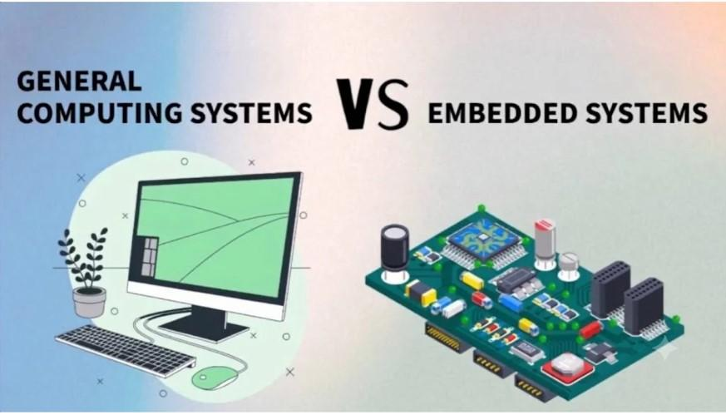
1.3. EMBEDDED SYSTEMS VS. GENERAL-PURPOSE PCS
▶ Specialization vs. Versatility: General-Purpose Computers (GPC) run arbitrary multi-user software, office suites, and gaming. Embedded systems are deeply pruned for one dedicated workload.
▶ Monolithic SoC Integration: Embedded MCUs integrate CPU, SRAM, Flash ROM, ADC/DAC, timers, and serial controllers on a single die. PCs rely on discrete motherboards with socketed CPUs and RAM sticks.
▶ Environmental Robustness: Embedded systems survive extreme industrial temperatures (-40°C to +85°C/125°C), high vibration, dust, and electrical noise. PCs require climate-controlled rooms and active fans.
▶ Cost & Unit Optimization: MCU Bill-of-Materials cost is measured in single-digit dollars for mass production, whereas PC platforms cost hundreds to thousands of dollars.
Figure 1.5: Paradigm Comparison: General-Purpose PC vs. Embedded System.
9

Slide 10
1.3. DETAILED TECHNICAL COMPARISON MATRIX
Evaluation Metric | Embedded Systems (MCU-based) | General-Purpose Computers (PC-based)
Design Objective | Application-specific; deeply optimized for a single mission | General-purpose; supports arbitrary concurrent user applications
Processor Architecture | Low-power MCU (e.g., ARM Cortex-M), SoC, DSP (MHz) | High-performance multi-core CPU (x86/x64, GHz), discrete GPU
Memory Budget | Flash: 32 KB – 4 MB; SRAM: 8 KB – 1 MB (On-chip) | RAM: 8 GB – 64+ GB; NVMe SSD Storage: 512 GB – Multiple TBs
Operating System | Bare-metal firmware, Hard RTOS (FreeRTOS, Zephyr) | General-Purpose OS (Windows, Linux, macOS)
Timing Constraints | Deterministic hard/soft real-time; bounded µs latency | Best-effort execution; non-deterministic task scheduling
Power Consumption | Ultra-low power (mW to µA); multi-year battery operation | High power draw (50W – 500W+); requires continuous AC mains
Operating Environment | Harsh industrial (-40°C to 85°C), vibration, moisture, dust | Benign indoor climate; office/datacenter controlled environments
Maintenance & Lifecycle | Secure remote OTA firmware; decades-long operational life | Frequent OS patches, dynamic package installations, short lifespan
⇒ Conclusion: For dedicated IoT edge monitoring, dedicated microcontrollers (e.g. ARM Cortex-M85 / RA8M1) vastly outperform PCs in determinism, reliability, power efficiency, and unit cost.
10

Slide 11
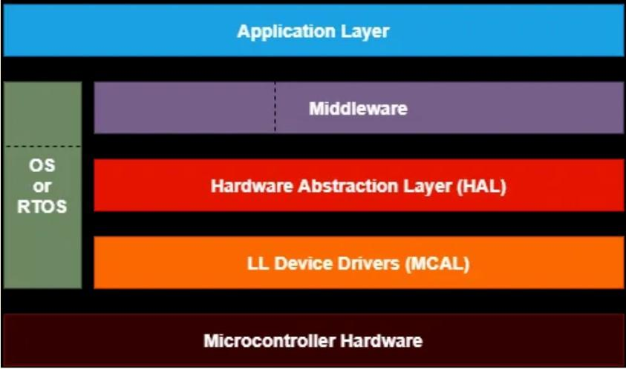
1.4. THE 5-LAYER EMBEDDED SOFTWARE ARCHITECTURE
▶ Separation of Concerns: Each architectural tier encapsulates specific functional responsibilities, hiding lower-level hardware quirks from upper layers.
▶ Hardware Decoupling: Application logic never manipulates raw chip registers; all hardware interactions pass through standardized APIs.
▶ Concurrent Engineering: Hardware schematics and software develop in parallel; allows extensive Unit Testing natively on host PCs.
▶ Silicon Portability: When migrating to an alternative MCU vendor, only the MCAL/HAL drivers are rewritten—preserving 100% of Middleware and Application code.
▶ Extensibility: Modifying hardware components (e.g., swapping an analog sensor for an I2C sensor) requires zero changes to core business rules.
Figure 1.6: Standard 5-Layer Embedded Software Stack.
11

Slide 12
1.4.1 – 1.4.2. HARDWARE LAYER & MCAL / HAL
Physical Hardware Layer
▶ Target Silicon: MCU silicon (e.g., Renesas RA8M1 / Cortex-M85), analog front-ends, relay drivers, communication transceivers.
▶ PCB Layout Integrity: Physical trace routing directly dictates Signal-to-Noise Ratio (SNR), ADC sampling precision, and parasitic leakage currents.
▶ Hardware Robustness: In-line PTC resettable fuses, TVS suppression diodes, and galvanic isolation prevent field electrical destruction.
▶ Engineering Reality: Silicon layout bugs and hardware flaws cannot be solved by software patches alone—demands rigorous design validation.
MCAL vs. HAL Driver Layers
▶ MCAL (Microcontroller Abstraction): Hardware-dependent register manipulation; configures internal silicon clocks, pin multiplexing, interrupt routing, and DMA channels.
▶ HAL (Hardware Abstraction Layer): Vendor-neutral API abstraction wrapping register complexity into uniform C calls (HAL_GPIO_WritePin(), HAL_ADC_Read()).
▶ Device Driver Interface: Provides standard bus interfaces allowing external sensor/actuator drivers to operate seamlessly across different chips.
▶ Portability Boundary: Decouples silicon-specific CMSIS headers from higher-level middleware and application stacks.
12

Slide 13
1.4.3. REAL-TIME OPERATING SYSTEM (RTOS LAYER)
Preemptive Multitasking vs. Super-Loop
▶ Super-Loop Pitfalls: Sequential while(1) polling suffers catastrophic latency blockage when long I/O tasks (e.g., TCP network handshakes) stall the CPU.
▶ Preemptive Priority Scheduling: Critical high-priority tasks (e.g., fire detection, over-temperature alarm) preempt the CPU within microseconds upon interrupt.
▶ Deterministic Software Timers: Non-blocking software timers drive periodic sensor acquisitions with millisecond determinism.
▶ Tickless Low-Power Idle: Automatically transitions the MCU core into deep sleep whenever all tasks are blocked in wait states.
IPC & Resource Synchronization
▶ Message Queues: Safe FIFO message queues pass sensor telemetry to processing tasks without memory corruption or locks.
▶ Mutexes & Semaphores: Guard shared communication buses (I2C, SPI, UART) against race conditions and priority inversions.
▶ Task Priority Hierarchy: Emergency Safety Alarms (High) -> Sensor Filtering (Medium) -> Cloud MQTT Telemetry (Low).
▶ Leading Industrial RTOS: FreeRTOS (ubiquitous, minimal footprint), Zephyr RTOS (modular, modern IoT stack), Azure RTOS / ThreadX.
13

Slide 14
1.4.4. MIDDLEWARE & SYSTEM SERVICES LAYER
IoT Networking & Protocol Stacks
▶ Embedded TCP/IP Stack: Lightweight network stacks (LwIP, FreeRTOS-Plus-TCP) powering low-overhead Ethernet and Wi-Fi connectivity.
▶ MQTT Protocol: Lightweight Publish/Subscribe messaging protocol minimizing transmission packet overhead and radio active time.
▶ CoAP & HTTP Micro-Servers: Embedded micro-web servers for on-site device commissioning, status diagnostics, and RESTful APIs.
▶ DHCP & DNS Clients: Automated IP dynamic configuration and central cloud hostname resolution over dynamic local networks.
Security, Storage & Maintenance
▶ Cryptographic Library (MbedTLS): Implements industry-grade TLS 1.3 / DTLS encryption, safeguarding telemetry against eavesdropping and MITM attacks.
▶ Embedded File System (FatFS): Hardware-independent FAT12/16/32 and exFAT implementation for local microSD and external SPI Flash storage.
▶ Robust OTA Engine: Handles remote firmware download, cryptographic hash validation (SHA-256), and dual-bank Flash staging.
▶ Diagnostics & Logging: Tracks runtime CPU load, stack watermarks, memory leaks, and records multi-level error logs for post-mortem analysis.
14

Slide 15
1.4.5. APPLICATION LAYER & DOMAIN LOGIC
Core Domain Tasks & Signal Processing
▶ Periodic Sampling: Orchestrates multi-sensor data acquisition (ambient temperature, relative humidity, VOC/toxic gas, structural vibration).
▶ Digital Signal Processing: Implements Moving Average or Kalman filters to eliminate electrical noise spikes and sensor drift.
▶ Threshold Evaluation: Classifies environmental health across multi-tiered levels: Normal -> Early Warning -> Critical Alarm.
▶ Autonomous Emergency Actuation: Drives safety actuators immediately upon anomaly detection (opening relays, running fans, sirens).
▶ Telemetry Serialization: Encodes validated telemetry into compact standard formats (JSON, CBOR, Protocol Buffers).
Design Decoupling & Host Testability
▶ Total Hardware Independence: Pure business logic interacts strictly through generic domain APIs (get_sensor_data(), trigger_alarm()).
▶ Transducer Modularity: Replacing an analog sensor with an I2C sensor leaves 100% of threshold comparison logic completely untouched.
▶ Host-Based Simulation: Entire application state machine compiles and runs on a host PC using simulated sensor streams for rapid verification.
▶ Finite State Machine (FSM): Structured as deterministic states: Boot -> Normal Operation -> Warning -> Emergency Fault.
15

Slide 16
CHAPTER I SUMMARY & TRANSITION TO CHAPTER II
▶ Embedded Systems Defined: Tight co-design synergy between specialized MCU silicon, deterministic firmware, and physical world transducers.
▶ The Core Triad: Stringent resource boundaries, deterministic real-time deadlines, and 24/7 unassisted autonomous reliability.
▶ The 5-Layer Software Stack: Golden architectural standard separating silicon registers from business logic, ensuring portability and maintainability.
▶ Escalating Edge Demands: Modern IoT edge stations demand on-device ML/DSP, sub-microsecond interrupt latency, and silicon-enforced domain security.
▶ Bridge to Chapter II: Transitioning from legacy 8/16-bit or basic 32-bit cores to advanced vector-accelerated architectures.
⇒ Chapter II: Embedded Processor Architectures & ARM Cortex-M85 on Renesas RA8M1
16

