Slide 1

TRAINING
PROXMOX VIRTUAL ENVIRONMENT

Slide 2
WELCOME
Proxmox Server Solutions GmbH reserves the right to make changes to this document and to the products described herein without notice. Before installing and using the software, please review the latest version of the Proxmox VE reference documentation, which is available at https://pve.proxmox.com/pve-docs.
Proxmox® is a registered trademark of Proxmox Server Solutions GmbH. Product or company names different from Proxmox may be trademarks or registered trademarks of their respective owners.
© Copyright 2025 Proxmox Server Solutions GmbH. All rights reserved. No part of this publication may be reproduced, photocopied, stored in a retrieval system, or transmitted without the express prior written consent of Proxmox.
September 2025 | v9.0
Proxmox VE Training
2/60

Slide 3
Training Schedule 5-days
2 pm | 10min |  | Break 30min |  | 10min | 8 pm
Day 1
2 pm | 10min |  | Break 30min |  | 10min | 8 pm
Day 2
2 pm | 10min | 4:30pm | Break 30min | 5 pm | 10min | 8 pm
Day 3
2 pm | 10min |  | Break 30min |  | 10min | 8 pm
Day 4
2 pm | 10min |  | Break 30min |  | 10min | 8 pm
Day 5
Deployment & Management
Clustering & Shared Storage
Proxmox VE Training
3/60

Slide 4
Agenda — Deployment and Management
●
Understanding the architecture of Proxmox VE
●
Networks (bridging and bonding, VLANs, software- defined networking)
Storage options in Proxmox VE
Virtual guest management: Exploring the options for VMs and Linux OS containers (LXC)
●
Setting up Proxmox VE: system requirements, installation, updates, and network configuration.
Management interfaces (web GUI, CLI)
●
●
●

Slide 5
Agenda — Deployment and Management
●
Migration to Proxmox VE from other hypervisors (V2V) or physical hosts (P2V)
Backup and restore strategies: guest backups, Proxmox Backup Server, retention management, and restore possibilities.
Authentication and permissions
Integrated Firewall
Troubleshooting common issues
●
●
●
●

Slide 6
Agenda — Clustering and Shared Storage
Shared storage options
Deploying Ceph: hyper- converged infrastructure (HCI), Ceph RBD, Ceph FS
●
Architecture and components of a Proxmox VE cluster
Proxmox Cluster File System (pmxcfs) and Corosync
Cluster networking and redundancy, software-defined networking (SDN), and VLANs
●
●
●
●

Slide 7
Agenda — Clustering and Shared Storage
●
Migration of guests between nodes
ZFS for asynchronous guest disk replication
High availability (HA) for VMs and containers
Failure scenarios with exercises for HA and Ceph
●
Considerations for a minimal 2 node setup with an external tiebreaker (QDevice).
Automating tasks with REST API or CLI
Troubleshooting common issues
●
●
●
●
●

Slide 8
INTRODUCTION
About Proxmox Server Solutions

Slide 9
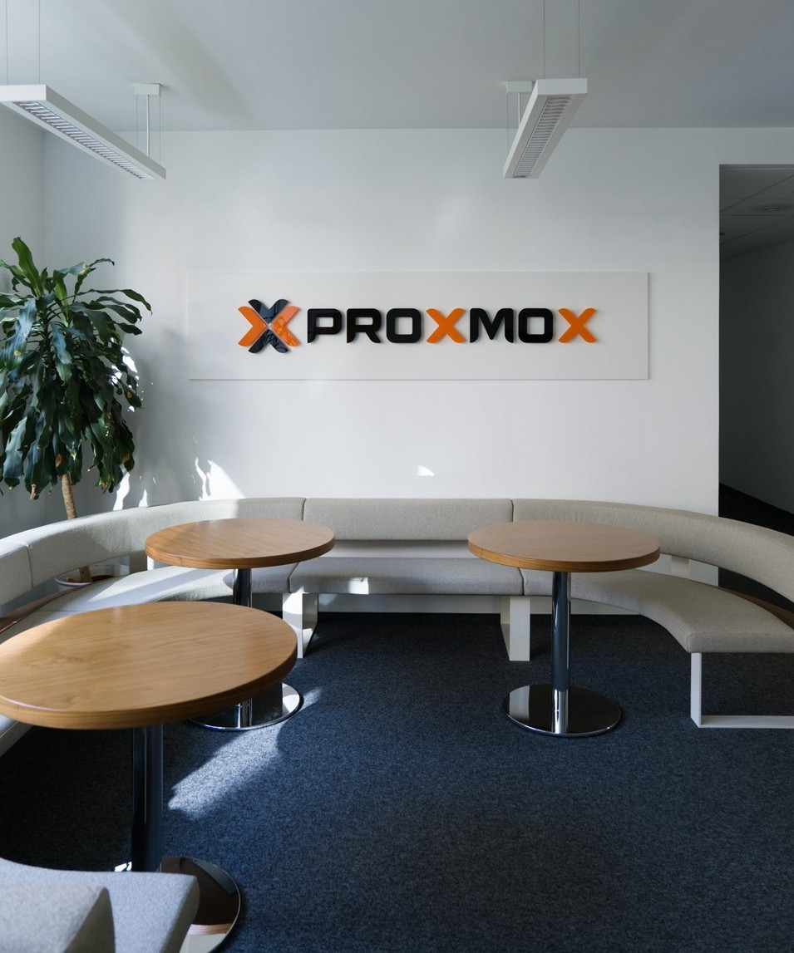
About Proxmox
●
Delivering open-source enterprise solutions to simplify server management.
Based in Vienna (Austria). Established in 2005.
Privately owned, free from venture capital influence.
●
●
●

Slide 10
About Proxmox — Business Model
Software Services
Open Source License: AGPLv3
All features included
●
●
Subscriptions
– Enterprise Repository Support Tickets
●
–
●
Training courses
Global partner ecosystem
●
●

Slide 11
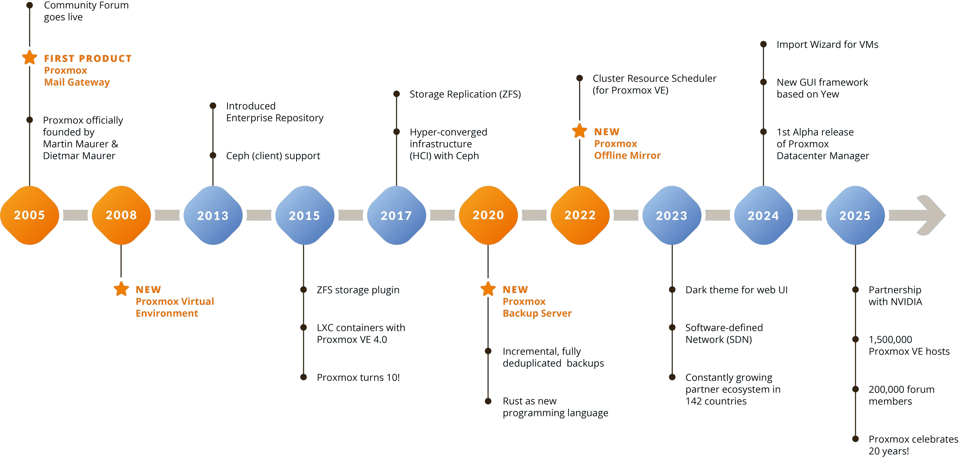
About Proxmox — History

Slide 12
About Proxmox — Some Facts
142
1,600,000
Active Hosts
Active Hosts
Countries
1,600,000
225,000
Forum members
Enterprises of all sizes and industries
3.0
4.0
5.1 6.0 7.0
Proxmox VE Version
8.0
9.0

Slide 13
TRAINING COURSE
Proxmox Virtual Environment

Slide 14
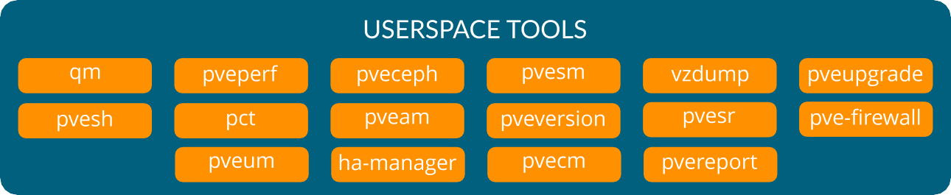
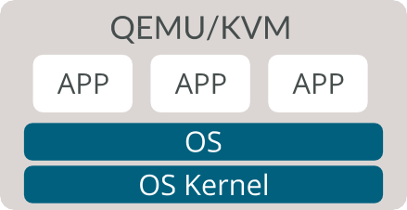
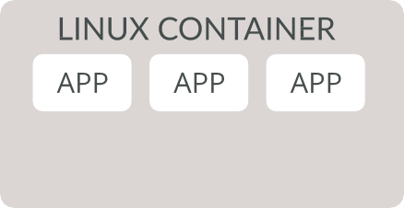
Proxmox VE Management Tools

Slide 15




Training Scenario
Windows Server
APP APP APP
Windows Kernel
Linux Webserver
Webserver
PC 1
Linux
PC...
NIC
NIC
CPU
CPU
Storage Box
NFS CIFS
Linux NAS
Switch
WAN
NIC
CPU

Slide 16
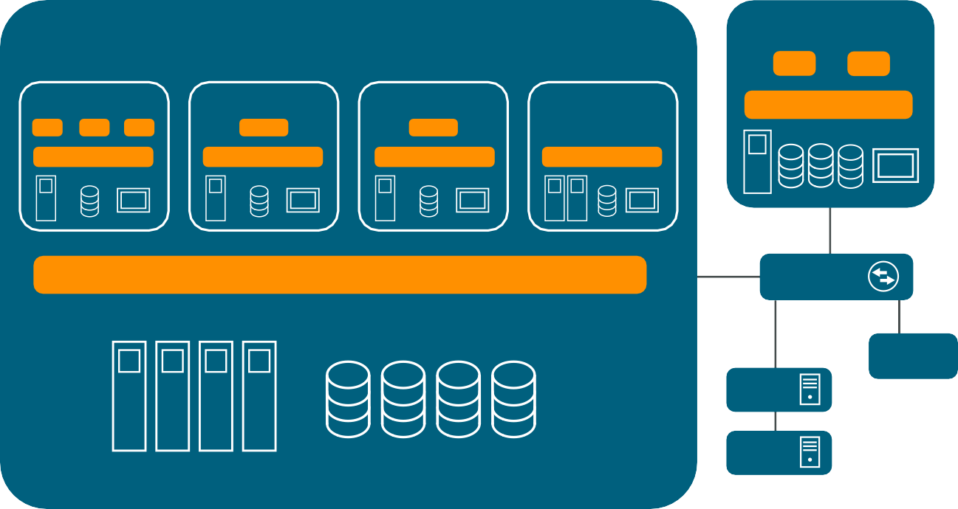
Training Scenario
Virtual Training Server
Storage Box
NFS CIFS
Linux NAS
Windows Server
APP APP APP
Windows Kernel
Linux Webserver
Webserver
Linux Container
Webserver
Router
Linux
Linux
BSD
NIC
CPU
NIC
CPU
NIC
CPU
NIC
CPU
NIC
NIC
CPU
Proxmox VE
Switch
WAN
PC 1
NIC
NIC NIC
NIC
...
PC...

Slide 17
Guests in Virtual Network behind Router
Default base install
SDN simplezone
Router VM
VM1
VM2
LXC1
VM1
VM2
LXC1
Router VM
VM2
LXC1
vmbr0
simple_vnet
vmbr0
vmbr1
routed or natted
vmbr0
NIC1
NIC2
bond0
NIC1
NIC2
bond0
NIC1
NIC2

Slide 18
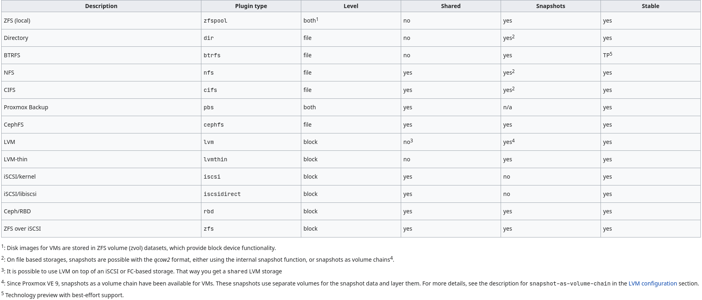
Available Storage in Proxmox VE
Read more in the DOCS →

Slide 19
Firewall Datacenter Level
Proxmox VE Node Level
Proxmox VE Node Level
Guest Level
Guest Level
VM101 CT103
VM100 CT102
vNIC
vNIC
vNIC
vNIC
Read more in the DOCS →

Slide 20
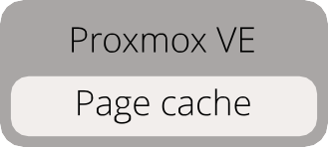
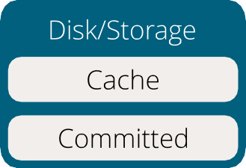
Cache Modes
host page cache is not used
guest disk cache is set to writeback
●
●
More Details →

Slide 21
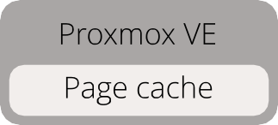
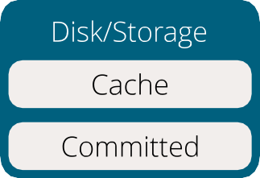
Cache Modes
host page cache is not used
guest disk cache mode is writethrough
fsync is made for each write
●
●
●
More Details →

Slide 22

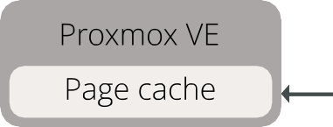
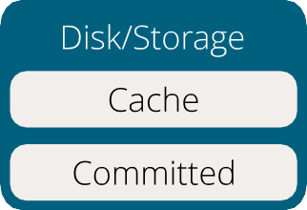
Cache Modes
host page cache is used as read cache
guest disk cache mode is writethrough
fsync for each write, more secure, can't lose data on power-loss, slower
●
●
●
More Details →

Slide 23
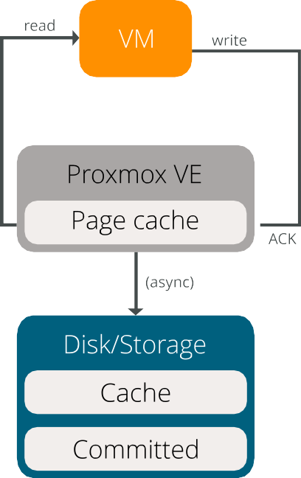
Cache Modes
host page cache is used as read & write cache
guest disk cache mode is writeback
Warning: you can lose data in case of a power failure
●
●
●
More Details →

Slide 24
Backups
Mode | VM | Container
stop | Shutdown, start immediately | Stop during whole backup
suspend | Provided for compatibility, better use snapshot | Rsync to tmp while running, suspend container and rsync again
snapshot | Use virtualization to take a consistent backup | Use storage snapshot functionality, fallback to suspend mode
Read more in the DOCS →

Slide 25
Proxmox VE
Begin at start
Network
Backup Target

Slide 26
Proxmox VE
VM
VM wants to write data
Network
Backup Target

Slide 27
Proxmox VE
VM
Backup out of order
BLOCK
Network
Backup Target

Slide 28

Proxmox VE
VM
Let VM write data
Network
Backup Target

Slide 29
Proxmox VE
Continue backup
Network
Backup Target

Slide 30
Proxmox VE
VM
BLOCK
Network
Temporary Local Storage
(fleecing image)
Backup Target

Slide 31


Network — Star Topology
Can scale well
MLAG (multi device LAG) for redundancy
●
●
Switch
Switch

Slide 32
Network — Full Mesh
No switches
Can only scales so much…
– Usually 3 to 5 nodes
Useful in cluster internal networks (Ceph)
●
●
●
Full-Mesh Guide →

Slide 33











Slide 34
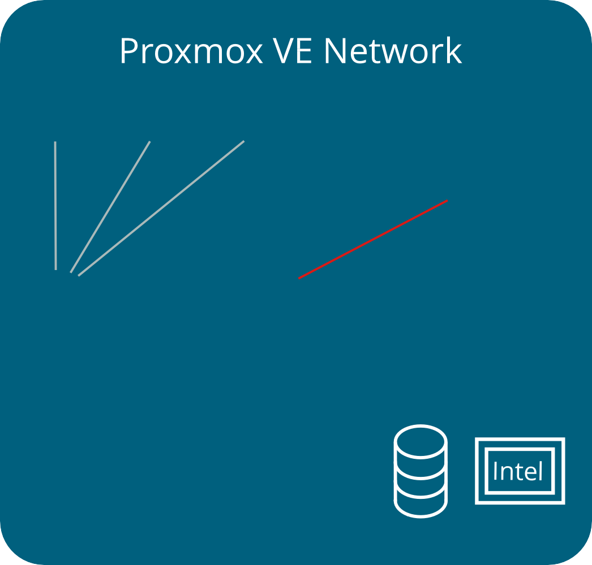
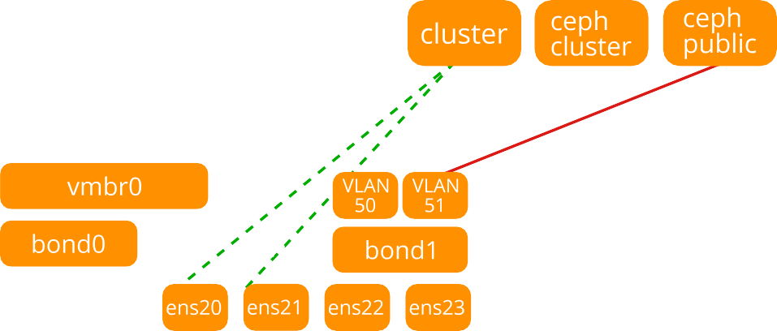

Slide 35



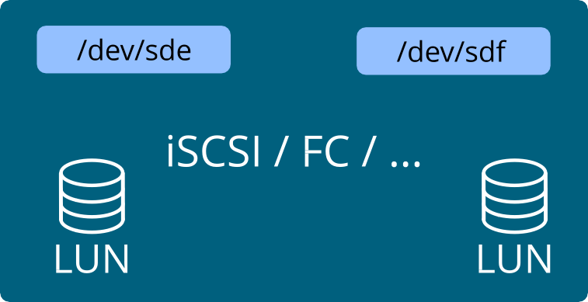
Multipath
Multipath Guide →

Slide 36
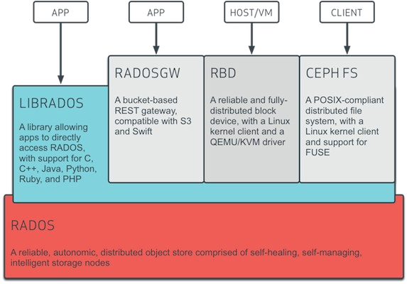
Ceph Stack
Source: docs.ceph.com

Slide 37
Ceph Services
●
OSD (Object Storage Daemon) checks its own state and the state of other OSDs and reports back to monitors.
MON (Monitor) maintains a master copy of the cluster map. A cluster of Ceph monitors ensures high availability should a monitor daemon fail.
Storage cluster clients retrieve a copy of the cluster map from the Ceph Monitor.
MGR (Manager) acts as an endpoint for monitoring, orchestration, and plug- in modules.
MDS (Metadata Server) manages file metadata when CephFS is used to provide file services.
●
●
●

Slide 38
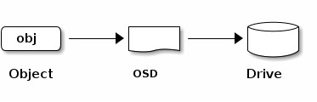
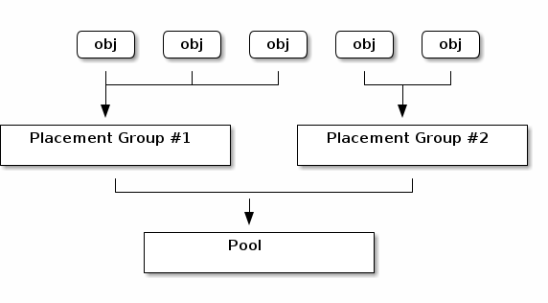
Ceph Data Organization
Source: docs.ceph.com

Slide 39
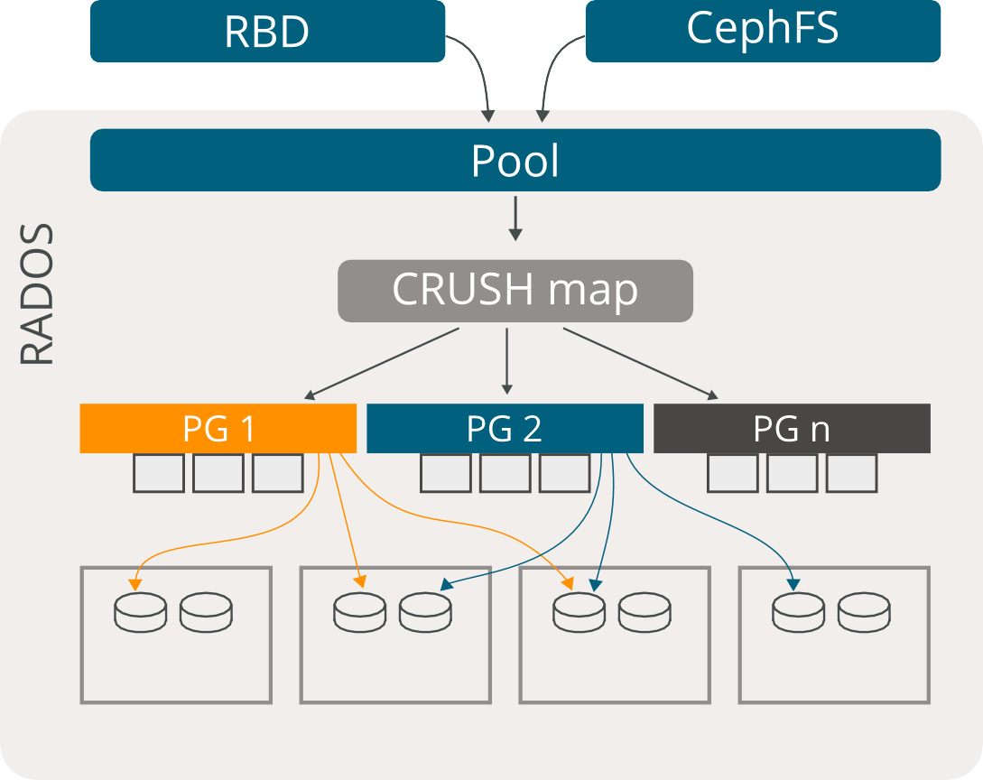
Obj Obj Obj
Obj Obj Obj
Obj Obj Obj
Node
Node
Node
Node
Notes:
1. Tầng Khách / Giao diện lưu trữ (Trên cùng)
Đây là nơi các tài nguyên tính toán (Compute) của Proxmox kết nối vào hệ thống lưu trữ:
RBD (Block Storage): Cung cấp lưu trữ dạng khối (hoạt động như ổ cứng).
Máy ảo (VM) kết nối vào RBD thông qua thư viện không gian người dùng LIBRBD.
Container (CT) kết nối thông qua module nhân Linux KRBD.
CephFS (File Storage): Cung cấp hệ thống tập tin chia sẻ, được mount vào hệ điều hành thông qua FUSE hoặc trực tiếp qua Kernel client.
2. Tầng Xử lý Logic RADOS (Khối màu xám lớn)
Dữ liệu từ giao diện bên trên (RBD/CephFS) khi đi vào hệ thống Ceph sẽ trải qua một chuỗi phân nhỏ và ánh xạ:
Pool: Dữ liệu trước tiên được đẩy vào các Pool (Bể lưu trữ). Pool là các phân vùng logic quản lý các chính sách lưu trữ (như dữ liệu này cần nhân mấy bản sao, dùng loại ổ cứng gì).
CRUSH map: Đây là "bộ não" phân bổ của Ceph. Nó là một thuật toán toán học giúp định tuyến và quyết định xem dữ liệu sẽ được cất vào đâu một cách tự động mà không cần máy chủ chỉ mục trung tâm.
PG (Placement Group - Nhóm phân bổ): Để tránh việc phải quản lý hàng tỷ tập tin nhỏ lẻ (Obj - Objects), Ceph gom các Object này lại thành từng nhóm gọi là PG (PG 1, PG 2... PG n). CRUSH map sẽ tính toán vị trí cho các PG này thay vì tính toán cho từng Object lẻ tẻ, giúp tiết kiệm cực kỳ nhiều tài nguyên RAM/CPU.
3. Tầng Vật lý (Dưới cùng)
Đây là nơi dữ liệu thực sự được ghi vào các ổ cứng trên các máy chủ Proxmox (Node).
Cơ chế dự phòng (Replication): Nếu bạn nhìn kỹ các đường mũi tên, bạn sẽ thấy dữ liệu từ một nhóm PG duy nhất (ví dụ mũi tên màu cam của PG 1) được phân tán và ghi thành nhiều bản sao lên nhiều Node khác nhau (trong hình là 3 Node).
Ý nghĩa thực tiễn: Thiết kế này chính là nền tảng của tính linh hoạt và an toàn dữ liệu. Nếu một máy chủ (Node) bị mất điện hoặc cháy ổ cứng, dữ liệu của bạn không hề bị mất vì các bản sao của PG 1 vẫn đang nằm an toàn ở 2 Node còn lại.

Slide 40
Ceph Pool Types
●
Replicated
–
Stores copies / replicas on multiple hosts for redundancy
●
Erasure Code (EC)
–
Splits data into k chunks and creates m coding chunks. Each chunk is stored on a separate node.

Slide 41
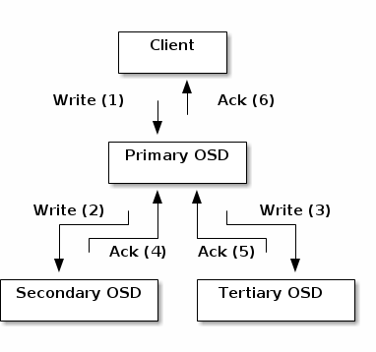
Ceph Write

Slide 42
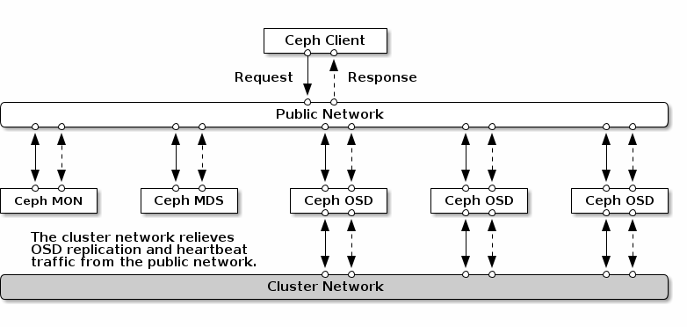
Ceph Networks

Slide 43
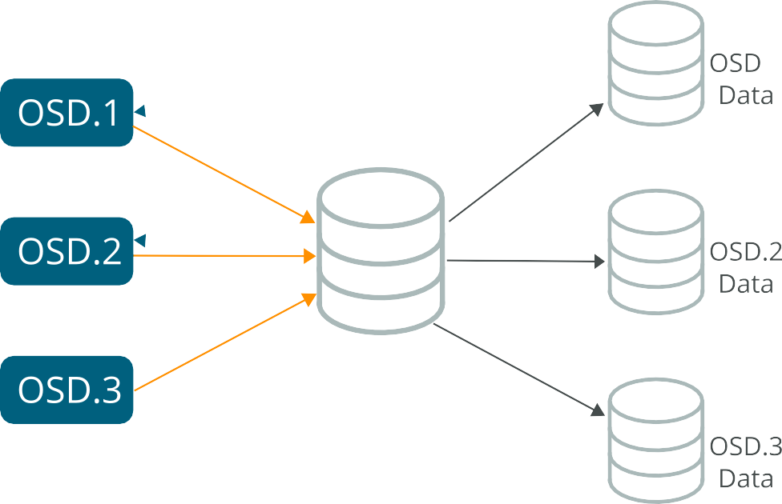
Ceph WAL/DB/Block on SSD

Slide 44
OSDs in a Three–Node Ceph Cluster
Node 1
OSD 1 OSD 2
Node 2
Node 3
OSD 3
OSD 4
OSD 5
OSD 6

Slide 45
OSDs in a Three–Node Ceph Cluster
Node 1
OSD 1 OSD 2
Node 2
Node 3
OSD 3
OSD 4
OSD 5
OSD 6

Slide 46
OSDs in a Three–Node Ceph Cluster
Node 1
OSD 1 OSD 2
Node 2
Node 3
OSD 3
OSD 4
OSD 5
OSD 6

Slide 47
OSDs in a Three–Node Ceph Cluster
Node 1
OSD 1 OSD 2 OSD 3 OSD 4
Node 2
OSD 5 OSD 6 OSD 7 OSD 8
Node 3
OSD 9 OSD 10 OSD 11 OSD 12

Slide 48
HA Node Affinity Rules

Slide 49



HA Resource Affinity Rules

Slide 50
HA – Shared vs. Replicated Storage
Node 1
Node 2
Node 3
Node 1
Node 2
All nodes see same shared storage
Nodes see local storage with potentially older data

Slide 51








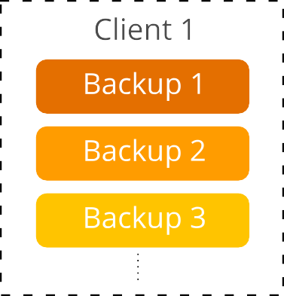
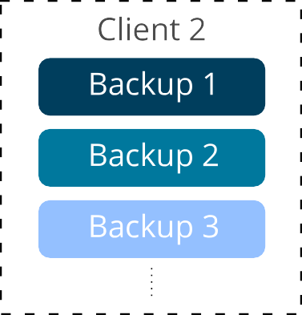
Proxmox Backup Server Chunks Deduplication

Slide 52
ROADMAP
Upcoming Features

Slide 53
Roadmap
●
Proxmox VE 9.1 is planned for Q3/Q4 2025: https://pve.proxmo x.com/wiki/Roadmap
Follow our mailing lists for latest information https://lists.proxm ox.com
●

Slide 54
PROXMOX
SUPPORT & SERVICE

Slide 55
Enterprise Support
Annual subscription: provides access to the stable Enterprise repositories
Technical help: fast and direct support from the Proxmox support team
Access to the Proxmox Customer Portal https://my.proxmox.co m
Remote access via SSH/HTTPS
●
●
●
●

Slide 56
Package Repositories
Proxmox solutions use APT as package management tool as well as the following three repositories:
Enterprise Repository
Default
For all subscribers The most stable packages
For production use
No-Subscription Repository
Test Repository
Latest packages and new features For developers and testing
●
No subscription is needed
For non- production use and testing
●
●
●
●
●
●

Slide 57
“TRAINING PLUS” Promotion
Get 20% discount on your Proxmox VE subscriptions!
(Valid if you buy within 2 months after the training. For new subscriptions only. See Training FAQs for more details.)
Contact your local reseller or purchase via
the Proxmox Online Shop at https://shop.proxmox.com

Slide 58
Get involved
●
Community
–
https://www.proxmox.com/en/about/open-source/community
●
Development
–
https://www.proxmox.com/en/about/open-source/developers

Slide 59
ANY QUESTIONS?
We’re looking forward to help!
Please contact us at: https://www.proxmox.com/en/about/contact

Slide 60

PROXMOX SERVER SOLUTIONS GMBH BRÄUHAUSGASSE 37, 1050 VIENNA, AUSTRIA OFFICE@PROXMOX.COM | WWW.PROXMOX.COM
© 2025 Proxmox. All Rights Reserved. Proxmox is a registered trademark. All brand names, product names, or trademarks belong to their respective holders.

