Slide 1
Spam detection
Anh Dung Le

Slide 2
Overview of problem
Story:
You've just been recruited by the Digital Communications Intelligence Unit (DCIU), a shadow division tasked with protecting humanity from cyber threats. The world is drowning in spam from fake lottery wins to phishing scams. Your mission is clear: build an intelligent system using Python to detect and flag spam messages before they reach unsuspecting inboxes. This is your first real field assignment as a junior data agent.
Business question and tasks
1. What words appear most often in spam vs ham?
2. How accurate is your classifier?
3. Which messages are falsely labeled?
4. Does message length affect likelihood of spam?
5. What are the most predictive keywords or features?
Data: ”spam_dataset.csv”

Slide 3
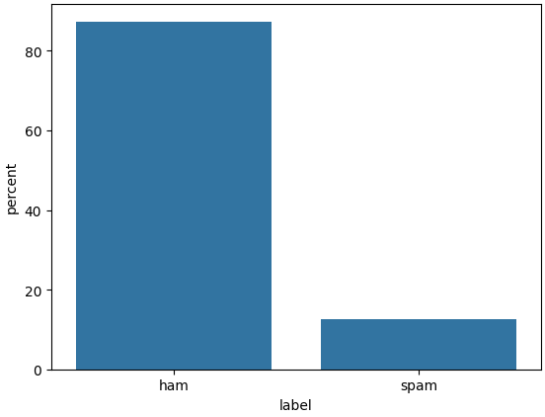
Simple analysis of the data
Distribution of labels
  Ham messages dominate the dataset (>80%)
  This is an imbalanced dataset. This property should be taken into account in modeling.

Slide 4
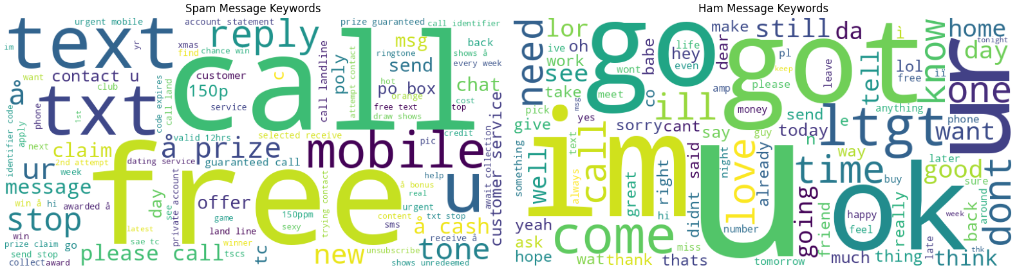
Simple analysis of the data
Word clouds
- Some words appearing more frequently in “Spam”: free, call, text, txt, reply, mobile, offer.
- Some words appearing more frequently in “Ham”: go, im, ok, come, got, time.

Slide 5
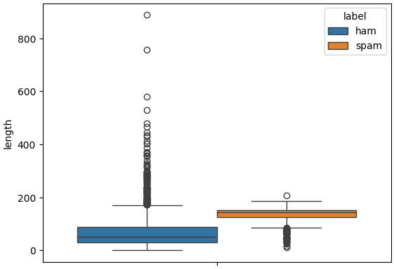
Simple analysis of the data
Length vs. Spam
  Message’s length has a strong correlation with message’s label: Spam messages tend to be significantly longer than ham messages
mean median
label
ham 67.153233 50.0
spam 132.482389 143.0

Slide 6
Modeling
Two classifiers are built and evaluated:
  Naive Bayes (MultinomialNB)
  Logistic Regression
Classifiers are optimized using grid search. The best models are evaluated using f1 score

Slide 7
Modeling
Classification reports:
Observations:
1. Naive Bayes and Logistic Regression have the relatively similar performance on ham messages.
2. On spam messages:
- Precision: Naive Bayes acts slightly better than Logistic Regression. For Naive Bayes, 2.8% of spam-labeled messages are actually hams. For Logistic Regression, 3.3% of spam-labeled messages are actually hams.
- Recall: On this measure, Logistic Regression acts better than Naive Bayes. LR successfully catches about 88.5% of all the spam messages, while NB is less effective (84.7%).
- F1-score: Logistic Regression's score of 0.924 proves it handles the trade-off between "missing spam" and "false alarms" more effectively than Naive Bayes (0.910).
Conclusion: In overall, Logistic Regression is better for production than Naive Bayes for spam detection.
Naive Bayes:
precision recall f1-score support
ham 0.978 0.998 0.988 903
spam 0.982 0.847 0.910 131
accuracy 0.979 1034
macro avg 0.980 0.923 0.949 1034
weighted avg 0.979 0.979 0.978 1034
Logistic regression:
precision recall f1-score support
ham 0.984 0.996 0.990 903
spam 0.967 0.885 0.924 131
accuracy 0.982 1034
macro avg 0.975 0.941 0.957 1034
weighted avg 0.981 0.982 0.981 1034

Slide 8
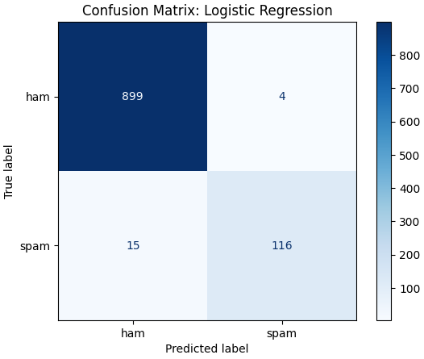
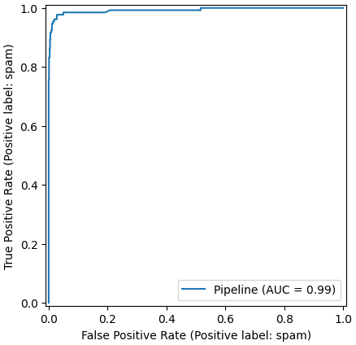
Modeling
More on Logistic Regression: nice model

Slide 9
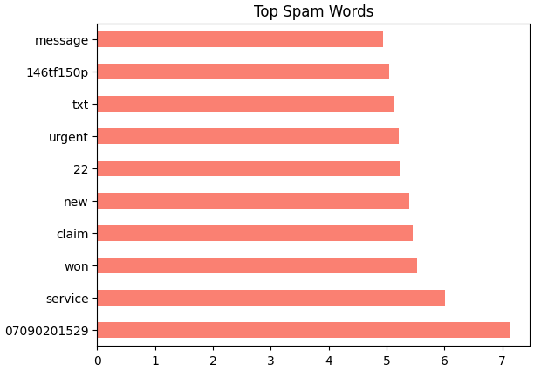
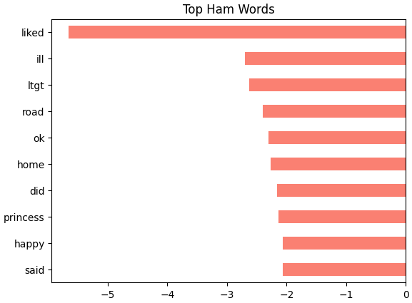
Modeling
Top predictive words for Spam and Ham from the best logistic classifier

Slide 10
What was learned?
Text preprocessing
Text tokenization and vectorization
Classification modeling (Logistic Regression and Naive Bayes)
Grid search for model optimization
Classification metrics: precision, recall, f1

