Slide 1
POWER OF VUEJS

Slide 2
I
What is Vuejs
II
Vue instance
III
Template syntax
IV
Computed and watcher
V
Binding data
VI
Components
VII
Transition and animations
VIII
Route

Slide 3
I.1>What is Vuejs
Vue (pronounced /vjuː/, like view) is a progressive framework for building user interfaces. Unlike other monolithic frameworks, Vue is designed from the ground up to be incrementally adoptable. The core library is focused on the view layer only, and is easy to pick up and integrate with other libraries or existing projects. On the other hand, Vue is also perfectly capable of powering sophisticated Single-Page Applications when used in combination with modern tooling and supporting libraries.

Slide 4
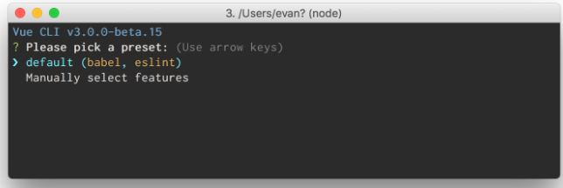
I.2> How to build app
-Install vuecli:
+npm install -g @vue/cli
+creat project:
-vue create hello-world:

Slide 5
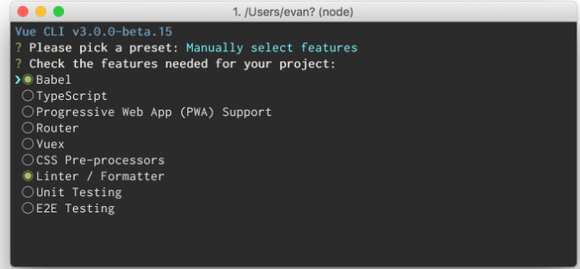
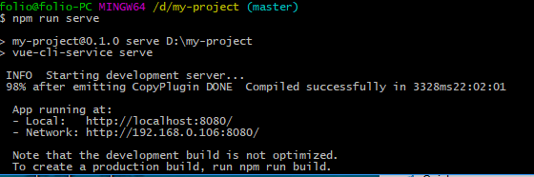
After run :
+npm run serve

Slide 6
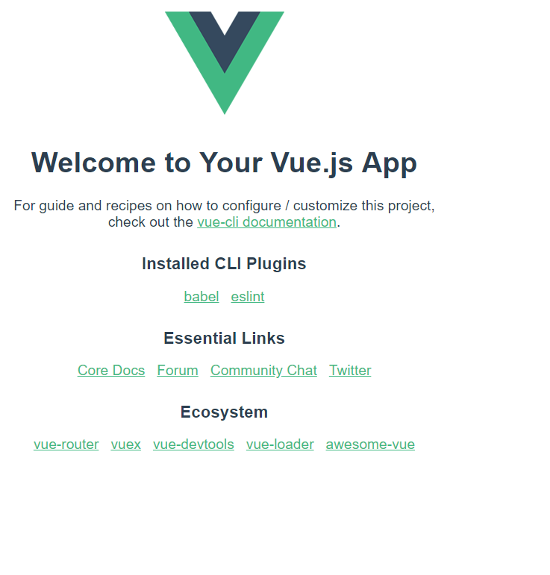

Slide 7
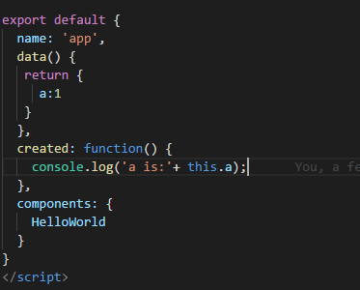
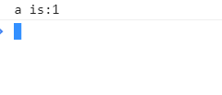
II> Vue instance
1. Instance Lifecycle Hooks
This is first code with vuejs about instance lifecycle hooks:
and result:

Slide 8
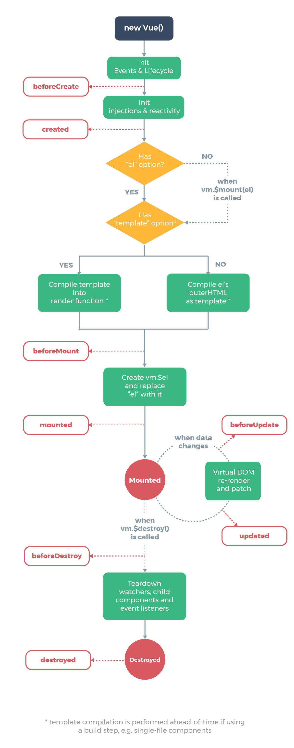

Slide 9
III> Template Syntax
Vue.js uses an HTML-based template syntax that allows you to declaratively bind the rendered DOM to the underlying Vue instance’s data. All Vue.js templates are valid HTML that can be parsed by spec-compliant browsers and HTML parsers.
Under the hood, Vue compiles the templates into Virtual DOM render functions. Combined with the reactivity system, Vue is able to intelligently figure out the minimal number of components to re-render and apply the minimal amount of DOM manipulations when the app state changes.
If you are familiar with Virtual DOM concepts and prefer the raw power of JavaScript, you can also directly write render functions instead of templates, with optional JSX support.

Slide 10




III.1> Interpolations
+text:
1.code
2.result:
+ raw html:
1.code:
2.result:

Slide 11
III.2> Attributes
Example:
+code:
+result:

Slide 12
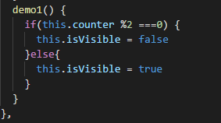

III.3> Using javascript expression
Example:
+code:
+result:

Slide 13

IV> Directive
Example:
+Code:
+ result:

Slide 14

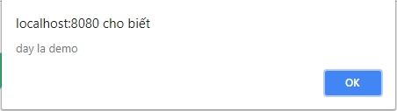
1.agrument:
Example:
Code:
Result:

Slide 15



2.Modifider:
Example:
Code:
Result:
After add modifider :
Code:
Result:

Slide 16



V. Computed and watch
1.Computed:
Example:
Code:
Result:

Slide 17


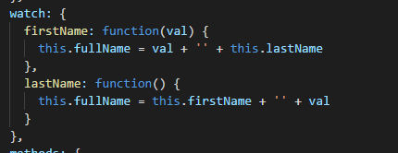

2.Computed vs Watched propety:
Example:
Code:
Result:

Slide 18

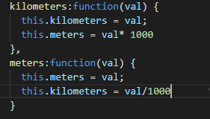
3.Watcher:
Example:
+Code:
+Result:

Slide 19

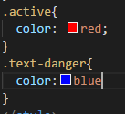

VI> Data binding
1.Class and Style binding:
-Object Syntax:
Result:

Slide 20


Array Syntax:
Example:
Code:
Result:

Slide 21


2. Binding Inline Styles
-Object Syntax:
+Example:
Code:
Result:

Slide 22

-Array Syntax:
Example:
Result:

Slide 23


VI.1 Conditional Rendering
1.V-if :
+Example:
Code:
Result:
2.v-else:
Code:
Result:

Slide 24



3. v-else-if:
+Example:
Code:
Result:
4.v-show:
+Example:
Code:
Result:

Slide 25



4.v-for:
+Example:
Code:
Result:

Slide 26
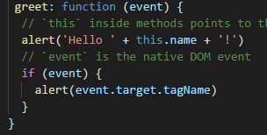
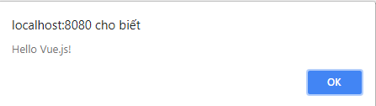
VI.2> Event handling
Method Event Handlers:
Example:
Code:
Result:

Slide 27


VI.3> Form input bindings
Example:
+Code:
+Result:

Slide 28
VII> Components
1.Prop
-Prop casing:
+Example:
Code:
Result:

Slide 29
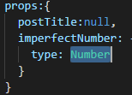
-Prop passing number:
+Example:
Code:
Result:

Slide 30



One-Way Data Flow
Example:
Code:
Result:

