Slide 1
INTRODUCTION TO THE DNS SYSTEM
Tran Thi Dung

Slide 2
Overview
Introduction to the DNS
DNS Components
DNS Structure and Hierarchy

Slide 3
DNS History (1)
ARPANET utilized a central file HOSTS.TXT
  Contains names to addresses mapping
  Maintained by SRI’s NIC (Stanford-Research-Institute: Network-Information-Center)
Administrators email changes to NIC
  NIC updates HOSTS.TXT periodically
Administrators FTP (download) HOSTS.TXT
Notes:
Advanced Research Projects Agency Network (ARPANET) was the world's first operational packet switching network, the first network to implement TCP/IP

Slide 4
DNS History (2)
As the system grew, HOSTS.TXT had problems with:
  Scalability (traffic and load)
  Name collisions
  Consistency
In 1984, Paul Mockapetris released the first version (RFCs 882 and 883, superseded by 1034 and 1035 …)
Notes:
RFC: Request for Comments
RFC 882 - Domain names: Concepts and facilities

Slide 5
The DNS is…
The “Domain Name System”
What Internet users use to reference anything by name on the Internet
The mechanism by which Internet software translates names to attributes such as addresses

Slide 6
DNS as a Lookup Mechanism
Users generally prefer names to numbers
Computers prefer numbers to names
DNS provides the mapping between the two
  I have “x”, give me “y”

Slide 7
DNS as a Database
Keys to the database are “domain names”
  www.foo.com, 18.in-addr.arpa, 6.4.e164.arpa
Over 200,000,000 domain names stored
Each domain name contains one or more attributes
  Known as “resource records”
Each attribute individually retrievable

Slide 8
The DNS is also…
A globally distributed, scalable, reliable database
Comprised of three components
  A “name space”
  Servers making that name space available
  Resolvers (clients) which query the servers about the name space

Slide 9
Global Distribution
Data is maintained locally, but retrievable globally
  No single computer has all DNS data
DNS lookups can be performed by any device
Remote DNS data is locally cachable to improve performance

Slide 10
Loose Coherency
Each version of a subset of the database (a zone) has a serial number
  The serial number is incremented on each database change
Changes to the master copy of the database are propagated to replicas according to timing set by the zone administrator
Cached data expires according to timeout set by zone administrator

Slide 11
Scalability
No limit to the size of the database
No limit to the number of queries
  Tens of thousands of queries handled easily every second
Queries distributed among masters, slaves, and caches

Slide 12
Reliability
Data is replicated
  Data from master is copied to multiple slaves
Clients can query
  Master server
  Any of the copies at slave servers
Clients will typically query local caches
DNS protocols can use either UDP or TCP
  If UDP, DNS protocol handles retransmission, sequencing, etc.

Slide 13
Dynamicity
Database can be updated dynamically
  Add/delete/modify of any record
  Only master can be dynamically updated
Modification of the master database triggers replication

Slide 14
Overview
Introduction to the DNS
DNS Components
  The name space
  The servers
  The resolvers
DNS Structure and Hierarchy
The DNS in Context

Slide 15
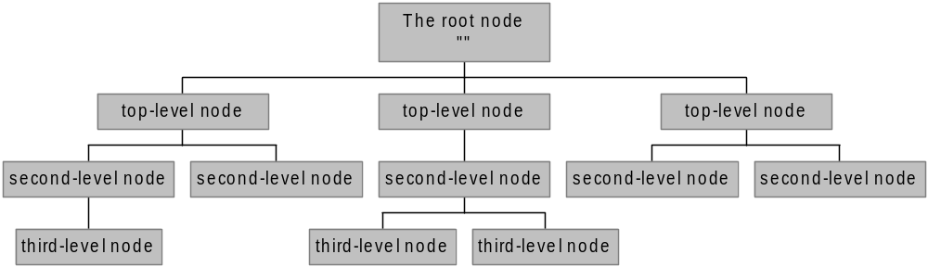
The Name Space
The name space is the structure of the DNS database
  An inverted tree with the root node at the top
Each node has a label
  The root node has a null label, written as “”

Slide 16
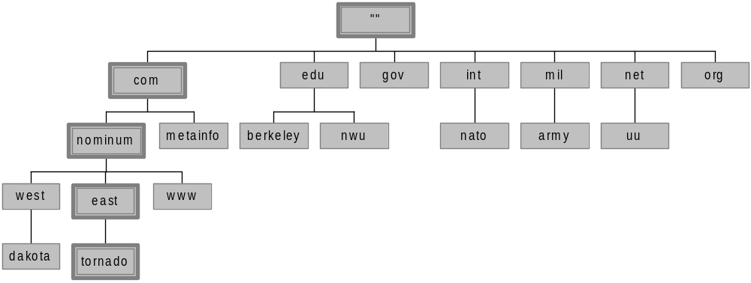
Domain Names
A domain name is the sequence of labels from a node to the root, separated by dots (“.”s), read left to right
  The name space has a maximum depth of 127 levels
  Domain names are limited to 255 characters in length
A node’s domain name identifies its position in the name space

Slide 17
Subdomains
One domain is a subdomain of another if its domain name ends in the other’s domain name
  So sales.nominum.com is a subdomain of
    nominum.com & com
  nominum.com is a subdomain of com

Slide 18
Delegation
Administrators can create subdomains to group hosts
  According to geography, organizational affiliation etc.
An administrator of a domain can delegate responsibility for managing a subdomain to someone else
  But this isn’t required
The parent domain retains links to the delegated subdomains
  The parent domain “remembers” who it delegated the subdomain too

Slide 19
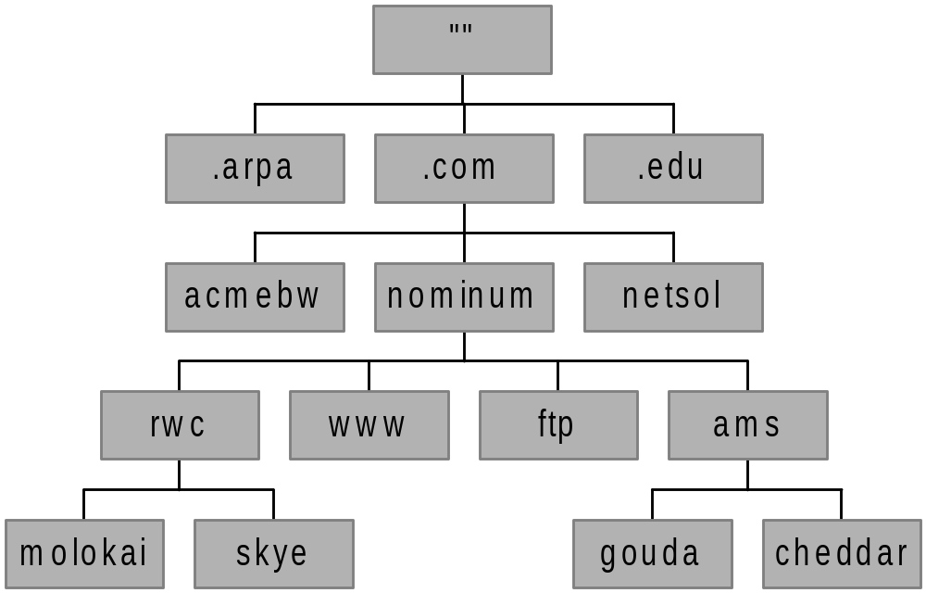
Dividing a Domain into Zones
nominum.com domain
nominum.com zone
ams.nominum.com zone
rwc.nominum.com zone

Slide 20
Overview
Introduction to the DNS
DNS Components
  The name space
  The servers
  The resolvers
DNS Structure and Hierarchy
The DNS in Context

Slide 21
Name Servers
Name server answeres “DNS” questions
Name servers store information about the name space in units called “zones”
  The name servers that load a complete zone are said to “have authority for” or “be authoritative for” the zone
Usually, more than one name server are authoritative for the same zone
  This ensures redundancy and spreads the load
Also, a single name server may be authoritative for many zones

Slide 22
Name Servers and Zones
128.8.10.5 serves data for both nominum.com and isc.org zones
Name Servers
Zones
128.8.10.5
nominum.com
202.12.28.129 serves data for nominum.com zone only
202.12.28.129
isc.org
204.152.187.11 serves data for isc.org zone only
204.152.187.11

Slide 23
Types of Name Servers
Two main types of servers
  Authoritative – maintains the data
    Master – where the data is edited
    Slave – where data is replicated to
  Caching – stores data obtained from an authoritative server
No special hardware necessary
Notes:
BIND: Berkeley Internet Name Domain

Slide 24
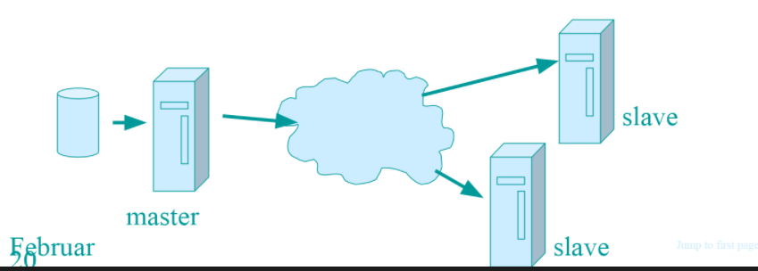
Authoritative name server
The master server normally loads the data from zone file
A slave server normally replicates the data from
the master via zone transfer

Slide 25
Recursive servers
Recursive servers do the actual lookups; they ask questions to the DNS on behalf of the clients.
Answers are obtained from authoritative servers but the answers forwarded to the clients are marked as not authoritative
Answers are stored for future reference in the cache

Slide 26
Overview
Introduction to the DNS
DNS Components
  The name space
  The servers
  The resolvers
DNS Structure and Hierarchy
The DNS in Context

Slide 27
Resolvers
Resolver ask the question to DNS system on behalf of the application

Slide 28
Overview
Introduction to the DNS
DNS Components
DNS Structure and Hierarchy
The DNS in Context

Slide 29
The Root Nameservers
The root zone file lists the names and IP addresses of the authoritative DNS servers for all top-level domains (TLDs)
The root zone file is published on 13 servers, “A” through “M”, around the Internet
Root name server operations currently provided by volunteer efforts by a very diverse set of organizations

Slide 30
Top-level Domain servers
TLD divided the internet domain name space organizationally into 7 domains:
  Com, edu, gov, mil, net, org, int
Storing TLDs’ address information

Slide 31
The Resolving Process
Let’s look at the resolving process step-by-step:
annie.west.sprockets.com
ping www.nominum.com.

Slide 32
The Resolving Process
The workstation annie asks its configured name server, dakota, for www.nominum.com’s address
dakota.west.sprockets.com
What’s the IP address of www.nominum.com?
annie.west.sprockets.com
ping www.nominum.com.

Slide 33
The Resolving Process
The name server dakota asks a root name server, m, for www.nominum.com’s address
m.root-servers.net
dakota.west.sprockets.com
What’s the IP address of www.nominum.com?
annie.west.sprockets.com
ping www.nominum.com.

Slide 34
The Resolving Process
The root server m refers dakota to the com name servers
This type of response is called a “referral”
m.root-servers.net
dakota.west.sprockets.com
Here’s a list of the com name servers. Ask one of them.
annie.west.sprockets.com
ping www.nominum.com.

Slide 35
The Resolving Process
The name server dakota asks a com name server, f, for www.nominum.com’s address
What’s the IP address of www.nominum.com?
m.root-servers.net
dakota.west.sprockets.com
f.gtld-servers.net
annie.west.sprockets.com
ping www.nominum.com.

Slide 36
The Resolving Process
The com name server f refers dakota to the nominum.com name servers
Here’s a list of the nominum.com name servers. Ask one of them.
m.root-servers.net
dakota.west.sprockets.com
f.gtld-servers.net
annie.west.sprockets.com
ping www.nominum.com.

Slide 37
The Resolving Process
The name server dakota asks a nominum.com name server, ns1.sanjose, for www.nominum.com’s address
What’s the IP address of www.nominum.com?
m.root-servers.net
dakota.west.sprockets.com
ns1.sanjose.nominum.net
f.gtld-servers.net
annie.west.sprockets.com
ping www.nominum.com.

Slide 38
The Resolving Process
The nominum.com name server ns1.sanjose responds with www.nominum.com’s address
m.root-servers.net
dakota.west.sprockets.com
Here’s the IP address for www.nominum.com
ns1.sanjose.nominum.net
f.gtld-servers.net
annie.west.sprockets.com
ping www.nominum.com.

Slide 39
The Resolving Process
The name server dakota responds to annie with www.nominum.com’s address
Here’s the IP address for www.nominum.com
m.root-servers.net
dakota.west.sprockets.com
ns1.sanjose.nominum.net
f.gtld-servers.net
annie.west.sprockets.com
ping www.nominum.com.

Slide 40
Resolving Process (Caching)
After the previous query, the name server dakota now knows:
  The names and IP addresses of the com name servers
  The names and IP addresses of the nominum.com name servers
  The IP address of www.nominum.com
Let’s look at the resolving process again
annie.west.sprockets.com
ping ftp.nominum.com.

Slide 41
Resolving Process (Caching)
The workstation annie asks its configured name server, dakota, for ftp.nominum.com’s address
m.root-servers.net
dakota.west.sprockets.com
What’s the IP address of ftp.nominum.com?
ns1.sanjose.nominum.net
f.gtld-servers.net
annie.west.sprockets.com
ping ftp.nominum.com.

Slide 42
Resolution Process (Caching)
dakota has cached a NS record indicating ns1.sanjose is an nominum.com name server, so it asks it for ftp.nominum.com’s address
What’s the IP address of ftp.nominum.com?
m.root-servers.net
dakota.west.sprockets.com
ns1.sanjose.nominum.net
f.gtld-servers.net
annie.west.sprockets.com
ping ftp.nominum.com.

Slide 43
Resolution Process (Caching)
The nominum.com name server ns1.sanjose responds with ftp.nominum.com’s address
m.root-servers.net
dakota.west.sprockets.com
Here’s the IP address for ftp.nominum.com
ns1.sanjose.nominum.net
f.gtld-servers.net
annie.west.sprockets.com
ping ftp.nominum.com.

Slide 44
Resolution Process (Caching)
The name server dakota responds to annie with ftp.nominum.com’s address
Here’s the IP address for ftp.nominum.com
m.root-servers.net
dakota.west.sprockets.com
ns1.sanjose.nominum.net
f.gtld-servers.net
annie.west.sprockets.com
ping ftp.nominum.com.

Slide 45
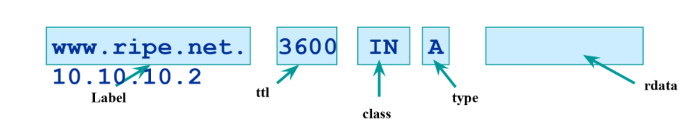
Resource records (Detail)
Format {name, ttl, class,type, rdata}
TTL is timer used in caches
  An indication for how long the data may be used
  Data that is expected to be “stable” can have high TTLs
IN class is widest used
There are mutilple types of RR
Everything behind the type identifier is called rdata

Slide 46
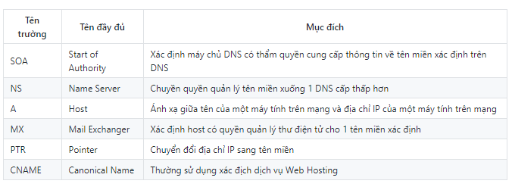
Resource records

Slide 47
CNAME
CNAME
WWW=Web2
CNAME
WWW=Web1
DNS server
Tạo một bản ghi thay thế hay biệt danh cho một bản ghi
Địa chỉ ip của WWW là gì?
Computer
Web 1
Web 2

Slide 48
Mail exchange (MX)
Định danh mail server cho dns name
Mail1.xxx.com
Mx record cho xxx.com là gì?
Mx record cho
xxx.com
mail1
Sending Mail server
DNS server
Mx record
M1.xxx.com
mail1

Slide 49
Mail exchange
Có nhiều mx record cho cùng một dns name
Độ ưu tiên thấp nhất được dùng đầu tiên
Nếu cùng độ ưu tiên thì mx sẽ được chọn ngẫu nhiên
Nếu email gửi đến server có độ ưu tiên thấp bị lỗi thì Mx sẽ gửi độ ưu tiên tiếp theo cho mail server

Slide 50
Reference
*referred to slides by David Conrad at nominum.com\

