Slide 1
MOTEL MANAGEMENT SYSTEM
Passengers
Web Application Development

Slide 2
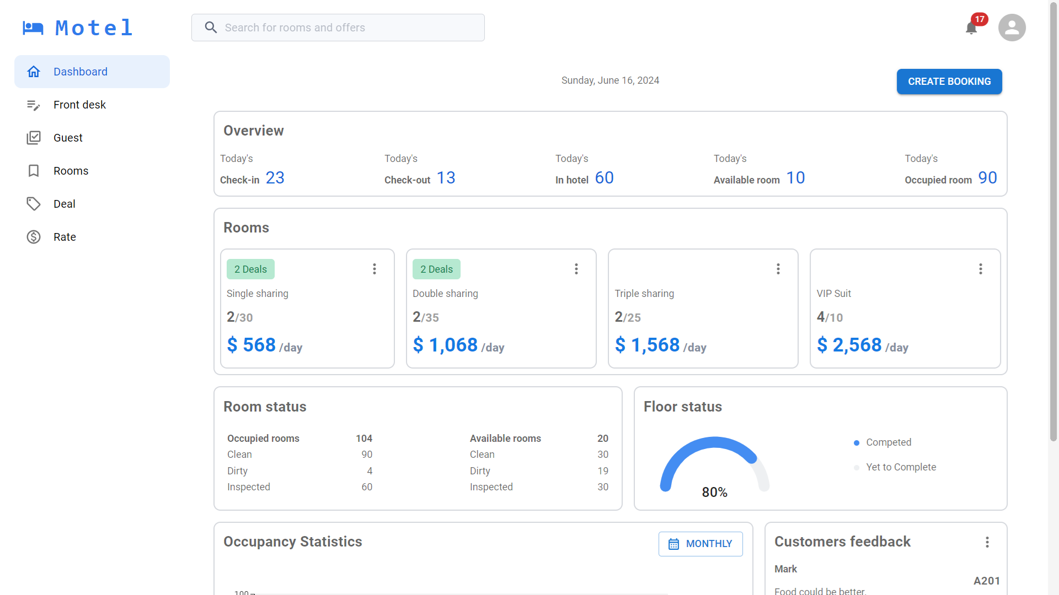
I. Introduction
1. Overview

Slide 3
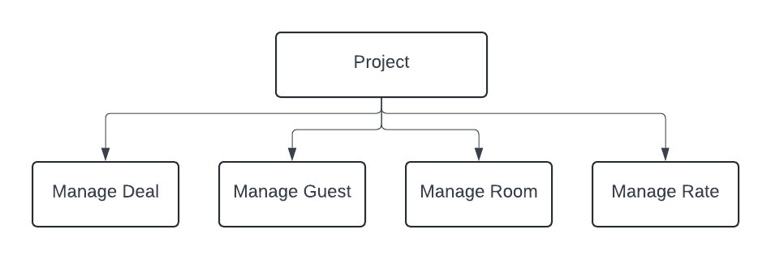
I. Introduction
2. Work structure

Slide 4
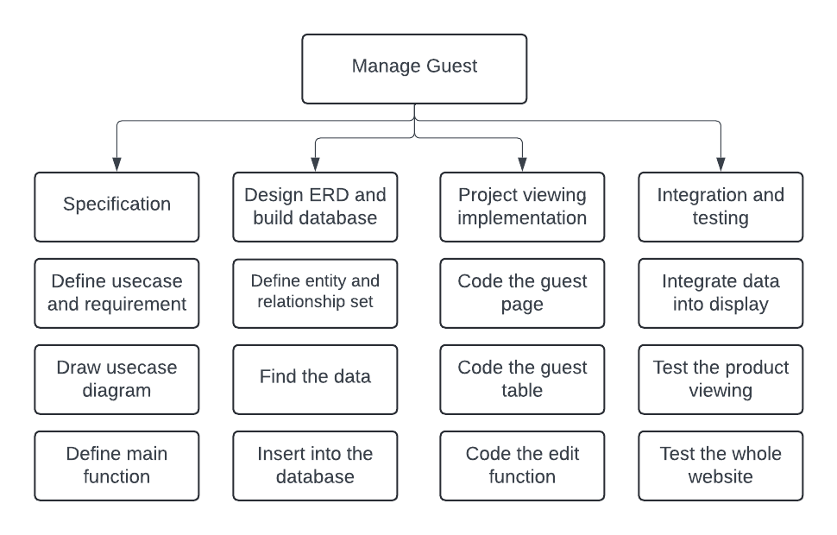
I. Introduction
2. Work structure (cont)

Slide 5
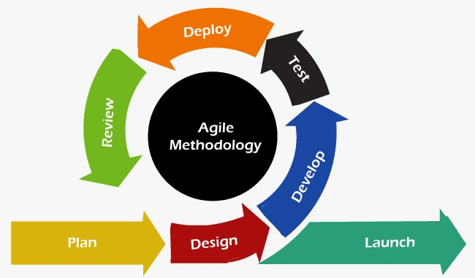
I. Introduction
3. Development process

Slide 6
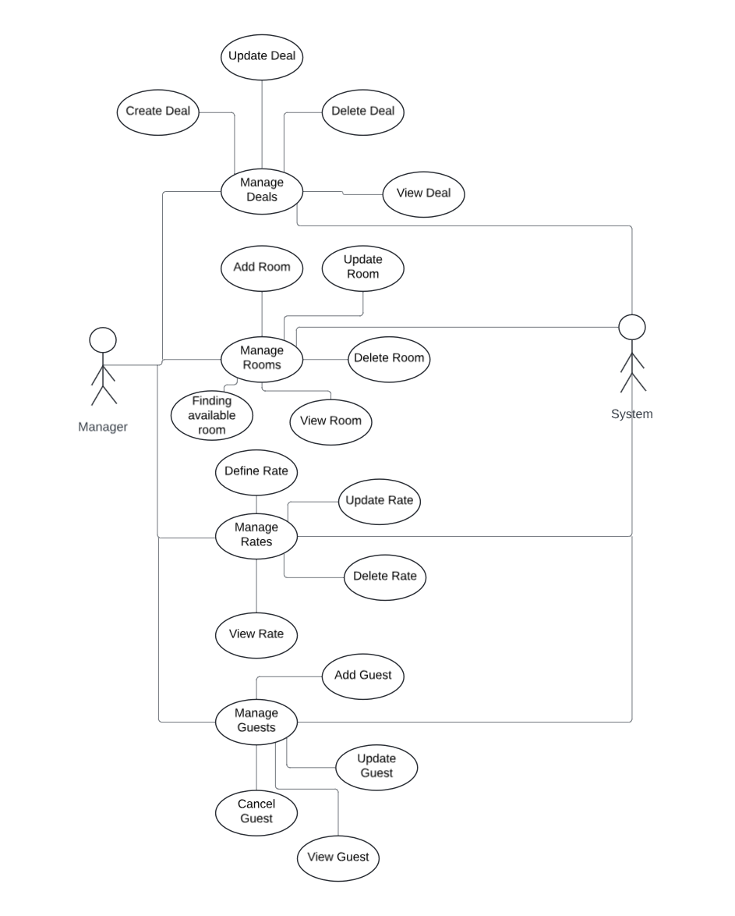
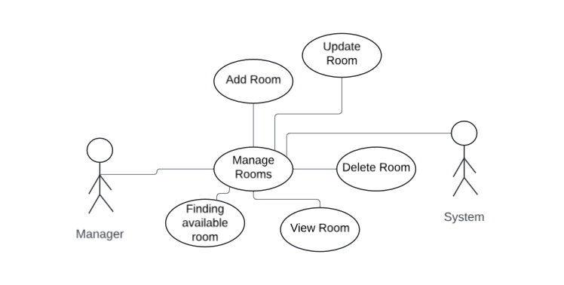
II. Analysis & Design
1. Use case diagram

Slide 7
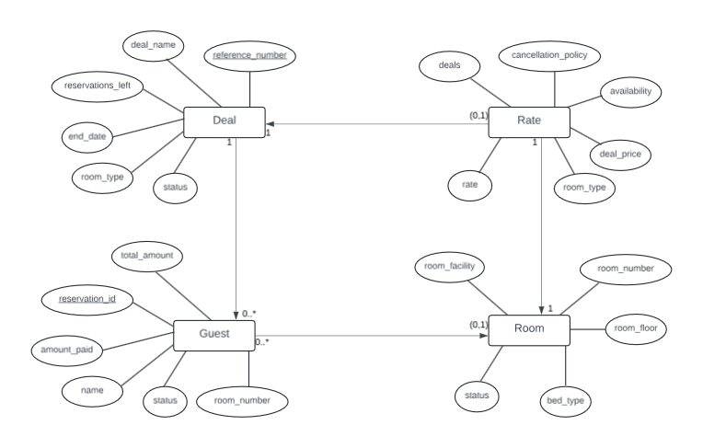
II. Analysis & Design
2. Entity-Relationship diagram (ERD)

Slide 8
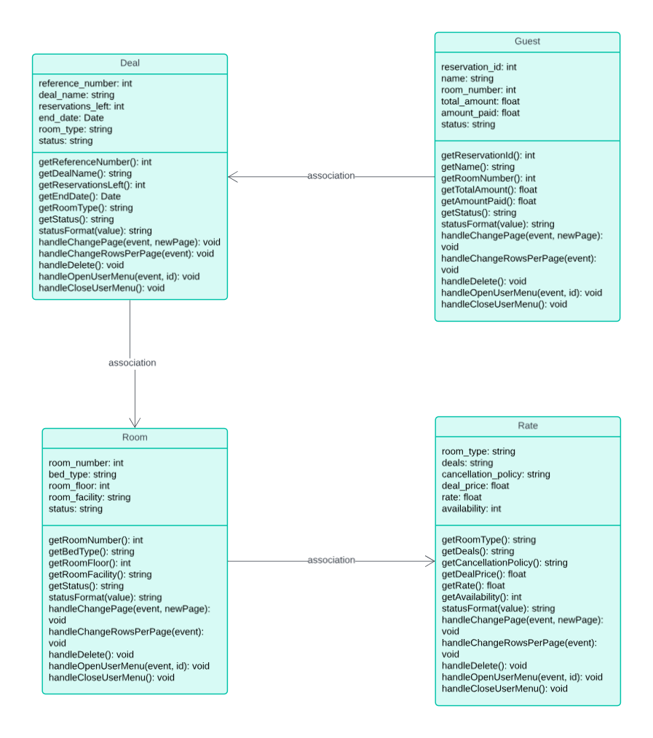
II. Analysis & Design
3. Class diagram

Slide 9
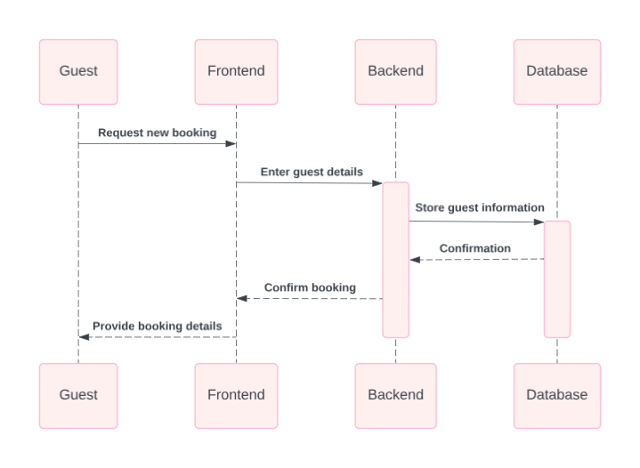
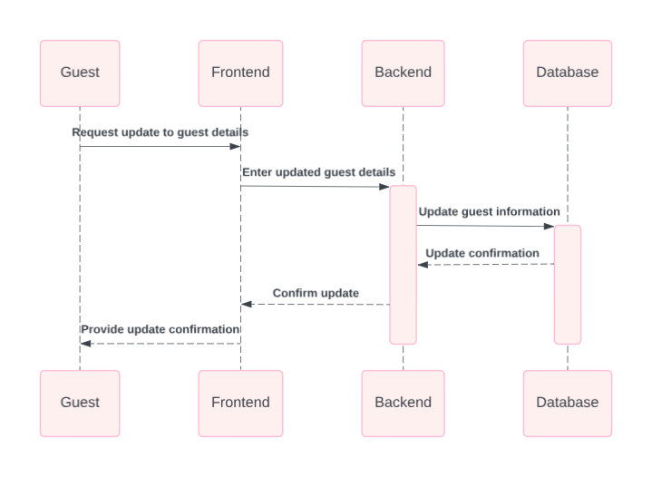
II. Analysis & Design
4. Sequence diagram

Slide 10
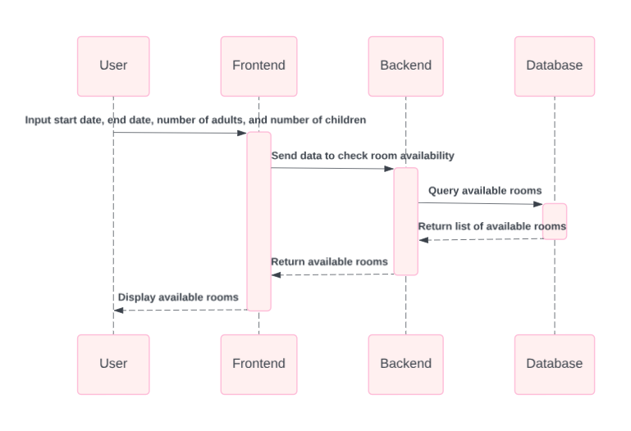
II. Analysis & Design
4. Sequence diagram (cont)
Finding available room feature

Slide 11
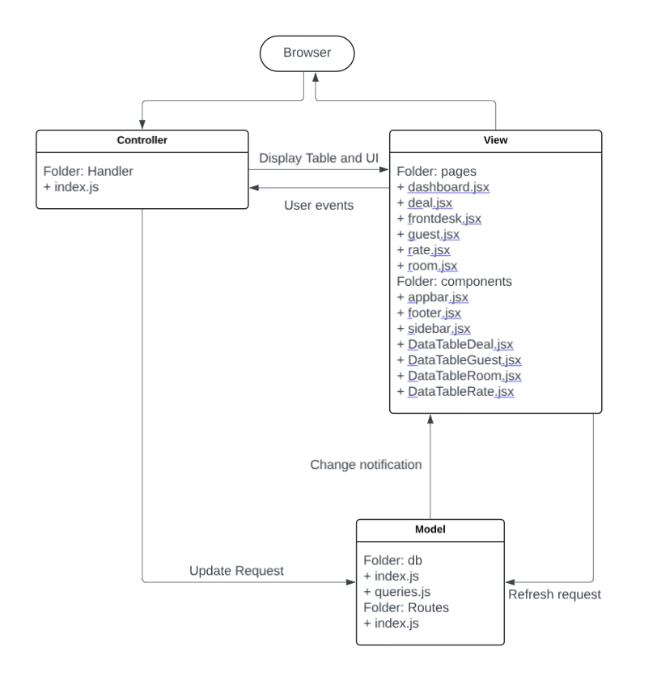
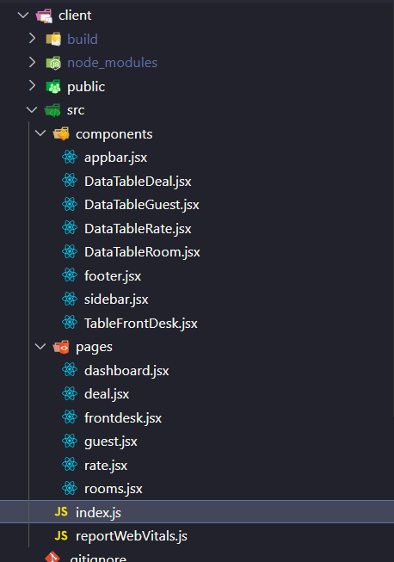
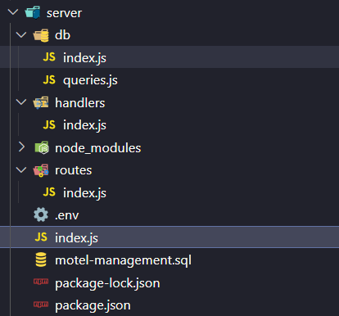
II. Analysis & Design
5. Design structure

Slide 12
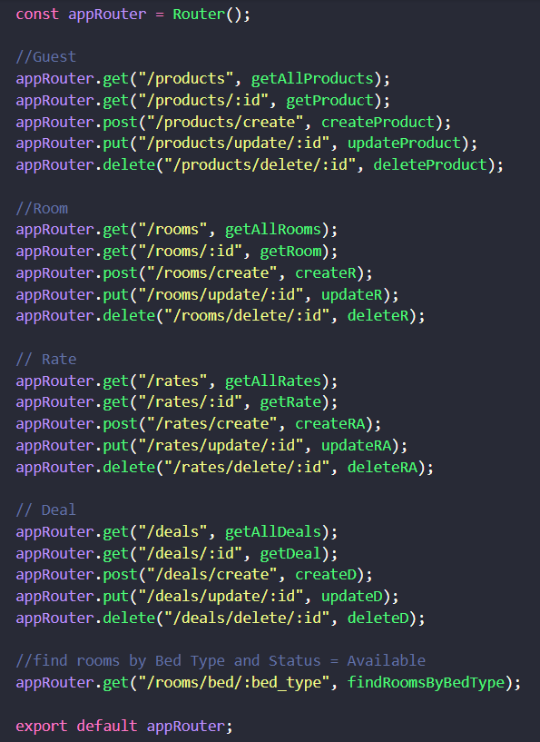
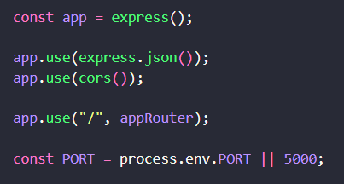
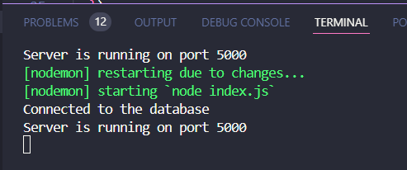
II. Analysis & Design
5. Design structure (cont)

Slide 13
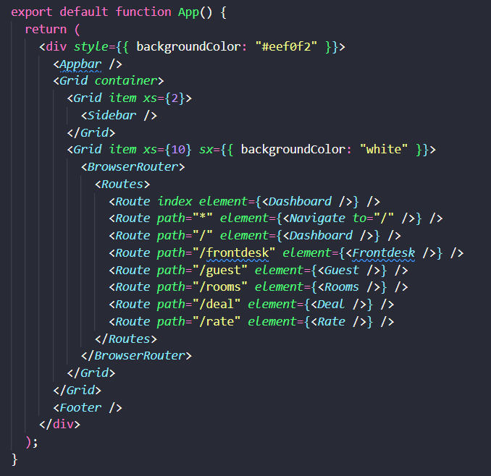
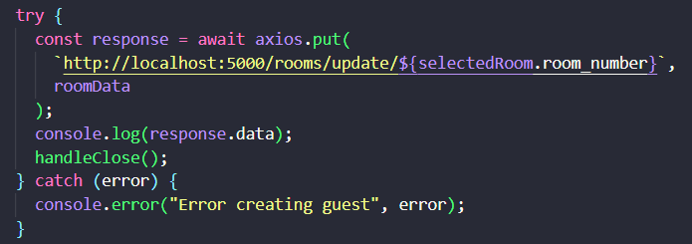
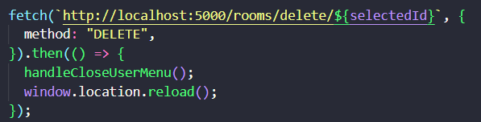
II. Analysis & Design
5. Design structure (cont)

Slide 14
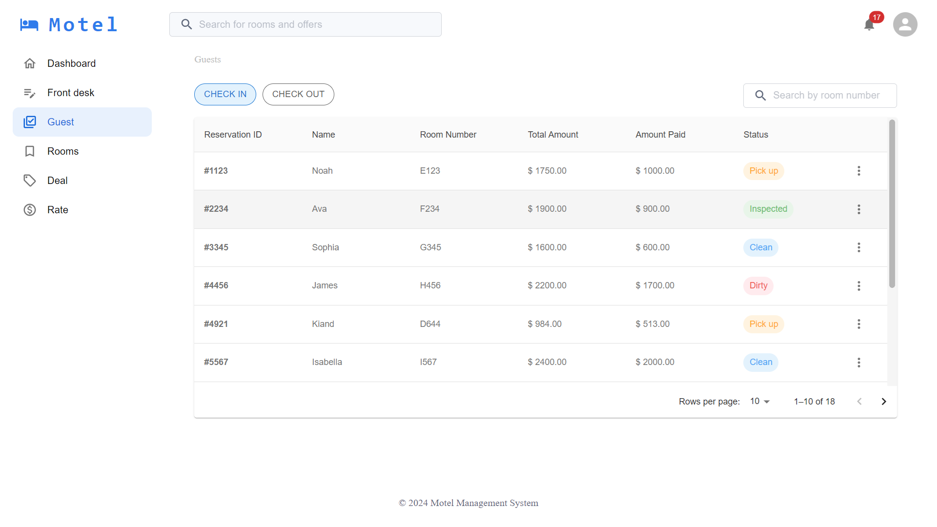
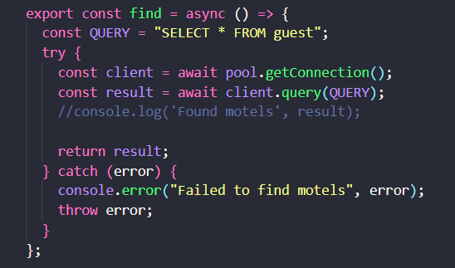
III. Implementation
1. Guest management

Slide 15
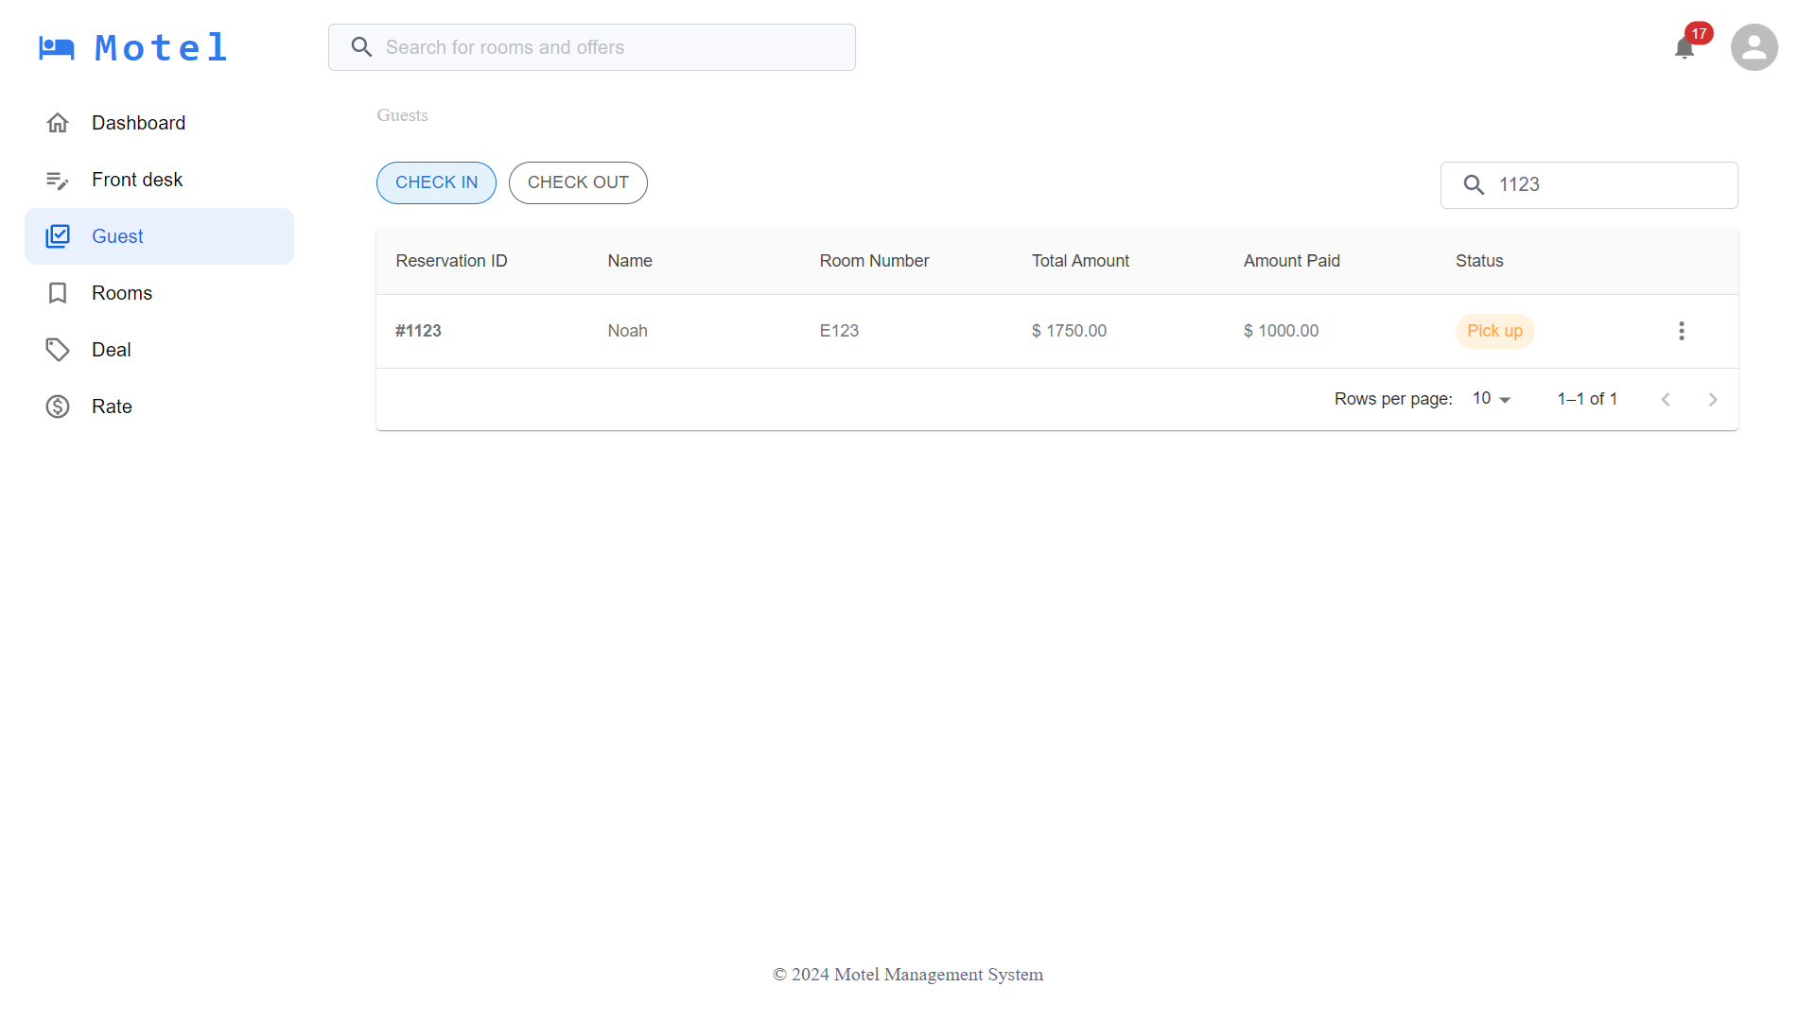
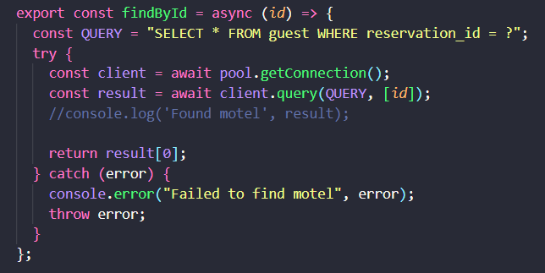
III. Implementation
1. Guest management (cont)

Slide 16
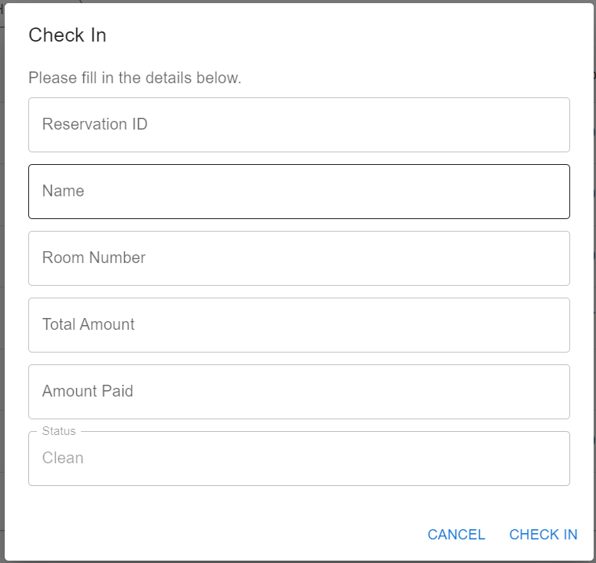
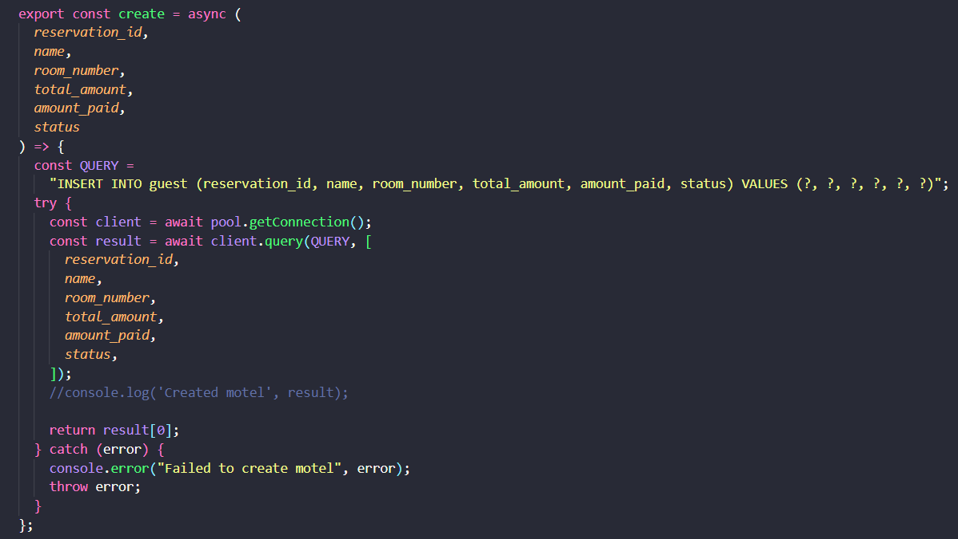
III. Implementation
2. Add guest

Slide 17
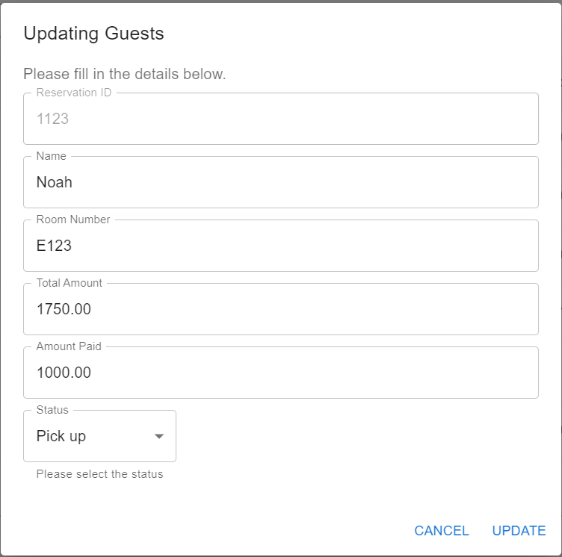
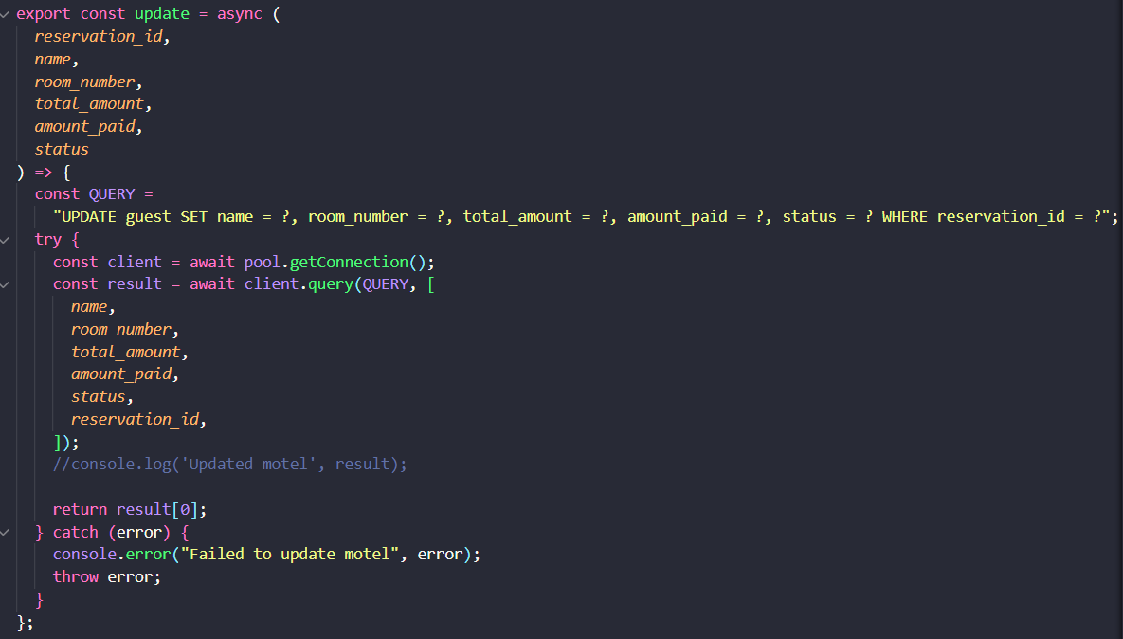
III. Implementation
3. Update guest

Slide 18
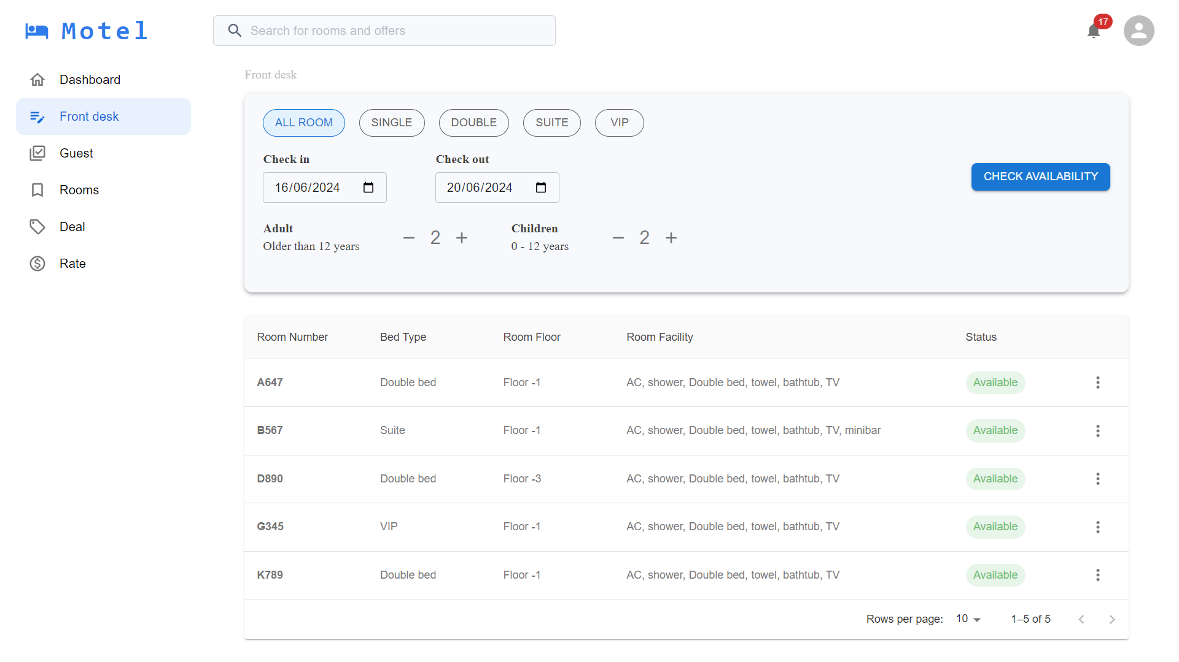
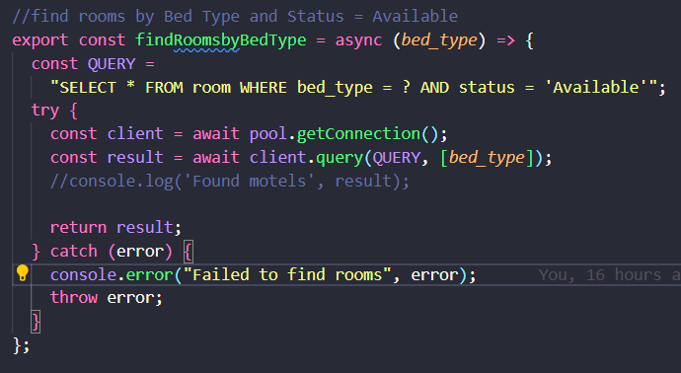
III. Implementation
4. Finding available room

Slide 19
IV. Demo

