Slide 1
MOTEL MANAGEMENT SYSTEM
The Passenger
Web Application Development

Slide 2
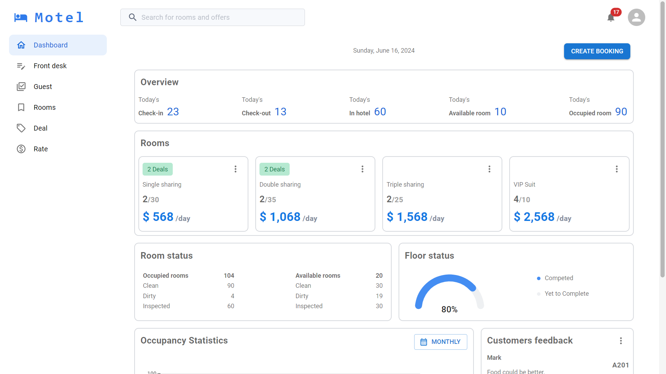
I. Introduction
1. Overview

Slide 3
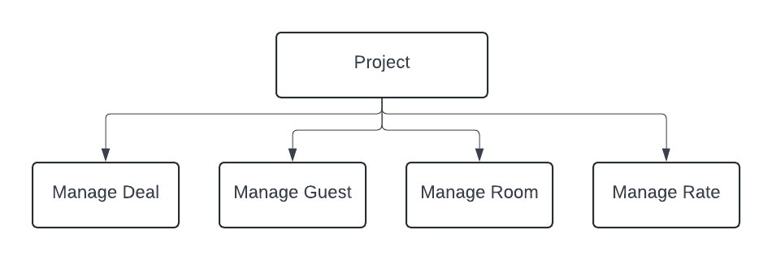
I. Introduction
2. Work structure

Slide 4
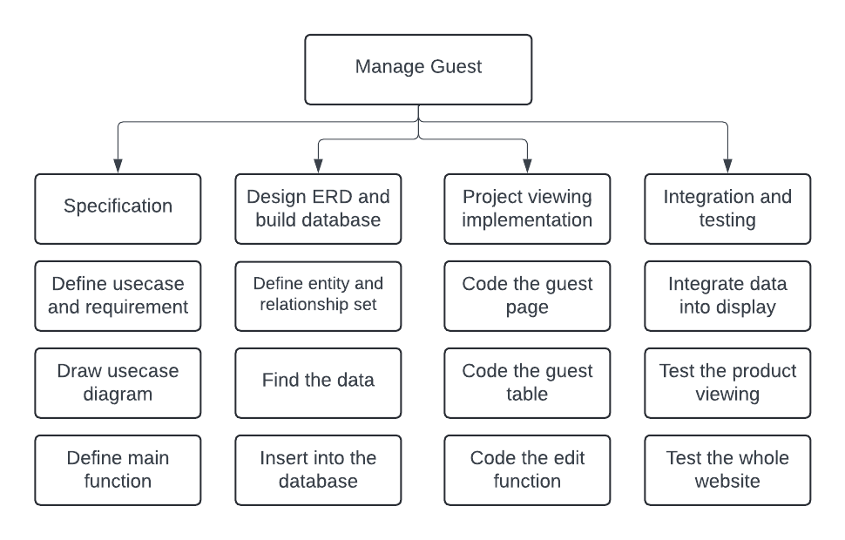
I. Introduction
2. Work structure (cont)

Slide 5
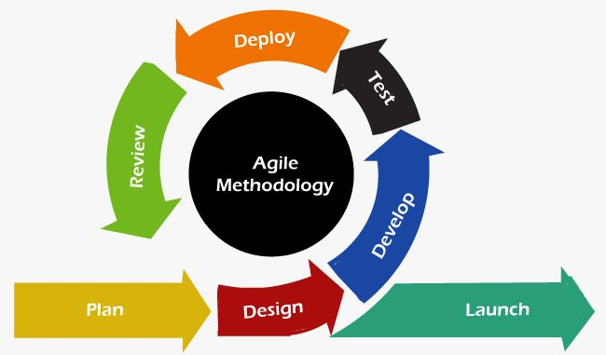
I. Introduction
3. Development process

Slide 6
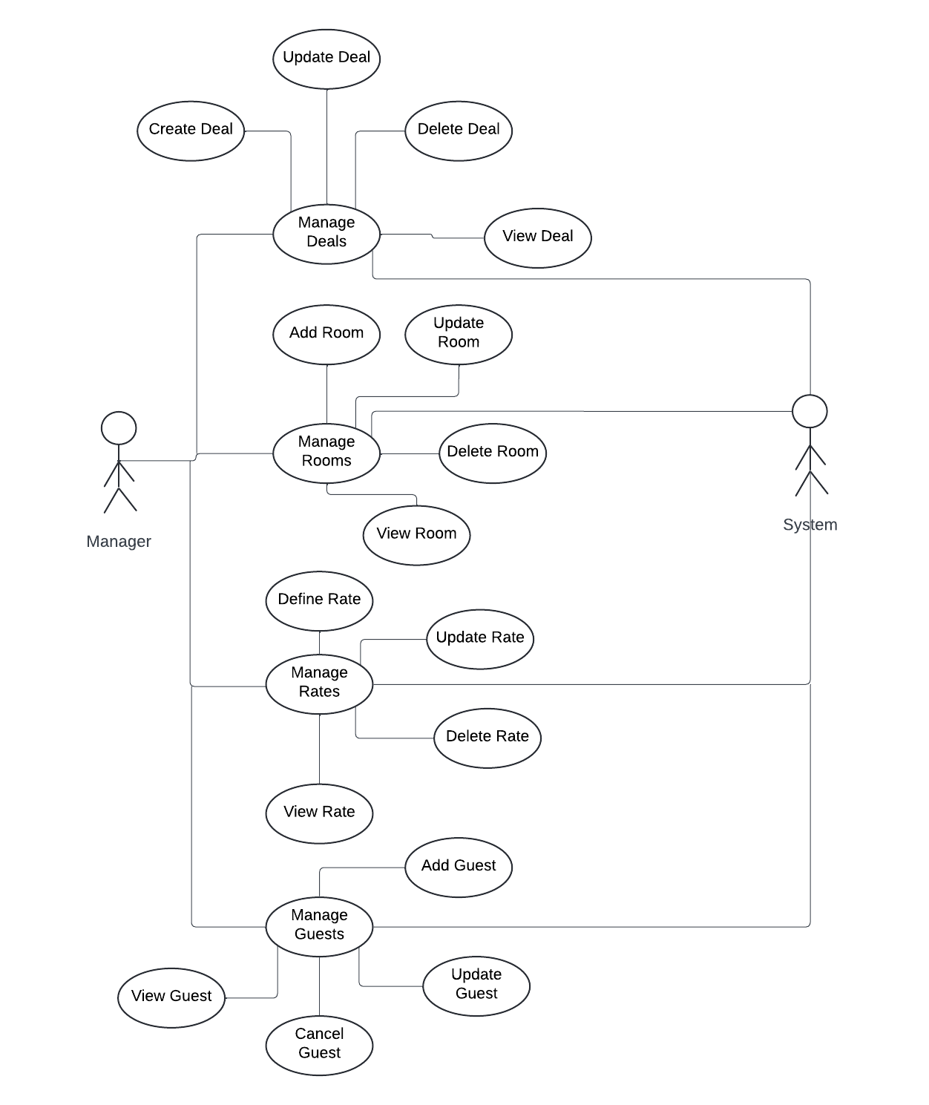
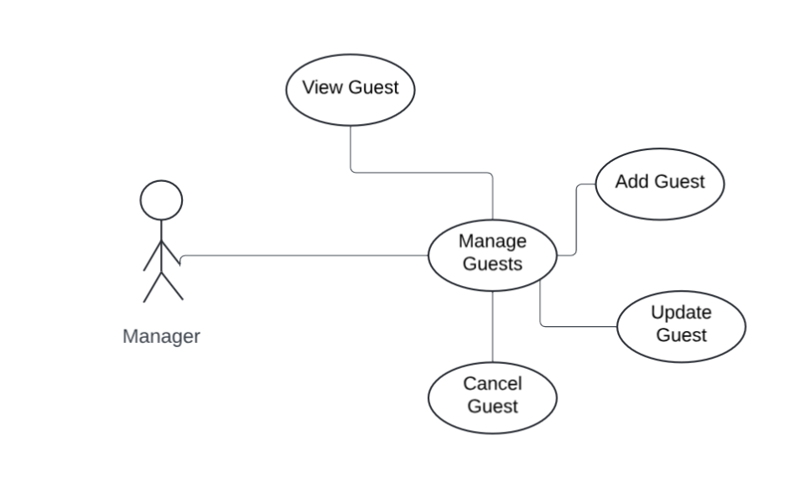
II. Analysis & Design
1. Use case diagram

Slide 7
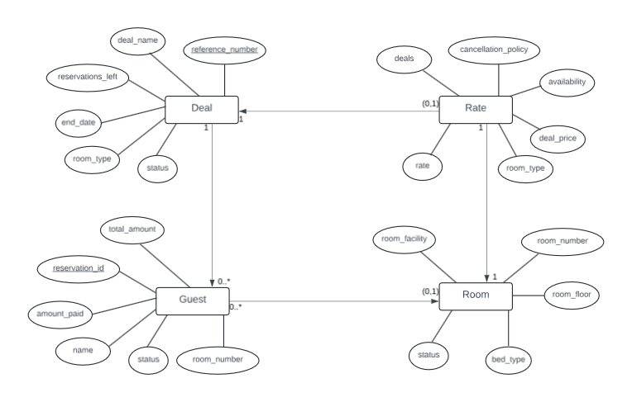
II. Analysis & Design
2. Entity-Relationship diagram (ERD)

Slide 8
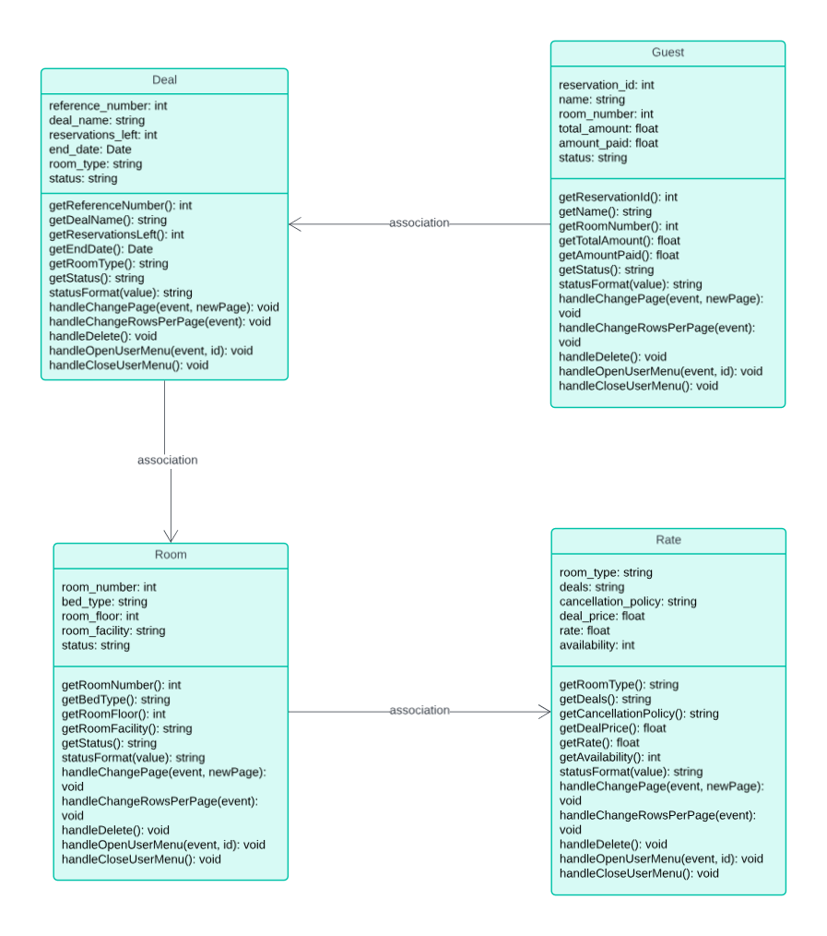
II. Analysis & Design
3. Class diagram

Slide 9
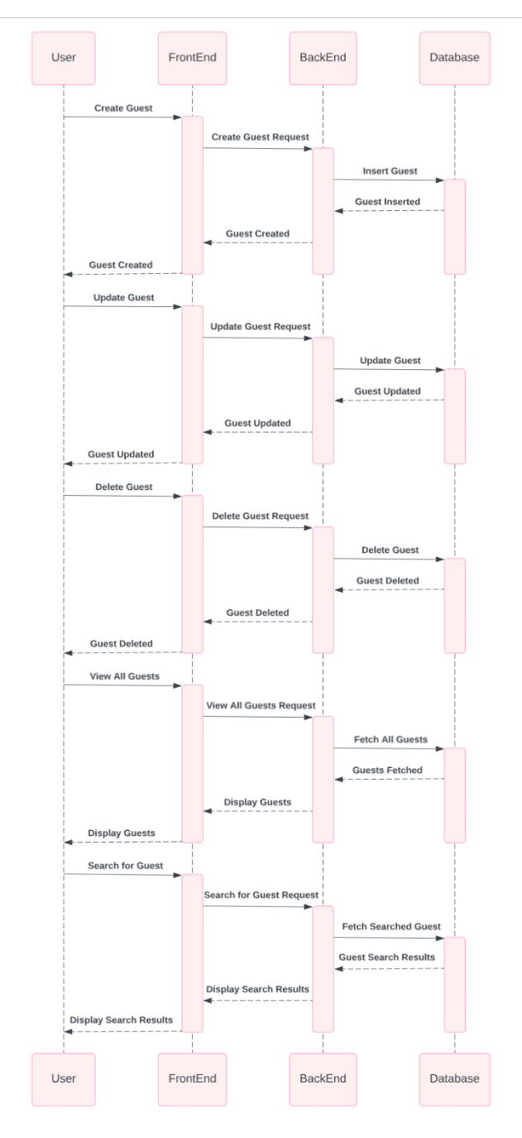
II. Analysis & Design
4. Sequence diagram

Slide 10
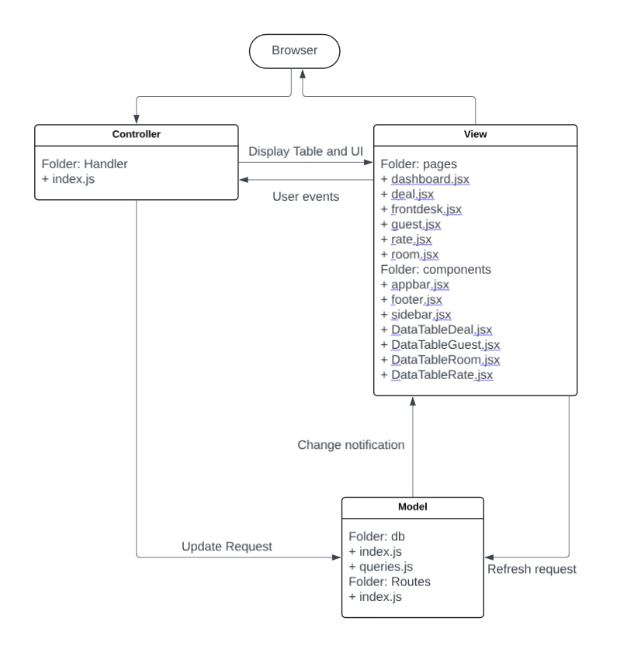
II. Analysis & Design
3. Design structure

Slide 11
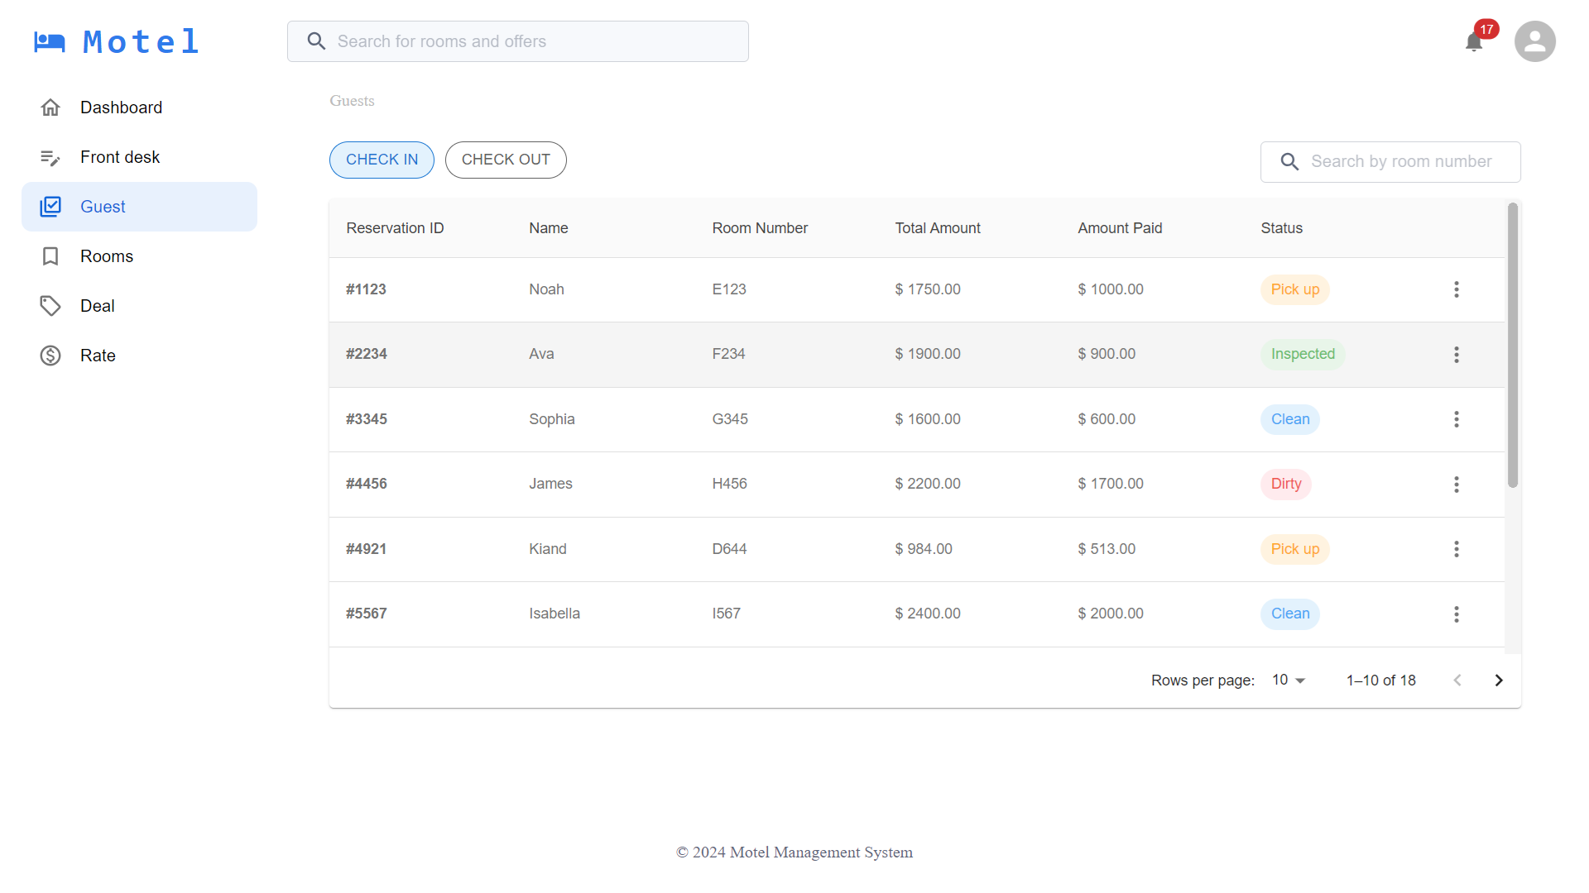
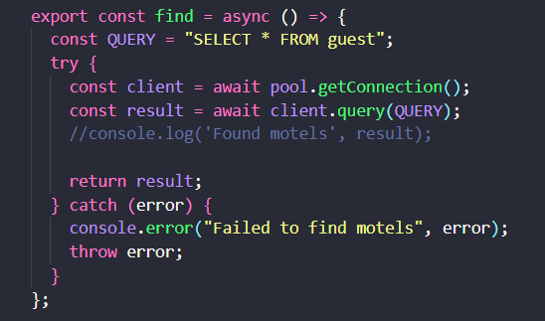
III. Implementation
1. Guest management

Slide 12
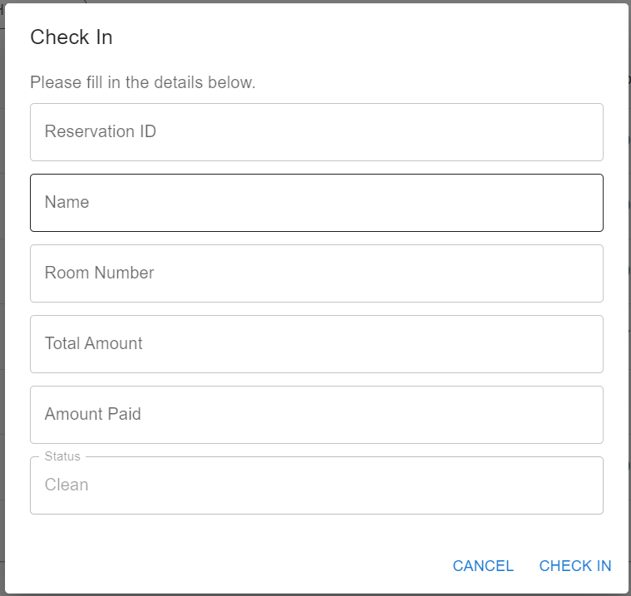
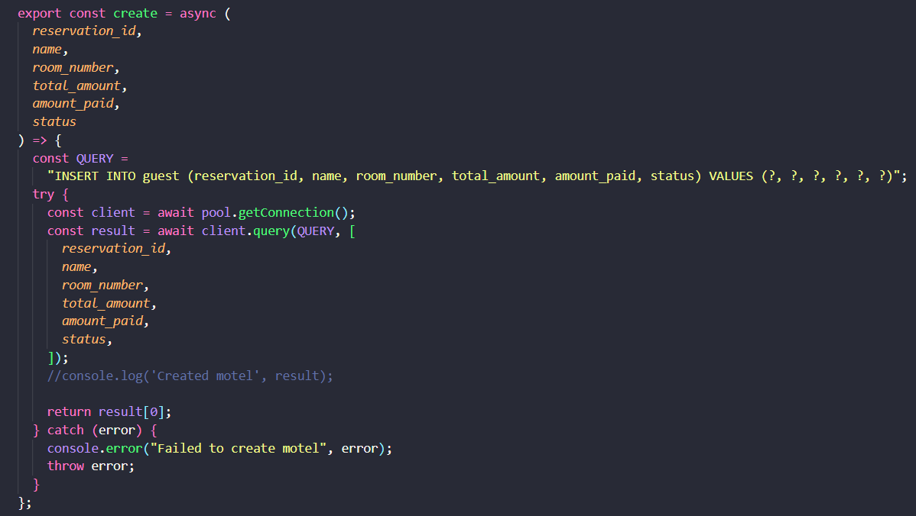
III. Implementation
2. Add guest

Slide 13
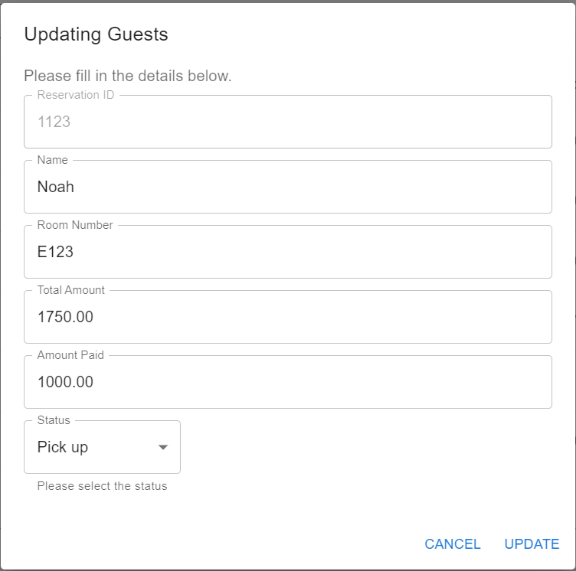
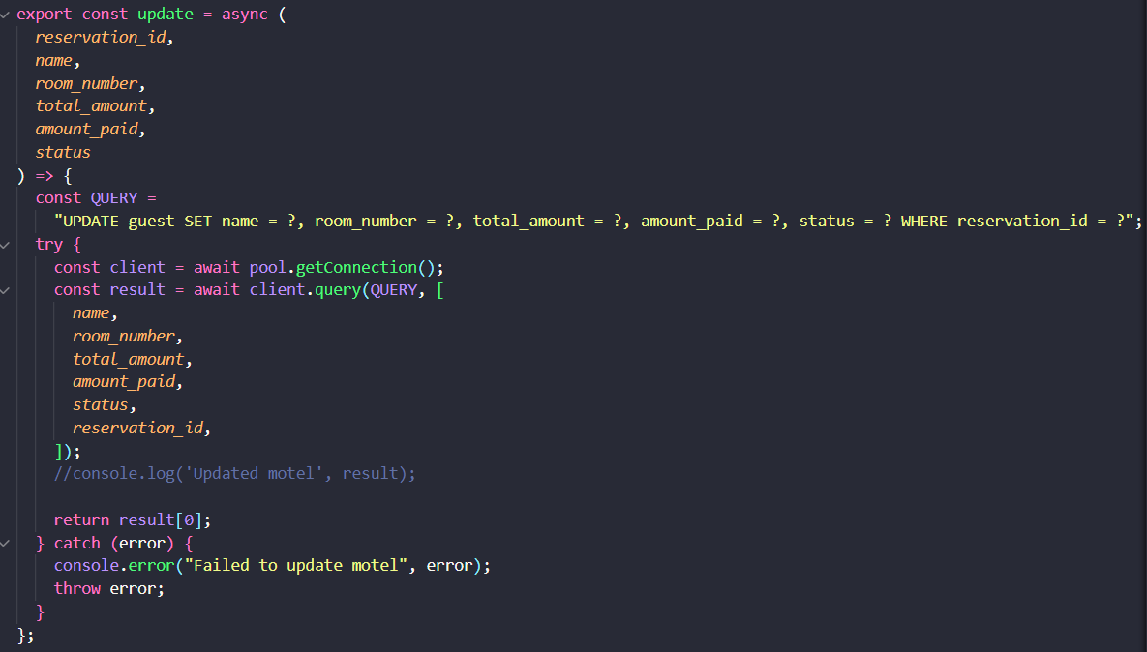
III. Implementation
3. Update guest

Slide 14
III. Implementation
3. Check room infomation

