Slide 1


Tree Operation - Tree Data Structure Visualization Application
JavaFX desktop app that visualizes tree data structures and operations step by step for teaching and debugging.

Slide 2
Members & Assignment
Member
ID
Responsibilities & Contribution
Nguyen Tien Dung
202417116
Controller development, view designing and building, bug fixing, refactoring, navigation flow implementation, design class diagram, and use case diagram support— 21%
Nguyen Khac Khiem
202417142
Developed controller logic, designed and built view components, supported animation handling, implemented navigation flow, refactored code, and contributed to class diagram and use case diagram design — 21%
Tran Quang Thang
202417196
Model architecture design, tree data structure algorithm implementation, pseudo-code display implementation, controller connection support, report writing support, and use case diagram design. — 20%
Vu Khanh Toan
202417204
Model diagram design, BST, AVL and Red-Black Tree model implementation, pseudo-code display support, controller connection support, debugging and testing, main report and slide preparation, and partial controller/view development. — 20%
Nguyen Xuan Thuy
202417202
Partial View and Controller development, exception handling implementation, and input error handling support. — 18%

Slide 3
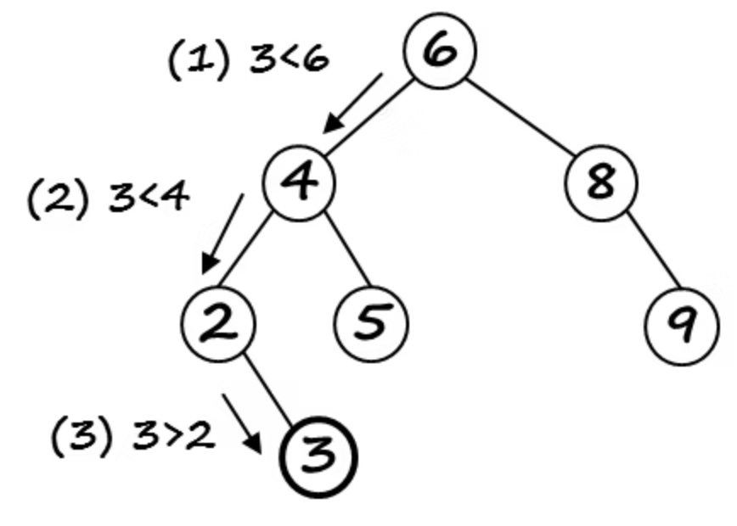
Problem Statement
Tree data structures are fundamental in computer science.
Static diagrams are not enough to understand tree algorithms.
Operations such as insertion, deletion, traversal, AVL rotation and Red-Black recoloring have many intermediate steps.
Our application solves this by visualizing tree operations step by step.

Slide 4
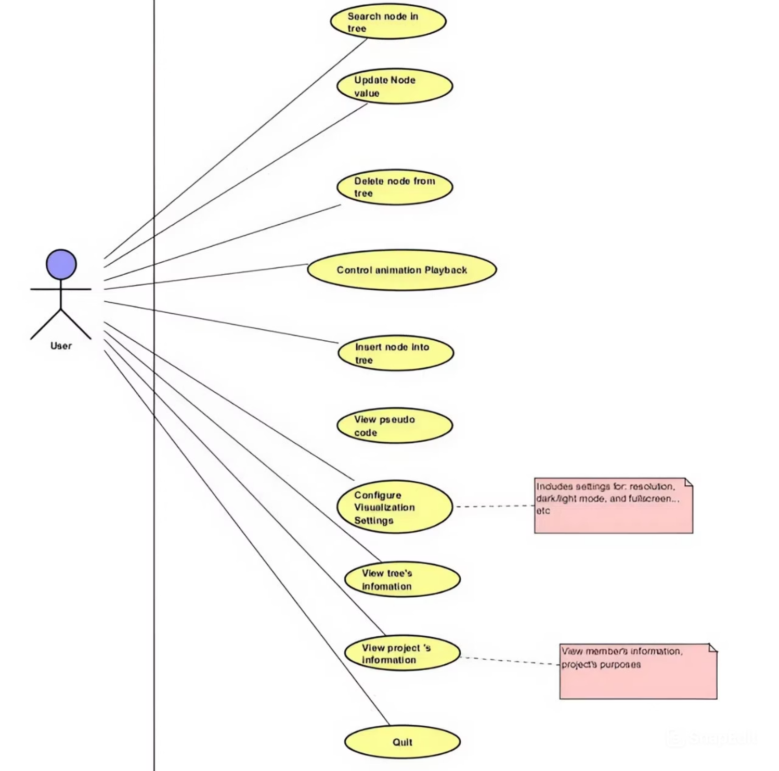
Main Features
Use Cases
Insert, delete, update and search nodes
View traversal and algorithm steps
Control animation playback
Customize theme, resolution and fullscreen mode
View tree details and project information

Slide 5
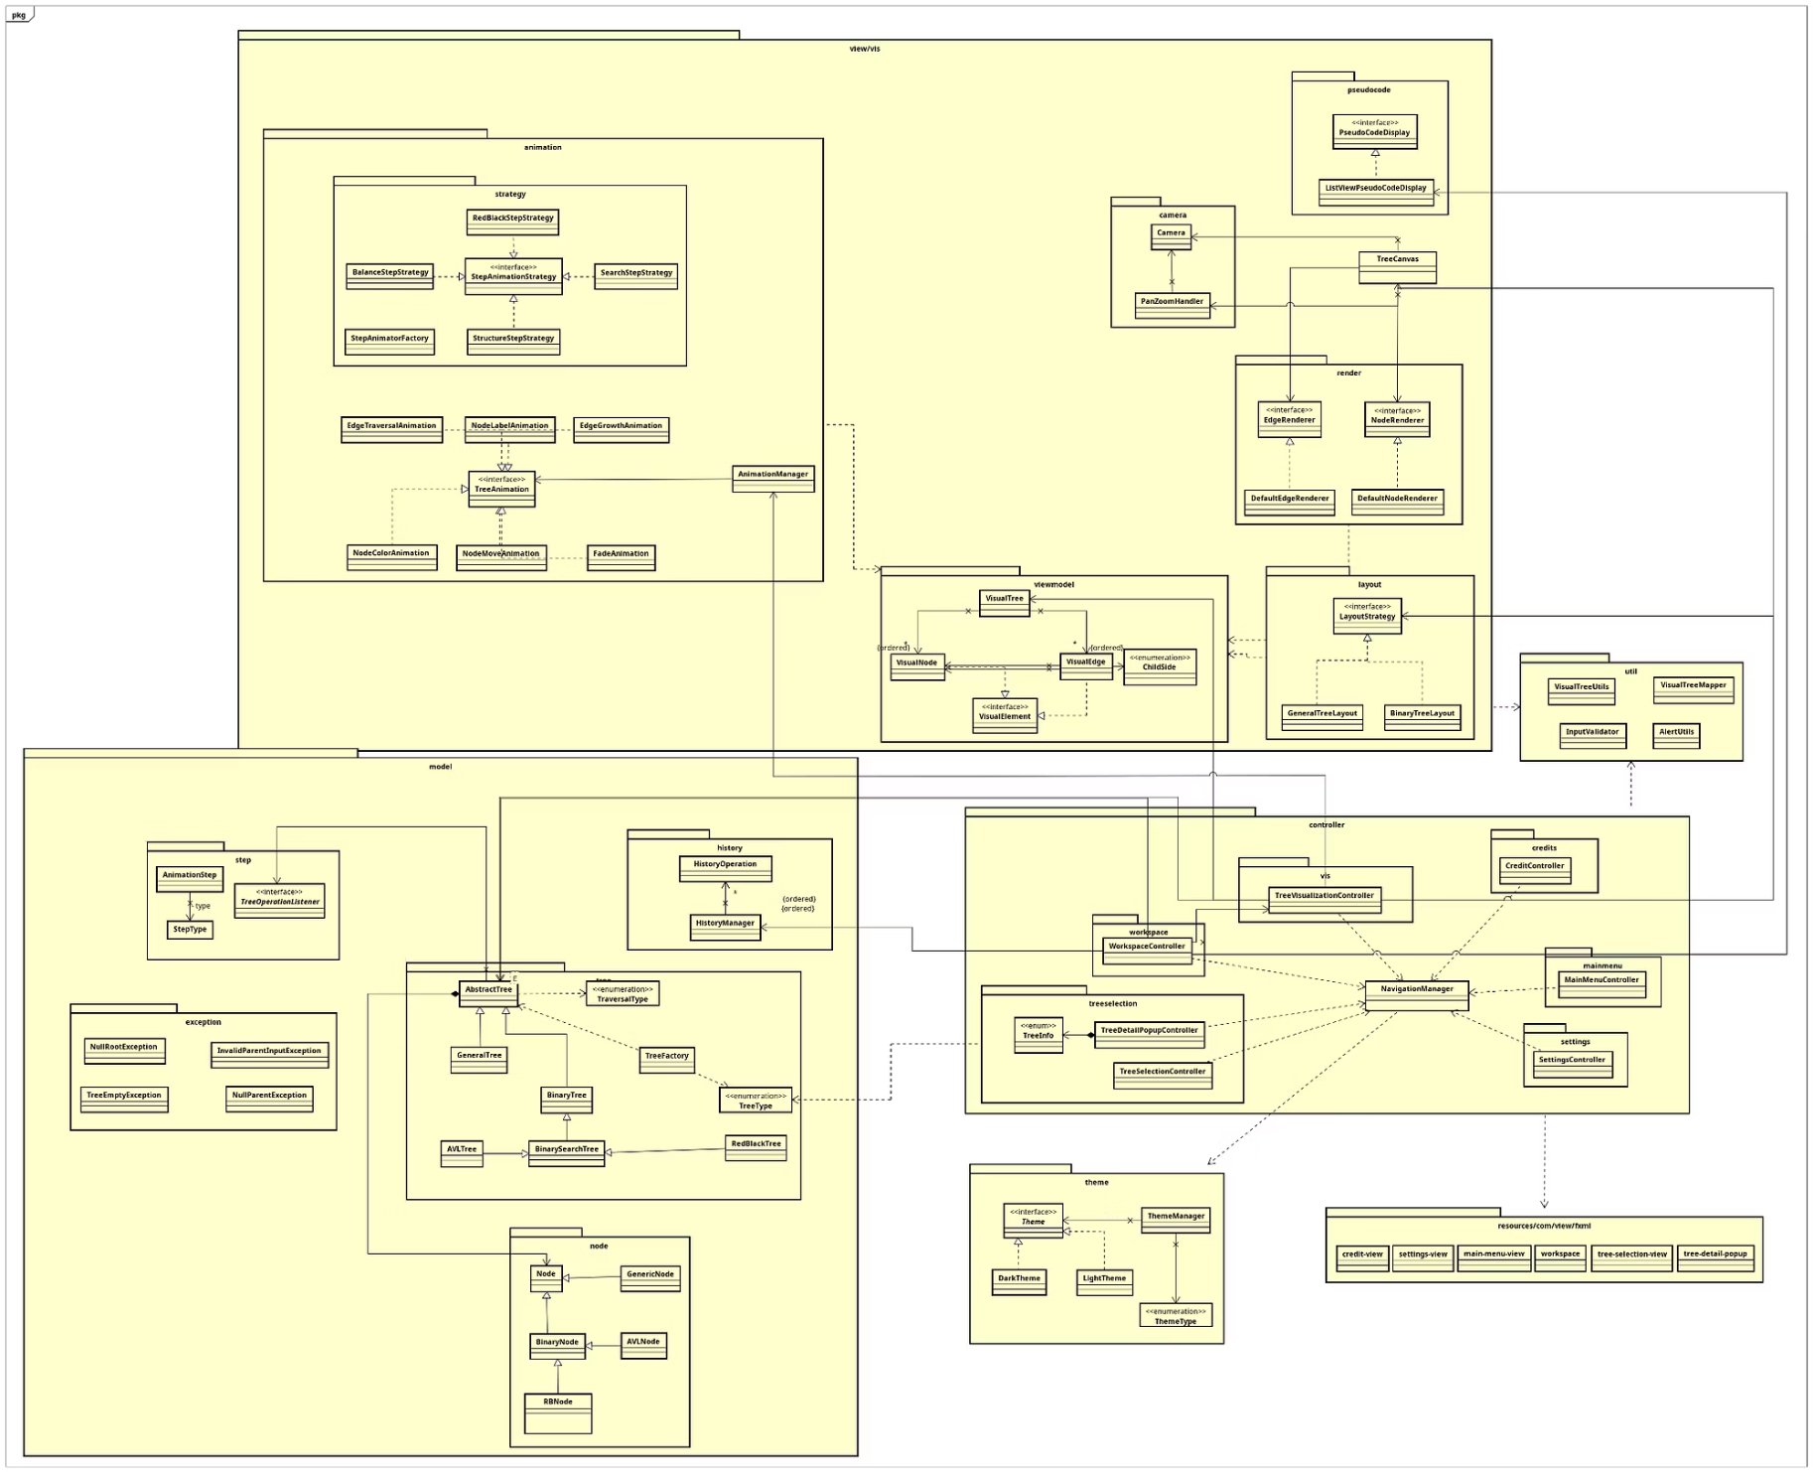
General Class Diagram
Explain the overall MVC architecture:
Model: tree structures, nodes, algorithm steps and history
View: canvas, visual tree, layouts, renderers and animations
Controller: handles user actions, navigation and visualization flow
Supporting packages: theme, util, exceptions and FXML resources
The model reports operation steps but does not depend on JavaFX UI

Slide 6
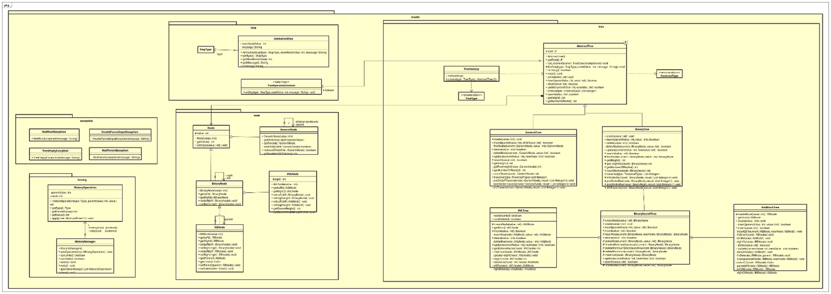
Model Class Diagram
AbstractTree defines the common tree operation API.
Concrete trees implement different rules: GeneralTree, BinaryTree, BST, AVL and Red-Black.
Node hierarchy represents different node types: GenericNode, BinaryNode, AVLNode and RBNode.
Step classes report algorithm events through StepType, AnimationStep and TreeOperationListener.
Supporting classes handle factory creation, traversal types, history and exceptions.

Slide 7
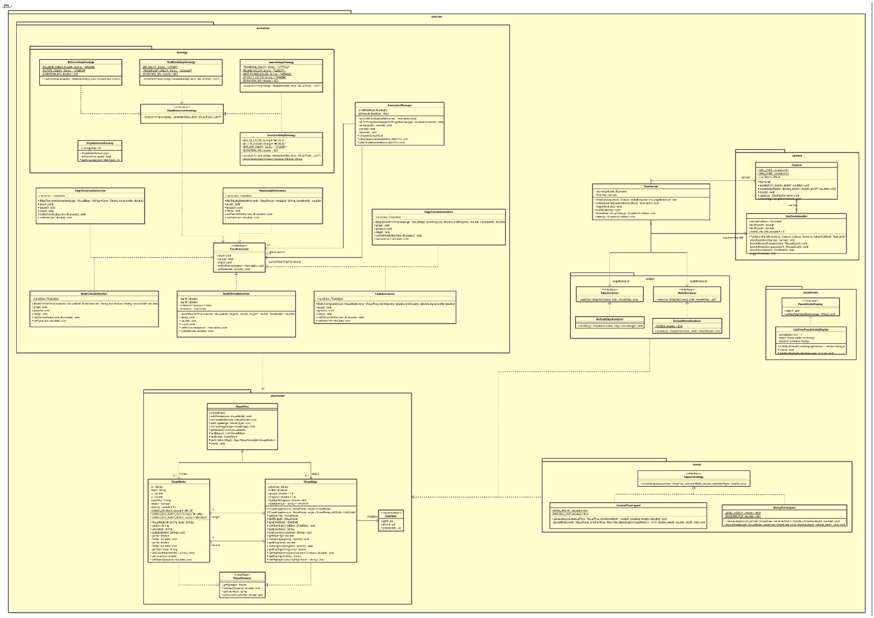
View Class Diagram
VisualTree, VisualNode and VisualEdge store the visual state.
VisualTree, VisualNode and VisualEdge store the visual state.
Renderers separate node and edge drawing logic.
LayoutStrategy supports GeneralTreeLayout and BinaryTreeLayout.
Animation and strategy classes convert algorithm steps into visual effects.
Camera and pseudocode components improve user interaction.

Slide 8
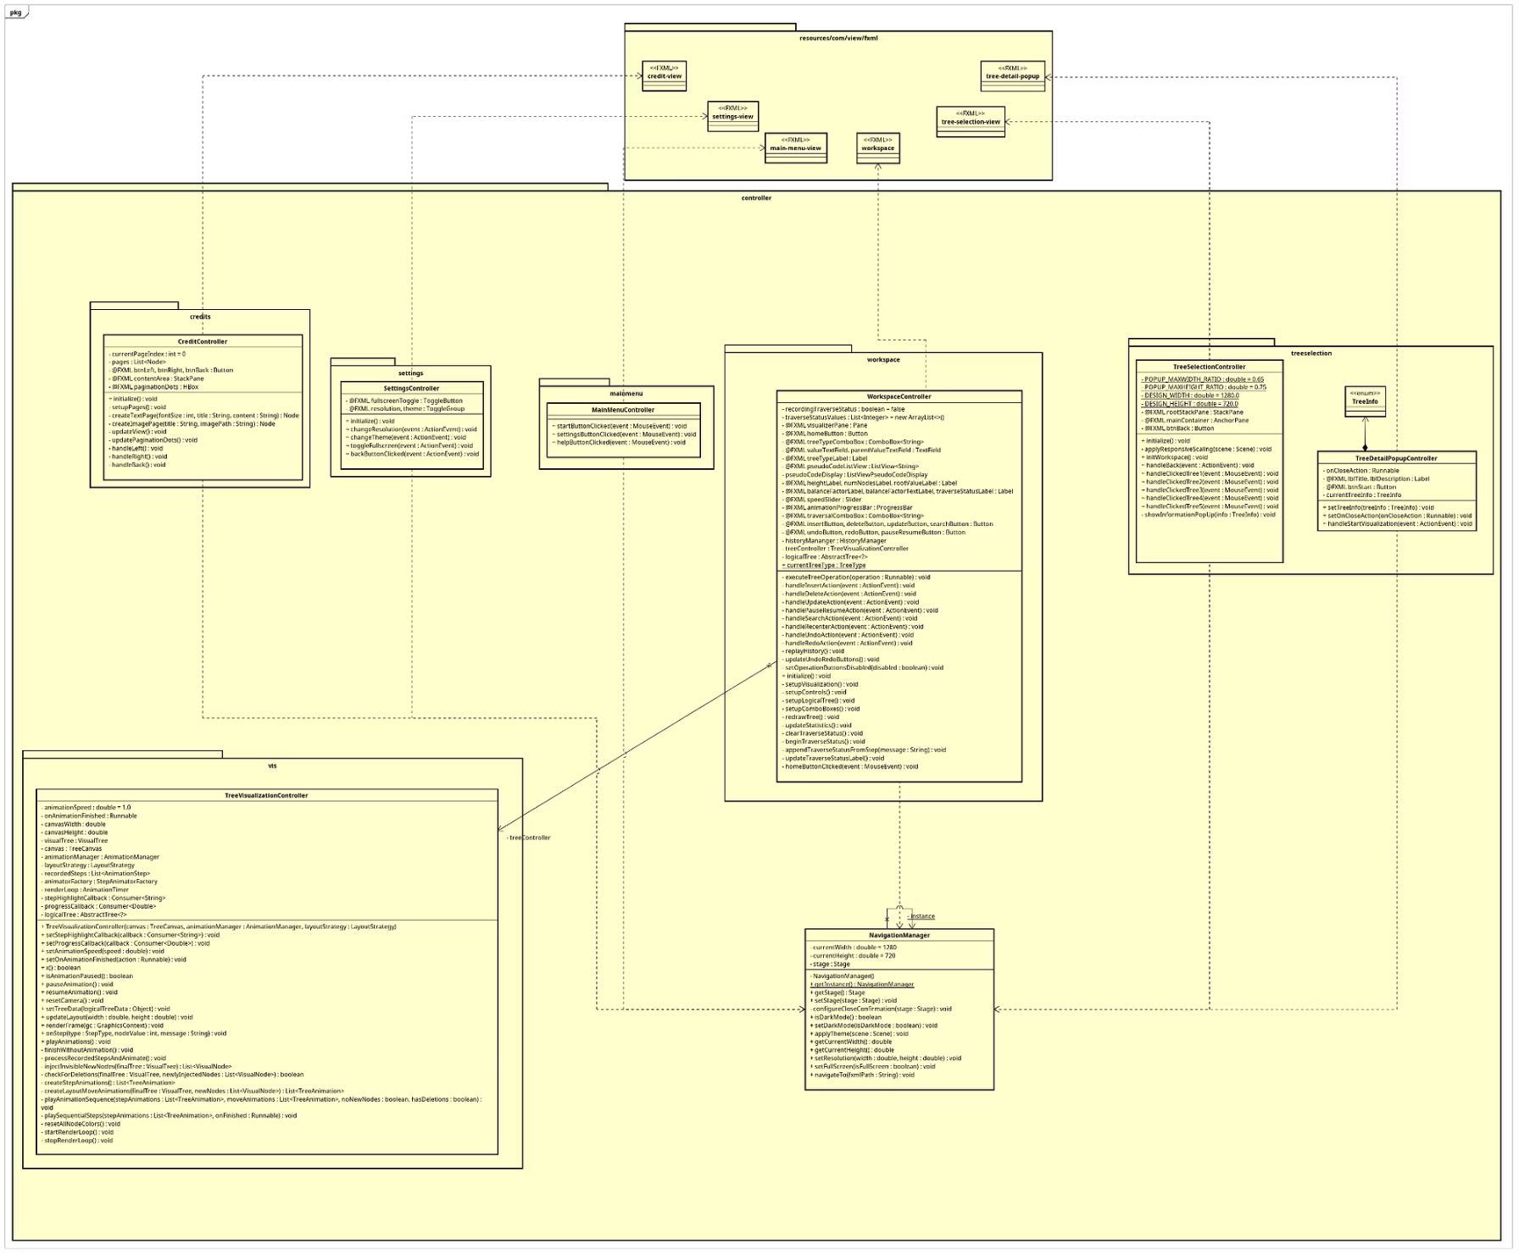
Controller Class Diagram
WorkspaceController handles tree operations and UI updates.
TreeVisualizationController records model steps and converts them into animations.
NavigationManager centralizes screen switching and theme application.
TreeSelectionController and TreeDetailPopupController manage tree selection flow.
MainMenu, Settings and Credit controllers handle their own screens.

Slide 9
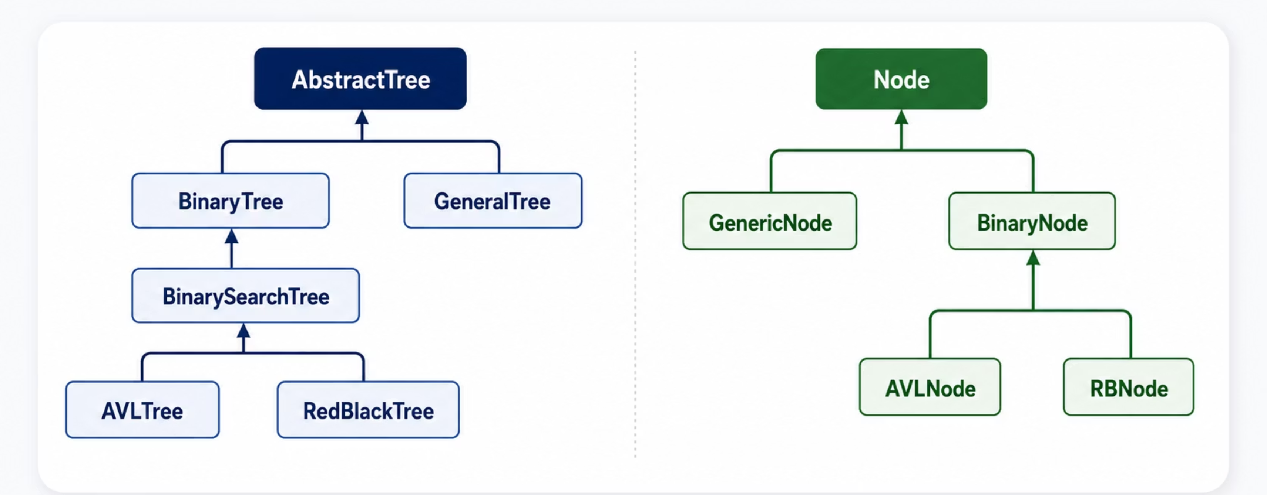
OOP Technique - Inheritance
AbstractTree defines the common operation contract for all tree types.
GeneralTree and BinaryTree inherit directly from AbstractTree.
BinarySearchTree extends BinaryTree, while AVLTree and RedBlackTree extend BinarySearchTree.
Node is the base class for GenericNode and BinaryNode.
AVLNode and RBNode specialize BinaryNode with height and color information.
Inheritance helps reuse shared behavior and keep tree interfaces consistent.

Slide 10

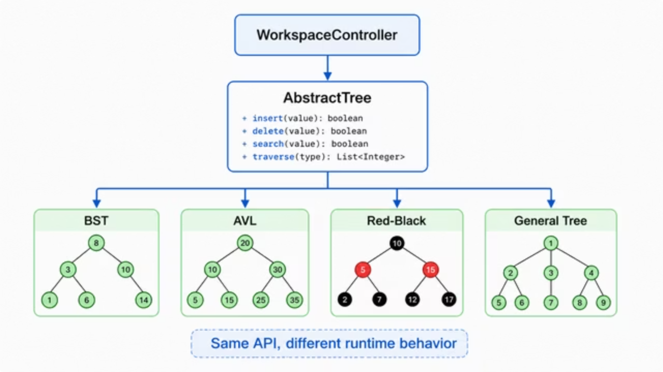
OOP Technique - Polymorphism
Polymorphism lets controllers use one common API while each tree type provides its own behavior.
Dynamic Dispatch
Same API, Different Behavior
WorkspaceController calls methods through AbstractTree<?>.
Java selects the correct tree implementation at runtime.
insert(), delete(), search() and traverse() are shared method names.
Each tree type implements them differently.
Factory Support
Interface Polymorphism
TreeFactory creates the correct tree object from TreeType.
The controller does not instantiate concrete trees directly.
LayoutStrategy and StepAnimationStrategy allow different layouts and animations through common interfaces.

Slide 11

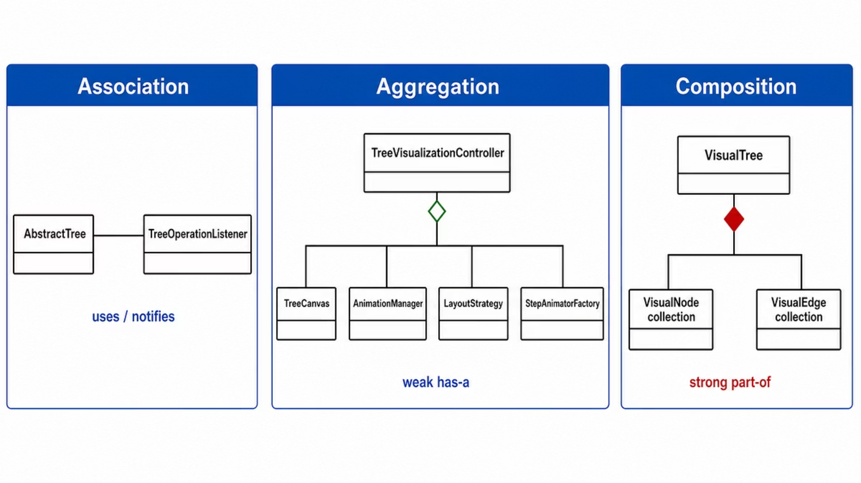
OOP Technique - Class Relationships
The system uses association, aggregation and composition to organize class dependencies.
Association
“uses-a” / “knows-a” relationship
AbstractTree notifies TreeOperationListener
Objects can exist independently
Aggregation
weak “has-a” relationship
TreeVisualizationController groups TreeCanvas, AnimationManager and LayoutStrategy
Parts can still exist independently
Composition
strong “part-of” relationship
VisualTree owns VisualNode and VisualEdge collections
Parts belong to the whole object's state

