Slide 1


Tree Operation - Tree Data Structure Visualization Application
JavaFX desktop app that visualizes tree data structures and operations step by step for teaching and debugging.

Slide 2
Members & Assignment
Member
ID
Responsibilities & Contribution
Nguyen Tien Dung
202417116
Controller development, view designing and building, bug fixing, refactoring, navigation flow implementation, design class diagram, and use case diagram support— 21%
Nguyen Khac Khiem
202417142
Developed controller logic, designed and built view components, supported animation handling, implemented navigation flow, refactored code, and contributed to class diagram and use case diagram design — 21%
Tran Quang Thang
202417196
Model architecture design, tree data structure algorithm implementation, pseudo-code display implementation, controller connection support, report writing support, and use case diagram design. — 20%
Vu Khanh Toan
202417204
Model diagram design, BST, AVL and Red-Black Tree model implementation, pseudo-code display support, controller connection support, debugging and testing, main report and slide preparation, and partial controller/view development. — 20%
Nguyen Xuan Thuy
202417202
Partial View and Controller development, exception handling implementation, and input error handling support. — 18%

Slide 3
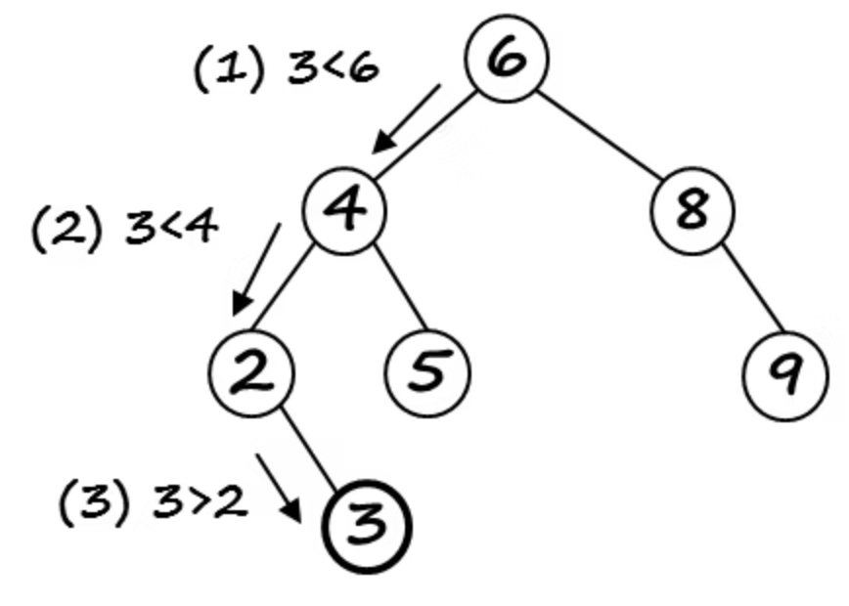
Problem Statement
Tree data structures are important in computer science.
Static diagrams are not enough to understand tree algorithms.
Insertion, deletion, traversal, AVL rotations, and Red‑Black recoloring have many intermediate steps.
We solve this by visualizing tree operations step by step.

Slide 4
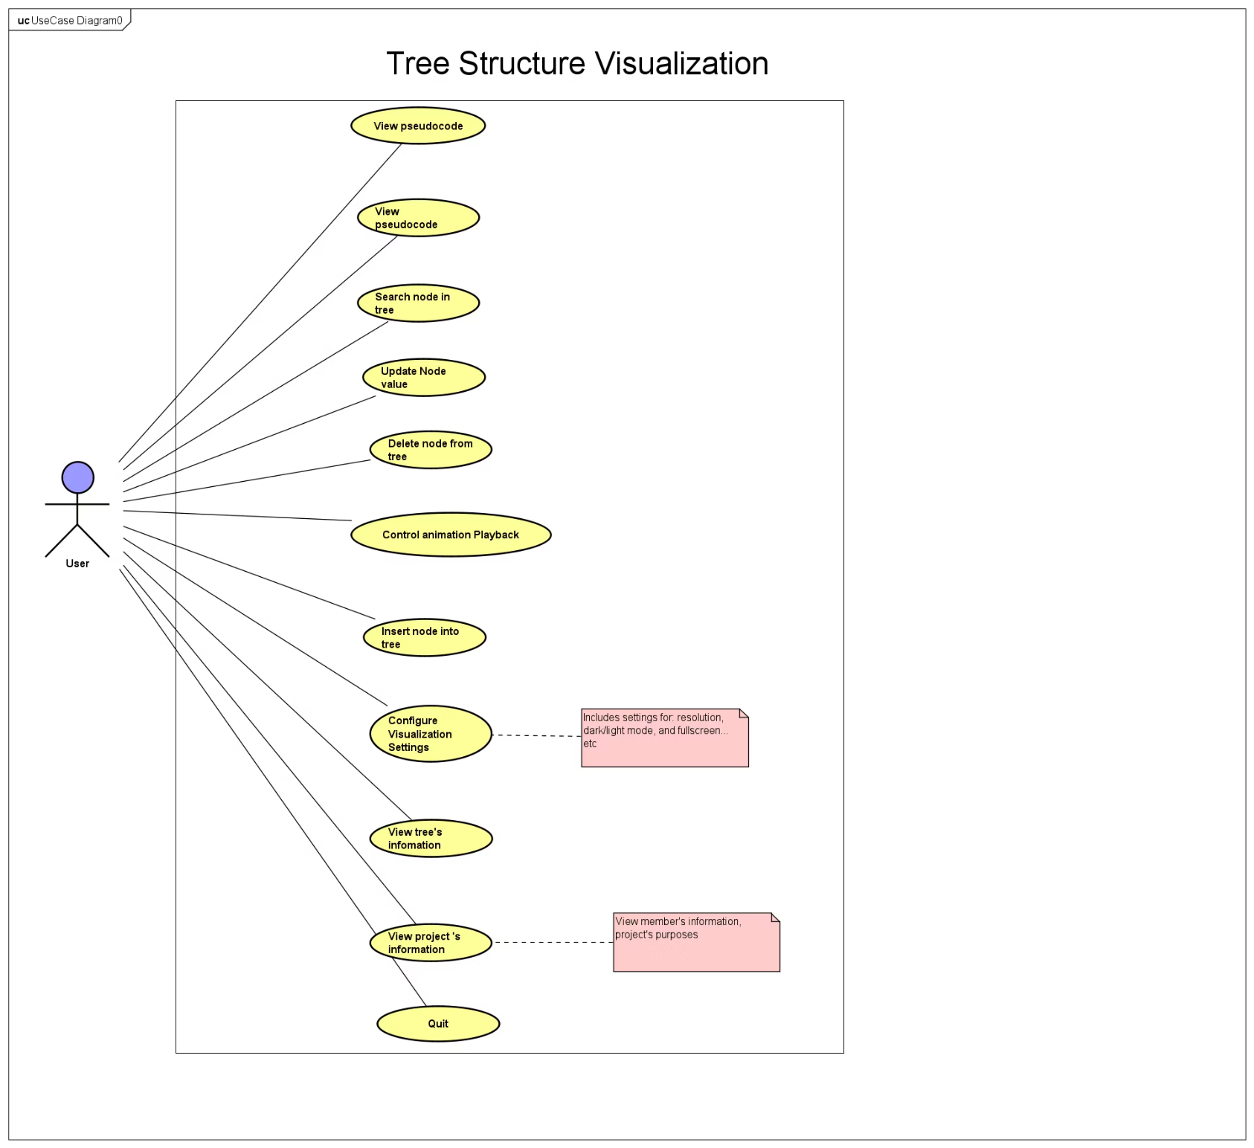
Use Cases
Main Features
Perform tree operations: insert, search, update, delete
View algorithm pseudocode
Control animation playback
Customize visualization settings
View tree and project information

Slide 5
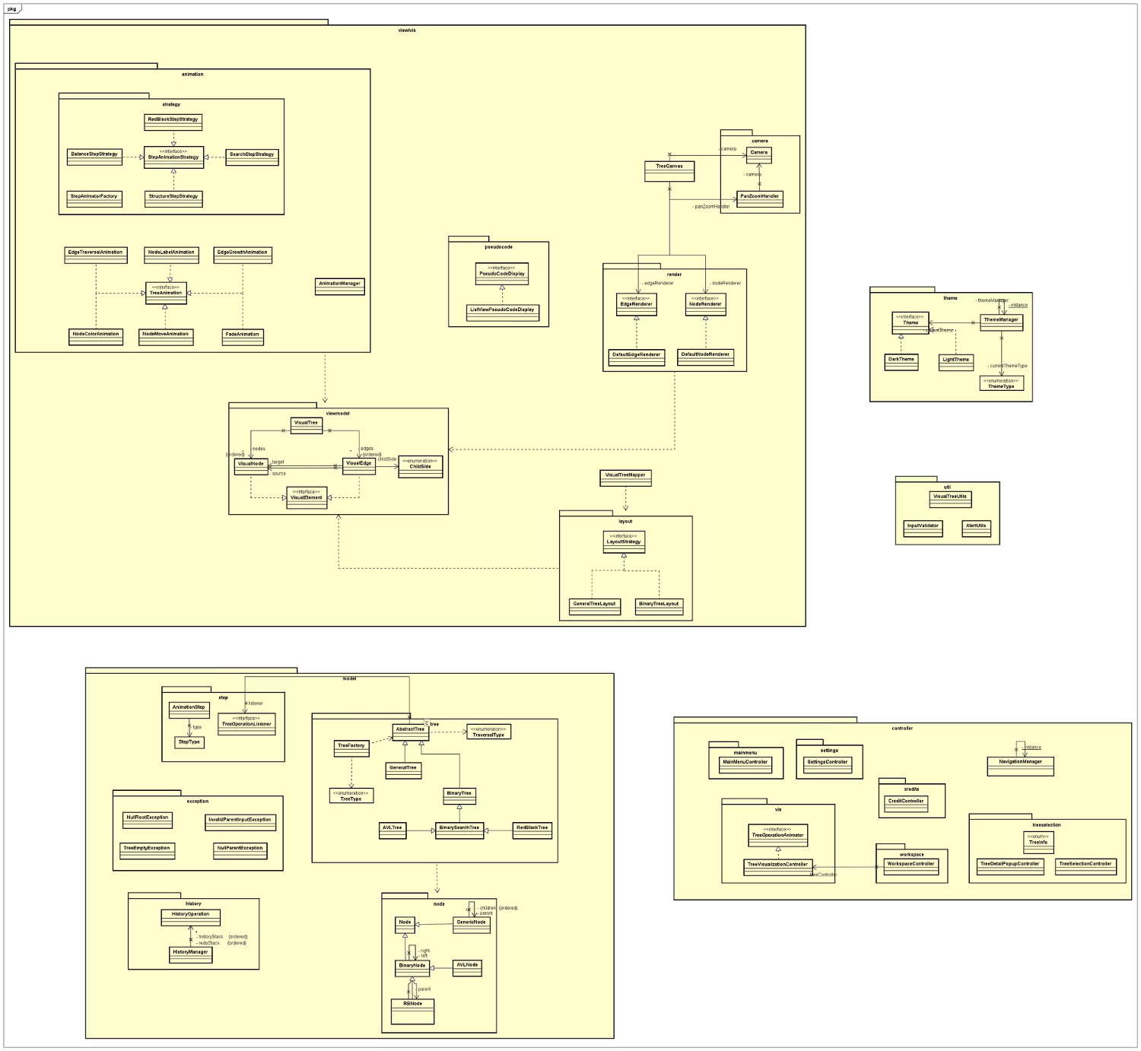
General Class Diagram
Explain the overall MVC architecture:
Model: tree algorithms, nodes, operation steps, history, exceptions
View: canvas, visual nodes, visual edges, renderers, layouts
Controller: workspace, navigation, tree selection, visualization, settings
The model does not directly depend on JavaFX UI.

Slide 6
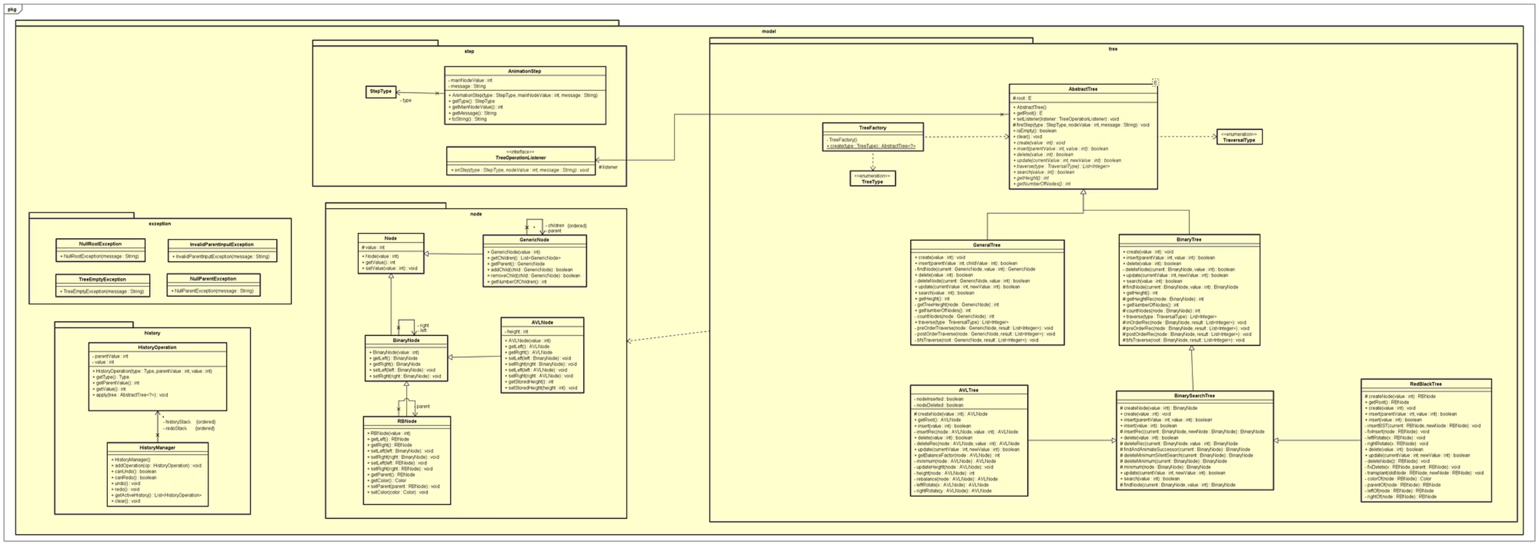
Model Class Diagram
AbstractTree defines the common tree API.
Concrete tree classes: GeneralTree, BinaryTree, BinarySearchTree, AVLTree, RedBlackTree.
Node classes: Node, GenericNode, BinaryNode, AVLNode, RBNode.
Step classes: StepType, AnimationStep, TreeOperationListener.

Slide 7
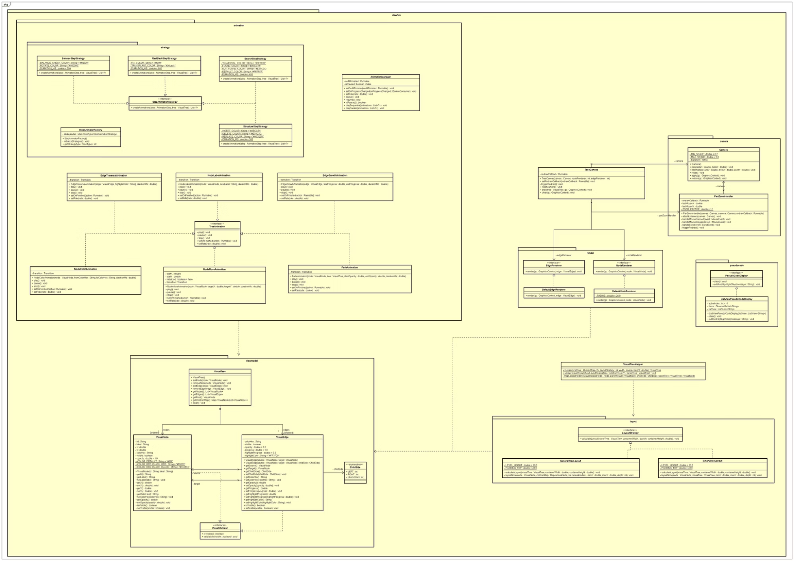
View Class Diagram
VisualTree, VisualNode, VisualEdge represent the visual state.
VisualTreeMapper converts logical trees into visual trees.
TreeCanvas renders the tree on JavaFX Canvas.
NodeRenderer and EdgeRenderer handle drawing.
LayoutStrategy is implemented by BinaryTreeLayout and GeneralTreeLayout.

Slide 8
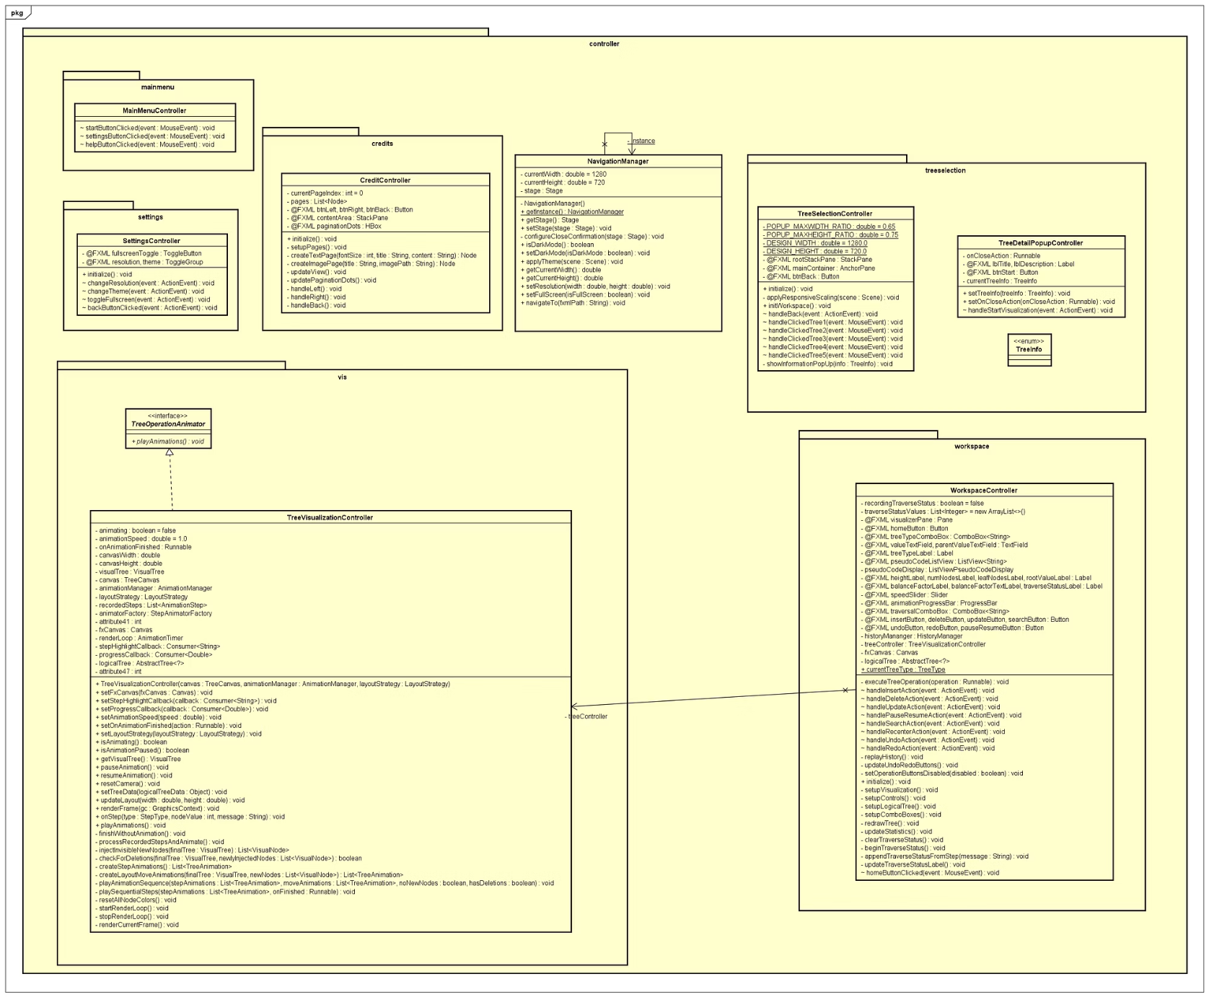
Controller Class Diagram
WorkspaceController handles main user operations.
TreeVisualization Controller records model steps and plays animations.
NavigationManager handles screen switching.
TreeSelection Controller handles tree type selection.
SettingsController handles theme and resolution settings.

Slide 9
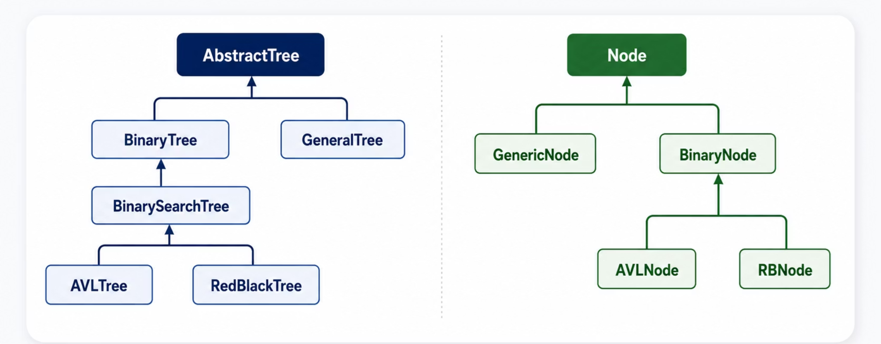
OOP Technique - Inheritance
AbstractTree serves as the foundational base class for all concrete tree implementations.
BinarySearchTree, AVLTree, and RedBlackTree inherit and expand upon binary tree functionalities.
Node provides the base structure for specialized node types like GenericNode and BinaryNode.
AVLNode extends BinaryNode, incorporating height information for balancing.
RBNode extends BinaryNode, adding color attributes essential for Red-Black Tree properties.
This inheritance structure promotes code reuse and ensures consistent interfaces across all tree implementations.

Slide 10

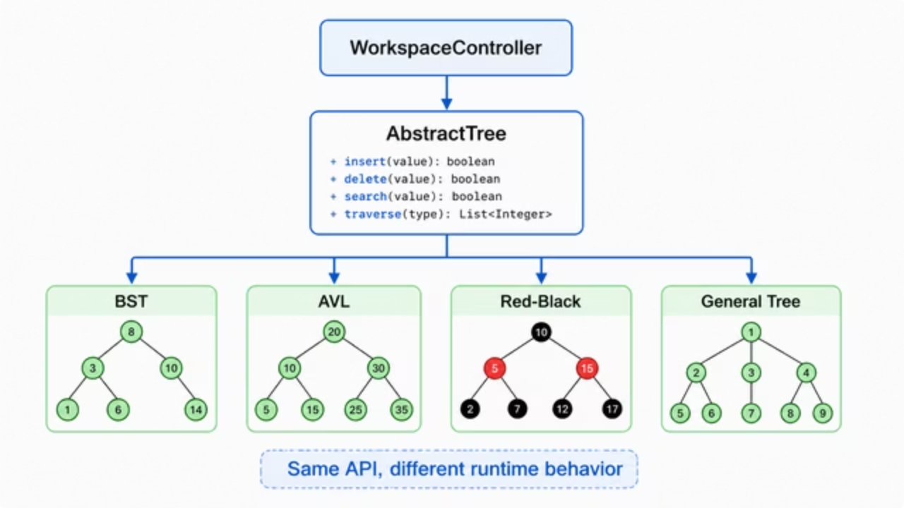
OOP Technique - Polymorphism
Polymorphism is crucial for handling diverse tree types dynamically without altering core controller logic.
Dynamic Dispatch
Same API, Different Behavior
The controller calls methods through AbstractTree. At runtime, Java chooses the correct implementation for BST, AVL, Red-Black, or General Tree.
insert(), delete(), search(), and traverse() share the same method names, but each tree type implements its own algorithm.
Factory Support
Interface Polymorphism
TreeFactory returns the correct tree object from TreeType, so object creation is centralized and controller logic stays simple.
LayoutStrategy and StepAnimationStrategy allow different layout and animation behaviors to be used through common interfaces.

Slide 11

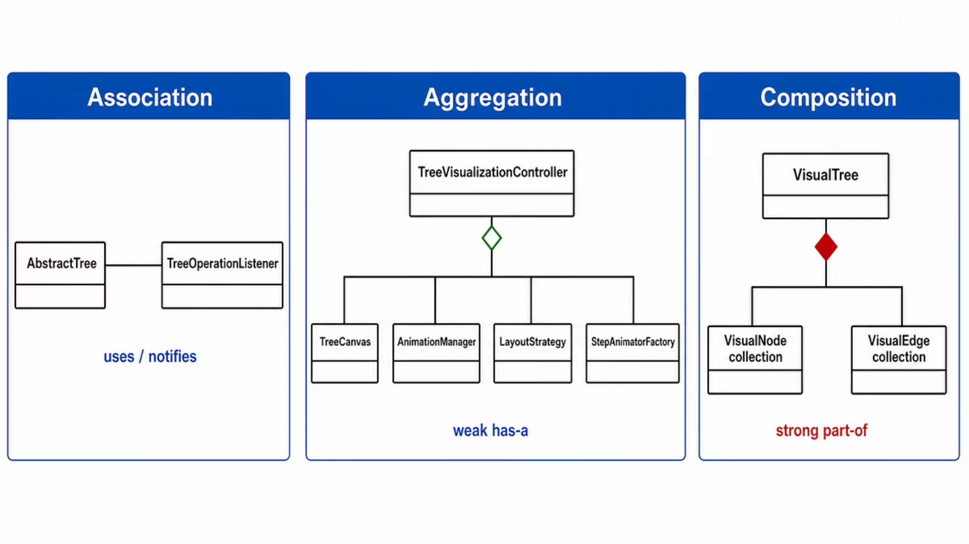
OOP Technique - Association, Aggregation, Composition
Understanding the relationships between classes is crucial for building robust and maintainable software architectures.
Association
"uses-a" / "knows-a"
AbstractTree notifies TreeOperationListener
Objects can exist independently
Aggregation
weak "has-a"
TreeVisualizationController groups Canvas, AnimationManager, LayoutStrategy
Parts can still exist independently
Composition
strong "part-of"
VisualTree owns VisualNode and VisualEdge collections
Parts belong to the whole object state

