Slide 1
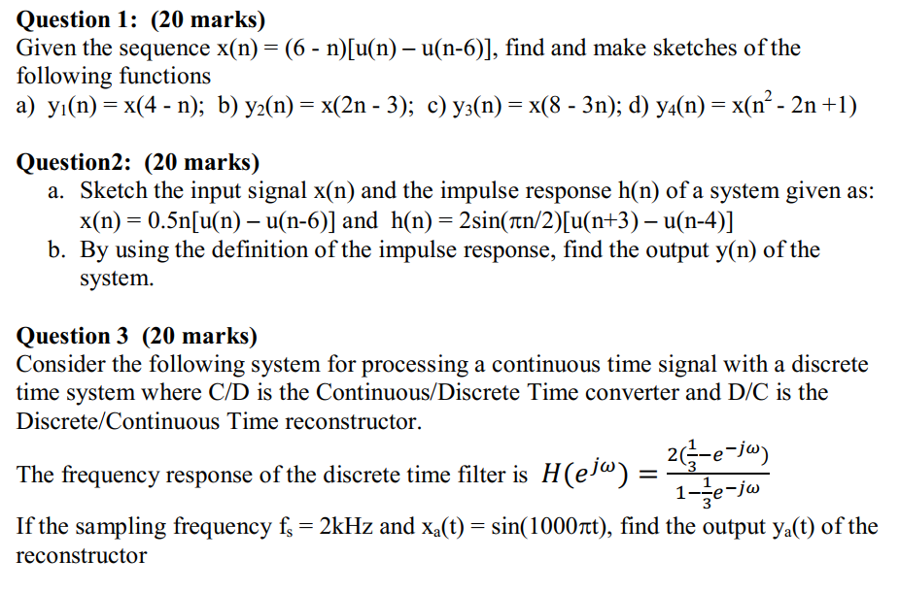
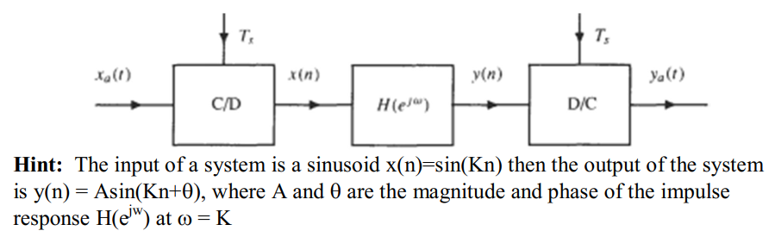
Mid-term
Paper
Pen
Calculator

Slide 2
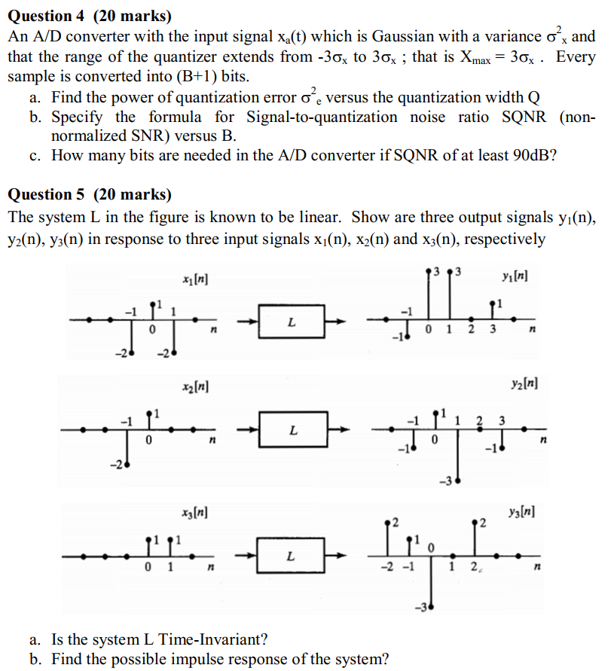
Mid-term
Paper
Pen
Calculator

Slide 3
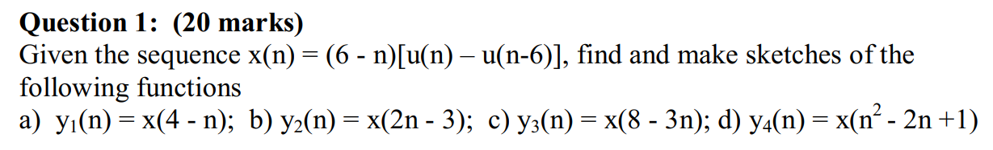
x(n) = { 6^; 5; 4; 3; 2; 1 }
y₁(n) = { ; ; ; ; ; }
y₂(n) = { ; ; ; ; ; }
y₃(n) = { ; ; ; ; ; }
y₄(n) = { ; ; ; ; ; }

Slide 4
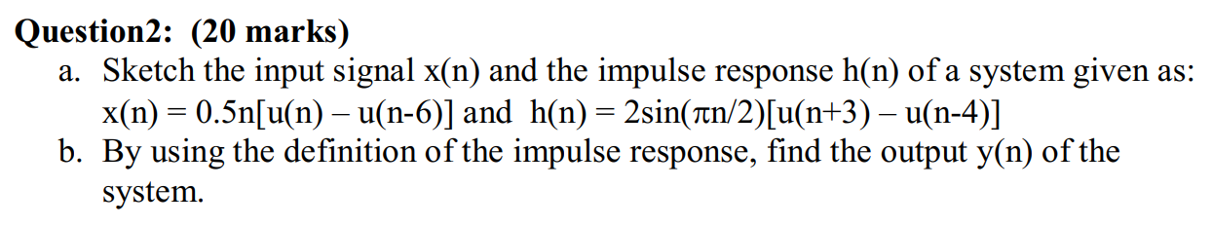
x(n) = { 0^; 0.5; 1; 1.5; 2; 2.5 }
h(n) = { 2; 0; -2; 0^; 2; 0; -2 }

Slide 5
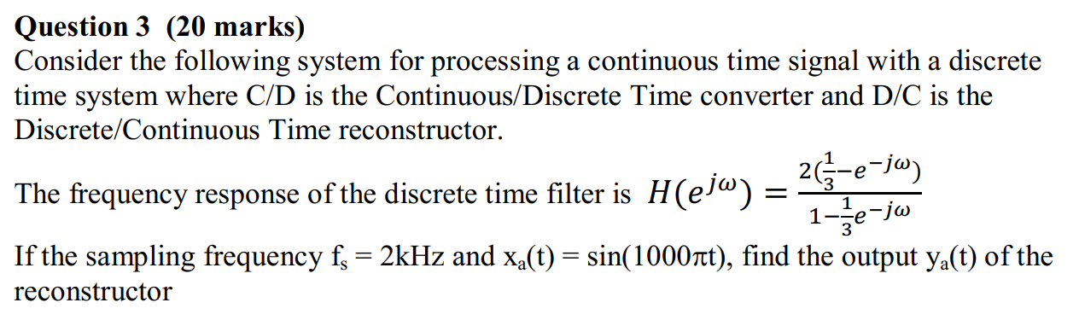
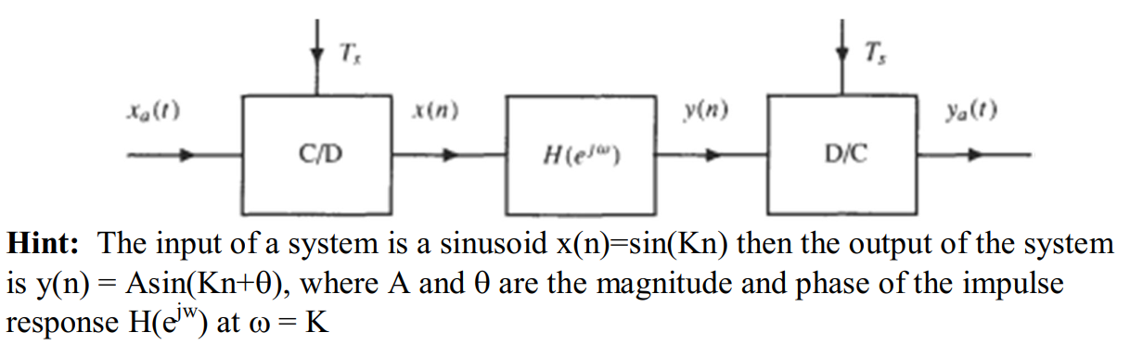
sampling period T_{s} = 1/F_{s}
sampled signal x(n) = x(t=nT_{s})

Slide 6
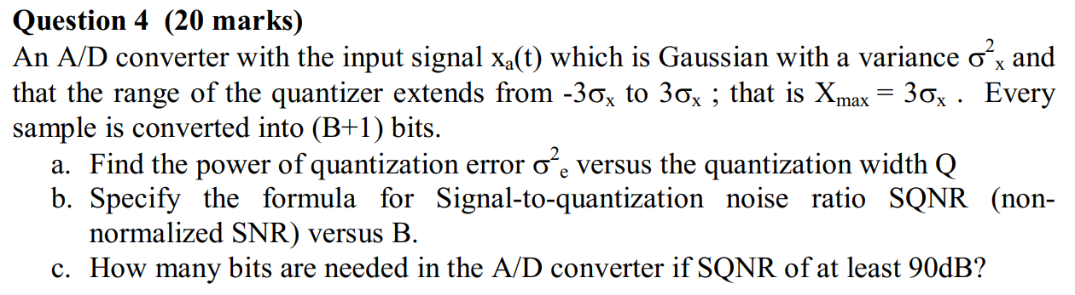
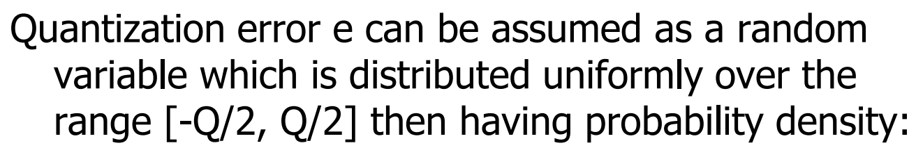
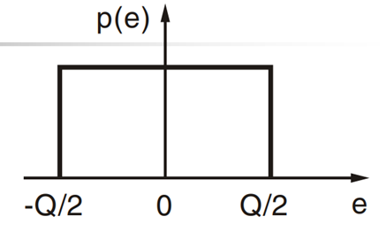
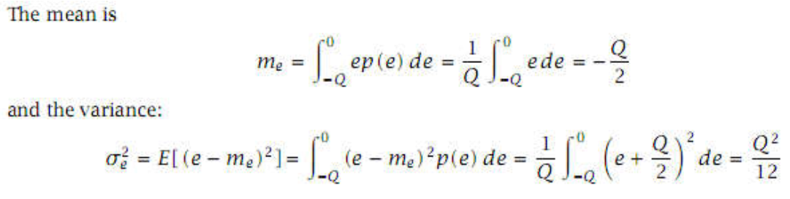
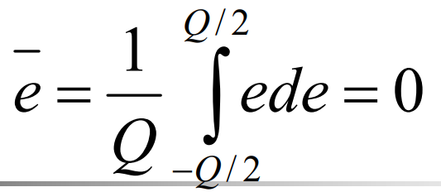
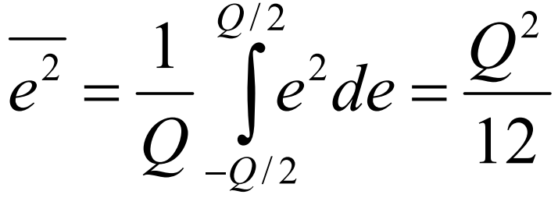
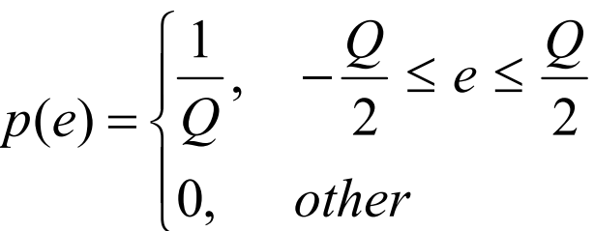

Slide 7
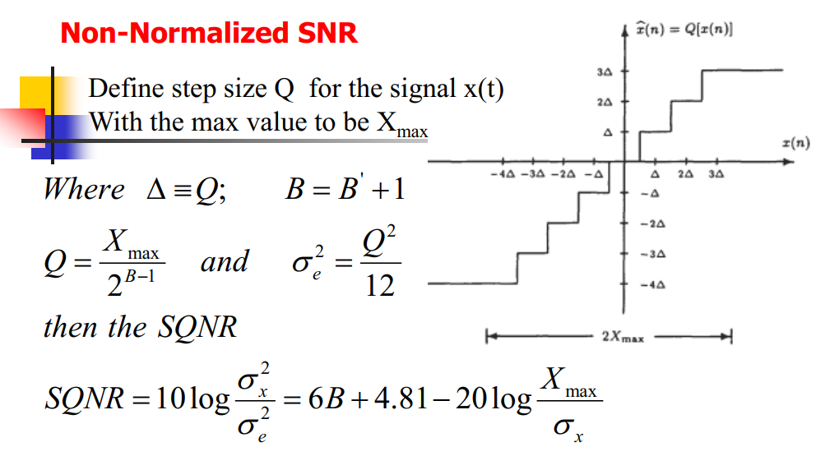




Slide 8
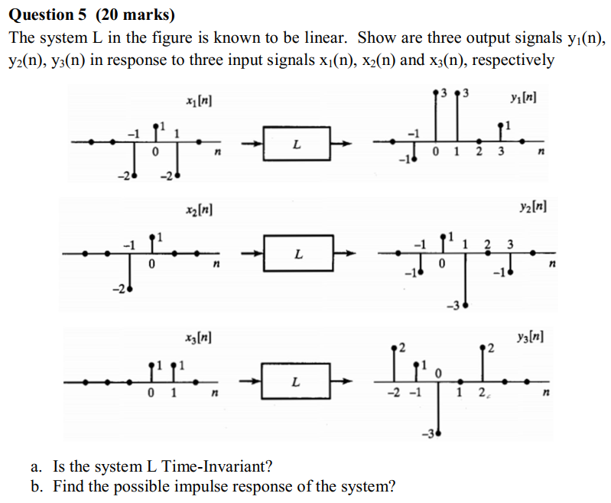
k₁x₁(n – D₁) + k₂x₂(n – D₂) + k₃x₃(n – D₃) = 0
if k₁y₁(n – D₁) + k₂y₂(n – D₂) + k₃y₃(n – D₃) ≠ 0: not time-invariant
if k₁y₁(n – D₁) + k₂y₂(n – D₂) + k₃y₃(n – D₃) = 0: maybe time-invariant
δ(n) = c₁x₁(n) + c₂x₂(n) + c₃x₃(n)
h(n) = c₁y₁(n) + c₂y₂(n) + c₃y₃(n)

Slide 9
x₄(n) = a₁x₁(n) + a₂x₂(n) + a₃x₃(n)
x₅(n) = b₁x₁(n) + b₂x₂(n) + b₃x₃(n)
x₅(n) = x₄(n – D)
y₄(n) = a₁y₁(n) + a₂y₂(n) + a₃y₃(n)
y₅(n) = b₁y₁(n) + b₂y₂(n) + b₃y₃(n)
if y₅(n) ≠ y₄(n – D): not time-invariant
if y₅(n) = y₄(n – D): maybe time-invariant
δ(n) = c₁x₁(n) + c₂x₂(n) + c₃x₃(n)
h(n) = c₁y₁(n) + c₂y₂(n) + c₃y₃(n)

Slide 10
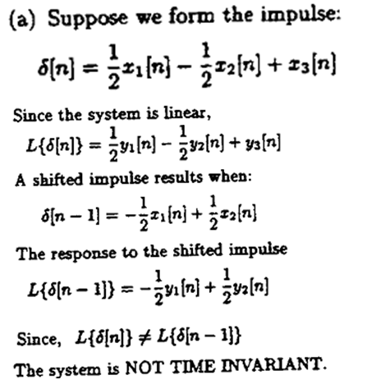
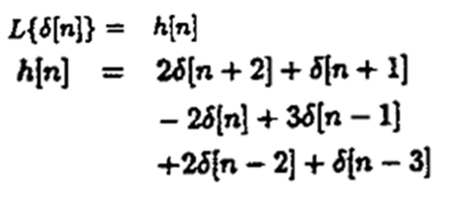

Slide 11
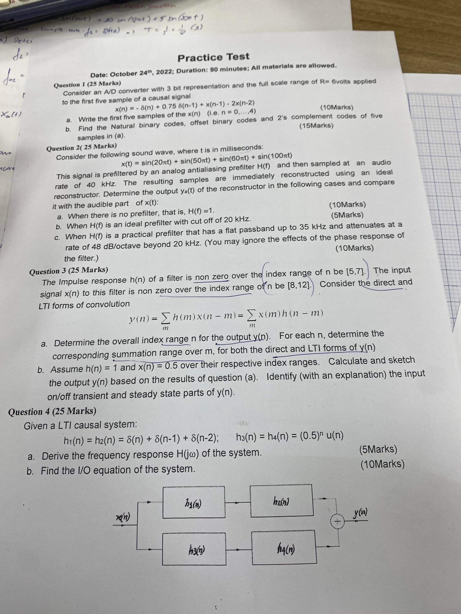

Slide 12
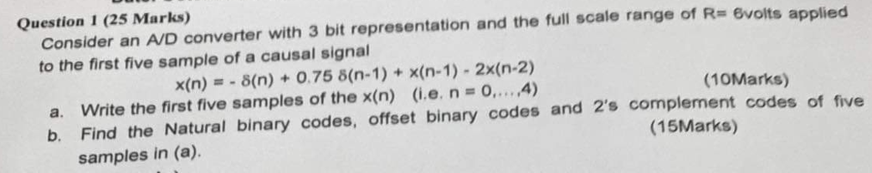
Causal signal: x(n<0) = 0
x(0) = -1
x(1) = -0,25
x(0) = 1,75
x(0) = 2,25
x(0) = -1,25

