Slide 1
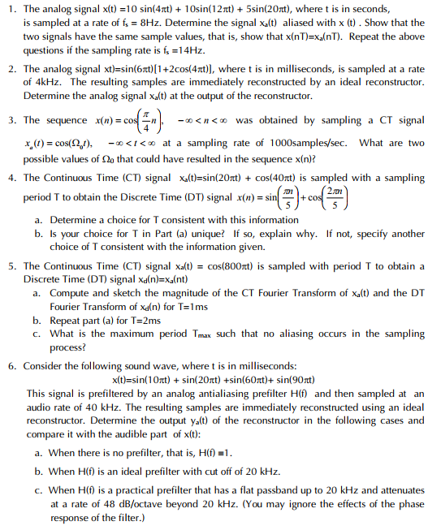
Tutorial 2
Paper
Pen
Calculator

Slide 2
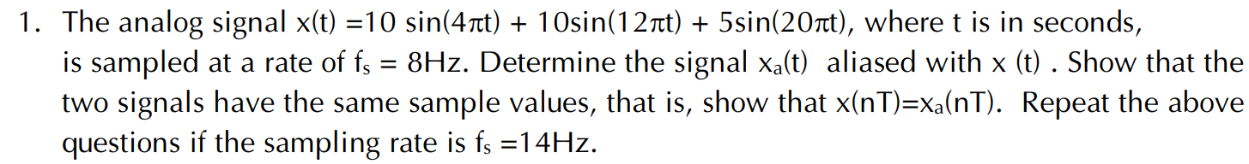
sampling period T = 1/F_{s}
sampled signal x(n) = x(nT) = x(t=nT)
x(t) with frequency F_{x} → aliased signal x_{a}(t) with frequency F_{a} ≠ F_{x}
Definition 1 (based on sampling): F_{a} = F_{x} + k.F_{s} → many sols
Definition 2 (based on rescontruction): F_{a} = (F_{x} + k.F_{s})∈ [-F_{s}/2 ÷ F_{s}/2] → only 1 sol

Slide 3
x(t) with frequency F_{x} → aliased signal x_{a}(t) with frequency F_{a} = (F_{x} + k.F_{s}) ∈ [-F_{s}/2 ÷ F_{s}/2]
F₁ = 2, F₂ = 6, F₃ = 10 (Hz)
F_{1aliased} = 2, F_{2aliased} = -2, F_{3aliased} = 2
→ x_{aliased}(t) = 10sin(2.π.2.t) + 10sin(2.π.(-2).t) + 5sin(2.π.2.t)
x_{aliased}(t) ≠ x(t) ?
x_{aliased}(n) = x(n) ?
x(n) = 10sin(4.π.n.T) + 10sin(12.π.n.T) + 5sin(20.π.n.T)
x_{aliased}(n) = 10sin(2.π.2.n.T) + 10sin(2.π.(-2).n.T) + 5sin(2.π.2.n.T)
T = 1/8
10sin(12.π.n.T) = 10sin(12.π.n/8)= 10sin(12.π.n/8-2.π.n)= 10sin(-4.π.n/8)
10sin(2.π.(-2).n.T) = 10sin(-4.π.n/8)

Slide 4
Q1 (answer_def2)
F_{s} = 8Hz
x_{a_only1}(t) = 10sin(2.π.2.t) + 10sin(2.π.(-2).t) + 5sin(2.π.2.t)
F_{s} = 14Hz
x_{a_only1}(t) = 10sin(2.π.2.t) + 10sin(2.π.6.t) + 5sin(2.π.3.t)

Slide 5
x(t) with frequency F_{x} → aliased signal x_{a}(t) with frequency F_{a} = F_{x} + k.F_{s} (k ≠ 0)
F₁ = 2, F₂ = 6, F₃ = 10 (Hz)
F_{1aliased} = 10 (or -6, 18, …), …
→ x_{aliased}(t) = 10sin(2.π.10.t) + 10sin(12.π.t) + 5sin(20.π.t)
x_{aliased}(t) ≠ x(t) ?
x_{aliased}(n) = x(n) ?
x(n) = 10sin(4.π.n.T) + 10sin(12.π.n.T) + 5sin(20.π.n.T)
x_{aliased}(n) = 10sin(2.π.10.n.T) + 10sin(12.π.n.T) + 5sin(20.π.n.T)
T = 1/8
10sin(4.π.n.T) = 10sin(4.π.n/8)= 10sin(π.n/2)
10sin(2.π.10.n.T) = 10sin(2.π.10.n/8)=10sin(2.π.10.n/8 – 2.π.n)=10sin(π.n/2)

Slide 6
Q1 (answer_def1)
F_{s} = 8Hz
x_{a1}(t) = 10sin(20πt) + 10sin(12πt) + 5sin(20πt)
x_{a2}(t) = 10sin(36πt) + 10sin(12πt) + 5sin(20πt)
F_{s} = 14Hz
x_{a1}(t) = 10sin(32πt) + 10sin(12πt) + 5sin(20πt)
x_{a2}(t) = 10sin(60πt) + 10sin(12πt) + 5sin(20πt)

Slide 7
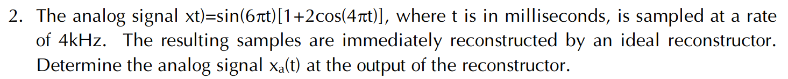
Nyquist reconstructed frequency range: [-F_{s}/2 ÷ F_{s}/2]
Sampling signal x(t) with frequency F → reconstructed signal x_{a}(t) with frequency F_{a} = (F + k.F_{s})∈ [-F_{s}/2 ÷ F_{s}/2]

Slide 8
Q2 (answer)
x(t) = sin(6πt) + 2sin(6πt).cos(4πt) = sin(6πt) + sin(10πt) + sin(2πt)
Fs = 4
Nyquist reconstructed frequency range: [-2 ÷ 2]
f_{a1} = (3 + k₁4) ∈ [-2 ÷ 2] = -1
f_{a2} = (5 + k₂4) ∈ [-2 ÷ 2] = 1
f_{a3} = (1 + k₃4) ∈ [-2 ÷ 2] = 1
Reconstructed signal x_{a}(t) = sin(-2πt) + sin(2πt) + sin(2πt) = sin(2πt)

Slide 9
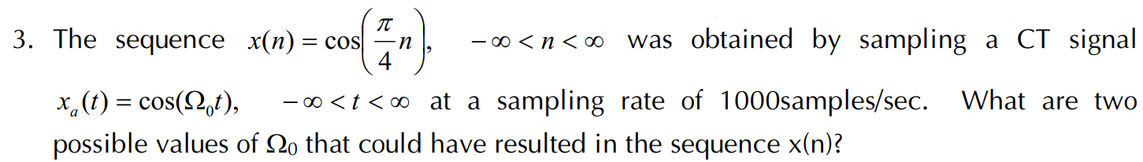
Sampling period T = 1/F_{s}
x(n) = x_{a}(t = nT)

Slide 10
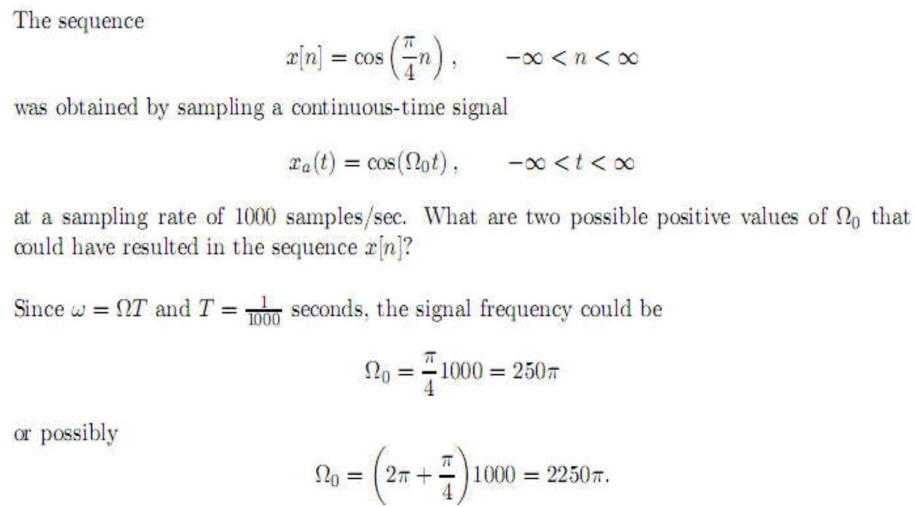
Q3 (answer)

Slide 11
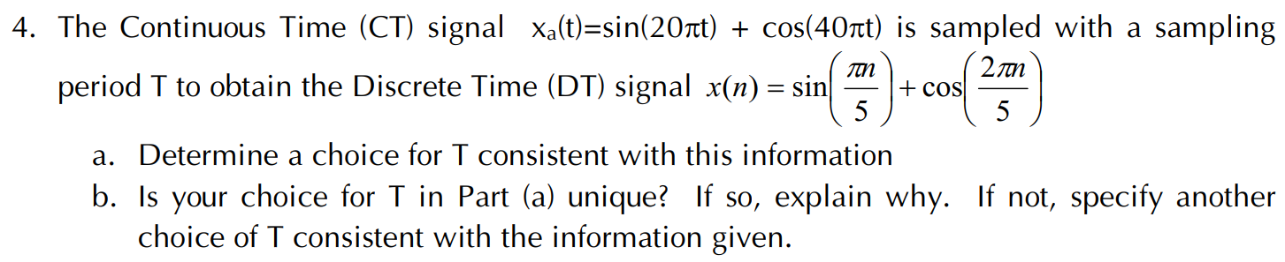
Sampling period T
x(n) = x_{a}(t = n.T)

Slide 12
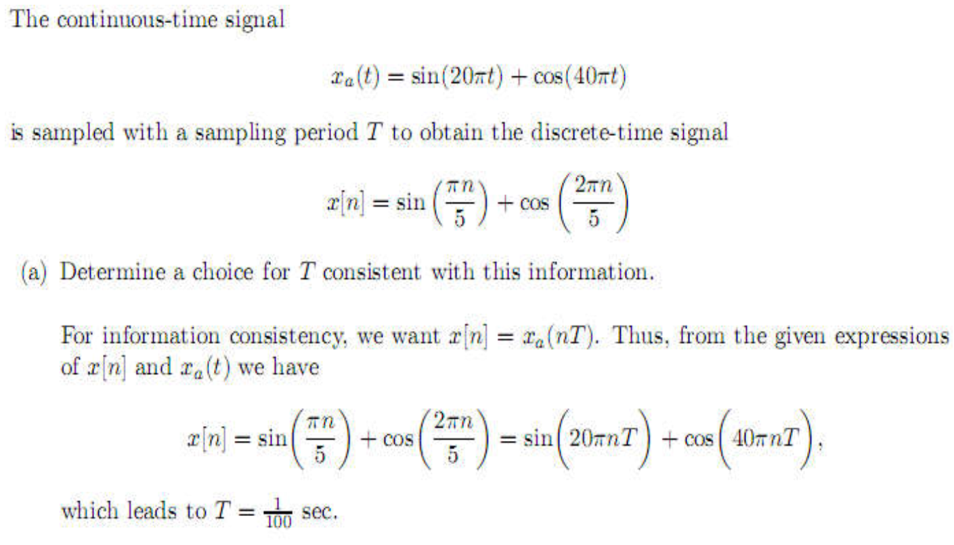
Q4 (answer)

Slide 13
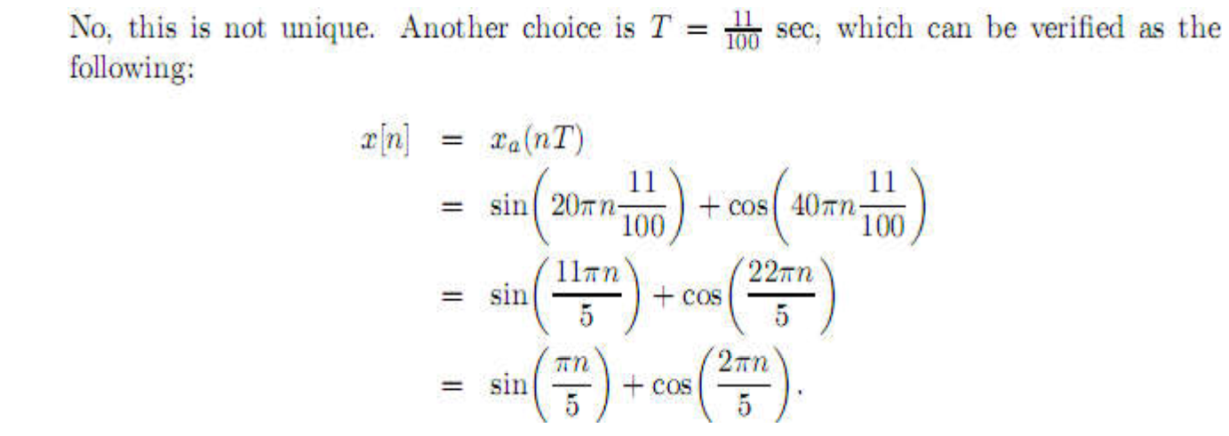
Q4 (answer)

Slide 14
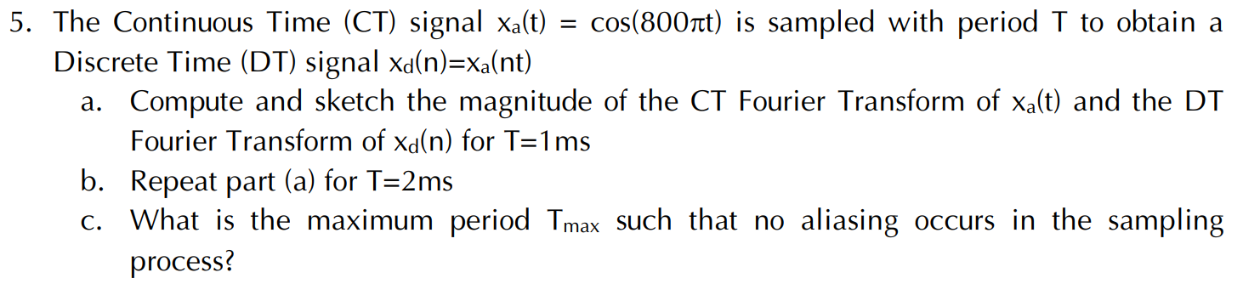
CT Fourier Transform of x_{a}(t) = cos(w₀.t) = cos(2.pi.f₀.t):
X_{a}(w) = pi.δ(w + w₀) + pi.δ(w - w₀) {or X_{a}(f) = 0.5δ(f + f₀) + 0.5δ(f - f₀) }
Sampling period T
DT Fourier Transform of x_{d}(n) = x_{a}(t=nT) = cos(w_{n}.n)
X_{d}(w) = pi.δ(w + w_{n}) + pi.δ(w - w_{n}) but w_{n} ∈[-pi pi]

Slide 15
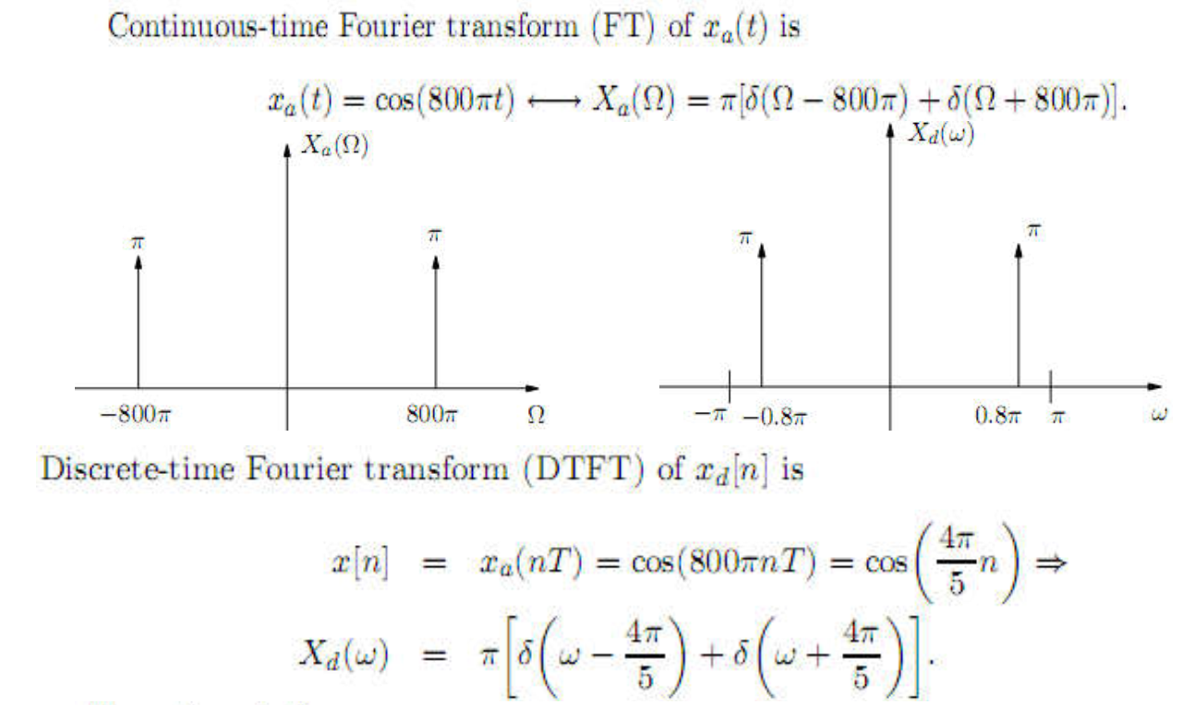
Q5 (answer a)

Slide 16
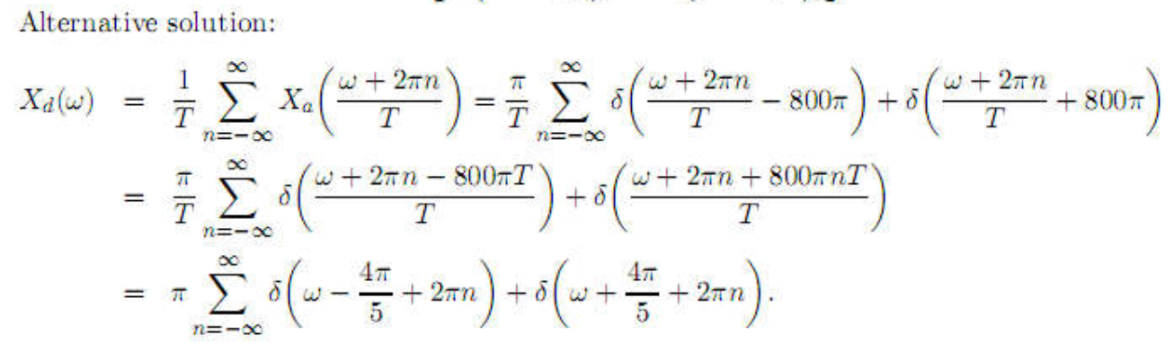
Q5 (answer)

Slide 17
Q5 (answer b)
T = 2ms
x(n) = cos(800.pi.n.2/1000) = cos(1,6.pi.n) = cos(1,6.pi.n – 2.pi.n) = cos(-0,4.pi.n) = cos(0,4.pi.n)
X_{d}(w) = pi.δ(w – 0,4.pi) + pi.δ(w + 0,4.pi)
= pi.δ(w + 0,4.pi) + pi.δ(w - 0,4.pi)

Slide 18
Q5 (answer c)
Tmax = ? (no aliasing)
w_{n} = pi → w₀.Tmax = pi → Tmax = pi/w₀ = pi/(800.pi) = 1/800

Slide 19
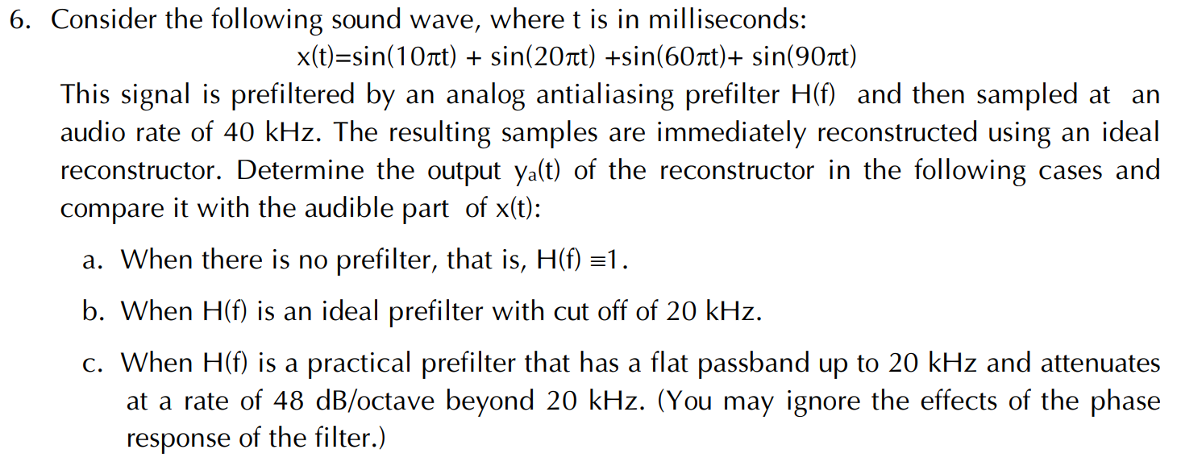

Slide 20
HdB = 20.log₁₀(H) → H = 10^(HdB/20)
H = 1 → HdB = 0 dB
1 octave = 2 times, 2 octaves = 4 times, 3 octaves = 8 times, …
1 decade = 10 times, 2 decades = 100 times, 3 decades = 1000 times, …

Slide 21
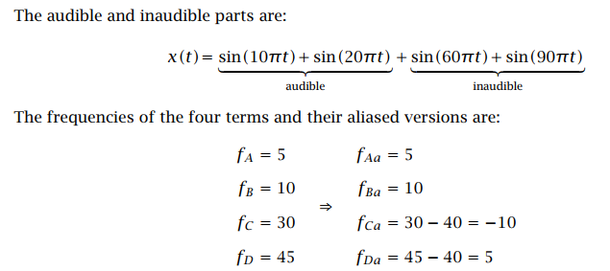
Q6 (answer)

Slide 22
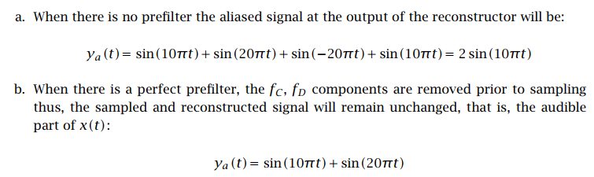
Q6 (answer)

Slide 23
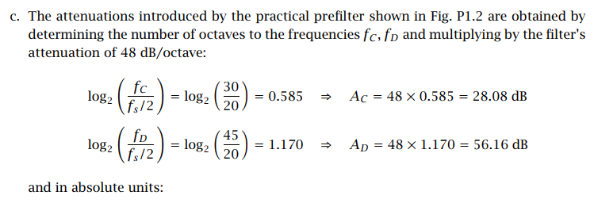
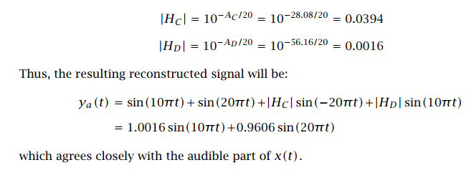
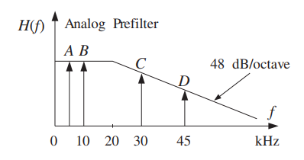
Q6 (answer)

