Slide 1
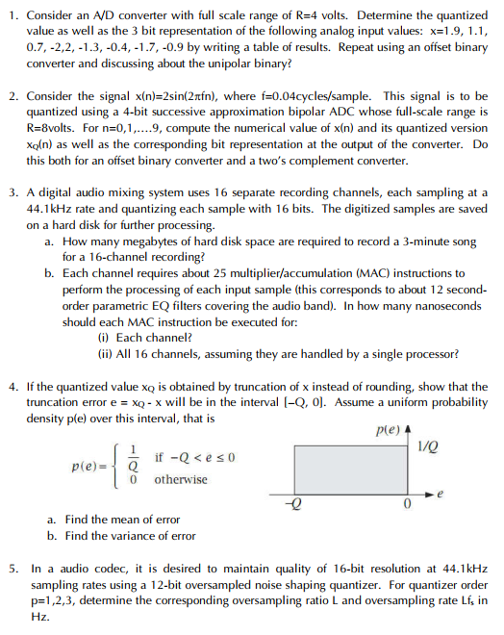
Tutorial 3
Paper
Pen
Calculator

Slide 2
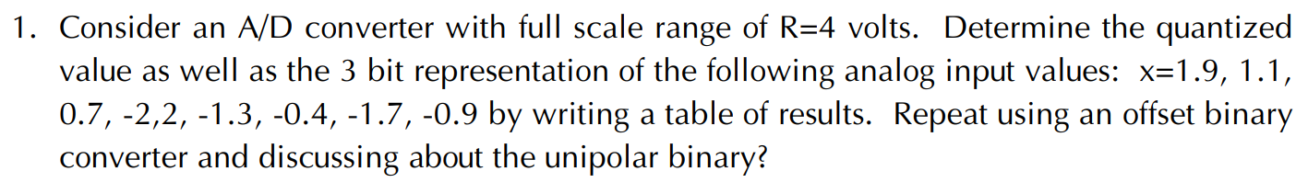

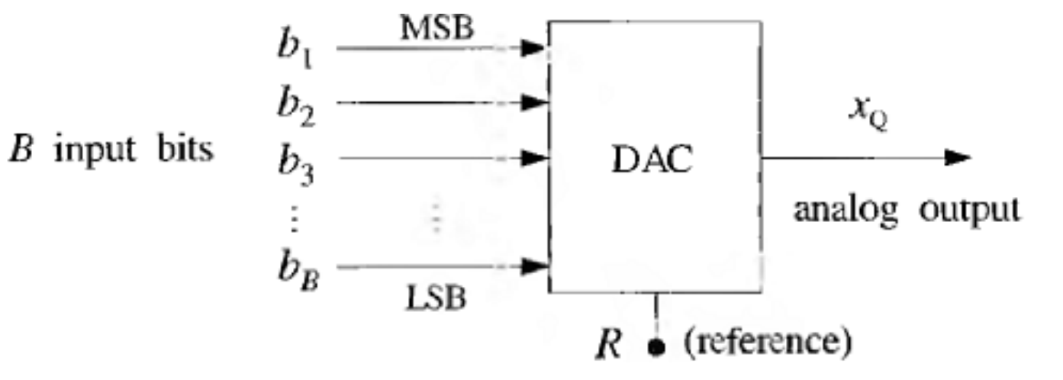
Unipolar binary
Bipolar offset binary

Slide 3
Q1 (answer)
Codeword | Quantized value
 | Unipolar | Offset
111
110
101
100
011
010
001
000
R = 4, B = 3 → Q = R/2^{B} =
Nearest rounding
Mid-point: up rounding
Input 1.9
Unipolar quantized value =
Offset quantized value =
Input 1.25
Unipolar quantized value =
Offset quantized value =

Slide 4
Q1 (answer)
Codeword | Quantized value
 | Unipolar | Offset
111 | 3.5 | 1.5
110 | 3 | 1
101 | 2.5
100 | 2
011 | 1.5
010 | 1 | -1
001 | 0.5 | -1.5
000 | 0 | -2
R = 4, B = 3 → Q = R/2^{B} = 0.5
Nearest rounding
Mid-point: up rounding
Input 1.9
→ Unipolar quantized value = 2 (100)
Offset quantized value = 1.5 (111)
Input 1.25
Unipolar quantized value = 1.5 (011)
Offset quantized value = 1.5 (111)

Slide 5
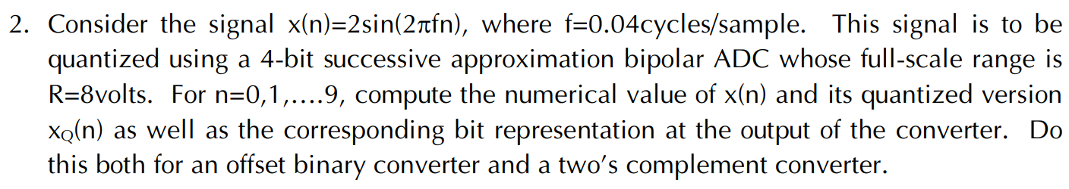

Bipolar offset binary
Two’s complement

Slide 6
Q2 (answer)
Codeword | Quantized value
 | Offset | Two’s complement
1111 | 3.5
1110
1101 |  | -1.5
1000 | 0 | -4
…
0010 | -3
0001 | -3.5
0000 | -4 | 0
R = 8, B = 4
→ Q = R/2^{B} = 0.5
Nearest rounding
Mid-point: up rounding

Slide 7
Q2 (answer)
Codeword | Quantized value
 | Offset | Two’s complement
1111 | 3.5
1110
1101 |  | -1.5
1000 | 0 | -4
…
0010 | -3
0001 | -3.5
0000 | -4 | 0
R = 8, B = 4
→ Q = R/2^{B} = 0.5
Nearest rounding
Mid-point: up rounding

Slide 8
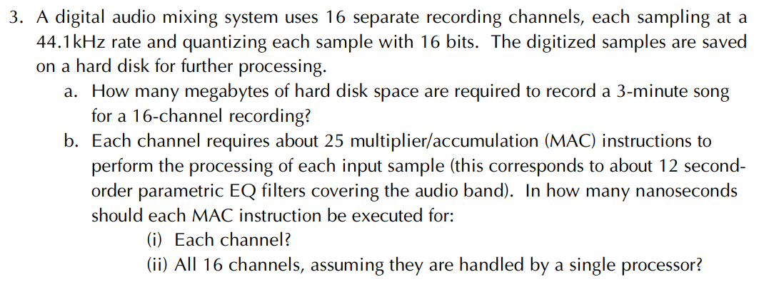
Real-time processing: T_processing < T_sampling

Slide 9
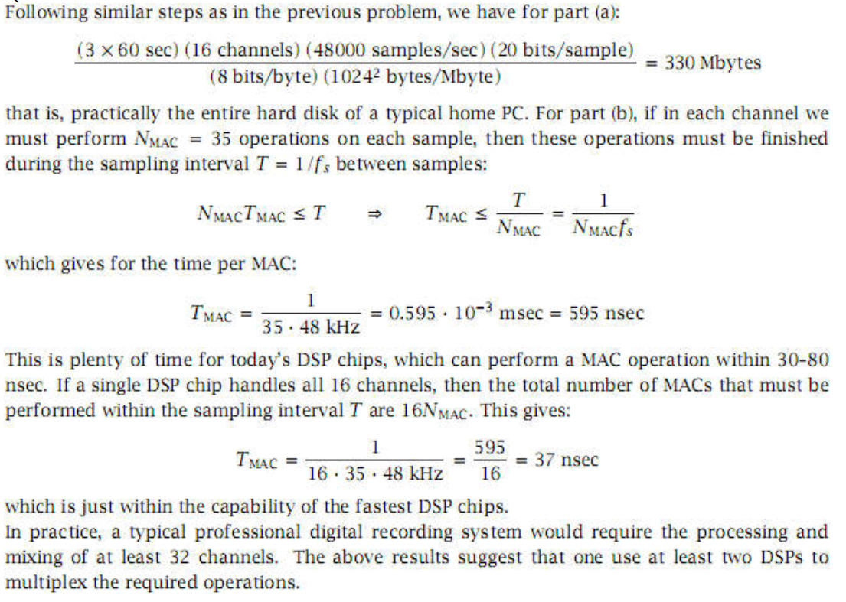
Q3 (answer)
48000 samples/sec → 44100
20 bits/sample → 16
35 MAC → 25
242,25MB

Slide 10
Q3 (answer)

Slide 11
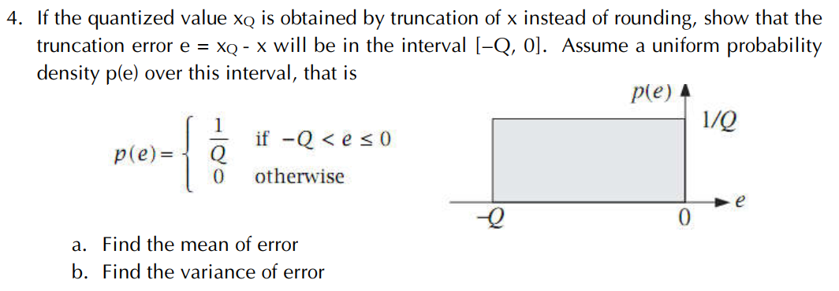
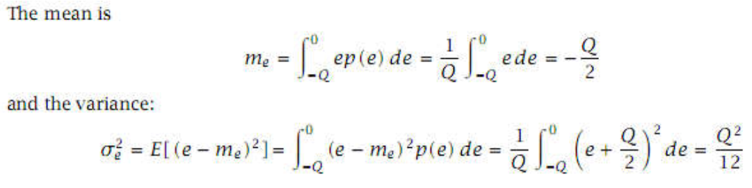

Slide 12
Q4 (answer)

Slide 13
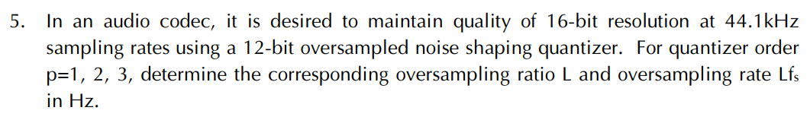
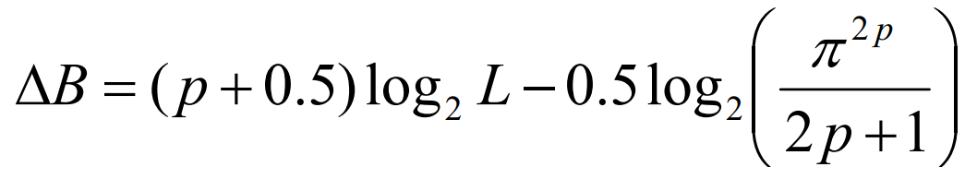
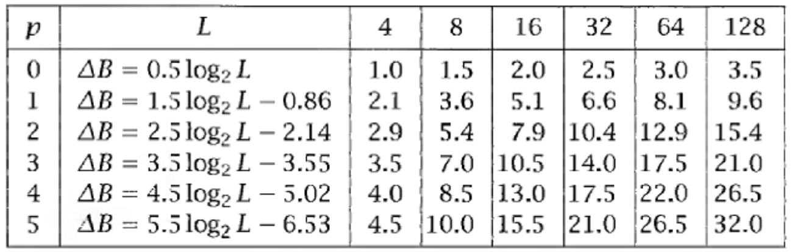

Slide 14
 | Without oversampled noiseshaping | With oversampled noiseshaping
Number of bits | B | B’
Sampling fre | Fs | Fs’=L.Fs
Noiseshaping filter order | p=0 | p≠0
 | ΔB=B - B’ | L = Fs’/Fs

Slide 15
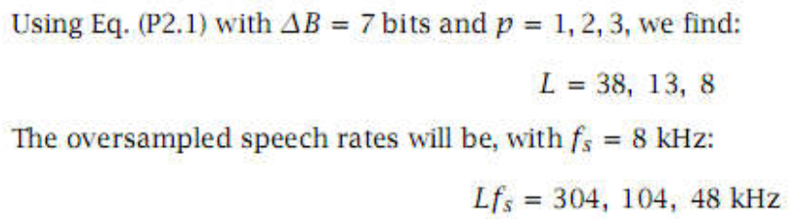
Q5 (answer)
ΔB = 7 bits → 4
Fs = 8 kHz → 44.1

