Slide 1
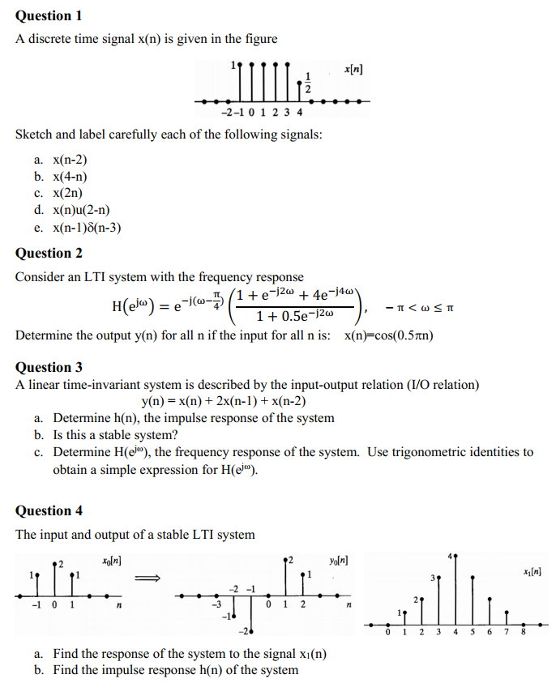
Tutorial 4
Paper
Pen
Calculator

Slide 2
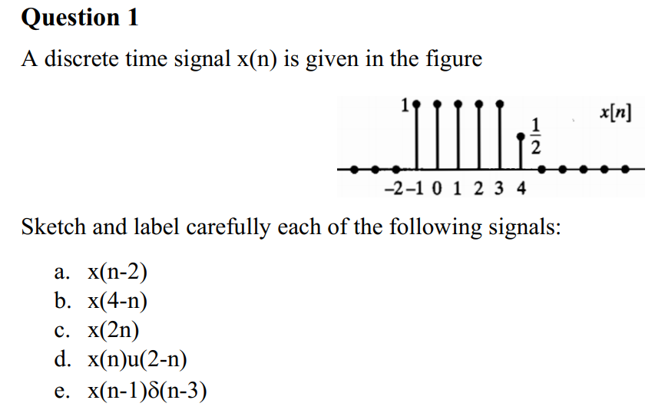

n | … | -2 | -1 | 0 | 1 | 2 | 3 | 4 | 5 | …
x(n) | 0 | 0 | 1 | 1^ | 1 | 1 | 1 | 1/2 | 0 | 0
x_{a}(n) |  |  |  | 0 | 1 | 1 |  | 1
x_{b}(n) |  |  | 0 | 1/2 |  | 1
x_{c}(n) |  | 0 | 0 | 1 | 1 | 1/2 | 0 | 0

Slide 3
x(n) = [1 ; 1^ ; 1; 1 ; 1; ½ ] = [0 ; 1 ; 1^ ; 1; 1 ; 1; ½ ; 0]
x_{a}(n) = x(n-2)
x_{a}(n=0) = x(0-2) = x(-2) = 0
x_{a}(n=1) = x(1-2) = x(-1) = 1
x_{a}(n=-1) = x(-1-2) = x(-3) = 0
x_{a}(n=±2,3,…) = …

Slide 4
Q1 (answer)
n | < -2 | -2 | -1 | 0 | 1 | 2 | 3 | 4 | 5 | > 5
x(n) | 0 | 0 | 1 | 1^ | 1 | 1 | 1 | 1/2 | 0 | 0
n | … | -5 | -4 | -3 | -2 | -1 | 0 | 1 | 2 | 3 | 4 | 5 | 6 | 7 | …
x_{a}(n) | 0 | 0 | 0 | 0 | 0 | 0 | 0^ | 1 | 1 | 1 | 1 | 1 | 1/2 | 0 | 0
x_{b}(n) | 0 | 0 | 0 | 0 | 0 | 0 | 1/2^ | 1 | 1 | 1 | 1 | 1 | 0 | 0 | 0
x_{c}(n) | 0 | 0 | 0 | 0 | 0 | 0 | 1^ | 1 | 1/2 | 0 | 0 | 0 | 0 | 0 | 0

Slide 5
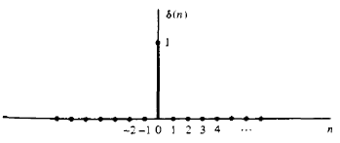
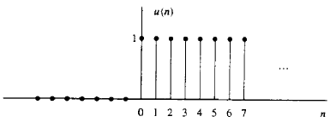
Q1 (answer)

Slide 6
Q1 (answer)
n | < -2 | -2 | -1 | 0 | 1 | 2 | 3 | 4 | 5 | > 5
x(n) | 0 | 0 | 1 | 1^ | 1 | 1 | 1 | 1/2 | 0 | 0
n | … | -5 | -4 | -3 | -2 | -1 | 0 | 1 | 2 | 3 | 4 | 5 | 6 | 7 | …
u(2-n) |  |  | … | 1 | 1 | 1 | 1^ | 1 | 1 | 0 | 0 | 0
x_{d}(n) |  |  |  | 0 | 0 | 1 | 1^ | 1 | 1 | 0 | 0 | 0
x(n-1) |  |  |  | 0 | 0 | 0 | 1^ | 1 | 1 | 1 | 1 | 1/2 | 0
δ(n-3) |  |  |  | 0 | 0 | 0 | 0^ | 0 | 0 | 1 | 0 | 0
x_{e}(n) |  |  |  | 0 | 0 | 0 | 0^ | 0 | 0 | 1 | 0 | 0

Slide 7
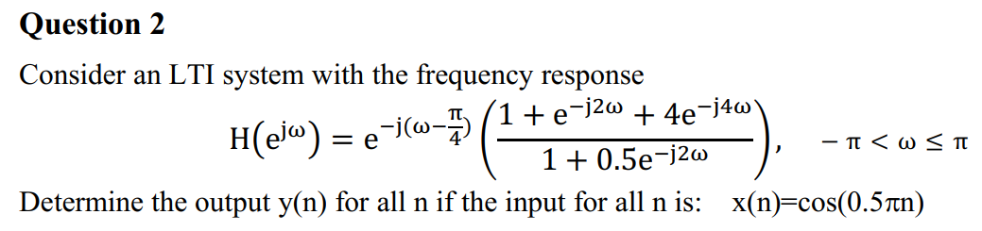
Input signal x(n)=cos(0.5πn) has frequency: w_{x} = 0.5π
Frequency response H(w_{x}) → |H(w_{x})| and argH(w_{x})
Output signal y(n) = |H(w_{x})|.cos(w_{x}n + argH(w_{x}))
e^{jφ} = cos(φ) + j.sin(φ)

Slide 8
Exp(-j(pi/2-pi/4)=exp(-j*pi/4) = 0.7 – j*0.7
Exp(-j(2*pi/2))=exp(-j*pi)= -1
Exp(-j(4*pi/2))=exp(-j*2*pi)= 1
H(pi/2)=(0.7 – j*0.7).(1+(-1) + 4.1)/(1+0.5 x (-1)) = 8*(0.7 – j*0.7)

Slide 9
Q2 (answer)
H(0.5π) = 5.6569 - 5.6569j
|H(0.5π)|=8
argH(0.5π) = -0.7854 rad = -π/4 = -45º
y(n) = 8.cos(0.5πn - π/4)

Slide 10
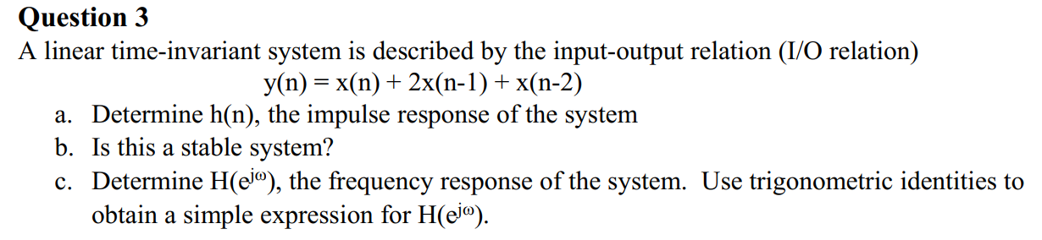
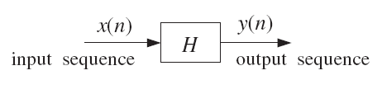
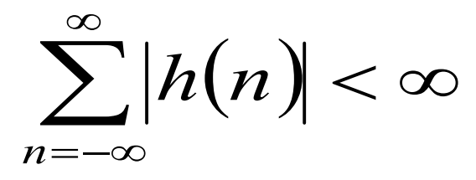
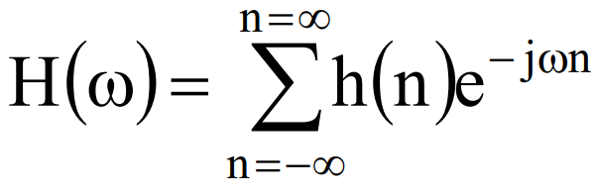

x(n) = δ(n) → y(n) = h(n)
Stable:
Frequency response:

Slide 11
Q3 (answer)
h(n) = δ(n) + 2δ(n-1) + δ(n-2) = {1^, 2, 1}
h(0) = 1, h(1) = 2, h(2) = 1
sum{|h(n)|} = 4 < ∞ → stable
H(w) = h(0).e^{-jw.0} + h(1).e^{-jw.1} + h(2).e^{-jw.2}
= 1.1 + 2.{cos(w) – j.sin(w)} + 1.{cos(2w) – j.sin(2w)}

Slide 12
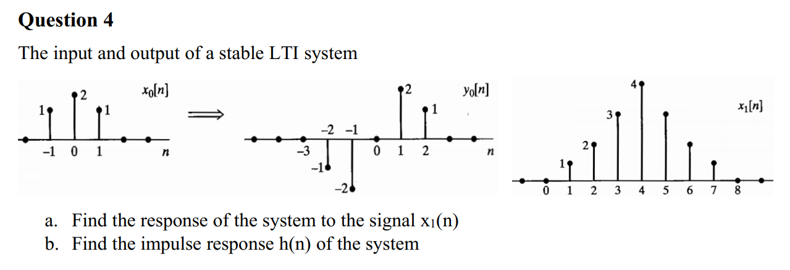
A.x_{A}(n – D_{A}) + B.x_{B}(n – D_{B}) → A.y_{A}(n – D_{A}) + B.y_{B}(n – D_{B})
x₁(n) = A.x₀(n – D_{A}) + B.x₀(n – D_{B}) + …
→ y₁(n) = A.y₀(n – D_{A}) + B.y₀(n – D_{B}) + …

Slide 13
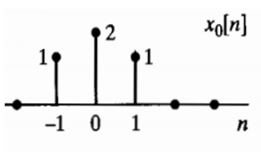
Q4 (answer)
a. x₁(n) = x₀(n – 2) + 2x₀(n – 4) + x₀(n – 6)
→ y₁(n) = y₀(n – 2) + 2y₀(n – 4) + y₀(n – 6)
= …
b. x(n) = δ(n) → y(n) = h(n)
From the given graph, we have: x₀(n) = δ(n+1) + 2δ(n) + δ(n-1)
y₀(n) = h(n+1) + 2h(n) + h(n-1)
From the given graph, we have: y₀(n) = -δ(n+2) - 2δ(n+1) + 2δ(n-1) + δ(n-2)
→ h(n) = …

Slide 14
Q4 (answer)
a. x₁(n) = x₀(n – 2) + 2x₀(n – 4) + x₀(n – 6)
→ y₁(n) = y₀(n – 2) + 2y₀(n – 4) + y₀(n – 6)
b. x₀(n) = δ(n+1) + 2δ(n) + δ(n-1) = δ(n+1) + δ(n-1) + 2δ(n)
y₀(n) = -δ(n+2) - 2δ(n+1) + 2δ(n-1) + δ(n-2)
= [-δ(n+2) + δ(n)] + [-δ(n) + δ(n-2)] + 2[-δ(n+1) + δ(n-1)]
= h(n+1) + h(n-1) + 2h(n)
→ h(n) = -δ(n+1) + δ(n-1)

Slide 15
Q4 (answer)
H(z) = Y₀(z)/X₀(z)
Y₁(z) = H(z).X₁(z) → y₁(n)
h(n)
y₁(n) = h(n)*x₁(n)

