Slide 1
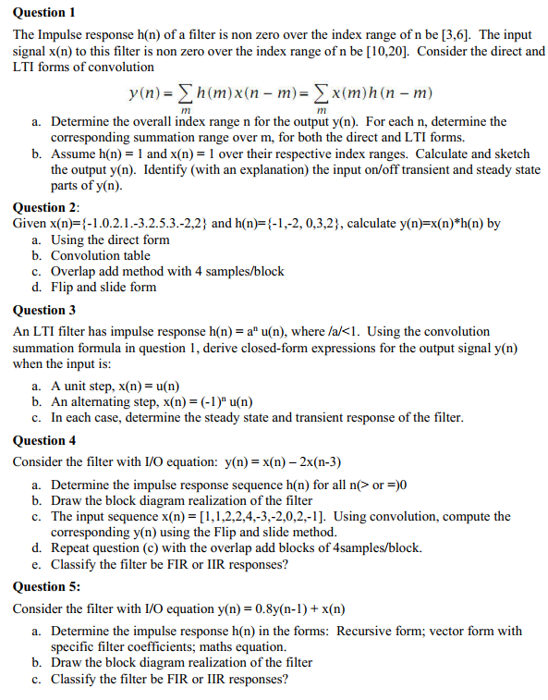
Tutorial 5
Paper
Pen
Calculator

Slide 2
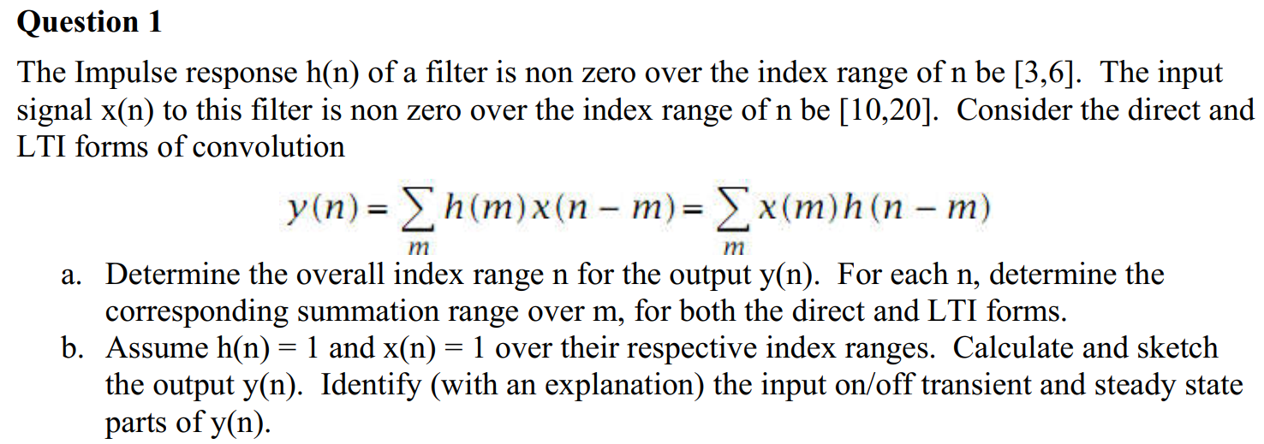

Slide 3
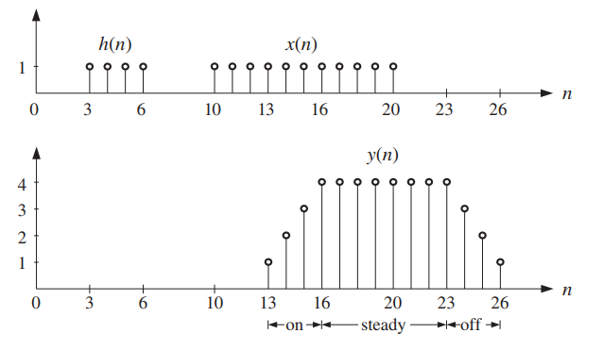
Q1 (answer)

Slide 4
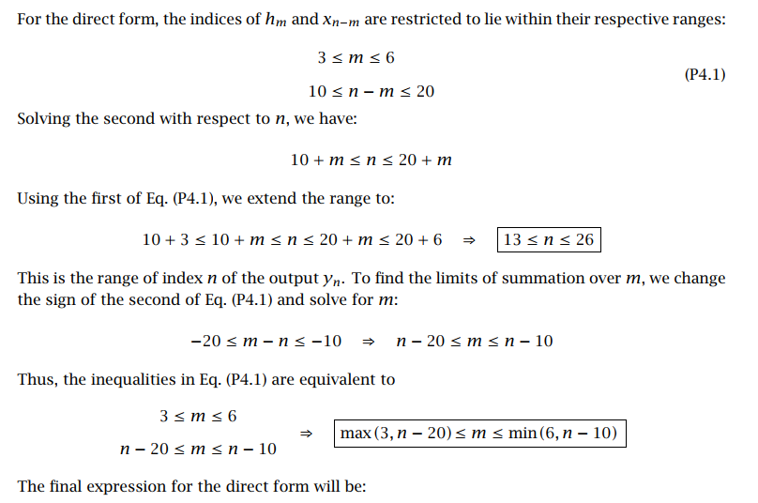

Q1 (answer)

Slide 5
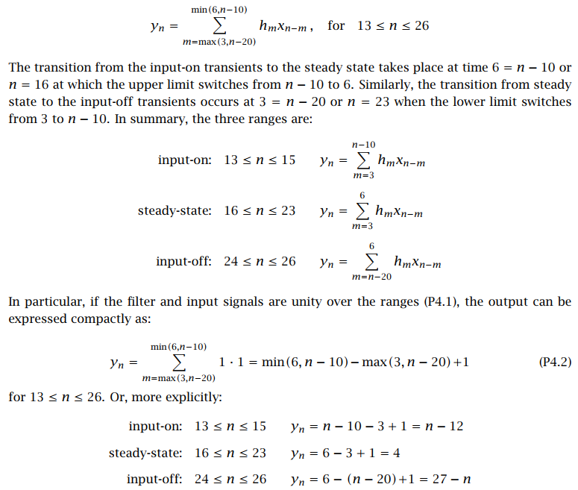
Q1 (answer)

Slide 6
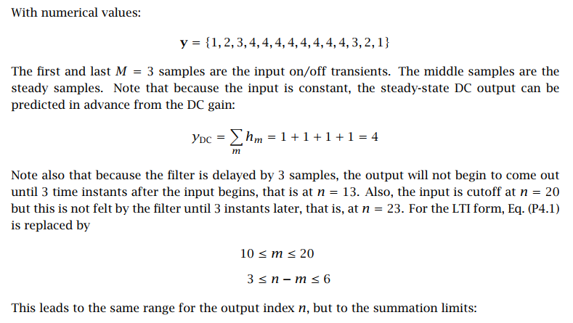

Q1 (answer)

Slide 7
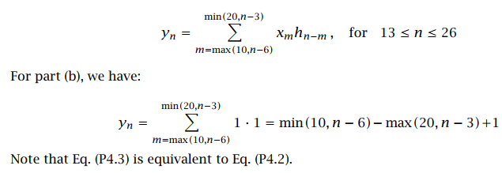
Q1 (answer)

Slide 8
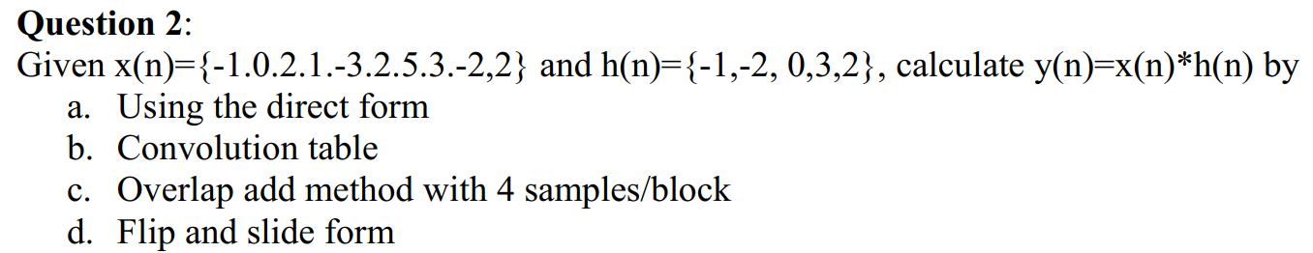
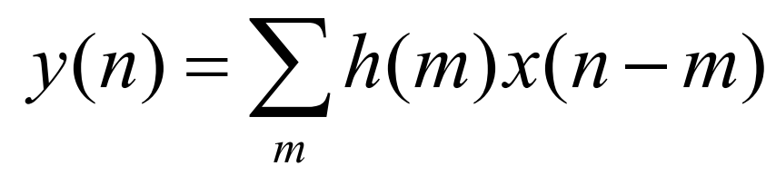
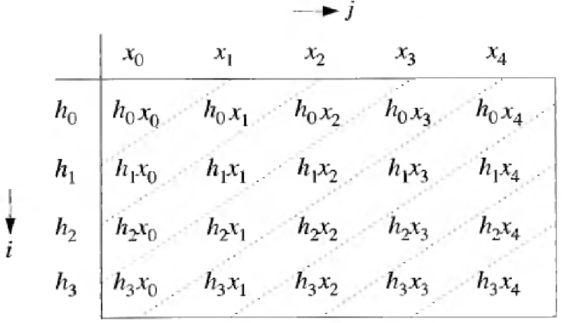
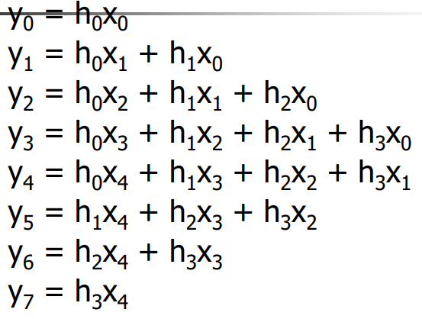

Slide 9
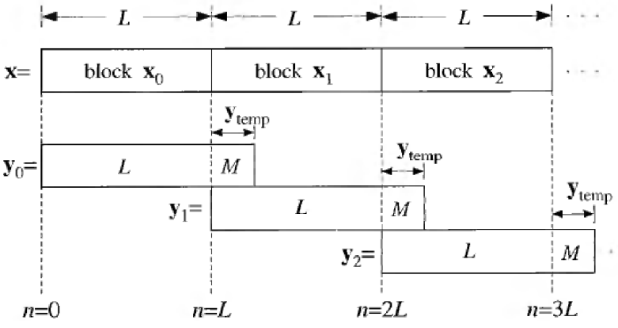
Q2 (answer)

Slide 10
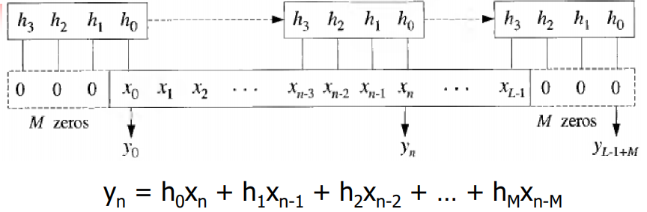
Q2 (answer)

Slide 11
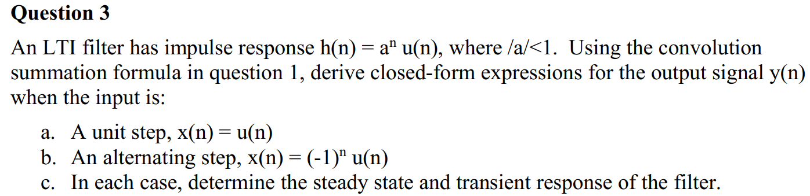

Slide 12
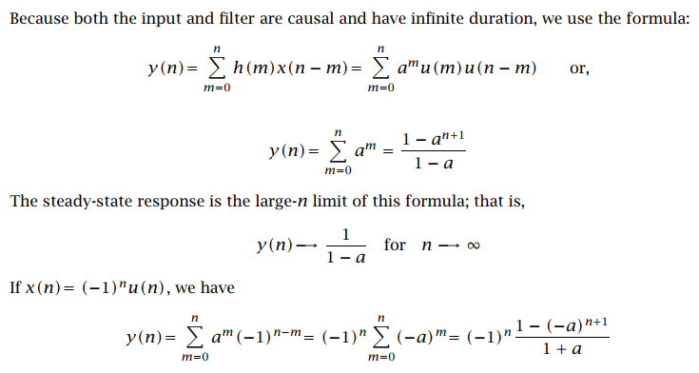
Q3 (answer)

Slide 13
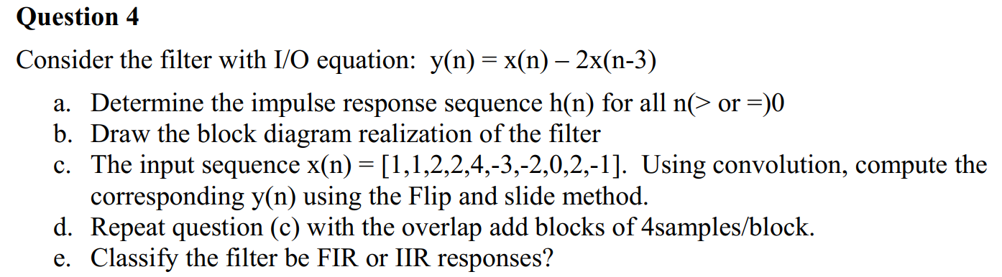

Slide 14
Q4 (answer)
h(n) = δ(n) - 2δ(n-3) = { 1↑; 0 ; 0 ; -2}

Slide 15
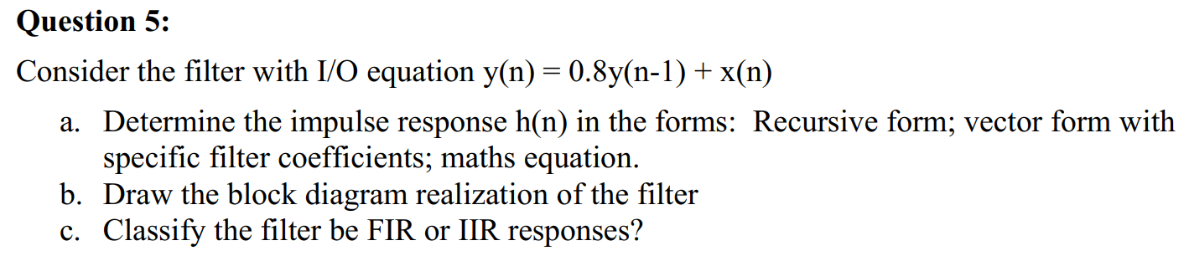

Slide 16
Causal (default): h(n<0) = 0
Recursive form: h(n) = 0.8h(n-1) + δ(n)
Vector form: h(0) = 0.8h(-1) + 1 = 1, h(1) = 0.8h(0) = 0.8, h(2) = 0.8h(1) = 0.8² = 0.64, …
Maths equation form: h(n) = 0.8^{n} , n >= 0 and h(n) = 0 if n < 0

Slide 17
Anti-causal → y(n-1) = (1/0.8)y(n) – (1/0.8)x(n)
→ y(n) = (1/0.8)y(n+1) – (1/0.8)x(n+1)

