Slide 1
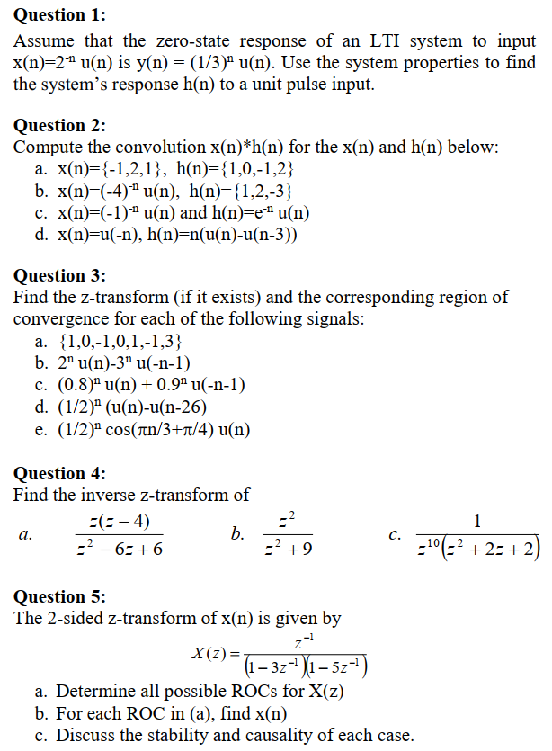
Tutorial 7 (8 new)

Slide 2
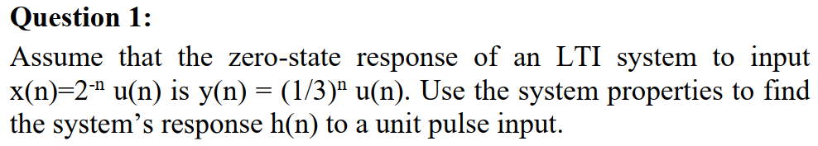
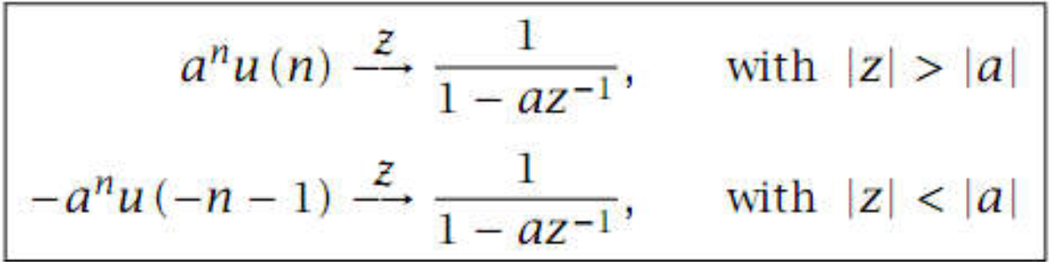
x(n) = δ(n) → y(n) = h(n)
H(z) = Y(z) / X(z)

Slide 3
Q1 (answer with LTI system properties)
x(n) = 2^{-n}u(n) = {1^, 2⁻¹, 2⁻², …}
x(n – 1) = 2^{-(n-1)}u(n – 1) = {0^, 1, 2⁻¹, 2⁻², …}
2⁻¹x(n – 1) = {0^, 2⁻¹, 2⁻², …}
x(n) – 2⁻¹x(n – 1) = {1^} = δ(n)
h(n) = y(n) – 2⁻¹y(n – 1) = (1/3)^{n}u(n) - 2⁻¹(1/3)^{n-1}u(n-1)

Slide 4
Q1 (answer with z transform)
x(n) = 2^{-n}u(n) = (2⁻¹)^{n}u(n) = (0.5)^{n}u(n) → X(z) = 1/(1 – 0.5z⁻¹)
ROC_{X} = |z| > 0.5
y(n) = (1/3)^{n}u(n) → Y(z) = 1/(1 – (1/3)z⁻¹)
ROC_{Y} = |z| > 1/3
H(z) = Y(z) / X(z) = (1 – 0.5z⁻¹)/(1 – (1/3)z⁻¹) = A₀ + A₁/(1 – (1/3)z⁻¹)
ROC_{Y} = ROC_{X}  ROC_{H} → ROC_{H} = |z| > 1/3
h(n) = A₀δ(n) + A₁(1/3)^{n}u(n)

Slide 5
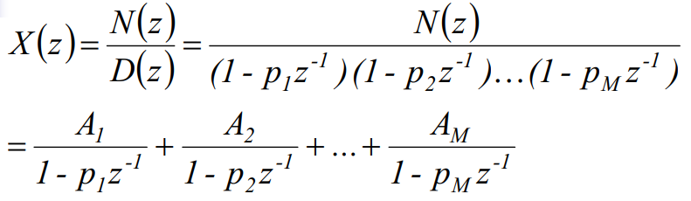
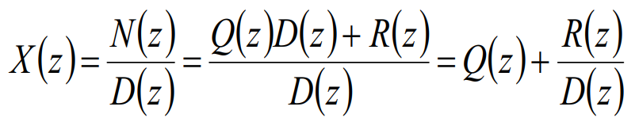

Slide 6
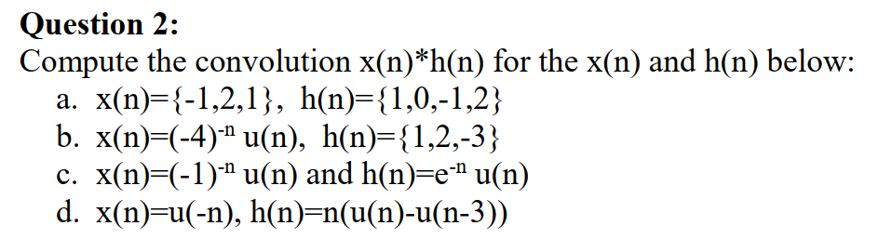

Slide 7
Q2a (answer)
X(z) = -1 + 2z⁻¹ + z⁻²
H(z) = 1 – z⁻² + 2z⁻³
Y(z) = H(z).X(z) = (1 – z⁻² + 2z⁻³).(-1 + 2z⁻¹ + z⁻²) =
y(n) =

Slide 8
Q2b (answer using z-transform)
X(z) = 1/(1 + 0.25z⁻¹), ROC_{X} = |z| > |-0.25| = 0.25
H(z) = 1 +2z⁻¹ - 3z⁻² , ROC_{H} = ∀z ≠ 0
Y(z) = H(z).X(z) = (1 +2z⁻¹ - 3z⁻²)/(1 + 0.25z⁻¹) = A₀ + A₁z⁻¹ + A₂/(1 + 0.25z⁻¹)
ROC_{Y} = ROC_{X}  ROC_{H} = |z| > 0.25
y(n) = A₀δ(n) + A₁δ(n-1) + A₂(-0.25)^{n}u(n)

Slide 9
Q2b (answer using convolution property)
x(n – N₁)*δ(n – N₂) = x(n – N₁ – N₂)
h(n) = δ(n) + 2δ(n-1) - 3δ(n-2)
y(n) = x(n)*h(n) = x(n)*δ(n) + 2x(n)*δ(n-1) – 3x(n)*δ(n-2)
= x(n) + 2x(n-1) – 3x(n-2)
= (-4)^{-n}u(n) + 2.(-4)^{-(n-1)}u(n-1) – 3.(-4)^{-(n-2)}u(n-2)

Slide 10
Q2c (answer)
X(z) = 1/(1 + z⁻¹), ROC_{X} =
H(z) = 1/(1 - e⁻¹z⁻¹), ROC_{H} =
Y(z) = H(z).X(z) = 1/{(1 - e⁻¹z⁻¹).(1 + 0.25z⁻¹)] = A₁/(1 - e⁻¹z⁻¹) + A₂/(1 + z⁻¹)
ROC_{Y} = ROC_{X}  ROC_{H} =
y(n) = A₁(e⁻¹)^{n}u(n) + A₂(-1)^{n}u(n)

Slide 11
Q2d (answer using z-transform)
g(n) = v(n – 1) → G(z) = z⁻¹V(z)
f(n) = u(-n-1) → F(z) = -1/(1 – z⁻¹)
f(n-1) = u(-(n-1)-1) = u(-n) = x(n) → X(z) =
x(n) = u(-(n-1) - 1) → X(z) = -z⁻¹/(1 - z⁻¹), ROC_{X} = |z|<1
h(n) = {0^, 1, 2} → H(z) = z⁻¹ + 2z⁻²
Y(z) = H(z).X(z) = -(z⁻¹ + 2z⁻²)z⁻¹/(1 - z⁻¹) = A₀ + A₁z⁻¹ + A₂z⁻² + A₃/(1 - z⁻¹)
ROC_{Y} = ROC_{X}  ROC_{H} =|z|<1
y(n) = A₀δ(n) + A₁δ(n-1) + A₂δ(n-2) - A₃u(-n-1)

Slide 12
Q2d (answer using convolution)
h(n) = {0^, 1, 2} = δ(n-1) + 2δ(n-2)
y(n) = x(n)*h(n) = x(n)*(δ(n-1) + 2δ(n-2)) = x(n)*δ(n-1) + 2x(n)*δ(n-2)
= x(n-1) + 2x(n-2) = u(-(n-1)) + 2u(-(n-2))

Slide 13
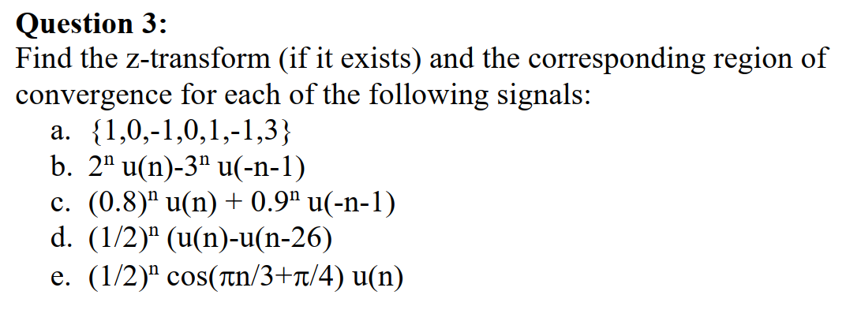
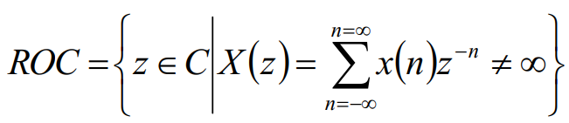

Slide 14

Q3a (answer)
X(z) = 1 – z⁻² + z⁻⁴ + 3z⁻⁵
ROC = ∀z ≠ 0

Slide 15

Q3b (answer)
X(z) = 1/(1-2z⁻¹) + 1/(1-3z⁻¹)
ROC = (|z|>2)(|z|<3)

Slide 16

Q3c (answer)
X(z) = 1/(1-0.8z⁻¹) - 1/(1-0.9z⁻¹)
ROC = (|z|>0.8)(|z|<0.9)

Slide 17

Q3d (answer)
x(n) = (0.5)^{n}u(n) - (0.5)^{n}u(n-26) = (0.5)^{n}u(n) – (0.5)²⁶(0.5)^{n-26}u(n-26)
X(z) = 1/(1-0.5z⁻¹) – (0.5)²⁶z⁻²⁶/(1-0.5z⁻¹)
x(n) = {1^, 0.5, 0.5², … , 0.5²⁵} is finite
X(z) = 1 + 0.5z⁻¹ + 0.5z⁻² + … + 0.5²⁵z⁻²⁵
ROC = ∀z ≠ 0

Slide 18

Q3e (answer)
cos(pi.n/3+pi/4) = 0.5e^{j(pi.n/3+pi/4)} + 0.5e^{-j(pi.n/3+pi/4)} = 0.5e^{j.pi/4}.e^{j(pi.n/3)} + 0.5e^{-j.pi/4}.e^{-j(pi.n/3)} = A₁.p₁^{n} + A₂.p₂^{n}
A₁ = 0.5e^{j.pi/4}, A₂ = 0.5e^{-j.pi/4}
p₁ = e^{j.pi/3}, p₂ = e^{-j.pi/3}
x(n) = A₁.(0.5p₁)^{n}u(n) + A₂.(0.5p₂)^{n}u(n)
X(z) = A₁/(1-0.5p₁z⁻¹) + A₂/(1-0.5p₂z⁻¹)
ROC = |z|>|0.5p₁|= |0.5p₂|=0.5

Slide 19
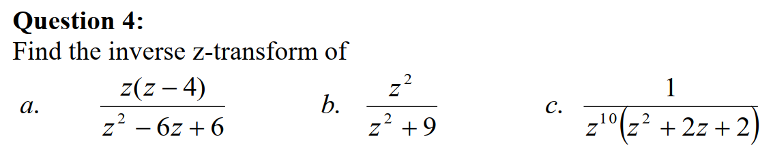
Xa(z) = (1 - 4z⁻¹)/(1 - 6z⁻¹ + 6z⁻²)
Xb(z) = 1/(1 + 9z⁻²)
Xc(z) = z⁻¹²/(1 + 2z⁻¹ + z⁻²)

Slide 20
Q4 (answer)
Xa(z) = A_{1a}/(1 – p_{1a}z⁻¹) + A_{2a}/(1 – p_{2a}z⁻¹)
Xb(z) = A_{1b}/(1 – p_{1b}z⁻¹) + A_{2b}/(1 – p_{2b}z⁻¹)
Xc(z) = B₀ + B₁z⁻¹ + B₂z⁻² + … + B₁₀z⁻¹⁰ + A_{1c}/(1 – p_{1c}z⁻¹) + A_{2c}/(1 – p_{2c}z⁻¹)
Xc(z) = z⁻¹²G(z) with G(z) = 1/(1 + 2z⁻¹ + z⁻²) = G_{1c}/(1 – p_{1c}z⁻¹) + G_{2c}/(1 – p_{2c}z⁻¹) → g(n)
xc(n) = g(n – 12)

Slide 21
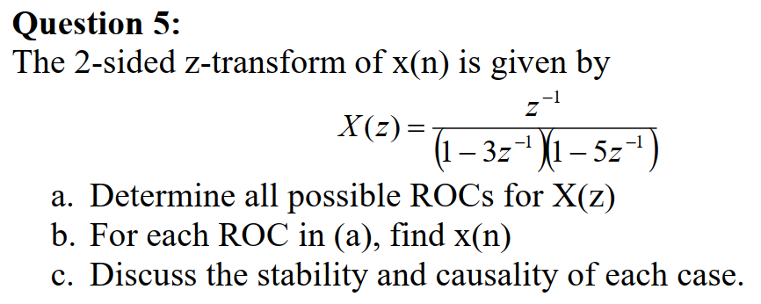

Slide 22
Q5 (answer)
X(z) = A₁/(1 – 3z⁻¹) + A₂/(1 – 5z⁻¹)
ROC₁ = (|z|<3)  (|z|<5) : inside (anticausal), contains the unit circle (stable) → x₁(n) = -A₁3^{n}u(-n-1) -A₂5^{n}u(-n-1)
ROC₂ = (|z|>3)  (|z|>5) : outside (causal), unstable → x₂(n) = A₁3^{n}u(n) +A₂5^{n}u(n)
ROC₃ = (|z|>3)  (|z|<5) : mixed (two-sided), unstable → x₃(n) =
ROC₄ = (|z|<3)  (|z|>5) =  : none

