Slide 1
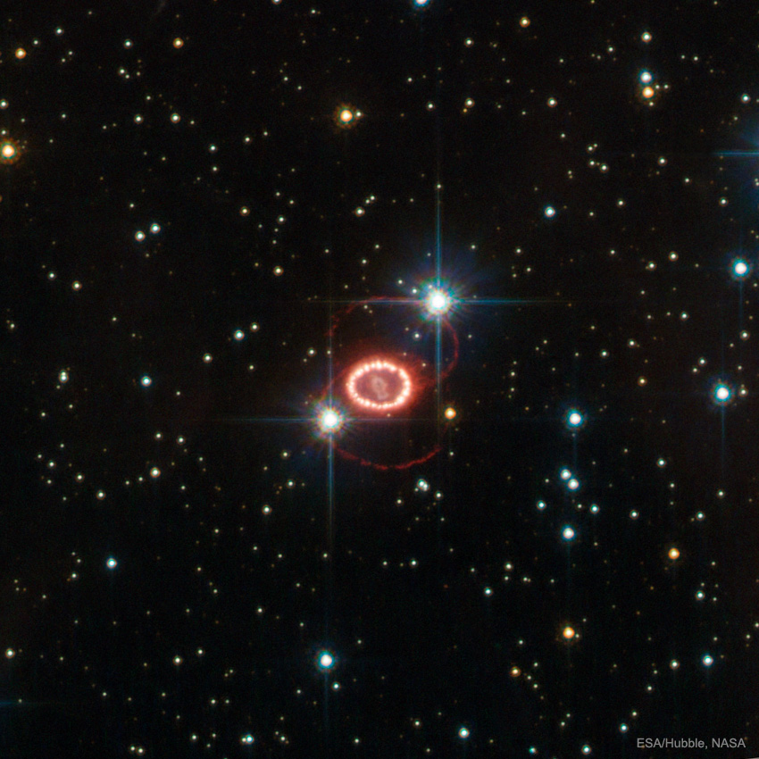





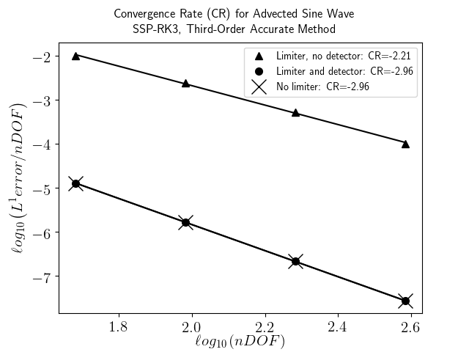
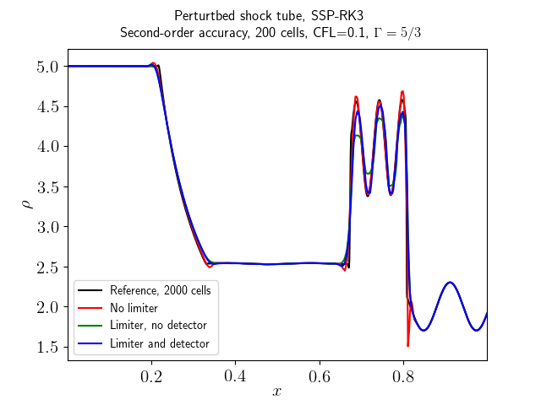
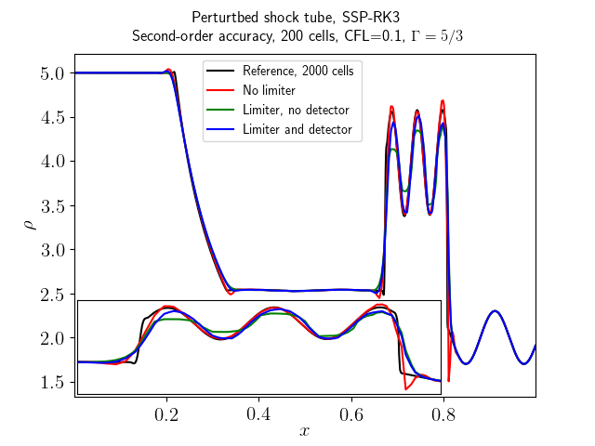

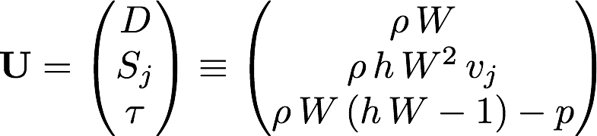
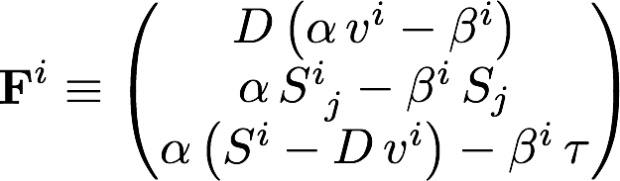
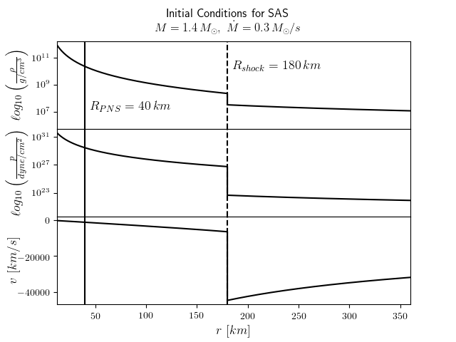

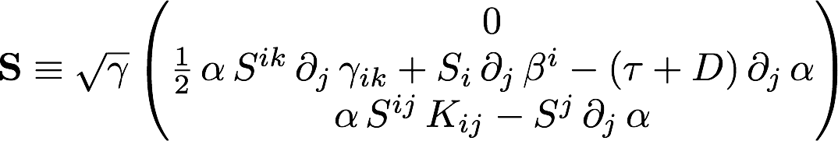



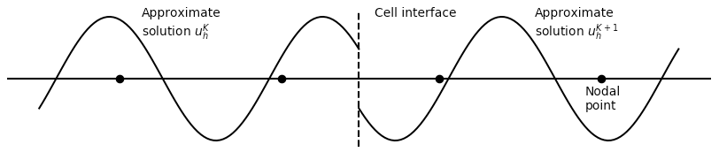

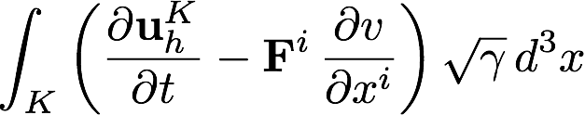
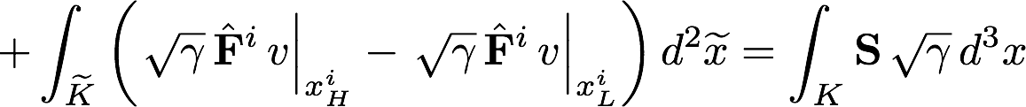



A Discontinuous Galerkin Method for General Relativistic Hydrodynamics
Sam Dunham^{1,2}, Eirik Endeve^{3,4}, Anthony Mezzacappa^{3,4}
¹Fisk University, Department of Life and Physical Sciences, 1000 17th Ave N, Nashville TN, 37208
²Vanderbilt University, Department of Astronomy, 6301 Stevenson Center Lane, Nashville TN, 37212
³University of Tennessee, Department of Physics and Astronomy, 401 Nielsen Physics Building, 1408 Circle Dr, Knoxville TN, 37916
⁴Oak Ridge National Laboratory, 1 Bethel Valley Rd, Oak Ridge TN, 37830
Overview
Ultimate goal: Determine the core-collapse supernova explosion mechanism
Why study this?: It will provide insights into distributions of metals in galaxies, nuclear properties of matter, gravitational waveforms, and more!
Multi-faceted problem including gravity, neutrino transport, and hydrodynamics
As a first step we are developing numerical methods to solve the general relativistic hydrodynamics equations using a discontinuous Galerkin (DG) method
- DG method provides high-order accuracy along with a local approach, making it desirable for problems involving shocks
Slope Limiter/Troubled-Cell Indicator
About the code: THORNADO
The algorithms are being implemented in the Toolkit for High-ORder Neutrino rADiation-hydrOdynamics, THORNADO, which is being developed for simulations of core-collapse supernovae and related phenomena. THORNADO combines continuous and discontinuous finite element (CG and DG) methods for the major physics components in the conformal flatness approximation (CFA).
• Hydrodynamics (DG)
• Neutrino transport (DG)
• Gravity (CG)
If using the limiter but not the troubled-cell indicator (triangles) we don't get third-order accuracy. This is because the limiter is activating--unnecessarily--in smooth regions (the peaks of the sine wave). The effect of the troubled-cell indicator is to only activate the limiter near discontinuities. Since this is a smooth problem there are no discontinuities and the limiter never activates, which is why using the limiter with the troubled-cell indicator results in third-order accuracy. The lines are straight-line fits, and their slope is defined as the convergence rate (CR).
Main: Fluid mass-density in the comoving frame at a time 0.35 for a Riemann problem with sinusoidal perturbations ahead of the shock [3]. We see that if no limiters are used (red line) the three peaks near 0.7<x<0.8 are well-resolved, but there is a large overshoot around x=0.8. When we use the slope limiter, but not the discontinuity detector (green line), we see that the overshoot around x=0.8 is gone, but the three peaks are not well-resolved. Finally, when we use the slope limiter and the troubled-cell indicator (blue line) we again see that the overshoot around x=0.8 is gone, but now the three peaks are better resolved. We also note that for this problem we made use of the positivity limiter, which ensures positivity of the density (among other things), without which the simulation crashes. The black line is a high-resolution reference for comparison. Inset: blow-up of three peaks.
3+1 Decomposed GR Hydro Equations in Conservative Form
Standing Accretion Shock Instability (SASI)
What is the SASI?: An instability in the supernova shockwave that eventually disrupts the stellar envelope. It is characterized by global sloshing and spiral motions in the post-shock flow.
Why study the SASI?: The SASI is widely believed to be a key instability that aids the neutrino-driven supernova explosion.
The supernova explosion mechanism is a multi-physics problem, but details of important hydrodynamics phenomena can be studied with simplified models such as the one described here
About the Initial Conditions
To generate these initial conditions we start with the 3+1 decomposed GR hydro equations (see box), assuming:
spherical symmetry
conformally-flat, steady-state spacetime metric
perfect fluid
ideal gas (polytropic) equation of state
initial gauge (coordinate) choice: zero shift-vector
With this we can derive two conservation laws:
Conservation of mass:
Conservation of energy:
The pre-shock flow is assumed to be cold, so p~0. For numerical reasons we then artificially add in a small pre-shock pressure by assuming a constant Mach number of 100.
Discontinuous Galerkin Method
Discretize the spatial domain into local elements,
Approximate the actual solution in each , , with a polynomial approximation, , which is required to satisfy
Initial conditions for the spherically-symmetric standing accretion shock problem. The top panel shows the comoving mass-density in g/cm³, the middle panel shows the comoving pressure in dyne/cm², and the bottom panel shows the fluid three-velocity in km/s.The dashed vertical line shows the initial location of the shock and the solid vertical line shows the location of the surface of the proto-neutron star (PNS). The lower radial limit is three times the Schwarzschild radius.
for each element and each test function . Since the polynomials are local they are in general discontinuous at the cell interfaces (see figure)
This sets up a Riemann problem at each interface, which we solve using the HLLC numerical flux,
The discontinuities can lead to spurious oscillations in the solution, so we use a slope limiter to damp them (see slope limiter box)
- However, in smooth regions the slope limiter unnecessarily causes a loss in accuracy, so we also employ a troubled-cell indicator so that the slope limiter only activates in areas where a discontinuity is present, i.e. shocks
Acknowledgments
We would like to thank the NSF for helping to fund this research:
NSF GP-1505933
We would also like to thank the GAANN program for helping to fund this research:
Department of Education P200A150173
Future Work
Implement DG-GR hydro solver and study SASI-driven flows in GR
Upgrade to be fully three-dimensional
Couple with CG gravity solver and develop DG-GR neutrino transport solver
Use for core-collapse supernova simulations
References
[1] Fu, G., & Shu, C. W. (2017). A new troubled-cell indicator for discontinuous Galerkin methods for hyperbolic conservation laws. Journal of Computational Physics, 347, 305–327. http://doi.org/10.1016/j.jcp.2017.06.046
[2] Blondin, J. M., & Mezzacappa, A. (2006). The Spherical Accretion Shock Instability in the Linear Regime. The Astrophysical Journal, 642(1), 401–409. http://doi.org/10.1086/500817
[3] Del Zanna, L., & Bucciantini, N. (2002). An efficient shock-capturing central-type scheme for multidimensional relativistic flows. I. Hydrodynamics, 1186, 1177–1186. http://doi.org/10.1051/0004-6361:20020776
Background image from APOD: https://apod.nasa.gov/apod/ap170305.html

