Slide 1




A Discontinuous Galerkin Method For General Relativistic Hydrodynamics
Samuel J. Dunham^{1,2}, Eirik Endeve^{3,2}, Anthony Mezzacappa^{4,2},
Jesse Buffaloe²
¹Vanderbilt University
²University of Tennessee-Knoxville
³Oak Ridge National Laboratory
⁴Joint Institute for Computational Sciences
APS, April 16th, 2019

Slide 2
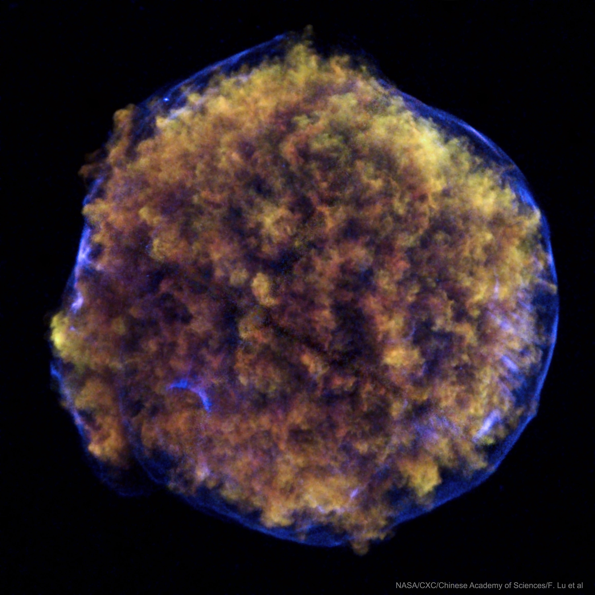
Core-collapse Supernovae
X-Ray remnant of Tycho's SN
(Figure courtesy of APOD)
Understand explosion mechanism
Predict nucleosynthetic yields
Gravitational waves
Nuclear matter
Neutrinos
APS, April 16th, 2019

Slide 3
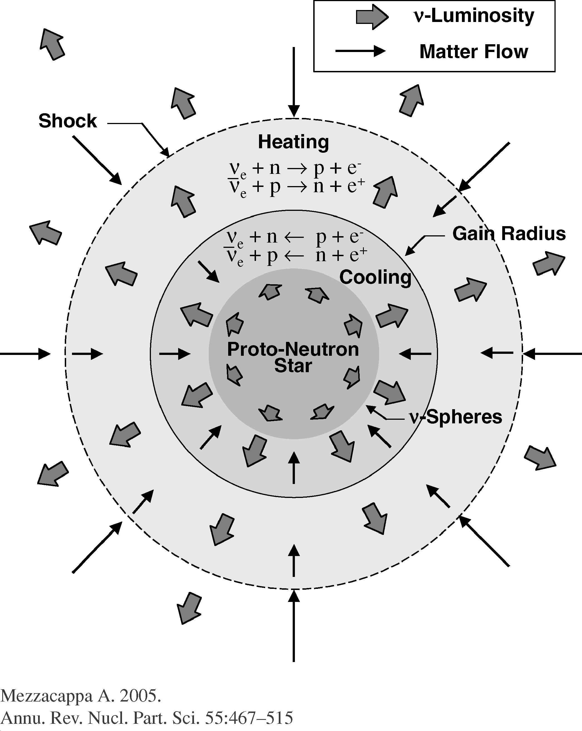
What are we doing?
Developing a new code to study core-collapse supernovae: the toolkit for high-order neutrino-radiation hydrodynamics (thornado)
3+1 (CFA)
  Hydrodynamics
  Neutrino transport
  Gravity
Runge-Kutta Discontinuous Galerkin
APS, April 16th, 2019

Slide 4
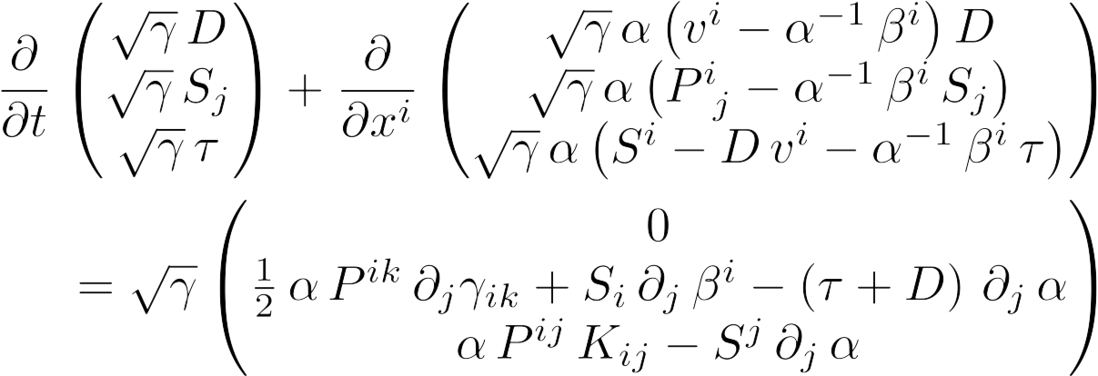
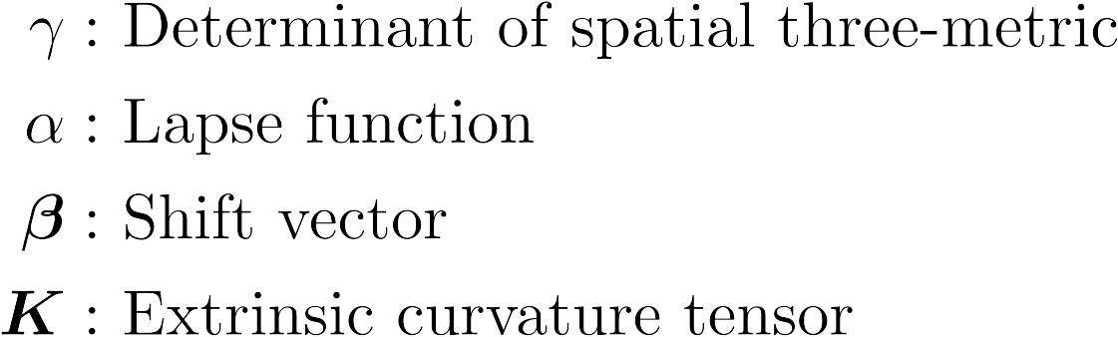
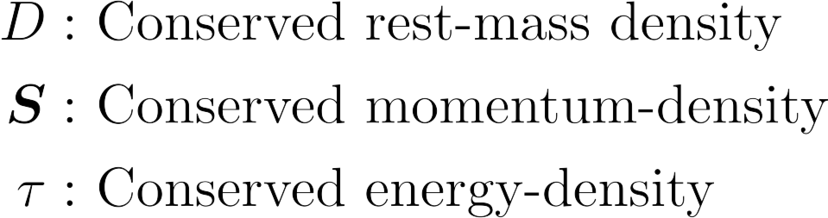
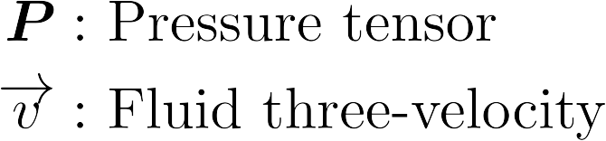
3+1 GR-Hydro Equations
Geometry
Evolved Quantities
Auxiliary Quantities
APS, April 16th, 2019

Slide 5
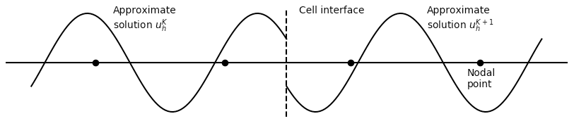
Discontinuous Galerkin Method
Approximate solution as a series of polynomials, discontinuous at cell-boundaries
Locally high-order accurate
Slope limiters
Bound-preserving limiters
APS, April 16th, 2019

Slide 6
Results
APS, April 16th, 2019

Slide 7

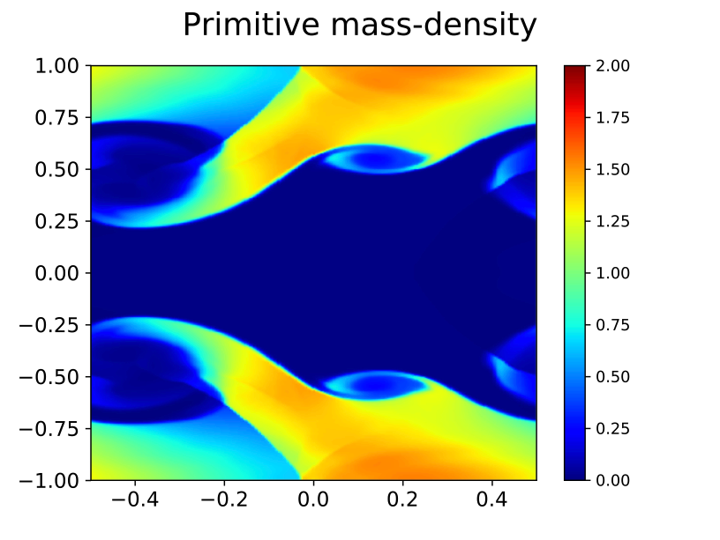
Relativistic Kelvin-Helmholtz Instability
Initial conditions from: Beckwith & Stone (2011), ApJS, 193:6
  Instability seeded in vertical component of velocity
Periodic boundary conditions in both dimensions
nX = 128, nY = 256
nNodes = 3
t = 3.0
SSP-RK3
APS, April 16th, 2019
APS, April 16th, 2019

Slide 8
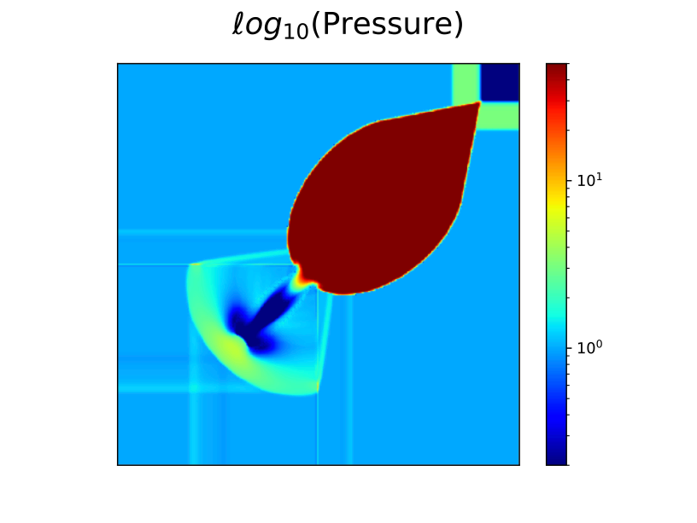
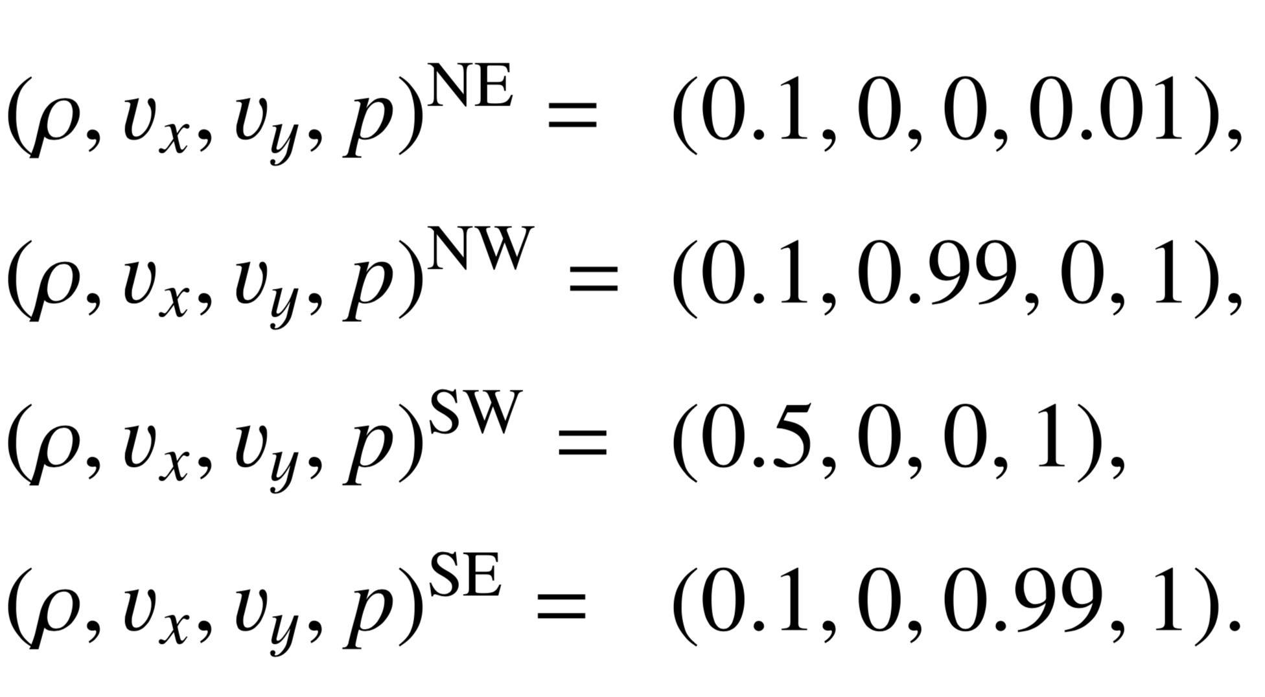
Special Relativistic 2D Riemann Problem
Strong shocks in multiple dimensions
Del Zanna & Bucciantini (2002), A&A, 390:1177
Free expansion
nX = nY = 256
nNodes = 3
t = 0.4
SSP-RK3
APS, April 16th, 2019

Slide 9
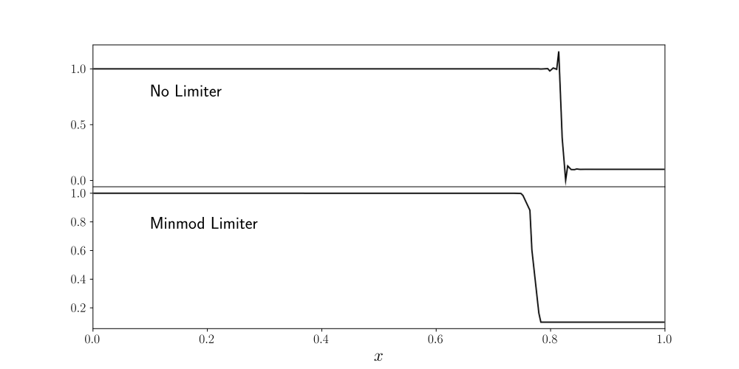
Limiters
Near shocks, polynomial representation can lead to oscillatory behavior in solution
To mitigate oscillations, degree of polynomial is truncated, slope is modified
We also use a shock detector to avoid limiting in smooth regions of solution
Additionally, we use a bound-preserving limiter to avoid non-physical situations
APS, April 16th, 2019
APS, April 16th, 2019

Slide 10
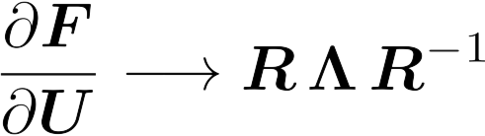
Component-Wise vs. Characteristic Limiting
Could limit component-wise, but components are coupled
Better is to limit characteristic variables
  Construct local characteristic decomposition with cell-averages
  Compute slopes in characteristic variables
  Limit with MinModB limiter
  Recover components from limited characteristic variables
APS, April 16th, 2019

Slide 11
Characteristic Limiting
nX = nY = 256
nNodes = 3
t = 0.4
SSP-RK3
APS, April 16th, 2019
APS, April 16th, 2019

Slide 12
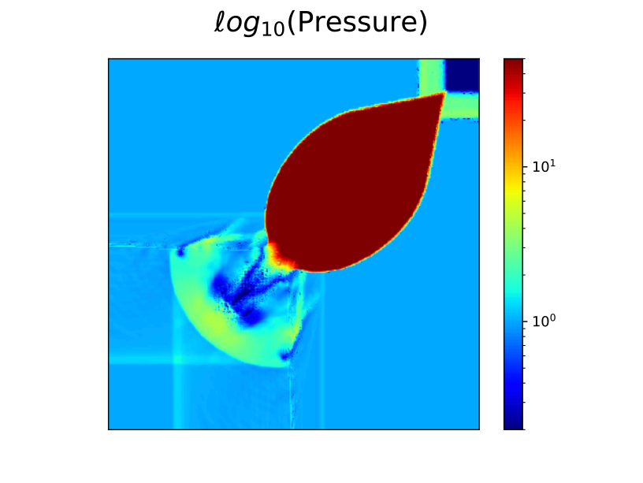
Characteristic Limiting
Component-Wise Limiting
nX = nY = 256
nNodes = 3
t = 0.4
SSP-RK3
APS, April 16th, 2019

Slide 13
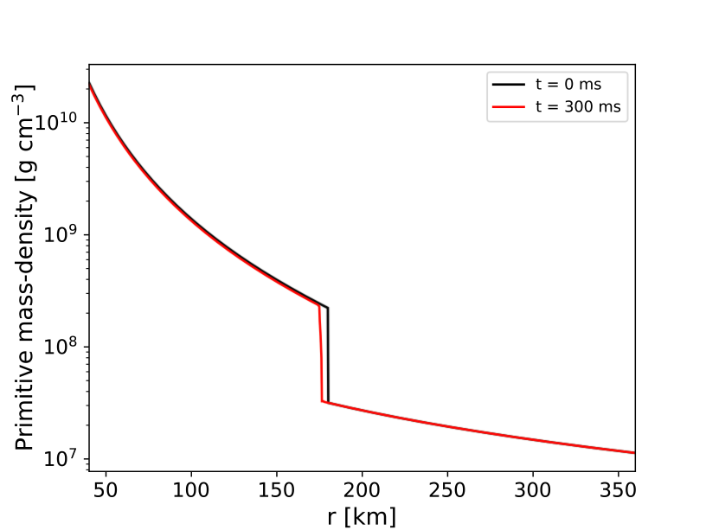
Relativistic Standing Accretion Shock Instability
Curvilinear coordinates
Initial conditions from solving relativistic Bernoulli equation
Extrapolate solution for inner boundary, constant inflow for outer
Point-mass potential, stationary spacetime
APS, April 16th, 2019

Slide 14
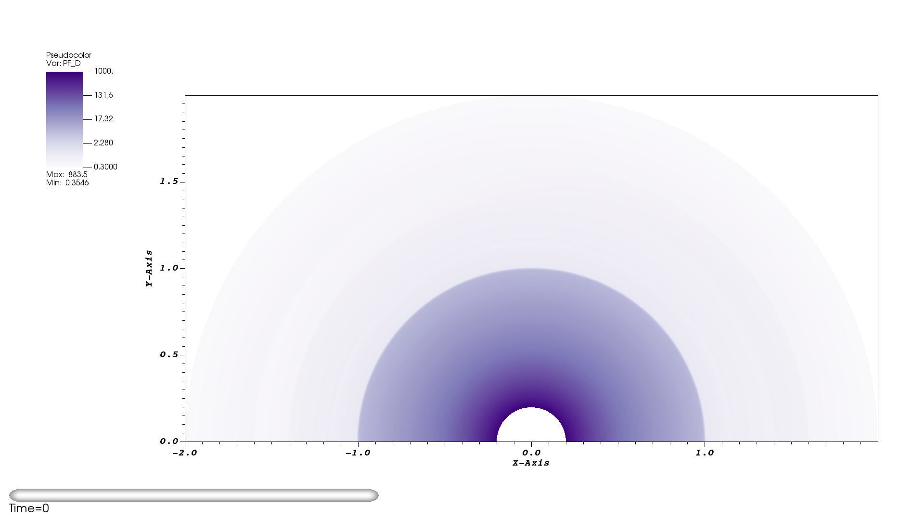
2D Standing Accretion Shock Instability
(Preliminary)
AMReX¹
nR = 256
nθ = 128
nNodes = 3
t = 80
SSP-RK3
64 MPI ranks
8 Compute nodes
¹https://github.com/AMReX-Codes/amrex
APS, April 16th, 2019
APS, April 16th, 2019

Slide 15
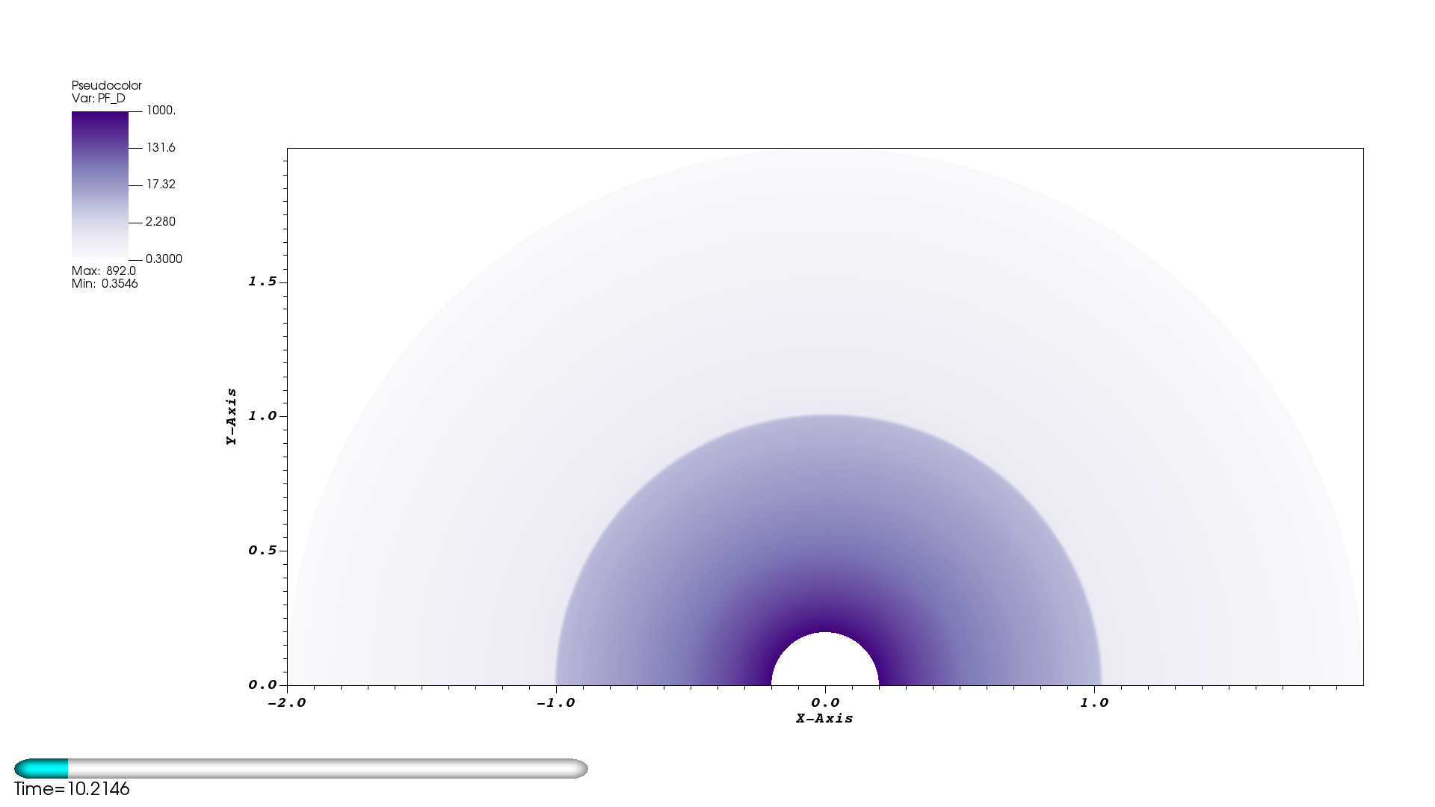
2D Standing Accretion Shock Instability
(Preliminary)
nR = 256
nθ = 128
nNodes = 3
t = 80
SSP-RK3
64 MPI ranks
8 Compute nodes
APS, April 16th, 2019

Slide 16
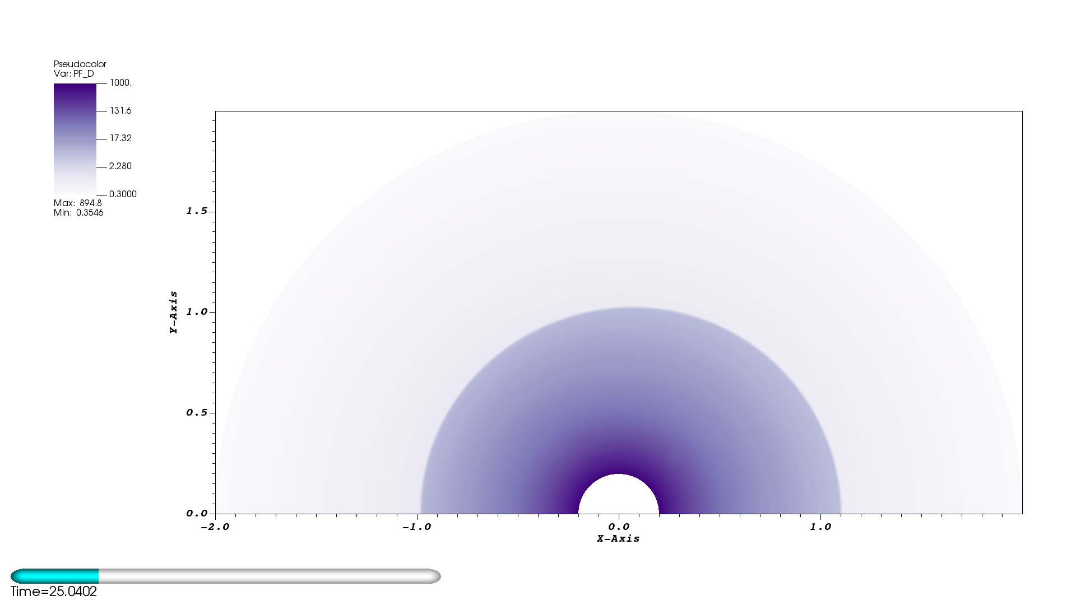
2D Standing Accretion Shock Instability
(Preliminary)
nR = 256
nθ = 128
nNodes = 3
t = 80
SSP-RK3
64 MPI ranks
8 Compute nodes
APS, April 16th, 2019
APS, April 16th, 2019

Slide 17
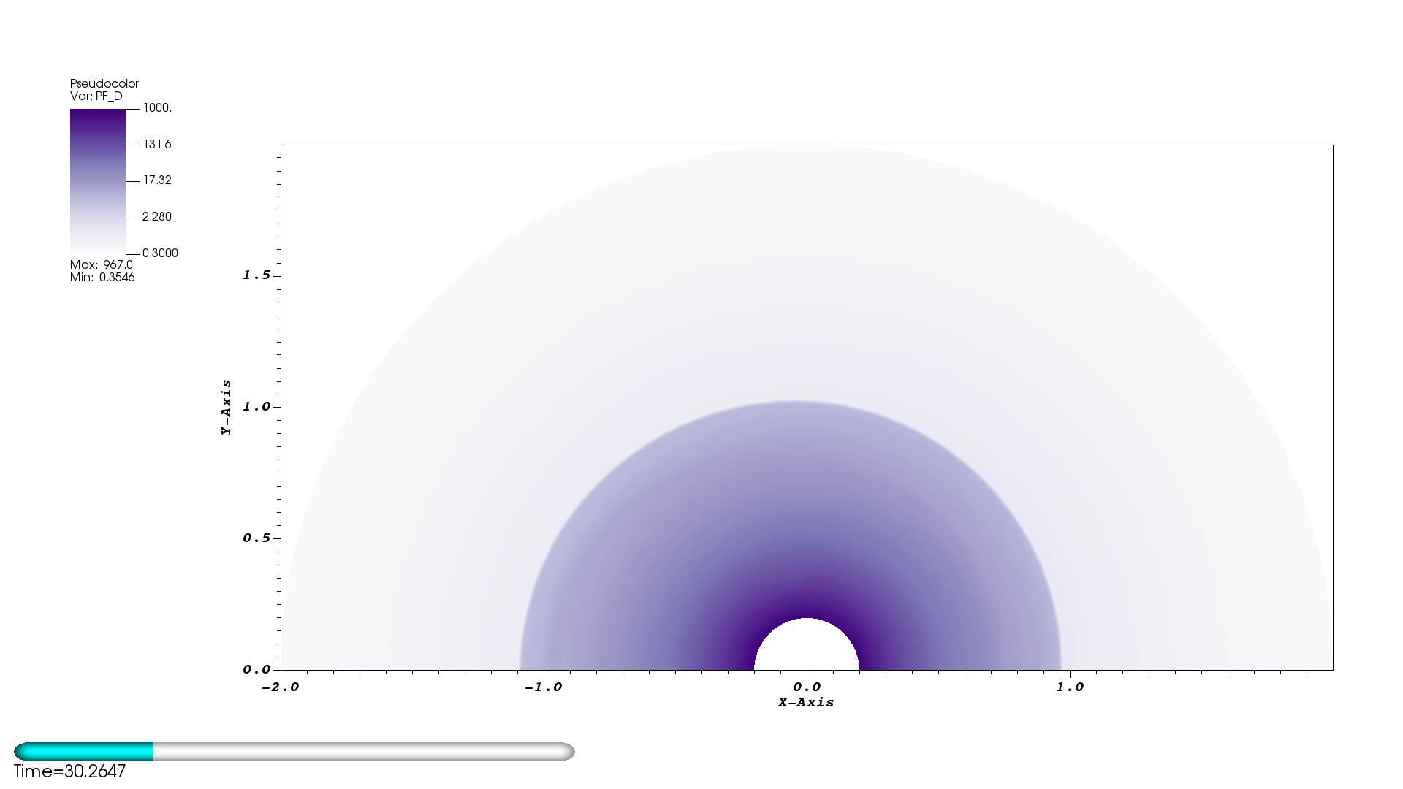
2D Standing Accretion Shock Instability
(Preliminary)
nR = 256
nθ = 128
nNodes = 3
t = 80
SSP-RK3
64 MPI ranks
8 Compute nodes
APS, April 16th, 2019

Slide 18
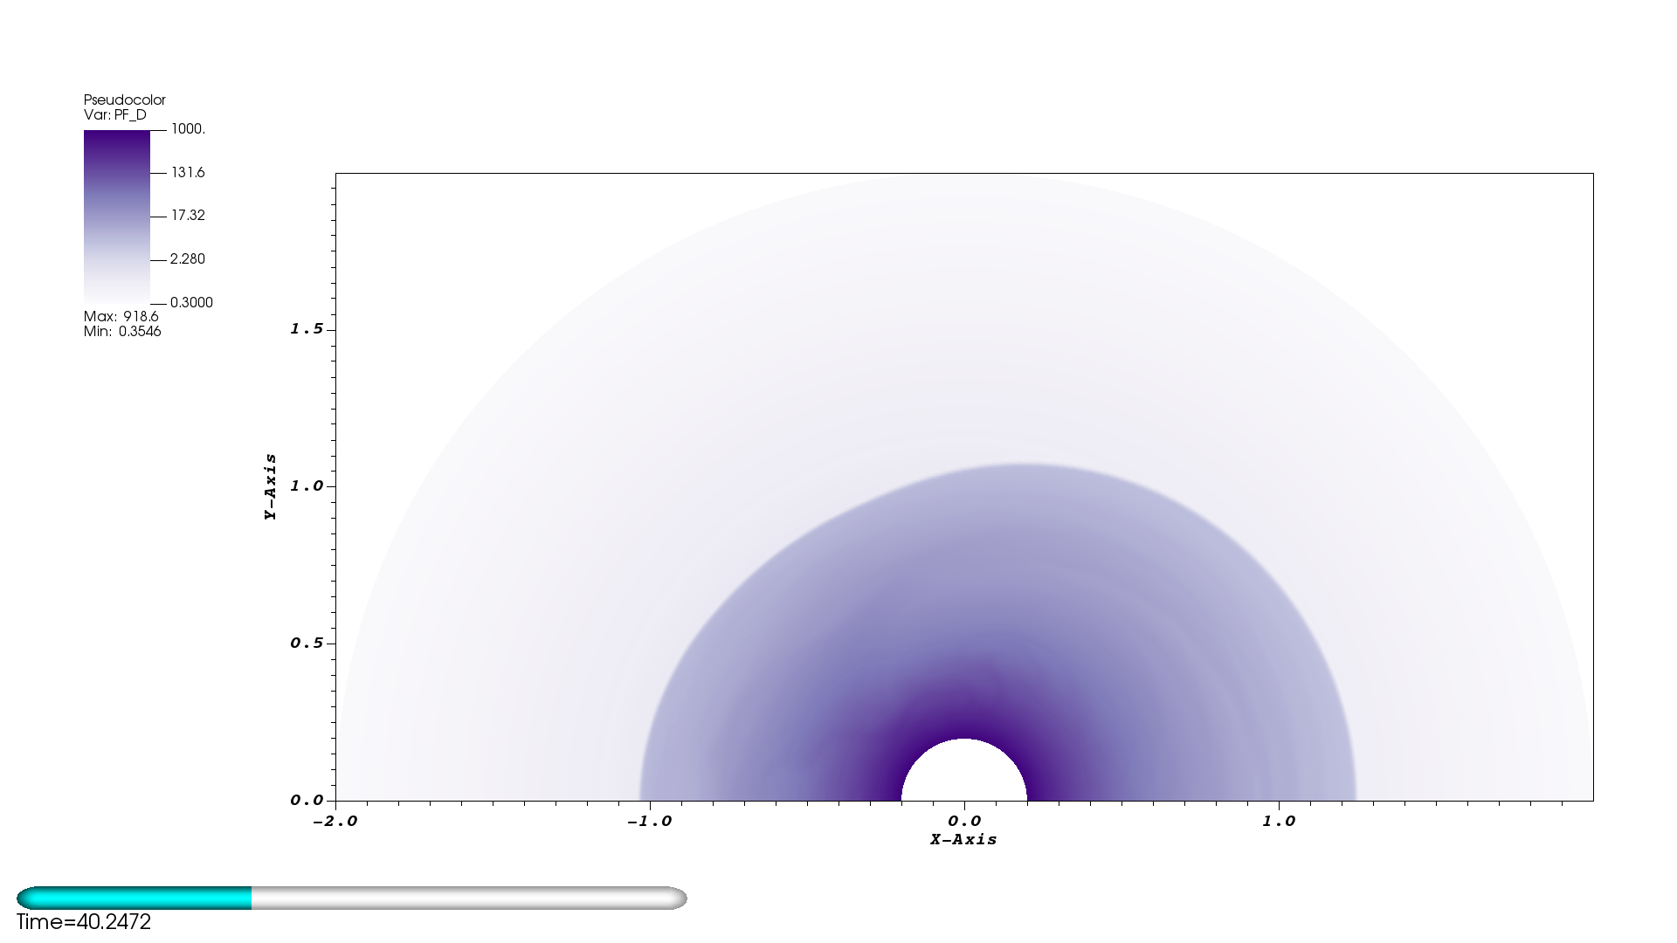
2D Standing Accretion Shock Instability
(Preliminary)
nR = 256
nθ = 128
nNodes = 3
t = 80
SSP-RK3
64 MPI ranks
8 Compute nodes
APS, April 16th, 2019
APS, April 16th, 2019

Slide 19
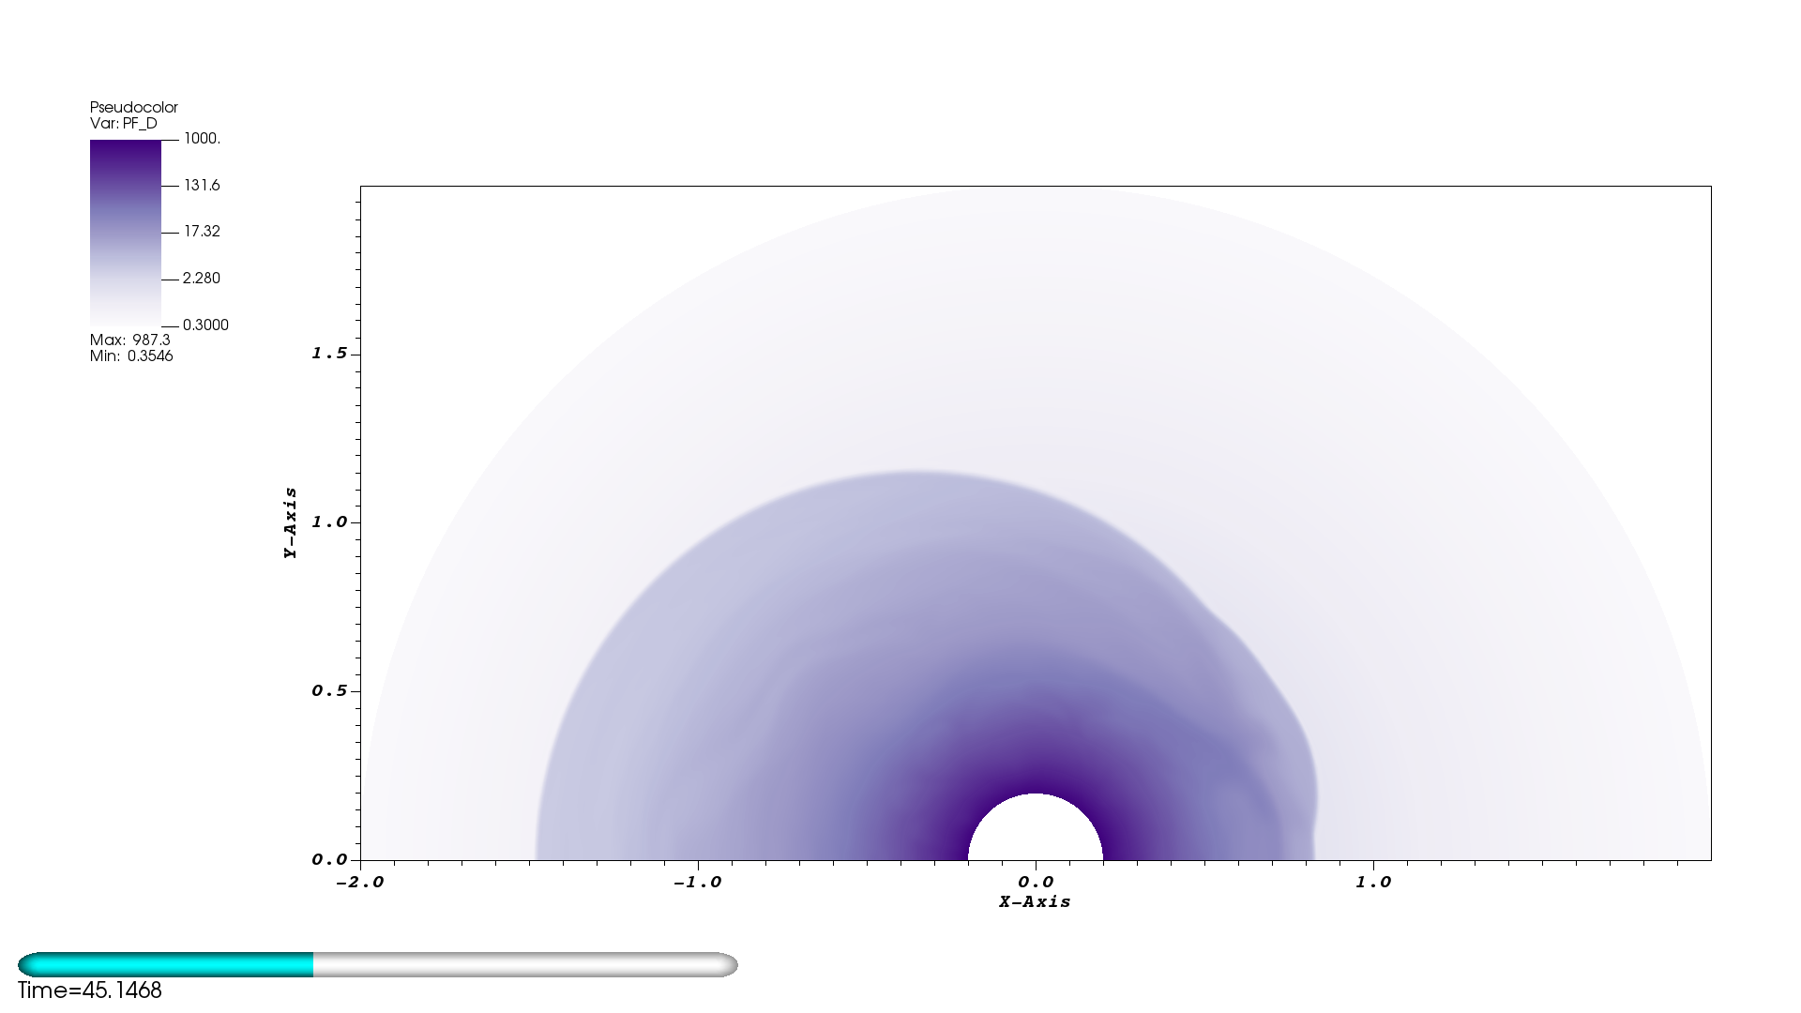
2D Standing Accretion Shock Instability
(Preliminary)
nR = 256
nθ = 128
nNodes = 3
t = 80
SSP-RK3
64 MPI ranks
8 Compute nodes
APS, April 16th, 2019

Slide 20
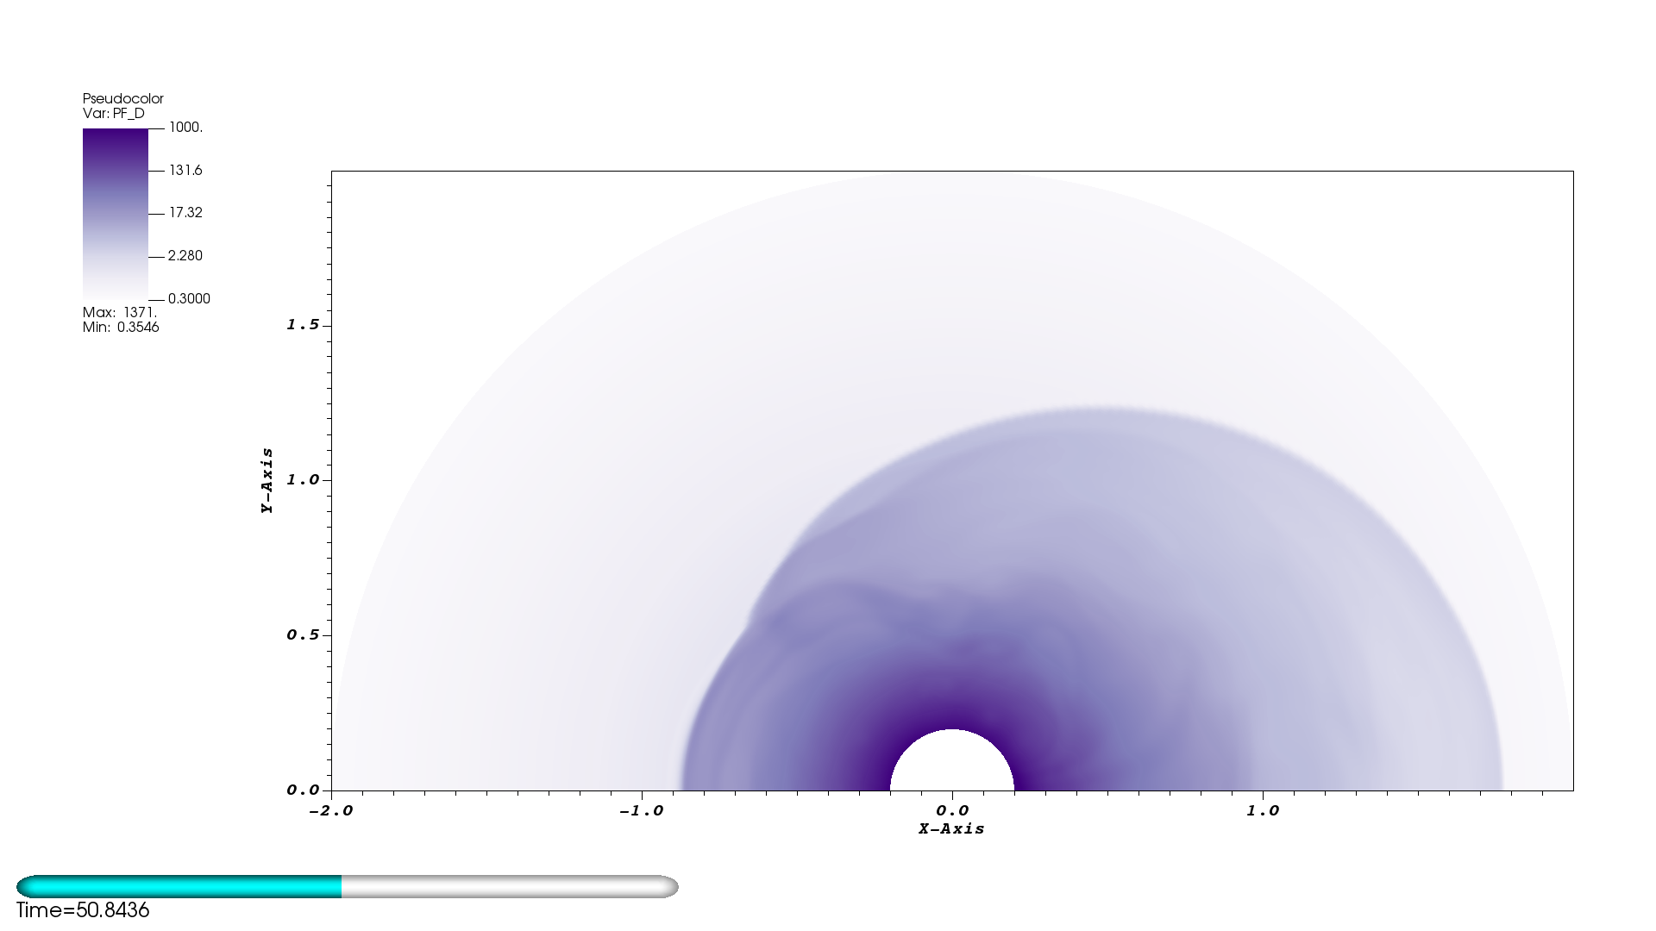
2D Standing Accretion Shock Instability
(Preliminary)
nR = 256
nθ = 128
nNodes = 3
t = 80
SSP-RK3
64 MPI ranks
8 Compute nodes
APS, April 16th, 2019

Slide 21
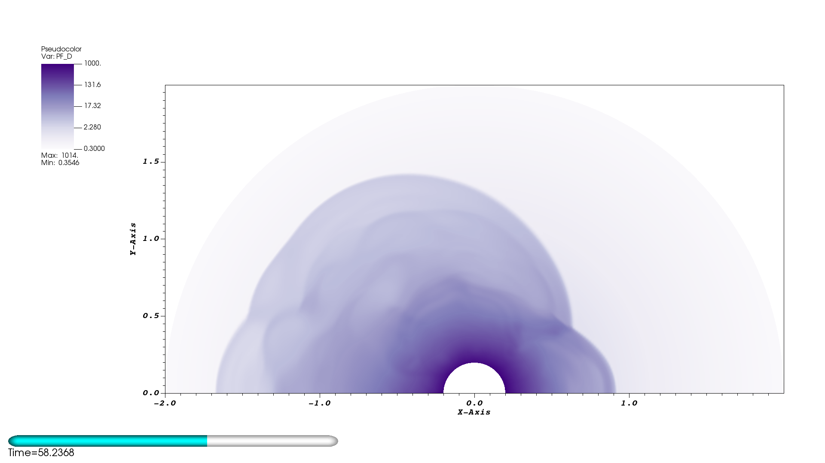
2D Standing Accretion Shock Instability
(Preliminary)
nR = 256
nθ = 128
nNodes = 3
t = 80
SSP-RK3
64 MPI ranks
8 Compute nodes
APS, April 16th, 2019

Slide 22
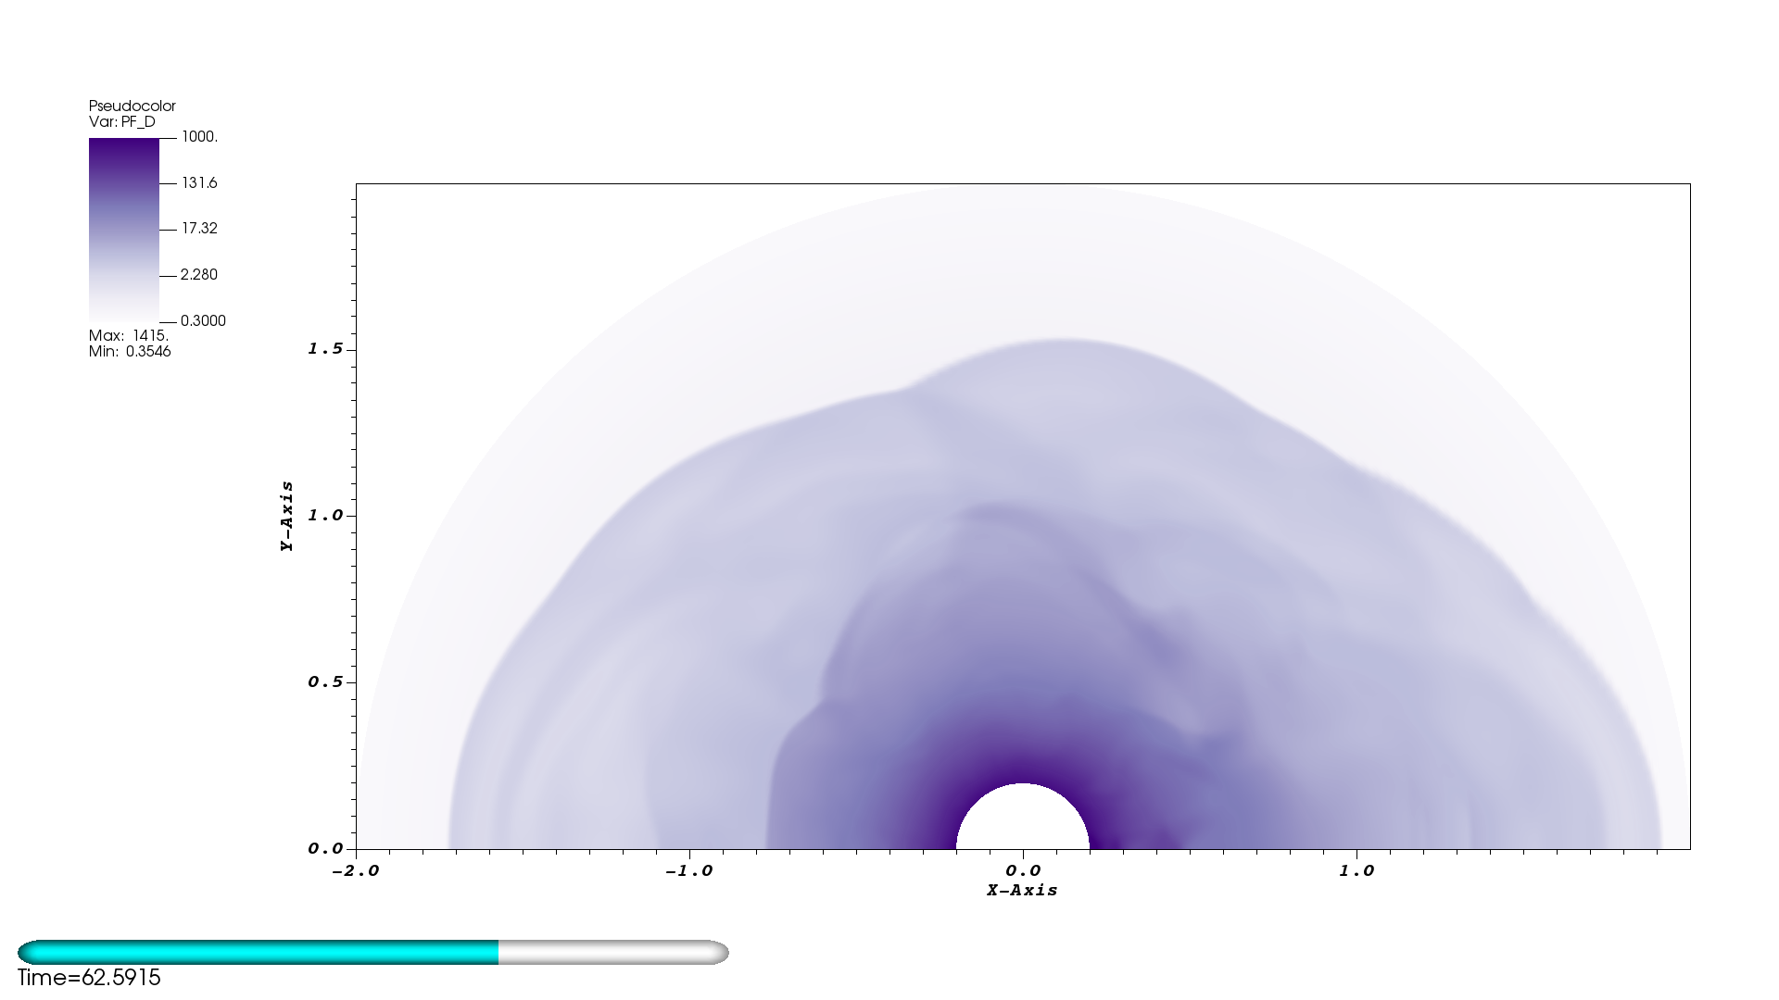
2D Standing Accretion Shock Instability
(Preliminary)
nR = 256
nθ = 128
nNodes = 3
t = 80
SSP-RK3
64 MPI ranks
8 Compute nodes
APS, April 16th, 2019

Slide 23
Acknowledgements
I would like to acknowledge NSF for helping to fund this research:
NSF GP-1505933
NSF GP-1806692
I would also like to acknowledge Vanderbilt University for helping to fund this research
APS, April 16th, 2019

Slide 24
Conclusion
Implemented DG method to solve GR-hydro equations
Code has been validated with several challenging test-problems
  Compares well with other published results
Characteristic limiting is necessary for higher order methods
Future Work
  Couple GR-hydro with adaptive mesh refinement (AMReX)
    Run multi-D GR SAS problem
      Investigate effect of SASI turbulence
  Couple with CFA gravity solver (Nick Roberts)
  Couple with neutrino transport solver (Zach Elledge, Ran Chu)
APS, April 16th, 2019

Slide 25
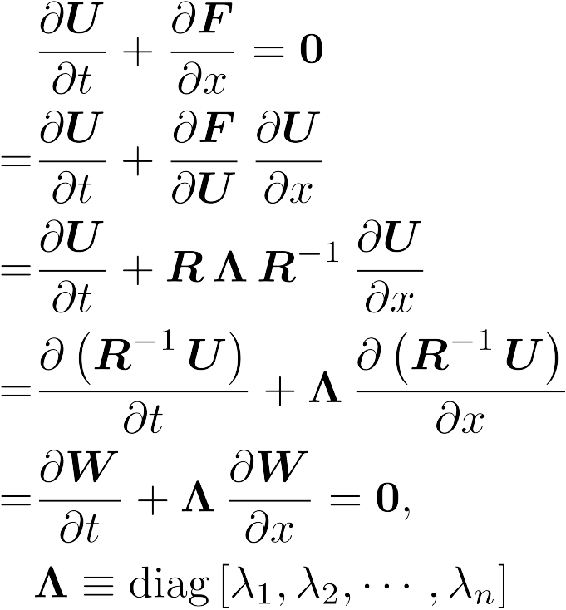
Characteristic Decomposition
(Proof of concept: Linear case)
APS, April 16th, 2019

