Slide 1




A Discontinuous Galerkin Method for GR-Hydrodynamics in thornado
Samuel J. Dunham^{1,2}, Eirik Endeve^{3,2}, Anthony Mezzacappa^{2,4}, Jesse Buffaloe²
¹Vanderbilt University
²University of Tennessee-Knoxville
³Oak Ridge National Laboratory
⁴Joint Institute for Computational Sciences

Slide 2
Outline
Background/Motivation
Numerical Method
Results
Summary/Future Work

Slide 3
Outline
Background/Motivation
Numerical Method
Results
Summary/Future Work

Slide 4

Observations
Chinese astronomers observe “guest stars” (~200 CE)
May 1, 1006
  Cast shadows on the ground at night

Slide 5
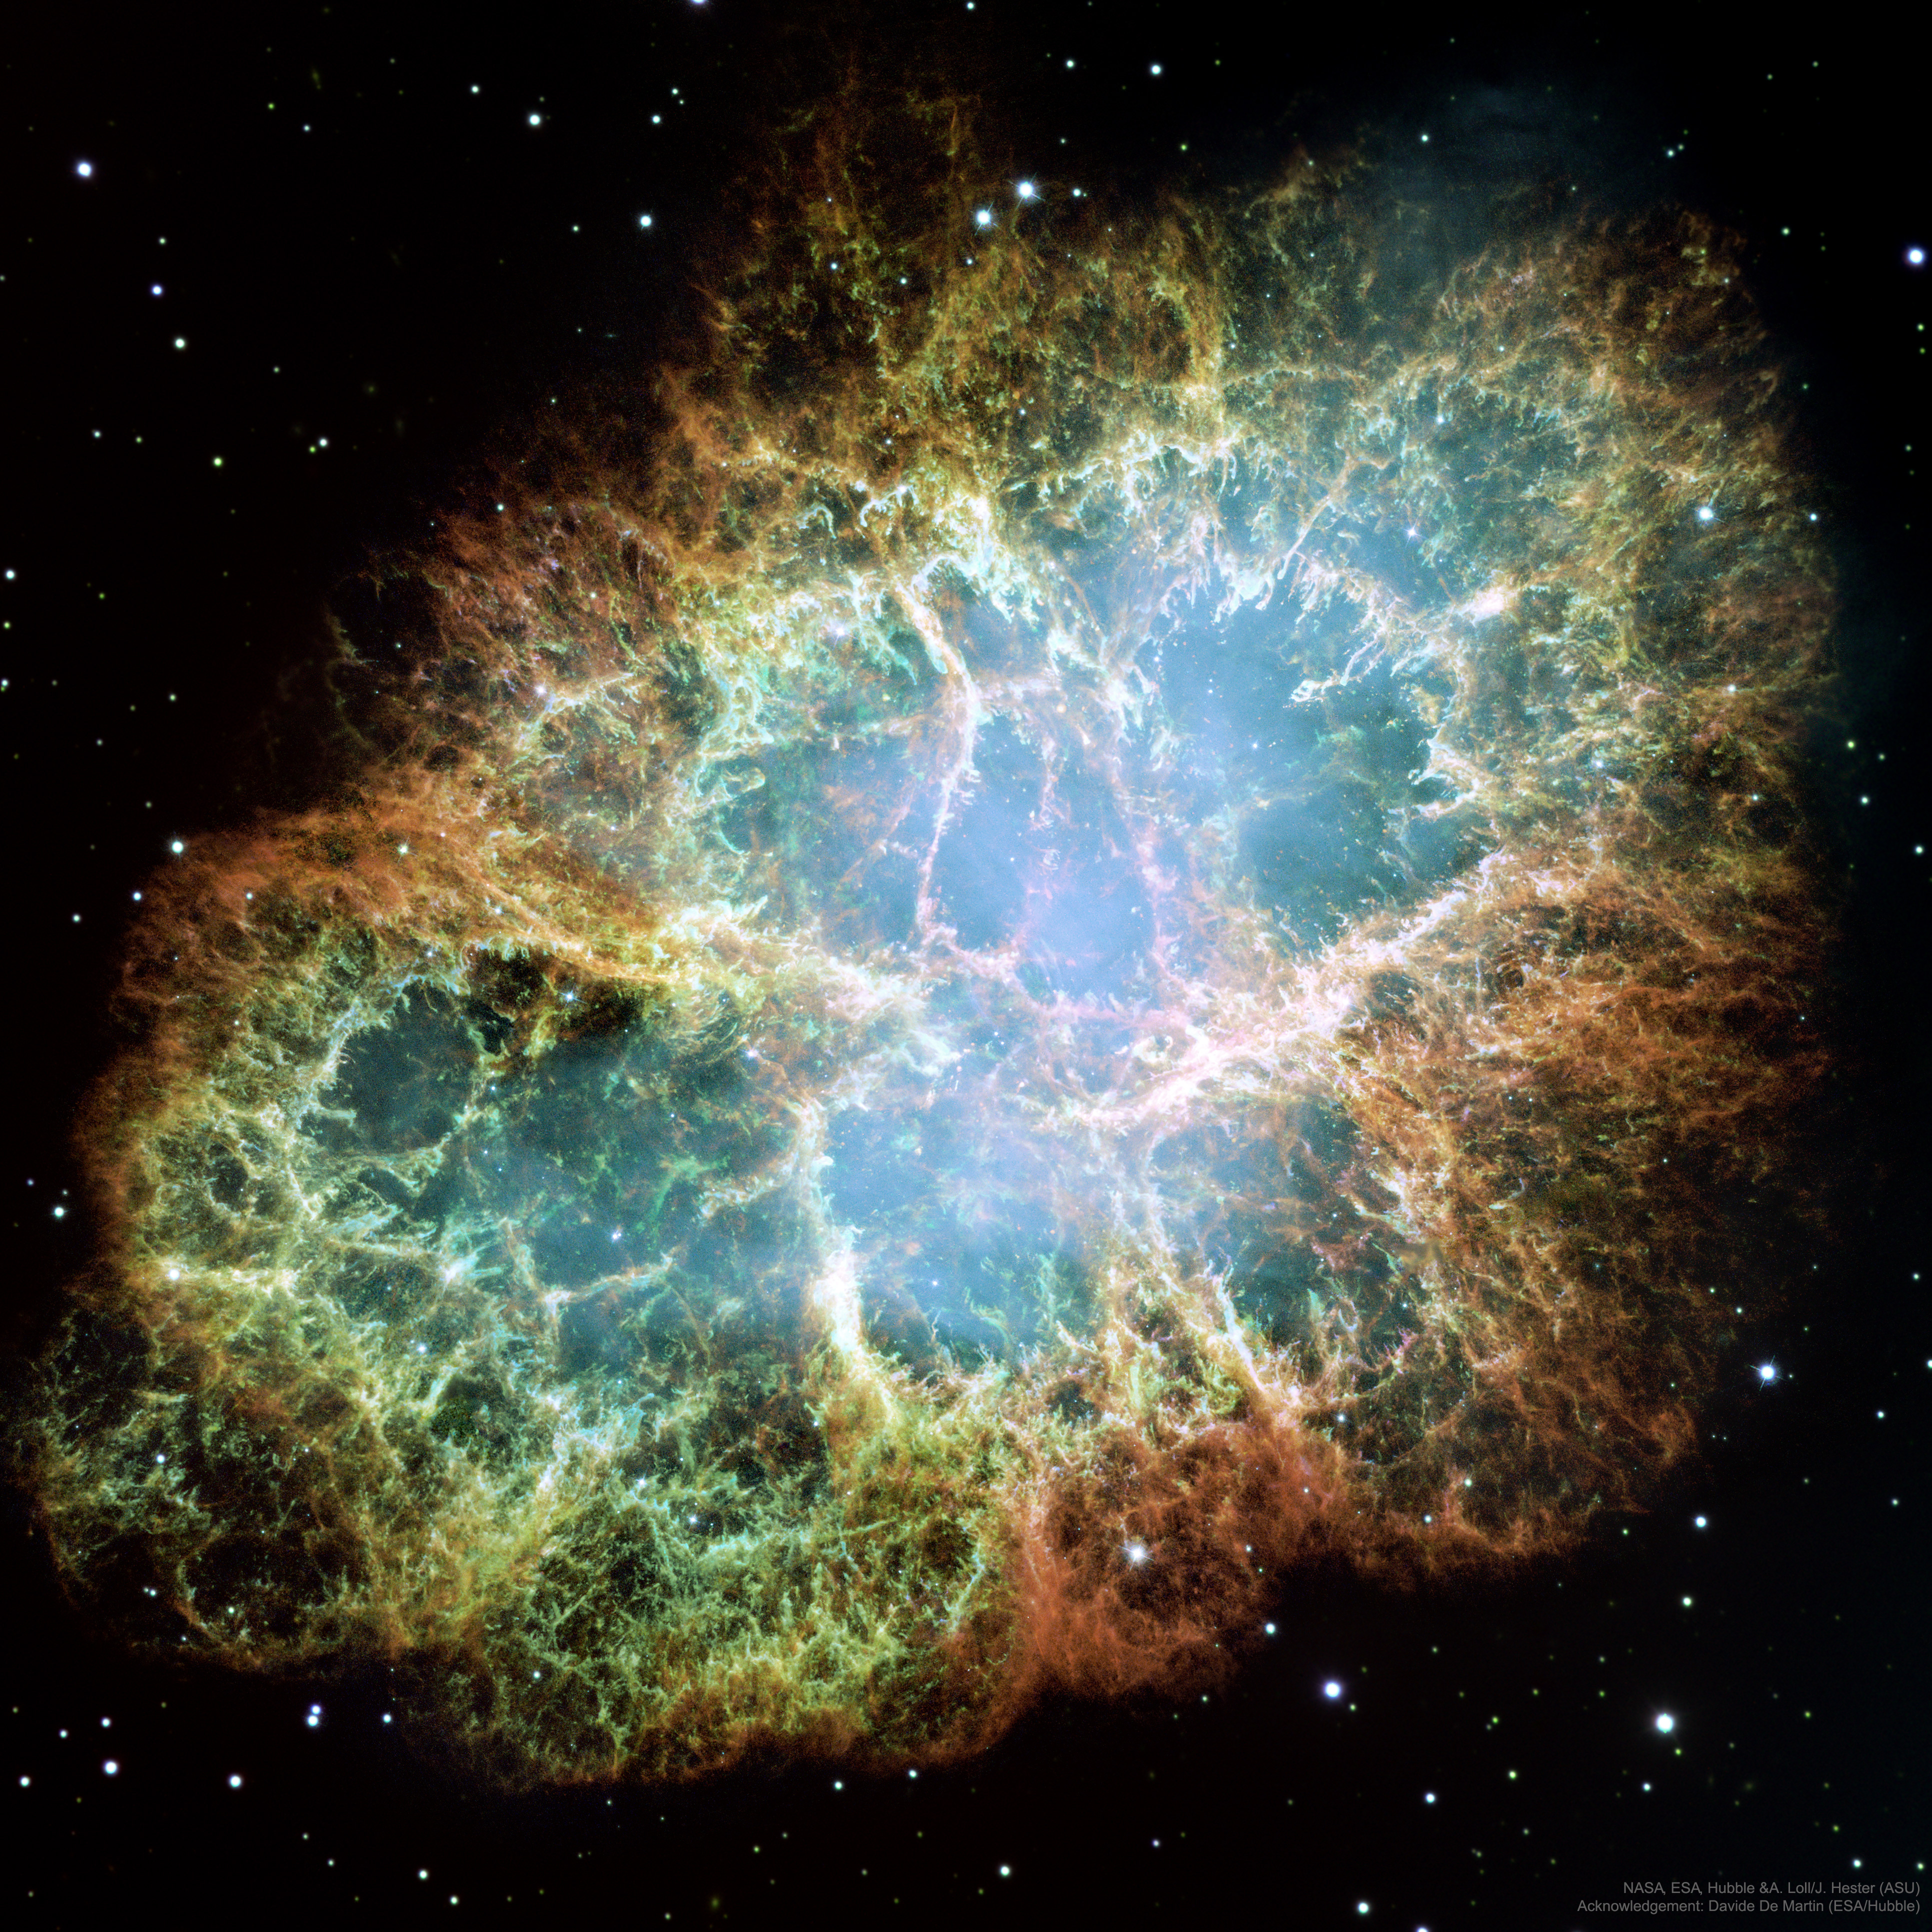
Crab
Observed in 1054 CE
Image shown is in optical
10 ly
Figure from APOD

Slide 6
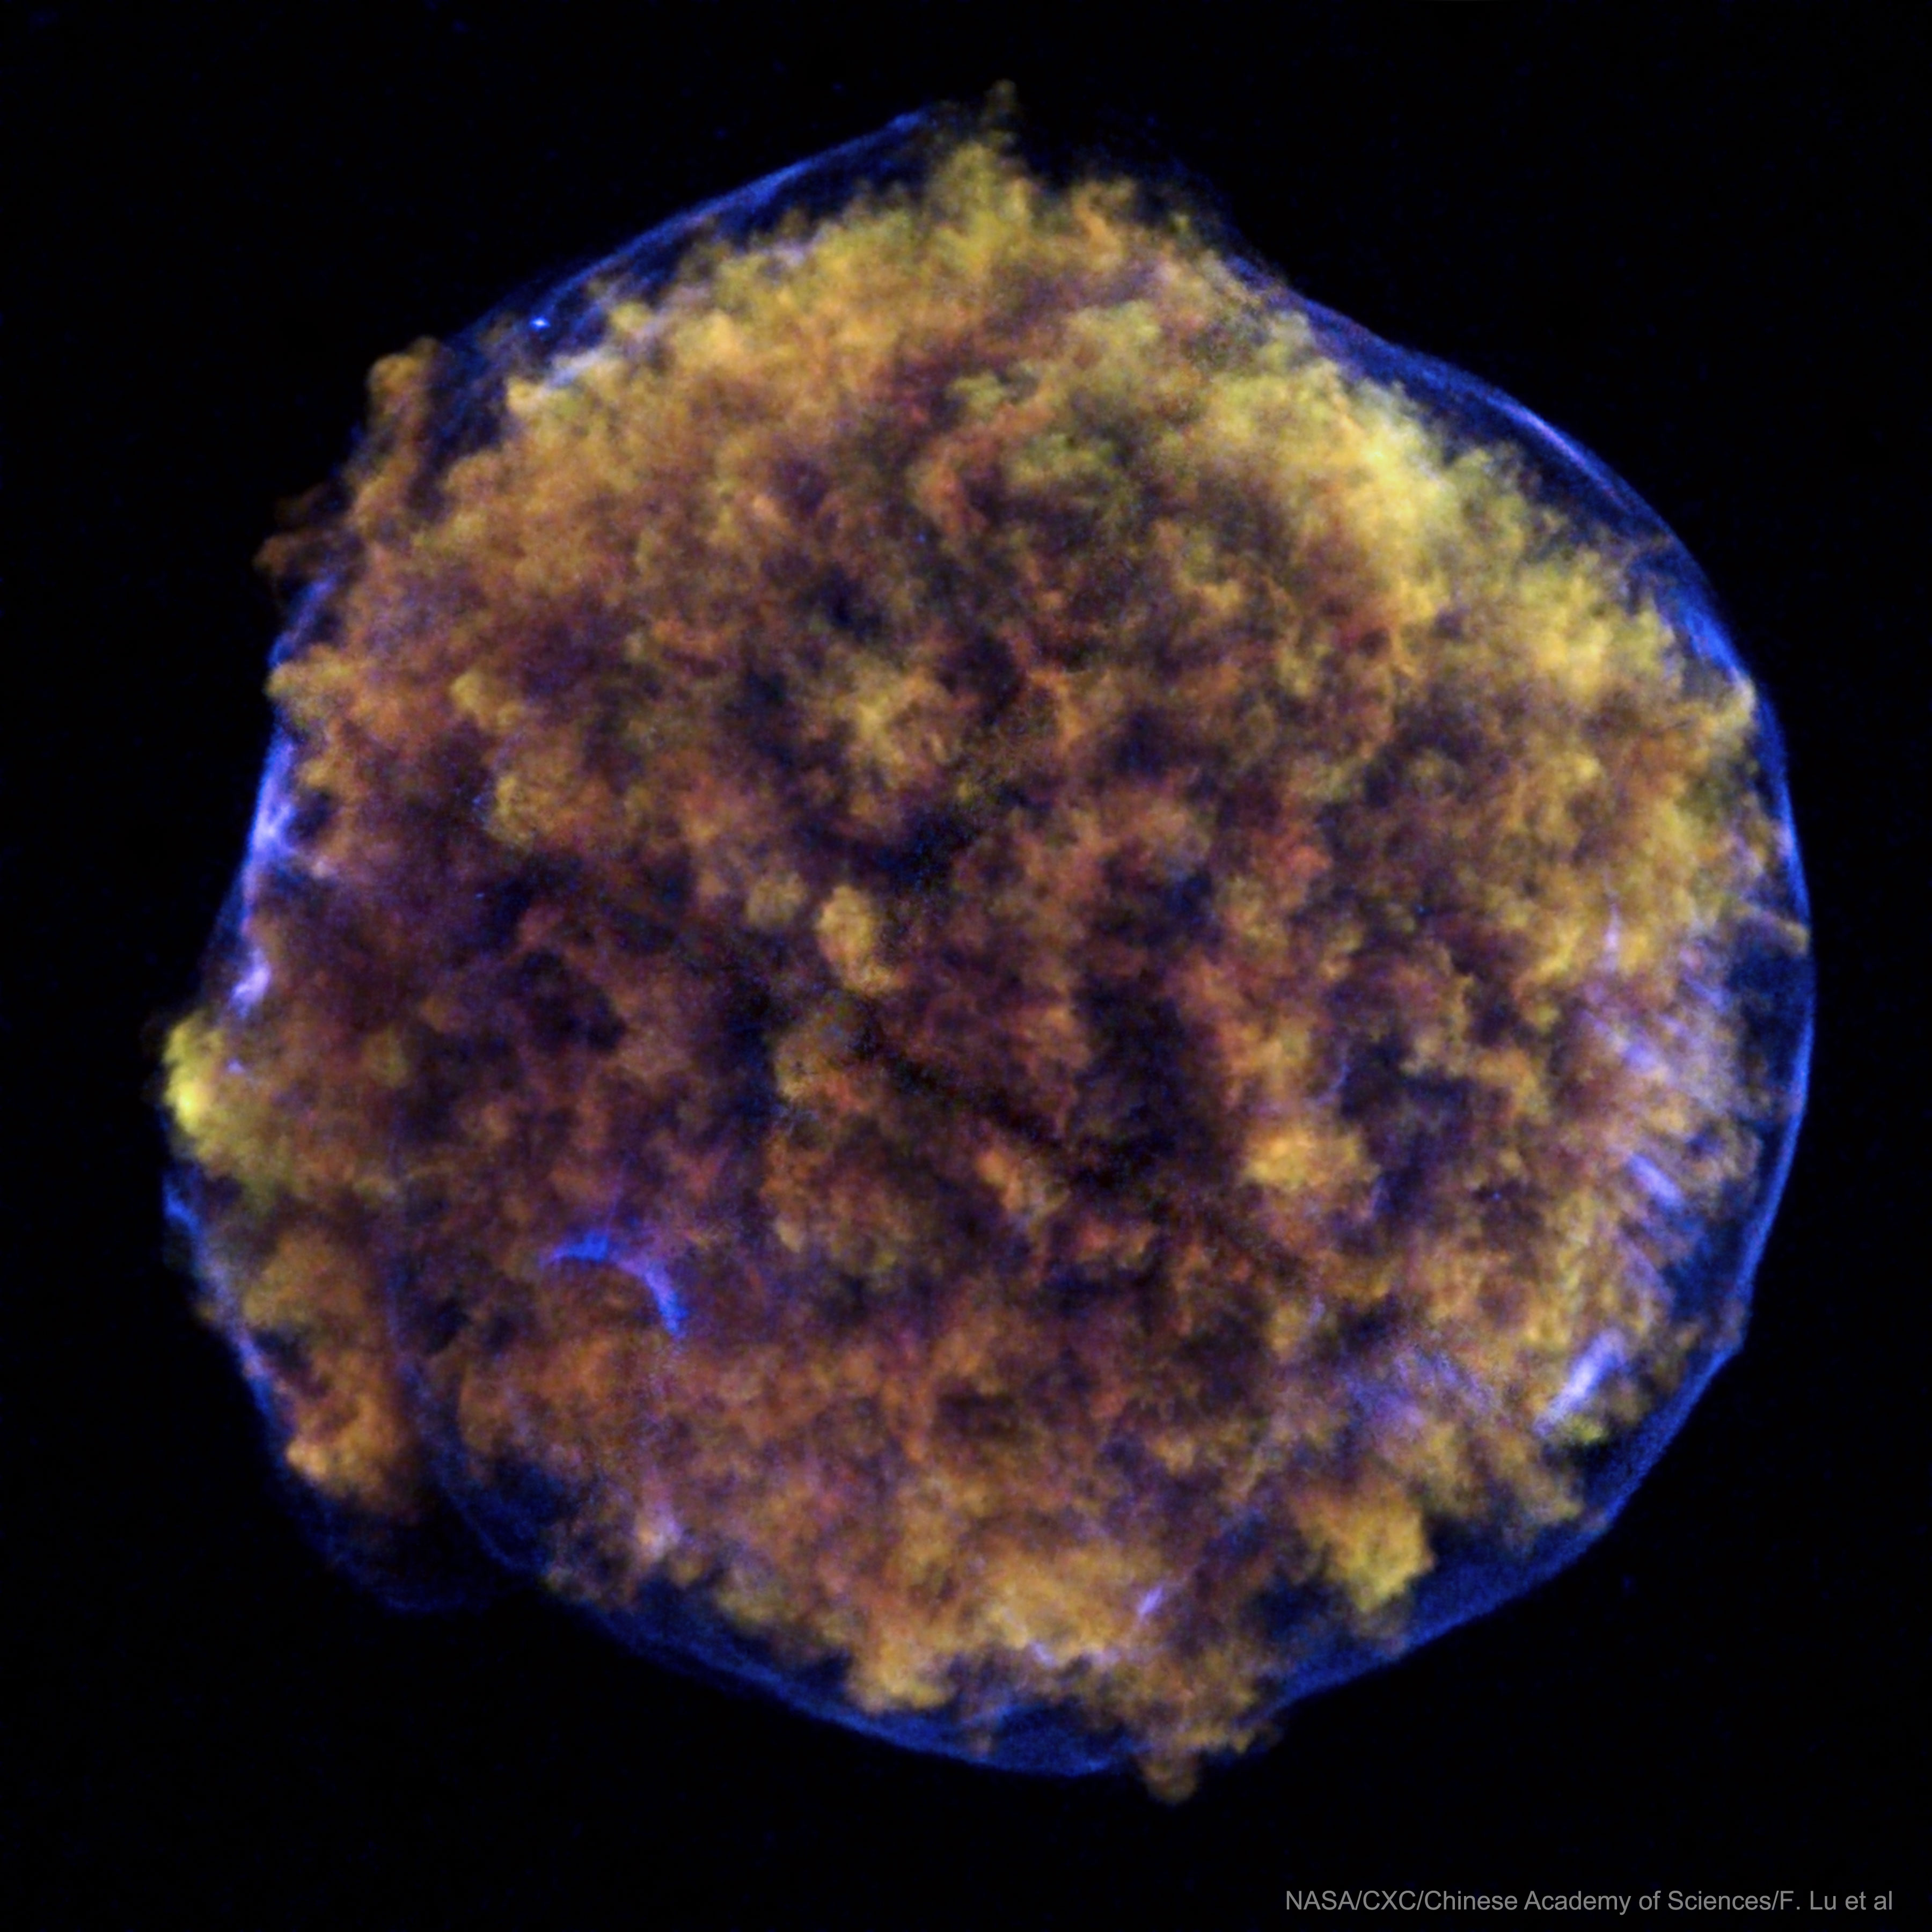
Tycho's Supernova
Observed in 1572
Image shown is in X-Ray
30 ly
Figure from APOD

Slide 7
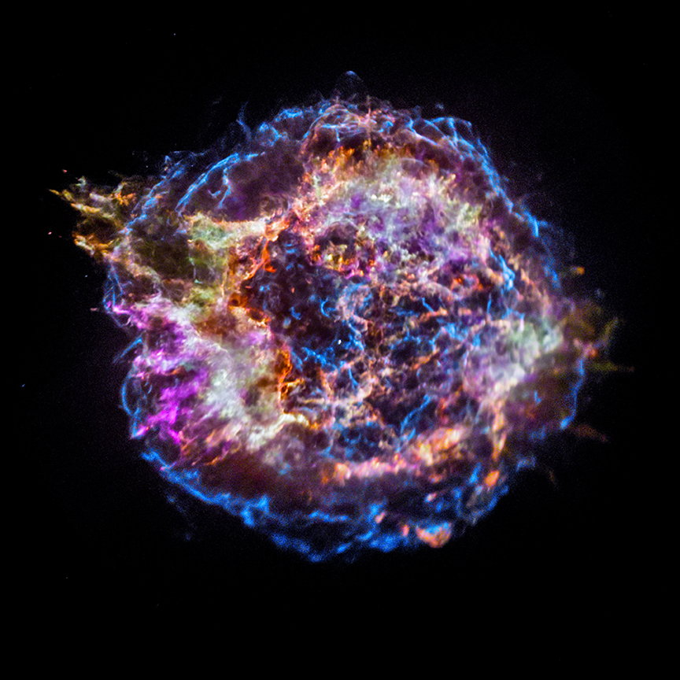
Cassiopeia A (Cas A)
Observed in mid-17th century
Find the pulsar!
Image shown is in X-Ray (with color-coded elements)
30 ly
Figure from APOD

Slide 8
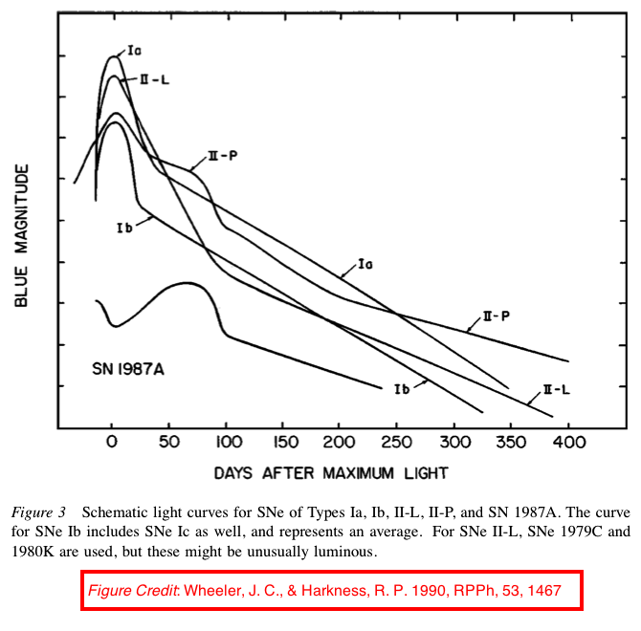
Light Curve

Slide 9
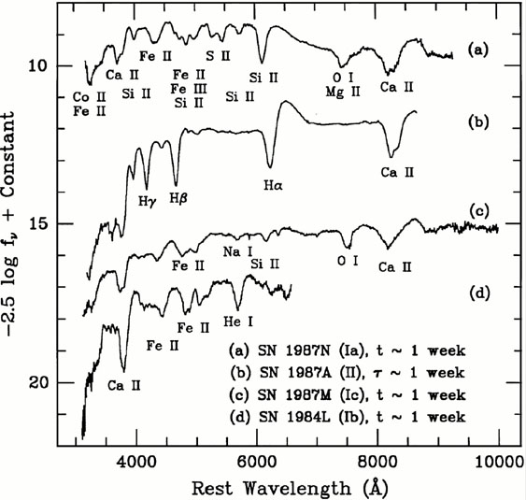
Spectra
https://ned.ipac.caltech.edu/level5/March03/Filippenko/Filippenko2.html

Slide 10
Interpretation/Theory
Fritz Zwicky (1898-1974)
  Type I and Type II SNe
  Much more than “spherical bastards”!
Baade and Zwicky (1934)
  Postulated Type II SNe are transitions to neutron stars
Colgate and White (1966)
  Neutrino-driven explosion (1D)
Bethe and Wilson (1985)
  Delayed neutrino-driven explosion (1D)
Modern picture
  Delayed neutrino-driven mechanism with multi-D effects

Slide 11
Motivation: Core-Collapse Supernovae
Explosion mechanism
Metal distribution
  Solar system is ~3-4 ly in diameter
Gravitational waves
Neutrinos
Nuclear matter
30 ly
Cas A, color-coded by chemical composition. Figure from APOD

Slide 12
Outline
Background/Motivation - CCSNe
Numerical Method
Results
Summary/Future Work

Slide 13
What Are We Doing?
Developing new code to study CCSNe: toolkit for high-order neutrino-radiation hydrodynamics (thornado)
3+1 (CFA)
  Hydrodynamics
  Neutrino Transport
  Gravity
Runge-Kutta Discontinuous Galerkin (RKDG)

Slide 14
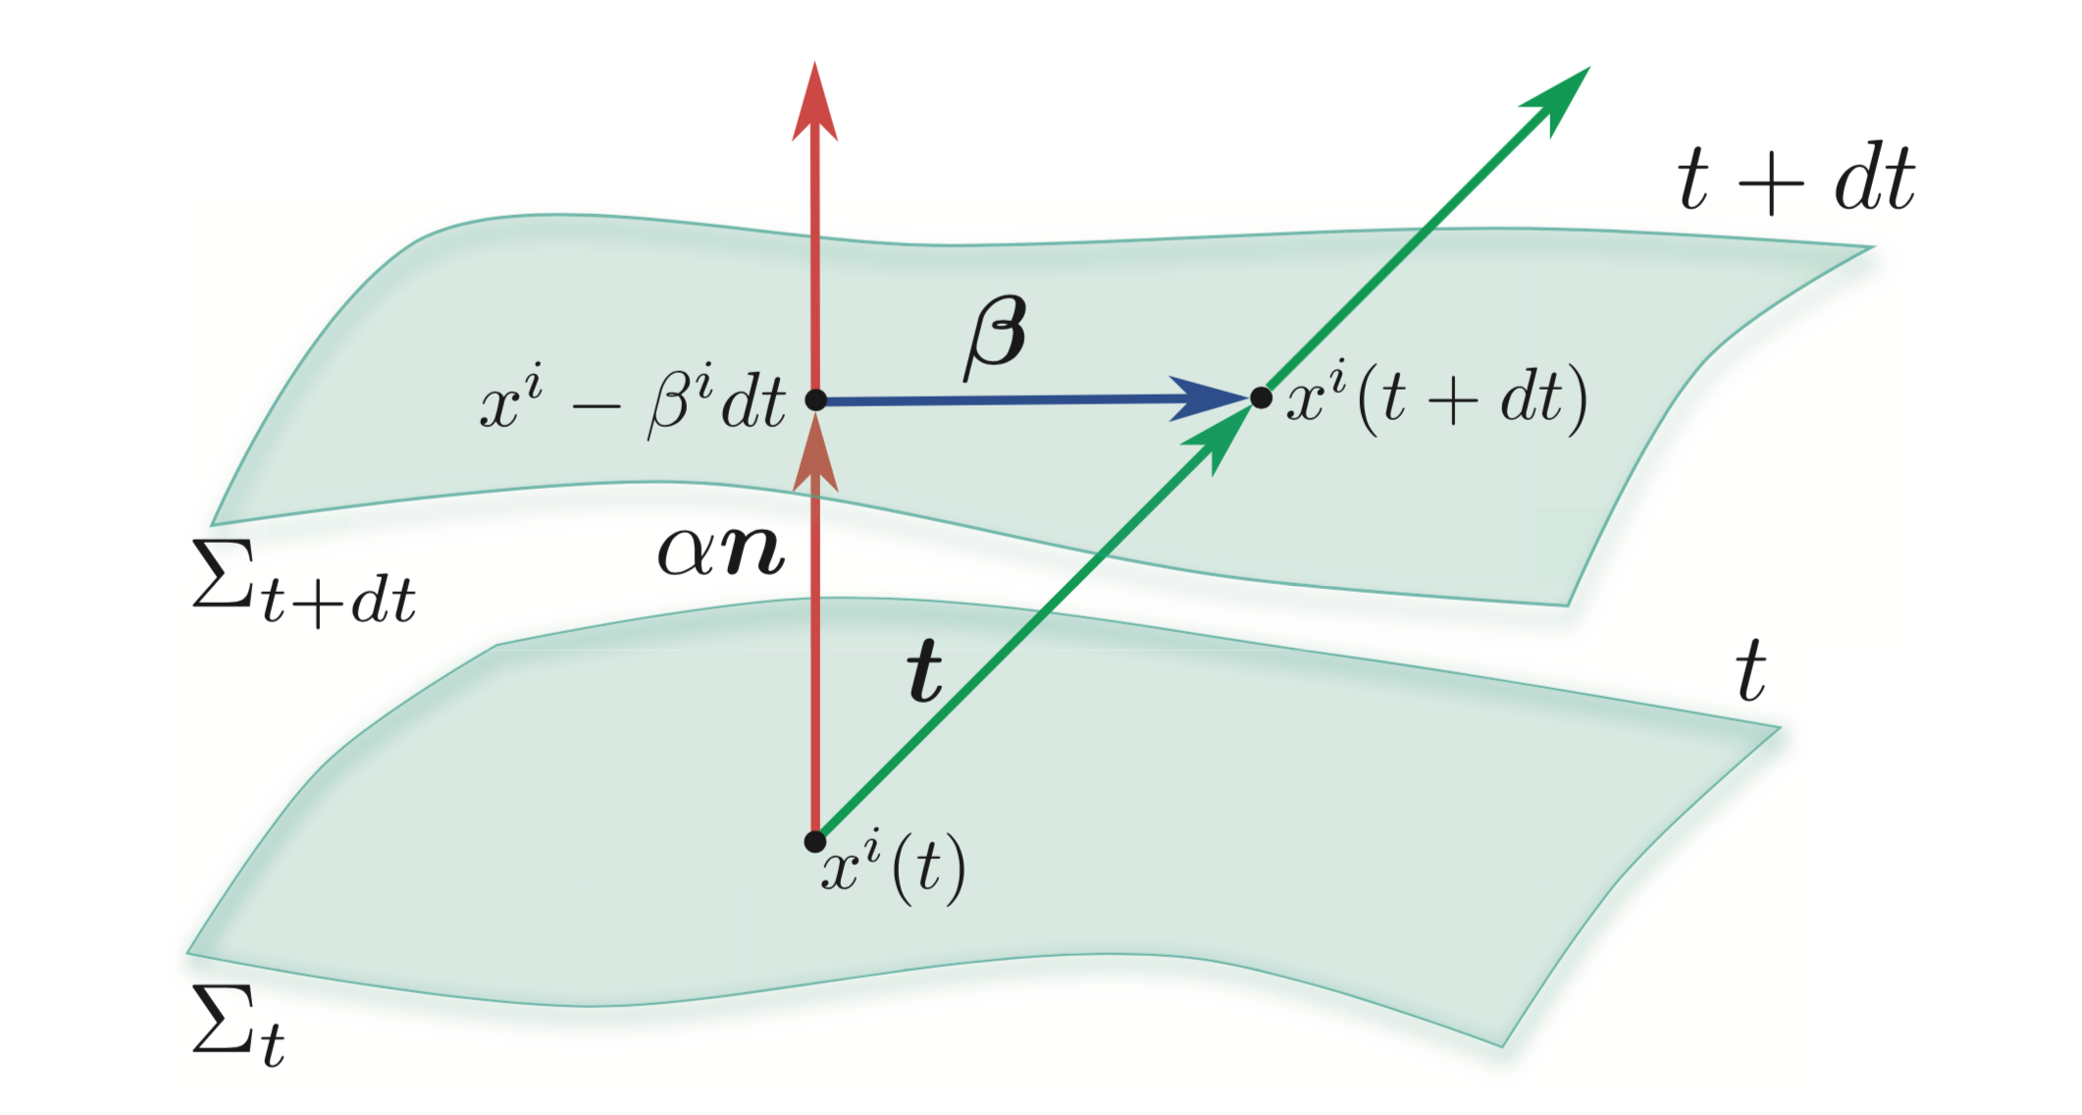
3+1 Decomposition
Rezzolla & Zanotti, Relativistic Hydrodynamics, 2013, Oxford

Slide 15
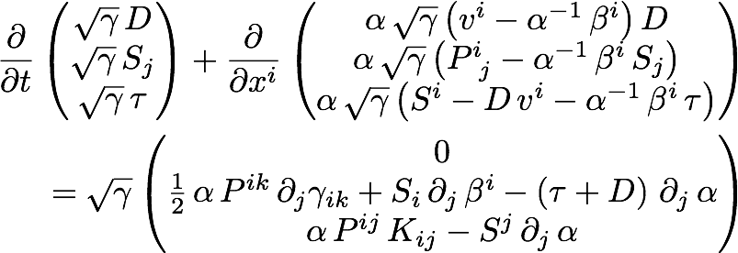
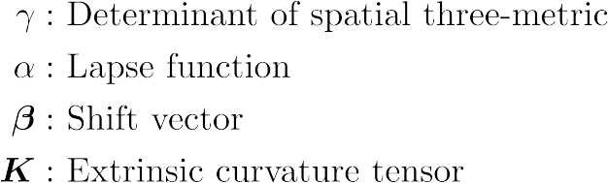
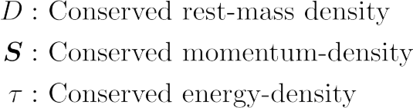

3+1 GR-Hydro Equations
Geometry
Evolved Quantities
Auxiliary Quantities

Slide 16
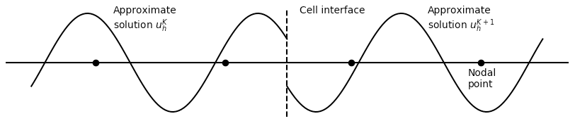
Numerical Method
Discontinuous Galerkin (DG)
xL
xR
Discretize spatial domain
xL
N=2
xR
K
K+1
Approximate local solution

Slide 17
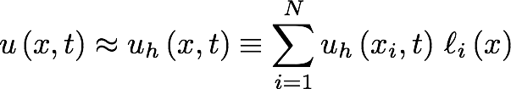
Numerical Method
Discontinuous Galerkin (DG)
Discretize spatial domain
Locally approximate solution as polynomial
Use weak form to evolve solution in time with SSP-RK methods
Apply slope and bound-preserving limiters at each stage of SSP-RK algorithm

Slide 18

Weak Form (1D)
Assume three-metric explicitly independent of time
Weak form
Numerical flux obtained with approximate Riemann solver

Slide 19
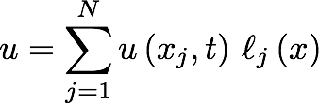
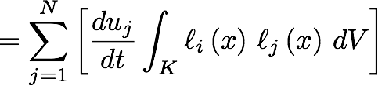

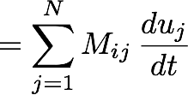


PDE → ODE

Slide 20


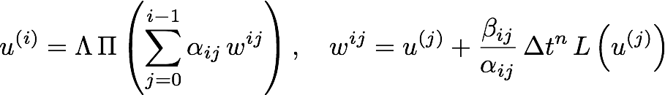

Time-Stepping Algorithm
Strong-Stability-Preserving Runge-Kutta (SSP-RK)
Cockburn & Shu, (2001) J. Sci. Comp., Vol. 16, No. 3
Limiters
Forward-Euler:

Slide 21
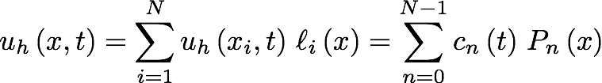
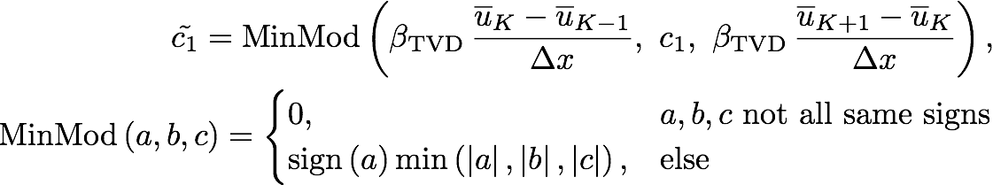
Slope Limiter
MinMod Limiter
Higher-order methods can develop unphysical oscillations
Map solution from nodal to modal representation
Compare slope in target cell to derivatives in neighbors via cell-averages
Legendre Polynomials
Dimensionless parameter with value between 1 and 2

Slide 22
Troubled-Cell Indicator
Fu & Shu, (2017), J. Comp. Phys. 347, 305
MinMod limiter activates at smooth extrema
To alleviate, we detect troubled-cells before applying limiter
Quantify the difference in solutions in neighboring cells
Extrapolate solution in neighboring cells into target cell
Compute magnitude of differences between extrapolated solution and cell-average
Compare value to constant parameter

Slide 23


Bound-Preserving Limiter
Qin et al., (2016), J. Comp. Phys., 315, 323
Higher-order methods can exceed physical bounds
  P < 0
  ρ < 0
  |v| > c
Cell-average is guaranteed to be physical, but all nodal points need to be physical
Define “set of admissible states”, G
Leads to two conditions:
  D > 0
Damp point-values towards cell-average (allowed because of CFL condition)
G

Slide 24
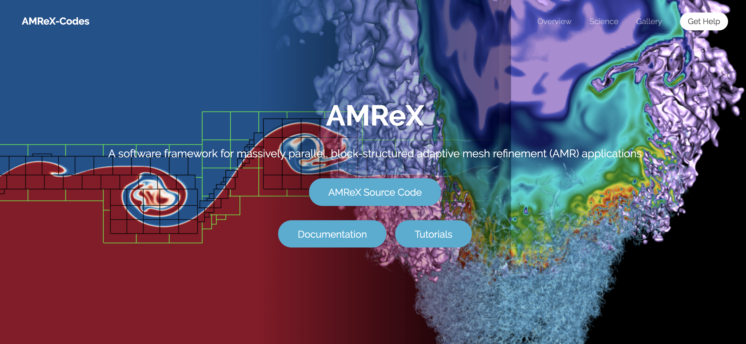
AMReX
https://amrex-codes.github.io/amrex/
Parallel/AMR framework developed primarily from Lawrence Berkeley National Laboratory
Block-Structured AMR

Slide 25
Outline
Background/Motivation - CCSNe
Numerical Method - RKDG
Results
Summary/Future Work

Slide 26
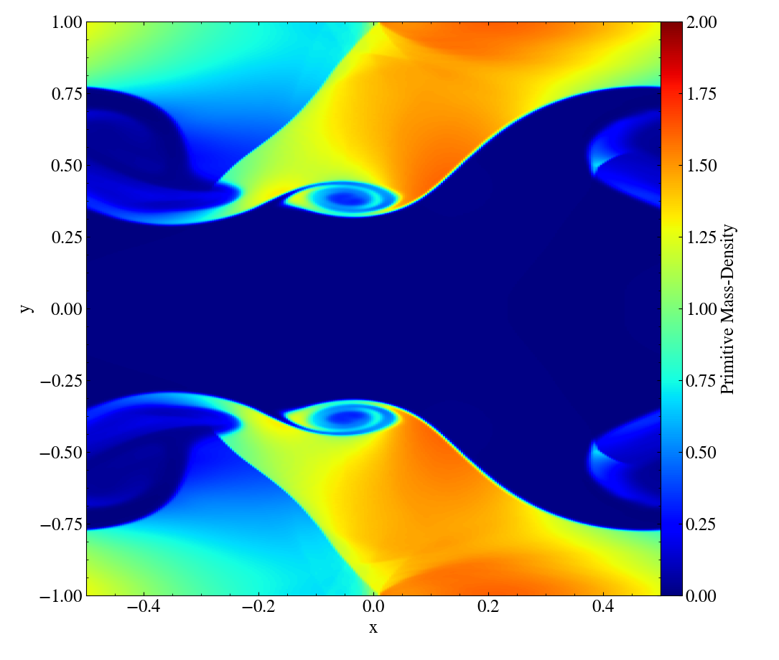
Relativistic Kelvin-Helmholtz Instability
Radice & Rezzolla, (2012), A&A, 547, A26
Smooth solution
Turbulent regions*
256 x 512
Third-order method
SSP-RK3
HLL Riemann solver
Characteristic Limiting
Run with AMReX
Primitive Mass-Density
* Assuming ideal EOS

Slide 27
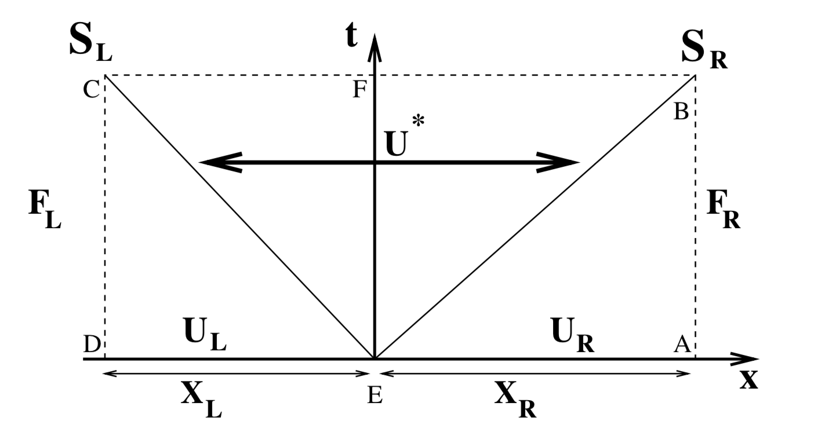
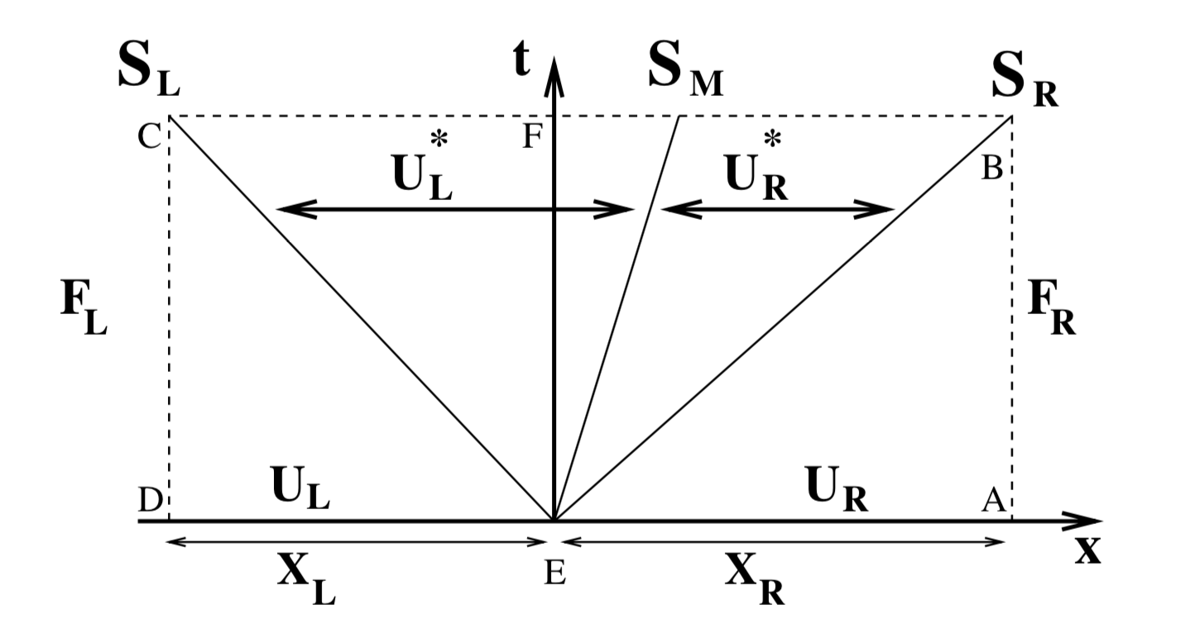
HLL vs. HLLC Riemann Solvers
Batten et al., 1997, SIAM-JSC, 18, 1553
HLL
HLLC

Slide 28
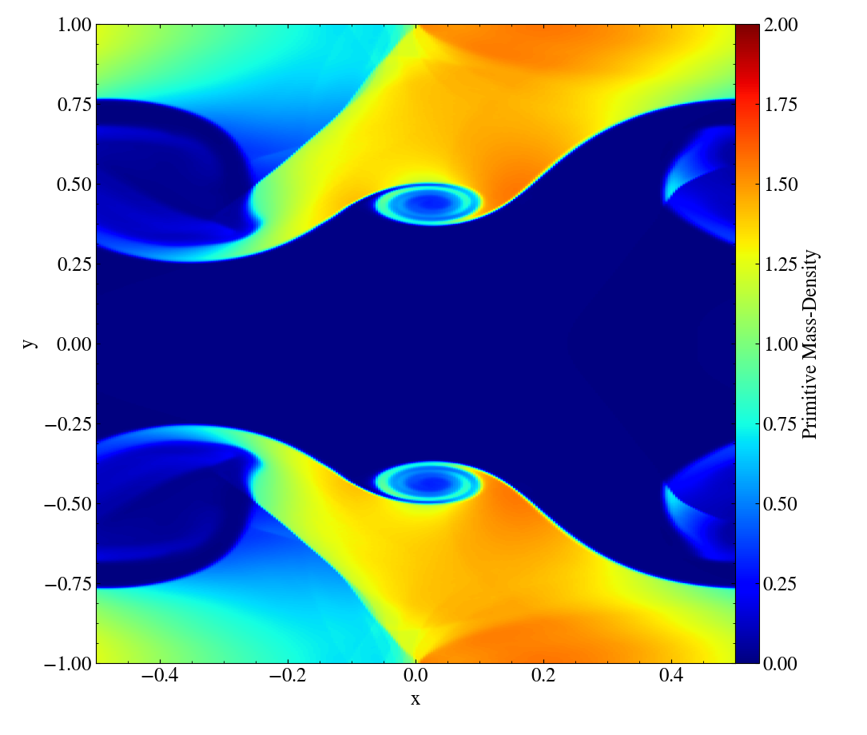
HLL vs. HLLC Riemann Solvers
Primitive Mass-Density
HLL
HLLC
Approximates Riemann fan with only two waves
nX = 256
nY = 512
nNodes = 3
SSP-RK3
Approximates Riemann fan with two waves and one contact wave
Mignone & Bodo (2005), MNRAS, 364, 126

Slide 29
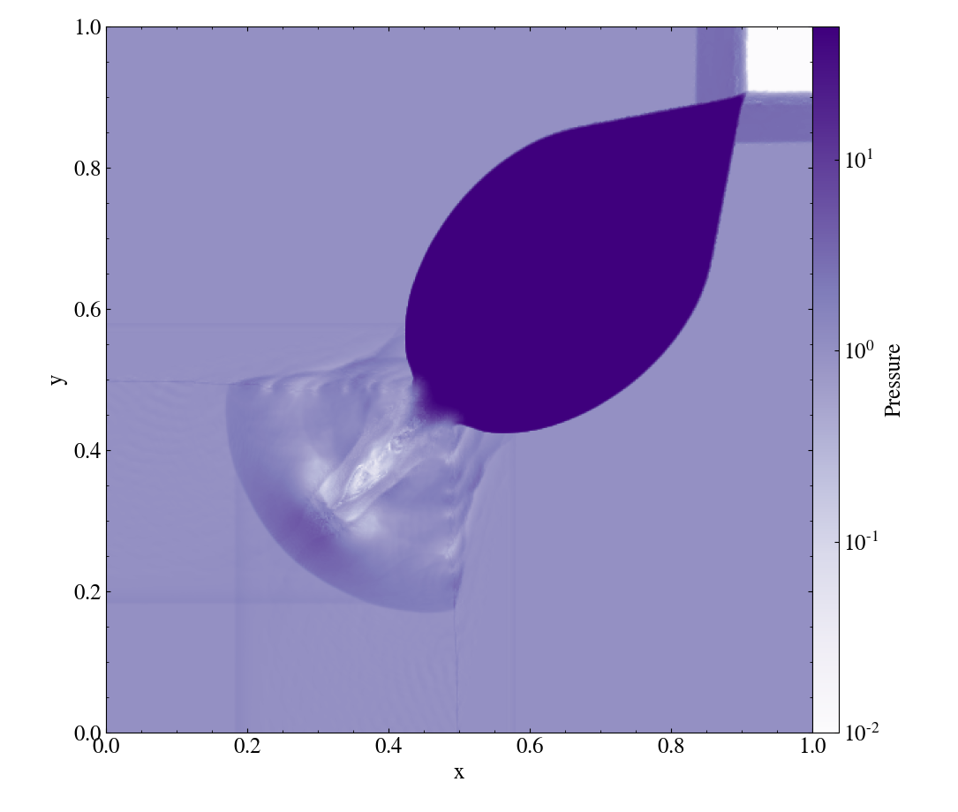
2D Riemann Problem
Del Zanna & Bucciantini, (2002), A&A, 390, 1177
Highly relativistic
  W ~ 7
Contact waves
512 x 512
Third-order method
SSP-RK3
HLL Riemann solver
Component-wise limiting
  Coupled variables
Run with AMReX
Pressure

Slide 30





Characteristic Decomposition
(Proof of concept: Linear case)
Decoupled!

Slide 31
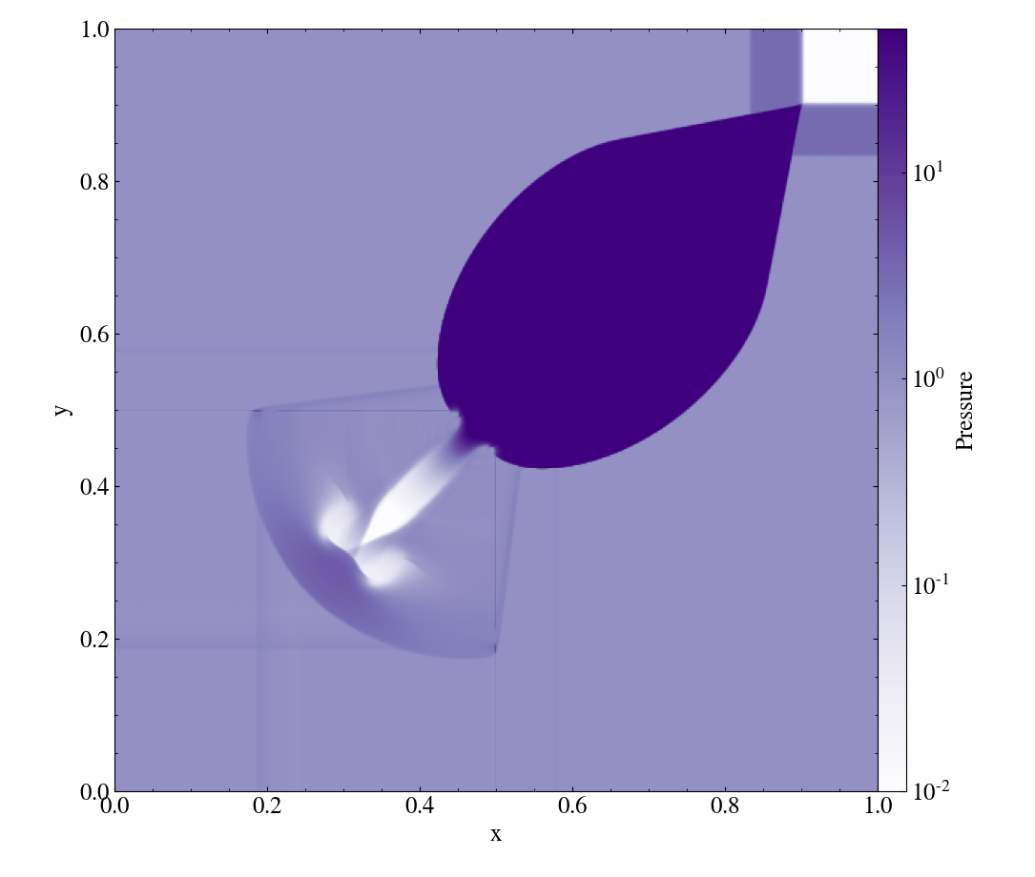
Characteristic Limiting
Pressure
Component-Wise Limiting
Characteristic Limiting
Limiting physical variables
nX = nY = 512
nNodes = 3
SSP-RK3
Limiting (decoupled) characteristic variables

Slide 32
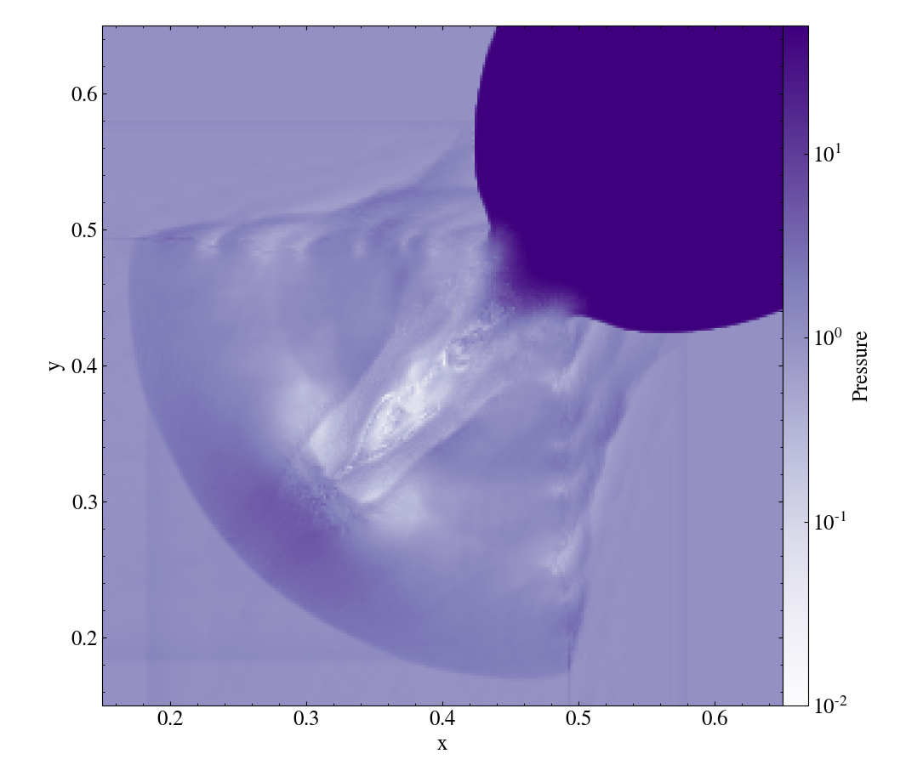
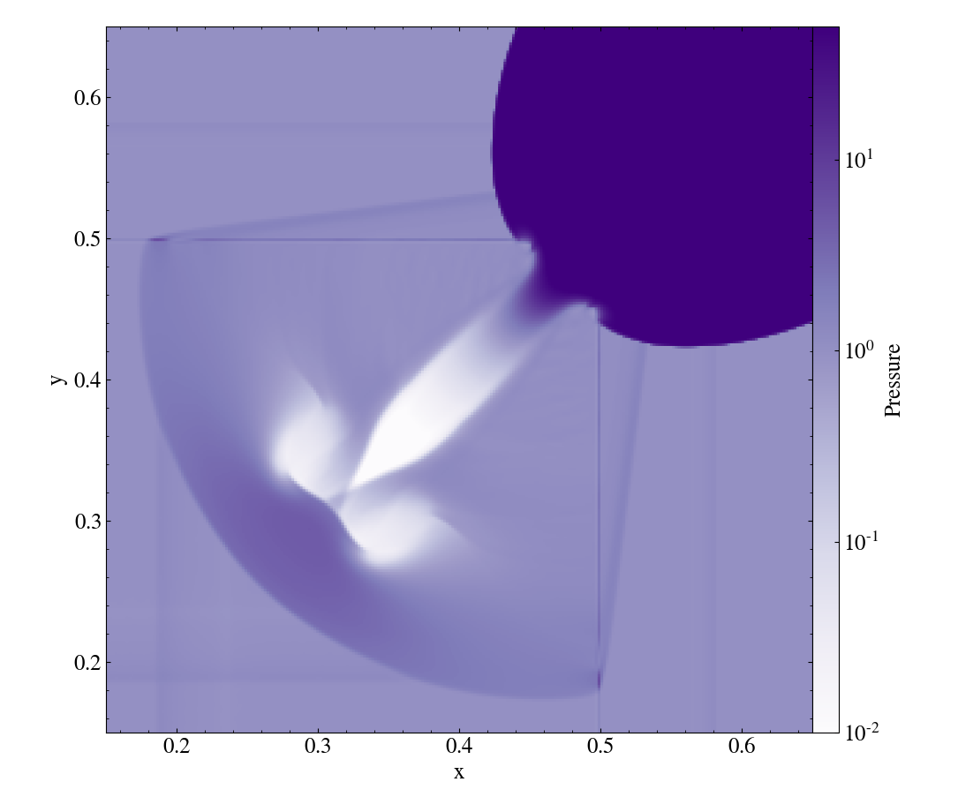
Characteristic Limiting
Pressure
Component-Wise Limiting
Characteristic Limiting
nX = nY = 512
nNodes = 3
SSP-RK3

Slide 33
2D, Non-Relativistic SASI
Physically motivated
Curvilinear coordinates
Point-mass gravitational potential
Perturbed with mode instability
256x128
Third-order method
SSP-RK3
Mass-Density
Run with AMReX

Slide 34
GR Standing Accretion Shock
Physically-motivated
Curvilinear coordinates
Stationary background spacetime
256 elements
Third-order method
HLLC Riemann solver
Characteristic-limiting
Run with AMReX
Evolved over several characteristic SASI development timescales

Slide 35
Outline
Background/Motivation - CCSNe
Numerical Method - RKDG
Results – KHI/2DRP/SASI/GR-SAS
Summary/Future Work

Slide 36
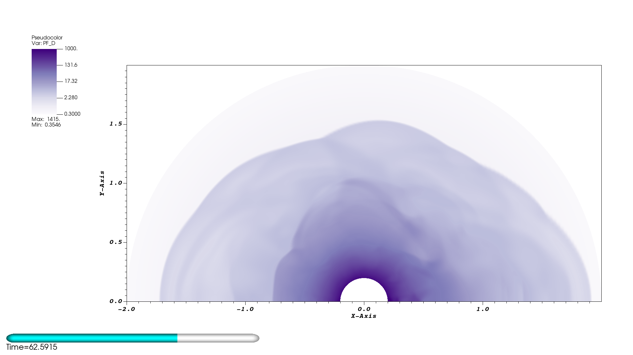
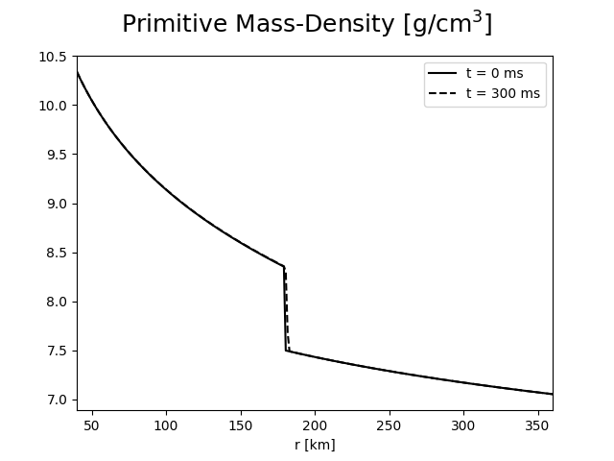
Summary
Developing Multi-D DG-GR Hydro solver
Implemented characteristic slope-limiting
Implemented bound-preserving limiter
Incorporated AMReX
Successfully run several challenging test problems

Slide 37
Future Work
MPI scaling tests
Implement and test 3D components
Run 2D and 3D, GR-SASI problem
  Investigate effects of GR-hydro
AMR
Couple with CFA gravity solver (Nick Roberts)
Couple with neutrino-transport solver (Ran Chu, Zach Elledge)

Slide 38
Acknowledgements
I would like to acknowledge the NSF for helping to fund this research
  NSF GP-1505933
  NSF GP-1806692
I would also like to acknowledge Vanderbilt University for helping to fund this research

Slide 39
Thank you!
Questions?

