Slide 1




A Discontinuous Galerkin Method for GR-Hydrodynamics in thornado
Samuel J. Dunham^{1,2}, Eirik Endeve^{3,2}, Anthony Mezzacappa^{2,4}, Jesse Buffaloe²
¹Vanderbilt University
²University of Tennessee-Knoxville
³Oak Ridge National Laboratory
⁴Joint Institute for Computational Sciences

Slide 2
Outline
Motivation/Background
Numerical Method
Results
Summary/Future Work

Slide 3
Outline
Motivation/Background
Numerical Method
Results
Summary/Future Work

Slide 4
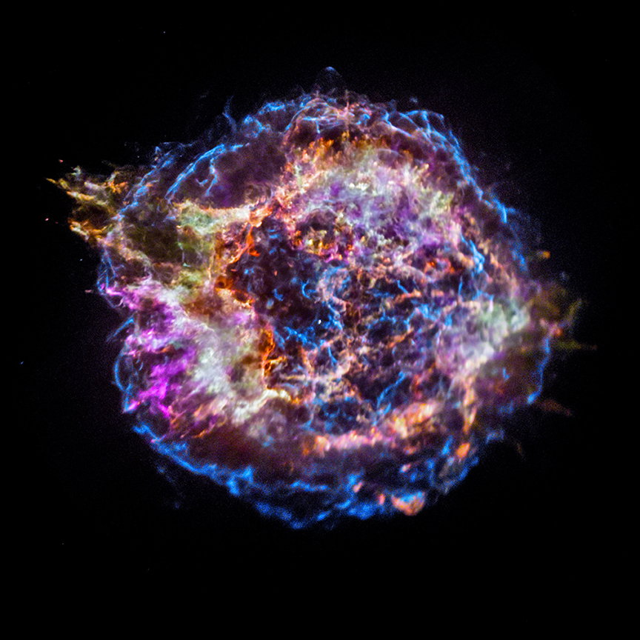
Motivation: Core-Collapse Supernova Explosion Mechanism
Nucleosynthesis
  Heavy element distribution
Gravitational waves
Neutrinos
Nuclear matter
Neutron star!
30 light-years
Cas A, color-coded by chemical composition. Figure courtesy of APOD

Slide 5
What Are We Doing?
Developing new code to study CCSNe: toolkit for high-order neutrino-radiation hydrodynamics (thornado)
3+1 (CFA)
  Hydrodynamics
  Neutrino Transport
  Gravity
Runge-Kutta Discontinuous Galerkin (RKDG)

Slide 6
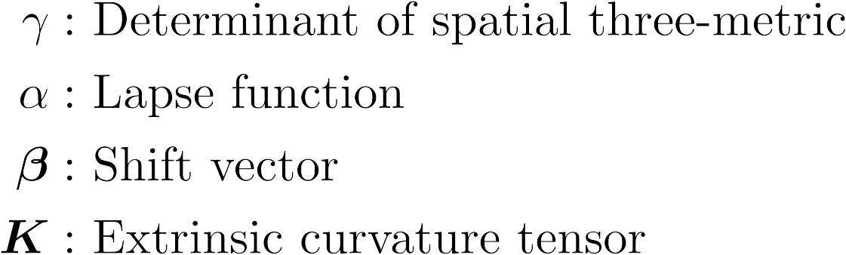

3+1 GR-Hydro Equations
Geometry
CFA:
Extrinsic curvature: describes how the 3D spatial hypersurface is curved in the 4D spacetime manifold

Slide 7

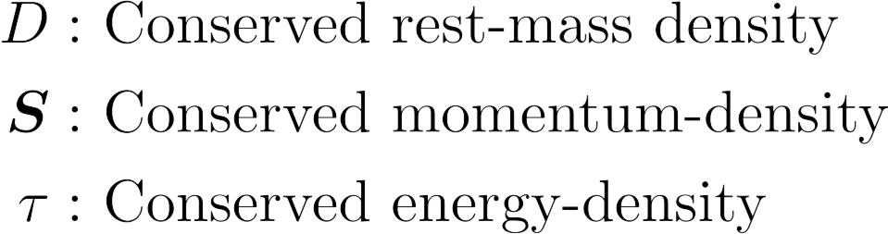
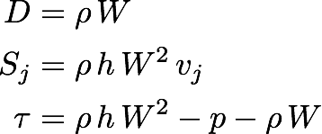
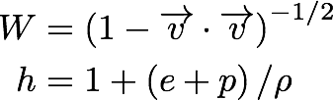
3+1 GR-Hydro Equations
Evolved Quantities

Slide 8
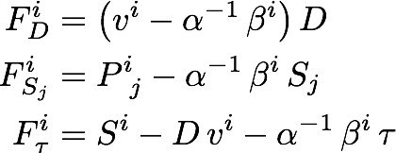

3+1 GR-Hydro Equations
Fluxes

Slide 9
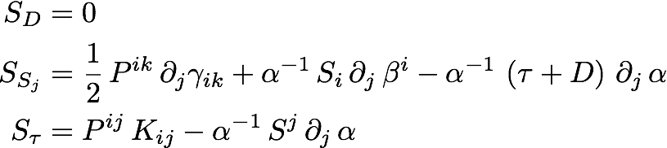
3+1 GR-Hydro Equations
Sources

Slide 10
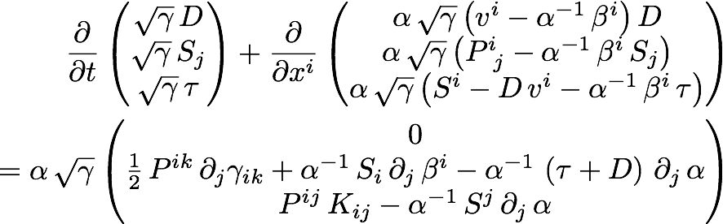
3+1 GR-Hydro Equations

Slide 11
Outline
Motivation/Background - CCSNe
Numerical Method
Results
Summary/Future Work

Slide 12
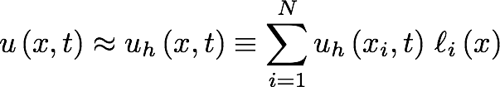
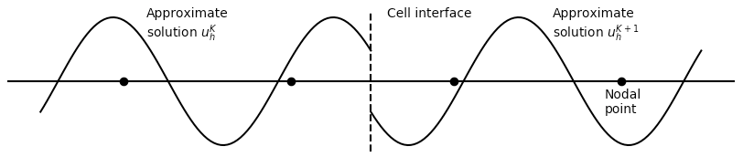
Numerical Method
Discontinuous Galerkin (DG)
Discretize computational domain
Locally approximate solution as polynomial
Use weak form to evolve in time with SSP-RK methods
Apply slope- and bound-preserving-limiters at each stage of SSP-RK algorithm

Slide 13


Weak Form (1D)
(1)
Multiply (1) by test-function (Lagrange polynomial)
Integrate over element*
Integration-by-parts on flux term
*Assume three-metric explicitly independent of time
Numerical flux obtained with approximate Riemann solver

Slide 14
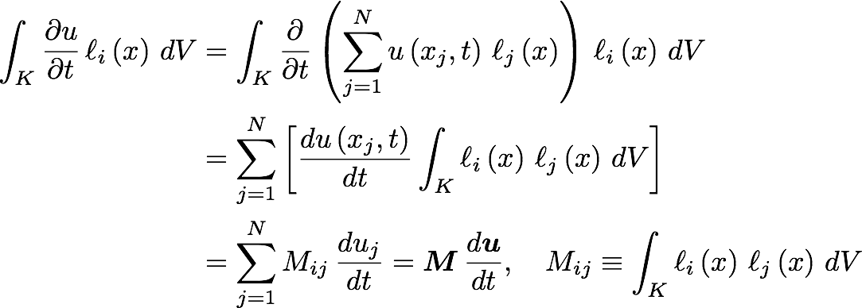

Slide 15

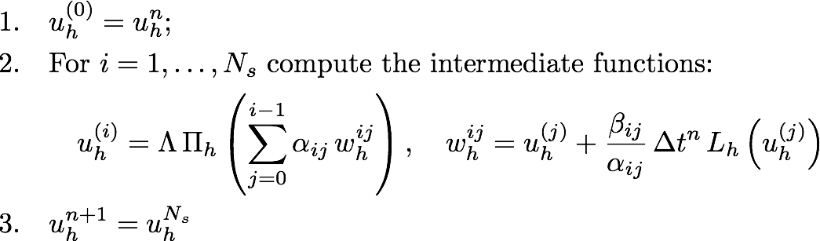
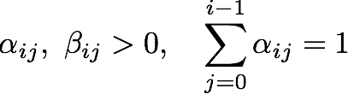
Time-Stepping Algorithm
Strong-Stability-Preserving Runge-Kutta (SSP-RK)
Cockburn & Shu, (2001) J. Sci. Comp., Vol. 16, No. 3
Convex-combinations of forward-Euler time-steps
Slope-limiter

Slide 16
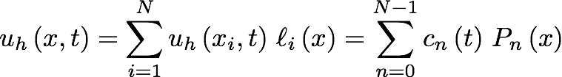
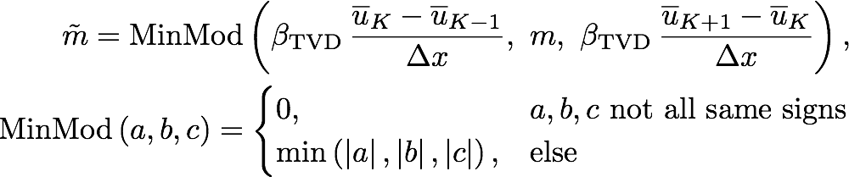
Slope-Limiter
MinMod Limiter
Higher-order methods can develop unphysical oscillations
Map solution from nodal to modal representation
Compare slope in target cell to approximation to derivatives in neighbors via cell-averages
Legendre Polynomials
Parameter with value between 1 and 2

Slide 17
Troubled-Cell Indicator
Fu & Shu, (2017), J. Comp. Phys. 347, 305
MinMod limiter activates at smooth extrema
To alleviate, we detect troubled-cells before applying limiter
Quantify the difference in solutions in neighboring cells
Extrapolate solution in neighboring cells into target cell
Compute cell-averages
Compute magnitude of differences between extrapolated solution and cell-average
Compare value to parameter set at run-time

Slide 18


Bound-Preserving Limiter
Qin et al., (2016), J. Comp. Phys., 315, 323
Higher-order methods can exceed physical bounds
  P < 0
  ρ < 0
  |v| > c
Cell-average is guaranteed to be physical, but all quadrature points need to be physical
Damp point-values towards cell-average (allowed because of CFL condition)
Define (convex) “set of admissible states”, G
Leads to two conditions:
  D > 0
G

Slide 19
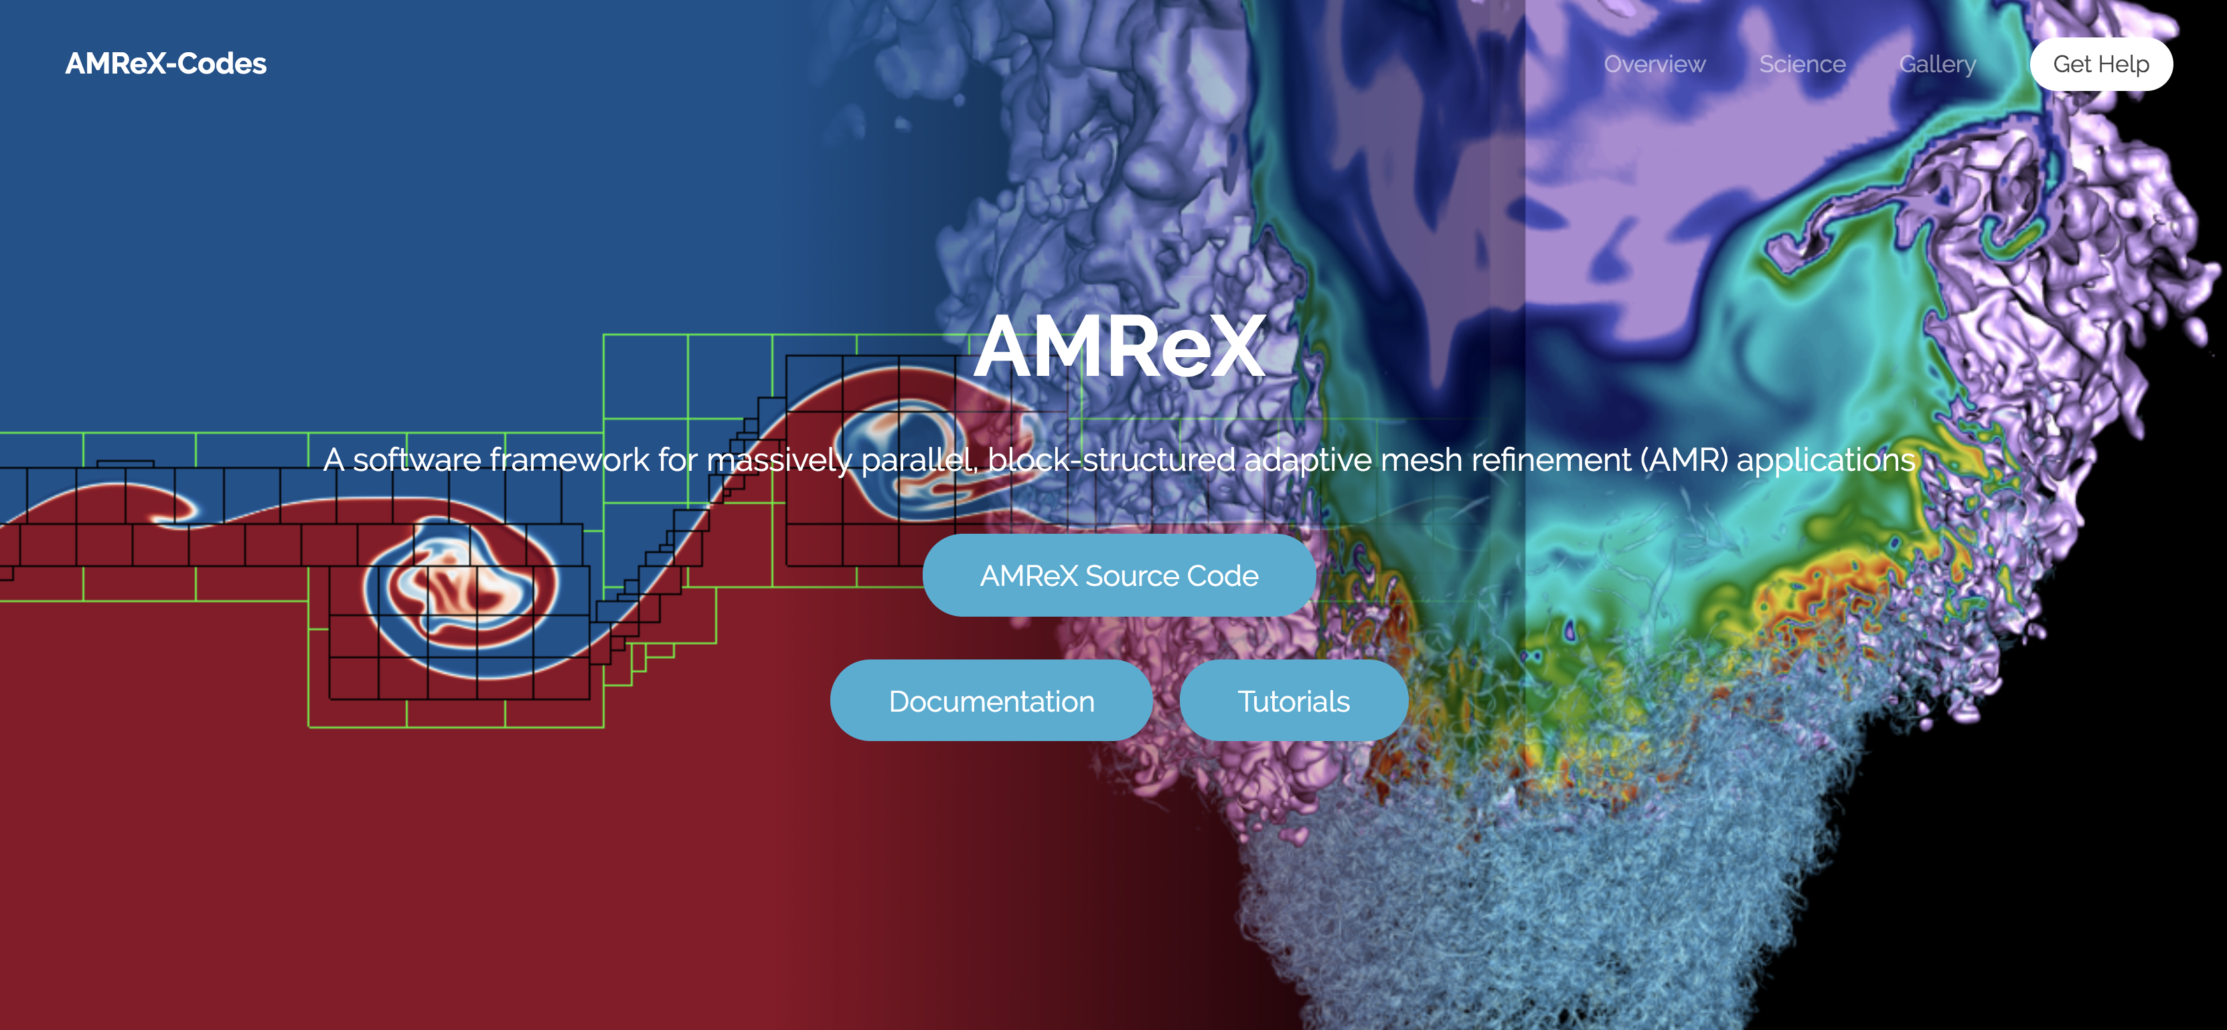
AMReX
https://amrex-codes.github.io/amrex/
Parallel/AMR framework developed primarily from Lawrence Berkeley National Laboratory
Block-Structured AMR

Slide 20
Outline
Motivation/Background - CCSNe
Numerical Method - RKDG
Results
Summary/Future Work

Slide 21
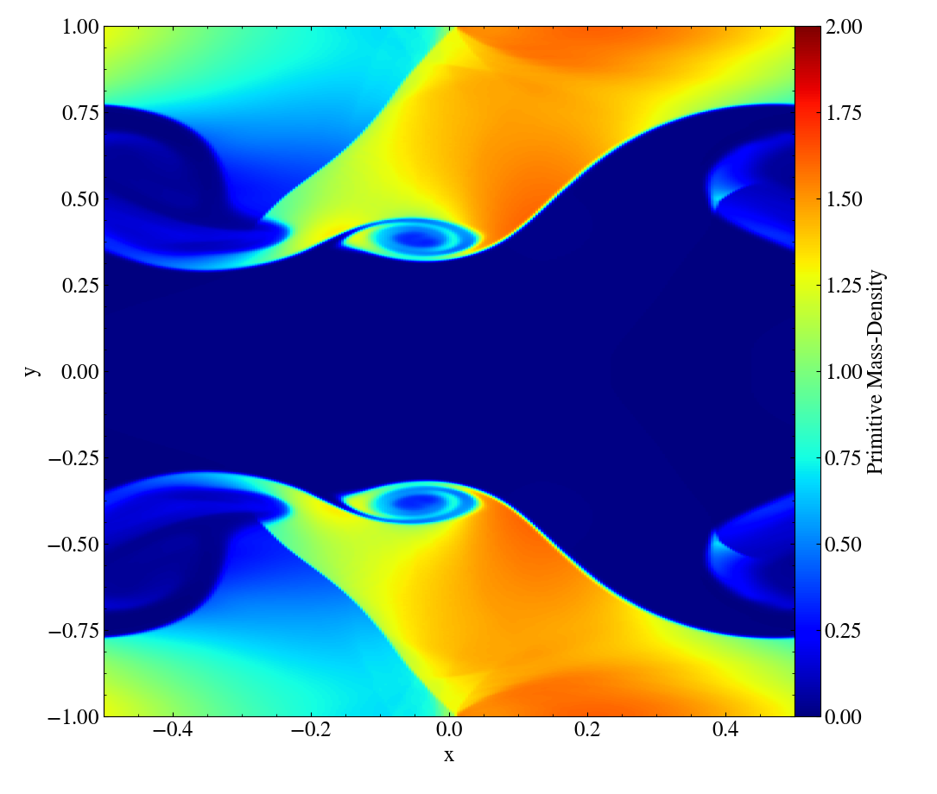
Relativistic Kelvin-Helmholtz Instability
Radice & Rezzolla, (2012), A&A, 547, A26
Smooth solution
Turbulent regions*
256 x 512
Third-order method
SSP-RK3
Periodic boundary conditions
HLL Riemann solver
Characteristic Limiting
Run with AMReX
Primitive Mass-Density
* Assuming ideal EOS

Slide 22
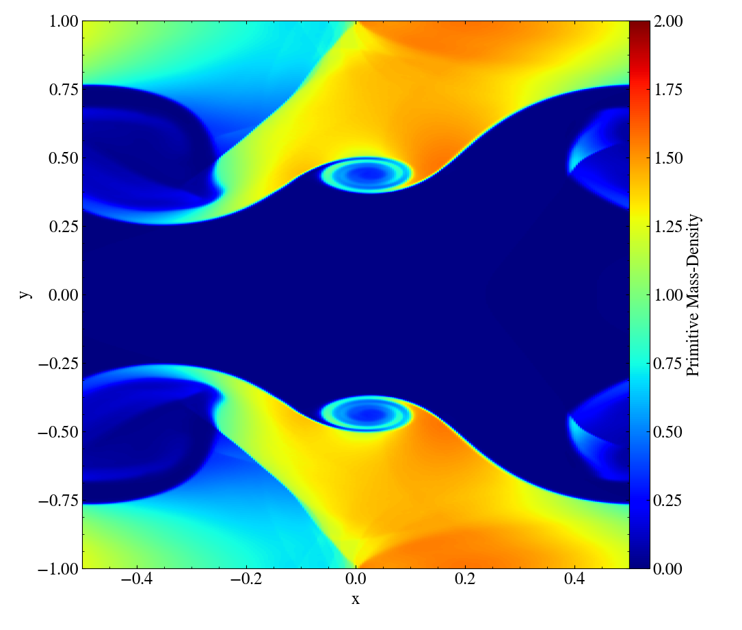
HLL vs. HLLC Riemann Solvers
Primitive Mass-Density
HLL
HLLC
Approximates Riemann fan with only two waves
nX = 256
nY = 512
nNodes = 3
SSP-RK3
Approximates Riemann fan with two waves and one contact wave
Mignone & Bodo (2005), MNRAS, 364, 126

Slide 23
2D Riemann Problem
Del Zanna & Bucciantini, (2002), A&A, 390, 1177
Highly relativistic
  W ~ 7
Contact waves
512 x 512
Homogeneous boundary conditions
HLL Riemann solver
Component-wise limiting
Run with AMReX
Pressure

Slide 24
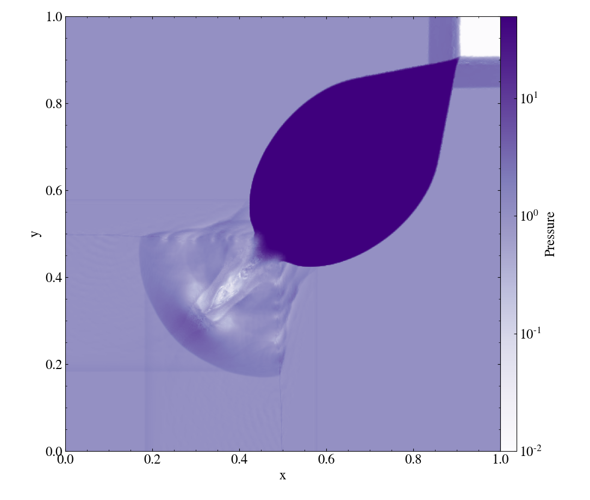
2D Riemann Problem
Del Zanna & Bucciantini, (2002), A&A, 390, 1177
Highly relativistic
  W ~ 7
Contact waves
512 x 512
Third-order method
SSP-RK3
HLL Riemann solver
Component-wise limiting
Run with AMReX
Pressure

Slide 25
Characteristic Limiting
Pressure
Component-Wise Limiting
Characteristic Limiting
nX = nY = 512
nNodes = 3
SSP-RK3

Slide 26
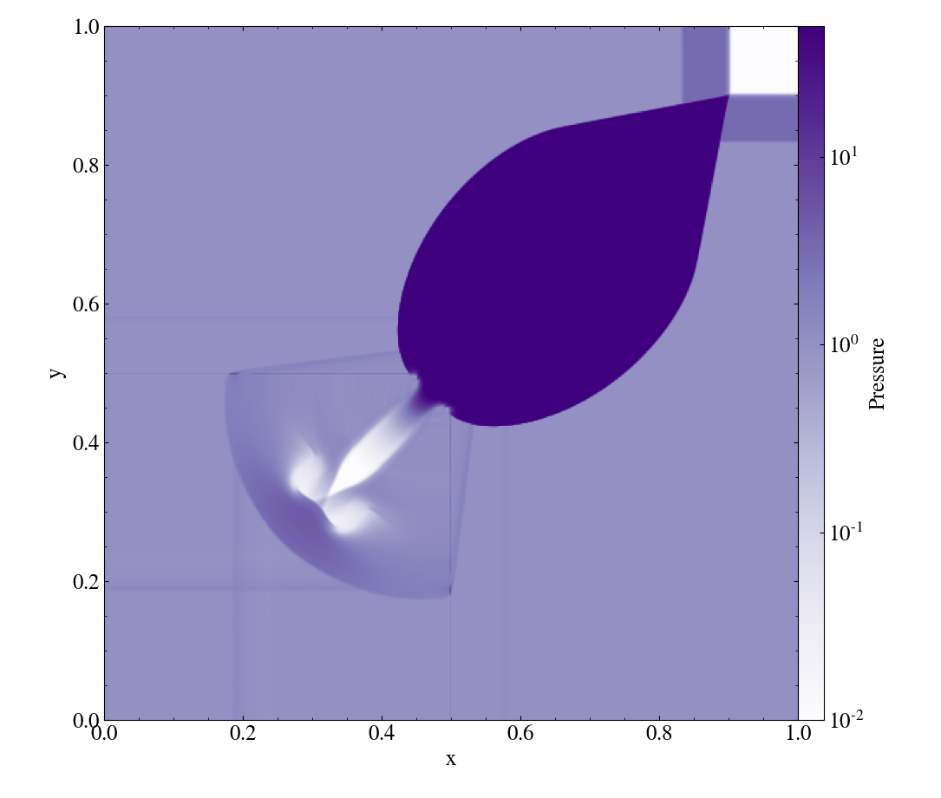
Characteristic Limiting
Pressure
Component-Wise Limiting
Characteristic Limiting
nX = nY = 512
nNodes = 3
SSP-RK3

Slide 27
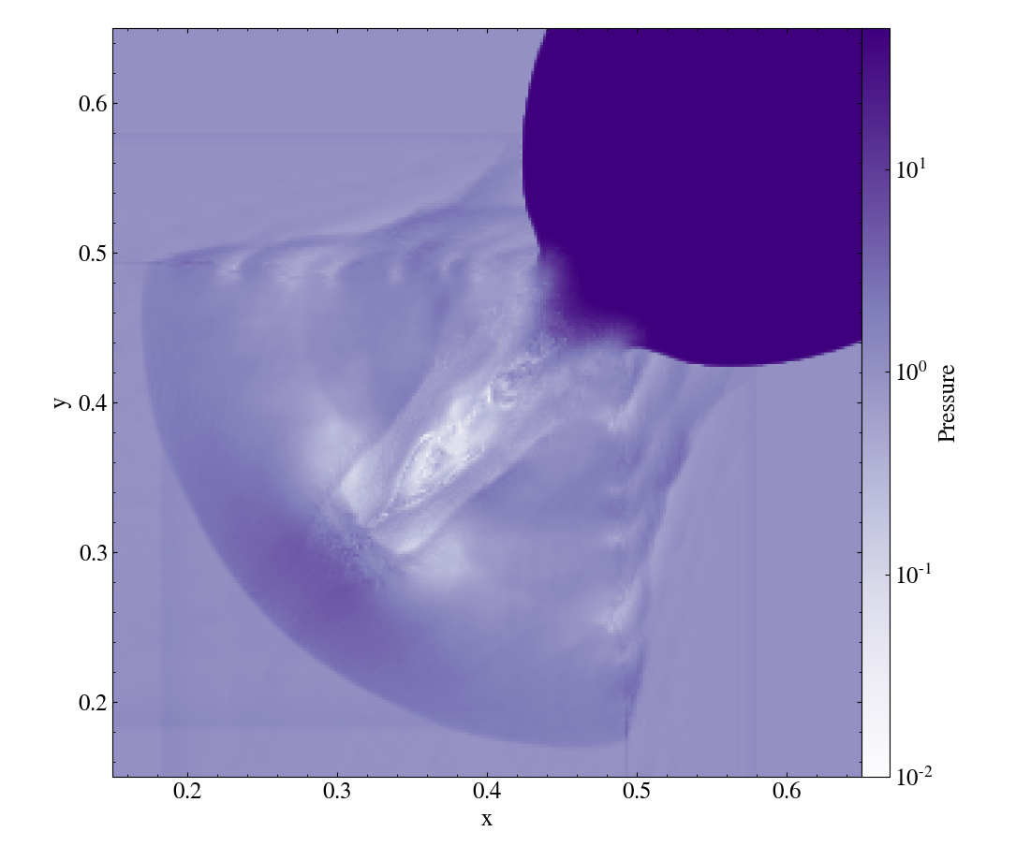
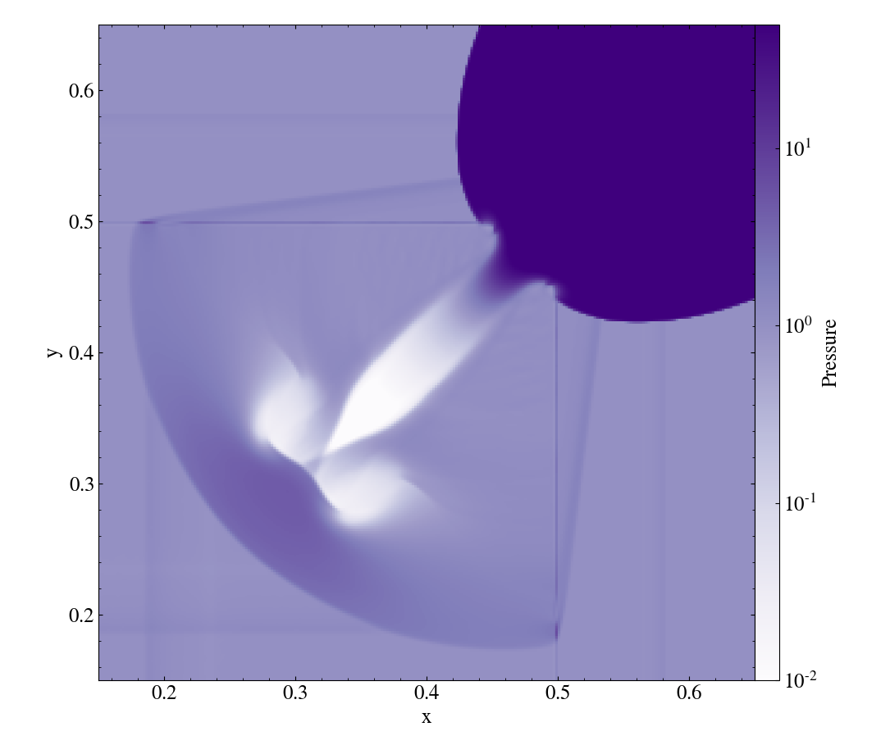
Characteristic Limiting
Pressure
Component-Wise Limiting
Characteristic Limiting
nX = nY = 512
nNodes = 3
SSP-RK3

Slide 28
2D, Non-Relativistic SASI
Physically motivated
Curvilinear coordinates
Point-mass gravitational potential
Perturbed with mode instability
256x128
Third-order method
SSP-RK3
Mass-Density
Run with AMReX

Slide 29
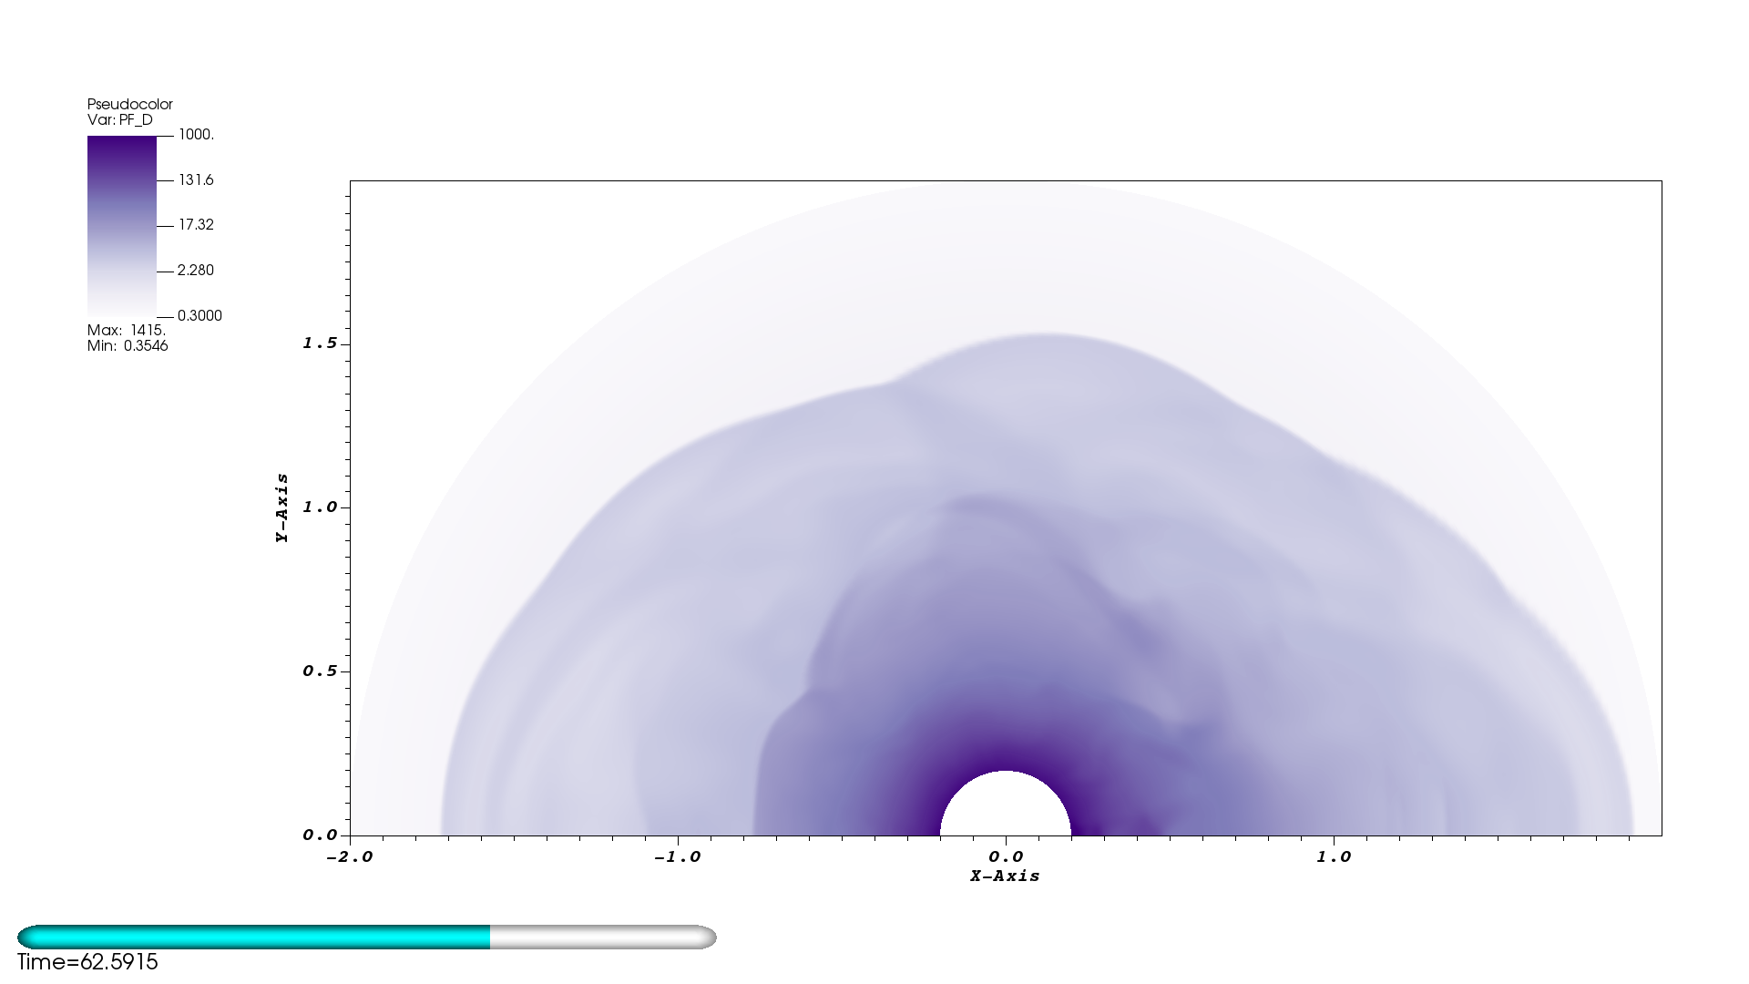
2D, Non-Relativistic SASI
Physically motivated
Curvilinear coordinates
Point-mass gravitational potential
256x128
Third-order method
SSP-RK3
Mass-Density
Run with AMReX

Slide 30
GR Standing Accretion Shock
Physically-motivated
Curvilinear coordinates
Stationary background spacetime
256 elements
Third-order method
HLLC Riemann solver
Characteristic-limiting
Run with AMReX
Evolved over several characteristic SASI development timescales

Slide 31
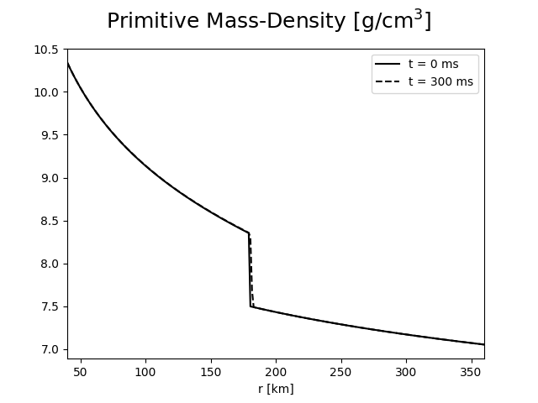
GR Standing Accretion Shock
Physically-motivated
Curvilinear coordinates
Stationary background spacetime
256 elements
Third-order method
HLLC Riemann solver
Characteristic-limiting
Run with AMReX
Evolved over several characteristic SASI development timescales

Slide 32
Outline
Motivation/Background - CCSNe
Numerical Method - RKDG
Results – KHI/2DRP/SASI/GR-SAS
Summary/Future Work

Slide 33
Summary
Developing Multi-D DG-GR Hydro solver
Implemented characteristic slope-limiting
Implemented bound-preserving limiter
Incorporated AMReX
Successfully run several difficult test problems

Slide 34
Future Work
MPI scaling tests
Implement and test 3D components
Run 2D and 3D, GR-SASI problem
  Investigate effects of GR-hydro
AMR
Couple with CFA gravity solver (Nick Roberts)
Couple with neutrino-transport solver (Ran Chu, Zach Elledge)

Slide 35
Acknowledgements
I would like to acknowledge the NSF for helping to fund this research
  NSF GP-1505933
  NSF GP-1806692
I would also like to acknowledge Vanderbilt University for helping to fund this research

Slide 36
Thank you!
Questions?

Slide 37
Bonus Material

Slide 38
GR-SAS Initial conditions
M_PNS = 1.4 Msun
R_PNS = 40 km
Mdot = 0.3 Msun/s
R_shock = 180 km

