Slide 1


A Discontinuous Galerkin Method for General Relativistic Hydrodynamics in thornado
Samuel J. Dunham, Eirik Endeve, Anthony Mezzacappa,
Jesse Buffaloe, Kelly Holley-Bockelmann
Tornado: http://www.clipartpanda.com/clipart_images/free-tornado-clip-art-5826131
Thor:
https://wallpaperaccess.com/viking-thor
Sam Dunham

Slide 2
Outline
Background/Motivation
Numerical Method
Results
Summary/Future Work

Slide 3
Outline
Background/Motivation
Numerical Method
Results
Summary/Future Work

Slide 4



What is this paper?
Presents general relativistic (GR)-hydrodynamical aspects of thornado
Validates code with test problems
First glimpse of GR-SASI
Okay, so...why thornado?
Einstein
Kilroy source: https://natchitochesparishjournal.com/2020/01/31/kilroy-was-here/

Slide 5
Why thornado?
Simulate core-collapse supernovae (CCSNe) with discontinuous Galerkin (DG) methods
Okay, so first...why CCSNe?

Slide 6
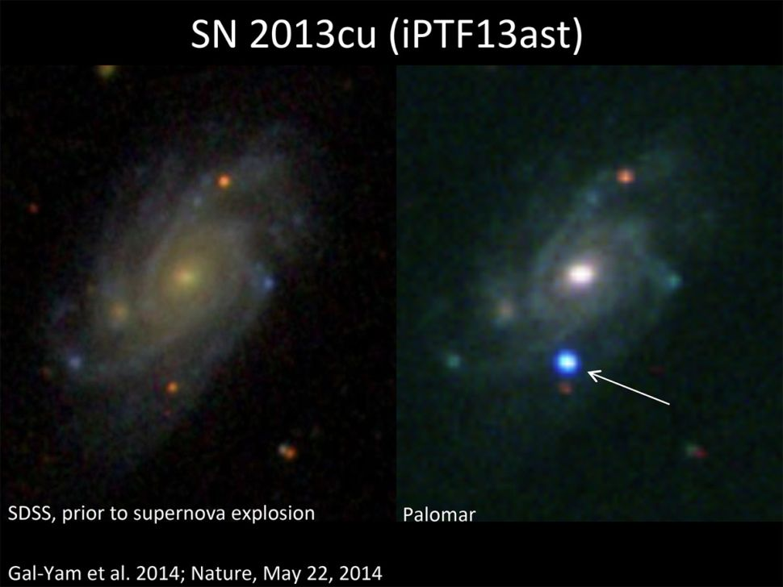
Why CCSNe?
Help drive chemo-galactic evolution
Create neutron stars
Sources of gravitational waves
Sold. So, why DG methods?

Slide 7
Physics of CCSN Explosions
Core supported by degenerate electron pressure
Once fusion stops, accretion increases core mass to Chandresekhar limit
Collapse ensues

Slide 8
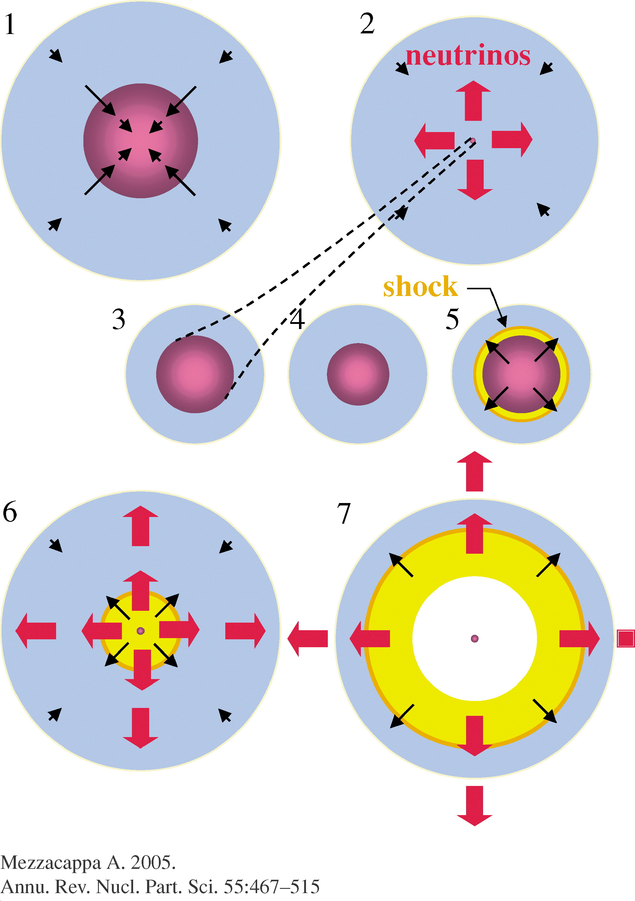
Physics of CCSN Explosions
Core separates
Inner core “bounces”, forming shock
Shock propagates
Shock stalls
Shock is re-energized...but how?

Slide 9
Hydrodynamics
Shock ultimately drives explosion
  Code must capture shocks (conservative formulation)
Post-shock turbulence may help reinvigorate shock
  Code must resolve turbulence (high-order methods)

Slide 10
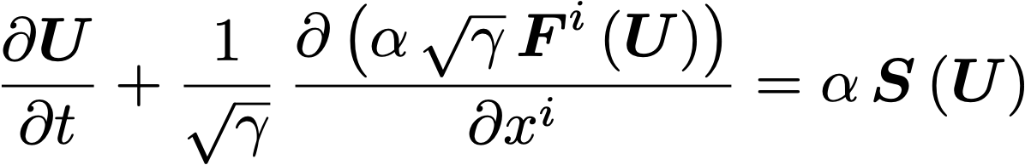
3+1 Hydrodynamics
Sources of mass density
Sources of momentum density
Sources of energy density
Mass flux
Momentum flux
Energy flux
Mass density
Momentum density
Energy density
Metric determinant
Lapse function

Slide 11

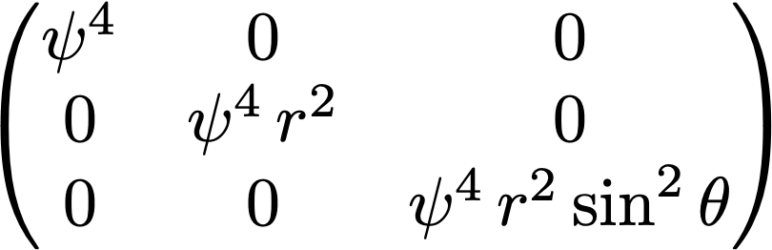
CFA
Conformally-flat approximation
e.g., spherical-polar coordinates

Slide 12
Outline
Background/Motivation
Numerical Method
Results
Summary/Future Work

Slide 13
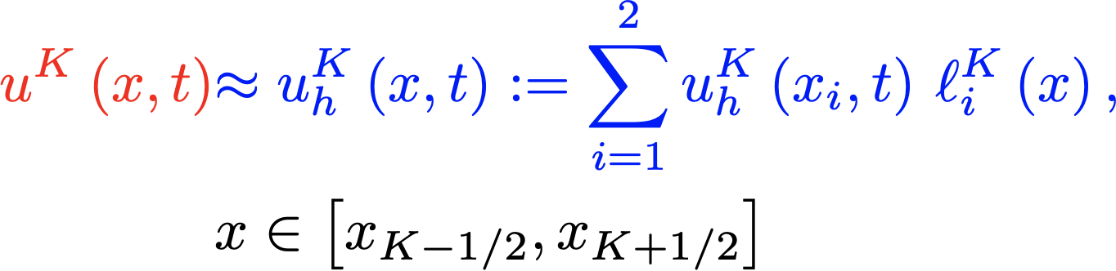
Discontinuous Galerkin (DG) Method
Actual solution
xL
xU
K-1
K
K+1
xK-1/2
xK+1/2

Slide 14
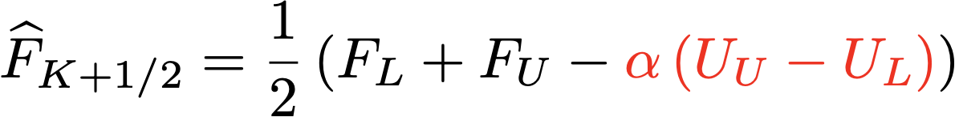
Discontinuities at Interfaces
Fluxes from sides are averaged with numerical viscosity
UU
UL
K
K+1
xK+1/2

Slide 15
Weak Form
To handle shocks, solve integral form of PDEs
Multiplying by a smooth function and integrating by parts...
Becomes...

Slide 16
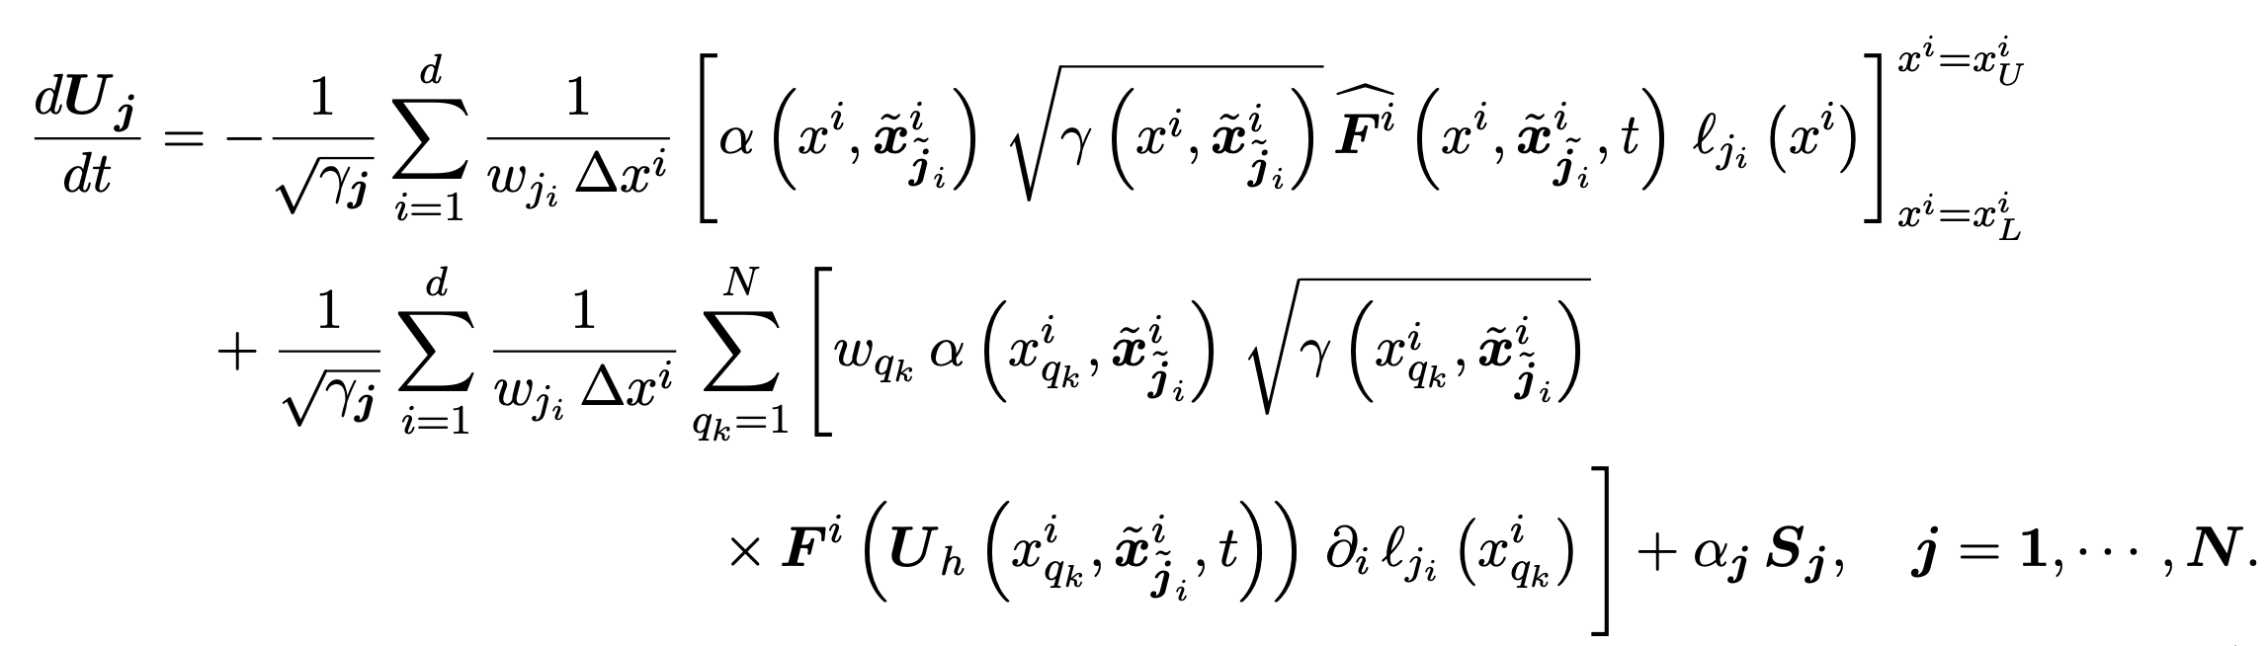
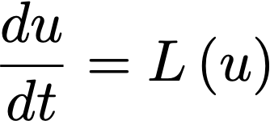
Semi Discrete Form
Evolved in time with SSP-RK methods...

Slide 17

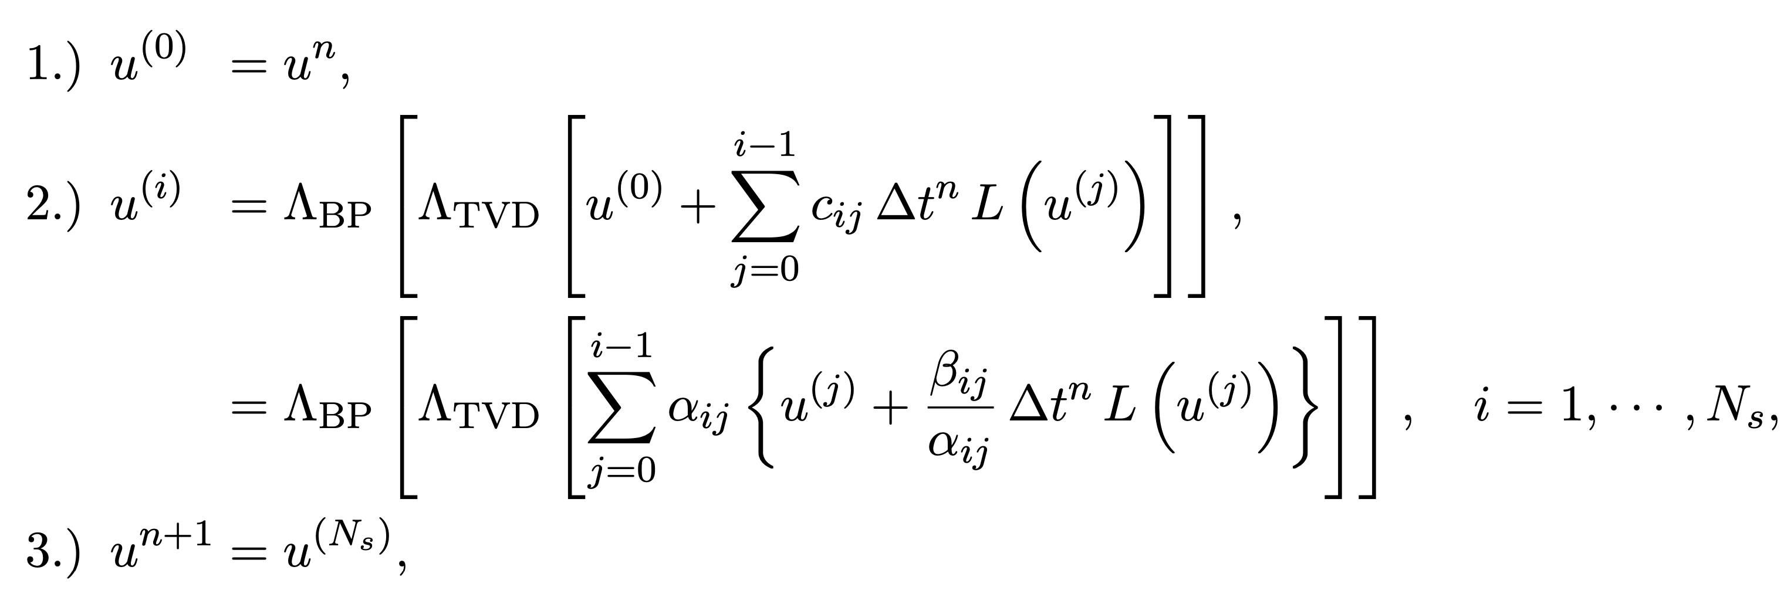
SSP-RK
Convex combinations of forward-Euler steps
Slope Limiter

Slide 18
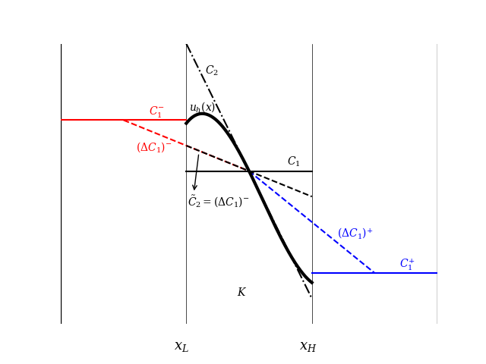
Slope Limiter
Figure from Pochik et al., (2020) (in prep.)

Slide 19
Outline
Background/Motivation
Numerical Method
Results
Summary/Future Work

Slide 20
Strong Scaling
(xL, yU)
(xU, yU)
1 Process
2 Processes
4 Processes
16 Processes
(xL, yL)
(xU, yL)

Slide 21
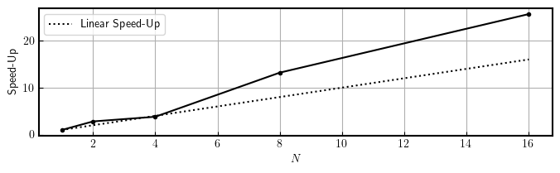
Strong Scaling

Slide 22
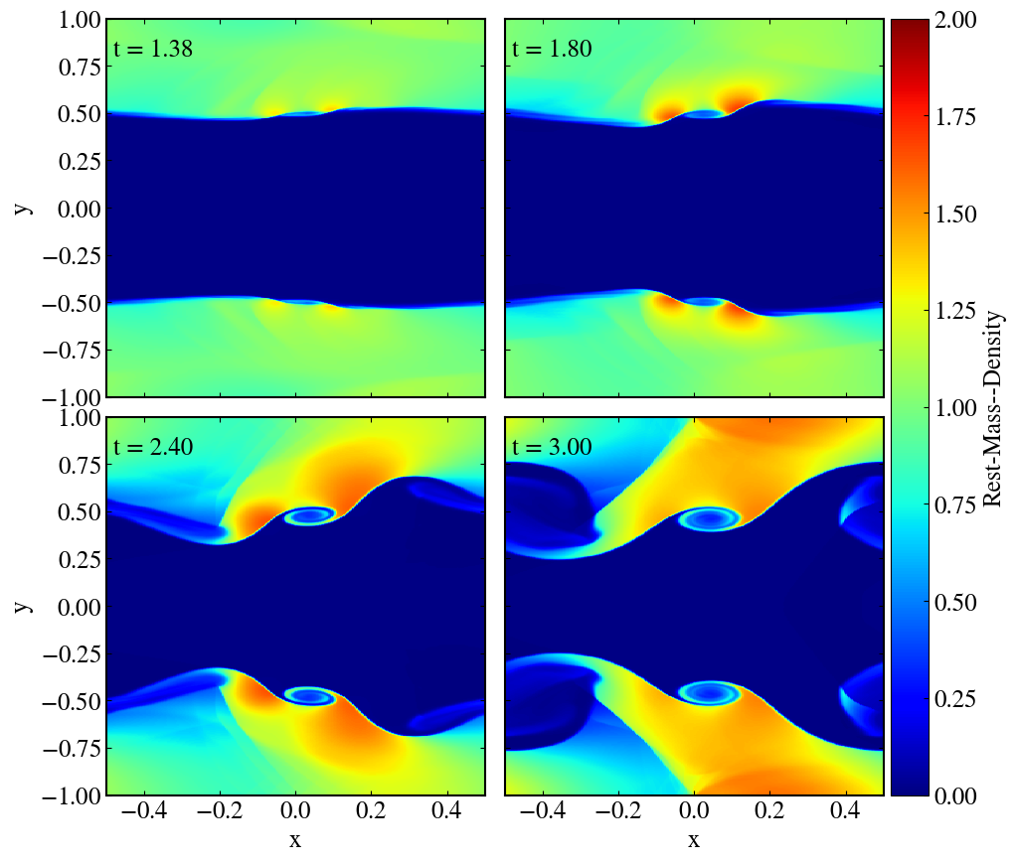
Kelvin—Helmholtz Instability

Slide 23
Characteristic Decomposition
Fluid fields (mass, momentum, energy density) are coupled
Change of variables from U to W
W variables are uncoupled
Limiting performed on W, then U are recovered

Slide 24
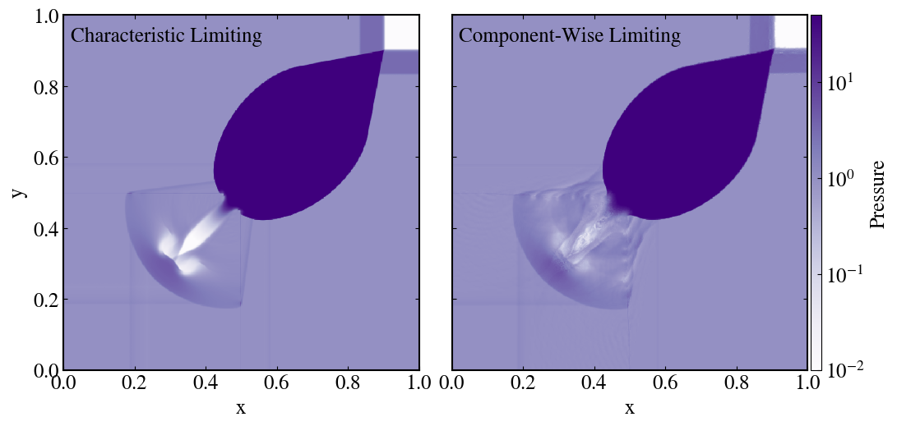
2D Riemann Problem

Slide 25
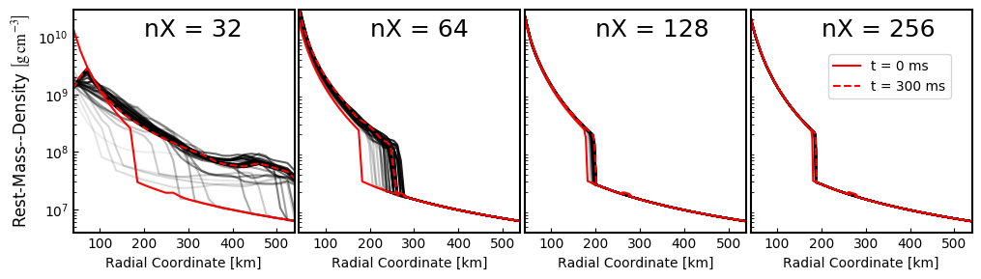
1D SAS

Slide 26
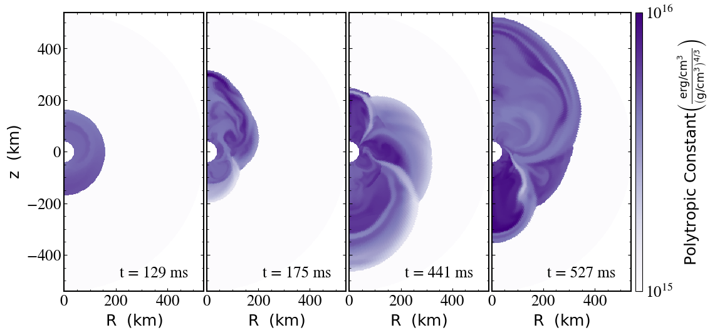
SASI

Slide 27
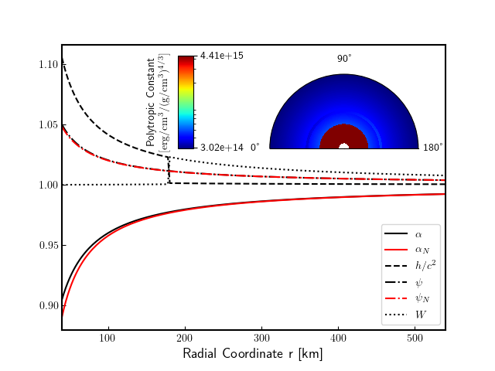
SASI
MPNS = 2.8 Msun

Slide 28
Outline
Background/Motivation
Numerical Method
Results
Summary/Future Work

Slide 29
Summary
Can solve 3+1 GR hydro equations in CFA
Parallelism
Validated against test problems
Reproduced SASI

Slide 30
Future Work
3D testing
  GR-SASI
GPUs
AMR
Couple to gravity solver
Couple to neutrinos
CCSN simulations

Slide 31
Discontinuous Galerkin (DG) Method
u^{K}h(x1,t)
x1
K
u^{K}h(x2,t)
x2
xK-1/2
xK+1/2

Slide 32
Theorems
Lax and Wendroff (1960):
  Any conservative scheme, if convergent, converges to weak solution
Hou and LeFloch (1994)
  Schemes not written in conservative form do not converge to the right solution if shocks are present

Slide 33

Numerical Viscosity
Chosen as maximum wave speed in system
  Maximum wavespeed from eigenvalues of flux-Jacobian on both sides of interface
  Non-relativistic value:

