Slide 1








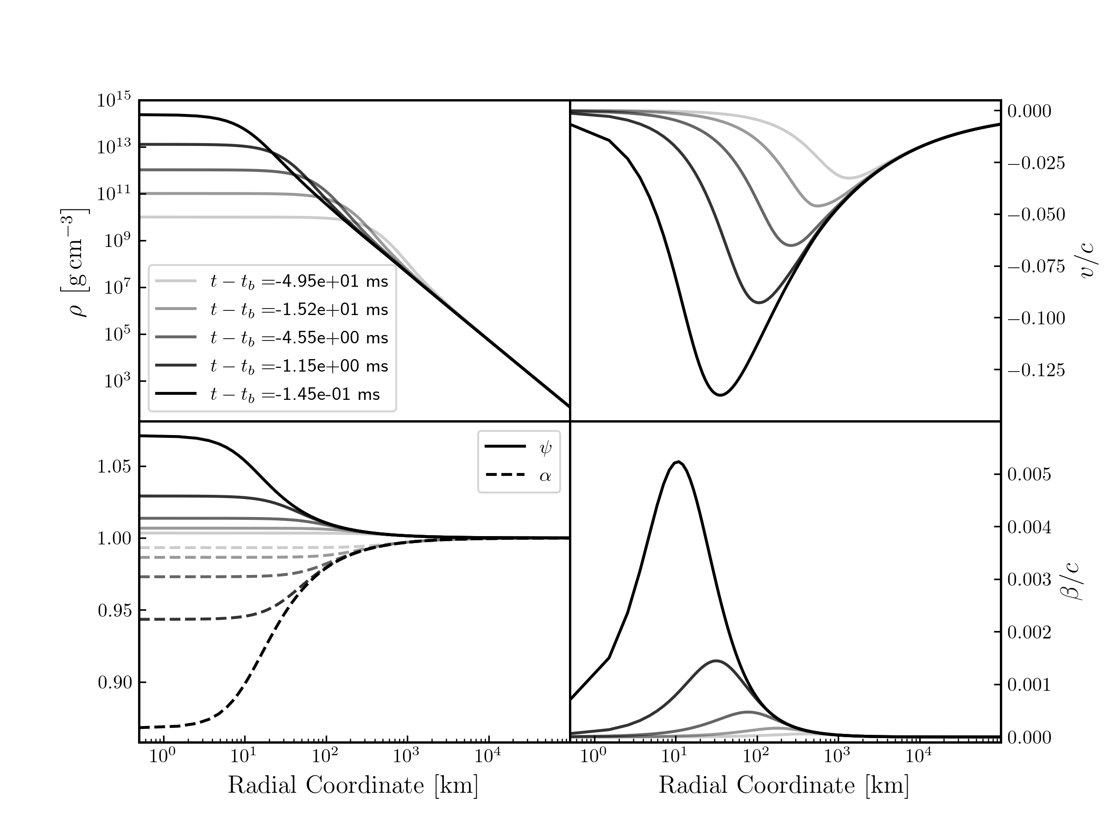

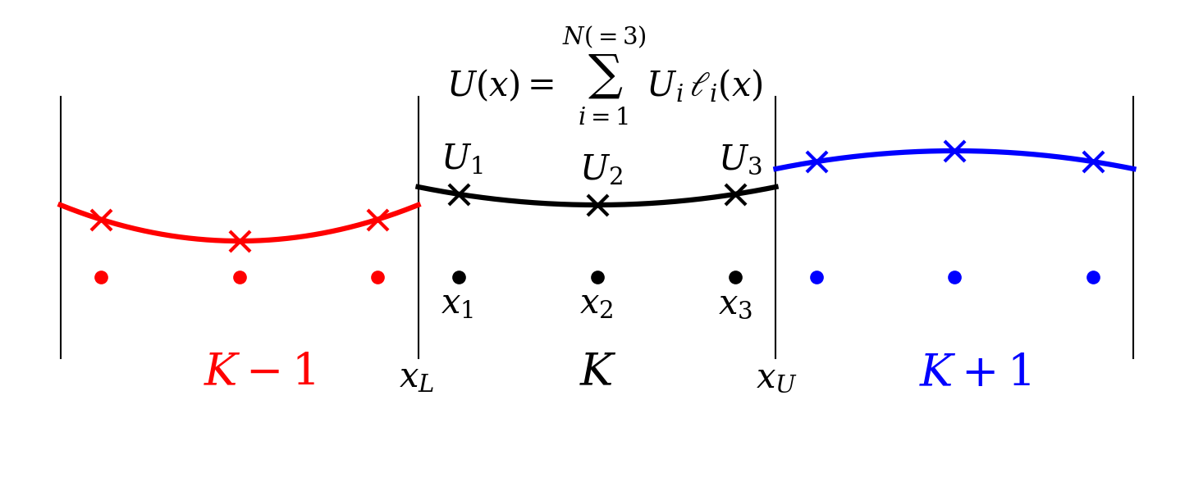
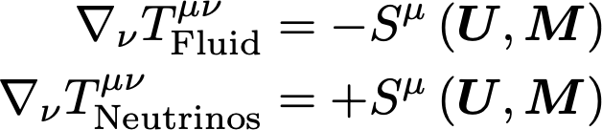

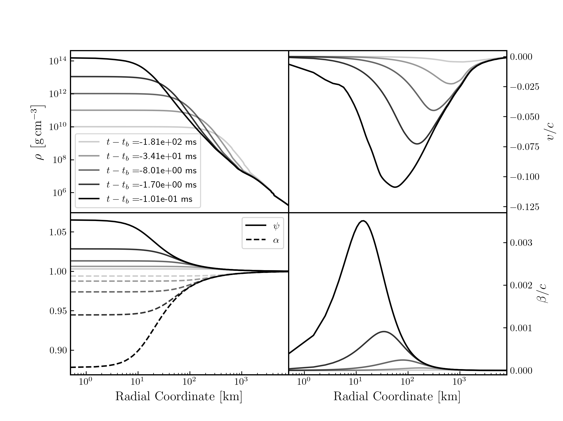
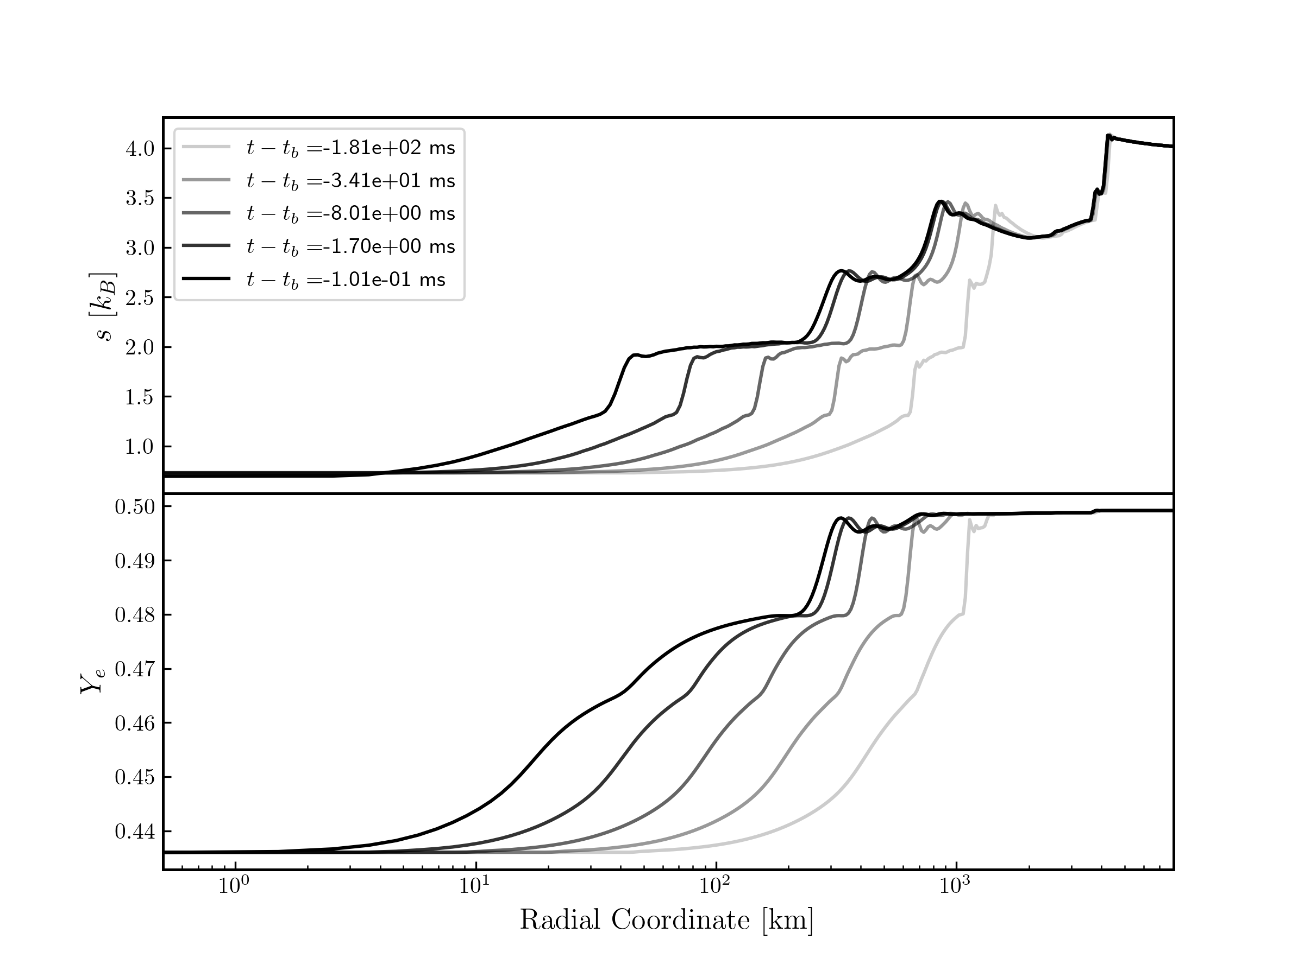

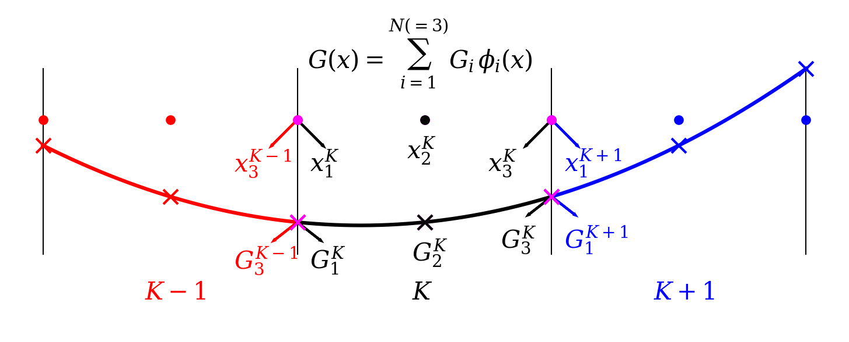
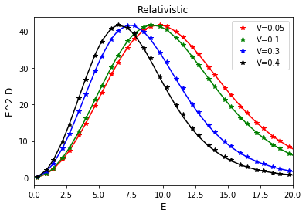
thornado-Hydro: A Discontinuous Galerkin Method for General Relativistic Hydrodynamics with an Eye towards Simulating Core-Collapse Supernovae
Samuel J. Dunham^{1,2}, Nick Roberts², Zachary M. Elledge², Eirik Endeve^{2,3}, Anthony Mezzacappa²,
Kelly Holley-Bockelmann^{1,4}, David Pochik⁵, Brandon Barker⁶, Jesse Buffaloe²
¹ Vanderbilt University, Nashville, TN, ² University of Tennessee, Knoxville, Knoxville, TN ³ Oak Ridge National Laboratory, Oak Ridge, TN,
⁴ Fisk University, Nashville, TN, ⁵ The Ohio State University, Columbus, OH, ⁶ Michigan State University, East Lansing, MI
Background/Motivation
Stars with mass explode as core-collapse supernovae, which:
  help drive galactic chemical evolution
  produce neutron stars
  generate gravitational waves
  are unique laboratories for fundamental neutrino physics
Exactly how they explode is still an open question
We want to understand the explosion mechanism and the observables core-collapse supernovae produce
  To that end, we are developing solvers for gravity, hydrodynamics, and neutrino transport in the thornado framework
thornado
toolkit for high-order neutrino-radiation hydrodynamics
(github.com/endeve/thornado)
Conformally-flat approximation (gravity, fluid, neutrinos)
Discontinuous Galerkin (hyperbolic conservation laws)
  Fluid and neutrinos
    Discretize spatial domain
    Approximate local solution with polynomial
      Linear combination of Gauss-Legendre nodal values with Lagrange polynomials
      Solutions discontinuous at element interfaces
    Resolve interface discontinuities with approximate Riemann solver
Continuous Galerkin/Spectral (elliptic equations)
  Gravity
    Discretize spatial domain
      Finite element in radius
      Spherical harmonic decomposition in angle
    Approximate local solution with polynomial
      Linear combination of Legendre-Gauss-Lobatto nodal values with modified Lagrange polynomials
      Solutions continuous at element interfaces (gravity assumed smooth)
Results ( Hydro + Gravity )
Self-similar collapse of polytrope [1],
with GR-CFA
  Dynamical spacetime
  Evolution of fluid remains self-similar
  Results are similar to those in [2]
Results ( Hydro + Gravity + EOS )
Adiabatic collapse of inner 8000 km of realistic progenitor [3]
  Uses tabulated nuclear equation of state [4] as implemented in weaklib
  (github.com/starkiller-astro/weaklib)
  Entropy and electron fraction simply advect inwards, expected for adiabatic collapse
  Compare to Newtonian results in [5] (also see David Pochik's poster: SP01.00028)
Results ( Neutrino Transport )
Streaming doppler shift [6]
  Neutrinos traversing background of
  spatially-varying velocity
  Plotted is neutrino number density as
  function of energy measured by
  comoving observer at maximum velocity
  Numerical results agree well with
  analytic results
  Special relativistic
Link to Movie
Relevant Equations
Evolution of spacetime
Conservation of energy/momentum
Conservation of rest-mass
Evolution of electron number
Fluid
Neutrino angular moments
Link to Movie
Link to Movie
Summary/Conclusions
DG methods are well-suited for core-collapse supernova simulations
thornado can evolve the fluid with dynamical spacetimes and tabulated nuclear equations of state
thornado can evolve neutrinos in special relativity
Future Work
Develop a more sophisticated bound-preserving limiter
Evolve neutrino radiation field with GR (CFA)
Couple neutrino transport to hydrodynamics and gravity
Incorporate magnetic fields
Core-collapse supernova simulations!
References
[1] Yahil, A.,1983, ApJ, 265 1047
[2] Endeve et al., 2019, J. Phys. Conf. Ser., 1225 012014
[3] Woosley & Heger, 2007, Phys. Reports, 442 269
[4] Steiner et al., 2013, ApJ, 774 17
[5] Pochik et al., 2021, ApJS, 253 21
[6] Just et al, 2015, MNRAS, 453 3386
Acknowledgements
AM DP EE JB NR and SJD acknowledge support from NSF PHY 1505933 and 1806692
BB is supported by NSF DGE-1848739
AM and EE acknowledge support from the Exascale Computing Project, 17-SC-20-SC
AM and ZE acknowledges support from SciDAC DOE DE-SC0018232
KHB acknowledges support from NASA ATP: 80NSSC1K0523
Lines: Analytic
Symbols: Numeric

