Slide 1



Towards Discontinuous Galerkin Methods for General Relativistic Core-Collapse Supernova Simulations
Samuel J. Dunham^{1,2}
Eirik Endeve^{2,3}
Jesse Buffaloe²
Nick Roberts²
Brandon Barker⁴
David Pochik⁵
Anthony Mezzacappa²
¹ Department of Physics & Astronomy, Vanderbilt University
² Department of Physics & Astronomy, University of Tennessee, Knoxville
³ Computer Science and Mathematics Division, Oak Ridge National Laboratory
⁴ Department of Physics and Astronomy, Michigan State University
⁵ Department of Physics, The Ohio State University

Slide 2
Outline
Motivation
Methods
Results
Summary, etc.

Slide 3
Outline
Motivation

Slide 4
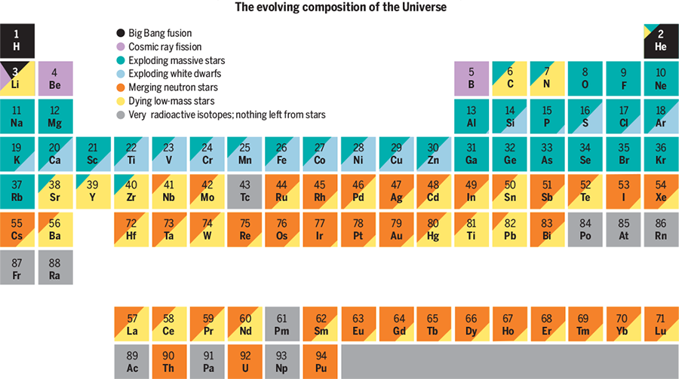
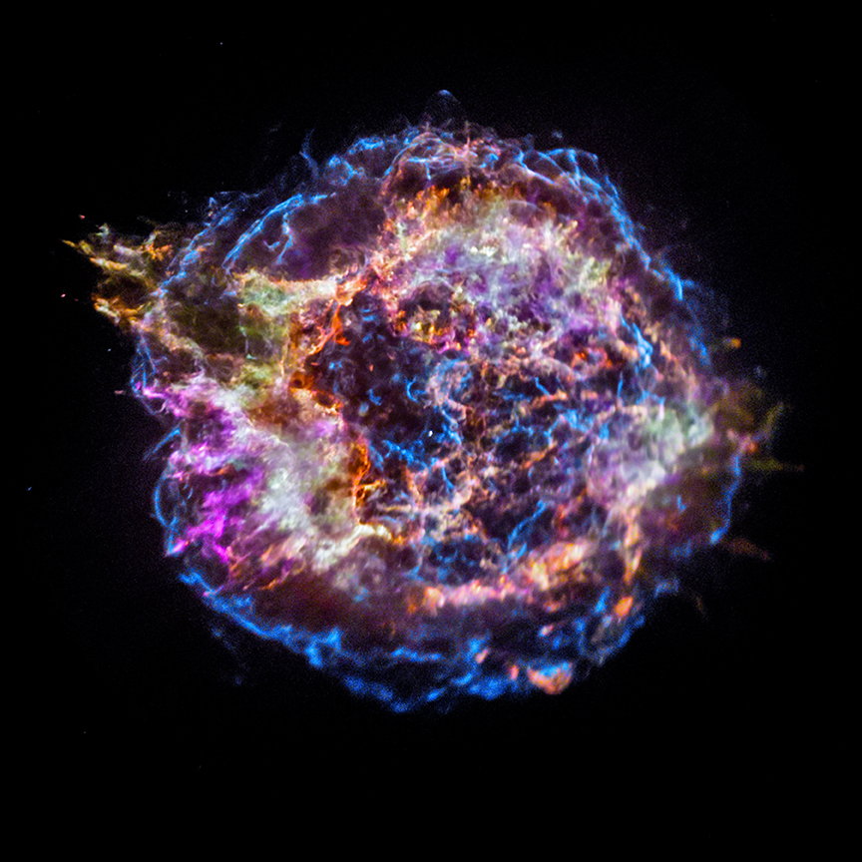
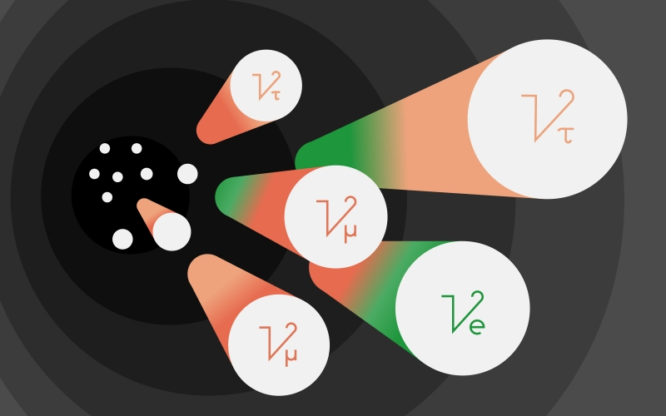
Motivation
Why study core-collapse supernovae (CCSNe)?
  Nucleosynthesis
  Neutron stars
  Gravitational waves
  Neutrinos
sciencemag.org
sanfordlab.org
APOD

Slide 5
Outline
Methods

Slide 6
How do we study CCSNe?
thornado (https://github.com/endeve/thornado)
  toolkit for high-order neutrino-radiation hydrodynamics
    Written primarily in Fortran 90
  Hydrodynamics
    Discontinuous Galerkin methods (space)
    Explicit Runge-Kutta methods
  Neutrino Transport
    Discontinuous Galerkin methods (phase space)
    Implicit/Explicit Runge-Kutta methods (see Paul Laiu's talk: MS72)
  Gravity
    Hybrid spectral and continuous Galerkin (finite-element) methods
  Tabulated microphysics from weaklib (https://github.com/starkiller-astro/weaklib)
  Parallelism via AMReX (https://amrex-codes.github.io/amrex/)

Slide 7

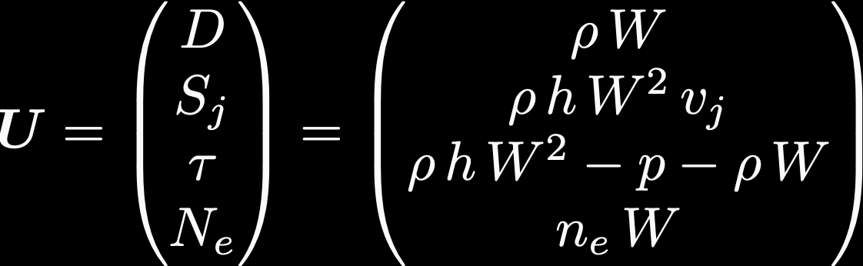



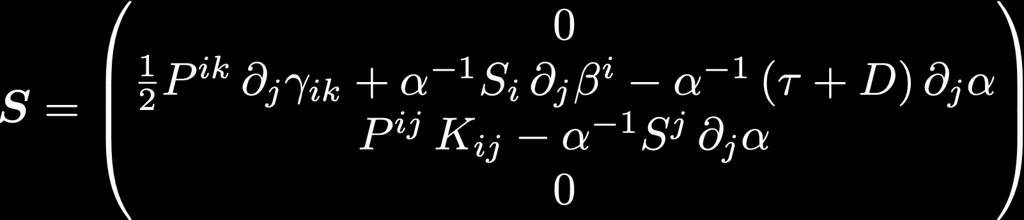
3+1 Hydrodynamics Equations

Slide 8
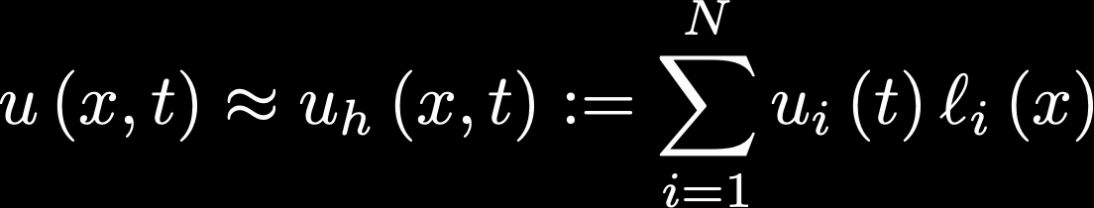
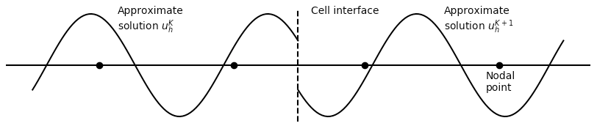
DG Method (1D Scalar Field)
Discretize computational domain
Locally approximate solution as polynomial
Use weak form to evolve in time with SSP-RK methods
Apply slope- and bound-preserving-limiters at each stage of SSP-RK algorithm

Slide 9




Weak Form (1D)
Multiply by test function (Lagrange polynomial)
Integrate over element
Time-dependent metric term incorporated here
Numerical flux obtained with approximate Riemann solver (e.g., HLL)
Substituting approximation in yields system of ODEs in

Slide 10
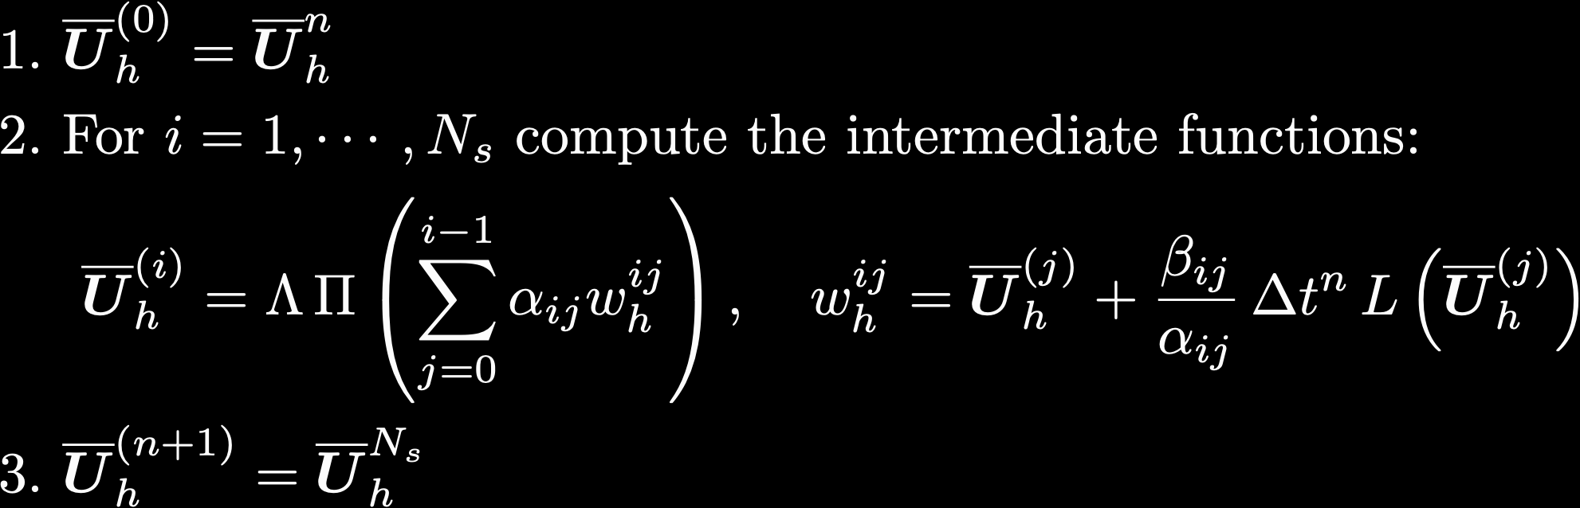
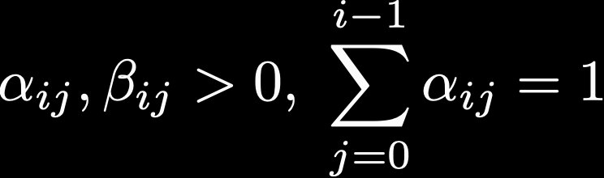
Time-Stepping Algorithm
Strong-Stability-Preserving Runge-Kutta (SSP-RK)
Cockburn & Shu, (2001) J. Sci. Comp., Vol. 16, No. 3
Convex combinations of forward-Euler steps
Limiters

Slide 11
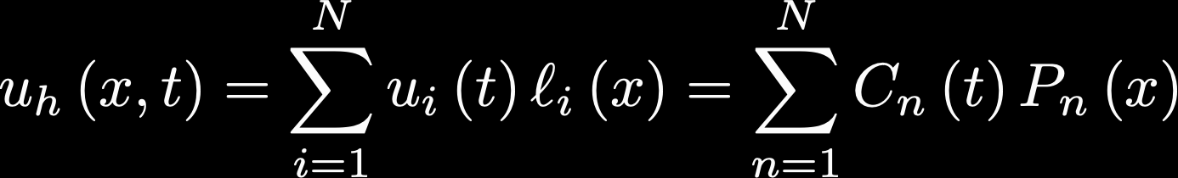
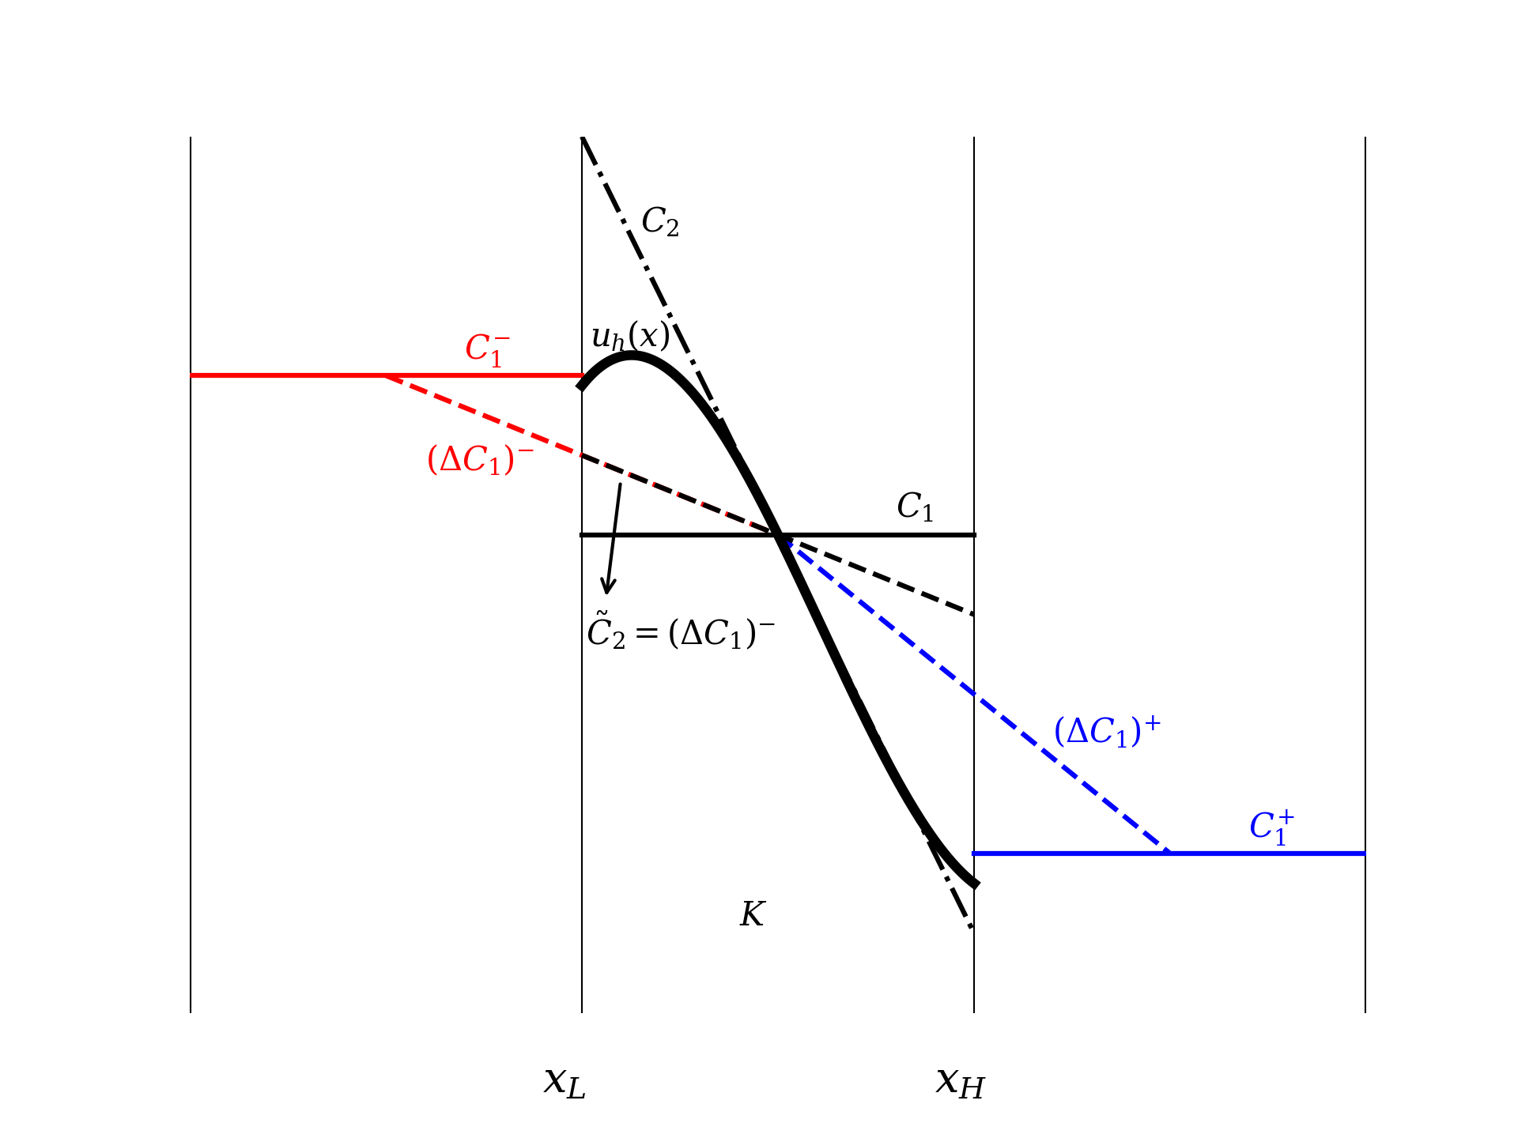
Slope-Limiter
Higher-order polynomials can develop unphysical oscillations
MinMod limiter
  Map to spectral representation
  Filter out high-order terms
  Map back
Pochik et al., (2020)

Slide 12



Bound-Preserving Limiter
The cell-averages are guaranteed to be physical, but not the nodal points (Qin et al. (2016))
“Set of admissible states”, G, forms a convex set
Unphysical nodal points are damped toward the cell average
G

Slide 13
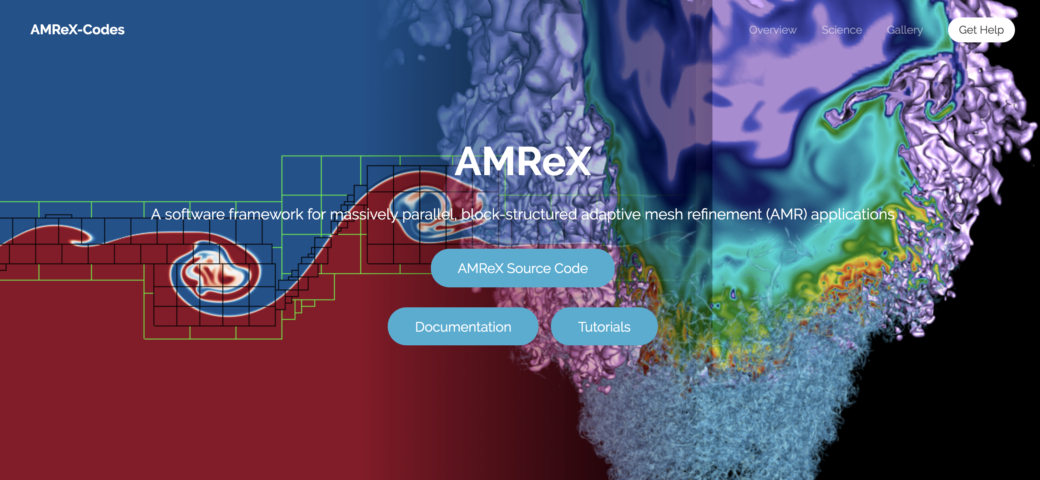
AMReX
https://amrex-codes.github.io/amrex/
Parallel/AMR framework developed primarily from Lawrence Berkeley National Laboratory
Block-Structured AMR

Slide 14
Outline
Results

Slide 15
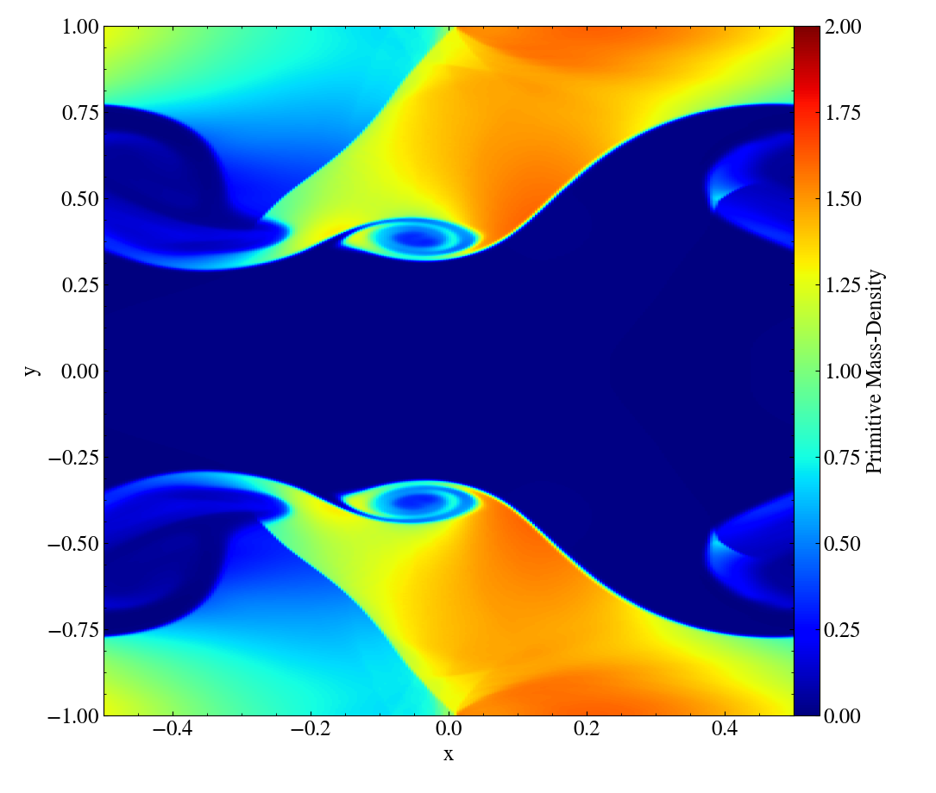
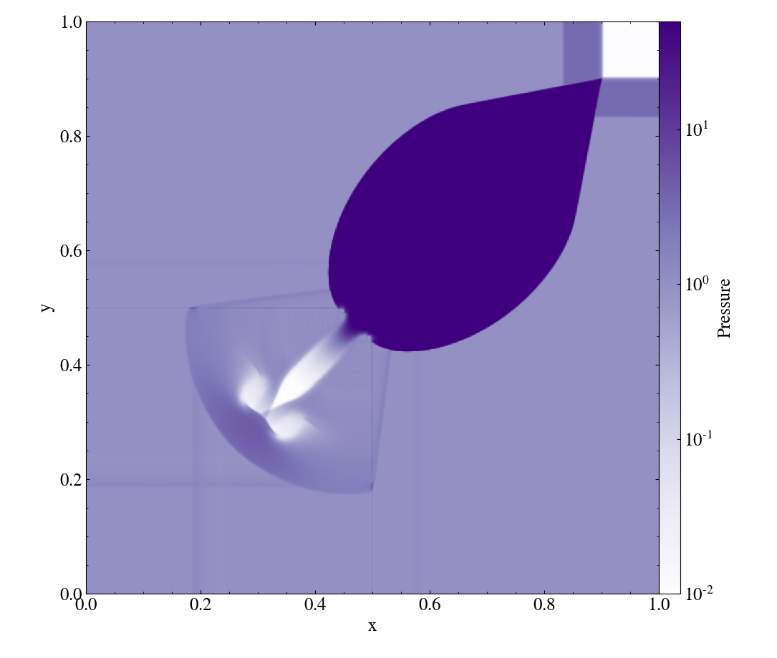
Results
Kelvin—Helmholtz instability
Initial conditions from Radice & Rezzolla (2012)
256 x 512 elements
3rd order methods
Run with AMReX
2D Riemann Problem
Initial conditions from Del Zanna & Bucciantini (2002)
512 x 512 elements
3rd order methods
Lorentz factor ~ 7
Run with AMReX

Slide 16
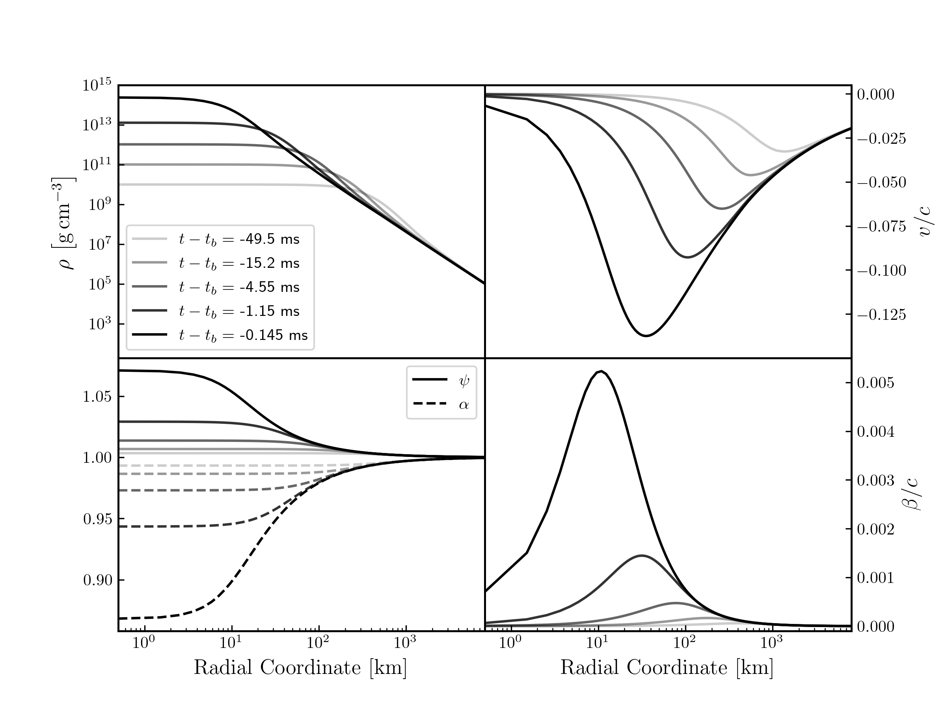


Results
Polytropic self-similar collapse (Yahil, A. (1983))
Simulates homologous collapse of stellar core
Evolved from t–tb=-150 ms until central density exceeds 1e15 g/cm³
3rd order methods
Geometric grid
  256 elements
  1e5 km
  1 km inner cell width
Yahil self-similar collapse (GR)
Compare to Newtonian results in Endeve et al., (2019)

Slide 17
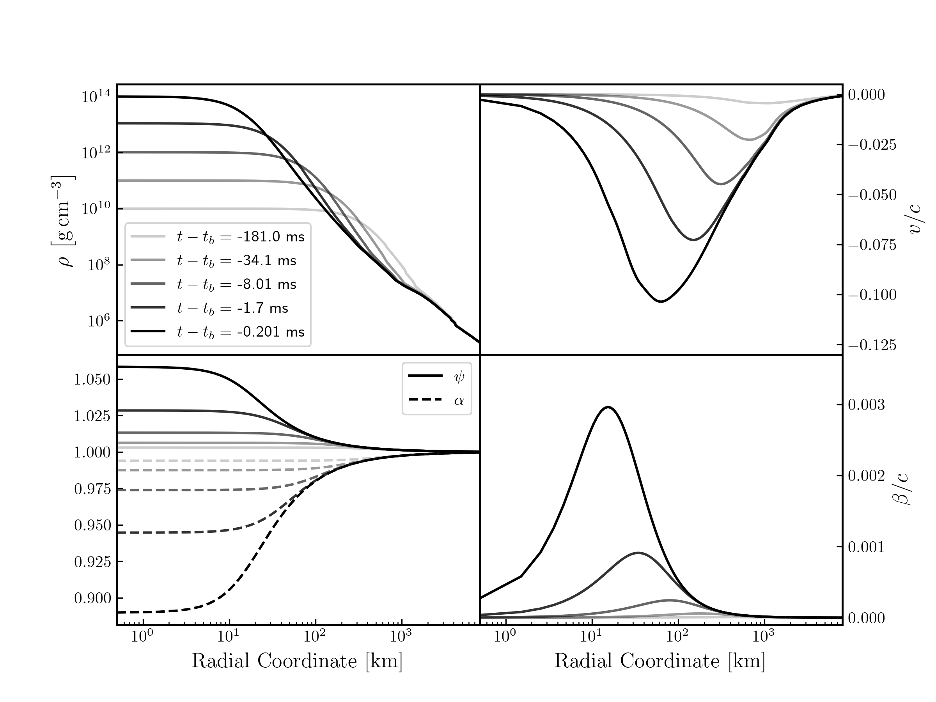
Results
Adiabatic collapse of 15 Solar mass progenitor (Woosley & Heger (2007))
SFHo EOS (Steiner et al., (2013a))
3rd order SSPRK method
2nd order DG method
Geometric grid
  256 elements
  8e3 km
  1 km inner cell width
Adiabatic Collapse (GR)
Compare to Newtonian results in Pochik et al., (2020)

Slide 18
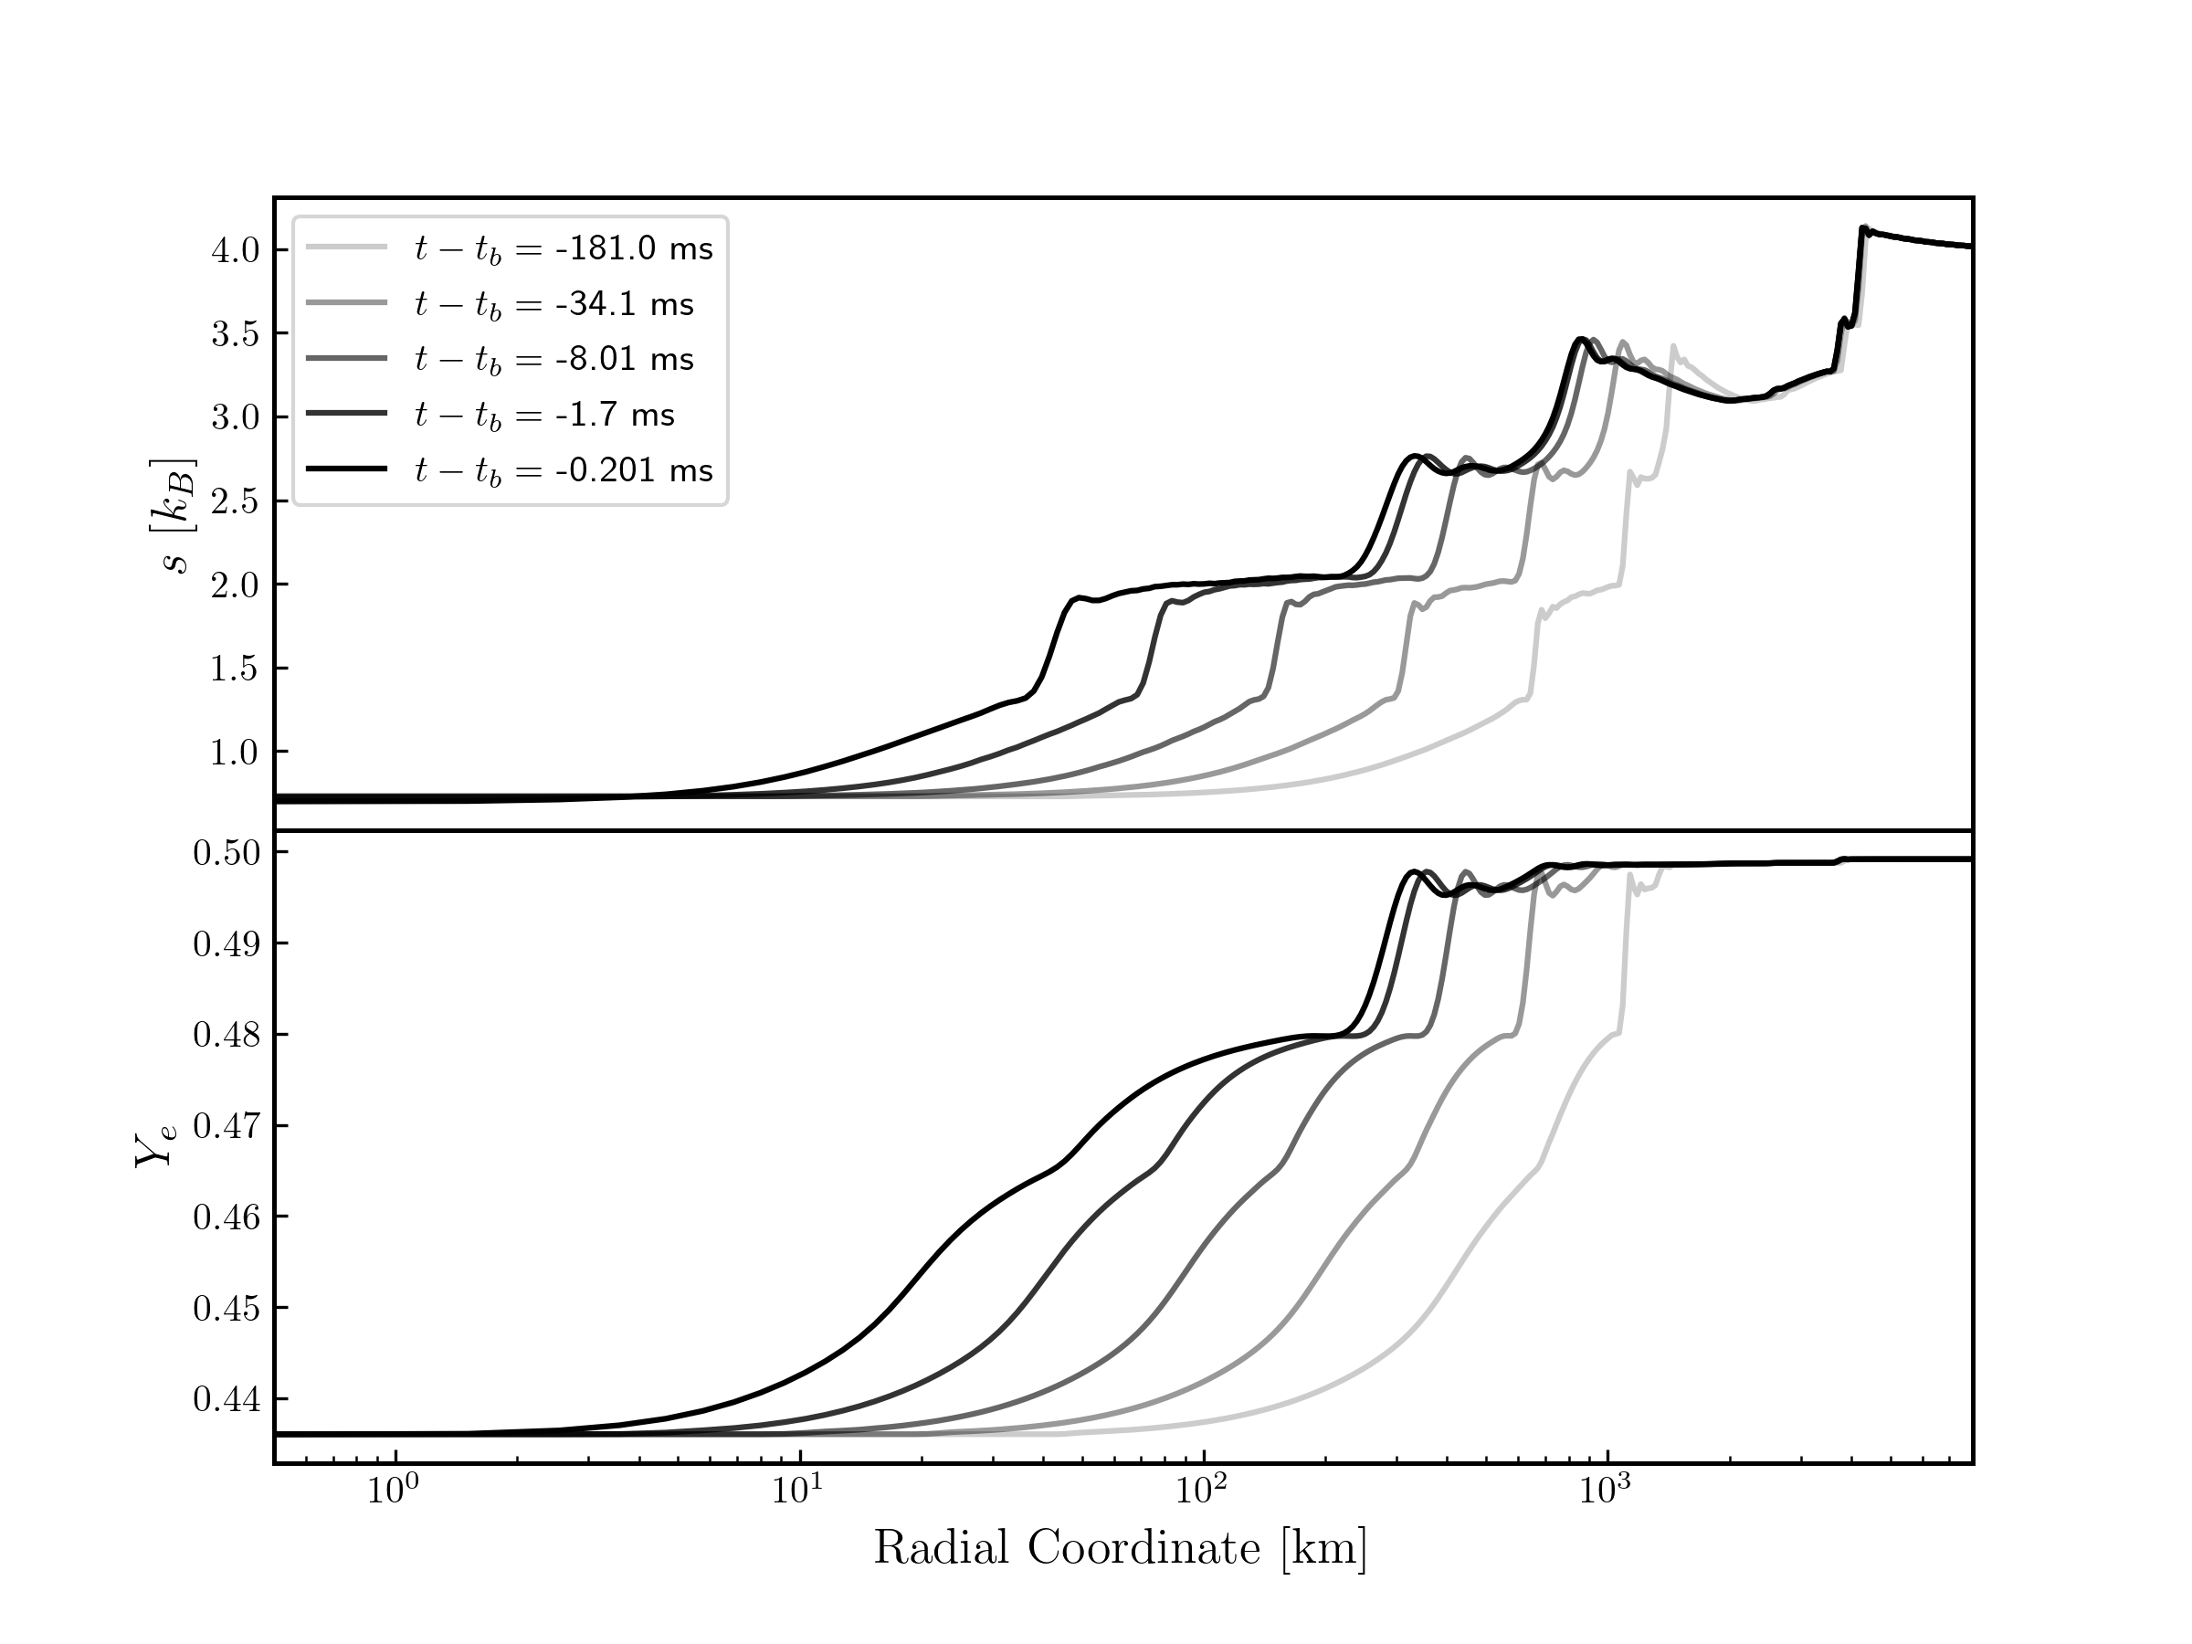
Results
Compare to Newtonian results in Pochik et al., (2020)

Slide 19
Outline
Summary, etc.

Slide 20
Summary
Developing thornado for CCSN simulations
  Relativistic hydrodynamics
  Relativistic gravity
  Tabulated, nuclear EOS
Evolved polytropic self-similar collapse
Evolved adiabatic collapse of realistic 15 Solar mass progenitor with nuclear EOS

Slide 21
Ongoing/Future Work
Evolve adiabatic collapse further
Multi-D test simulations
Incorporate neutrino transport solver
Port/optimize hydro solver on GPUs
Implement mesh refinement via AMReX
CCSN simulations!

Slide 22
References
Bruenn et al. (2001), ApJ, 560 326
Müller et al. (2012), ApJ, 756 84
Rezzolla & Zanotti, (2013), Relativistic Hydrodynamics, Oxford
Dimmelmeier et al., (2002), A&A, 388 917
Yahil (1983), ApJ, 265 1047
Endeve et al. (2019), J. Phys. Conf. Ser. 1225 012014
Pochik et al. (2020), arXiv: 2011.04680 (accepted to ApJ)
Woosley & Heger (2007), Physics Reports, 442 269
Steiner et al. (2013a), ApJ, 722 33
Cockburn & Shu, (2001) J. Sci. Comp., 16 3
Qin et al. (2016) JCP 315 323
Radice & Rezzolla (2012), A&A, 547 A26
Del Zanna & Bucciantini (2002), A&A, 390 1077

Slide 23
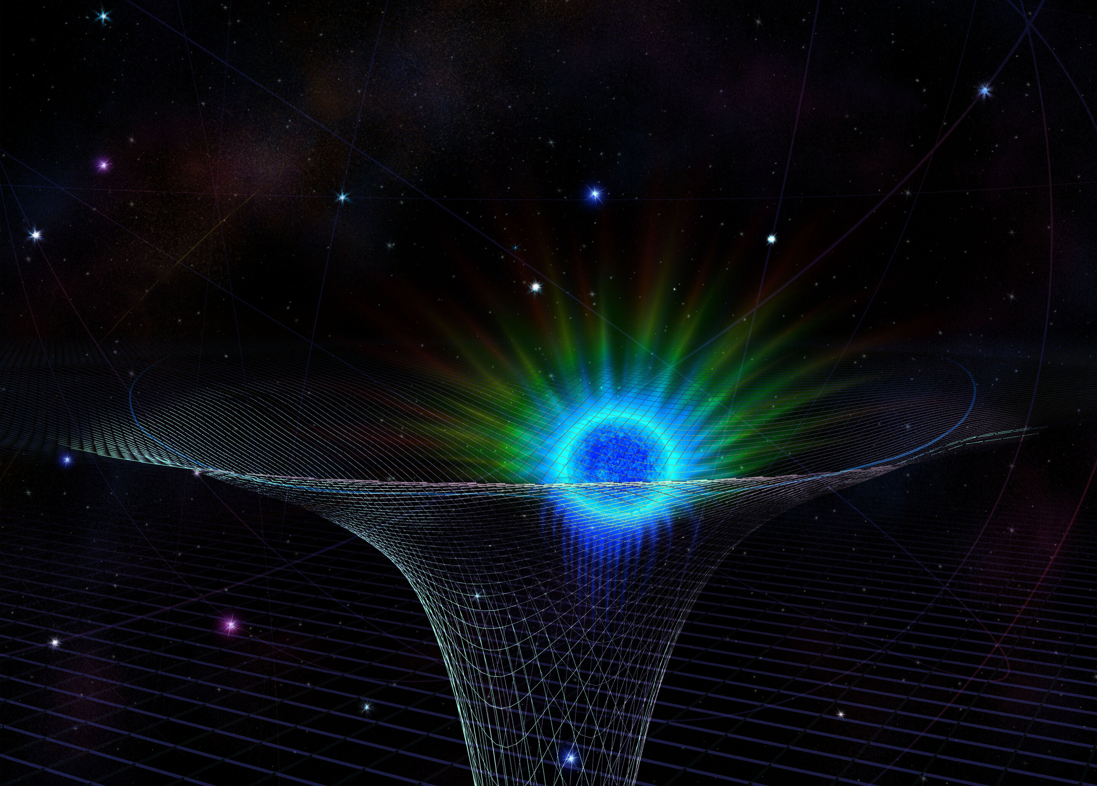
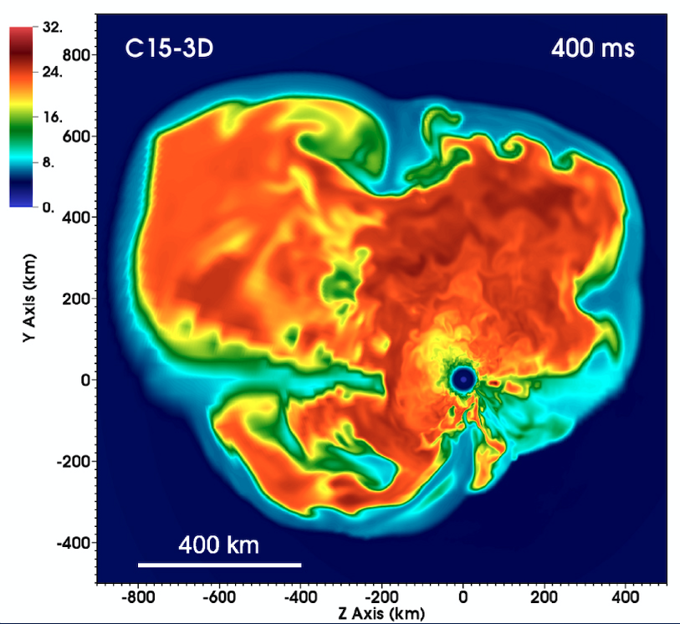

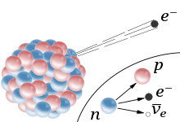
How to study CCSNe?
phys.org
Simulations!
  Macrophysics
    Gravity
    Hydrodynamics
    Neutrino transport
  Microphysics
    Equation of state
    Weak interactions
Lentz et al., 2015
wikipedia

Slide 24
Why GR?
Results of GR (e.g., Bruenn et al., (2001), Müller at al., (2012))
  Increased compactness of proto-neutron star
  Decreased region of net neutrino heating
  Increased post-shock fluid speed
Effects
  Harder neutrino spectra
  Higher neutrino luminosities
  Changes in neutrino heating
  Changes in convection and turbulence

Slide 25
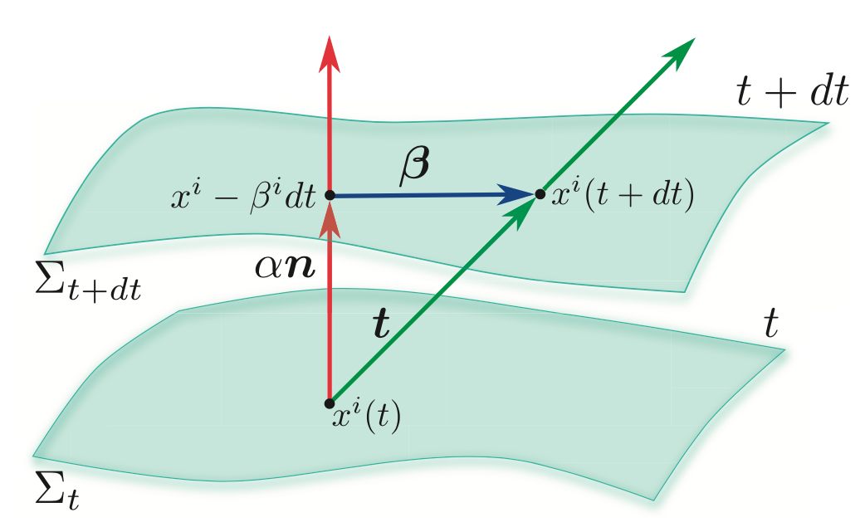





3+1 GR
Rezzolla & Zanotti (2013)
Lapse of proper time
How much coordinates have shifted
Freely specifiable
How the 3D surface is curved in the 4D manifold

Slide 26



Conformally-Flat Approximation (CFA)
Eliminates dynamical degrees of freedom
Exact in spherical symmetry
Valid for slowly rotating progenitors (Dimmelmeier et al., (2002))
“Maximal Slicing”

Slide 27
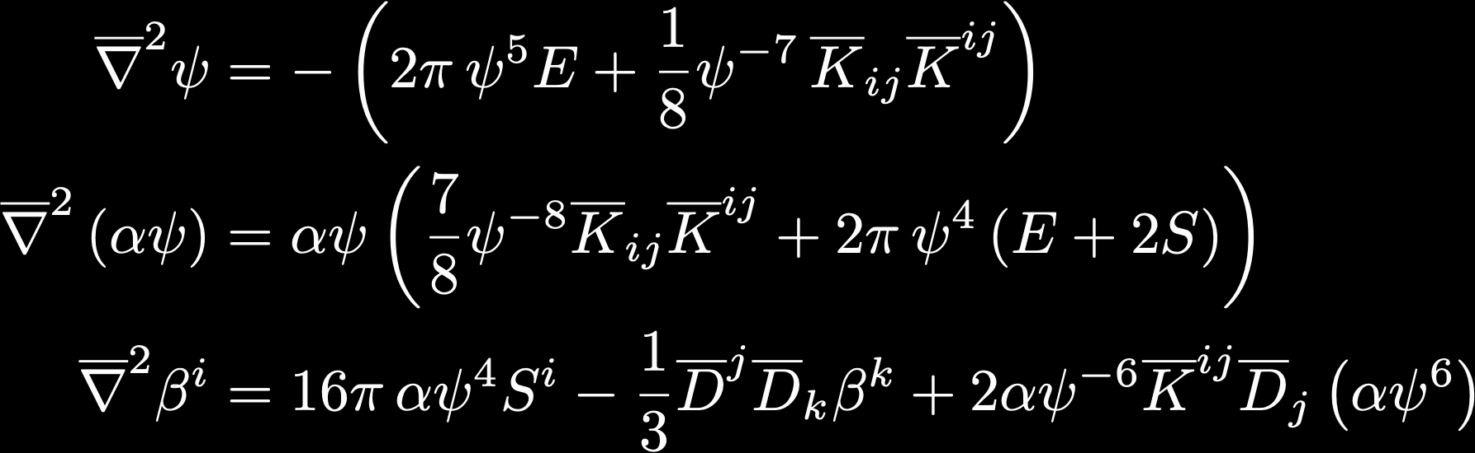
Gravity Solver
Solves CFA equations (coupled system of elliptic PDEs)
E, S, S^{i} are derived from stress-energy tensor of fluid
Uses hybrid of continuous Galerkin (finite element) and spectral methods

