Slide 1
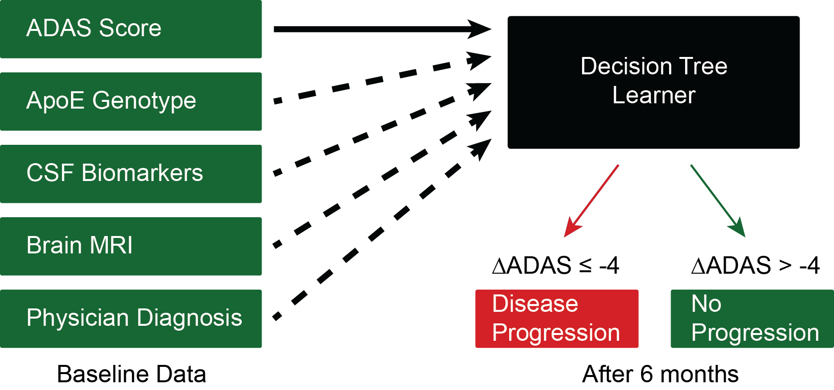
Predicting Alzheimer’s Disease (AD) Progression with mixed data groups
Currently, it is very challenging to predict which patients with mild cognitive impairment will progress to more severe AD in the future.
We are using a decision tree to predict AD progression because it is interpretable by clinicians and handles mixed data types and missing values well.
Notes:
In addition to the final report, you are also required to prepare a two-slide overview of your project. Think of these slides as a concise presentation of your project, highlighting the problem you worked on, your approach, and your results / contributions.
You may use any format you wish for the slides, but you are limited to only two slides. The goal is not to cram as much as possible into two slides, but to provide a clear and concise presentation of the main points of your project. You should avoid any font smaller than 14 pt, and most of your text should be around 18pt or larger. The best slides will use lots of graphics along with some text. You are welcome to re-use these graphics in your project report, and you may reuse the summary figure from your report in your slides.

