Slide 1
Immutable Infrastructure
Enabling Micro Service Architecture
Tomer Paz
28.June.2015

Slide 2
Agenda
Micro service Arch
Service Containers
II Concept
Notes:
II = Immutable Infrastructure

Slide 3
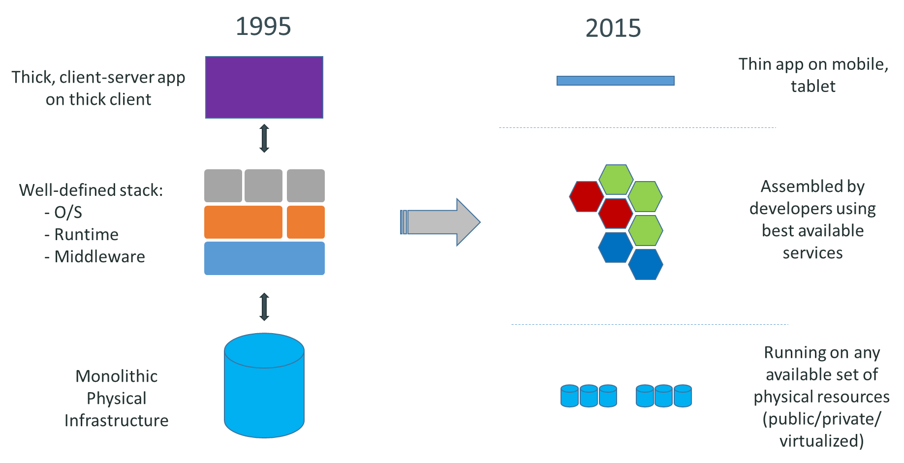
Market View: Evolution of IT
Source: Docker.io
Notes:
Source: docker.com slideshare

Slide 4

Background
12 factors site

Slide 5
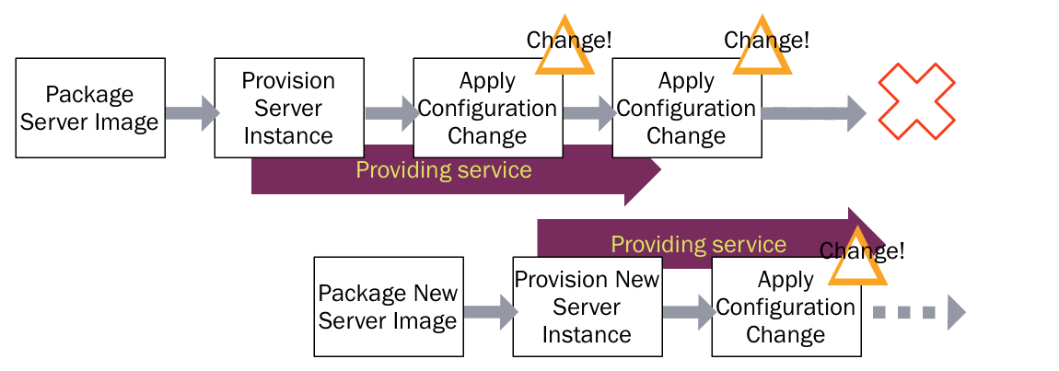
Immutable Infrastructure – What?
The Problem
Source: Kief Morris
Notes:
Source: http://martinfowler.com/bliki/ImmutableServer.html, Kief Morris

Slide 6

The Problem (CM Tools included)
Help!
CM tools (Chef, Puppet, Salt, …) made to try bringing machines to compliance (“state management”)
A race hardly to be won
More suitable to static environments, static machines (IT?!)
What if we could simply replace a service each time we upgrade, bringing it back to initial controlled known state?!

Slide 7
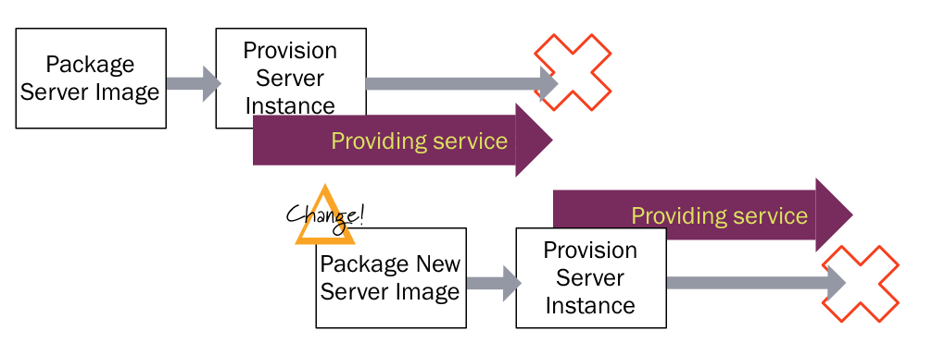
Immutable Infrastructure – How?
The solution
Source: Kief Morris
Notes:
Source: http://martinfowler.com/bliki/ImmutableServer.html, Kief Morris

Slide 8
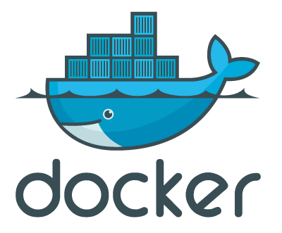
Yea yea, easier said then done, right?
Service Containers to the rescue!!!
Future of Application Delivery
Note: Docker is one option, there are others…

Slide 9
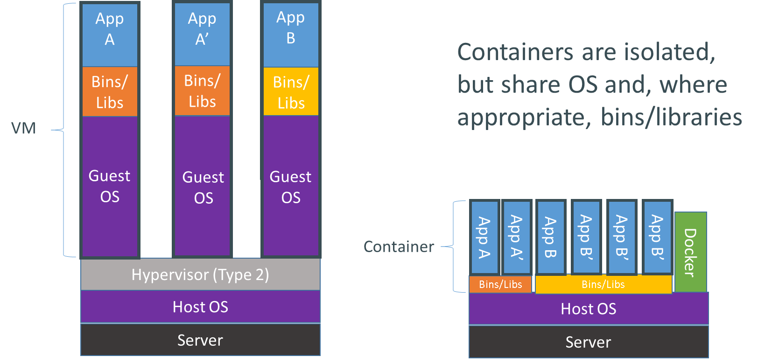
Service Containers (OS virtualization VS Server virtualization)
Source: Docker.io
Notes:
Source: Docker.io

Slide 10
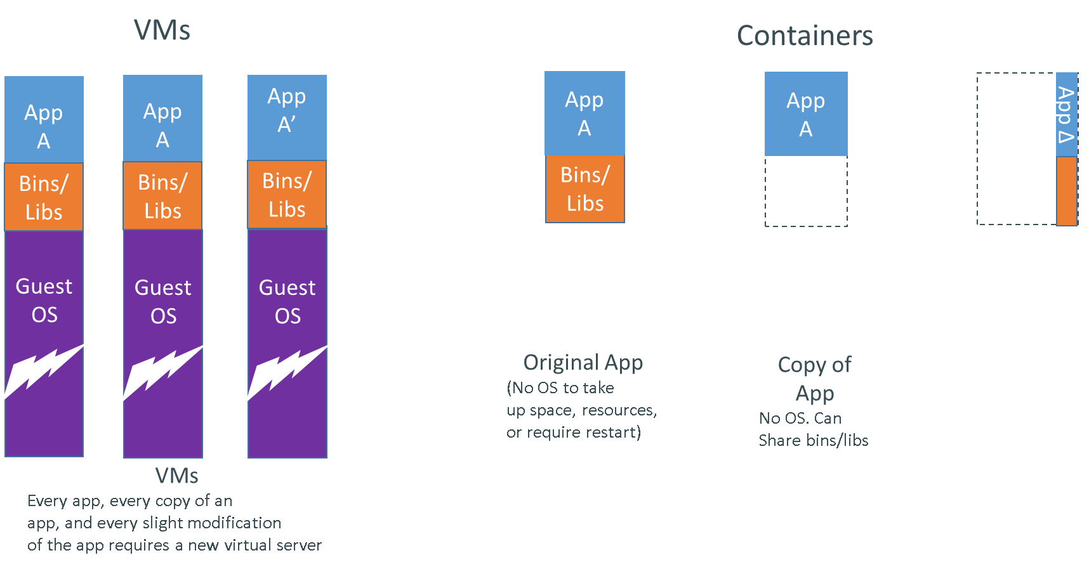
Docker awesomeness (Lightweight containers)
Source: Docker.io
Notes:
Source: Docker.io

Slide 11
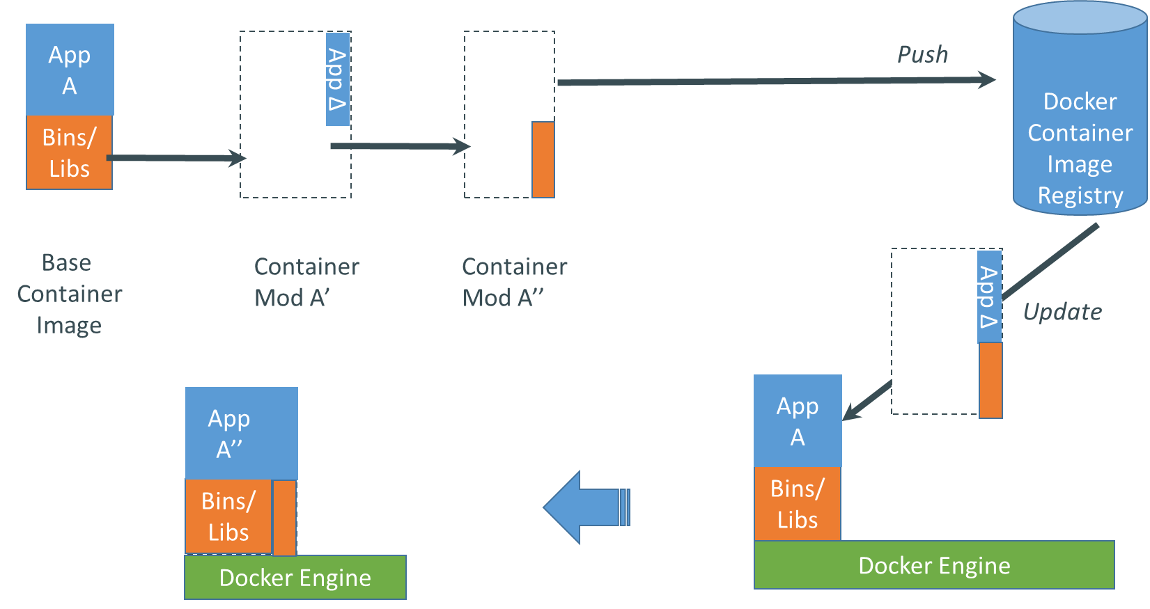
Docker awesomeness (Efficient push & pull)
Source: Docker.io
Notes:
Source: Docker.io

Slide 12
Docker as Immutable Infrastructure Enabler
So far we have seen what Docker allows us to do with how we deploy apps
Now we can realize the true power of it by changing our application architecture
Say hello to:
Micro Services Architecture
p.s. some call it “disparate services”

Slide 13

Micro Services definition (sort of)
The term "Microservice Architecture" has sprung up over the last few years to describe a particular way of designing software applications as suites of independently deployable services. While there is no precise definition of this architectural style, there are certain common characteristics around organization around business capability, automated deployment, intelligence in the endpoints, and decentralized control of languages and data.
“
”

Slide 14
Micro Services Concerns
Tooling
Configuration
Discovery
Routing
Observability
Data stores (Ephemeral!)
Operational: Orchestration and Deployment Infrastructure
Development: Languages and Container
Source: Adrian Cockfort
Notes:
Source of Diagram: Adrian Cockford
Tooling – e.g. Jenkins, Packer(lightweight to replace CM tools!), Vagrant
Configuration – Distributed vs Local (etcd, zookeeper etc)
Routing: how to route data between Services, messaging! E.g. Finagle, RabbitMQ etc
Observability (CLI, UI) to Trace activity or services, e.g. Twitter Zipkin, or ELK
Ephemeral – could replace and destroy nodes and the data will be recovered and rebuilt from replicas… (Kubernetes has that feature in its cluster)
Operational: Docker Compose, fleet?, Crane, Ansible, Ranchman (for GUI) and many more…

Slide 15
Domain Driven Tools:
Management Services
Resources Abstraction
Orchestration Engine
Service Discovery
Abstract
Clustering
UI/CLI
CM
D.Shared configuration
St.Monitoring
Management Services
Mesos/Swarm/Yarn?
Kubernetes/Helios/Fleet/Panamax/Compose…
Spy/Consul/sky…
Implementations
UI?
Puppet/Ansible/Compose/?
Zookeeper/etcd/…
Riemann + Graphite + ELK
Notes:
Source: Tomer Paz ☺
https://github.com/Capgemini/Apollo

Slide 16
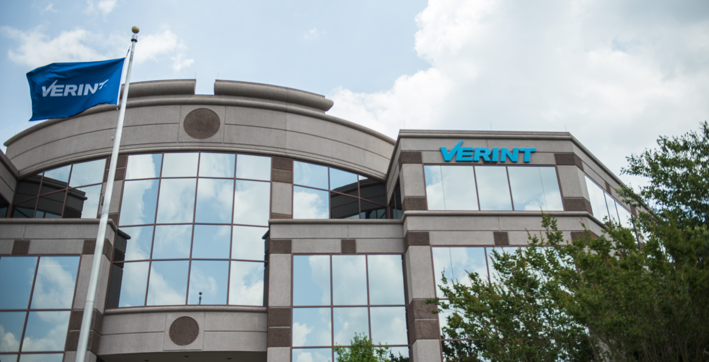

Slide 17

Examples & Demos
Container Orchestration, resource management, Service Discovery
Containers deployment Orchestration: Ansible (CM tool), Compose (Docker metadata orchestration tool), or Rancher (UI) (and many others…)
Service discovery: SkyDNS, docker-spy, Registrator (and there are others)
Distributed configuration: ETCD, Consul, Confd(for local sync with remote) (and there are many others…)
Streaming stats and logs & dashboards:
ELK for logs
Statsd/Collectd, Graphana, Graphite, Riemann
Notes:
Whatever time permits…

Slide 18
Example Clip
Mesosphere

Slide 19



Important resources
Micros Services & Immutable Infrastructure:
The 12 Factor App - architecture principles * Event Sourcing + CQRS pattern in micro-services architecture
Definition of Immutable Server (the “PhoenixServer”)
PhoenixServer
Micro services (Martin Fowler & James Lewis description)
microservices-practical-tips
Cloud-frozen-pizza-model-and-the-immutable-infrastructure
Reactive Manifesto
Docker specific highly recommended:
Dockerfile Best Practices
Docker Security Best Practices
How to use confd with etcd to dynamically update local app configuration
Packer & Crane for Docker Developer environments

Slide 20
Some Hot Open Source Projects
Etcetera Emerging technologies
Weave – “The Docker Network”
Terraform – a deployment tool for infrastructure as code
Rancher.io – Open source GUI product for Docker containers management (using IPSec for inter-hosts container communication, based on Docker, Compose and Swarm)
Apollo – Open source platform for micro services (based on Docker, Weave, Mesos, Packer, Consul, Terraform and HAProxy).
Flocker – yet another Docker multi host Cluster management with special care to Data volumes
SequenceIQ CloudBreak – Hadoop self service easy to deploy clusters based on containers, exposing REST API (“Hadoop as a Service”)
Dev Env++: Crane , Powerstrip
CloudFoundry: Lattice
Notes:
Crane – yaml meta data for container orchestration for dev env.
Powerstrip – Tool for prototyping Docker API Extensions, a.k.a. Adapters etc.

Slide 21
Thank You
Tomer Paz
Global Arch. Team, EIS
2015

Slide 22
Home Work (advance topics)
Micro services Architecture Concerns:
Monitoring: Message patterns (Actor, Chain, Subscriber, Tree). How to measure?
Property Based Testing
Key Design Tips – Architecture Safety patterns: Timeouts, Circuit-breaker, Bulkheads, Handshaking
Event Sourcing + CQRS pattern in micro-services architecture
Recommended reading: "Release It!" by Michael. T. Nygard
Stability patterns applied in a restful architecture

