Slide 1
Model-Based Sonification
December 16th, 2019
David Unland

Slide 2

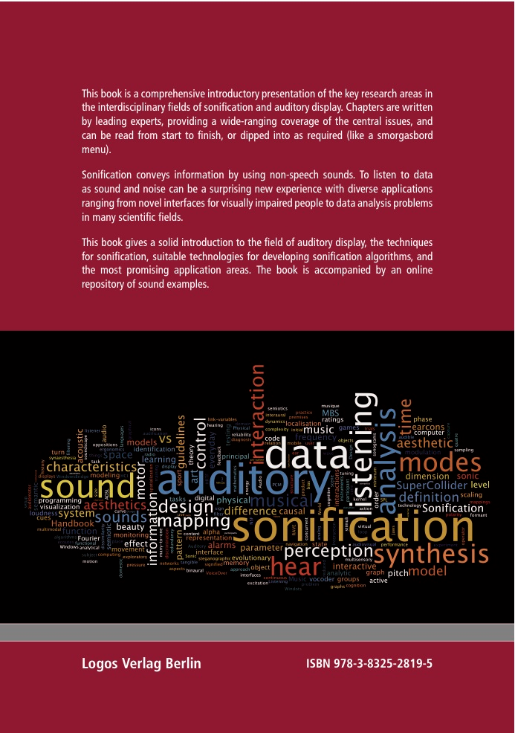
The Sonification Handbook by Thomas Herrmann, Andy Hunt, John G. Neuhoff
www.sonification.de/handbook
Chapter 16:
Model-Based Sonification
Notes:
I first thought of model-based sonification as “sonification of physical models / simulations”
My understanding: sonification of physical models where the data changes in time (show puredata sketch!)
This is not it! For Herrmann, Hunt and Neuhoff it is something more specific..

Slide 3
Model-Based Sonification: Creation of processes that evolve in time to systematically sonify data
data itself doesn’t need to have timely dimension --> even better without, else parameter mapping or similar recommended
excitation needed to start sounding: a dynamic sound that changes in time
Notes:
MBS - creation of processes that evolve in time to systematically sonify data
–> data itself doesn’t need to have timely dimension --> even better without, else parameter mapping or similar recommended
–> excitation needed to start sounding: a dynamic sound that changes in time
it’s a lot about the nature of the data (structure and distribution)
best analogy: like a box that one tries to guess the content of by shaking it: excitation, direct audible response, many possibilities of handling
–> gradually build up a mental representation

Slide 4
Model-Based Sonification: Definition according to Herrmann, Hunt, Neuhoff
“Model-Based Sonification (MBS) is defined as the general term for all concrete sonification techniques that make use of dynamic models which mathematically describe the evolution of a system in time, parameterize and configure them during initialization with the available data and offer interaction/excitation modes to the user as the interface to actively query sonic responses which depend systematically upon the temporal evolution model.”
Notes:
“The data neither determine the sound signal (as in audification) nor features of the sound (as in parameter mapping sonification), but instead they determine the architecture of a ‘dynamic’ model which in turn generates sound.”
Which data?
- high-dimensional
- non-timely

Slide 5
Constructive Conditions for the Design of Model-Based Sonification
Ubiquity
Invariance of binding mechanism
Immediate response
Sonic variability
Information richness
Notes:
in order to be able to get a representative mental picture of the data’s nature, the following conditions should be provided:
ubiquity (every action should be accompanied by sound)
invariance of binding mechanism (sound producing laws always the same and structurally independent of the dataset (e.g. for comparing different datasets))
immediate response: real-time sound generation
sonic variability: it should be possible to produce different sounds from different interaction
information richness: sounds should be complex and rich
–> “MBS offers a framework for the creation of sonification models which automatically behave according to these requirements” 1

Slide 6
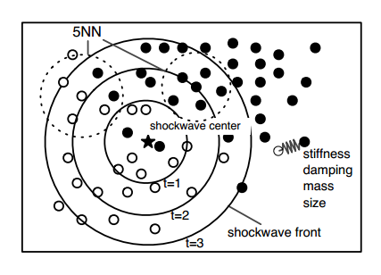
A Data Sonogram as an exemplary Model-Based Sonification
Notes:
scatter plot of data
–> excite a shock wave in data space
–> wave front excites mass-spring systems: each point is mass-spring system that oscillates once it is hit by shock wave
provides information about data density and clustering
parameters --> stiffness / damping of individual springs
sound examples 16.2a-c

Slide 7
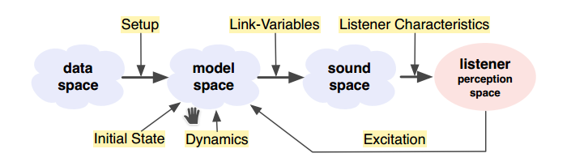
The step-by-step procedure for the Design of a Model-Based Sonification
Notes:
1. setup
bridges the gap between data-space (static) and model-space (dynamic)
--> what type of model? e.g. decide to make a data sonogram
2. dynamics
introduction of temporal dynamics: mathematical description of motion or whatever is applied from mechanics, electrodynamics, chemistry, machine learning, ...
3. excitation
interaction interfaces?
mouse click, keystroke, shake; hitting surfaces at different locations, squeezing, shaking, rubbing, deforming; controllers with parameter-rich interfaces (**what kind of sensors could be applied?**)
4. initial state
load and initialize data, puts system into initial position
5. link-variables
variables responsible for the sound signal generation from within the models' dynamic processes
keep the arbitrariness at a minimum!
simplification needed for real-time application in higher dimensional datasets (e.g. precalculate average values before sending them to dac)
6. listener characteristics
single sound source vs sound scenery?
location, orientation or distance of the listener? mono vs stereo vs surround implementations?

Slide 8
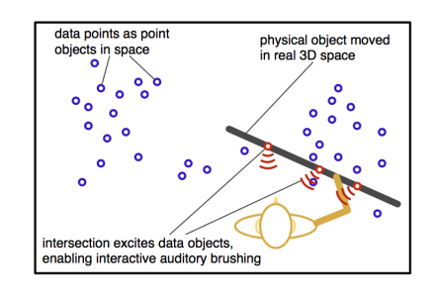
Exemplary Model-Based Sonification Applications: Tangible Data Scanning
Notes:
data points located in 3D-space around the user
moving a tracked planar object excites datapoints (as mass-spring system) when hit
sound example S16.3: Tangible Data Scanning Video

Slide 9
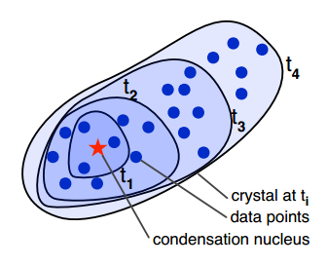
Exemplary Model-Based Sonification Applications:
Data Crystallization and Sonification
Notes:
fixed “molecules” (data points)
excitement: mouse click places crystallization seed
“the eigenvalues determine the harmonic series while the overall variance determines the size and thereby the fundamental frequency of the sound” [4]
growth --> pitch drops, brightness signature modulates
sound example S16.5: Data Crystallization Sonification
suitable for clustering of data and local dimensionality structure of clusters

Slide 10
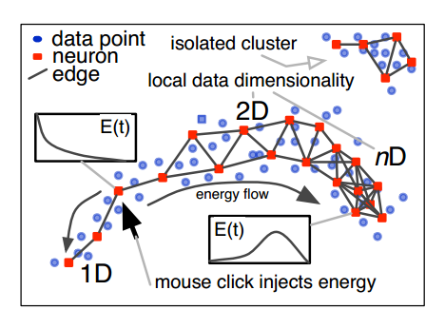
Exemplary Model-Based Sonification Applications:
Growing Neural Gas Sonification
Notes:
data points as “neurons”, each contributing to the overall sound:
edges add up to overall restoring force --> higher frequency of that neuron oscillating around its position
each neuron creates a sine wave, number of edges influencing the stiffness
allowing perception of overall connectivity of the graph structure
also reveals overfitting (shows where randomness of data is made audible instead of underlying relationship)
media file S16.9: video of a GNG growth for a 2d spiral data set

Slide 11
Notes:
what data suitable? any examples?
what sensors suitable?
what plot types interesting?
p3-Ausblick?

