Slide 1
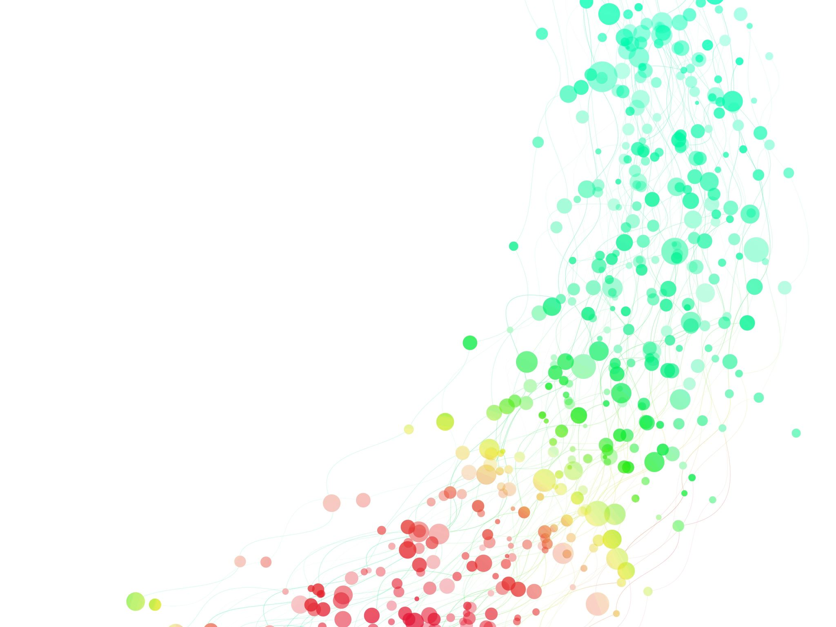
Protecting PHI (Protected Health Information)
While doing Open Science

Slide 2
Fundamental Conflict
You want to be transparent about your research
Share data
Share code
Enable others to check, verify your work
But data contains PHI
Don’t want to identify participants
Don’t want to violate medical center policy
Don’t want to violate federal law

Slide 3
Options
Share code, but not data, or supply ‘fake’ data
Not great, can’t replicate
Share code, remove PHI from data
Problematic if dates matter – but can be addressed
Share code and synthetic data
Reduce identifiability – lose some fidelity

Slide 4
How and Where to Share
Your goal: FAIR data – Findable, Accessible, Interoperable and Reusable.
Open Science Foundation – osf.io
Integration add-ons with ORCID, Zotero, Dropbox, Box, GoogleDrive, GitHub, OneDrive, GitLab, Figshare – 5GB per file unless use add-ons for storage

Slide 5
How and Where to Share
Zenodo/OpenAIRE (50GB per dataset), figshare, and dryad (300GB) – data repositories on the web
Get citable doi (digital object identifier) for your CV
Integrations with ORCID, other services
Larger file sizes
Github – code, linked to data elsewhere
None are HIPAA-compliant
What if repos go away (data lost) – some (OSF) have foundation $$ to protect in perpetuity, Zenodo/OpenAIRE hosted at CERN, Dryad linked to Zenodo

Slide 6
Local / external storage that is HIPAA
Local computer – but risky
S drive
H drive
UM Dropbox

Slide 7
Option 1: Share code, not Data
Not great, can’t replicate
Can share dummy data, may not help much other than to check code
Can use GitHub or GitLab
Can keep data in your local repository
Can back up with local git
But add datafiles to your .gitignore file in your Project

Slide 8
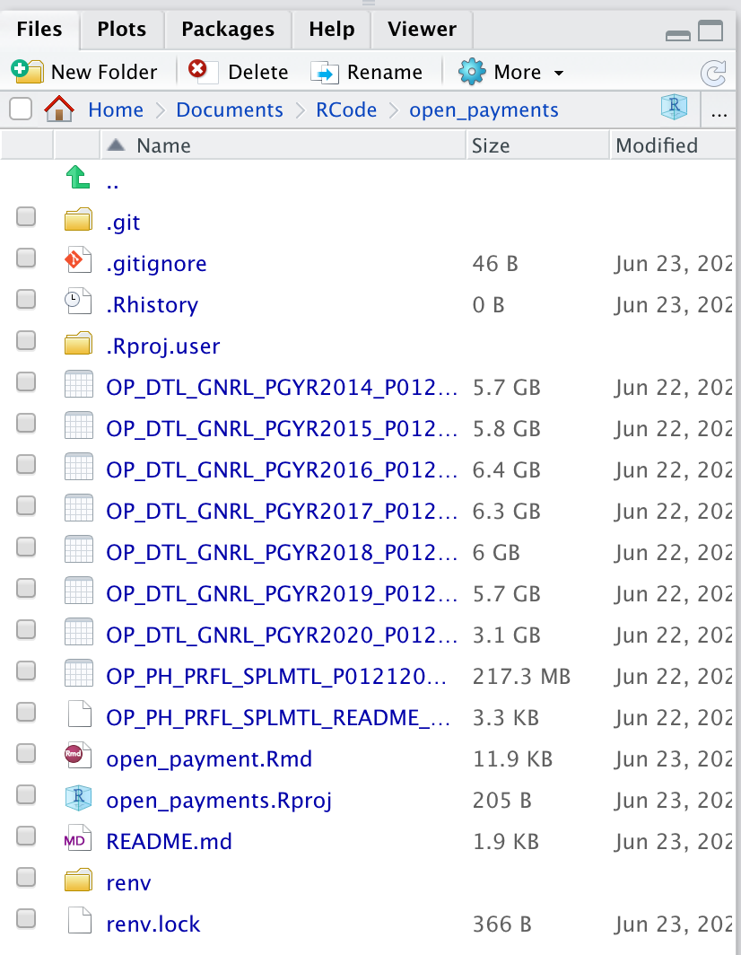
What does the .gitignore file do?
Tells git to ignore these files, and not track them
Never puts these into git, or on GitHub
Note lots of big .csv (GB) files in this project
Too big for GitHub
Total repo limit 100GB
Each file limited to 2GB
(Big) Data storage discouraged in GitHub

Slide 9
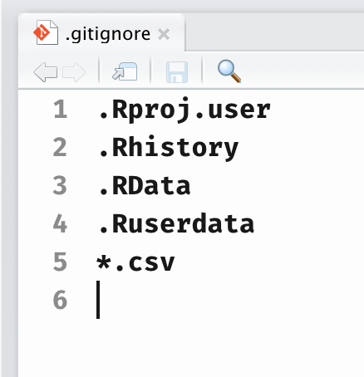
What to Do?
Open your .gitignore file
Add a new line
*.csv
Now all csv files will not be tracked by git
Will not go to GitHub

Slide 10
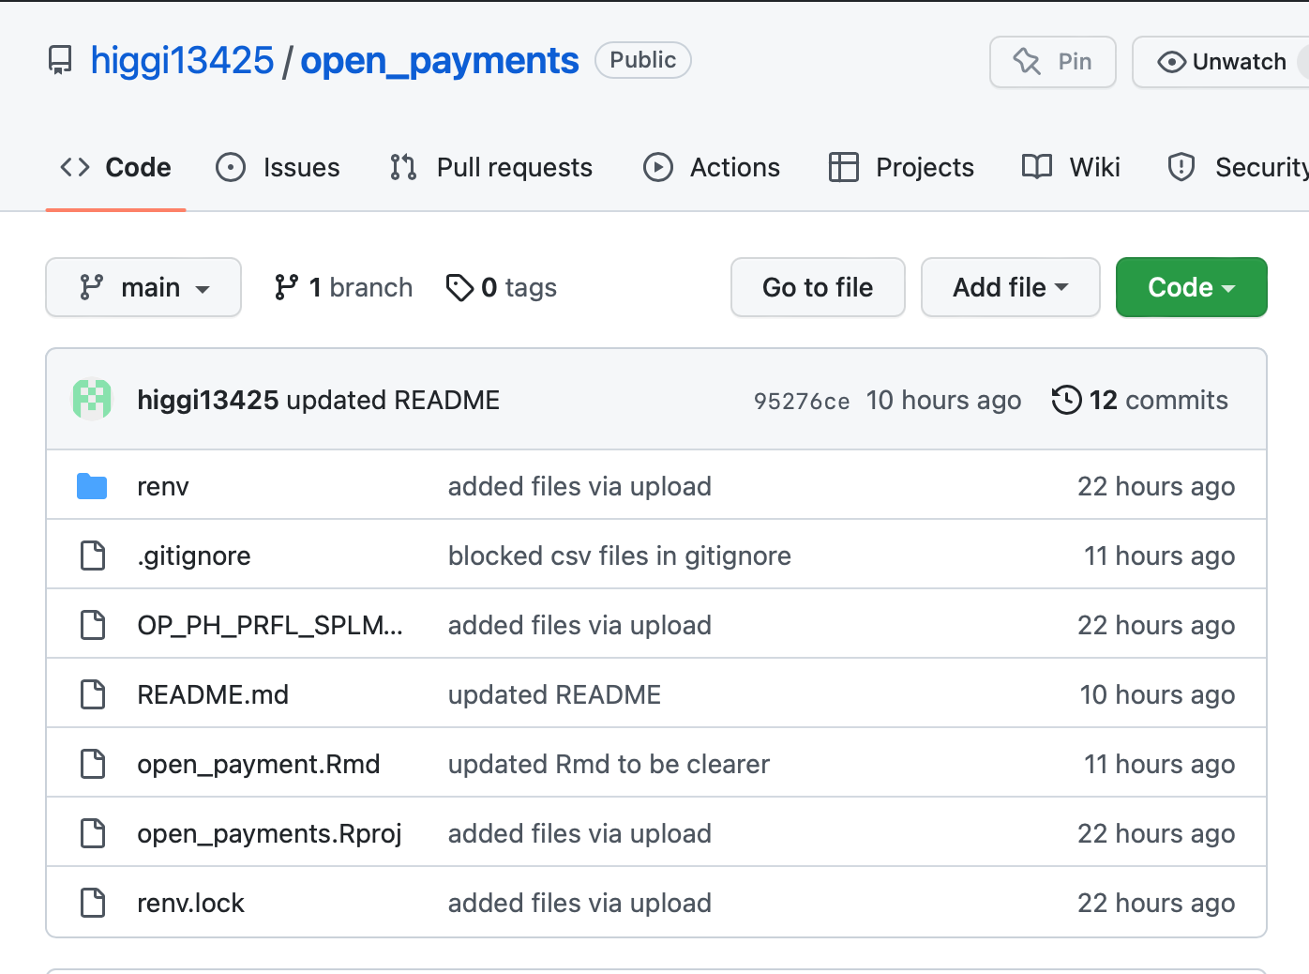
Result
Now, data files are in the local repository
Backed up on H drive
But NOT on GitHub
Not public
Only the code is public
But no one can replicate
But they can borrow your code for other projects

Slide 11
Try it
Open an RStudio project you have linked to git and GitHub
Make sure it is up to date – commit, push to GitHub
Create 2 new files in the Project
PHI.R script – File/New File/R Script
Anonymous.R script
Open your .gitignore file
Add a line for PHI.R
Commit and push to GitHub
See that anonymous.R was added to the public repository, PHI.R was not

Slide 12
Option 2: Share Code and Deidentified Data
Remove the PHI from dataframe
What are the components of PHI? 18 HIPAA identifiers
Name
Dates, except Year
Telephone numbers
Geographic data (address, city, state, zip) – census tract/block OK
FAX #, Phone #
Social Security #
Email address
Medical Record #
Account # of any kind
Health plan beneficiary #
Any certificate#/license #
Vehicle identifiers, VIN, license plate
Any Web URL assoc with patient

Slide 13
Is it clean?
Under HIPAA, PHI ceases to be PHI if it is stripped of all identifiers that can tie the information to an individual. If the above identifiers are removed the health information is referred to as de-identified PHI.
For de-identified PHI, HIPAA Rules no longer apply.
If there is any way to back-calculate PHI information, it is not clean
If a condition is very rare, and easy to identify (only 10 ppl in Michigan with rare disease, only one under age 10), fields like age can still be a PHI problem.

Slide 14
What about Date Intervals?
You need to know how long between clinic appointment date and procedure date.
But you can’t keep real dates in your data because of PHI
You can keep relative dates, not absolute dates – can still calculate intervals. Options:
Convert all dates to # days old the patient was
Convert all dates to # days since a random day in the year 1900
Or a random year before 1st event in your dataset
Use a random # generator (1 to 365)
Random, not an obvious day like Jan 1 – then someone else can still derive actual dates

Slide 15
Common Ways to Mess Up PHI
Derive your study id from components of PHI
Geographic info plus DOB – MI05071956, AZ11231974
Anonymize dates, then use a fixed date in your code
Dichotomize dates into before and after drug X was approved
Enables back calculation of all other dates

Slide 16
Try it
Download phi.csv from GitHub with file <- read_csv("https://raw.githubusercontent.com/higgi13425/rmrwr-book/master/data/phi.csv")
Open file
Identify which variables contain PHI
Use lubridate::mdy() to calculate clinic_days and colon_days (since [DOB]) as new vars
file %>% mutate(date_clinic_days = lubridate::mdy(date_clinic) - lubridate::mdy(dob))
Use select(-variable_name) to remove PHI vars, including real dates
Use write_csv to write this new dataset object to a new phi_deid.csv file
Write_csv(dataset, “phi_deid.csv”)

Slide 17
Option 3: Share Code and Synthetic Data
What is synthetic data?
Data generated from original data that mimics the original data distributions and relationships/correlations, but adds noise to anonymize
Can be used for rare disease datasets
Built with {synthpop} package
Will allow running code on nearly-real data
Results will be slightly off (0-10%) from original
model coefficients, p values, etc.

Slide 18
Full description of {synthpop}
Vignette here: https://www.synthpop.org.uk/get-started.html
Has data file SD2011 with UK data from 2011
Can try it out with shiny app demo https://synthpop.shinyapps.io/synthpop/
Or do it yourself with 2011 Scottish demographic data
install.packages(“synthpop”)
library(synthpop)
help(SD2011)

Slide 19
Synthpop in Action
dim(SD2011)
mydata <- SD2011[, c(1, 3, 6, 8, 11, 17, 18, 19, 20, 10)]
codebook.syn(mydata)$tab
# Only remaining item to check is the negative income values mydata$income # some NAs, some -8?? # We can see that income has both NA values and -8. # To make the synthetic data like the original we keep both types # of missingness by setting cont.na for income mysyn <- syn(mydata, cont.na = list(income = -8)) # default synth but adding -8 as missing values for income

Slide 20
Synthpop in Action
summary(mysyn)
compare(mysyn, mydata, stat = "counts”)
multi.compare(mysyn, mydata, var = "marital", by = "sex")
multi.compare(mysyn, mydata, var = "income", by = "agegr")
multi.compare(mysyn, mydata, var = "income", by = "edu", cont.type = "boxplot")

Slide 21
Take Home Options for Data Sharing
Share code, but not data
Not great, can’t replicate
Share code, remove PHI from data
Problematic if dates matter – but can be addressed
Can’t use event dates that are publicly known (e.g. date Stelara approved)
Share code and synthetic data
Reduce identifiability – lose some fidelity

