Slide 1

User Interface (ui) Section (aka “front end”)
server Section (aka “back end”)
Accept Inputs
From Users
methodInput(“ID”)
Display Outputs
From Server
typeOutput(“value”)
Accept from UI input$ID
Process this, then
Render Outputs to HTML
Assign Rendered
Outputs to
output$value
# Run the application
shinyApp(ui = ui, server = server)

Slide 2
Programming Styles
Imperative
What we use in data analysis
Load data, wrangle, visualize, model, save
Functions written – do this now
“Make me a sandwich”
Specific commands executed immediately
Code executed in top to bottom order
Declarative
What we use in Shiny apps
Express higher-level goals
Functions written – done when needed
“Ensure that there is a sandwich in the refrigerator whenever I look inside”
Code executed when new input available

Slide 3
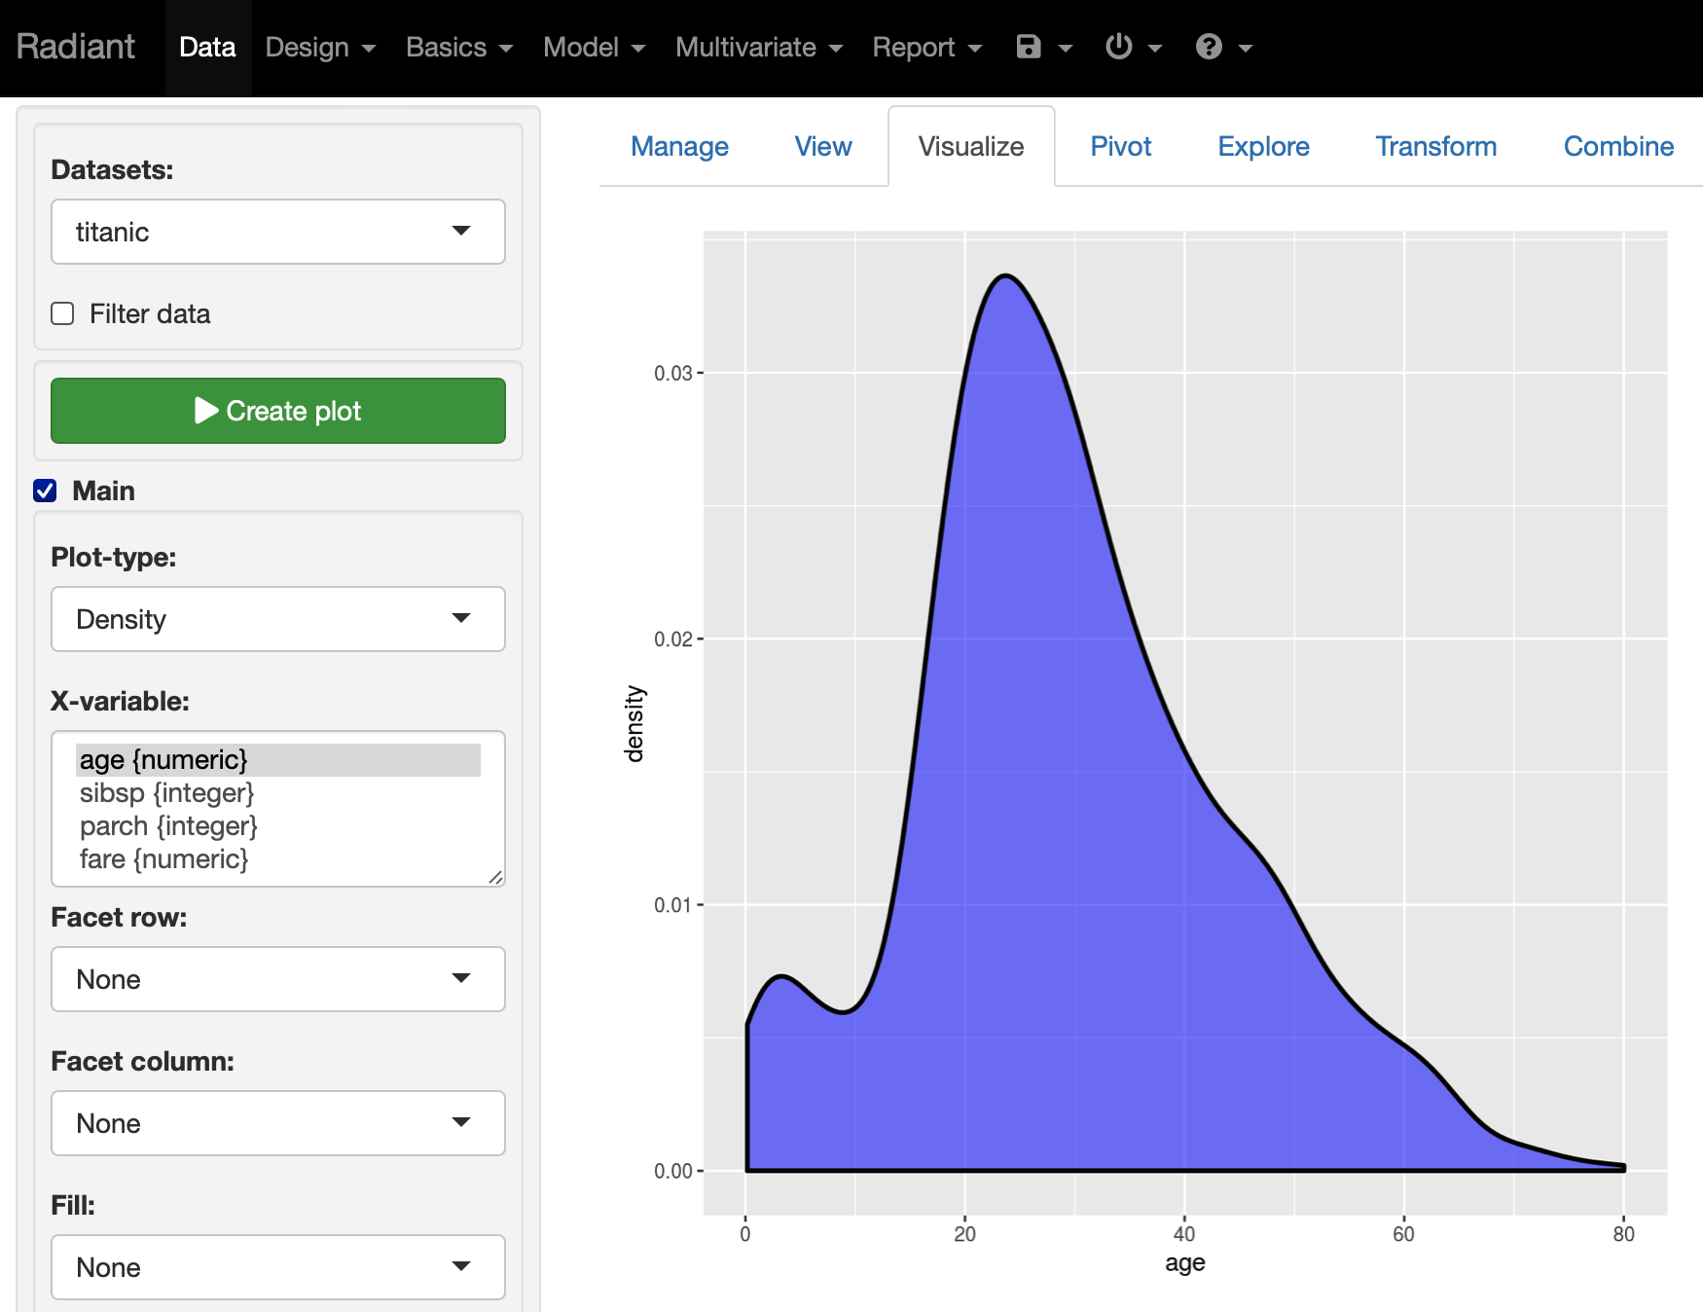
Shiny User Interface (ui) Sections
titlePanel / navbar
sidebarPanel
Within mainPanel,
a tabsetPanel with
multiple tabPanels
mainPanel
Model Prediction
Class: no remission
Prob. Remission: 24%
95% CI: 12-33%
actionButton
Within sidebarPanel,
multiple input
widgets
selectInput box

Slide 4
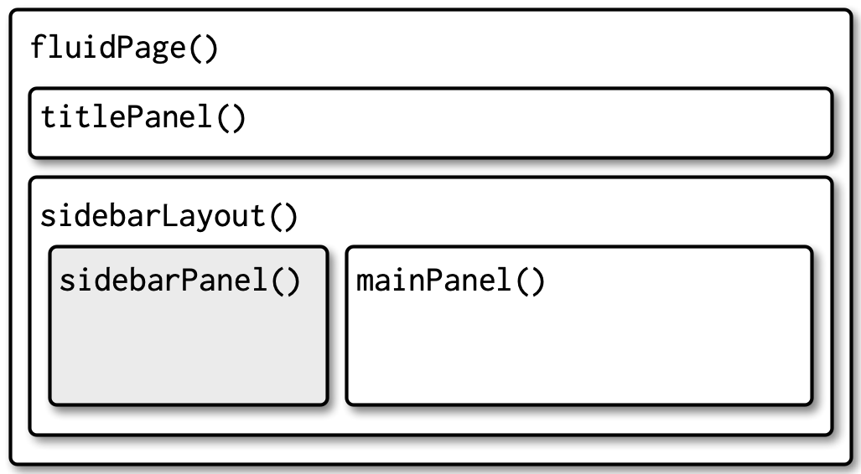
Basic ui (User Interface) Code structure
User Input widgets here
Output (text, tables, plots, maps) here

Slide 5
ui (User Interface) Code structure
as a hierarchy
fluidPage(
titlePanel(),
sidebarLayout(
sidebarPanel(),
typeInputs()
mainPanel()
typeOutputs()
)
)

Slide 6
Basic server Code structure (listening for new input)
server <- function(input, output, session) {
# bring in input$ID data
# do data wrangling / processing
# make predictions, tables, figures as outputs
# render these outputs to HTML
# assign these to output$ID
}

Slide 7
Code at the end of every Shiny app
to run the ui and the server
# Run the application
shinyApp(ui = ui, server = server)

