Slide 1
Programming with Big Data
Tim Savage
February 24, 2017
New York City

Slide 2
De-Mystifying the Un-Mystical
Like a hammer and nails,
these are just tools

Slide 3
My Background
I started in the pre-digital age using small, administrative data.
NLSY79: 3,000 young men tracked annually for about 20 years.
Complicated algorithm to examine whether early adverse labor market outcomes affected their “lives”.
The data was cheap but the computation was very expensive.

Slide 4
Programming Languages
Basic
Fortran
SAS/Stata
R
Python

Slide 5
Core Takeaways
If it can be digitized, it can be analyzed. And now everything is digitized.
The core components of big data did not simply appear a few years ago, but their confluence created the problems (and the solutions).
The open source computing community defeated Gresham’s “law”. Without open source, there would be no big data.
There is a reason Google won the search engines wars. Spark has brought clustered computing to the masses.

Slide 6
What is Big Data?
“Big Data” is data whose scale, distribution, diversity, and/or timeliness requires the use of new computing architectures and analytical tools that essentially didn’t exist 10 years ago.
Organizations are beginning to derive benefit from analyzing ever larger and more complex data sets in real time.

Slide 7
Key Characteristics
Volume, which has increased nearly 44 times since 2009.
Variety of different data structures to mine and analyze.
Structured, semi-structured, and unstructured.
Processing complexity because of changing data structures.

Slide 8
Business Drivers (Good and Bad)
Optimizing operations for profitability and efficiency.
Identifying potential risks from customer churn or fraud.
Predicting new opportunities.
Complying with the regulatory environment.

Slide 9
The Challenge
High-value data is hard to reach and leverage.
Sits in fragmented “puddles” without a proper data “lake”.
Predictive analytics are the last step in the chain.
Breaking down ad-hoc and isolated analytics projects.

Slide 10
Big Data Analytics Lifecycle
Preparation: Is there enough good data to be potentially useful.
Planning: There are many ML models to choose from. Which one(s) to use?
Building: Is the model robust? Is it appropriate?
Operationalizing: Scale the model(s) for deployment using the ideas discussed in this presentation.

Slide 11
Common Big Data Challenges
Volume
Too much data to process conventionally.
Reduce processing time by using distributed and parallel computing. Example: Performing OCR on thousands of articles simultaneously.
Too big to fit into memory when no clustered resources available. Example: Given 30GB of NYC taxi data, how would one calculate the average or the median fare?
Velocity
Data comes in real-time, but it cannot be stored or processed in real time.

Slide 12
Coding Matters

Slide 13
The Volume Problem: Parallelization
Make use of parallel computing architectures, such as multicores, multiprocessors, or clusters of machines.
Multiple cores for video processing.
Multiple processors for web servers and video games.
Clusters for simulations. (If we have time, I’ll show you an example.)

Slide 14
Task Parallelism
Distributing tasks to run simultaneously, achieving efficiency if the number of tasks is large.
Data cleaning.
Running linear regressions.
It is basically Henry Ford’s assembly line:
A bunch of boxes at Fedex need both shipping labels and barcode scanning. One worker can stamp the shipping labels, while the other scans the boxes.

Slide 15
Pipeline Parallelism
Explicitly allocating resources for each phase of the data processing pipeline, achieving efficiency when the number of phases is large.
Processes must communicate throughout the pipeline, so it’s a combination of task and streaming.
The assembly line: pass the boxes by the stamper and then by the scanner.

Slide 16
Data Parallelism
Distributing data to different processors that run simultaneously, achieving efficiency based on the number of nodes.
The assembly line: leave all boxes on the ground, and each worker can both stamp and scan one box. Then get more workers.

Slide 17
The Velocity Problem: Scaling
Scale up by make the process more scalable on a single computer.
Reduce the amount of data processed or the resources needed to perform the processing.
Increase the computing resources using parallel processing and faster memory and/or storage.
Improve the efficiency and/or performance of the process by, for example, better coding.
Scale out by adding more computing resources through the networking of multiple computers.

Slide 18
Too Much Data
Scale up with “streaming”.
An active area of research among “computing scientists.”
Started in the 1970s but getting more popular because of its successful application to massive data processing.
Big data world adopts the stream processing model.
Process data as soon as it arrives.
Continuous and incremental processing.

Slide 19
Streaming Computation
Given a data series of n elements: [a1, a2, …, an] that can only be examined in a limited number of passes, typically one.
Compute a function of the stream, such as an average, a median, or a histogram.
Primary constraints:
Limited working memory of size m (m << n).
Elements are accessed sequentially.

Slide 20
Handling Data Streams
There are many flavors of the streaming model:
Time series (HFT price data).
Cash register (storing incremental counts and totals).
Turnstile (arrival-departure summarization).
Sliding window (keeping a continuous but fixed subset of the input).
Many classes of techniques to process data elements:
Sampling (reduce data inputs).
Sketching (data aggregation).
Counting (data compression).

Slide 21
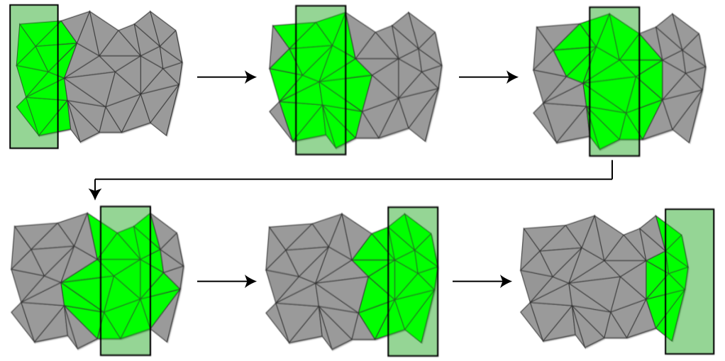
Picturing the Sliding Window

Slide 22

Example: Find the Omitted Number
There are 11 football players, numbered 1 to 11, walking from the locker room to the field.
Only 10 arrive: 8, 2, 6, 1, 10, 3, 5, 11, 9, 7.
How to determine the missing number in the “stream” of players?
Given the constraints:
We can only look at one number at a time.
We can only store one number in our head.
8 2 6 1 10 3 5 11 9 7
8 2 6 1 10 3 5 11 9 7

Slide 23
What’s the Missing Number?
It is 4. How so?
The sum of all numbers is fixed: (1+11)*11/2 = 66. (Simple mathematical formula of sums.)
Record only the sum of the numbers as we scan through the stream of players.
8, 10, 16, 17, 27, 30, 35, 46, 55, and 62.
Our missing number is 66 - 62 = 4.
Simple example that highlights many ideas.

Slide 24
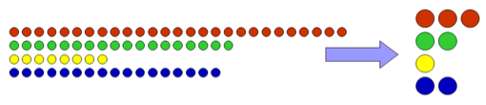
Sampling Techniques
Motivation: a small random sample of the data can be a good representation.
Action: sample the data based on a probability model, which is a challenge for data streams of unknown size.
Useful for showing patterns but not at detection deviations from central tendencies.

Slide 25
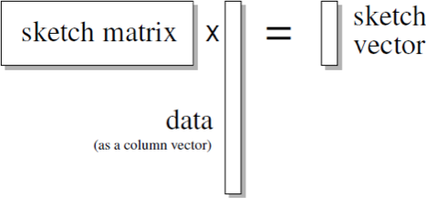
Sketching
Motivation: only certain pieces of the data are needed for computation.
Action: project data into a “sketch” space, progressively building the function of stream.
Useful for aggregation, but the sketch could be very large.

Slide 26
Sketching Examples
Computing a streaming average by sketching the (sum, count) pair.
For each element, add the incremental value to the sum and increase the count.
Compute a streaming histogram: sketch the count per category (apples, bananas, pears).
For each element, add to the count of its category.

Slide 27
For Streaming, Approximation
We need to speed up the computation.
Brute force approach often takes a too much time.
We sacrifice accuracy or granularity for efficiency.
Common approaches:
Memoization for repeated queries or computation.
Indexing for quickly retrieving a small subset of data.
Data cube for computing aggregation.

Slide 28
Example: Calculate a Median
Median is the middle mark and can potentially differ wildly from an average. Example: median income of your customer.
Well-studied problem in streaming algorithms.
Lots of methods to approximate the median value within an certain error bound.
Computationally expensive, needing multiple passes through the data.
Most of these methods rely on assuming that data are continuous and of large range (such as income).

Slide 29
Example: find the median range
Build a histogram of values based on bucketed ranges.
Select the 50th percentile bucket.
Choose the first bucket that passes the that mark.
In this case, $210,000.
[Nature Biotechnology 32, 393–395 (2014)]

Slide 30
Streaming and Big Data Queries
Often exact answers not required for decision making, and results can be pre-computed. This can be done in a streaming fashion (as the data arrives).
Yields more accurate answers than sampling.
Storage is not expensive.
This approach is used at Google, Twitter, and Facebook.
Twitter’s open source “Summingbird” toolkit:
HyperLogLog (count distinction): the number of unique users who perform a certain action.
Count-Min Sketch (hashing): the number of times a particular query is requested.
Bloom Filters (membership test): keep track of users who have been exposed to an event.

Slide 31
MapReduce
Hadoop
Divide and Conquer

Slide 32
Why MapReduce?
Big data is too large to handle using conventional means.
Sooner or later, you face limits on scaling up a given machine. But we can add more machines by scaling out.
MapReduce paradigm allows us to scale out.
Issue is: what’s going to herd all these cats?
Google’s paradigm won them the search-engine wars.

Slide 33
What is MapReduce?
A programming paradigm for big data processing.
Data is split into distributed chunks.
Transformations are performed on the chunks, running in parallel.
MapReduce is scalable by adding more machines to process distributed chunks.
It is the foundation for "Hadoop", which is an particular implementation of MapReduce.

Slide 34
Map(and)Reduce
A programming paradigm that processes data in two phases/operations: map() and then reduce().
instead of map(), filter(), reduce() in Python, we are limited to only map() and reduce().
In a nutshell, that is all there is:
User provides a data collection of separable records.
Applies a user-defined map function to each data record, say a count.
Reduces the mapped output with another user-defined function.

Slide 35
Python Example

Slide 36
Input
Data must be separable into records.
Lines of text or row of tables.
So CSV works easily, but not true for other data types, such as JSON and XML.
Key/value pairs
Key = line number, record index.
Value = text string, row data.

Slide 37
Phases
Map phase: transform each input record with a user-defined function.
Shuffle (and sort) phase: complicated but it amounts to ensuring stuff lines up properly (herding cats).
Reduce phase: Transform the output of the shuffle phase with another user-defined function. (May or may not be necessary.)

Slide 38
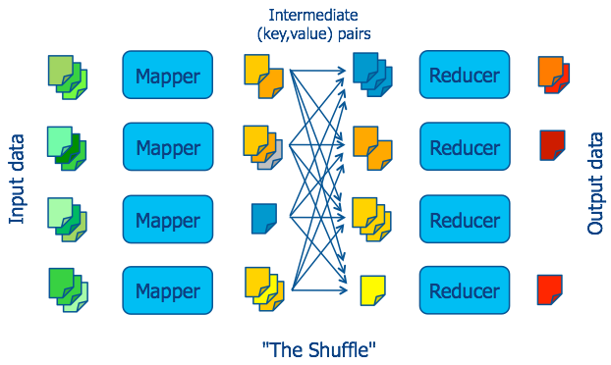
MapReduce Dataflow

Slide 39
When to use MapReduce?
When there are efficiencies to be gained from the types of parallelization we discussed earlier.
In other words, whenever you have big data.
Data must be split-able into chunks and records.

Slide 40
Designing MapReduce Algorithms
User must decide what is to be done by map and separately by reduce.
Map can act on individual key-value pairs, but it can't look at other key-value pairs, such as filtering.
Reduce can aggregate data by looking at multiple values, as long as map has properly mapped them.
If reduce needs to look at several values together, map must emit them using the same key.

Slide 41
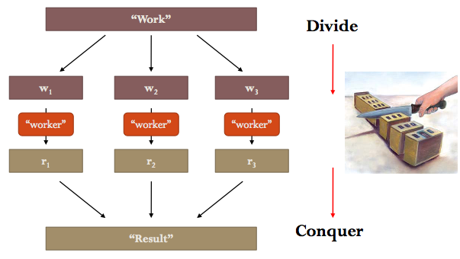
MapReduce for Big Data
Data parallelism: by scaling out:
Divide and Conquer
Distributed computing:
Data on different machines

Slide 42
What is Hadoop?
Hadoop is used in common parlance to describe:
The MapReduce Paradigm.
Massive unstructured data storage.
HDFS: the Hadoop distributed file system.
In other words:
Hadoop = HDFS + MapReduce.
Hadoop = Big Data + Analytics.

Slide 43
(H)DFS
Files are divided into chunks (typically 64MB in size).
Chunks are replicated at different compute nodes.
Chunk size and the degree of replication are chosen by the user.
A special file (the master node) stores, for each file, the positions of its chunks.
So-called “master/slave” architecture.
This is an important element of properly herdiing the cats.

Slide 44
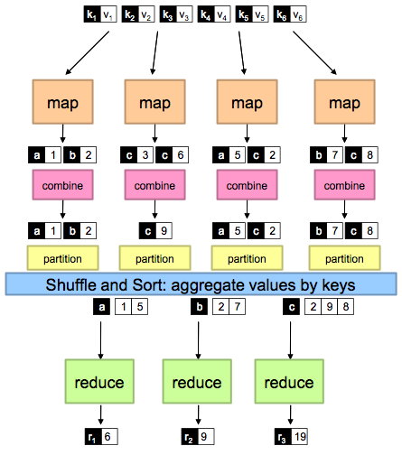
Hadoop and MapReduce
group
group
group

Slide 45
Hadoop Runtime Tasks
Handles scheduling.
Assigns workers to map and reduce tasks.
Handles data distribution.
Gets data to the workers.
Handles synchronization.
Gathers, sorts, and shuffles intermediate data.
Handles errors and faults.
Detects worker failures and restarts.
Everything happens on top of a distributed file sharing system.

Slide 46
Hadoop Operation Modes
Java MapReduce Mode.
Write Mapper, Combiner, Reducer functions in Java using Hadoop Java APIs.
Read records one at a time.
Streaming Mode.
Any statistical computing language, such as Python.
Input can be a line at a time or a stream at a time.

Slide 47
My Uses: Simulation
One of the most powerful simulation tools is the Markov chain Monte Carlo (MCMC).
It is a technique that can be massively scaled.
Re-ignited Bayesian approaches to analysis and inference.
If we have time:
Start with a calendar to motivate MCMC.
Use a drunken sailor to highlight its properties.

Slide 48
Where I Started: Spark
Brings clustered computing to the masses.
Native APIs for R, Python and SQL.
Massively extended the MapReduce paradigm so that folks like me can use it in everyday practice. (And so can you.)
The distributed computing environment is ideal for simulation, including MCMC.
A simple example (that helped win WWII).

Slide 49
Spark
A large number of start ups have focused on clustered computing using the Spark environment.
Participating in the big data revolution could run you less than your monthly cable or mobile bill.

Slide 50
Some Musings
All of this is developing very rapidly.
A large number of VC-funded start-ups have focused on clustered computing using Spark.
Participating in the big data revolution could run you less than your monthly cable or mobile bill.
Now the computation is cheap but the data are expensive.
A sleeping giant shakes the big data space.
(Everyone talks their book.)

Slide 51
Thank You

